Slide 1
First Look of the Beam Test at CERN PS T9 in Aug 2026 experimental setup and lessons learned
26.9.15 BIC ESB/System Testing Meeting
Jeongsu Bok

Slide 2
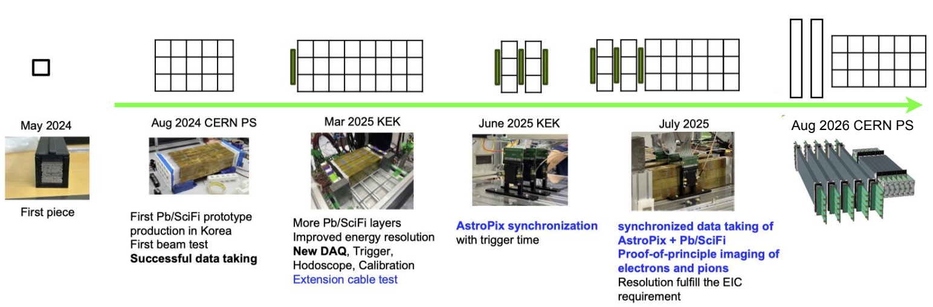
What we have done so far
KEK in May 2026: preparation for CERN PS

Slide 3
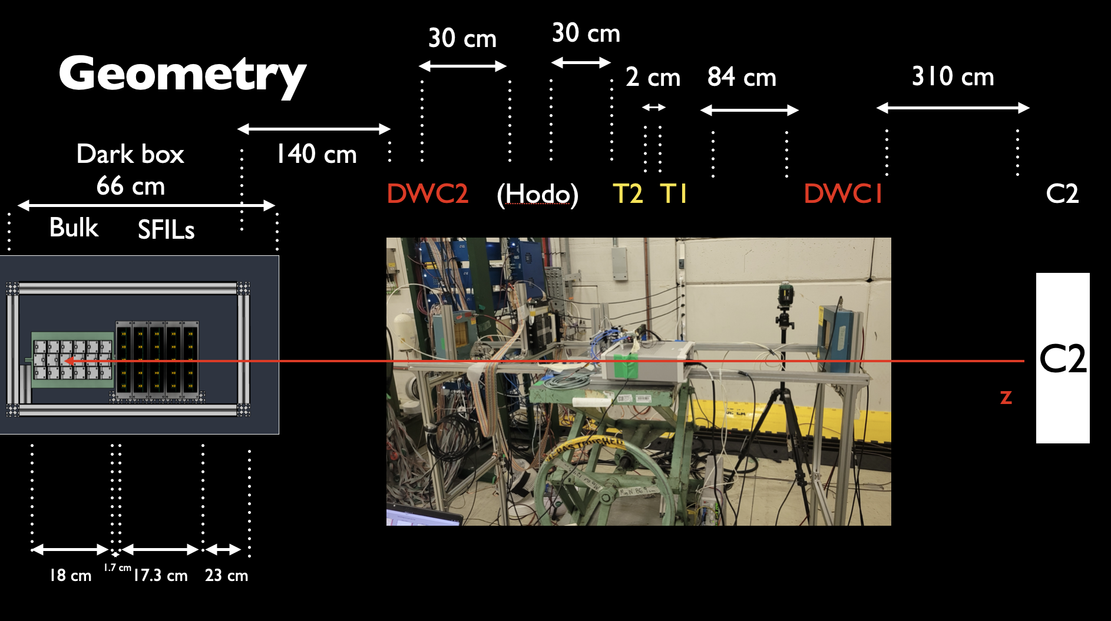
Detector Setup

Slide 4
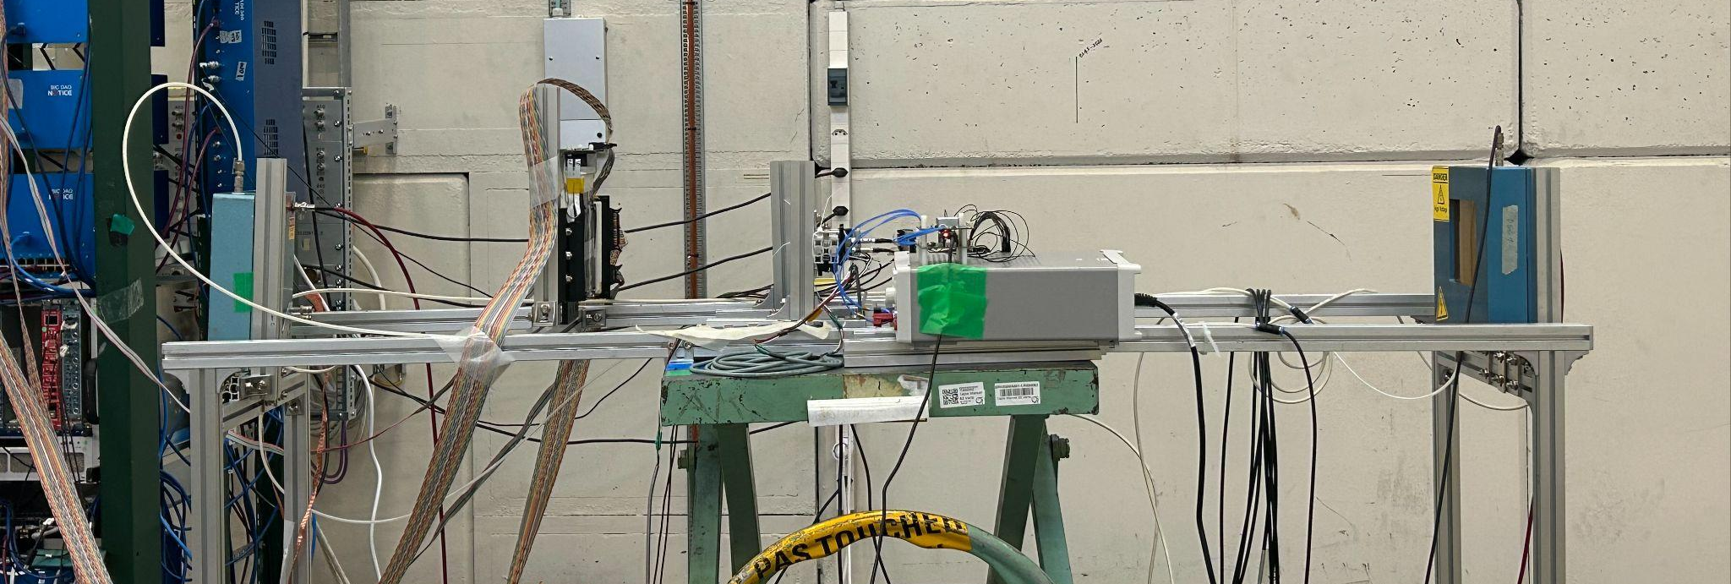
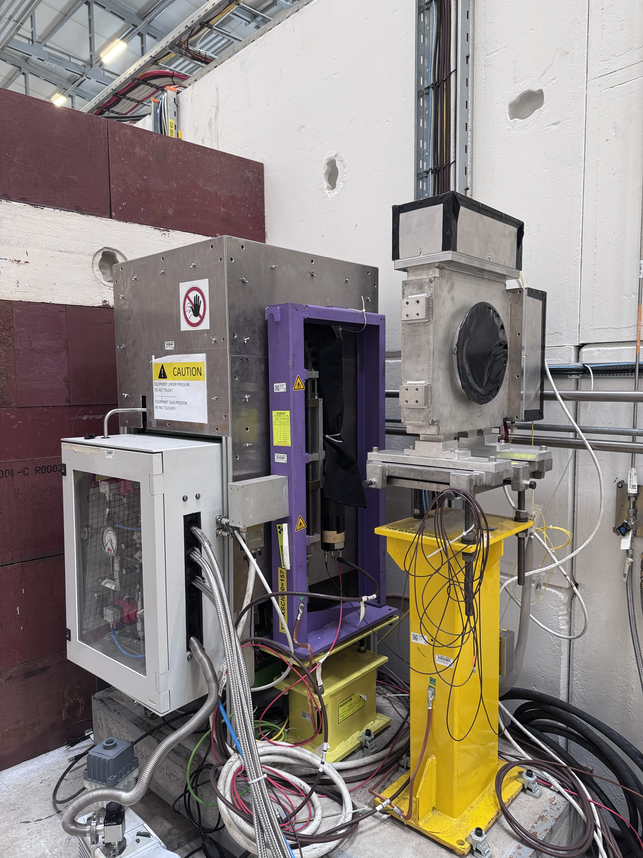
Ancillary Detectors
60 cm
84 cm
DWC 2
(2700 V)
Trigger
DWC 1
(2600 V)
Cherenkov counter (one of two)
Scintillator for beam monitoring
are equipped along the beam line

Slide 5
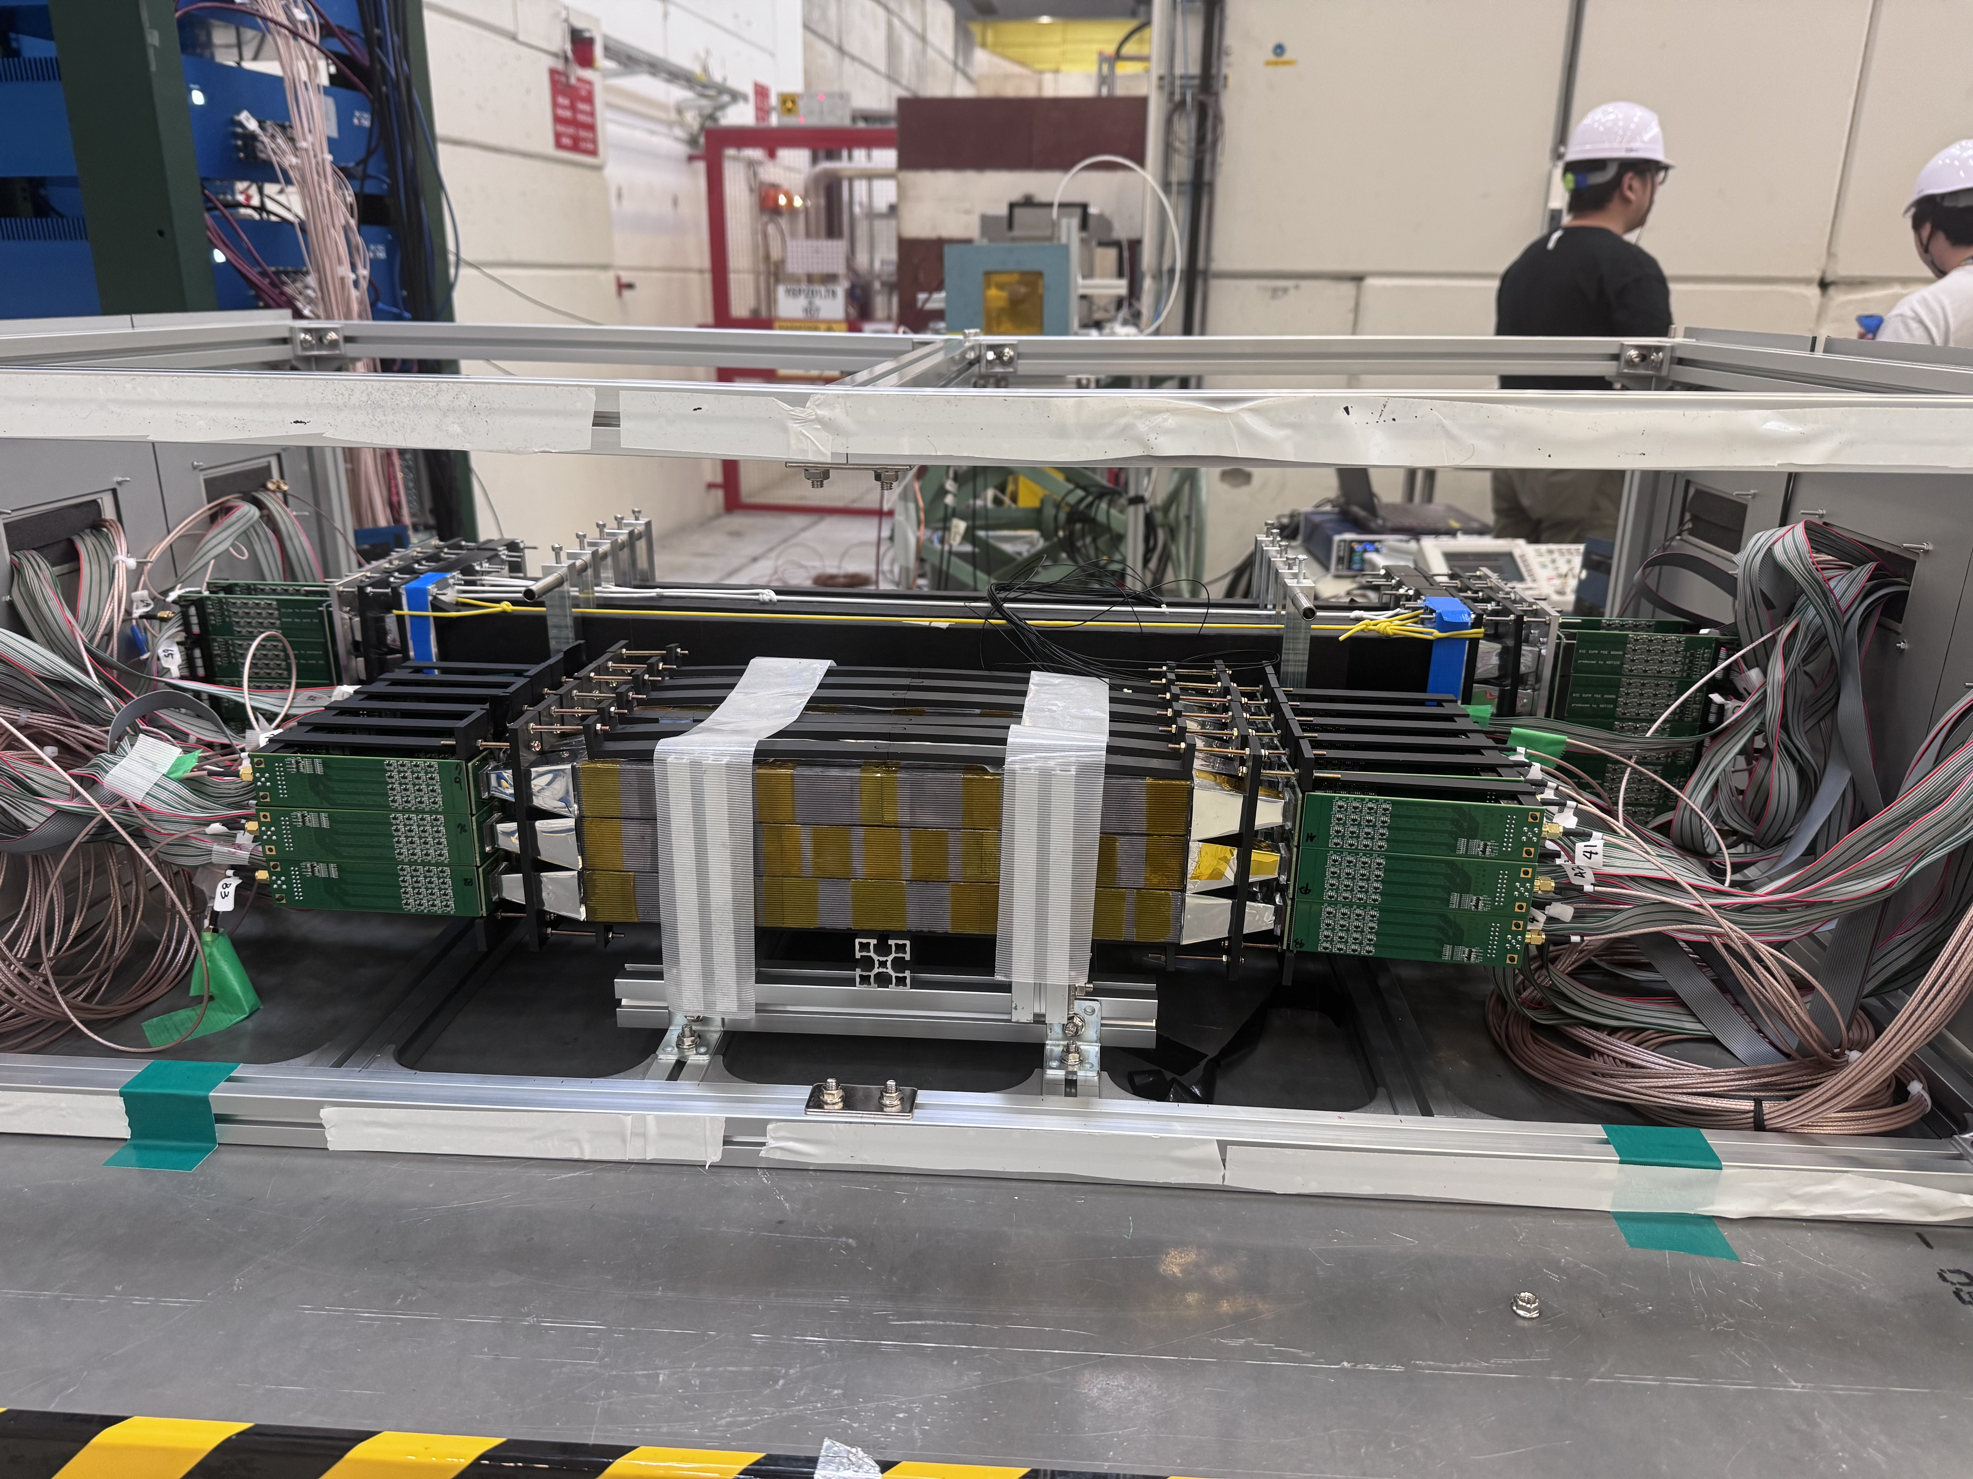
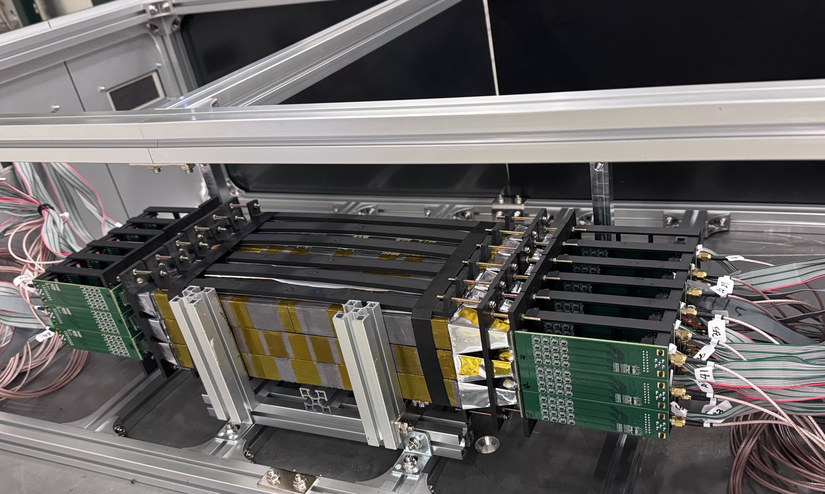
Detector Setup: Pb/SciFi
Bulk with SiPM+LG
(Previously bundled and PMT)

Slide 6
Pb/SciFi Setup
1) bulk: 3x6 array of 32x3x3cm unit module: 32x9x18cm
2) Added SFILs
  Added one then, electron calibration
  Added one more, electron/muon calibration
    Different LG length between , matching trapezoidal SFIL length for a sector.
3) Added SFILs without readout for checking shower response for each channel
4) Similar beam setup for two type of DAQs
  FADC and H2GCROC
e+pi, e, mu
Bulk with SiPM+LG
e, mu
e+pi, e, mu
dummy
DAQ

Slide 7
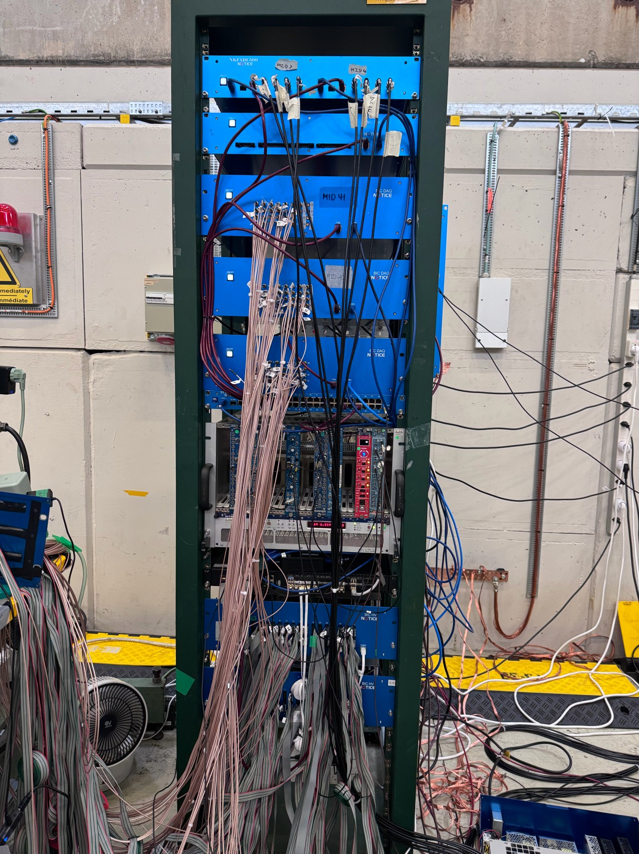
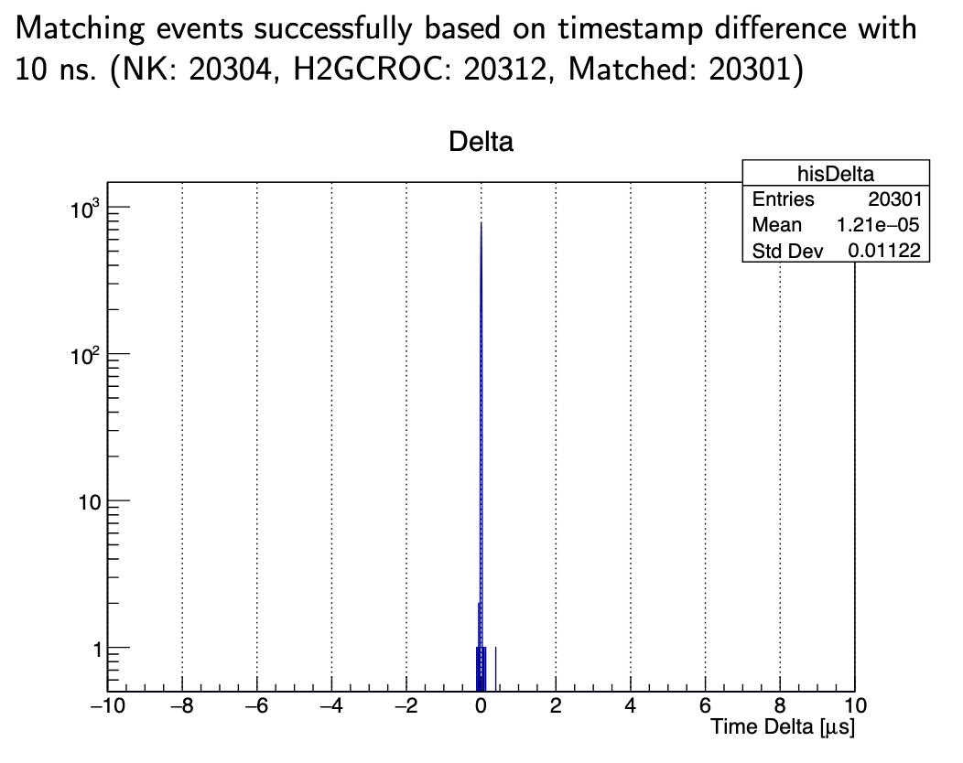
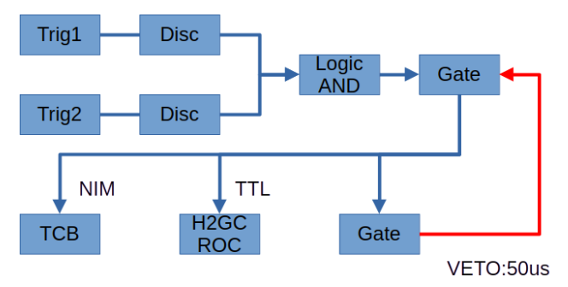
DAQ setup (Jongwon)
Tested timestamp matching between H2GCROC timestamp and FADC in Korea (NOTICE Korea, 1us coarse&8ns fine timestamp)
So, Cherenkov will be available for H2GCROC data, as well as we collected electron-enriched data.

Slide 8
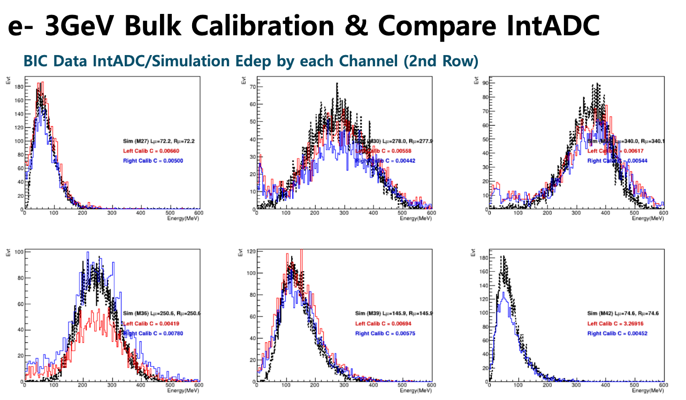
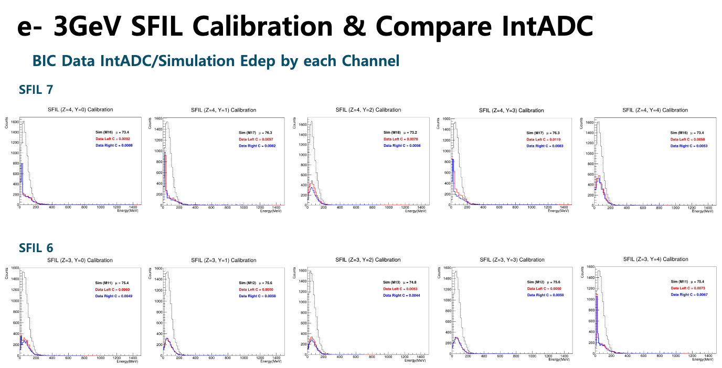
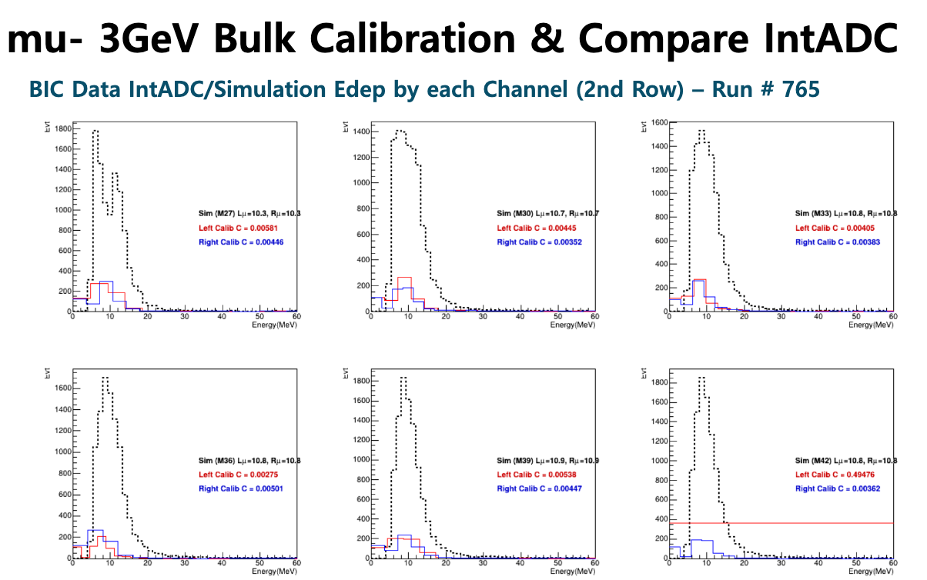
Prompt analysis for 3GeV electron (Notice Korea DAQ)
we had 3 bad channels at that time, we moved it to make 3x5 in one side
1) Bulk: looks OK for electrons. Muons should be checked with fine binning
2) SFIL: some channels do not seem to be good even in electrons. But we need to check more.
3) Anyway, this is Prompt analysis during the beam test to check the detectors were OK

Slide 9
Issues during the beam test - internal :)
Overall, we were OK at KEK in May, but we faced issues when
  the number of channels are increased (4→86)
  and for new detector setup (SFILs)
Optical coupling issue in SFIL: As usual in new setup
  3x6 bulk looked OK, but we found issues in SFILs, so we had to test only two SFILs within the beam time
  Some channels in SFIL seems to be bad after fixing mechanical coupling, but we need investigation.
  We will find a solution to secure optical coupling.
FEE/cable issue:
  As usual in new setup
  it turned out that the boards are OK, it was a matter of debugging during the experiment. We lost some channels, but we could do experiment.
More preparation may prevent some issues, but we learned from the experience and we have to-do-list in our hands. We expect smooth operation for the next beam test.

Slide 10
Concern for the next beam test (Pb/SciFi)
Muon beam is not available
Calibration for different LG coverage
  Slightly different height may prevent good electron calibration
  We will check the data to quantify the effect.
Ensure optical coupling: We are collecting idea, we would appreciate any idea or advice.
Plan for the next beam test
  not confirmed yet, but we will begin discussion.
KEK Application status
  For Oct-Dec 2026 period: Applied, but we did not receive result yet.
  We can apply Feb-Mar and May-June 2027

Slide 11
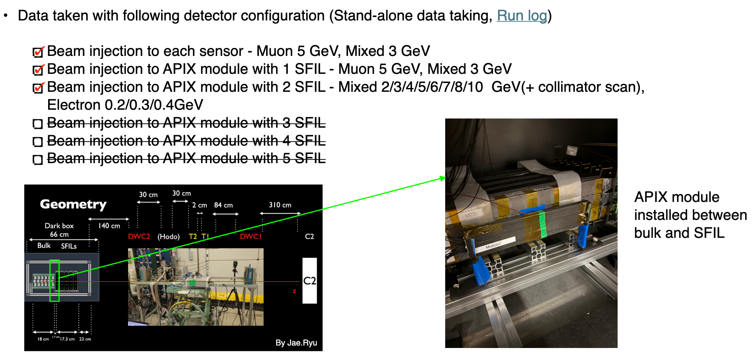
AstroPix 9-chip by Jinhyun and Sanghooon
Slide from Jinhyun, we investigated effect by increasing hit rate
We checked column-row matching probability for 9 chips under beam condition

Slide 12
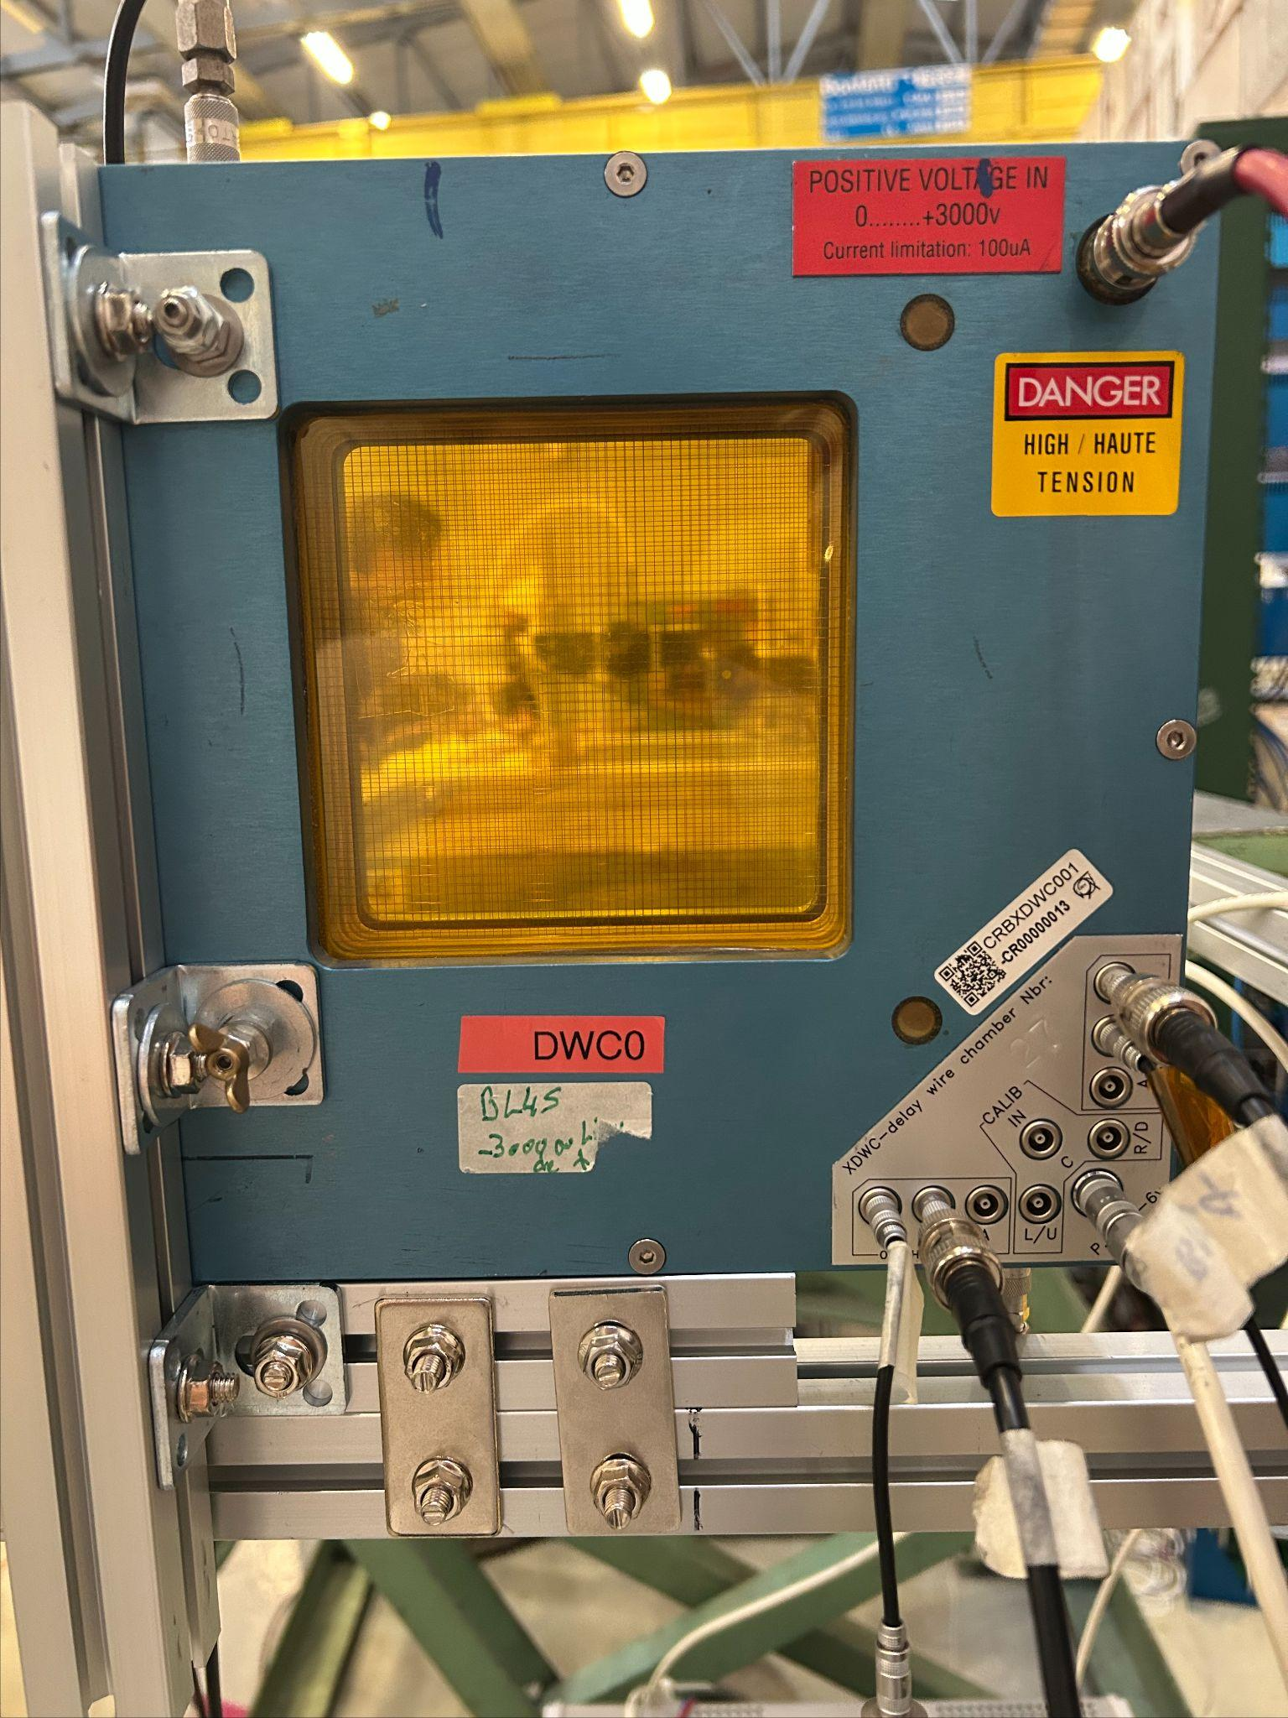
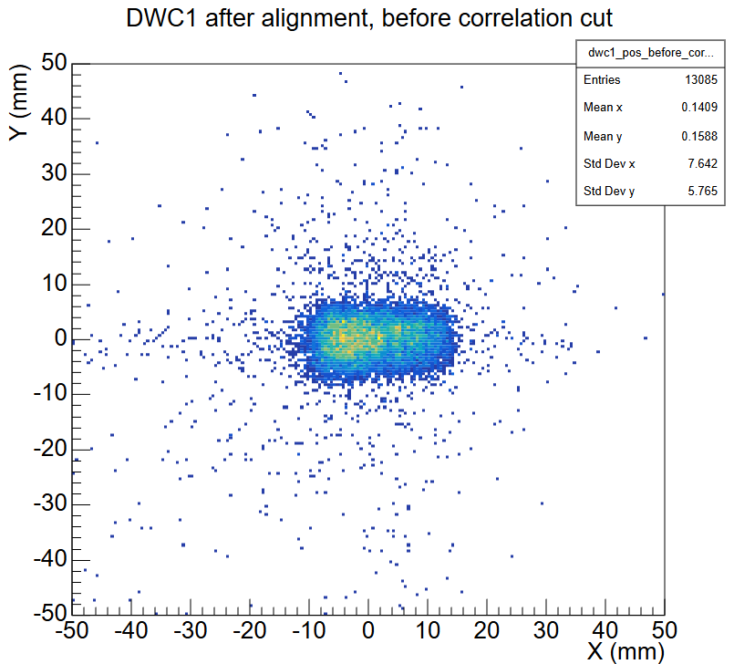
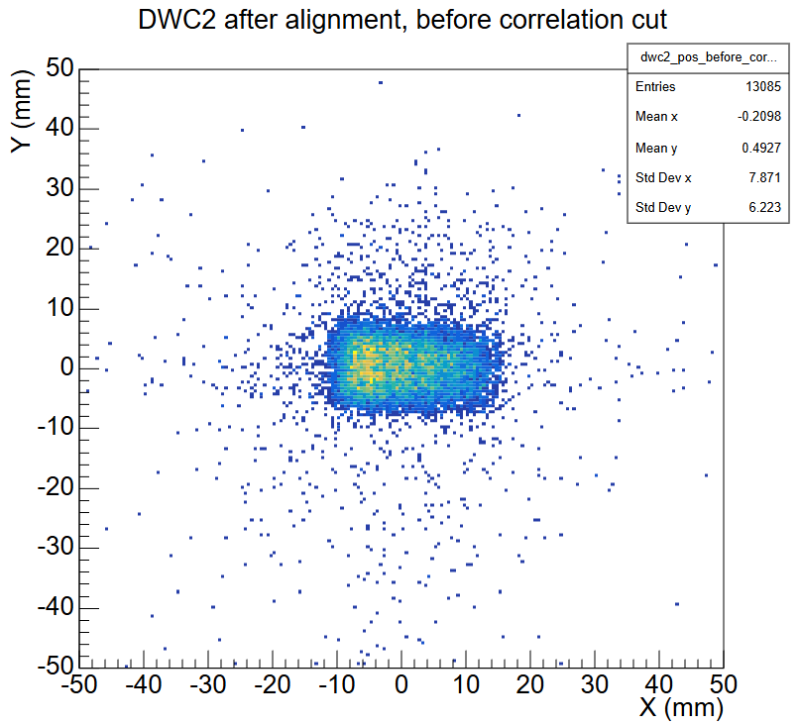
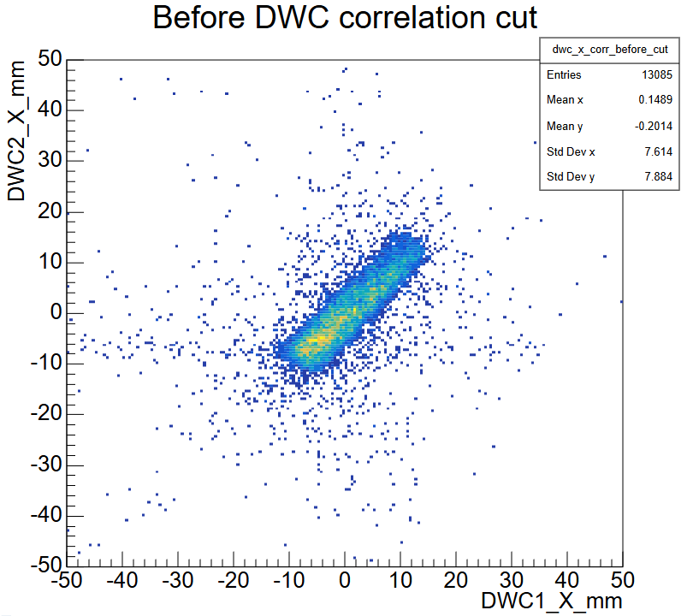
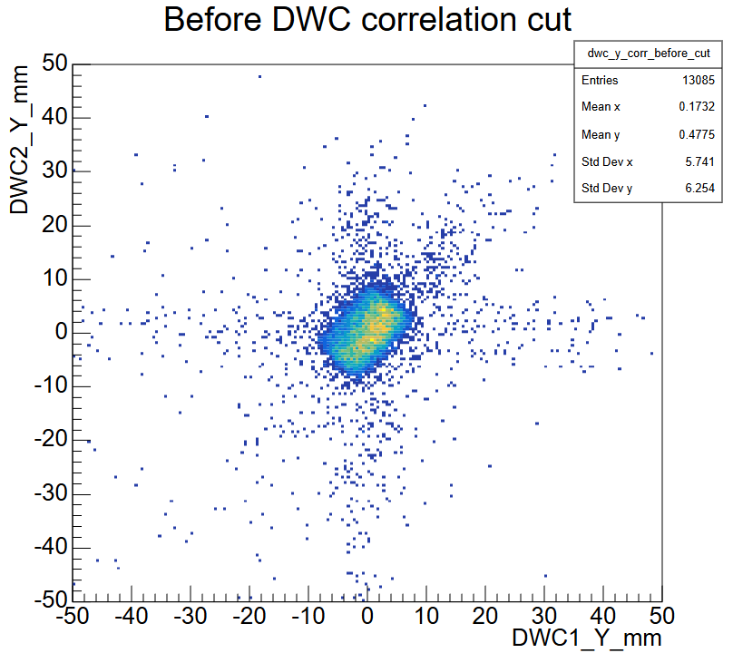
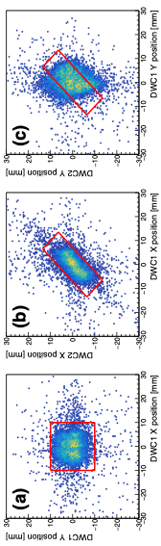
Beam Profile: Delay Wire Chamber
DWC1 X-Y
DWC2 X-Y
DWC X1,X2
DWC Y1,Y2
Electron beam
Trigger overlapping region is expected to be about 15mm x 10 mm
DWC data shows that ~20mm x 10mm
We will study with cuts for beam position and angle
2024 Trg 1cmx1cm

Slide 13
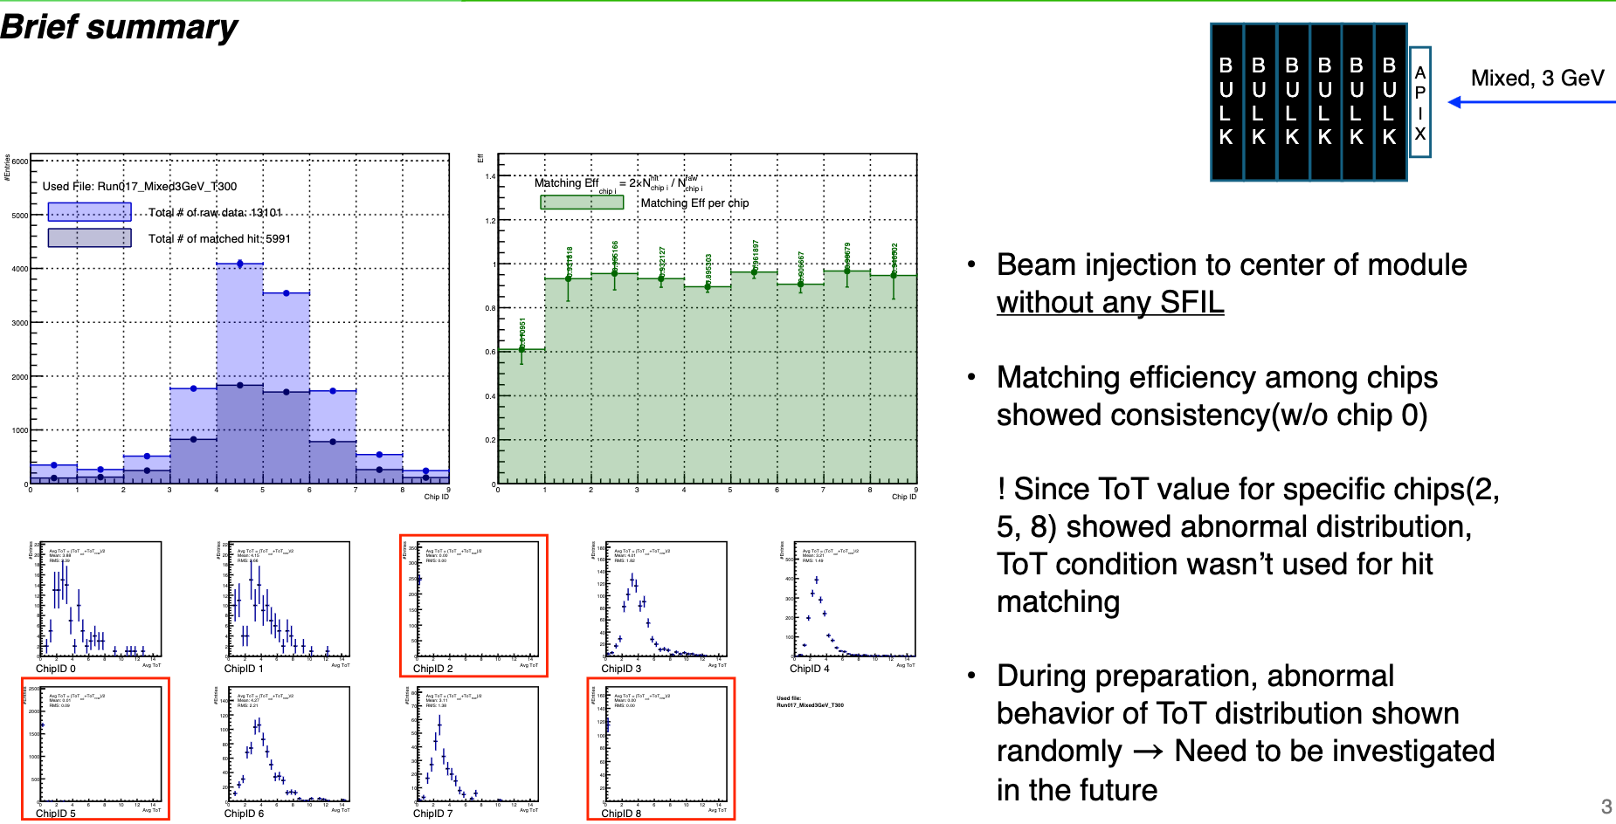
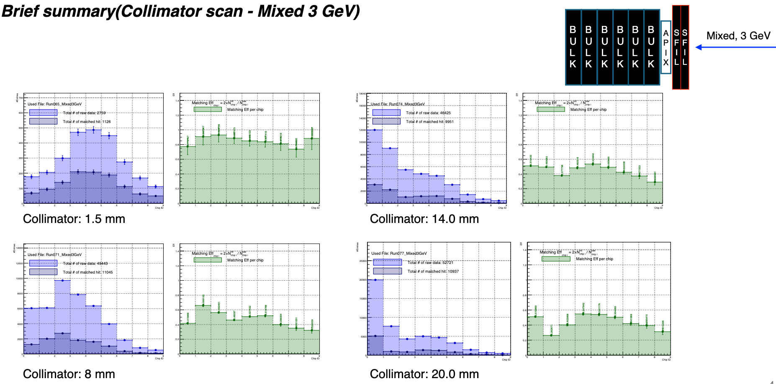
Backup: AstroPix by Jinhyun
column-row matching probability

