Slide 1
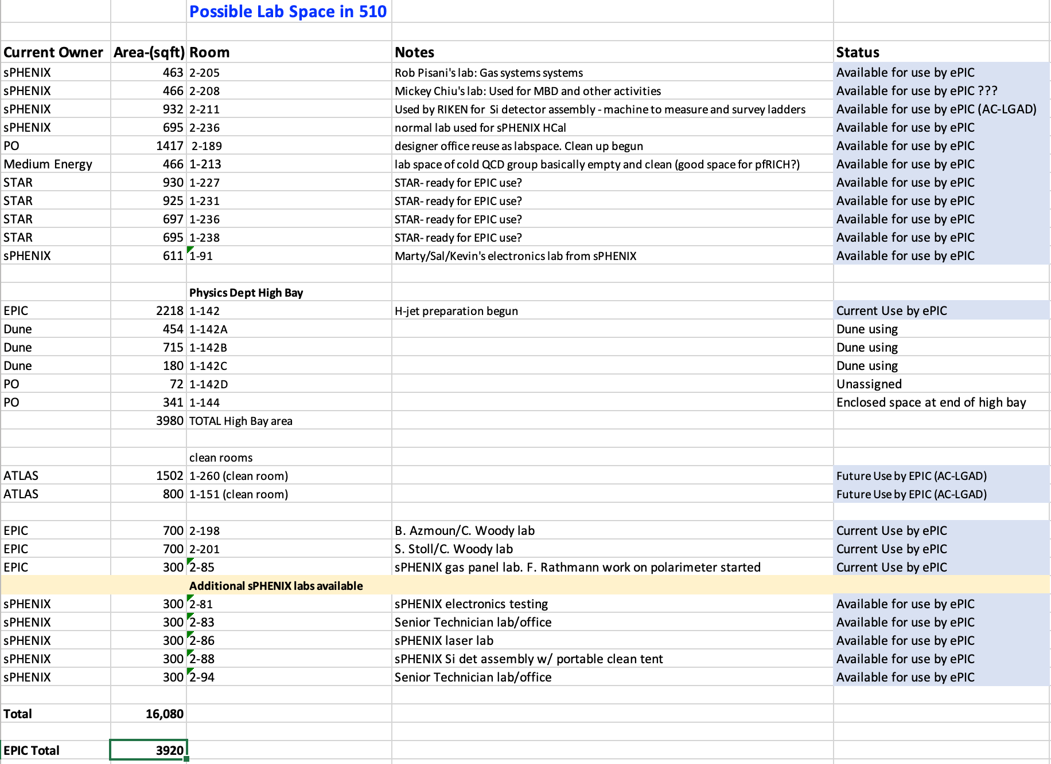
EPIC Lab Space in 510
EPIC Currently is using 3900 ft²
In the Physics Dept
At a minimum an additional 5900 ft² is available for EPIC use in 510 with additional storage space available in the North Wing.

