Slide 1
AC-LGAD + EICROC0 testing @ BNL
Alex Jentsch (BNL) on behalf of the BNL team
Alessandro Tricoli, Gabriele Giacomini, Souvik Paul (Stony Brook), Maya Mancini (Brandeis), Prashanth Shanmuganathan, Prithwish Tribedy, Souvik Paul (Stony Brook), Don Pinelli (BNL), Joe Pinz (BNL), Antonio Verderosa (BNL), Jack Fried (BNL)
September 18th, 2026

Slide 2
Current status (EICROC0) -- Alex and Maya
EICROC0 devices (3 boards total)
  (A1) ”old” PCB – mounted with wire-bonded sensor + ASIC, resistors changed to be compatible with ZCU106.
    Board will be left alone for now.
  (B1) “new” PCB 1 → in HDI lab to have HBK flip-chip removed and analyzed, will then mount with BNL flip-chip.
    HPK flip-chip removed and board being prepared for new flip-chip (next slide).
  (B2) “new” PCB 2 → in HDI lab to have EICROC mounted (not sure about sensor yet) to be our “control” board.
    Will have ASIC mounted, with no sensor, for now (control board).
A boards: EICROC0 v0 board
B boards: EICROC0 v1 board
C boards: EICROC0A
D boards: EICROC1 board

Slide 3
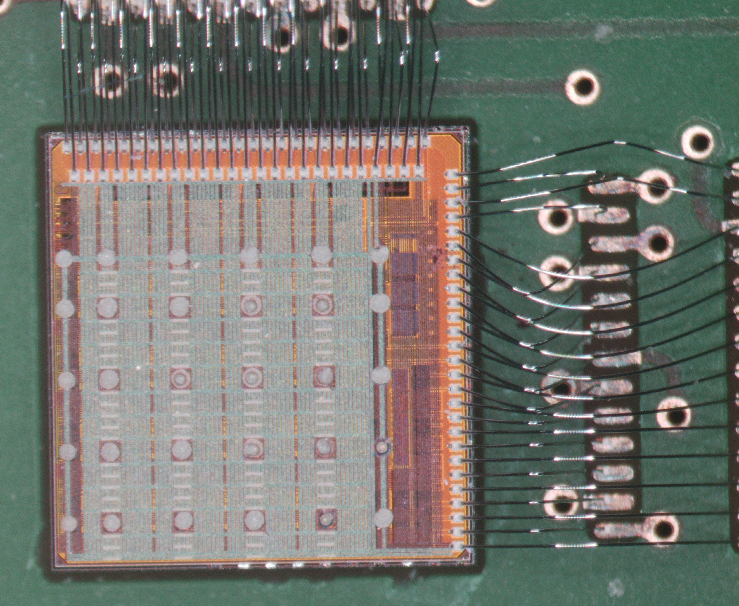
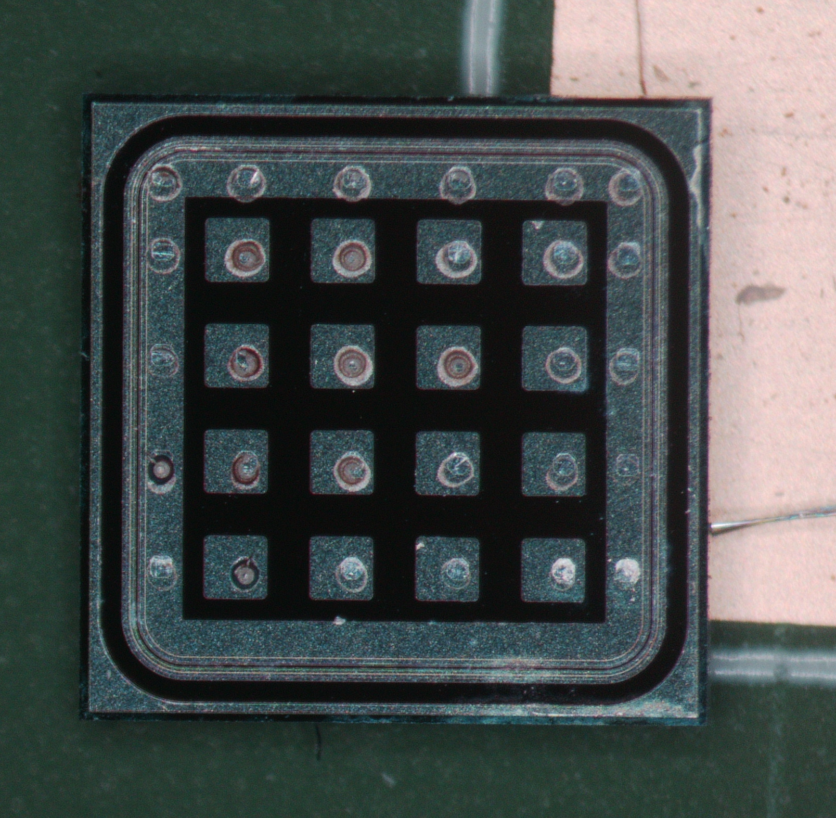
“etched” HPK flip-chip issue
This is the flip-chip we presented the results from at Glasgow meeting (or see backup slides).
  Most people agreed that the issue appeared to be bad connection between sensor and ASIC pads.
Flip-chip was successfully separated, no clear indication of mis-aligned bumps.
  Either the bumps were not making solid contact to sensor, or there was still oxide left on the bonding pads.
Antonio Verderosa and Don Pinell (BNL HDI lab)

Slide 4
Current status (EICROC0A) -- Alex and Maya
EICROC0A devices (3 boards total – all identical, no sensor)
  One board setup (C1) and tested with ZC706 board + firmware.
    First results from our testing presented today by Maya.
  Aside from the addressing issue affecting the ability to configure local registers, it also affects performance of charge scans and threshold scans.
    First 5 bits of 16 bit register address are used for global register selection in EoC block, but for local register only the first 3 bits are used.
    With the current ASIC, when you write to a global register, the overlapping 3 bits causes the local registers to ALSO be affected.
A boards: EICROC0 v0 board
B boards: EICROC0 v1 board
C boards: EICROC0A
D boards: EICROC1 board

Slide 5
Current status (EICROC0A) -- Alex and Maya
EICROC0A devices (3 boards total – all identical, no sensor)
  One board setup (C1) and tested with ZC706 board + firmware.
    First results from our testing presented today by Maya.
  Aside from the addressing issue affecting the ability to configure local registers, it also affects performance of charge scans and threshold scans.
    First 5 bits of 16 bit register address are used for global register selection in EoC block, but for local register only the first 3 bits are used.
    With the current ASIC, when you write to a global register, the overlapping 3 bits causes the local registers to ALSO be affected.
Example:
Register 0x400C → 0b11000000 (first 6 bits are used for the dacb_pulser amplitude to inject different amounts of charge into the PA front-end).
0x400C --> first 5 bits are 0000_1100 (red bits are the overlapping local address bits) → this means Local register 0x4 (all pixels) is ALSO written, with the same content.
  This register contains the bit to toggle the TDC on and off, so every cycle of odd/even injected charge causes the TDC to be on/off every other run.
A boards: EICROC0 v0 board
B boards: EICROC0 v1 board
C boards: EICROC0A
D boards: EICROC1 board

Slide 6
Current status (EICROC0A) -- Alex and Maya
EICROC0A devices (3 boards total – all identical, no sensor)
  One board setup (C1) and tested with ZC706 board + firmware.
    First results from our testing presented today by Maya.
  Aside from the addressing issue affecting the ability to configure local registers, it also affects performance of charge scans and threshold scans.
    First 5 bits of 16 bit register address are used for global register selection in EoC block, but for local register only the first 3 bits are used.
    With the current ASIC, when you write to a global register, the overlapping 3 bits causes the local registers to ALSO be affected.
  Board C2 is now hooked up to ZCU106 so Tonko can test his firmware on it.
A boards: EICROC0 v0 board
B boards: EICROC0 v1 board
C boards: EICROC0A
D boards: EICROC1 board

Slide 7
Current status (EICROC1) – Alex, Prithwish, and Souvik
EICROC1 devices (3 boards total – all identical)
  Board D1 setup and being used in lab in PO.
    Basic tests have been completed → can read digital data, plot ADC vs. input charge, etc.
    ASIC has same issue as EICROC0A with addressing of local registers.
    Using Tonko’s firmware to communicate with ZCU106.
    Found out the 3.3V input can really not be used for EICROC1 → digital data is corrupted, seems individual VDDA and VDDD do not consistently get enough voltage.
  Boards D2 and D3 wire-bonded, but then had to be taken back to add resistors to enable powering via VDDA and VDDD 1.2V inputs.
    Board D2 tested and packed to ship to Rice.
A boards: EICROC0 v0 board
B boards: EICROC0 v1 board
C boards: EICROC0A
D boards: EICROC1 board

Slide 8
Plans for coming weeks
Get PED requests approved to ensure no lapse in funding.
  Approved, new accounts being generated at BNL.
Complete initial testing of EICROC0A → this week.
Assess completion of tasks in HDI lab:
  Mount large AC-LGAD to preamp board.
    Done, but sensor damaged.
  Wirebond EICROC1 to two test boards.
  Understand HPK flip-chip failure.
  Prepare other EICROC0 boards to ensure all calibration tests are understood.
Once we get the pieces back from HDI lab:
  Sr-90 measurements with EICROC0 (to close the book on the failed studies with the bad HPK flip-chip)
  Calibrations with EICROC0A (as best as we can do).
  Wire up sensor with EICROC0A for initial tests.
  TCT and Sr-90 measurements with large AC-LGAD on analog preamp board.
A boards: EICROC0 v0 board
B boards: EICROC0 v1 board
C boards: EICROC0A
D boards: EICROC1 board

Slide 9
Backup

Slide 10
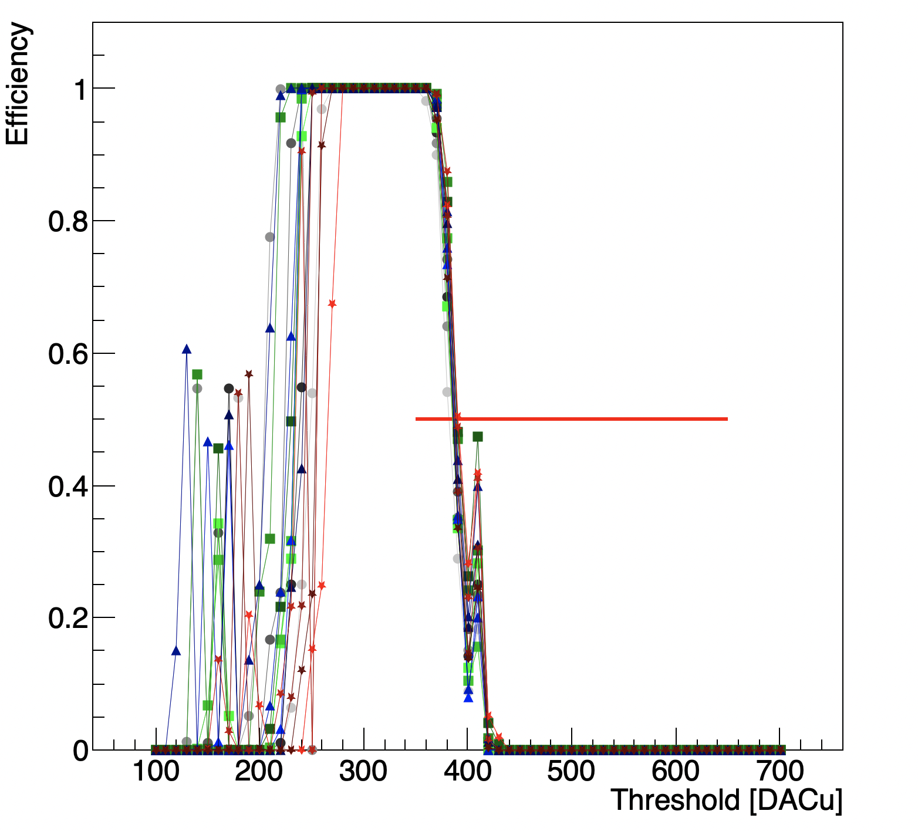
EICROC0 testing @ BNL
Using bump-bonded (30um gain layer) sensor to EICROC0 @ -170V.
Q = 45 DACu
Calibration performed successfully.
Focus is now on Sr-90 measurements.

Slide 11
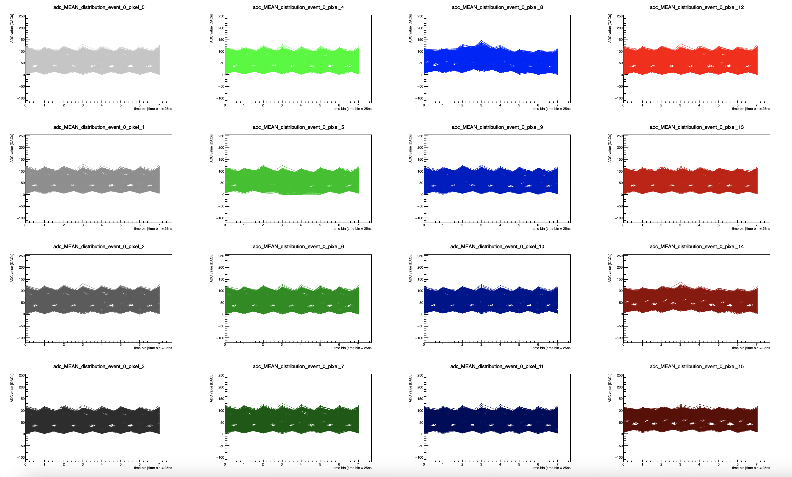
EICROC0 testing @ BNL: Sr-90 source
”trigger” pixel = 5
Running in mode where ACQ window is always “open”, closes only when TRGOUT received from any pixel.
Offline, only look at events where pixel five is over threshold, ONLY
NO pedestal subtraction

Slide 12
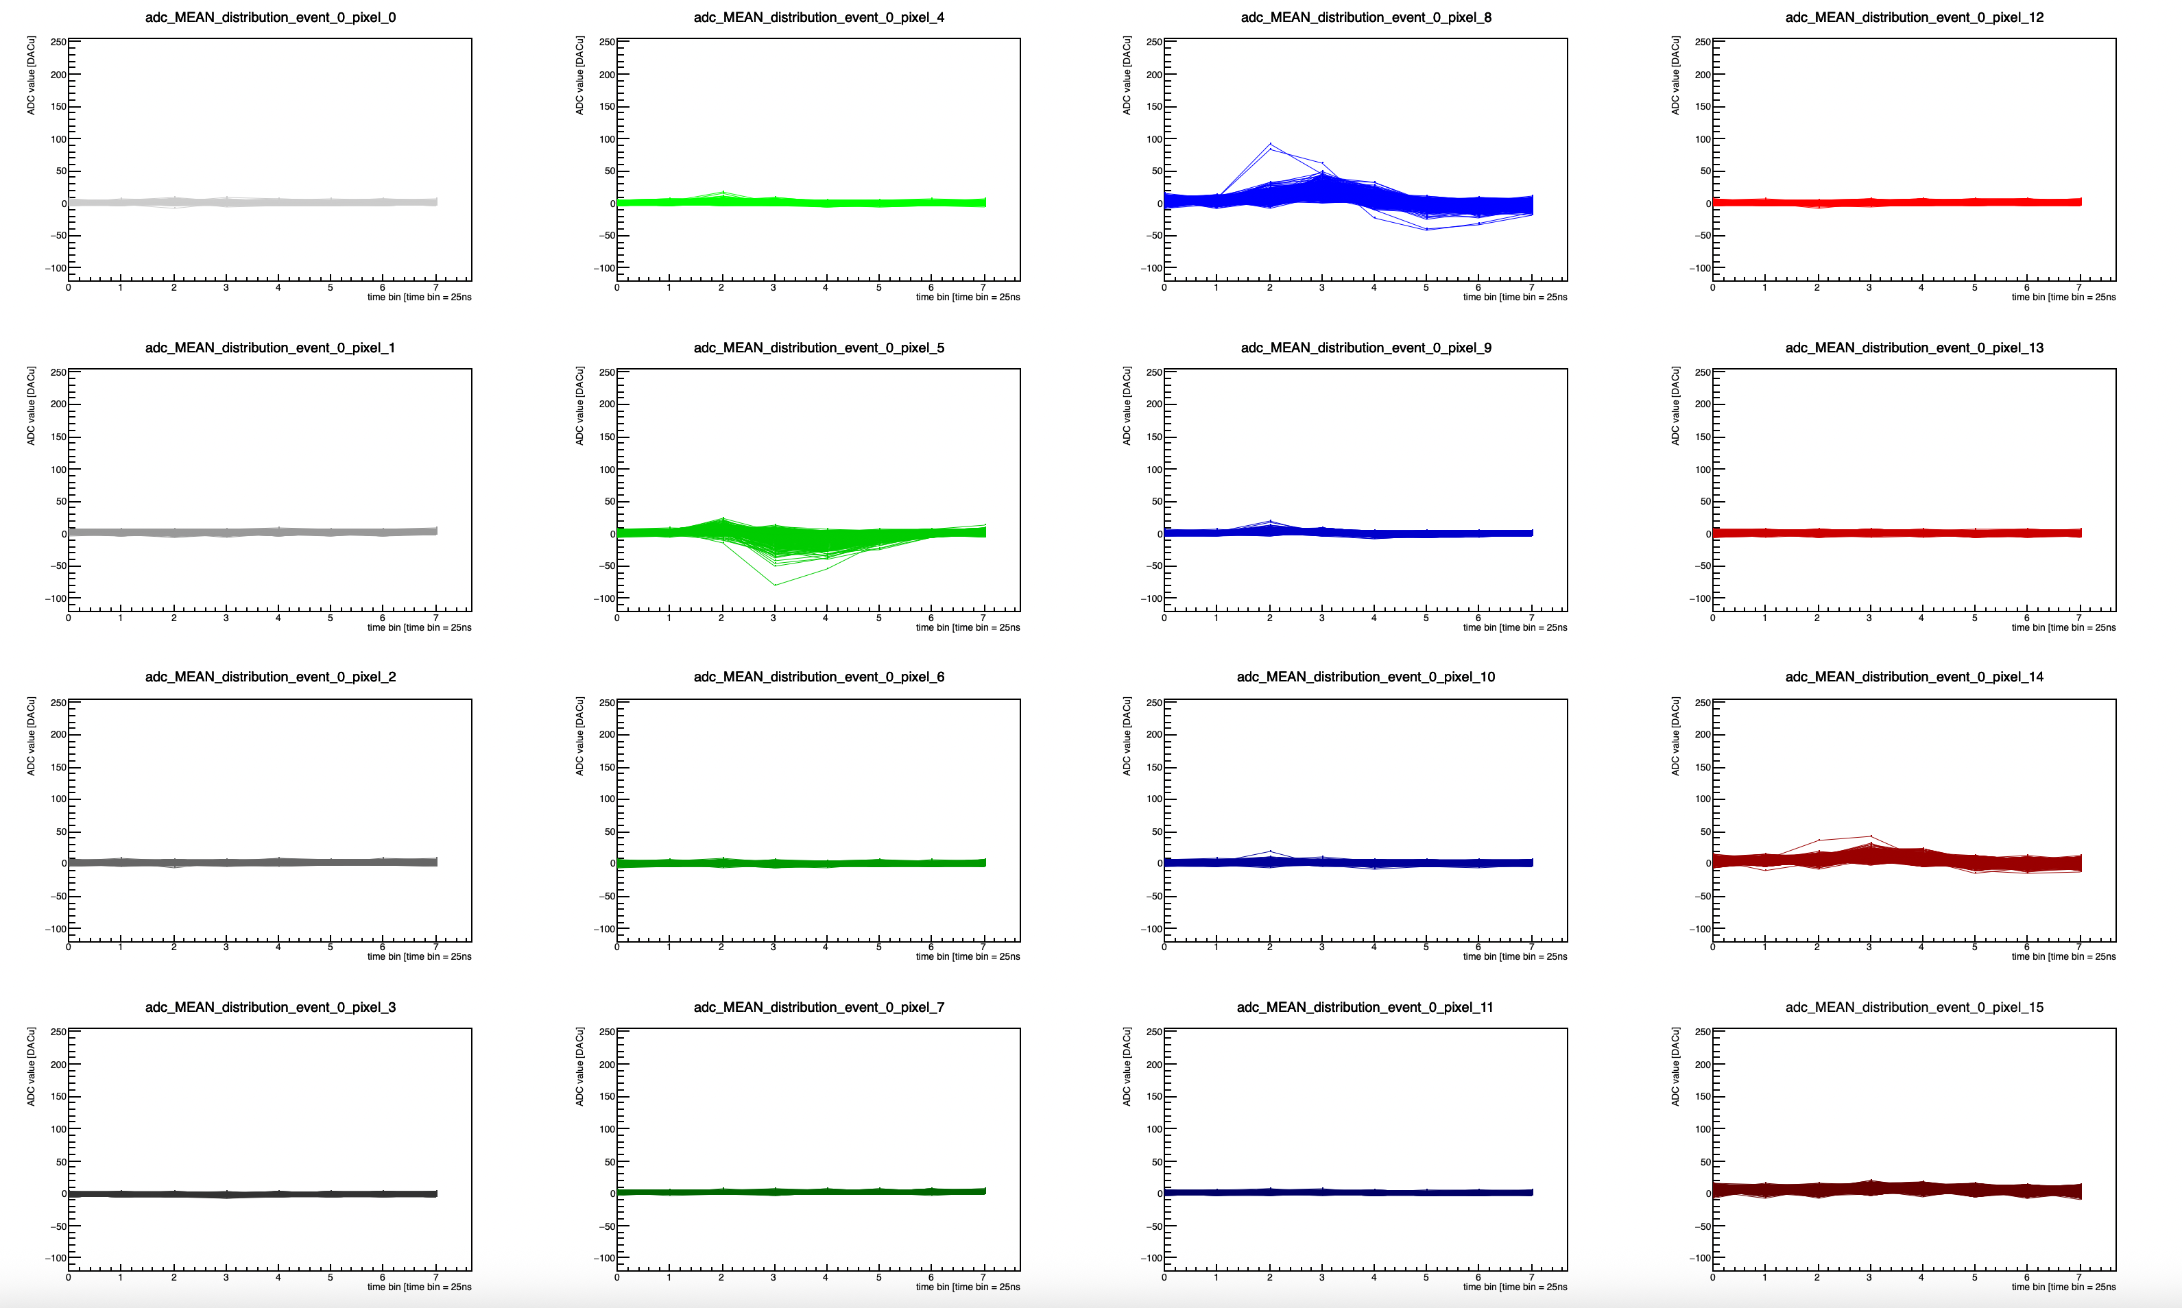
EICROC0 testing @ BNL: Sr-90 source
Using bump-bonded (30um gain layer) sensor to EICROC0 @ -170V.
  Internal trigger
”trigger” pixel = 5
Running in mode where ACQ window is always “open”, closes only when TRGOUT received from any pixel.
Offline, only look at events where pixel five is over threshold, ONLY
Pedestal is average of far pixels (far pixel 15 is very noisy).
No clear peak ADC after pedestal subtraction!!!

Slide 13
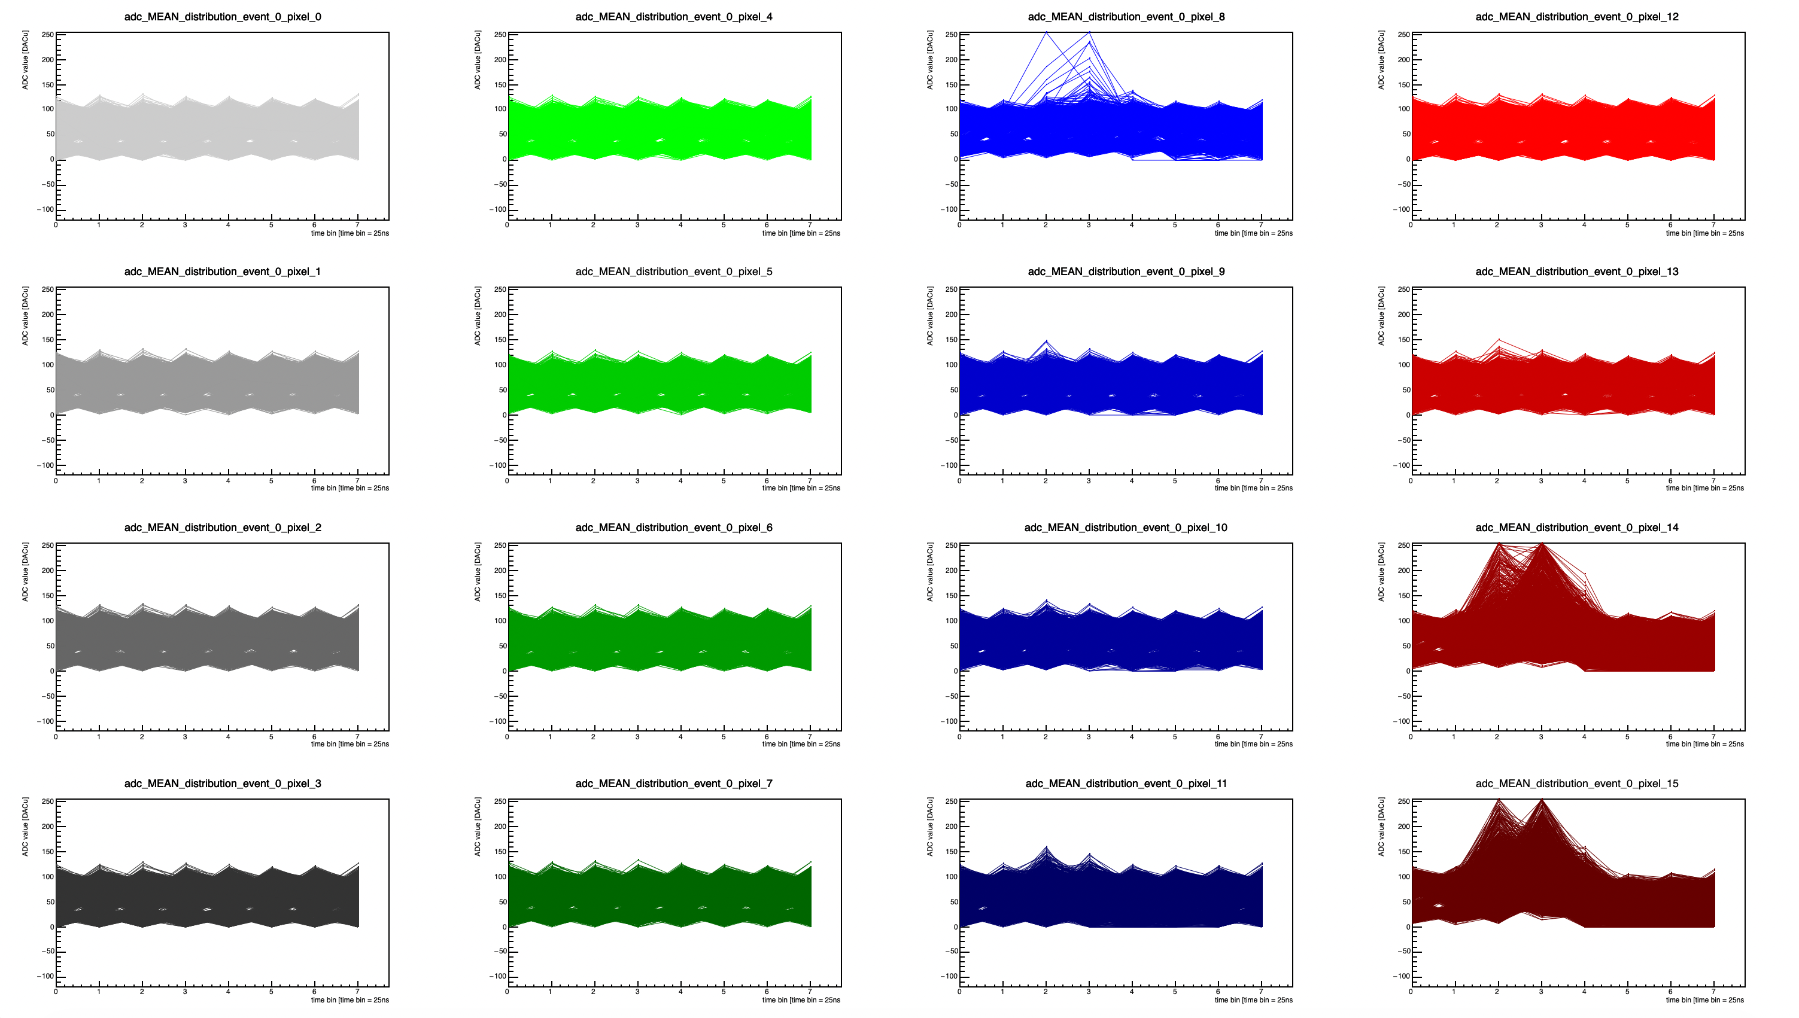
EICROC0 testing @ BNL: Sr-90 source
”trigger” pixel = 15
Running in mode where ACQ window is always “open”, closes only when TRGOUT received from any pixel.
Offline, only look at events where pixel fifteen is over threshold, ONLY
NO pedestal subtraction
Much more reasonable result – clear peak ADC seen in trigger pixel, and in a neighboring one (pixel 14).

Slide 14
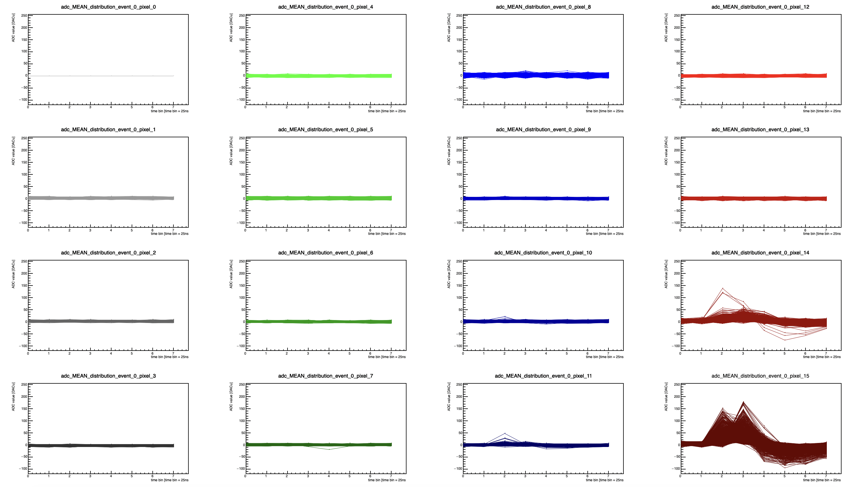
EICROC0 testing @ BNL: Sr-90 source
Using bump-bonded (30um gain layer) sensor to EICROC0 @ -170V.
  Internal trigger
”trigger” pixel = 15
Running in mode where ACQ window is always “open”, closes only when TRGOUT received from any pixel.
Offline, look at events where pixel 15 is over threshold (hitbit == 1), and ONLY pixel 15 has crossed threshold.
Pedestal subtraction performed using pixel 0, event-by-event.

Slide 15
So what is going on?
Pixels 8, 14, and 15 seem to behave like expected → if a hitbit is set to 1, that means pixel crossed threshold → focusing on those events in those pixels shows a clear ADC peak from a particle hitting the AC-LGAD roughly in the expected time bin.
  Delay was set to count 4 time bins (25ns each) before closing acquisition window after receiving TRGOUT signal → should expect peak in time bin 3 (time bins [0,7]), +/- one bin.
Other 13 pixels seem to never show a clear ADC peak above the pedestal, DESPITE crossing threshold and recording a reasonable TDC.
  Even tested with different delay values to see if we “missed” the peak – didn’t help.
Our goal was then to focus on what is actually fed to the ADC for sampling.

Slide 16
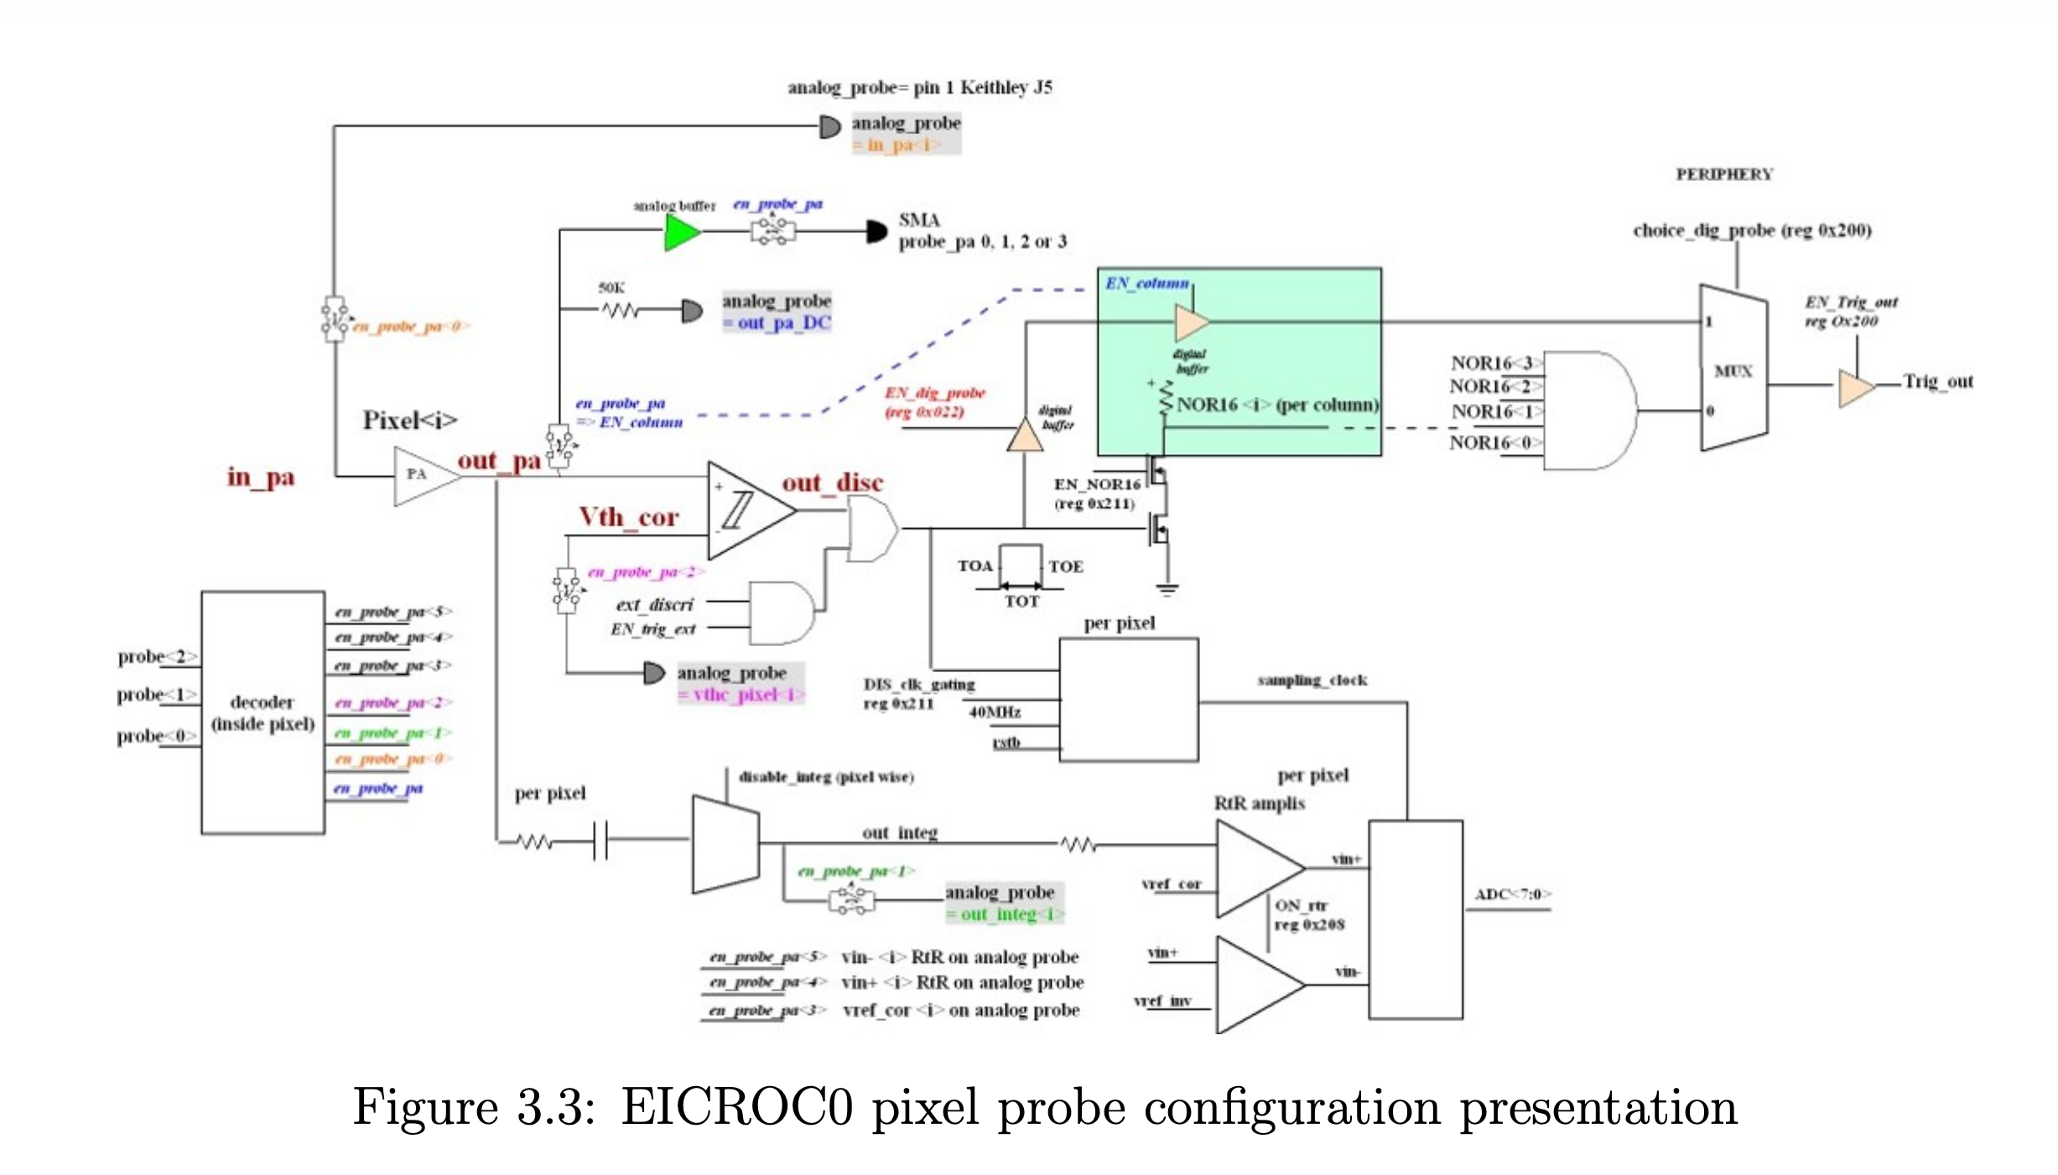
So why do the Sr-90 results (ADC) look odd?
Let’s start by looking to the overview of the circuit for the EICROC0 signal.
From EICROC user guide by Adrien Verplanke (Omega)

Slide 17
So why do the Sr-90 results (ADC) look odd?
Let’s start by looking to the overview of the circuit for the EICROC0 signal.
Fig. 3.3 from EICROC user guide by Adrien Verplanke (Omega)
Discriminator/TDC path
ADC path
Let’s just focus on the ADC path for now.

Slide 18
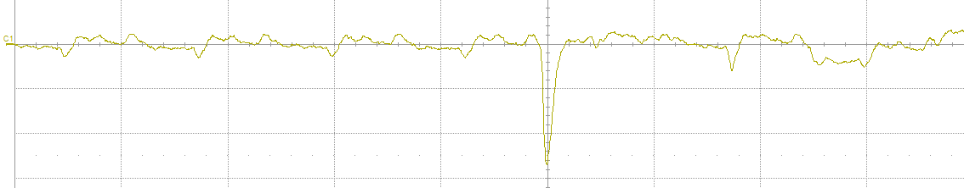
ADC “slow path” overview (charge injection)
Analog pulse comes from either direct charge injection (via FPGA board) or from bonded sensor.
Signal from AC-LGAD or charge injection
Preamp output
Clock noise
Injected pulse

Slide 19
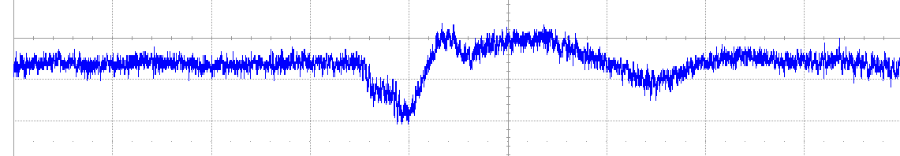
ADC “slow path” overview (charge injection)
Analog pulse comes from either direct charge injection (via FPGA board) or from bonded sensor.
Pulse then passes through integrator/shaper to stretch the very fast (~10ns) pulse into a longer time window (integrates in 25ns windows) to the ADC can eventually sample it (ADC samples at 40MHz, with 8 time samples in the ASIC buffer, so 200ns total).
Signal from AC-LGAD or charge injection

Slide 20
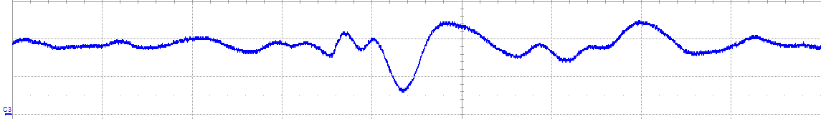
ADC “slow path” overview (charge injection)
Analog pulse comes from either direct charge injection (via FPGA board) or from bonded sensor.
Pulse then passes through integrator/shaper to stretch the very fast (~10ns) pulse into a longer time window (integrates in 25ns windows) to the ADC can eventually sample it (ADC samples at 40MHz, with 8 time samples in the ASIC buffer, so 200ns total).
Integrator output fed into a pair of RtR amplifiers.
  First amplifier takes integrator output and amplifies it, while also applying a reference voltage subtraction (can be set per-pixel) → important to ensure maximum dynamic range of the ADC.
Signal from AC-LGAD or charge injection
Clock noise
Injected pulse

Slide 21
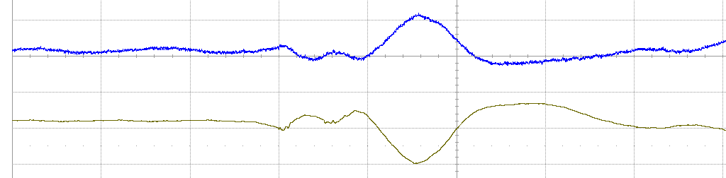
ADC “slow path” overview (charge injection)
Analog pulse comes from either direct charge injection (via FPGA board) or from bonded sensor.
Pulse then passes through integrator/shaper to stretch the very fast (~10ns) pulse into a longer time window (integrates in 25ns windows) to the ADC can eventually sample it (ADC samples at 40MHz, with 8 time samples in the ASIC buffer, so 200ns total).
Integrator output fed into a pair of RtR amplifiers.
  First amplifier takes integrator output and amplifies it, while also applying a reference voltage subtraction (can be set per-pixel) → important to ensure maximum dynamic range of the ADC. (Vin+)
  Second amplifier takes output from first amplifier and inverts it. (Vin-)
Signal from AC-LGAD or charge injection
Vin-
Vin+

Slide 22
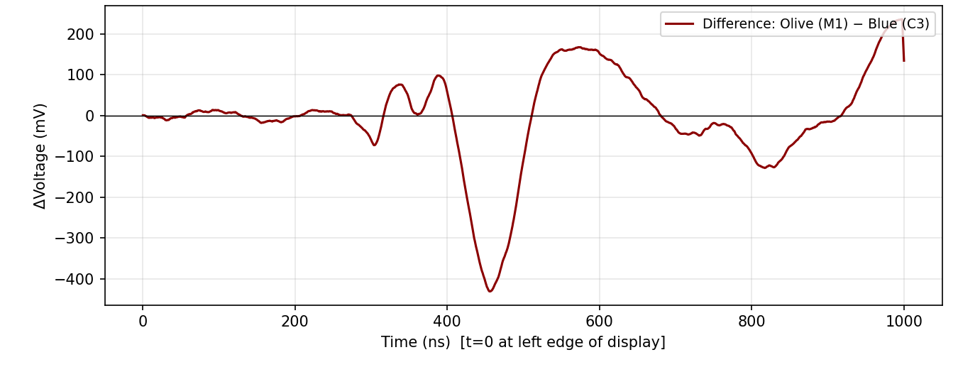
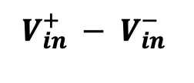

ADC “slow path” overview (charge injection)
Per pixel
40 MHz sampling clock
Integrator output
RtR amplifiers
Analog pulse comes from either direct charge injection (via FPGA board) or from bonded sensor.
Pulse then passes through integrator/shaper to stretch the very fast (~10ns) pulse into a longer time window (integrates in 25ns windows) to the ADC can eventually sample it (ADC samples at 40MHz, with 8 time samples in the ASIC buffer, so 200ns total).
Integrator output fed into a pair of RtR amplifiers.
  First amplifier takes integrator output and amplifies it, while also applying a reference voltage subtraction (can be set per-pixel) → important to ensure maximum dynamic range of the ADC. (Vin+)
  Second amplifier takes output from first amplifier and inverts it. (Vin-)
ADC will sample the difference between the two inputs.
Vin+
V_{ref}
$$V_{in}^{+} − V_{in}^{−}$$
Vin+
Vin-
$$V_{in}^{+} − V_{in}^{−}$$

Slide 23
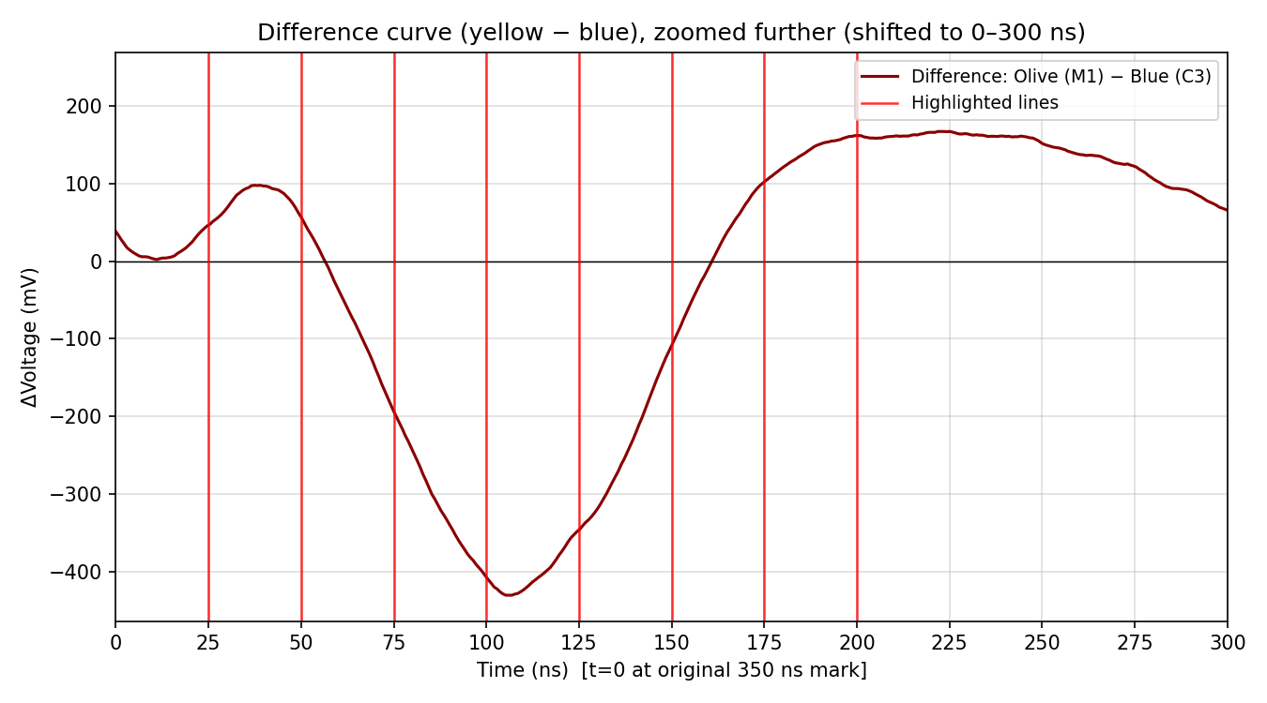
ADC “slow path” overview (charge injection)
Per pixel
40 MHz sampling clock
Integrator output
RtR amplifiers
Analog pulse comes from either direct charge injection (via FPGA board) or from bonded sensor.
Pulse then passes through integrator/shaper to stretch the very fast (~10ns) pulse into a longer time window (integrates in 25ns windows) to the ADC can eventually sample it (ADC samples at 40MHz, with 8 time samples in the ASIC buffer, so 200ns total).
Integrator output fed into a pair of RtR amplifiers.
  First amplifier takes integrator output and amplifies it, while also applying a reference voltage subtraction (can be set per-pixel) → important to ensure maximum dynamic range of the ADC. (Vin+)
  Second amplifier takes output from first amplifier and inverts it. (Vin-)
ADC will sample the difference between the two inputs.
Buffer has space for 8 ADC time samples → ADC samples in each of the 8 time bins, as illustrated by the red lines.
Vin+
V_{ref}
8, 25ns ADC samples of the differential input
$$V_{in}^{+} − V_{in}^{−}$$
Vin+
Vin-
$$V_{in}^{+} − V_{in}^{−}$$

Slide 24
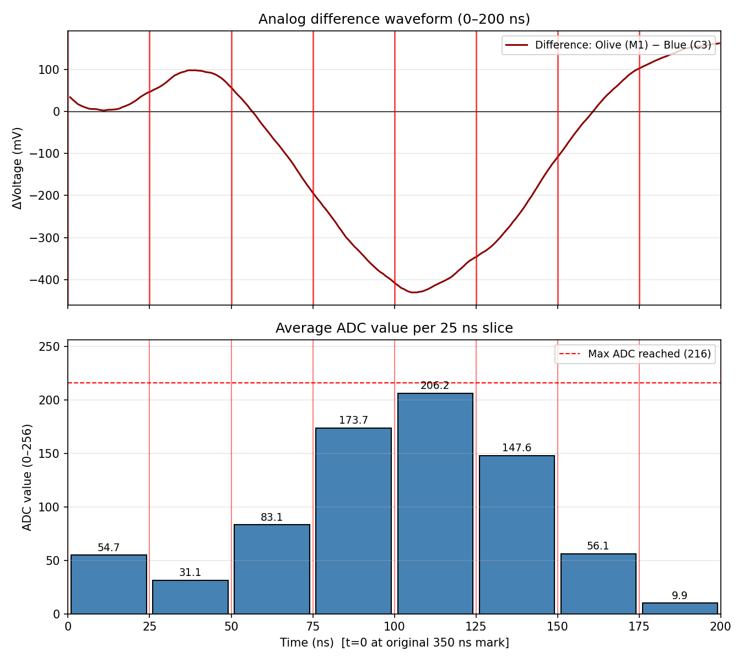
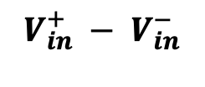
ADC “slow path” overview (charge injection)
Analog pulse comes from either direct charge injection (via FPGA board) or from bonded sensor.
Pulse then passes through integrator/shaper to stretch the very fast (~10ns) pulse into a longer time window (integrates in 25ns windows) to the ADC can eventually sample it (ADC samples at 40MHz, with 8 time samples in the ASIC buffer, so 200ns total).
Integrator output fed into a pair of RtR amplifiers.
  First amplifier takes integrator output and amplifies it, while also applying a reference voltage subtraction (can be set per-pixel) → important to ensure maximum dynamic range of the ADC. (Vin+)
  Second amplifier takes output from first amplifier and inverts it. (Vin-)
ADC will sample the difference between the two inputs.
Buffer has space for 8 ADC time samples → ADC samples in each of the 8 time bins, as illustrated by the red lines.
ADC-sampled waveforms should represent the real input waveform.
  **This ADC distribution is only an illustration.
$$V_{in}^{+} − V_{in}^{−}$$
0
1
2
3
4
5
6
7

Slide 25
IR laser and Sr-90 into AC-LGAD → EICROC0

Slide 26
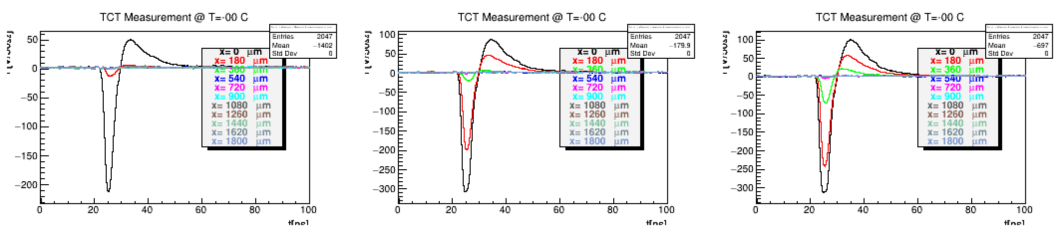
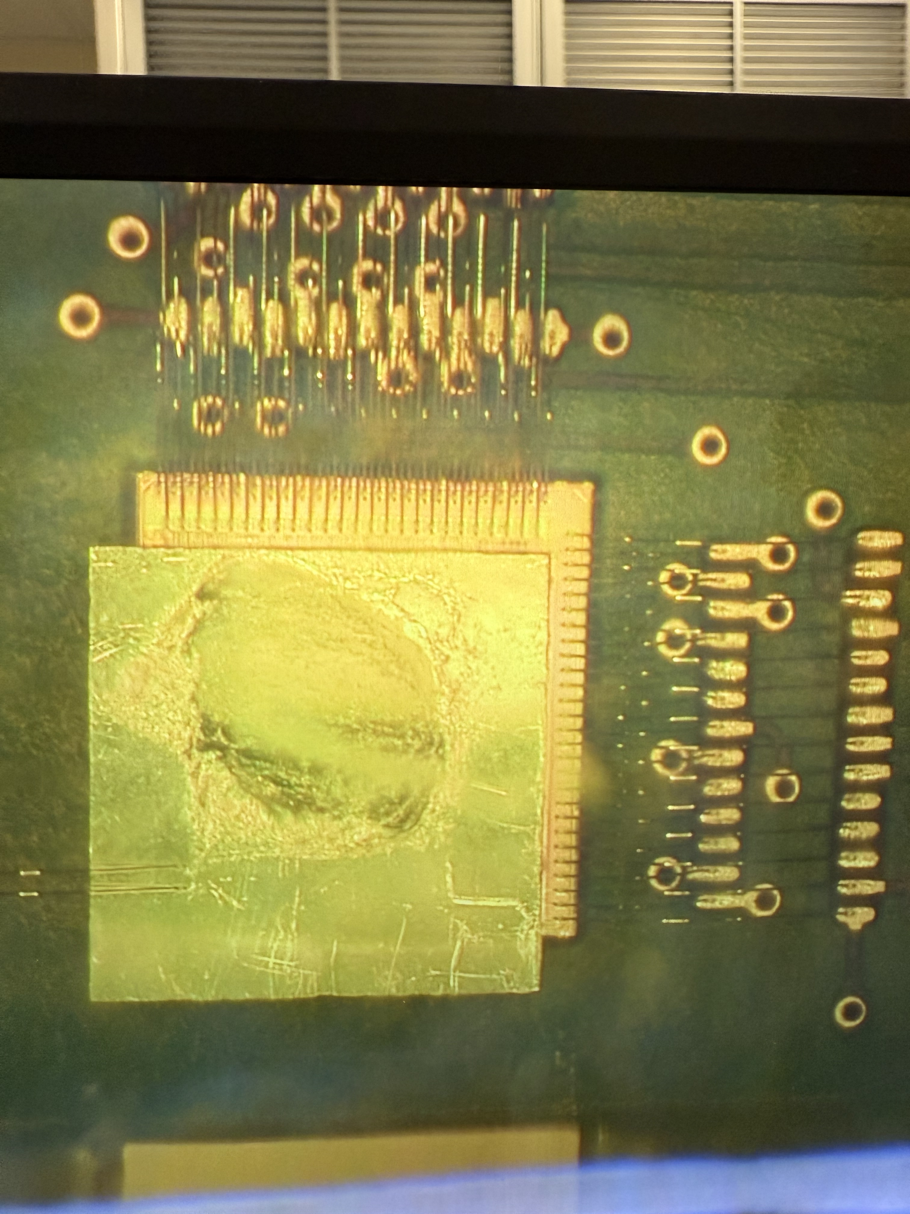
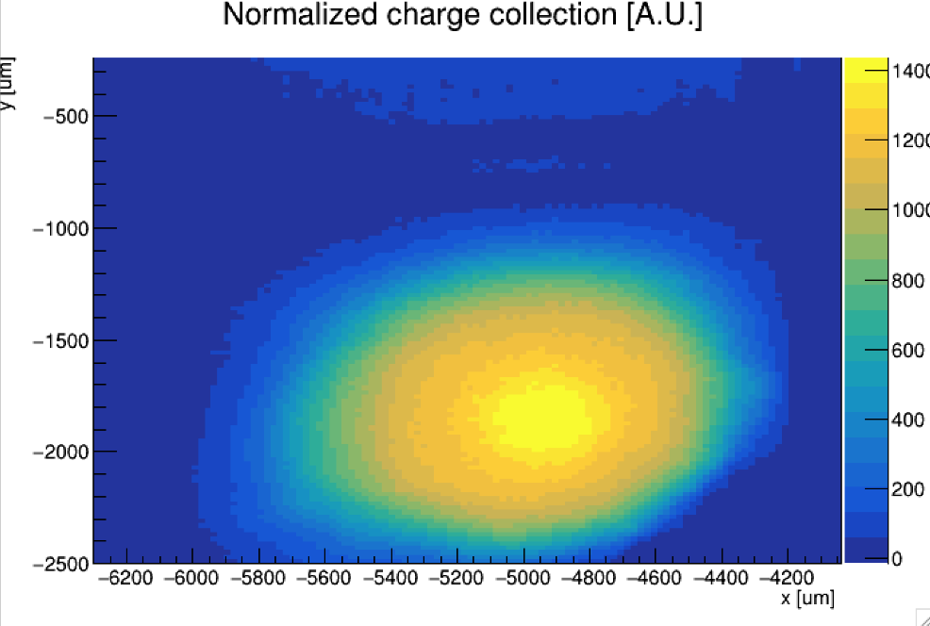
Test setup → etched HPK sensor, bump-bonded to EICROC0
V [mV]
V [mV]
V [mV]
t[ns]
t[ns]
t[ns]
AC-LGAD (HPK) “etched” to remove portions of the backplane (for TCT).
30um substrate thickness; 100um electrodes
Sensor bump-bonded to EICROC0.
  Results here show output of EICROC0 analog preamps (analog probe) using IR laser as input.
Bias: -170V
Measure avg. rise time ~ 400ps (FNAL board), ~ 1ns (EICROC0 analog output)
Etched, bump-bonded assembly.

Slide 27
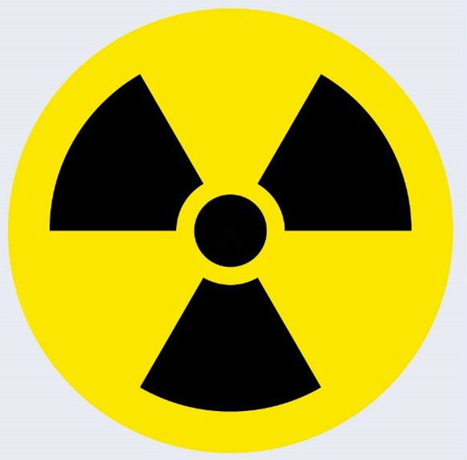
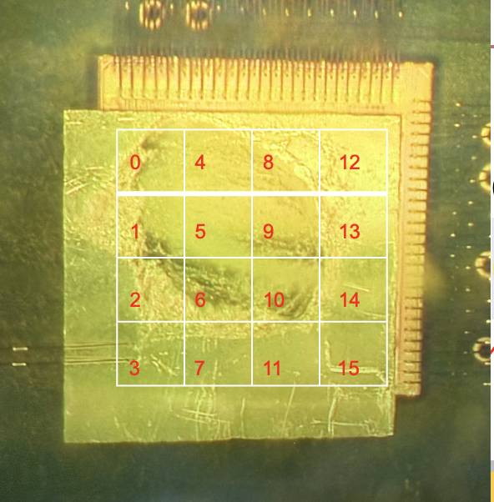
Test setups → AC-LGAD bump-bonded to ASIC
Laser
bump-bonding required backplane metal to be “etched” away
Sr-90 source (electrons ~ few hundred keV)
Etched section
backplane
AC-LGAD
EICROC0
PCB

Slide 28
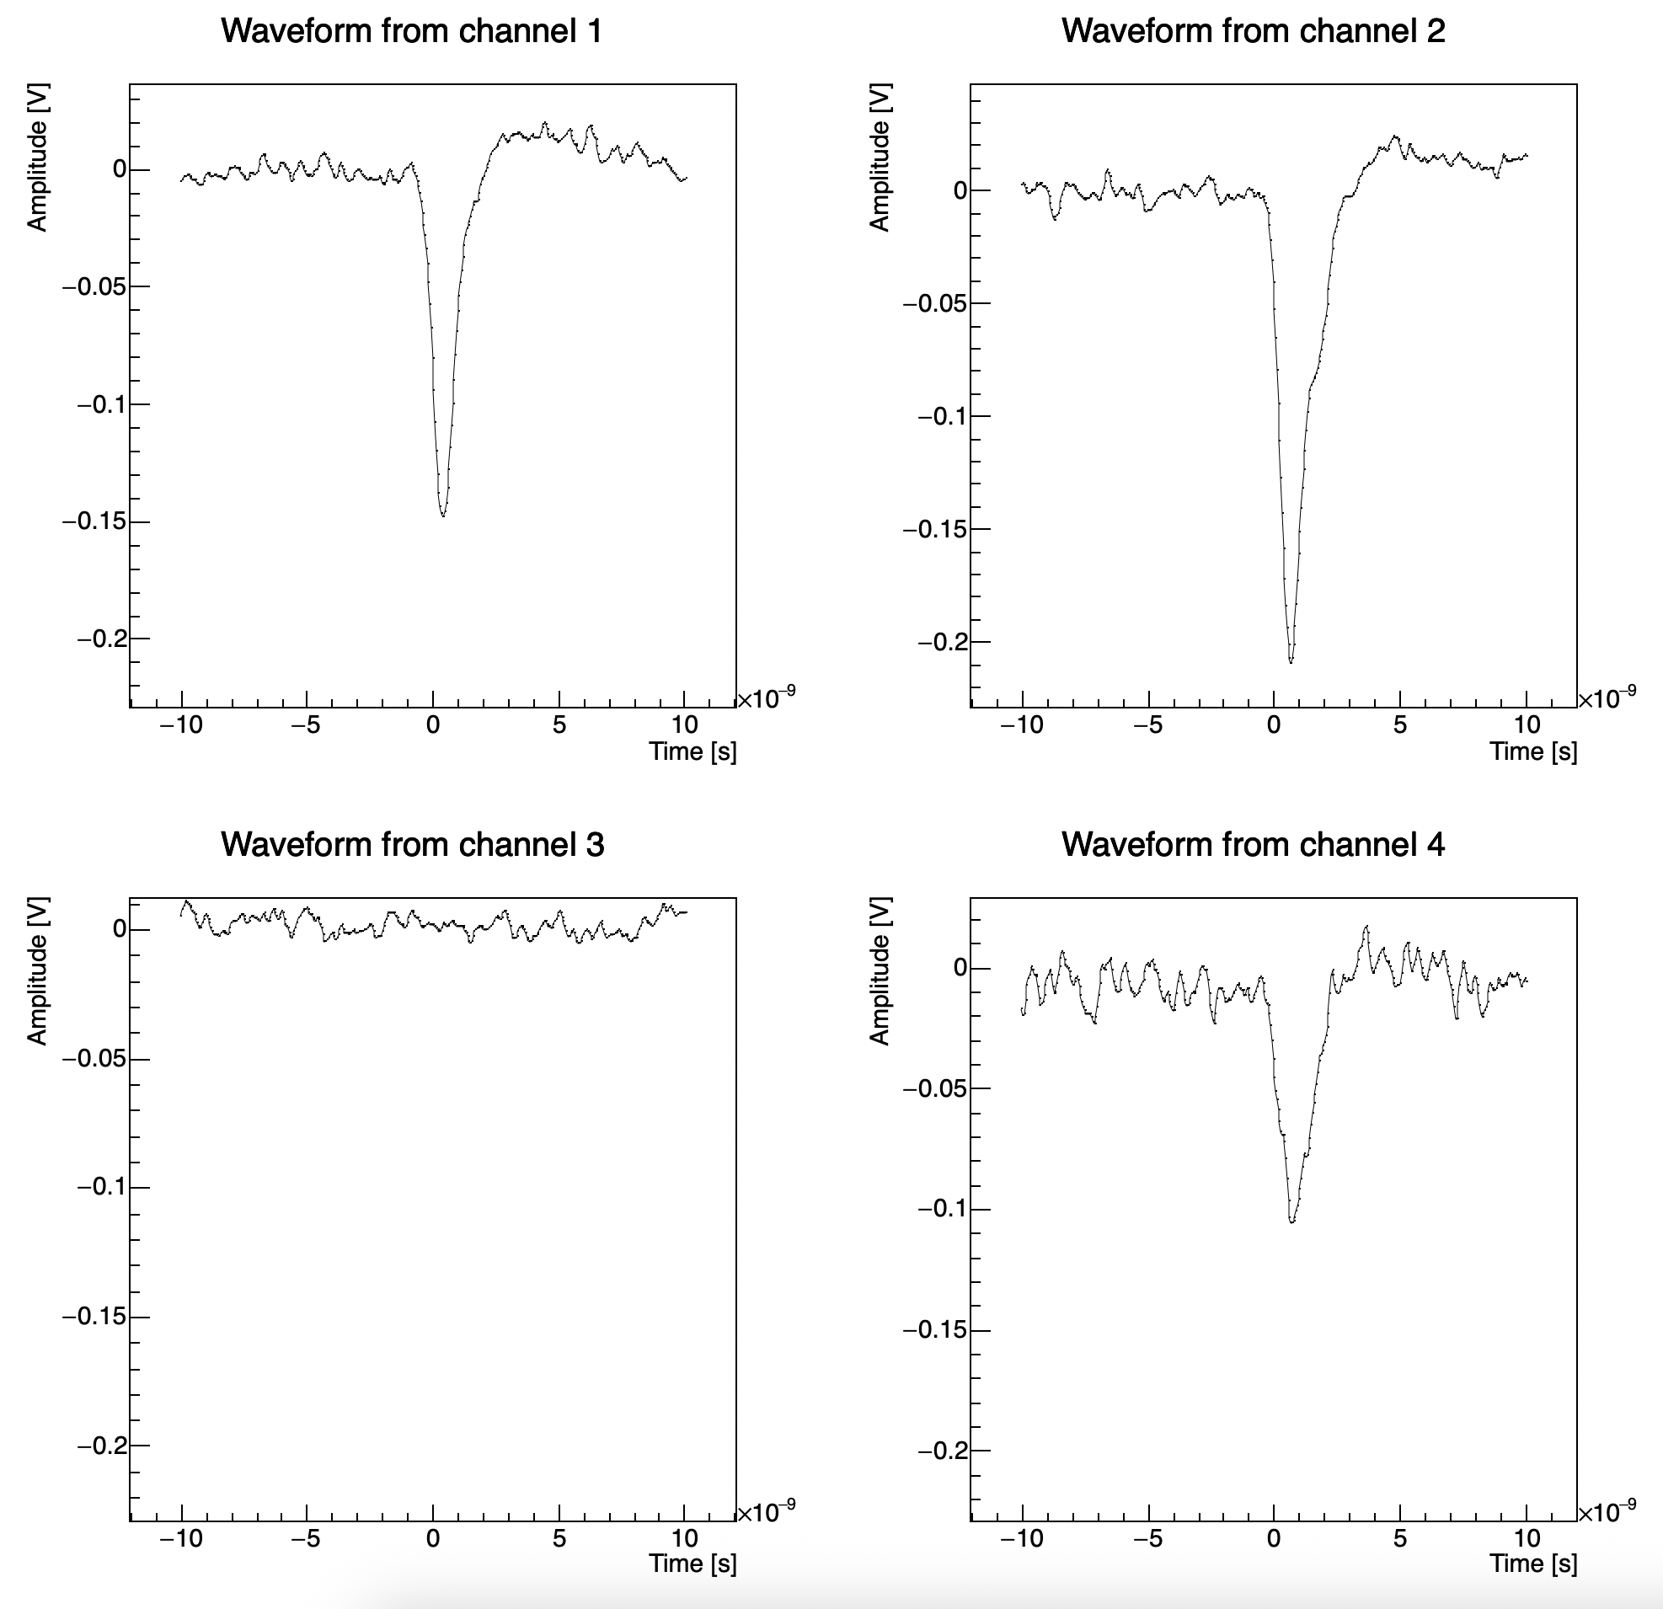
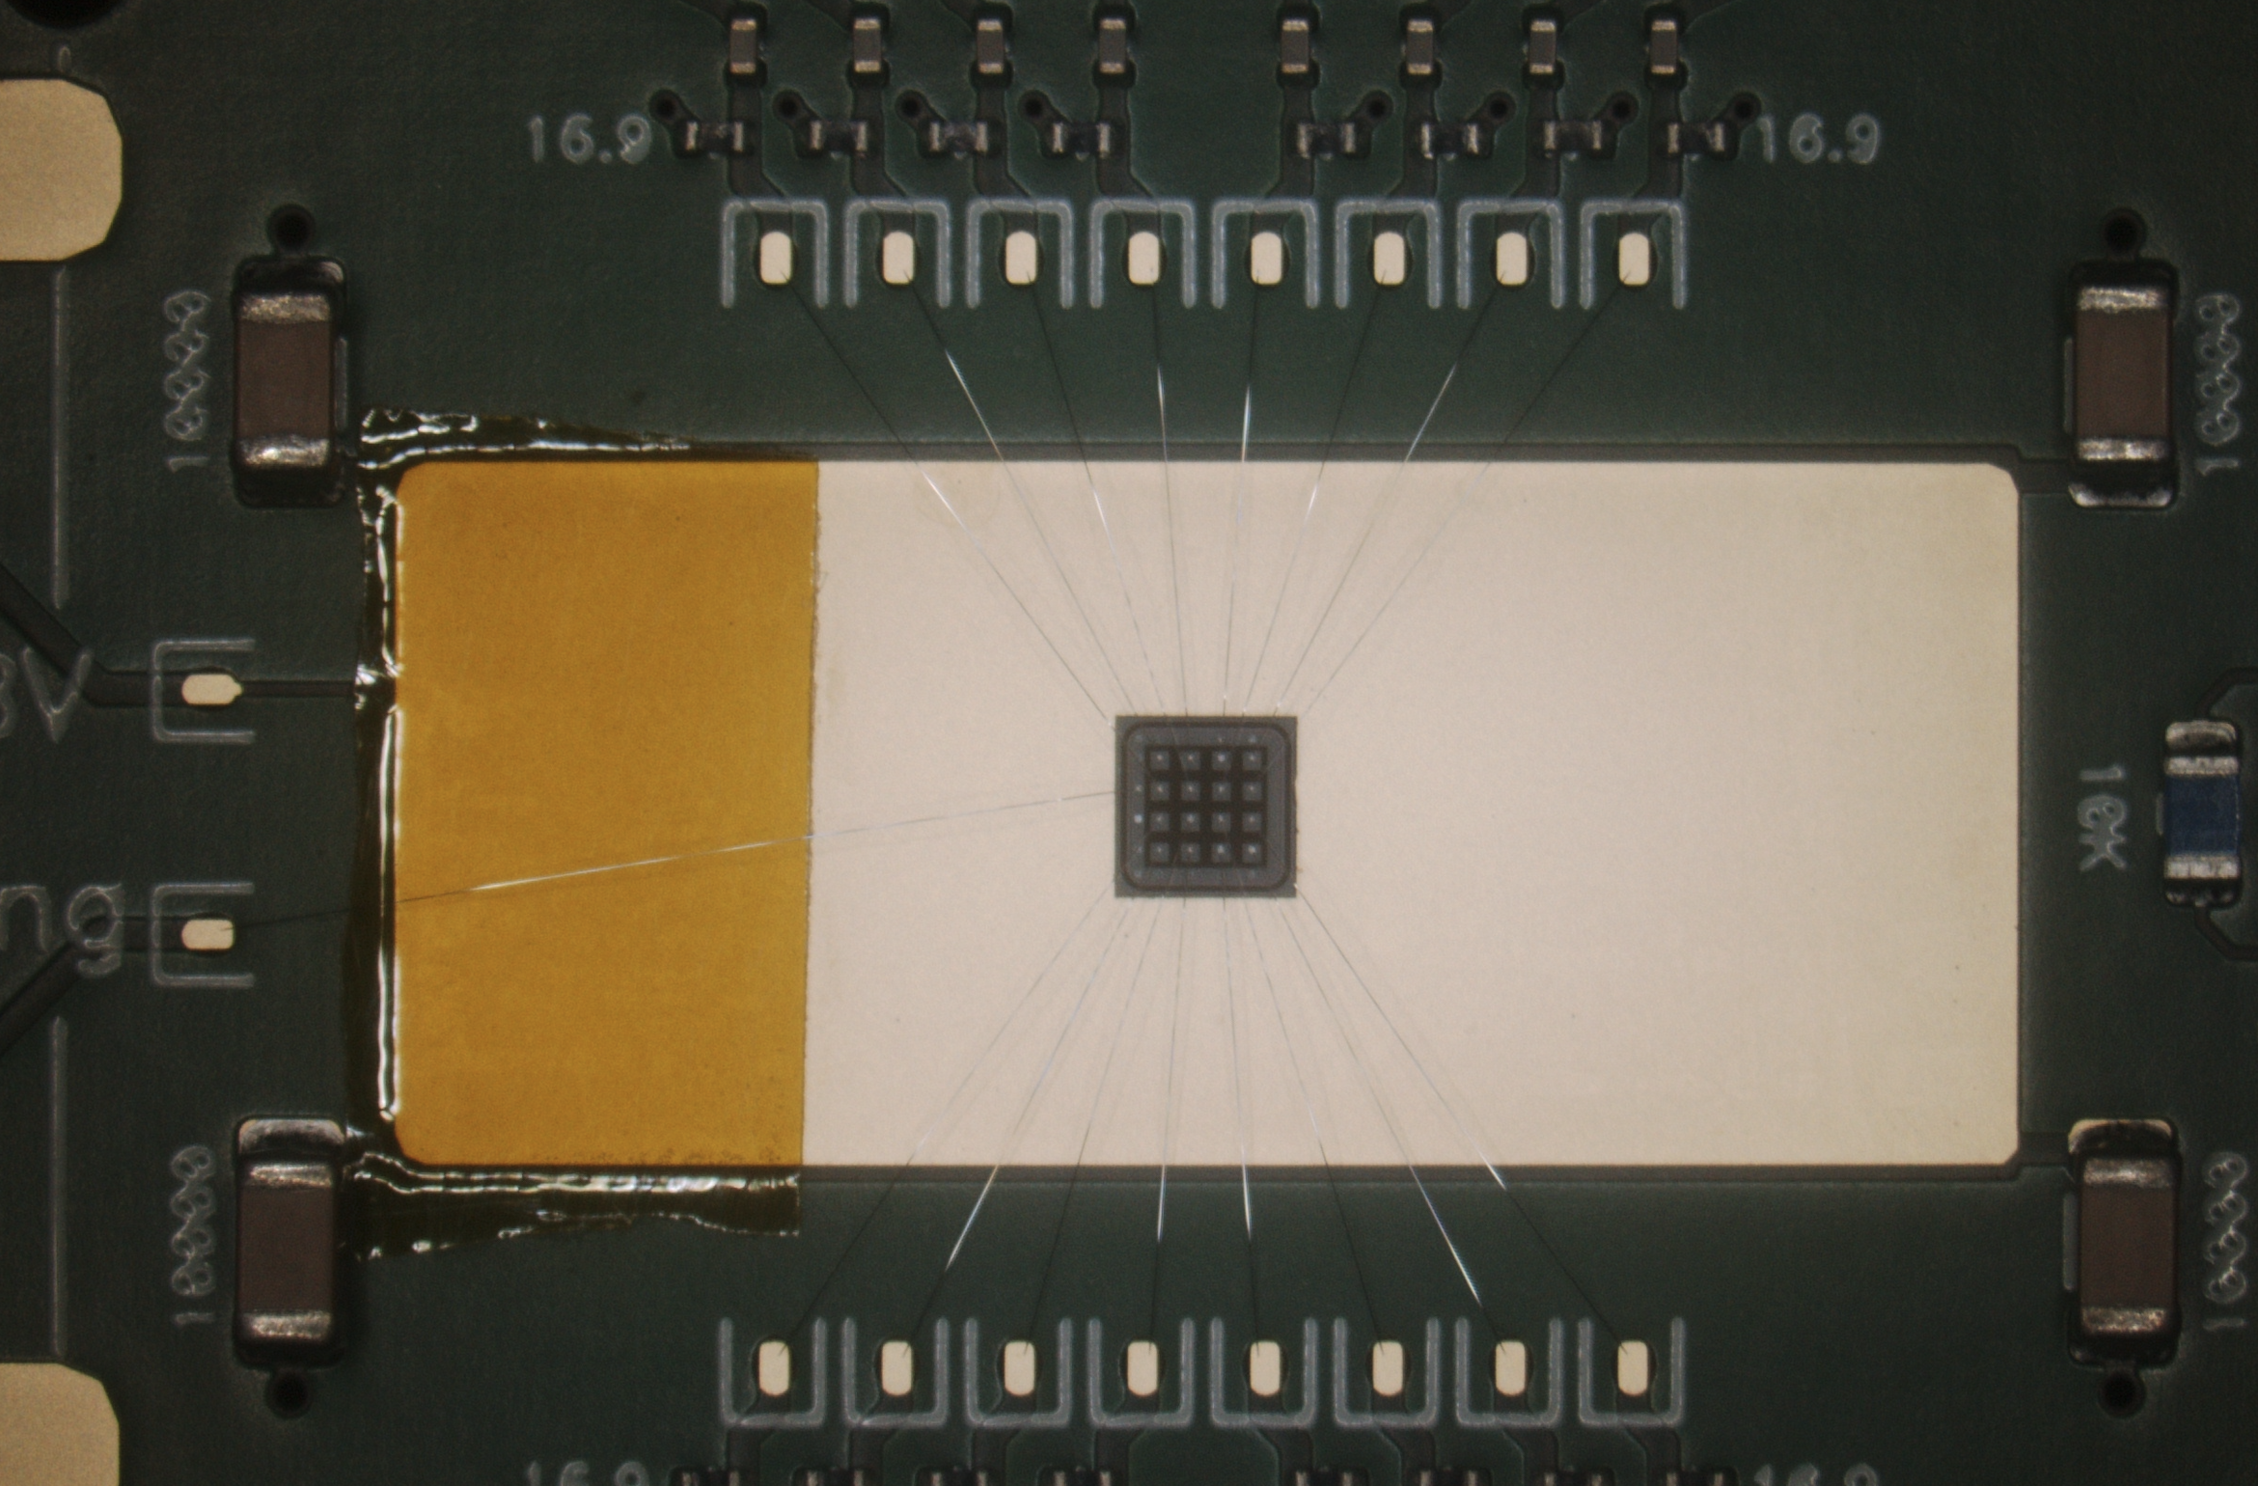
AC-LGAD bonded to FNAL preamp board
AC-LGAD wire-bonded to Fermilab test board with low noise preamplifiers.
  HPK sensor with same specs as etched sensor.
Sensor assembly placed under Sr-90 source and 4 channels readout at once.
  4 pixels in center of sensor.
Teledyne LeCroy 4-channel oscilloscope used to readout analog output from board.
  Channel 1 used as trigger with low threshold.
Goal was to measure the jitter from the pixel with maximum amplitude in each event.
28

Slide 29
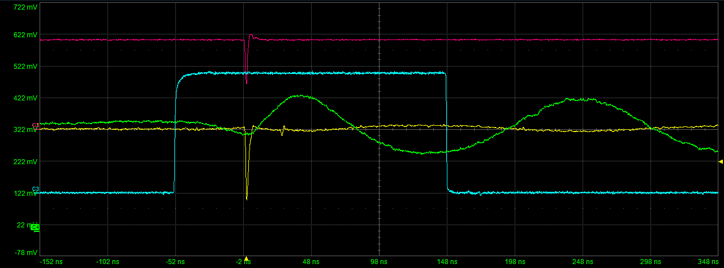
Q = 63 charge injection (~25 fC) – NO 160MHz clock
Yellow: Output of preamplifier (injected pulse).
Blue: 200ns acquisition window (tuned to bound the buffer, exactly).
Magenta: TRGOUT signal (discriminator threshold crossed by pulse).
Green: output of RtR amplifier (different channel than PA output).

Slide 30
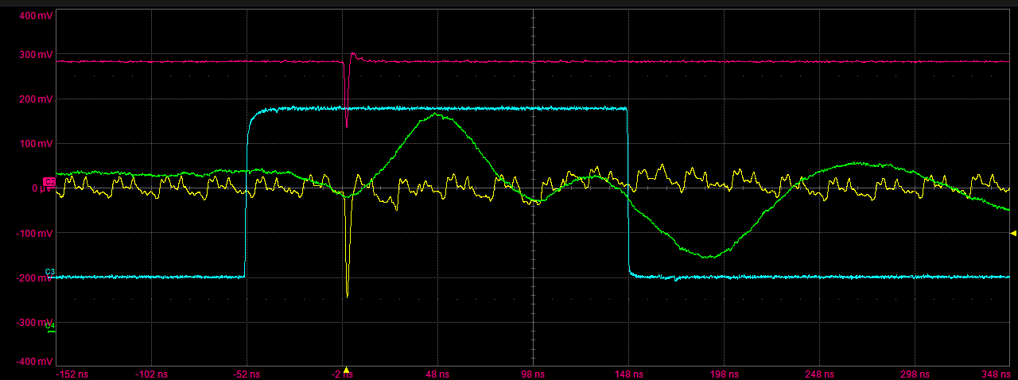
Q = 63 charge injection (~25 fC) – w/ 160MHz clock
Yellow: Output of preamplifier (injected pulse).
Blue: 200ns acquisition window (tuned to bound the buffer, exactly).
Magenta: TRGOUT signal (discriminator threshold crossed by pulse).
Green: output of RtR amplifier.

Slide 31
Things look reasonable with charge injection, with and without the clock

Slide 32
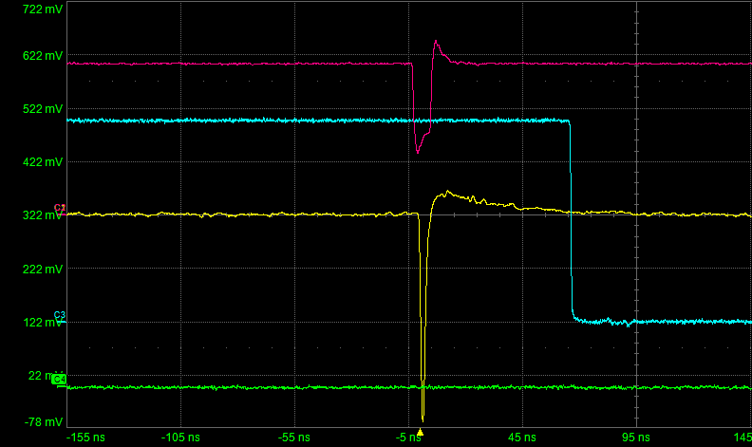
Sr-90 → pixel 15 (“good” pixel) - NO 160MHz clock
Cannot ”see” PA and RtR output from same channel at same time → triggered output “by-hand” on RtR output, by slowly raising threshold until we saw the closing ACQ window.
Once trigger signal received (discriminator, magenta), a 2 time-sample delay is used, and then the ACQ window closes, which then triggers the readout of the buffer.
Yellow: Output of preamplifier (injected pulse).
Blue: 200ns acquisition window (tuned to bound the buffer, exactly).
Magenta: TRGOUT signal (discriminator threshold crossed by pulse).
Green: output of RtR amplifier.

Slide 33
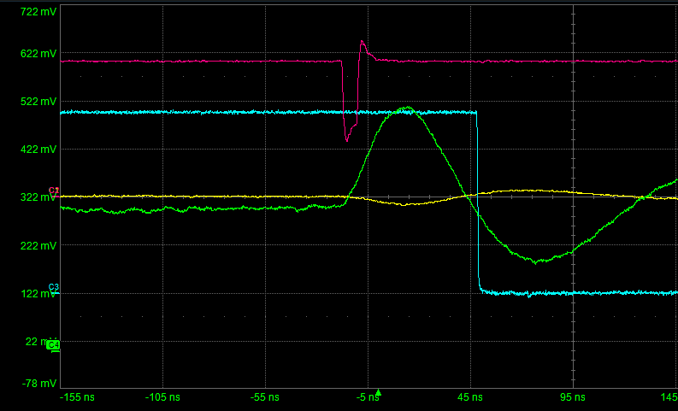
Sr-90 → pixel 15 (“good” pixel) - NO 160MHz clock
Cannot ”see” PA and RtR output from same channel at same time → triggered output “by-hand” on RtR output, by slowly raising threshold until we saw the closing ACQ window.
Once trigger signal received (discriminator, magenta), a 2 time-sample delay is used, and then the ACQ window closes, which then triggers the readout of the buffer.
Yellow: Output of preamplifier (injected pulse).
Blue: 200ns acquisition window (closes after a tuned delay when TRGOUT received)
Magenta: TRGOUT signal (discriminator threshold crossed by pulse).
Green: output of RtR amplifier.

Slide 34
Sr-90 → pixel 0 (“bad” pixel) - NO 160MHz clock
Cannot ”see” PA and RtR output from same channel at same time → triggered output “by-hand” on RtR output, by slowly raising threshold until we saw the closing ACQ window.
Once trigger signal received (discriminator, magenta), a 2 time-sample delay is used, and then the ACQ window closes, which then triggers the readout of the buffer.
Yellow: Output of preamplifier (injected pulse).
Blue: 200ns acquisition window (tuned to bound the buffer, exactly).
Magenta: TRGOUT signal (discriminator threshold crossed by pulse).
Green: output of RtR amplifier.

Slide 35
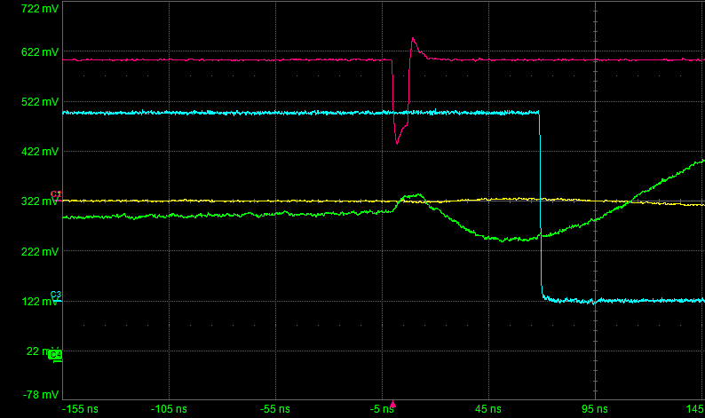
Sr-90 → pixel 0 (“bad” pixel) - NO 160MHz clock
Cannot ”see” PA and RtR output from same channel at same time → triggered output “by-hand” on RtR output, by slowly raising threshold until we saw the closing ACQ window.
Once trigger signal received (discriminator, magenta), a 2 time-sample delay is used, and then the ACQ window closes, which then triggers the readout of the buffer.
Yellow: Output of preamplifier (injected pulse).
Blue: 200ns acquisition window (closes after a tuned delay when TRGOUT received)
Magenta: TRGOUT signal (discriminator threshold crossed by pulse).
Green: output of RtR amplifier.

Slide 36
Conclusions
The reason we don’t see signal in many pixels with the Sr-90 source is due to the bi-polarity of the AC-LGAD pulses.
  25ns integrator window means the negative and positive portion of the pulse are integrated in the same time window, yielding a very small overall integrated charge.
  Bipolar signal is actually expected for AC-LGADs, but why such different behavior for say pixel 5 and pixel 15 in this sensor?
Next steps
  Working with a different testboard using a wire-bonded assembly, but with a BNL sensor.
  Want to look at the same spec’d HPK sensor, but wire-bonded, and compare results with bump-bonded assembly.

Slide 37
Backup

Slide 38
AC-LGAD + EICROC testing @ BNL (previous results)

Slide 39
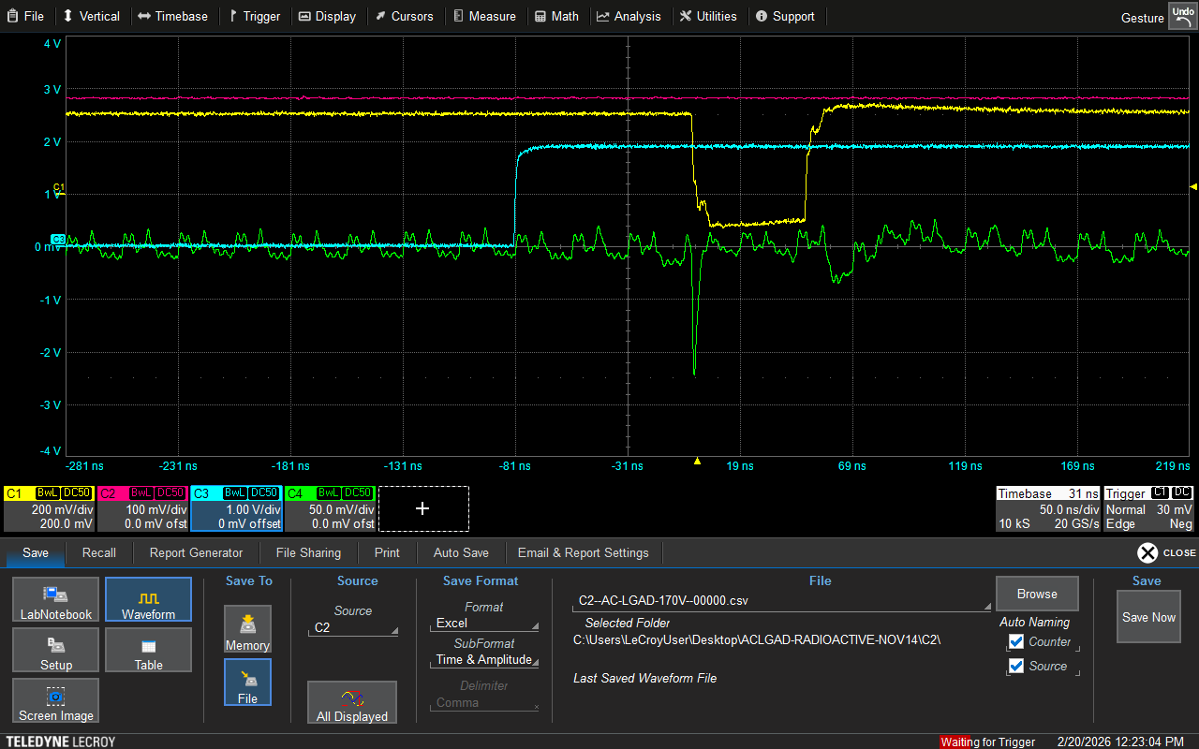
Trigger Issue
Using the ZU706
  Delays set incorrectly in script to interact with firmware.
  Blue: J67 output from FPGA board (start and stop ACQ?)
  Green: analog output from preamp.
  Yellow: command pulse output from testboard.
  Magenta: TRG_OUT from test board.
When scope looks like this, events do not look like they should (the blue output pulse exceeds the 200ns window expected for a shaped event?)
  What actually happens? Does it overwrite ADC/TDC values?

Slide 40
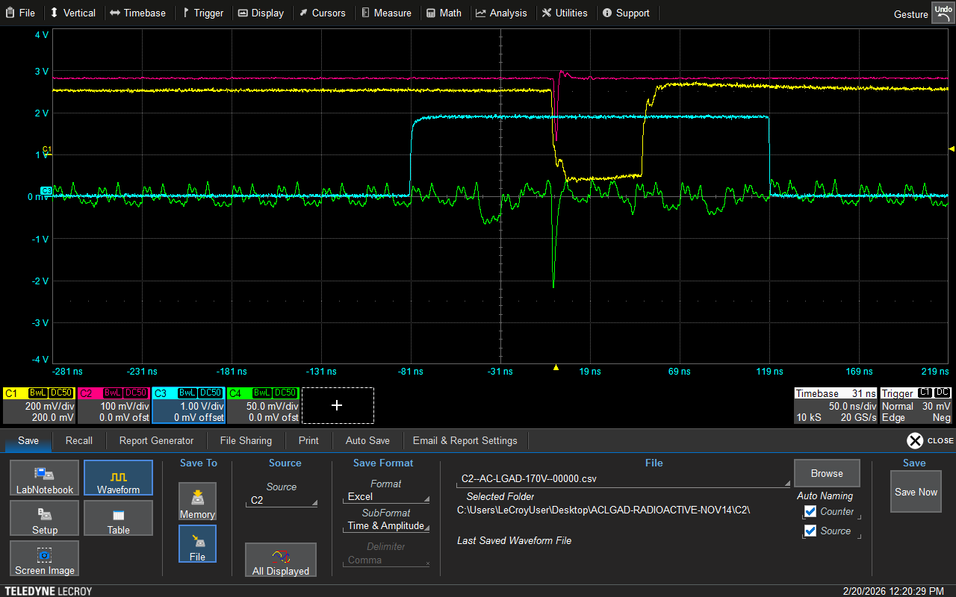
Trigger Issue
Using the ZU706
  Delays set incorrectly in script to interact with firmware.
  Blue: J67 output from FPGA board (start and stop ACQ?)
  Green: analog output from preamp.
  Yellow: command pulse output from testboard.
  Magenta: TRG_OUT from test board.
“guessed” that the blue trigger window established by the FPGA needed to be the same width as a shaped “event” (200ns; 8 time samples).
  Adjusted delays until this was true, then tried taking data.

Slide 41
Trigger Issue – shift to reduce noise
Using the ZU706
  Delays set incorrectly in script to interact with firmware.
  Blue: J67 output from FPGA board (start and stop ACQ?)
  Green: analog output from preamp.
  Yellow: command pulse output from testboard.
  Magenta: TRG_OUT from test board.
“guessed” that the blue trigger window established by the FPGA needed to be the same width as a shaped “event” (200ns; 8 time samples).
  Adjusted delays until this was true, then tried taking data.
1 time bin

Slide 42
ADC distributions

Slide 43
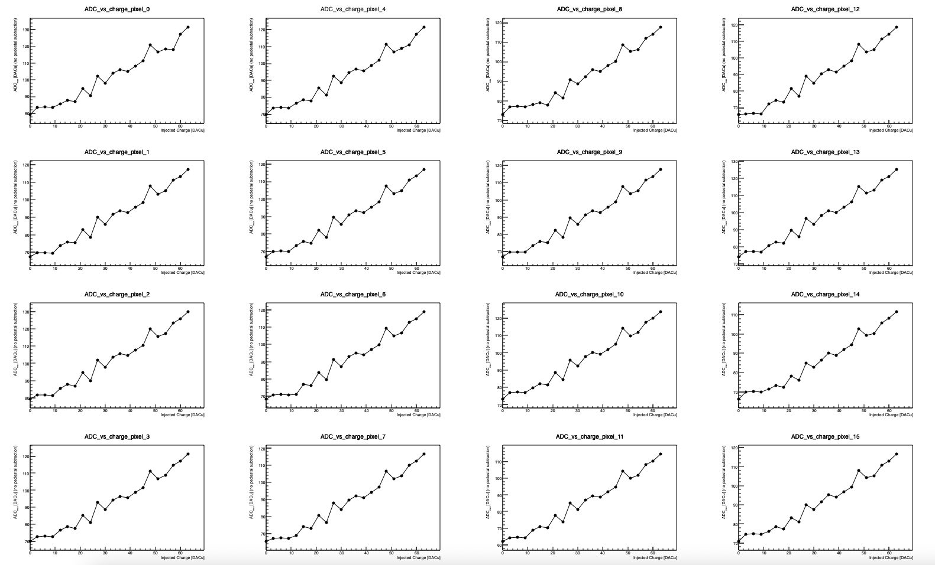
Snapshot of results after fixing trigger issue
All pixels show linear ADC response with increasing charge.
  Distributions are noisy due to combination of unbiased sensor, and potentially the location of the pulse within the trigger window (will adjust and re-take data).
Threshold = 350 DACu
(bump-bonded) Sensor unbiased
520227547096 | 0 | 39 | 0 | 0 | 89 | 0 | 562 | 142 | 0 | 0 | 100 | 0 | 0 | 60 | 1 | 0 | 55 | 0 | 0 | 67 | 0 | 0 | 78 | 0

Slide 44
Snapshot of results after fixing trigger issue
All pixels show linear ADC response with increasing charge.
  Distributions are noisy due to combination of unbiased sensor, and potentially the location of the pulse within the trigger window (will adjust and re-take data).
Threshold = 350 DACu
(bump-bonded) Sensor unbiased
520227547096 | 0 | 39 | 0 | 0 | 89 | 0 | 562 | 142 | 0 | 0 | 100 | 0 | 0 | 60 | 1 | 0 | 55 | 0 | 0 | 67 | 0 | 0 | 78 | 0
TDC ADC H

Slide 45
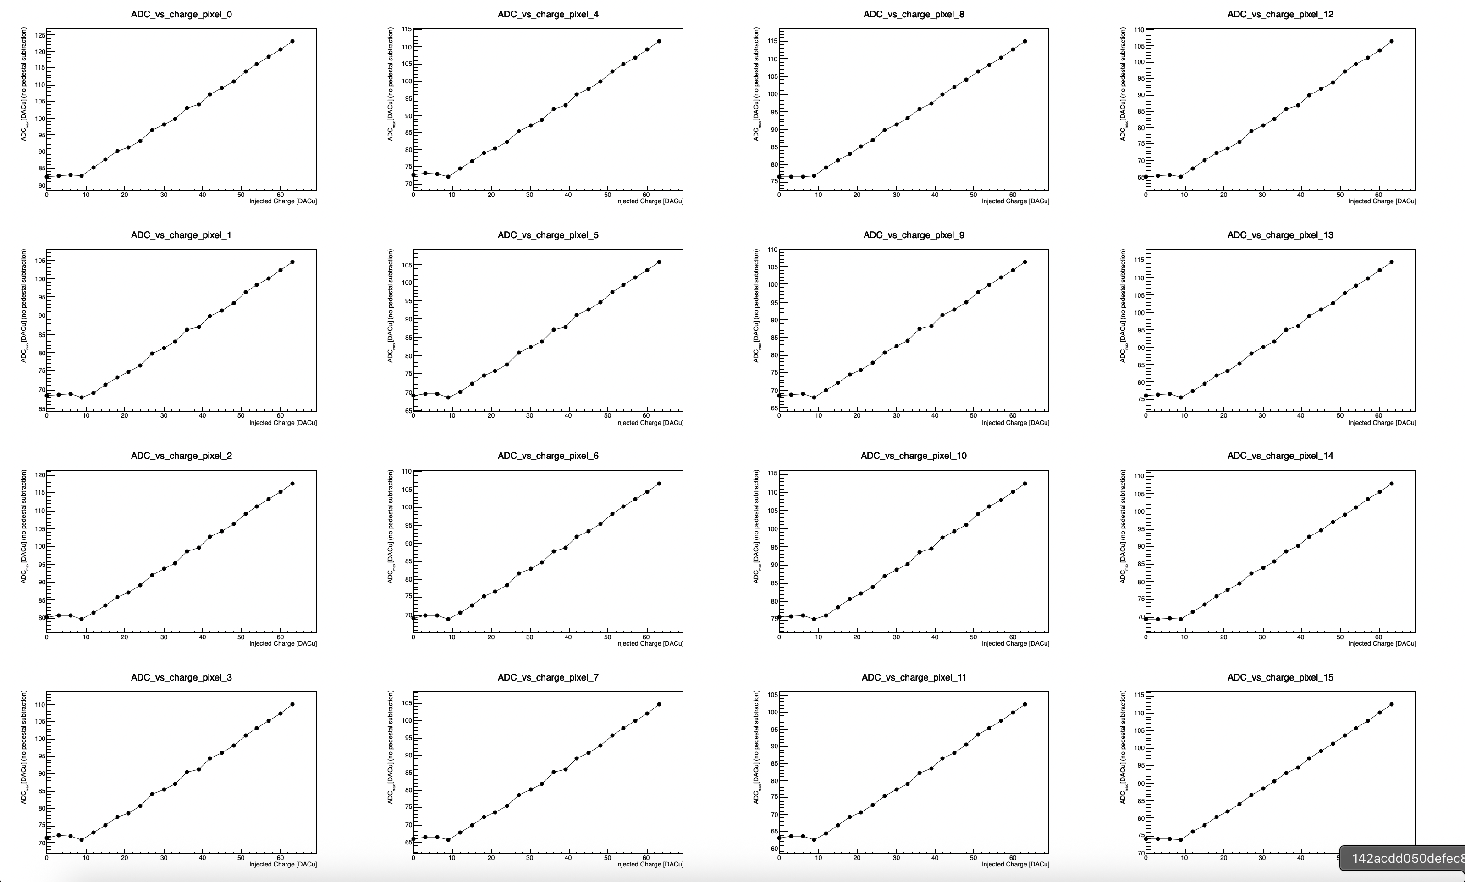
Snapshot of results after fixing trigger issue
All pixels show linear ADC response with increasing charge.
  Adjusted trigger window → shift pulse to center of acquisition window.
Threshold = 350 DACu
(bump-bonded) Sensor unbiased
520227547096 | 0 | 39 | 0 | 0 | 89 | 0 | 562 | 142 | 0 | 0 | 100 | 0 | 0 | 60 | 1 | 0 | 55 | 0 | 0 | 67 | 0 | 0 | 78 | 0
TDC ADC H

Slide 46
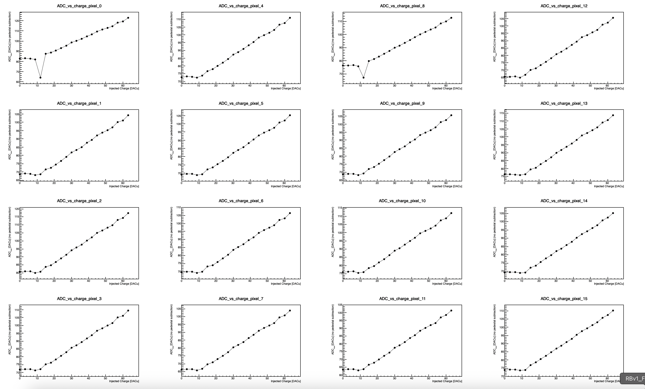
Snapshot of results after fixing trigger issue
All pixels show linear ADC response with increasing charge.
  Adjusted trigger window → shift pulse to center of acquisition window.
Threshold = 350 DACu
(bump-bonded) Sensor BIASED
520227547096 | 0 | 39 | 0 | 0 | 89 | 0 | 562 | 142 | 0 | 0 | 100 | 0 | 0 | 60 | 1 | 0 | 55 | 0 | 0 | 67 | 0 | 0 | 78 | 0
TDC ADC H

Slide 47
TDC distributions – first trigger window, unbiased sensor

Slide 48
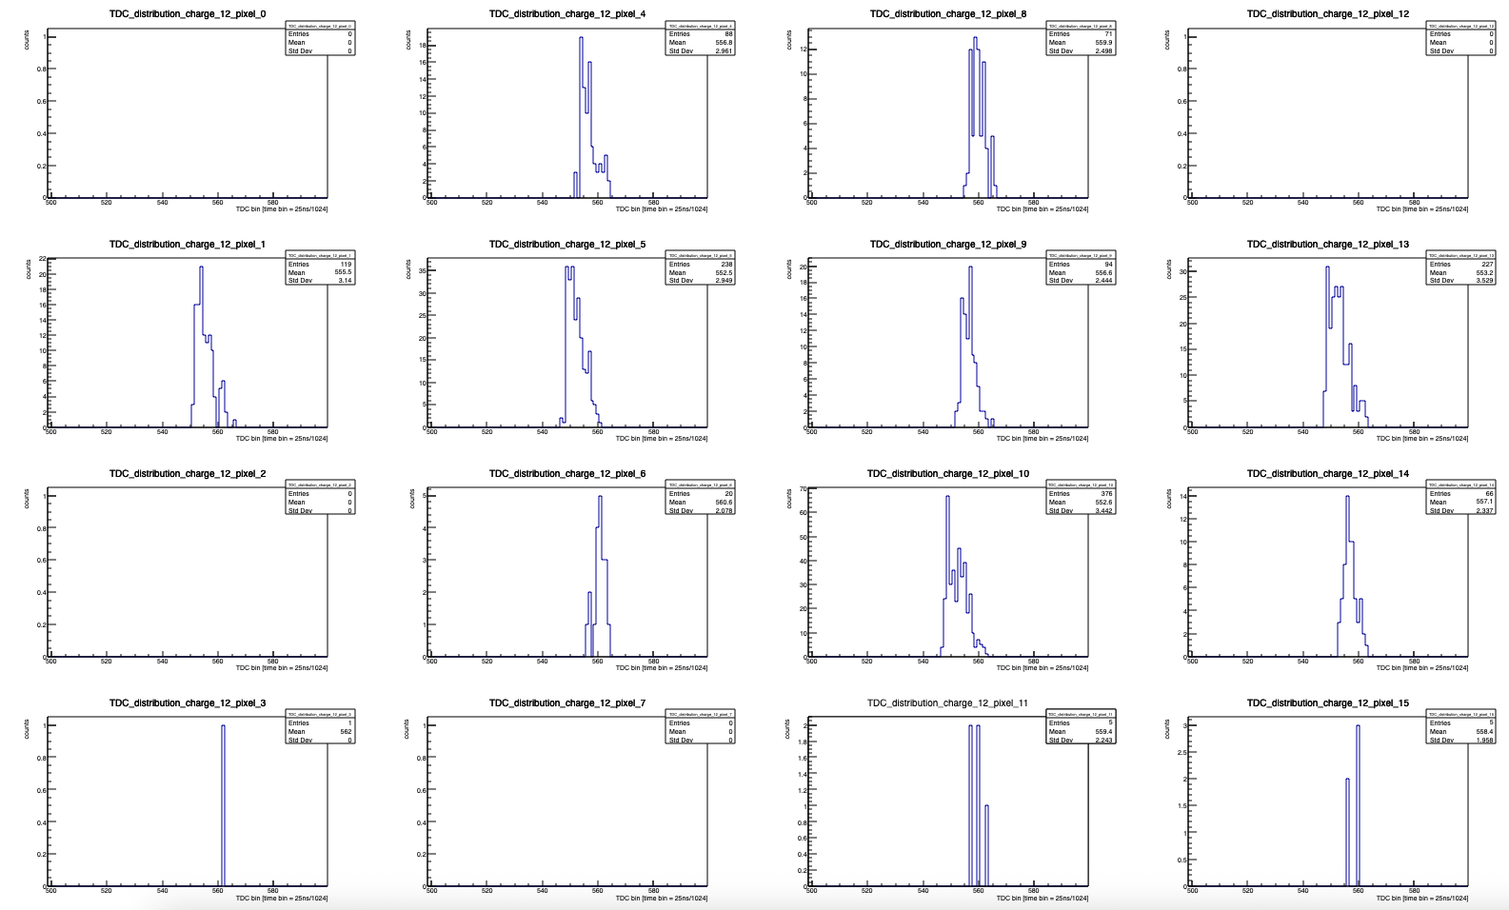
Snapshot of results after fixing trigger issue
TDC distributions for low (Q = 12 DACu ~ 5.3 fC) charge.
  Higher threshold causes come channels to never record TDC → this is what the offsets correct for.
Threshold = 350 DACu
(bump-bonded) Sensor unbiased
520227547096 | 0 | 39 | 0 | 0 | 89 | 0 | 562 | 142 | 0 | 0 | 100 | 0 | 0 | 60 | 1 | 0 | 55 | 0 | 0 | 67 | 0 | 0 | 78 | 0
TDC ADC H

Slide 49
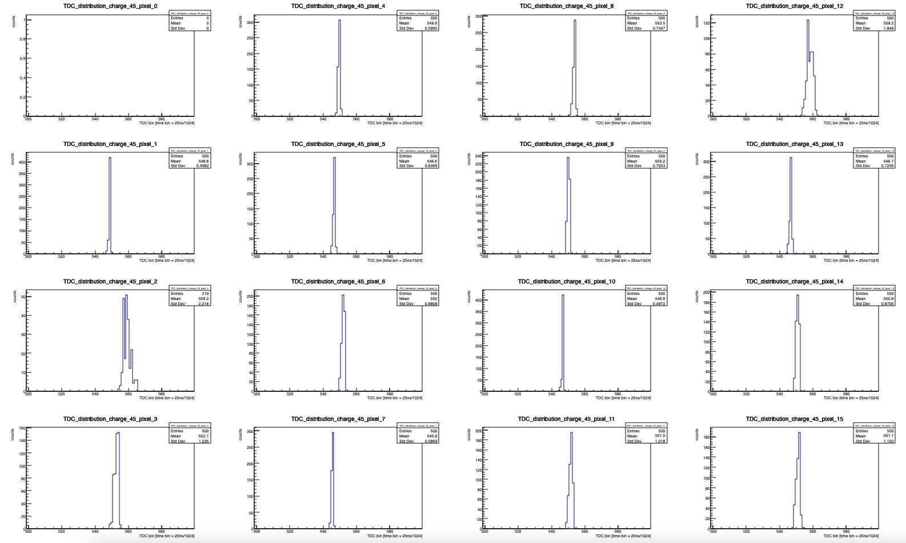
Snapshot of results after fixing trigger issue
TDC distributions for high (Q = 45 DACu ~18.4 fC) charge.
  Sharper TDC distribution (smaller sigma); channel 0 has an issue with its TDC.
Threshold = 350 DACu
(bump-bonded) Sensor unbiased
520227547096 | 0 | 39 | 0 | 0 | 89 | 0 | 562 | 142 | 0 | 0 | 100 | 0 | 0 | 60 | 1 | 0 | 55 | 0 | 0 | 67 | 0 | 0 | 78 | 0
TDC ADC H

Slide 50
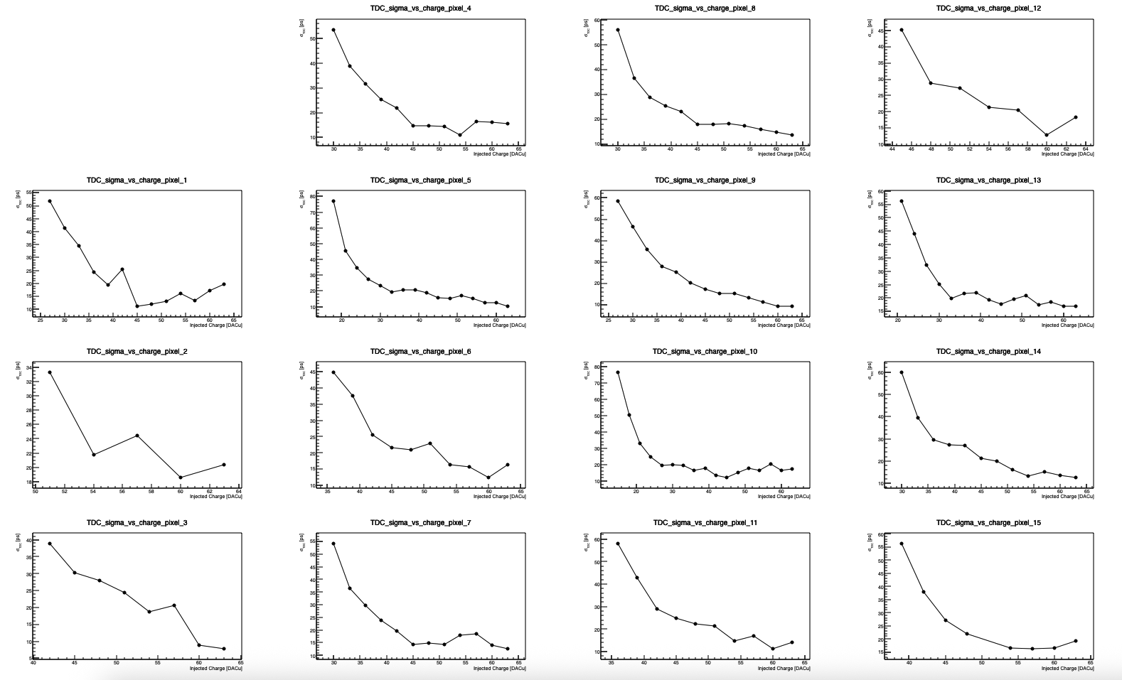
Snapshot of results after fixing trigger issue
TDC jitter distributions
Threshold = 350 DACu
(bump-bonded) Sensor unbiased
520227547096 | 0 | 39 | 0 | 0 | 89 | 0 | 562 | 142 | 0 | 0 | 100 | 0 | 0 | 60 | 1 | 0 | 55 | 0 | 0 | 67 | 0 | 0 | 78 | 0
TDC ADC H

Slide 51
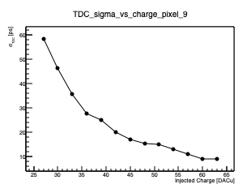
Snapshot of results after fixing trigger issue
TDC jitter distributions
Threshold = 350 DACu
(bump-bonded) Sensor unbiased
520227547096 | 0 | 39 | 0 | 0 | 89 | 0 | 562 | 142 | 0 | 0 | 100 | 0 | 0 | 60 | 1 | 0 | 55 | 0 | 0 | 67 | 0 | 0 | 78 | 0
TDC ADC H

Slide 52
TDC distributions – shifted trigger window, unbiased sensor

Slide 53
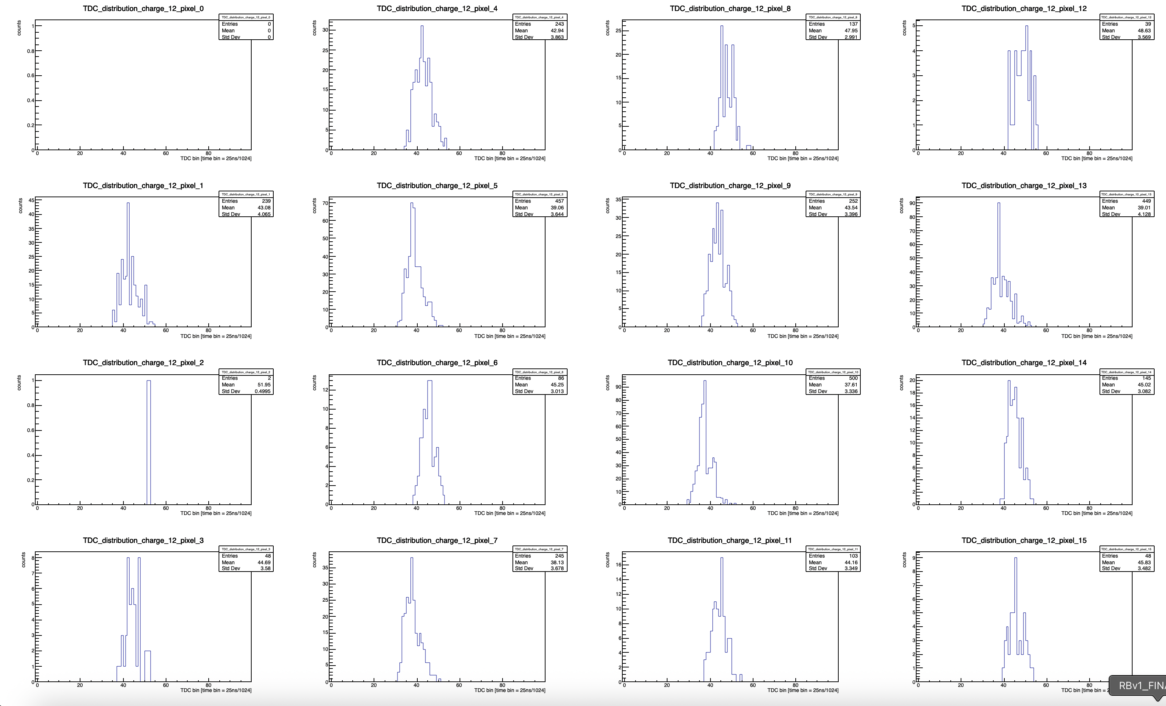
Snapshot of results after fixing trigger issue
TDC distributions for low (Q = 12 DACu ~ 5.3 fC) charge.
  Higher threshold causes come channels to never record TDC → this is what the offsets correct for.
Threshold = 350 DACu
(bump-bonded) Sensor unbiased
520227547096 | 0 | 39 | 0 | 0 | 89 | 0 | 562 | 142 | 0 | 0 | 100 | 0 | 0 | 60 | 1 | 0 | 55 | 0 | 0 | 67 | 0 | 0 | 78 | 0
TDC ADC H

Slide 54
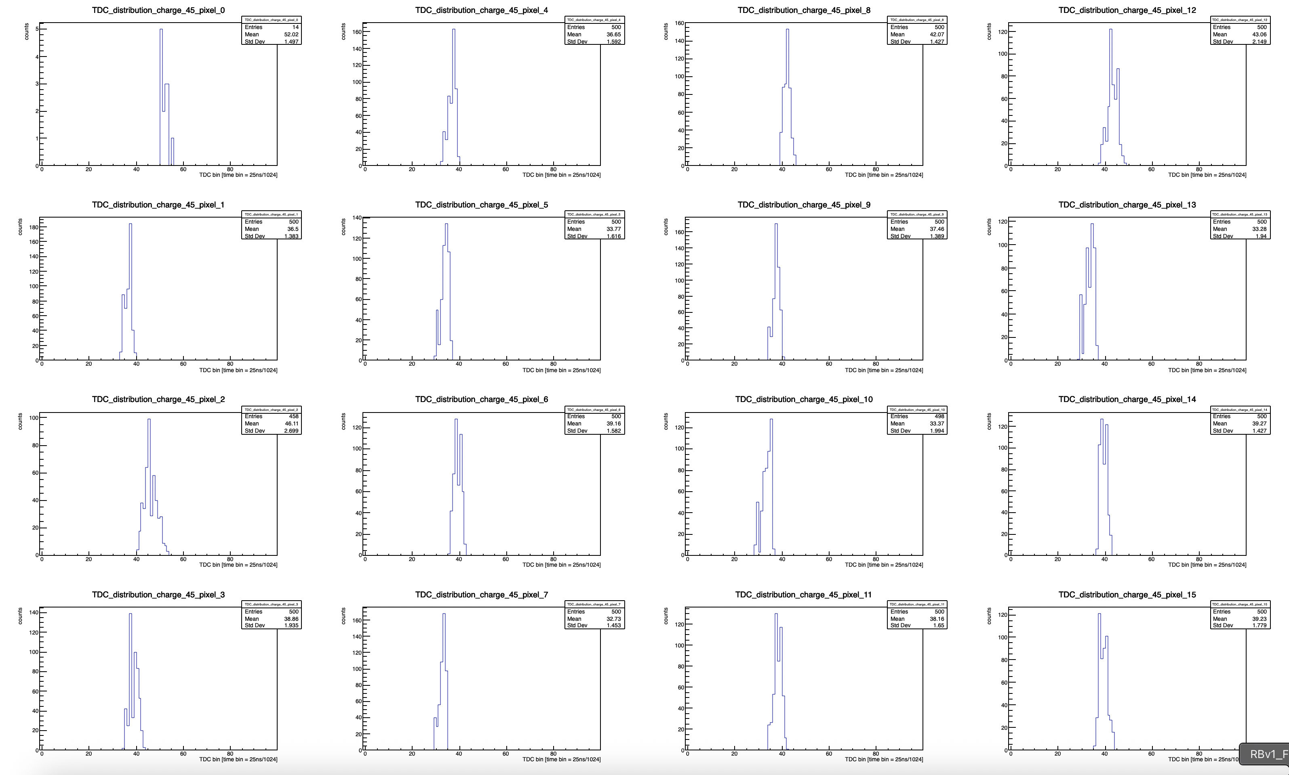
Snapshot of results after fixing trigger issue
TDC distributions for high (Q = 45 DACu ~18.4 fC) charge.
  Sharper TDC distribution (smaller sigma); channel 0 has an issue with its TDC.
Threshold = 350 DACu
(bump-bonded) Sensor unbiased
520227547096 | 0 | 39 | 0 | 0 | 89 | 0 | 562 | 142 | 0 | 0 | 100 | 0 | 0 | 60 | 1 | 0 | 55 | 0 | 0 | 67 | 0 | 0 | 78 | 0
TDC ADC H

Slide 55
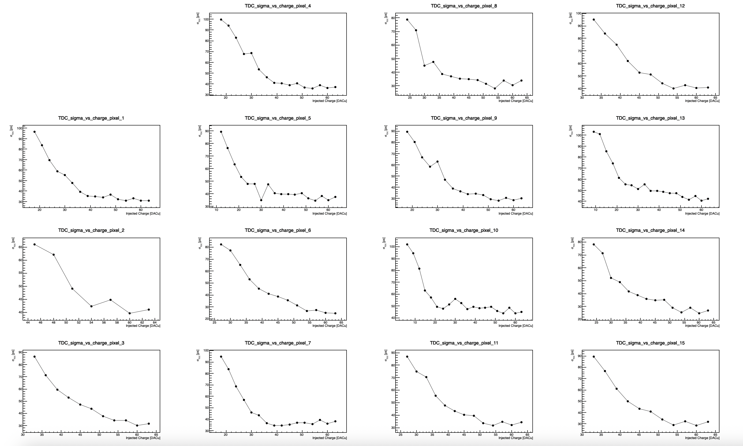
Snapshot of results after fixing trigger issue
TDC jitter distributions
Threshold = 350 DACu
(bump-bonded) Sensor unbiased
520227547096 | 0 | 39 | 0 | 0 | 89 | 0 | 562 | 142 | 0 | 0 | 100 | 0 | 0 | 60 | 1 | 0 | 55 | 0 | 0 | 67 | 0 | 0 | 78 | 0
TDC ADC H

Slide 56
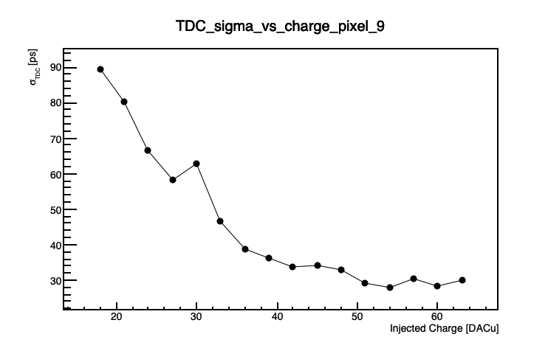
Snapshot of results after fixing trigger issue
TDC jitter distributions
  Worse overall jitter with shifted pulse in ACQ window
Threshold = 350 DACu
(bump-bonded) Sensor unbiased
520227547096 | 0 | 39 | 0 | 0 | 89 | 0 | 562 | 142 | 0 | 0 | 100 | 0 | 0 | 60 | 1 | 0 | 55 | 0 | 0 | 67 | 0 | 0 | 78 | 0
TDC ADC H

Slide 57
TDC distributions – shifted trigger window, biased sensor

Slide 58
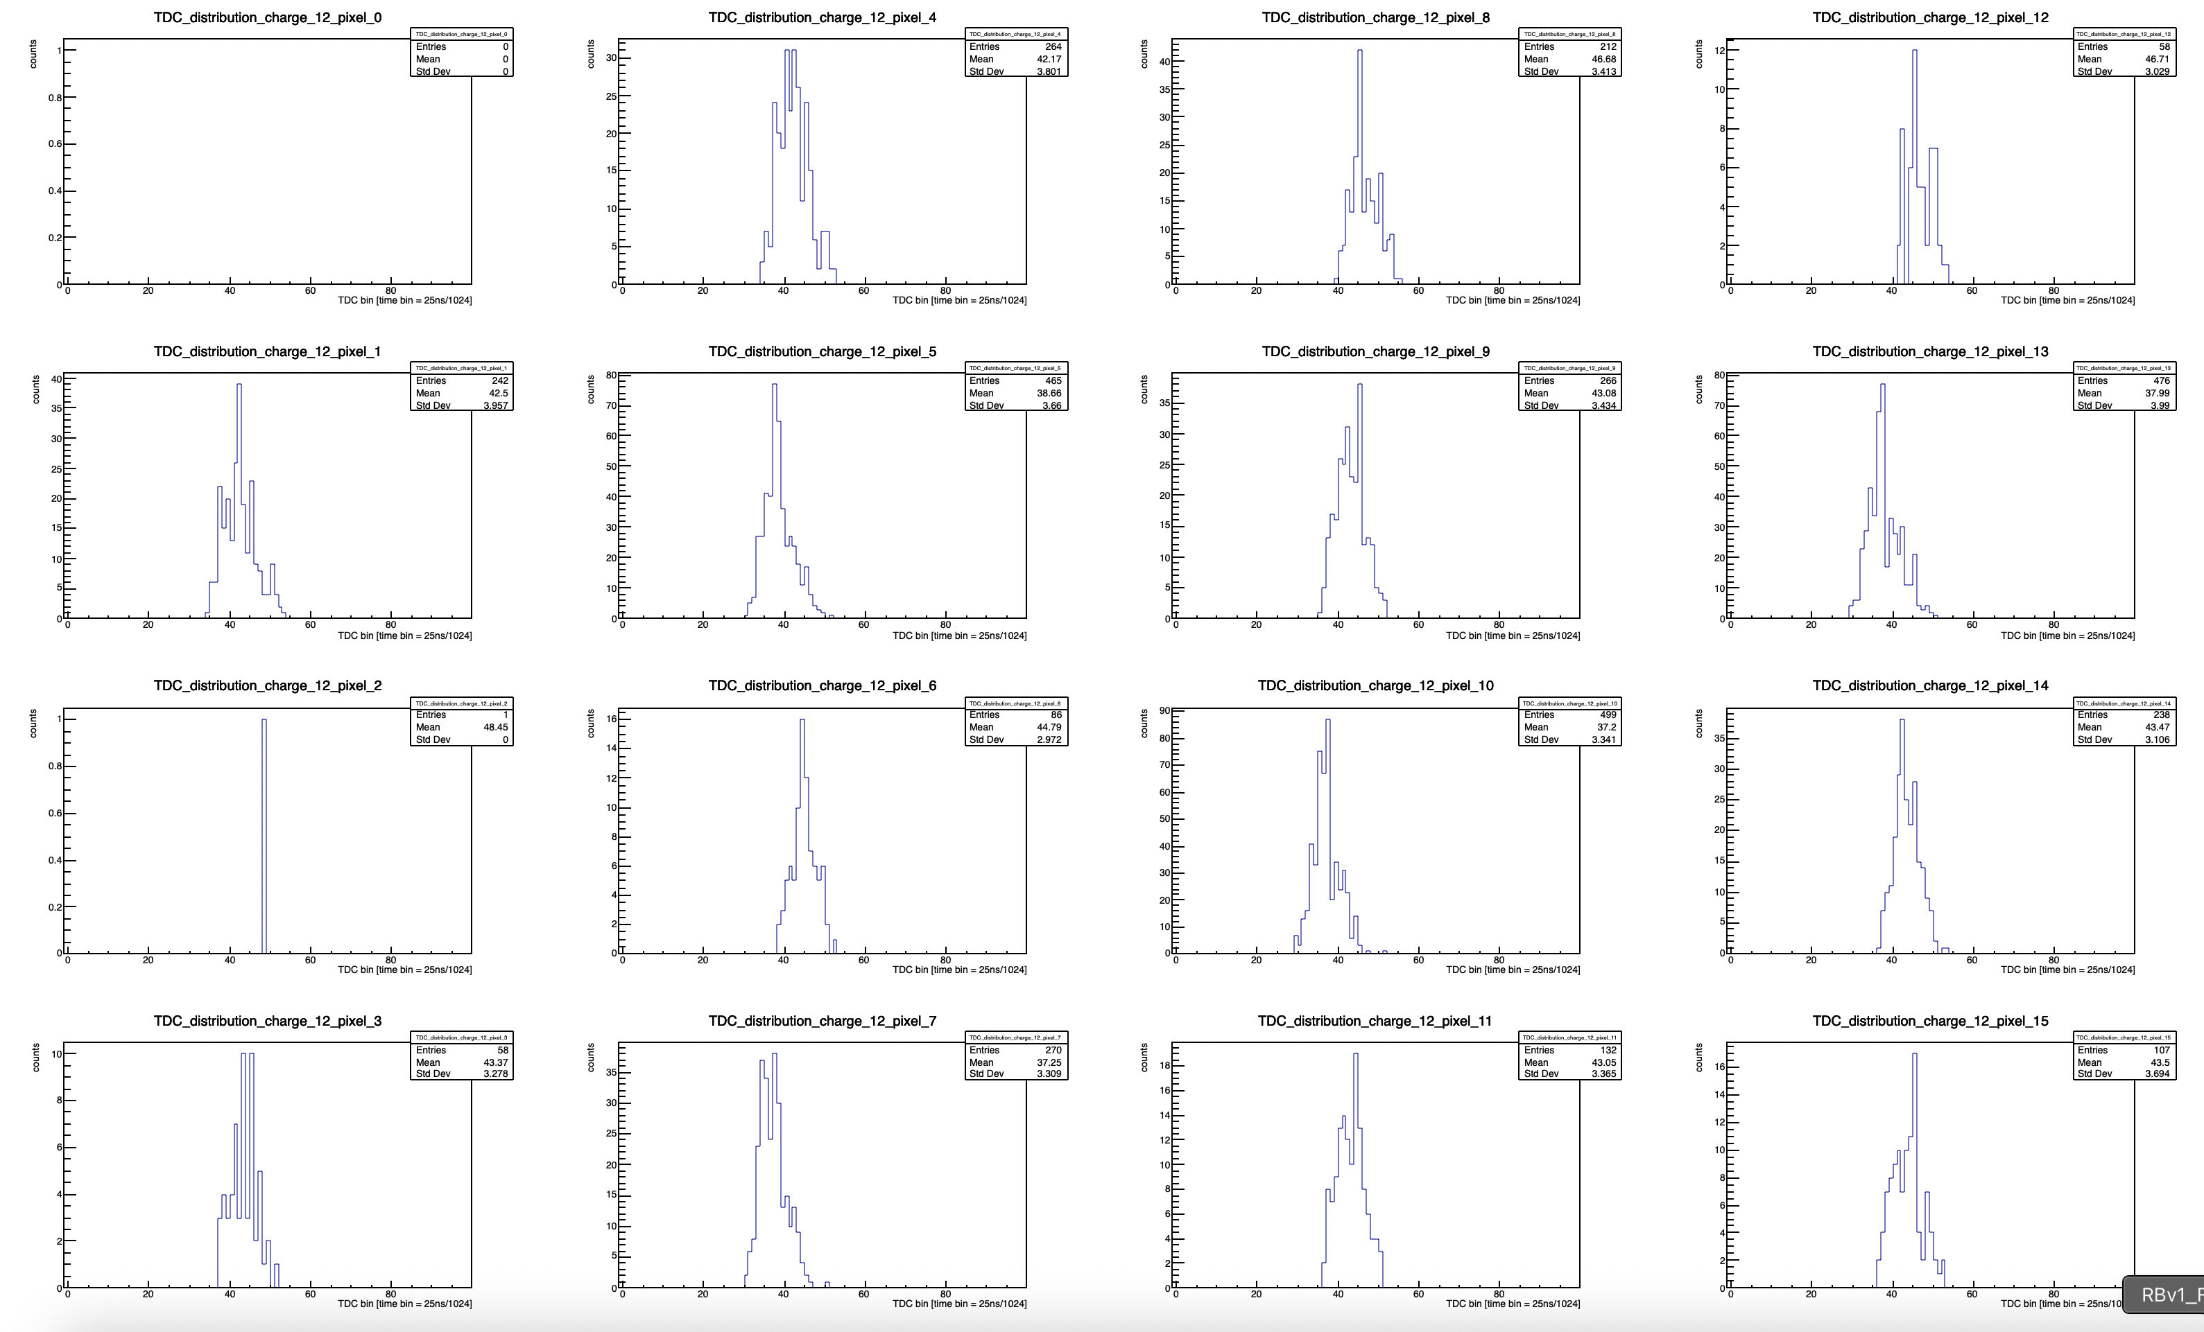
Snapshot of results after fixing trigger issue
TDC distributions for low (Q = 12 DACu ~ 5.3 fC) charge.
  Higher threshold causes come channels to never record TDC → this is what the offsets correct for.
Threshold = 350 DACu
(bump-bonded) Sensor BIASED
520227547096 | 0 | 39 | 0 | 0 | 89 | 0 | 562 | 142 | 0 | 0 | 100 | 0 | 0 | 60 | 1 | 0 | 55 | 0 | 0 | 67 | 0 | 0 | 78 | 0
TDC ADC H

Slide 59
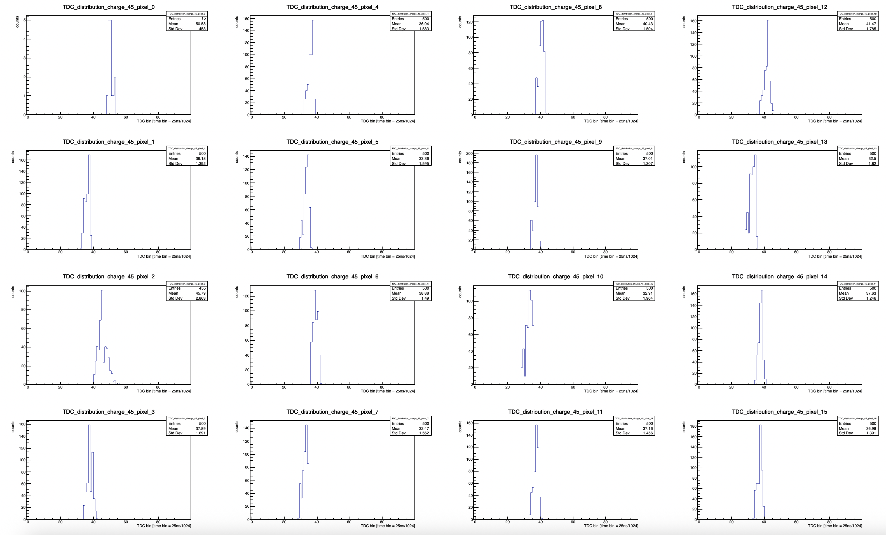
Snapshot of results after fixing trigger issue
TDC distributions for high (Q = 45 DACu ~18.4 fC) charge.
  Sharper TDC distribution (smaller sigma); channel 0 has an issue with its TDC.
Threshold = 350 DACu
(bump-bonded) Sensor BIASED
520227547096 | 0 | 39 | 0 | 0 | 89 | 0 | 562 | 142 | 0 | 0 | 100 | 0 | 0 | 60 | 1 | 0 | 55 | 0 | 0 | 67 | 0 | 0 | 78 | 0
TDC ADC H

Slide 60
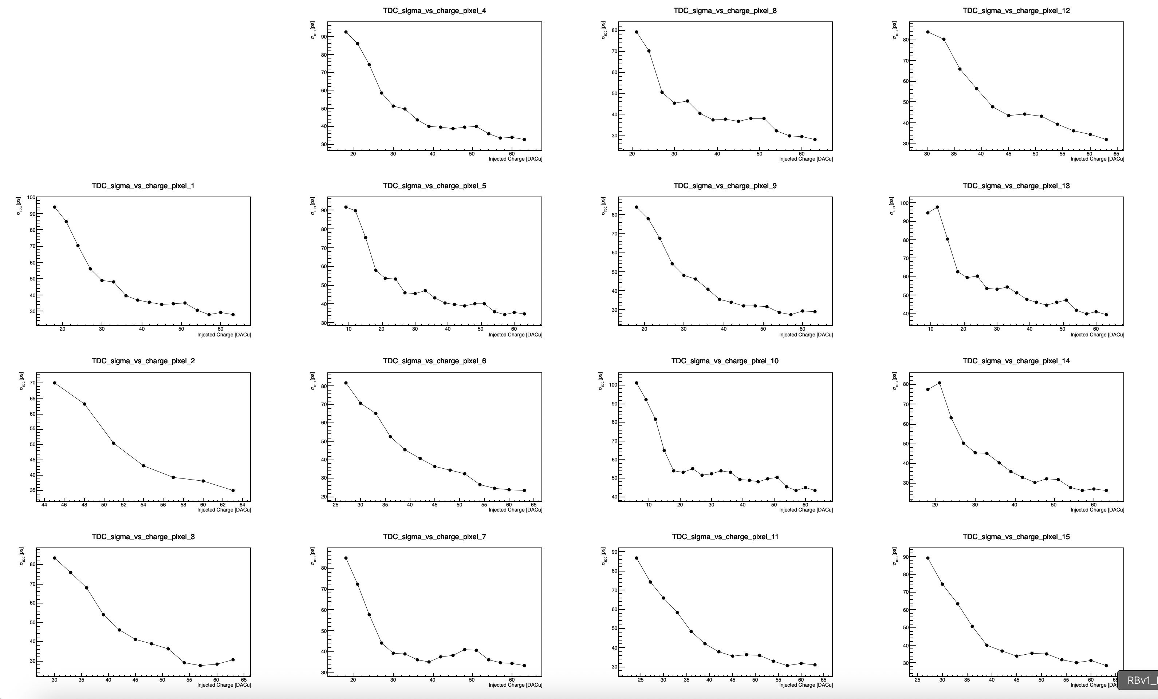
Snapshot of results after fixing trigger issue
TDC jitter distributions
Threshold = 350 DACu
(bump-bonded) Sensor BIASED
520227547096 | 0 | 39 | 0 | 0 | 89 | 0 | 562 | 142 | 0 | 0 | 100 | 0 | 0 | 60 | 1 | 0 | 55 | 0 | 0 | 67 | 0 | 0 | 78 | 0
TDC ADC H

Slide 61
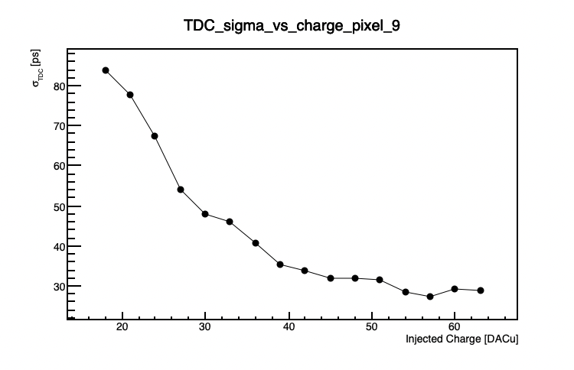
Snapshot of results after fixing trigger issue
TDC jitter distributions
  Worse overall jitter with shifted pulse in ACQ window
Threshold = 350 DACu
(bump-bonded) Sensor BIASED
520227547096 | 0 | 39 | 0 | 0 | 89 | 0 | 562 | 142 | 0 | 0 | 100 | 0 | 0 | 60 | 1 | 0 | 55 | 0 | 0 | 67 | 0 | 0 | 78 | 0
TDC ADC H

Slide 62
Summary and outlook
Major trigger window issues + I2C issues ironed-out for now (thanks to Dominique et al for some firmware updates which fixed the I2C issues).
Should have initial calibrations done in a few days, and will start setting up the Sr-90 data-taking with internal trigger.
  External trigger testing will follow soon after.
Order is ready for the analog preamp boards for large sensors (just need some boiler plate text added to drawings for export control).
  Ordering 25, but the company is local, so we can order more if needed down the road.
Stave/module board design for FF detectors in-progress, first version expected in 1-2 weeks (fabrication of v0 soon after).

Slide 63
Backup

Slide 64
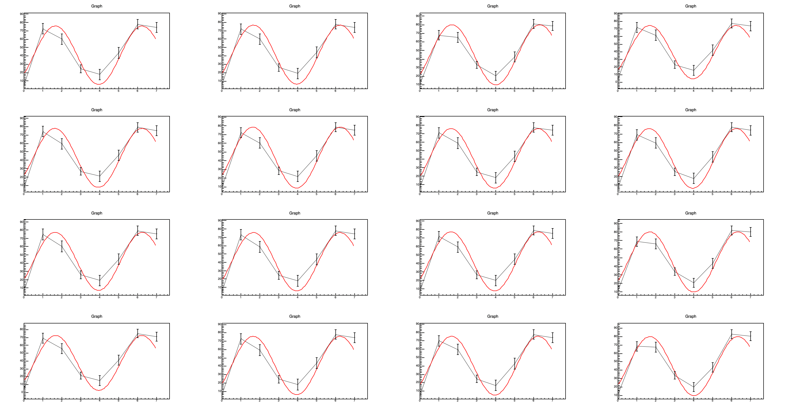
EICROC0 testing @ BNL: pedestal behavior
Using bump-bonded (30um gain layer) sensor to EICROC0 @ -170V.
  Internal trigger
Measure of pedestals (no source).
Delays set to have defined time window (causes pedestals to stay “in-phase”).
Large ADC waveforms from pedestal.
  Have found we can “subtract” these pedestal runs from Sr-90 data IF we match the pedestal phase to the data collected with the source.

Slide 65
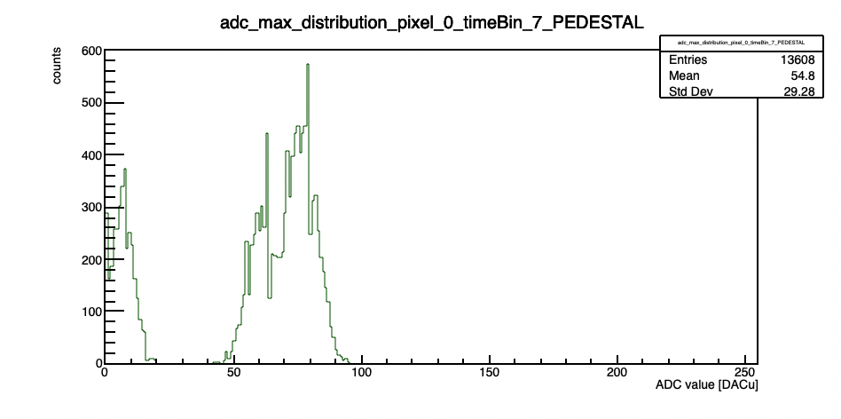
EICROC0 testing @ BNL: ADC issue
Using bump-bonded (30um gain layer) sensor to EICROC0 @ -170V.
  Internal trigger
Multimodal ADC distribution.
  Seemed “fixed” when we used “ceic.reset_before_acq(1)”
  What does this actually do?

Slide 66
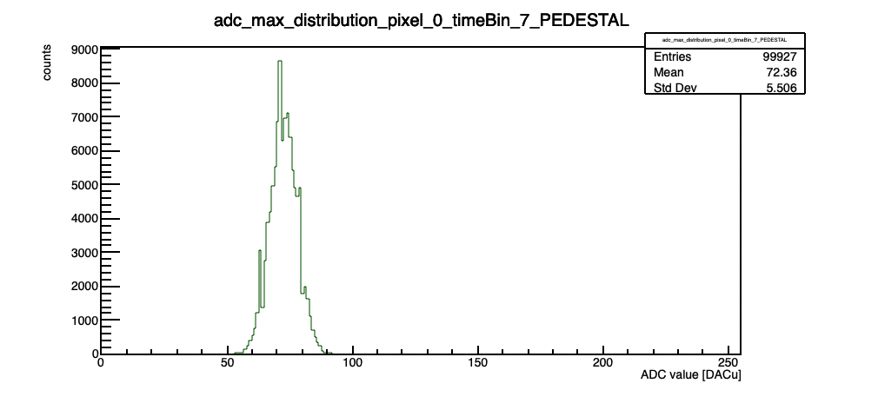
EICROC0 testing @ BNL: ADC issue
Using bump-bonded (30um gain layer) sensor to EICROC0 @ -170V.
  Internal trigger
  Seemed “fixed” when we used “ceic.reset_before_acq(1)”
  What does this actually do?

Slide 67
Trigger Issue
Using the ZU706
  Delays set incorrectly in script to interact with firmware.
  Blue: J67 output from FPGA board (start and stop ACQ?)
  Green: analog output from preamp.
  Yellow: command pulse output from testboard.
  Magenta: TRG_OUT from test board.
When scope looks like this, events do not look like they should (the blue output pulse exceeds the 200ns window expected for a shaped event?)
  What actually happens? Does it overwrite ADC/TDC values?

Slide 68
Trigger Issue
Using the ZU706
  Delays set incorrectly in script to interact with firmware.
  Blue: J67 output from FPGA board (start and stop ACQ?)
  Green: analog output from preamp.
  Yellow: command pulse output from testboard.
  Magenta: TRG_OUT from test board.
“guessed” that the blue trigger window established by the FPGA needed to be the same width as a shaped “event” (200ns; 8 time samples).
  Adjusted delays until this was true, then tried taking data.

Slide 69
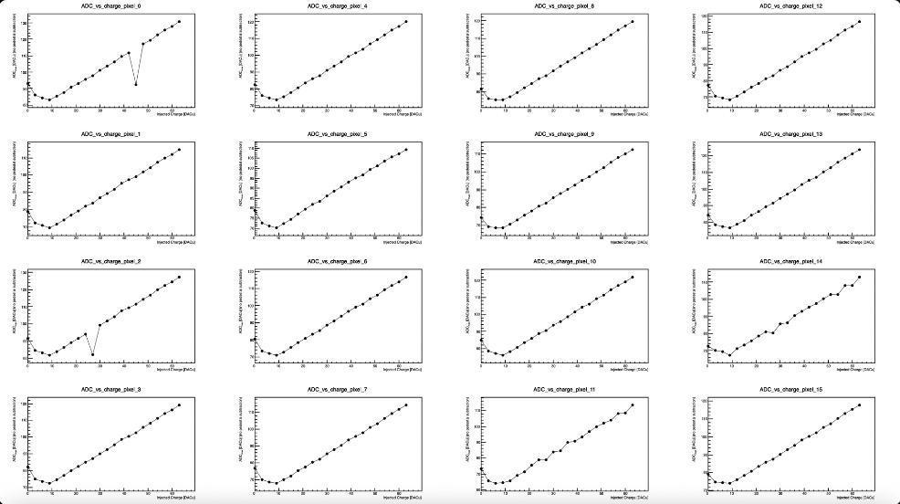
Trigger Issue
After this tinkering, finally got some results with charged injection that were not complete nonsense.
  ADC vs. injected charge.
TDC ADC H
520227547096 | 0 | 39 | 0 | 0 | 89 | 0 | 562 | 142 | 0 | 0 | 100 | 0 | 0 | 60 | 1 | 0 | 55 | 0 | 0 | 67 | 0 | 0 | 78 | 0

Slide 70
Trigger Issue
After this tinkering, finally got some results with charged injection that were not complete nonsense.
  ADC vs. injected charge.
For each charge, average ADC values in each time-bin, and then extract the maximum from the averaged waveforms.
  The maximum is plotted for each charge, per pixel.
TDC ADC H
520227547096 | 0 | 39 | 0 | 0 | 89 | 0 | 562 | 142 | 0 | 0 | 100 | 0 | 0 | 60 | 1 | 0 | 55 | 0 | 0 | 67 | 0 | 0 | 78 | 0

Slide 71

Trigger Issue
After this tinkering, finally got some results with charged injection that were not complete nonsense.
  S-curves.
TDC ADC H
520227547096 | 0 | 39 | 0 | 0 | 89 | 0 | 562 | 142 | 0 | 0 | 100 | 0 | 0 | 60 | 1 | 0 | 55 | 0 | 0 | 67 | 0 | 0 | 78 | 0

Slide 72
Trigger Issue
After this tinkering, finally got some results with charged injection that were not complete nonsense.
  S-curves.
Look for “good” events with one hitbit == 1 (only crossed threshold once).
  Should also have one TDC value, after hitbit == 1
TDC ADC H
520227547096 | 0 | 39 | 0 | 0 | 89 | 0 | 562 | 142 | 0 | 0 | 100 | 0 | 0 | 60 | 1 | 0 | 55 | 0 | 0 | 67 | 0 | 0 | 78 | 0

Slide 73
Open Issues
When we try to extract s-curves from lower injected charged (needed to calibrate the thresholds) – data look incoherent.
  Meaning, our events do not have the behavior they should.
  Still do not know if the trigger delays we are using are even correct → ”seems” correct doesn’t mean much – we need documentation on the meaning of the various variables so we can be sure.
Cannot replicate reasonable behavior with the newer Xilinx (ZCU106).
We have contacted IJCLab/OMEGA and will work to solve the issues so we can calibrate the thresholds and Vref, and start taking data with the Sr-90 source.

Slide 74


Implementation of AC-LGADs for FF Tracking
AC-LGAD
EICROC0
BNL AC-LGAD:
500x500 um² pixel pitch
100x100 um² metal electrode
30um active thickness
EICROC ASIC proposed for pixilated AC-LGADs.
  Uses infrastructure from ALTIROC (used for DC-LGADs in ATLAS) and HGCROC (I2C)
  Currently only 4x4 channel version exists, 32x32 (full channel count) in production (to arrive in Feb./March 2026).
  Also used in FTOF (or any pixilated AC-LGAD detector).

Slide 75
AC-LGAD Testing → AC-LGAD + EICROC0
V [mV]
V [mV]
V [mV]
t[ns]
t[ns]
t[ns]
AC-LGAD (HPK) “etched” to remove portions of the backplane which normally block incident TCT IR light from the laser in a bump-bonded assembly.
  Etching by Simone Mazza from UCSC.
TCT is useful for doing position dependent measurements (e.g for spatial resolution), and for probing uniformity of charge collection and gain.
Etched, bump-bonded assembly.

Slide 76


AC-LGAD Testing → AC-LGAD + EICROC0
Laser measurements (variable laser power)
Sr-90 radioactive source
Jitter measured using full bump-bonded sensor + ASIC (readout with commercial Xilinx FPGA board).
  Jitter of sensor ~ 10ps; EICROC (TDC) via charge injection ~ 10-15ps.
Total jitter (via analog output of EICROC test board) ~ 40ps – why?
  Likely from hybridization and/or non-optimal analog readout → under study.

Slide 77
AC-LGAD Testing → AC-LGAD + Fermilab Board
AC-LGAD wire-bonded to Fermilab test board with low noise preamplifiers.
Sensor assembly placed under Sr-90 source and 4 channels readout at once.
  4 pixels in center of sensor.
Teledyne LeCroy 4-channel oscilloscope used to readout analog output from board.
  Channel 1 used as trigger with low threshold.
Goal was to measure the jitter from the pixel with maximum amplitude in each event.
77

Slide 78

AC-LGAD Testing → AC-LGAD + Fermilab Board
Results with a single pixel taken as a baseline.
Analog signal amplitude converted to charge by integrating waveform over time over the signal region.
  Integral then divided by preamp gain (100) and preamp impedance (50 Ohms) to convert to fC.
Jitter of sensor found to be consistent with previous measurements of similar AC-LGADs.
78

Slide 79

AC-LGAD Testing → AC-LGAD + Fermilab Board
Jitter calculated using multiple pixels, with a focus on the pixel with maximum amplitude from each event.
  Results also found to be consistent with previous measurements.
Jitter measured here using a 30um HPK sensor (same as the other tests) wire-bonded to a Fermilab test board with fast, low-noise preamps.
  Much lower jitter observed.
Jitter measured here by reading out 4 pixels, with one serving as a trigger with a very low threshold, and taking the pixel with the maximum amplitude in each event – those were then used to calculate jitter as a function of charge.
  Waveform time-integrated, and then divided by preamp gain (100) and impedance (50 Ohms)
79

Slide 80
Overall testing plans for AC-LGADs @ BNL
Sensor and ASIC testing between TOF/auxiliary subsystems leverages workforce from all groups.
  Example (currently happening):
    HPK sensors characterized (IV curves) at UCSC (and potentially UIC),
    shipped to BNL for testing with EICROC + laser/sources,
    RBv1 developed by Rice, then sent to BNL (arrived in Dec. 2025),
    sensor/ASIC integration tested at BNL with FPGA; Rbv1 setup tested in parallel (in-progress; see discussion by Tonko),
    when EICROC1 received (Feb./March 2026), integration with RBv1 tested,
    all groups use results for e.g. test beam planning at SPS.
QA needs for sensors/modules for pixilated systems understood (for common items).
  Sensors, ASICs, readout, hybridization, etc.

Slide 81



Implementation of AC-LGADs for FF Tracking
Readout needs to be separated from sensor/ASIC board to obey physical constraints for far-forward subsystems.
*Stave dimensions will be updated once EICROC1 schematic is in-hand.
Far-forward sensor “staves”
  (3) 1.6cm x 1.6cm AC-LGADs with 500um pixel pitch
  bump-bonded to EICROC1/2 ASICs
  staggered on a two-sided PCB to provide full active-area coverage.
  These sensors have 32x32 channels, matching the EICROC1/2.
    Currently have 32x32 channel sensors from HPK which are under test.

Slide 82
Implementation of AC-LGADs for FF Tracking
Tonko Ljubicic (Rice Univ.)
*Stave dimensions will be updated once EICROC1 schematic is in-hand.
Far-forward sensor “staves”
  (3) 1.6cm x 1.6cm AC-LGADs with 500um pixel pitch
  bump-bonded to EICROC1/2 ASICs
  staggered on a two-sided PCB to provide full active-area coverage.
  These sensors have 32x32 channels, matching the EICROC1/2.
    Currently have 32x32 channel sensors from HPK which are under test.
Strong synergy with TOF: front-end + power board will be the same as FTOF.
  Only difference is sensor stave/module, and the separation of the FEB for flexibility for FF detector needs.
Presently optimizing choice of readout board “flavor” which works best for auxiliary detector needs.

Slide 83
Broad timeline of AC-LGAD activities (non-exhaustive)
Action Item | Current Status | Dates (expected completion) | Notes
4x4 BNL and HPK sensors tested at Fermilab | Complete | 2020 to Summer 2022 | Established timing resolution ~ 20ps and spatial resolution ~ 20um (7x better than normal for pixel pitch due to charge sharing)
EICROC0 testing with charge injection | Mostly complete (jitter still under study) | Summer 2023 to now (Feb. 2026) | Tested analog and digital output, measured jitter, tested linearity of ADC Firmware does not support external trigger; will be updated to enable this with EICROC1
4x4 sensor testing with EICROC0 | Mostly complete (jitter still under study) | Summer 2023 to now (Feb. 2026) | Testing has been done with AC-LGADs wirebonded to EICROC0 – noise unacceptably high. Now using bump-bonded assemblies. Tested with TCT and Sr-90 source. Jitter from individual components small (10-15ps) – total jitter from analog output of EICROC0 testboard with AC-LGADs bump-bonded high – under study now.
Testing of full-size 32x32 channel HPK sensors | In-progress | Summer 2025 to now (Summer 2026) | IV curves measured and breakdown voltages identified; production yield > 90%; first test beam @ DESY in December 2025; hope for test beam @ SPS in Summer 2026; Lab testing underway (laser, source)
RBv1 setup and initial tests | In-progress | Summer 2025 to now (Spring 2026) | Work done to validate setup at Rice; setup being established at BNL to test EICROC1 with two different readouts after receipt of ASIC
Testing of EICROC1 | Not started | March 2026 to Fall 2026 | Will test with FPGA setup as done with EICROC0; aim is to test with RBv1 (lpGBT-based readout) as soon as EICROC1 is received.
Full-chain tests (32x32 sensor with EICROC1 and RBv1) | Not started | Late Spring 2026 – TBD (end of 2026) | Goal is to have initial full chain testing done by Summer if EICROC1 testing + RBv1 setup is successful.

