Slide 1
Integration, Installation and Infrastructure (Triple I Group)
TIC Update
Roland Wimmer

Slide 2
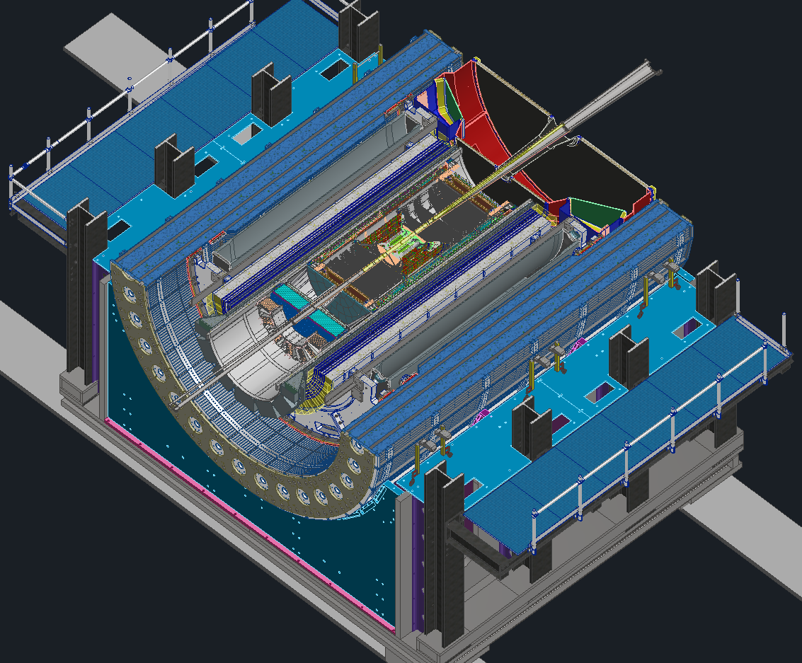
Detector Updates
Model updates
sPHENIX Piston Testing
1006 Hall Work
Stolen Slides
  Electronics Grounding
  Cooling updates

Slide 3
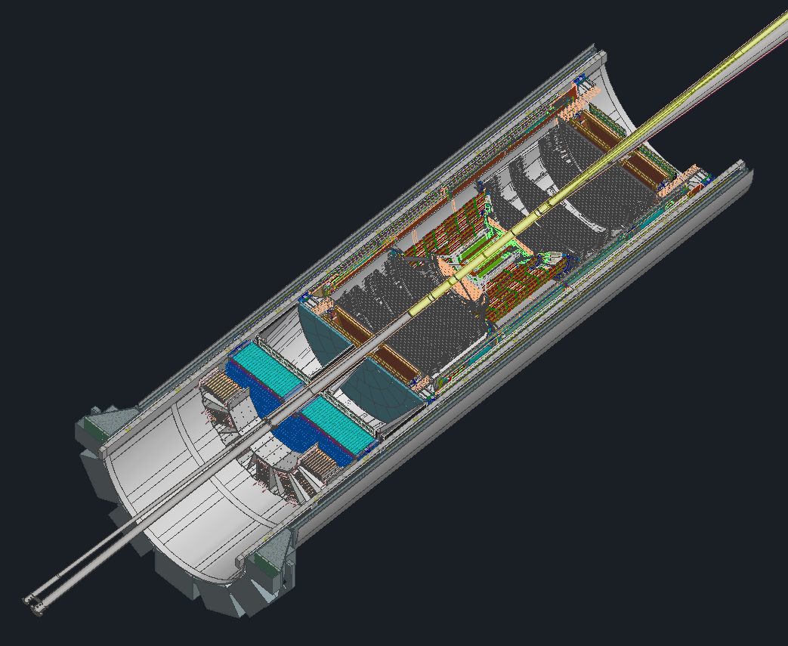
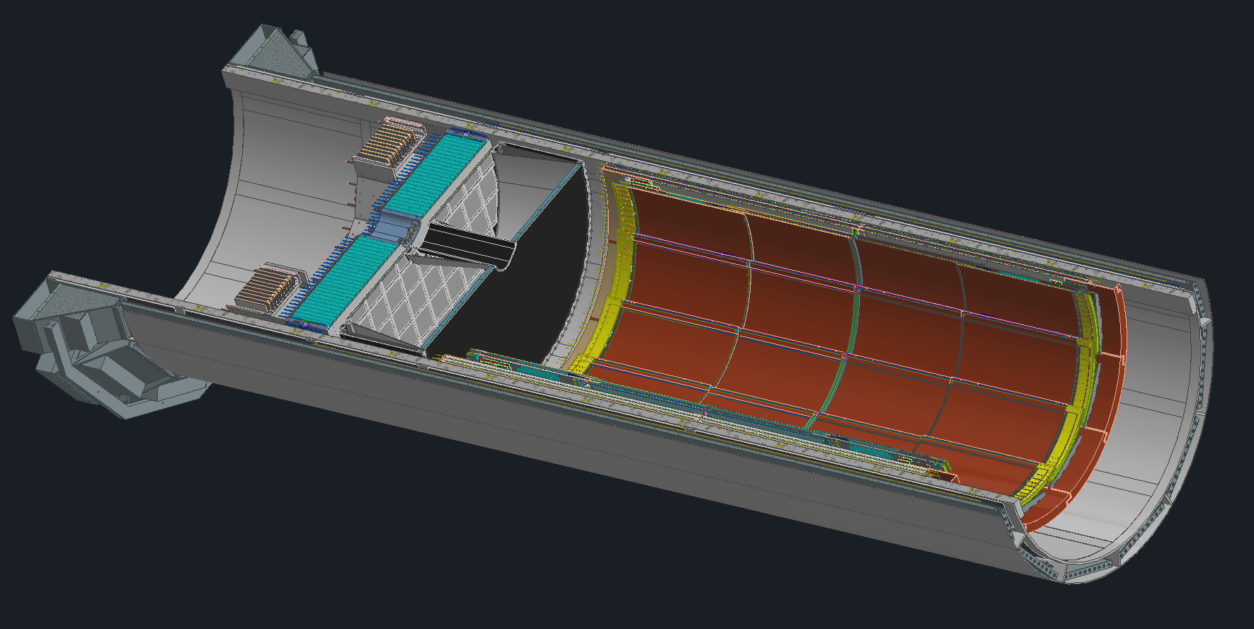
Model Updates
New ToF Model
Updated PST/SVT Model
Updated GST Model
Updated CYMBAL Model
Updated pfRICH Model
Updated EEEMCal Model

Slide 4
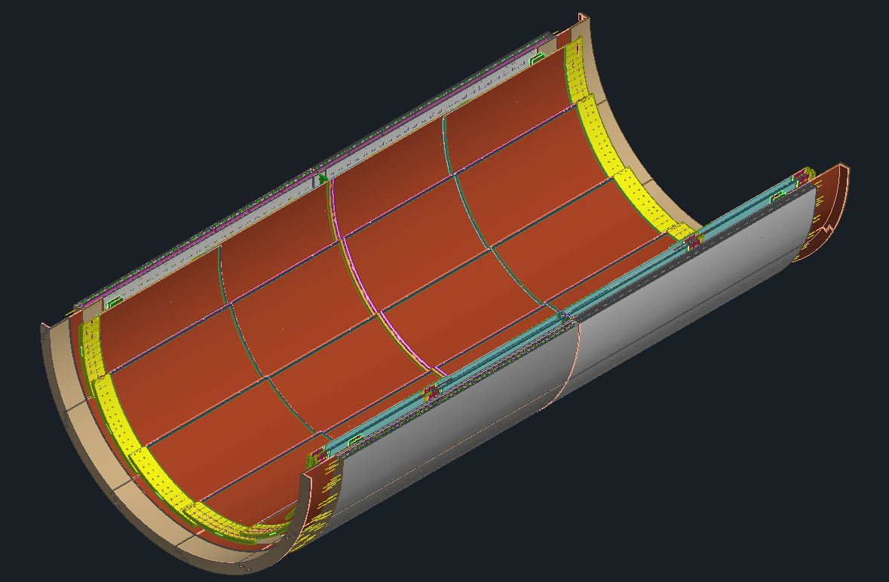
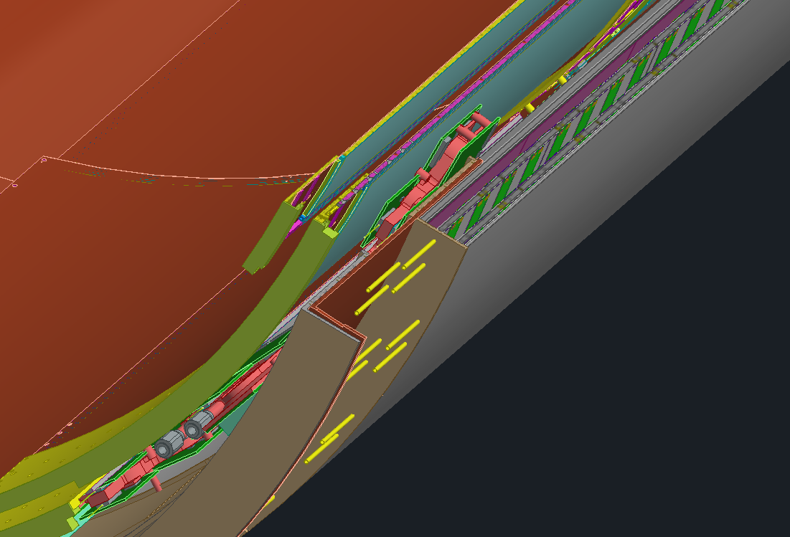
ToF & CYMBAL

Slide 5
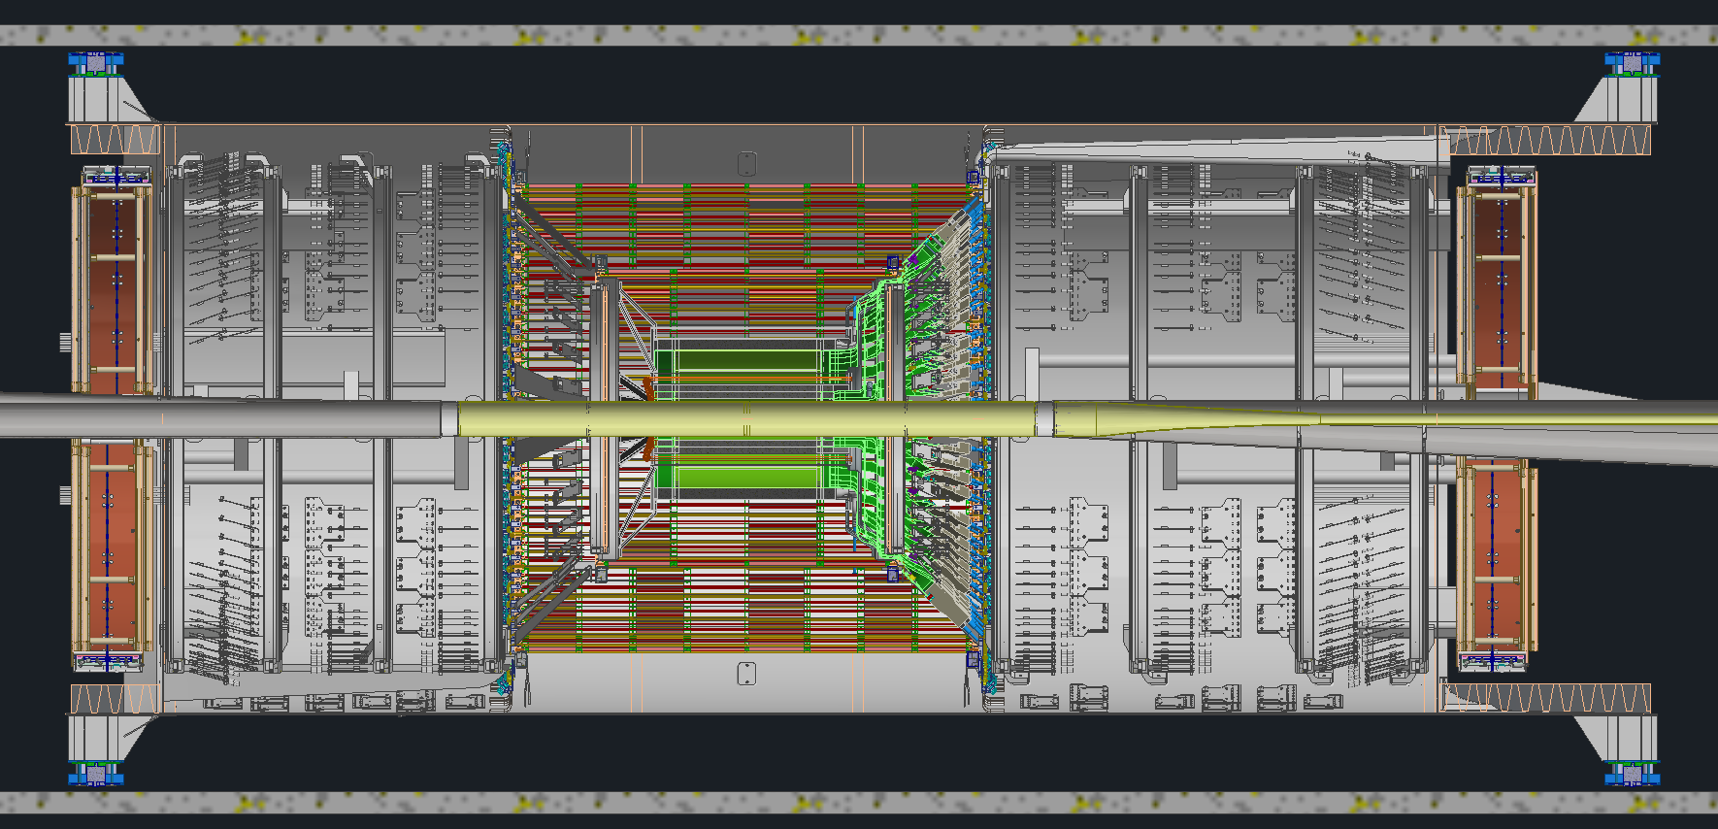
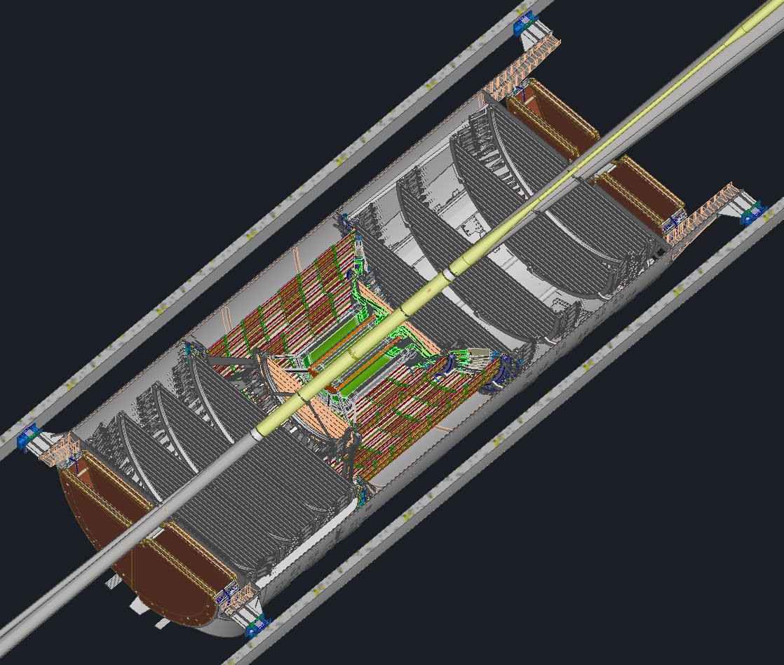
PST / SVT

Slide 6
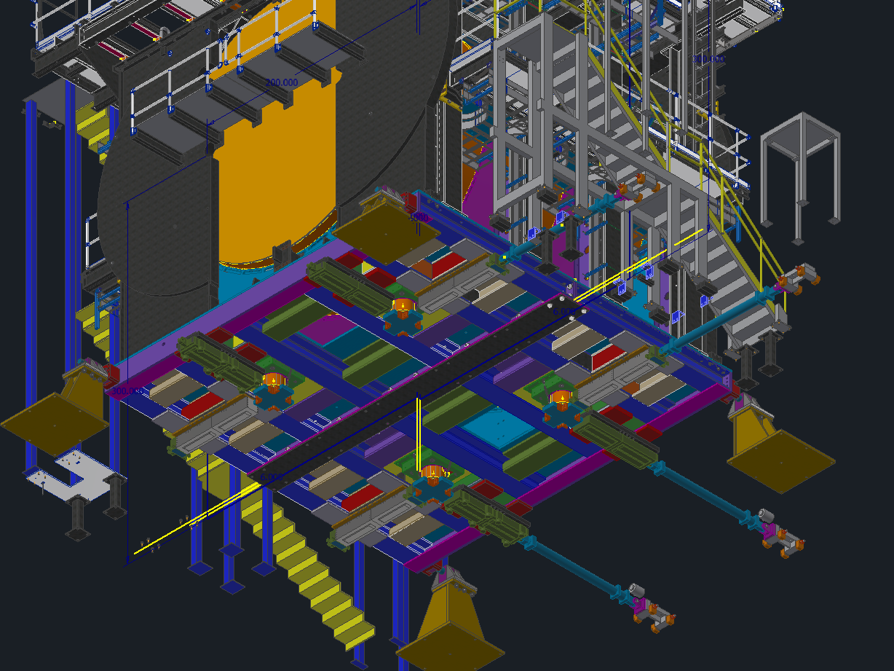
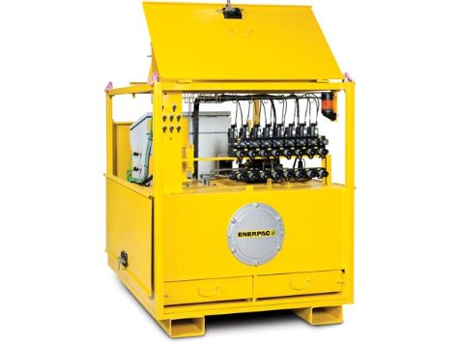
sPHENIX Lifting Pistons Testing
Conducting tests on the Pistons sPHENIX used to lift their detector
Want to check for precision and repeatability

Slide 7
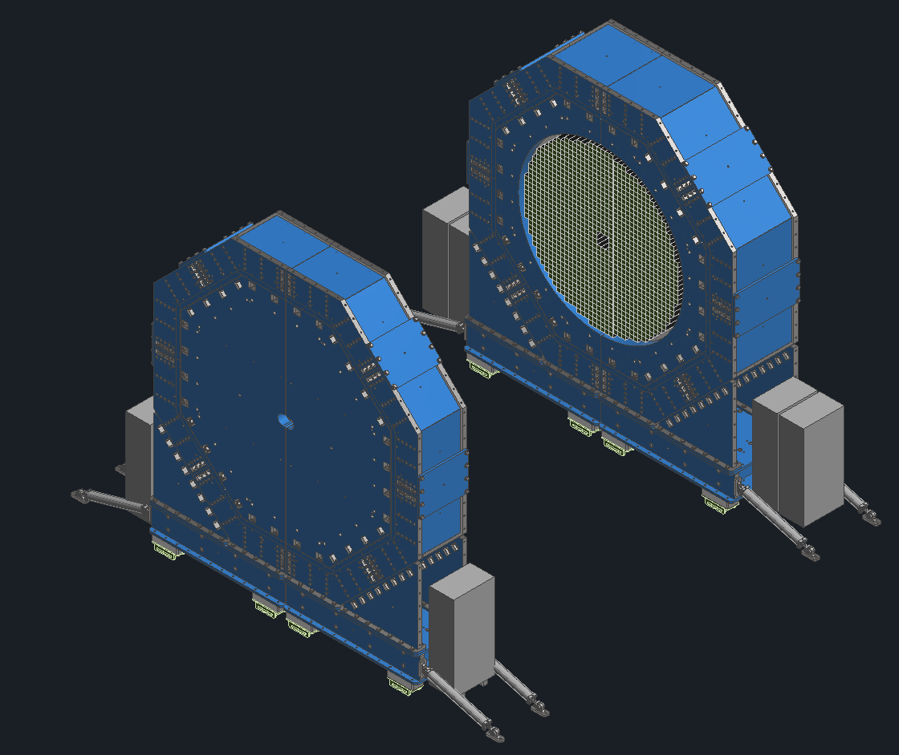
Hall Logistics and other work
Added racks to both sets of Endcaps
  Assessing space constraints and movement limitations
  Need to route services to the racks with disconnects for when the endcaps are opened.
Working on routing the trunk fibers in the Hall
Recently had a meeting regarding Gas systems, were looking for space to put everything along with how to integrate it all

Slide 8
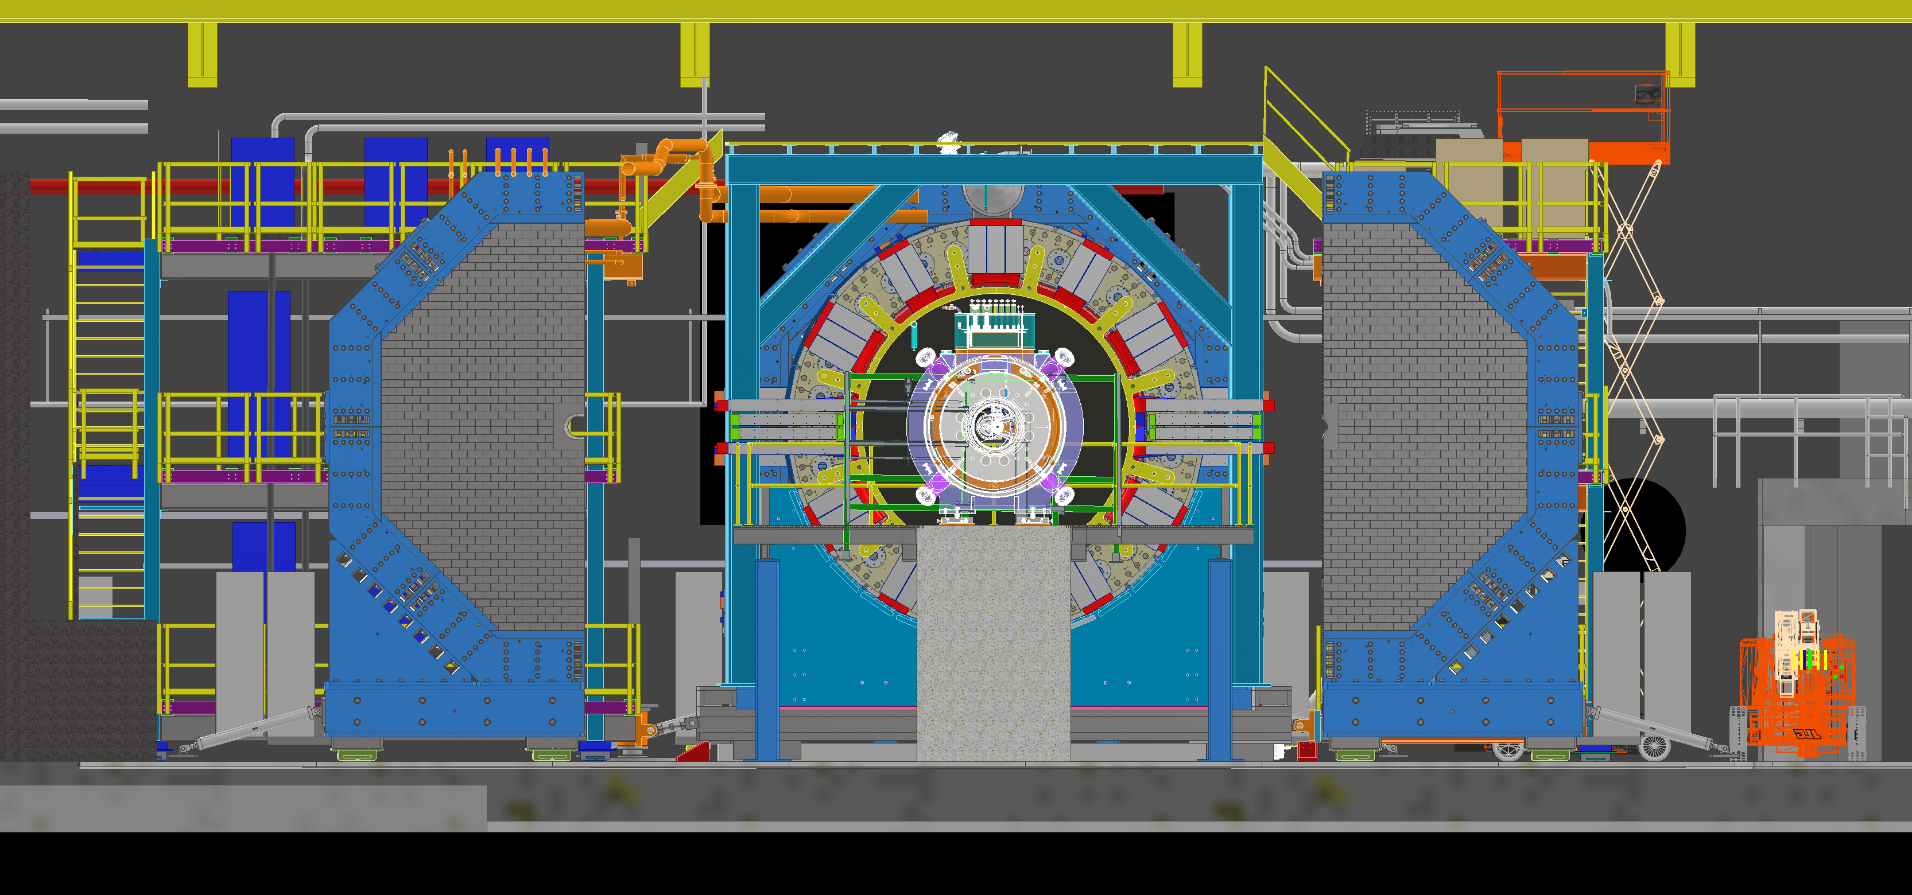
Hall Logistics and other work

Slide 9
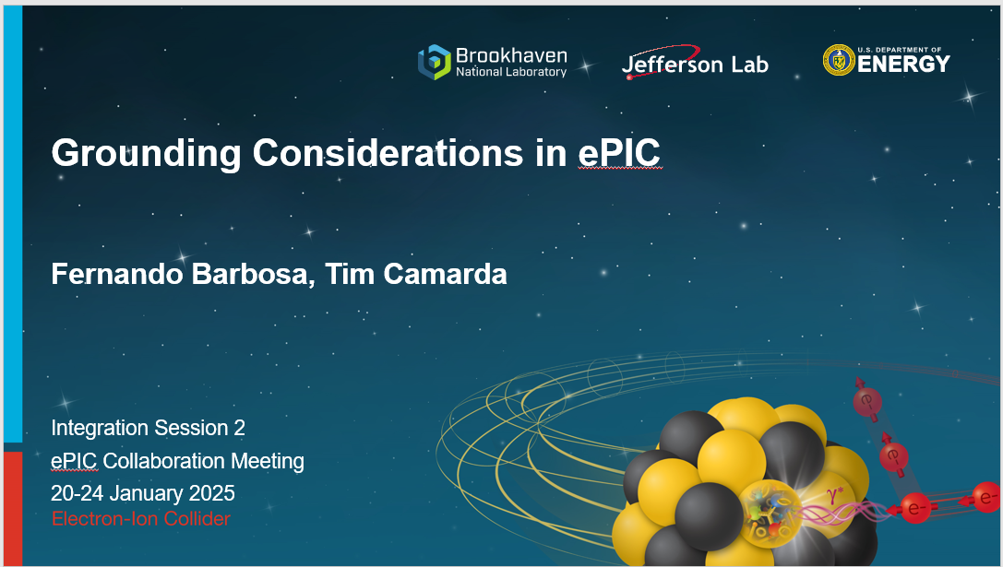
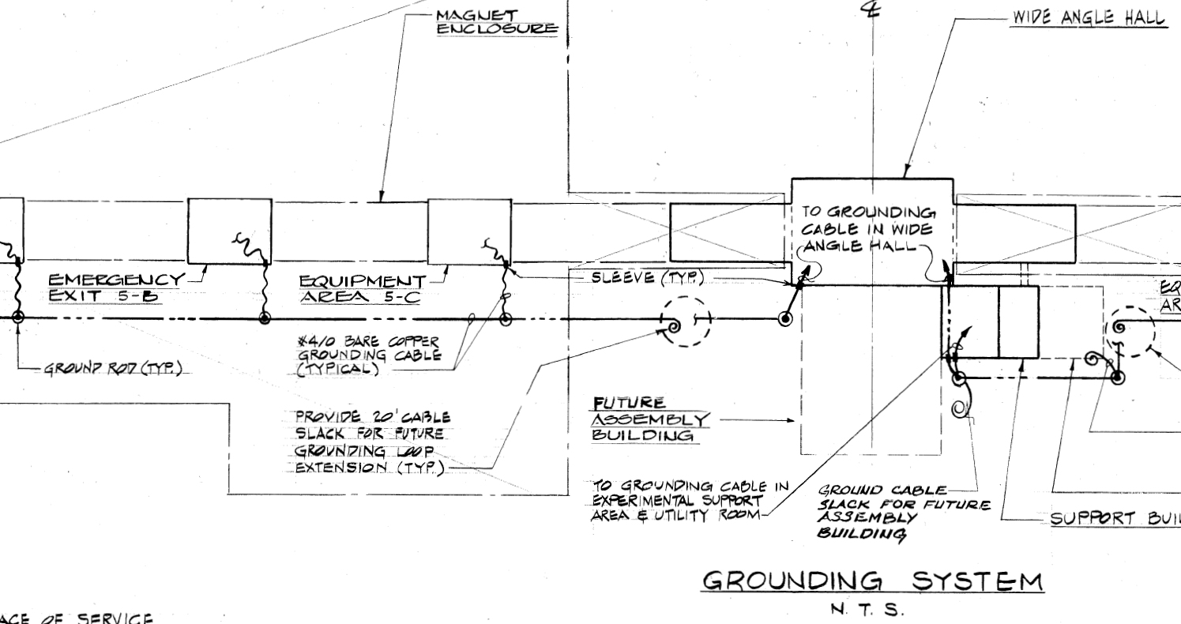
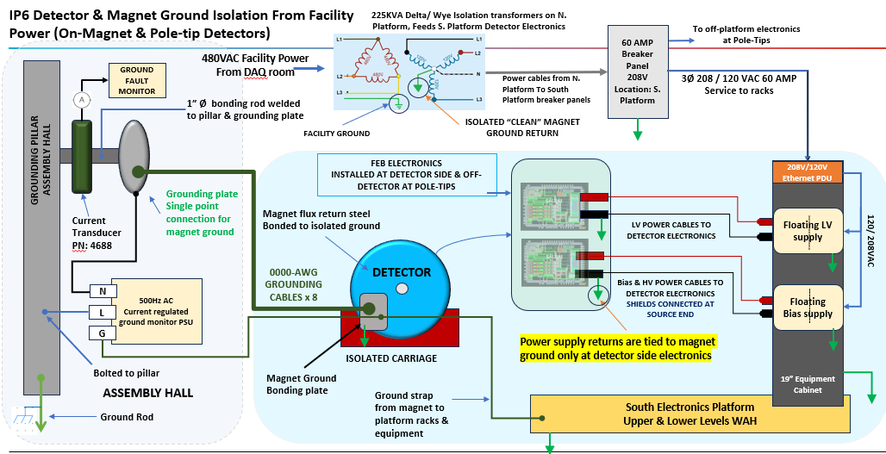
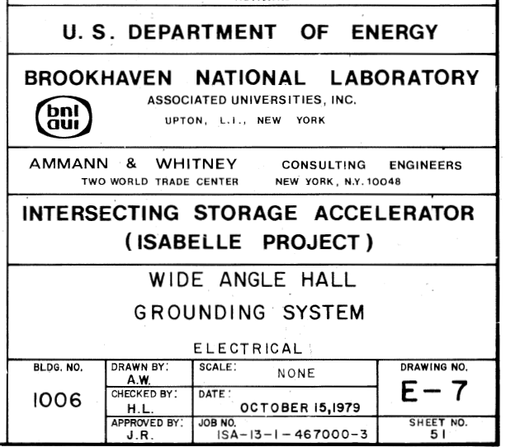
Electronics Technical Progress - Grounding
Slide from Fernando Barbosa
IP6
Grounding plan has been defined – refer to pre-brief materials.
Establishing grounding implementation with Integration, Infrastructure and Installation (I³) Group.

Slide 10
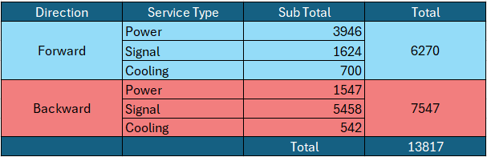
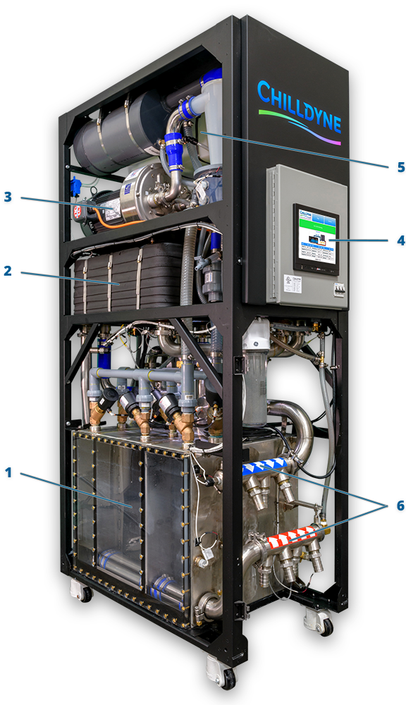
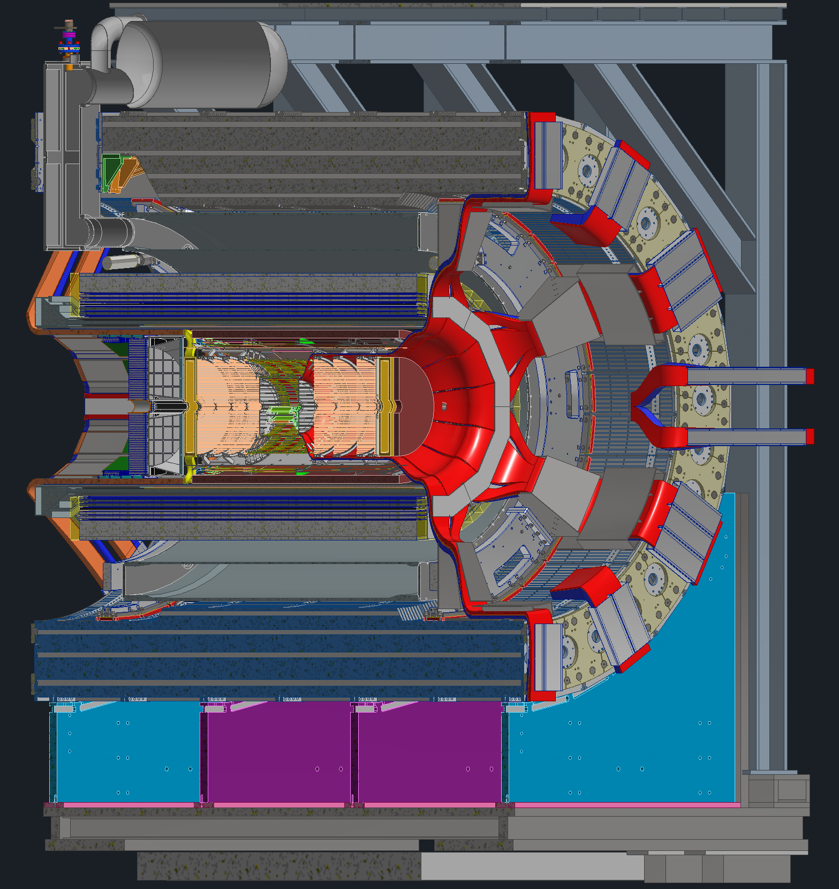
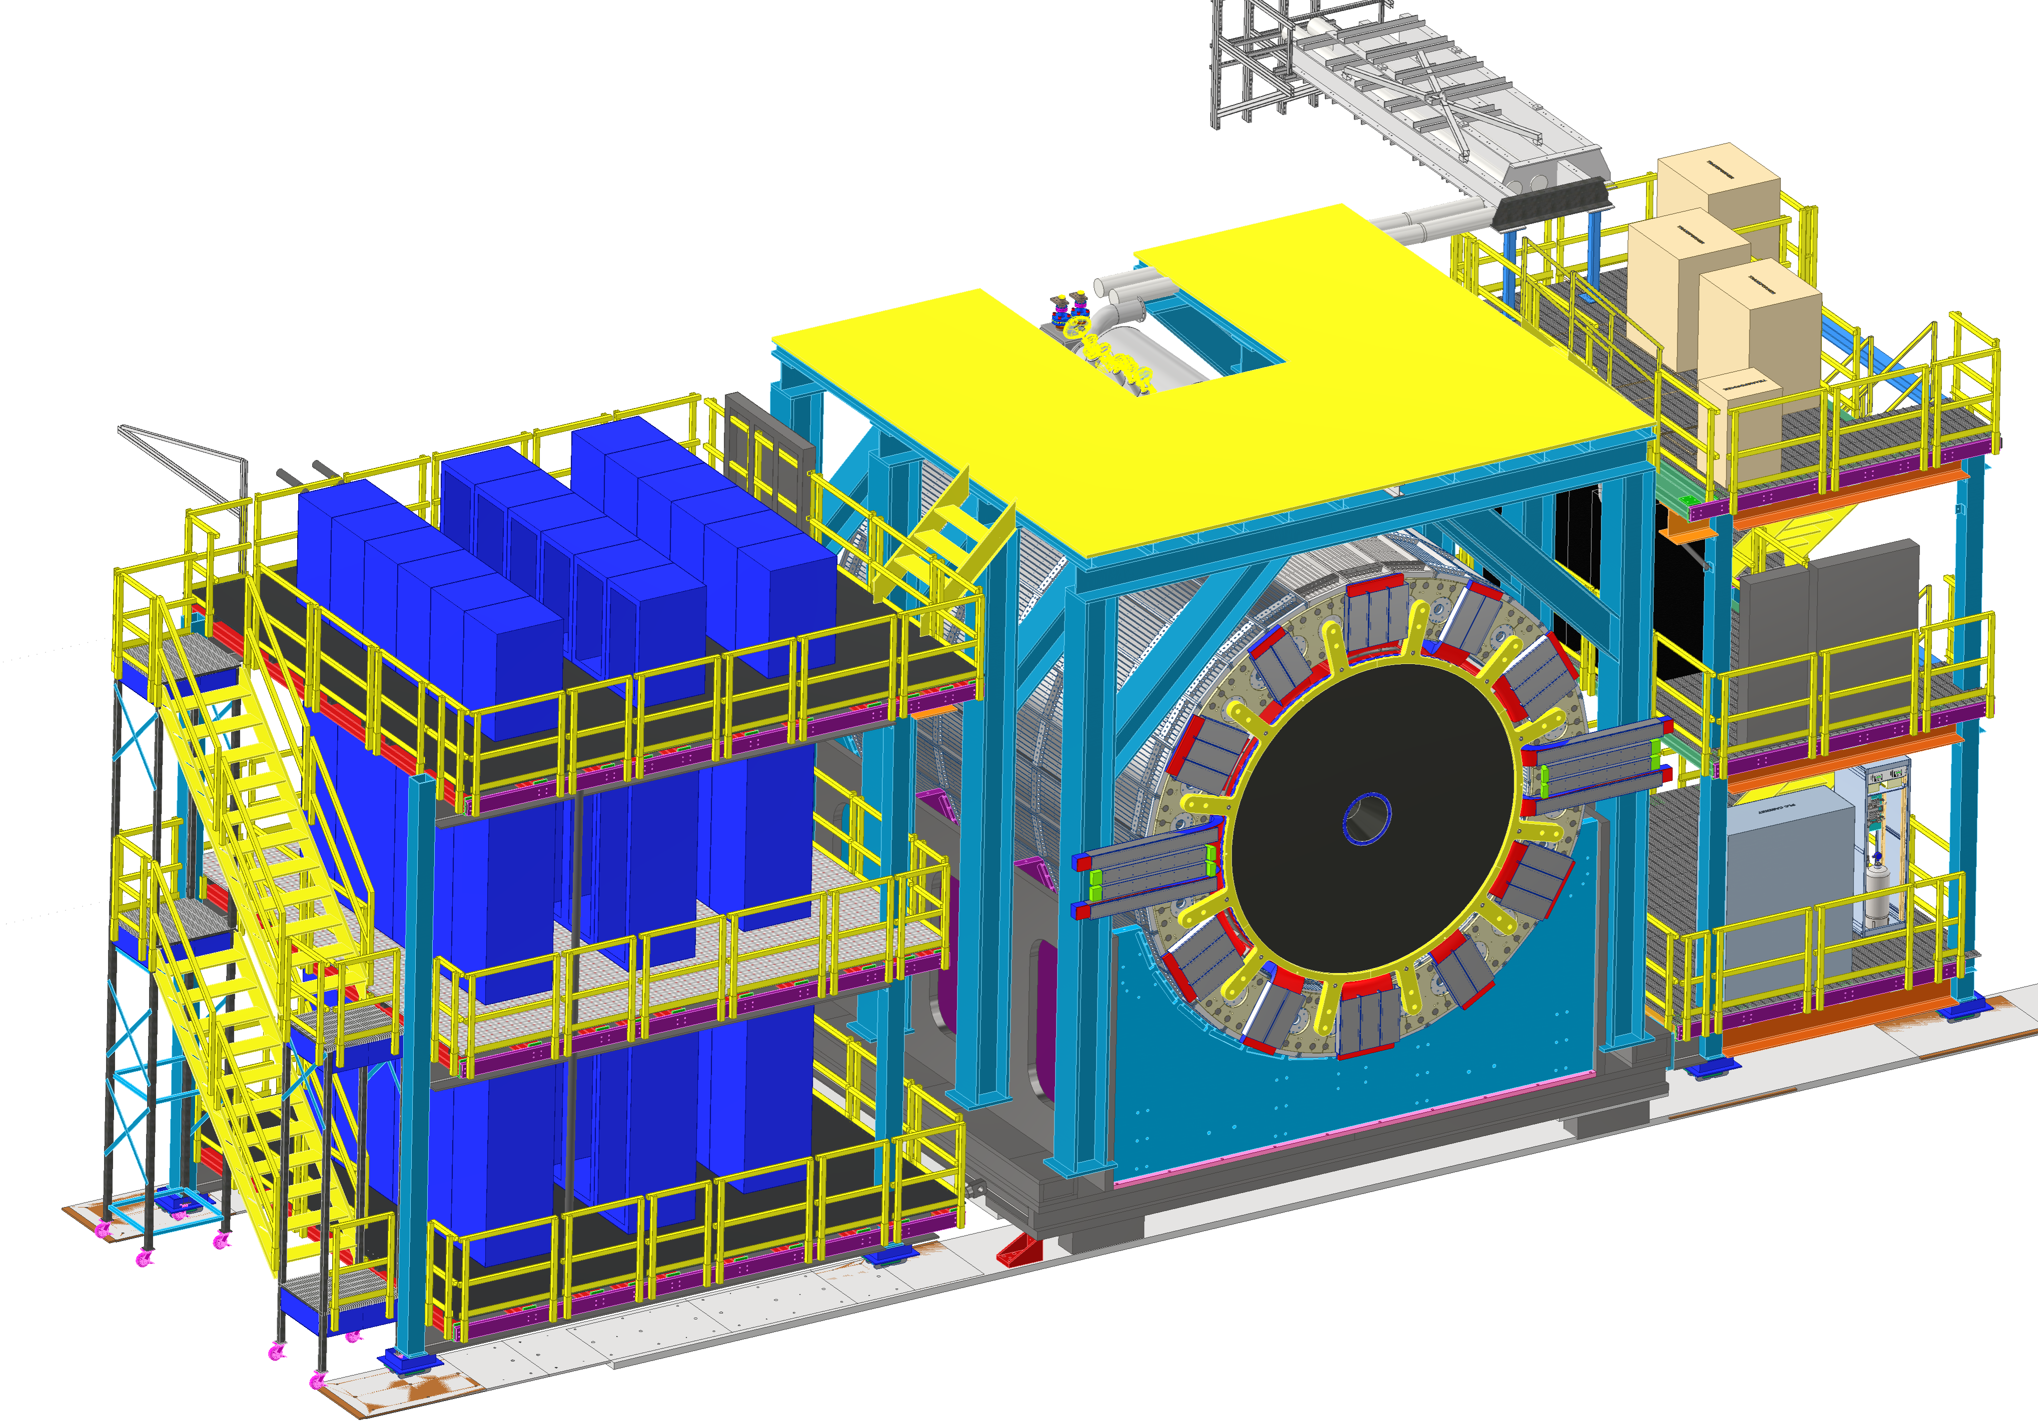
Integration, Install., Infrastr. Technical Progress
Services and Cooling
Slide from Rahul Sharma
Baseline services architecture defined and quantified:
  7,500 cables/lines (backward) and
  6,300 cables/lines (forward)
  Electronics Platform (Clean Power): Houses sub-detector electronics racks,
  Utilities platform (Dirty Power): Gas racks, Air/Liquid cooling units, Transformers).
  Independent tray segmentation supports partial removal/maintenance.
Cooling Baseline architecture defined:
  Facility primary loop Modified Chilled Water (MCW)
  Secondary loop using Cooling Distribution Units (CDUs - negative-pressure circulation units) cooled by MCW
  Aluminum Compatible Water (ACW) for aluminum manifolds/tubing.
  Convective air cooling used where appropriate.
  Special closed-loop cooling identified detectors that need it (eg dRICH).
  Building 1006 environmental control requirements are defined for key areas (WAH and Assembly Hall temperature/RH bands).
Work-in-progress and next steps:
  Physical mockups of tight service regions
  Global thermal model development is underway; next actions are to refine cooling calculations, finalize manifold sizing/locations, confirm subsystem temperature/flow/tubing requirements, and close remaining cooling interface details.

Slide 11
Next Steps of Integration Tasks
Grounding
  Basic grounding plan has been developed and documented within the electronics/DAQ group
  Grounding implementation has been ongoing including also the Integration, Installation and Infrastructure team; for the assembly Hall, experimental Hall, and IR for the auxiliary detectors
  We now will need to close the loop with you/Detector Subsystems, to integrate your subsystem grounding plans and needs
Services
  Physical mockups of tight service regions ongoing
  We will need information of sub-detectors relying on those tight regions for choice of connectors, etc.
Global Thermal Model and Cooling
  For each detector we collected assumed operating temperature (and what range is acceptable!), power budget, and assumed cooling needs
  Next step is to make a (simple) global thermal model to see pinch points of thermal impact
  Then we need to come back to each individual detector subsystem

Slide 12
Backup Slides

