Slide 1
Background Challenges Update – DAQ
Division of Effort for Data Rate Compilation
Data Rate Summary Spreadsheet
Application/Plan/Status for preTDR & NIM

Slide 2
Goals
Define Front End Sensor/ASIC Limitations
Specify aggregation (to understand/alleviate potential bottlenecks)
Estimate maximum hit rates in operating detector
  This is complex:
    Detector by Detector issues:
      Detector digitization doesn’t map simply to underlying event structure (e.g. RICH detectors)
      Detector channels don’t (always) map directly to simulated hit location (e.g. barrel ECAL, DIRC)
      Mechanism for sharing hits between channels must be understood detector by detector (e.g. Showering in calorimeter and charge sharing in AC-LGAD not the same in the simulations)
    Data Rates are dependent upon detector operation issues:
      Hit Thresholds
      ASIC parameters (e.g. # of time bins to readout/hit)
    Backgrounds / Physics rates are dependent on delivered beam / collider setup
      Vacuum
      Luminosity
      Species
Noise
  We will run in modes where noise / background may dominate event hits

Slide 3
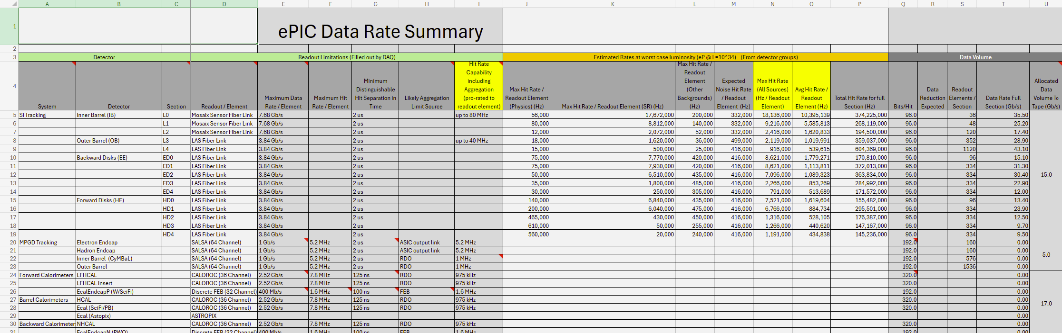
Data Rate Summary File
The tool to connect the data rate capabilities of the readout systems to the expected detector requirements is the “ePIC Data Rate Summary” spreadsheet…
https://brookhavenlab.sharepoint.com/:x:/s/EICPublicSharingDocs/IQB-kLhwyLvuSpfzxCNyxGDOAZRAjAheMUOrajAzU52MJ1s?e=AaBvS7

Slide 4
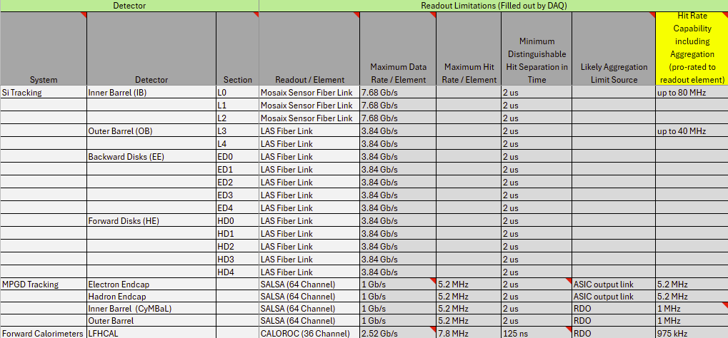
Data Rate Summary File (Page 2)

Slide 5
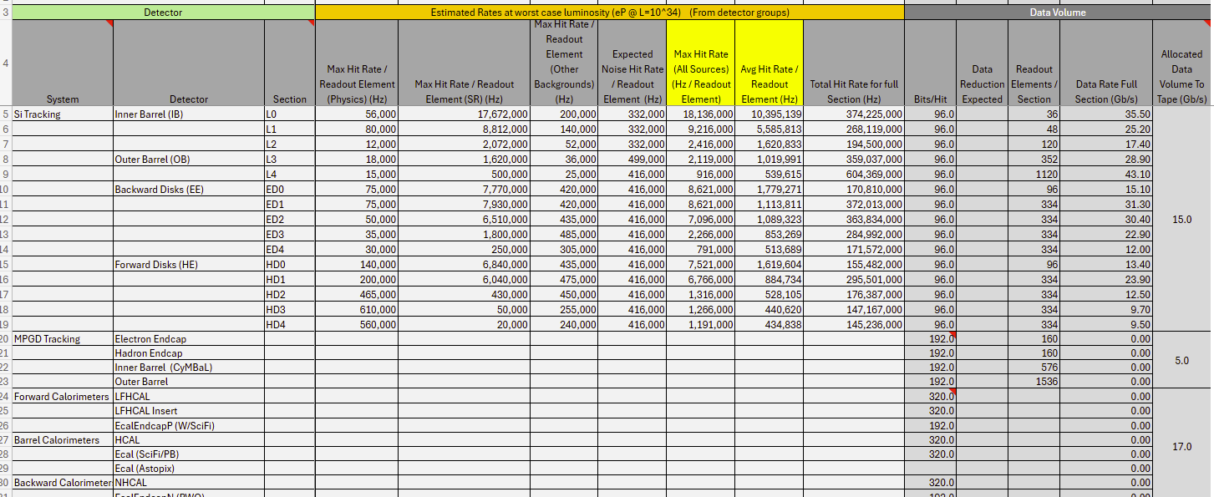
Data Rate Summary File (Page 3)

Slide 6
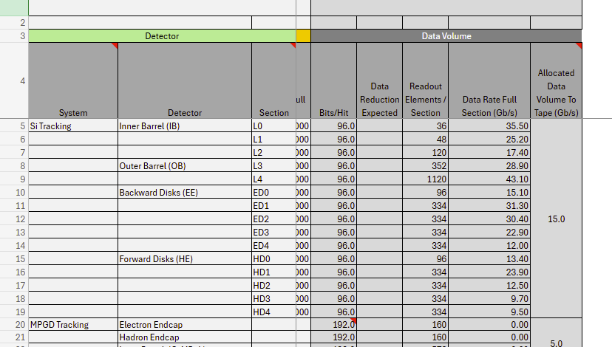
Data Rate Summary File (Page 4)
Data / Summary

Slide 7
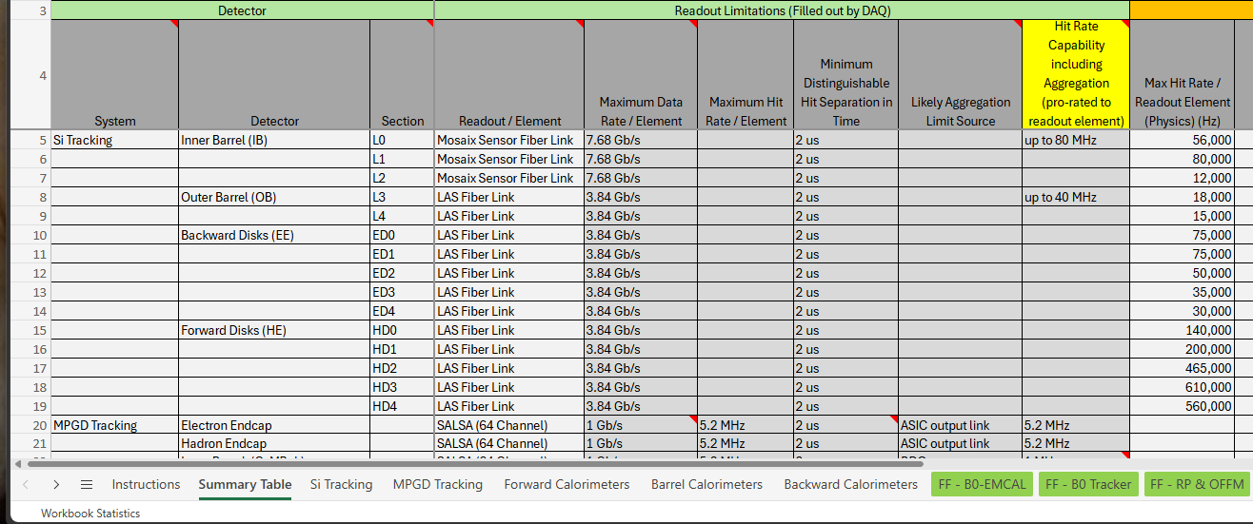
Data Rate Summary File (Page 5)
Additional Info goes in tabs (links to studies, additional details, notes regarding assumptions, confidence levels &/or plans for improving values, history of changes…)

Slide 8
preTDR / NIM
DAQ requirement from Physics:
  10x275 eP → 500 kHz, 3.2 MHz electron beam gas, 32 kHz hadron beam gas, ~?1 gHz? Sync rad
  Polarization must be tracked by bunch
  Detector organization (e.g ASIC ->FEB->RDO -> DAM -> E0 -> E1)
Requirements from Rad Hardness:
  Mention rad hardness requirement in central detector (ASIC/lpGBT/VTRX+)
  Mention issues SEU / Latchup / need for failure recovery
  Currently mention Dose / Neq in region of dRICH & Astropix (Which use FPGA)
  (Add worse case and compare to lpGBT/VTRX+ rad/hardness)
Requirements for data rates
  Existing tables are several years old. (No SR, only beam gas + DIS, poor understanding of detector distribution, many detectors un-simulated)
  Replace with simplified version of completed data rate summary spreadsheet
  Will add description of planned luminosity ramp-up and data reduction required at higher luminosities to keep rate to echelon 1 near 100 Gb/sec

