Slide 1


MPGD Rates
Matt Posik
Temple University

Slide 2
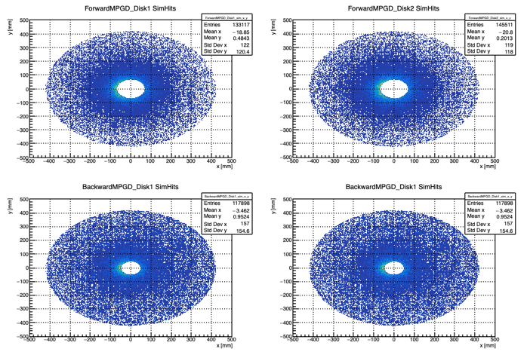
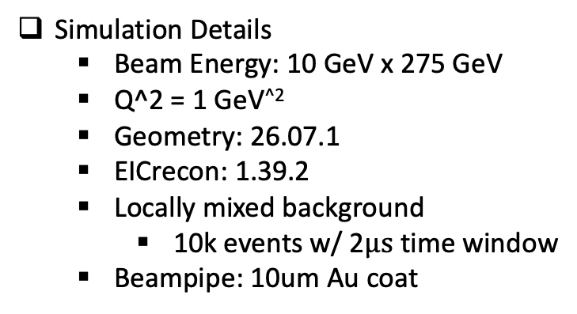
MPGD ECT Disks
Simulation Details
  Beam Energy: 10 GeV x 275 GeV
  Q^2 = 1 GeV^{^2}
  Geometry: 26.07.1
  EICrecon: 1.39.2
  Locally mixed background
    10k events w/ 2$μs$ time window
  Beampipe: 10um Au coat
Source Selection
  DIS: genStatus < 100
  SR: 2000 < genStatus < 2100
  Brem.: 3000 < genStatus <3100
  Coulomb: 4000 < genStatus < 4100
  Touschek. 5000 < genStatus < 5100
  P-gas: 6000 < genStatus < 6100
2 disks and 4 quadrants per disk

Slide 3
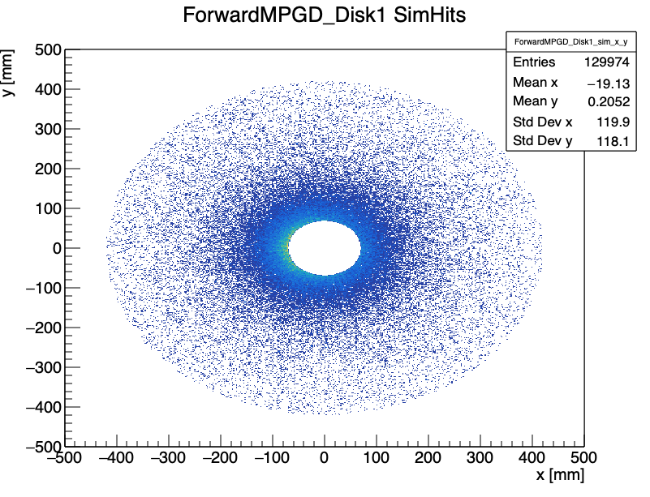
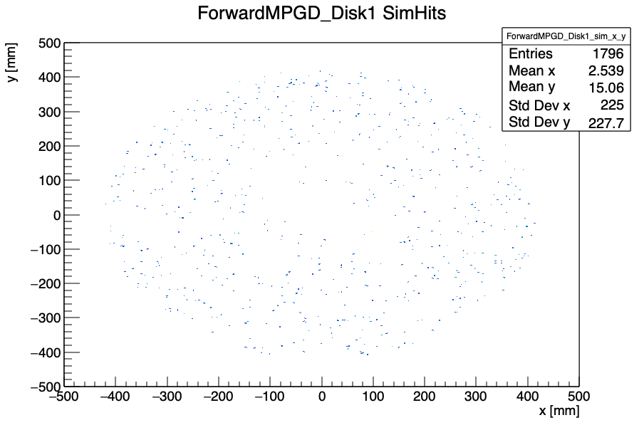
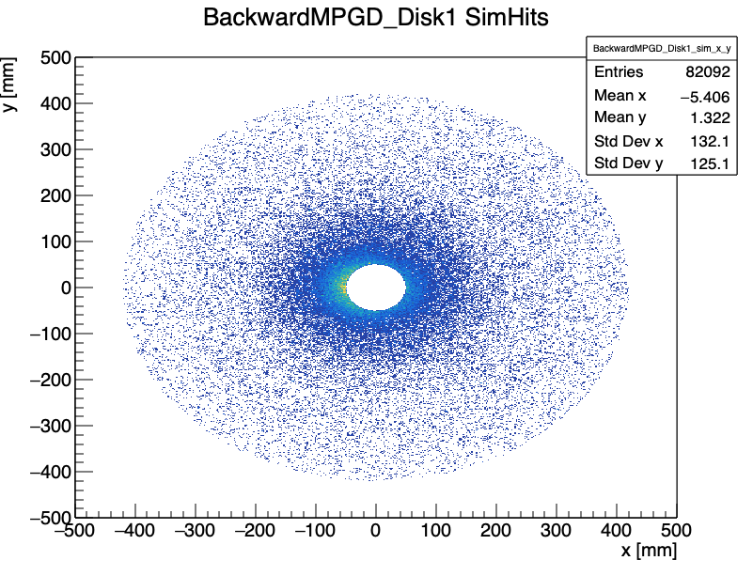
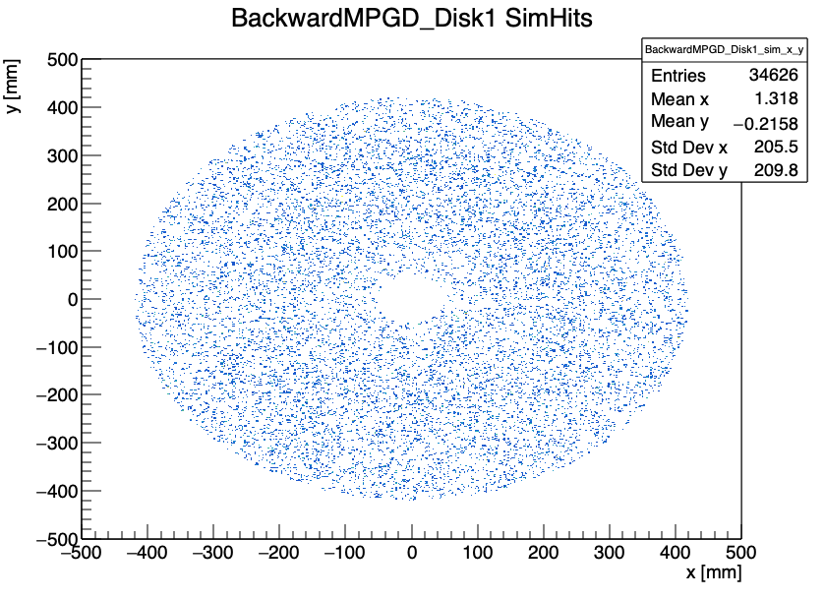
MPGD ECT Disks
Endcap hits are mostly DIS (non-background) events
SR is distributed uniformly across the disks
Few SR events in forward disks
DIS
SR
DIS
SR

Slide 4
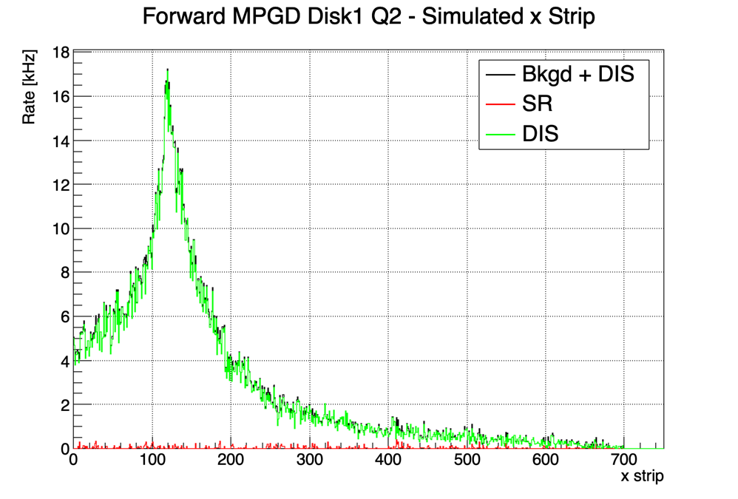
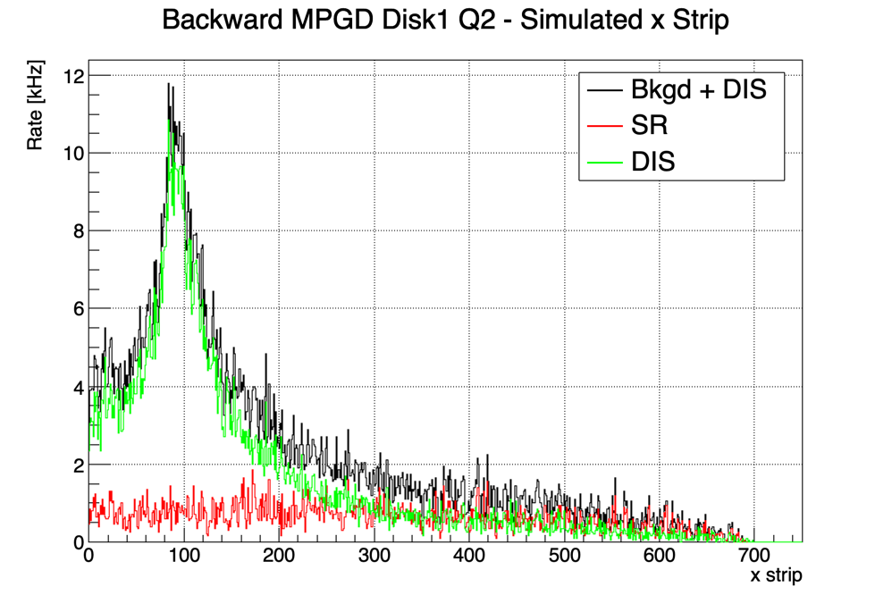
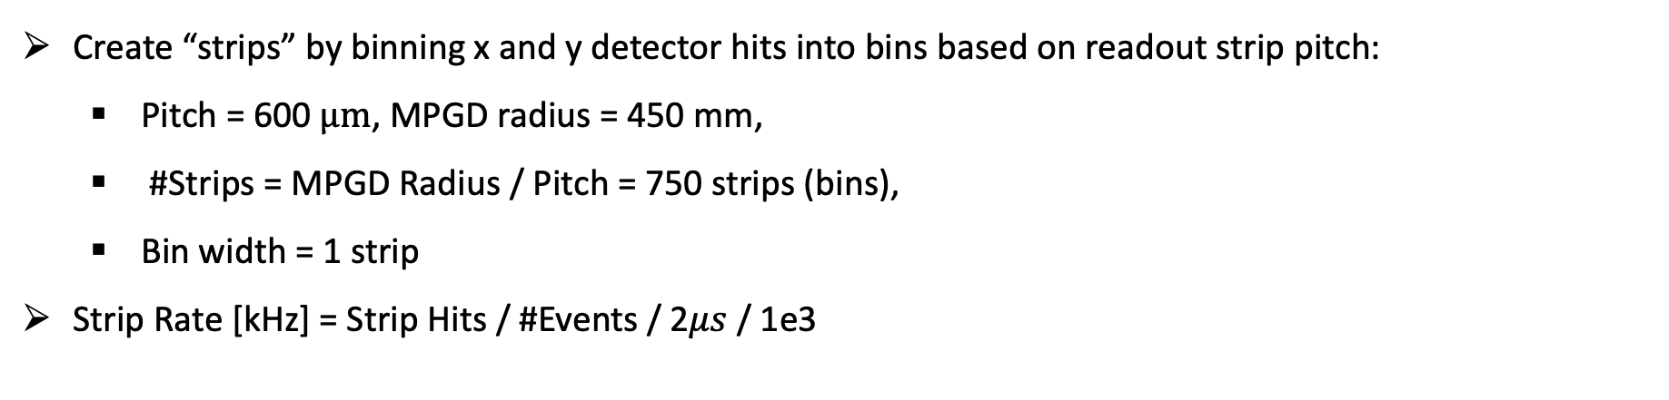
Calculating Rates
Create “strips” by binning x and y detector hits into bins based on readout strip pitch:
  Pitch = 600 $μm$, MPGD radius = 450 mm,
  #Strips = MPGD Radius / Pitch = 750 strips (bins),
  Bin width = 1 strip
Strip Rate [kHz] = Strip Hits / #Events / 2$μs$ / 1e3
No clustering effects are applied. Rates should be multiplied by ~5

Slide 5
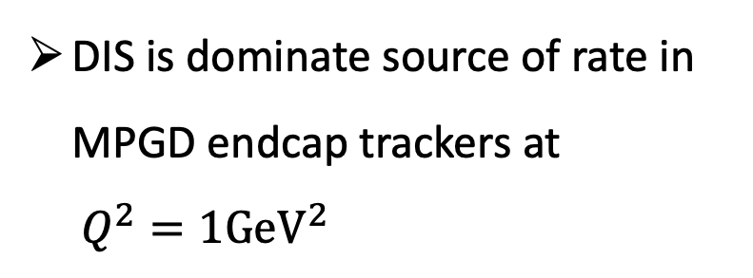
Strip Rate Summary
Detector | Max Rate [kHz] | Mean Rate [kHz] | SR Max Rate [kHz]
F Disk 1 | 17.3 | ~3 | < 1
F. Disk 2 | 21.4 | ~3 | < 1
B. Disk 1 | 11.8 | ~2 | ~2
B. Disk 2 | 13.2 | ~3 | ~3
DIS is dominate source of rate in MPGD endcap trackers at
$Q^{2}=1GeV^{2}$
No clustering effects are applied. Rates should be multiplied by ~5

Slide 6
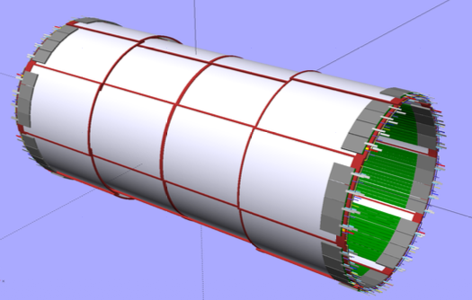
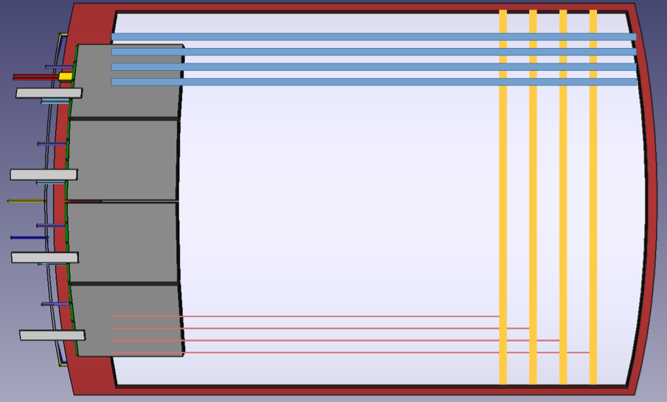
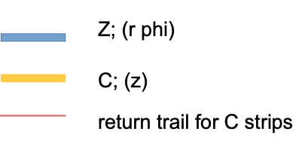
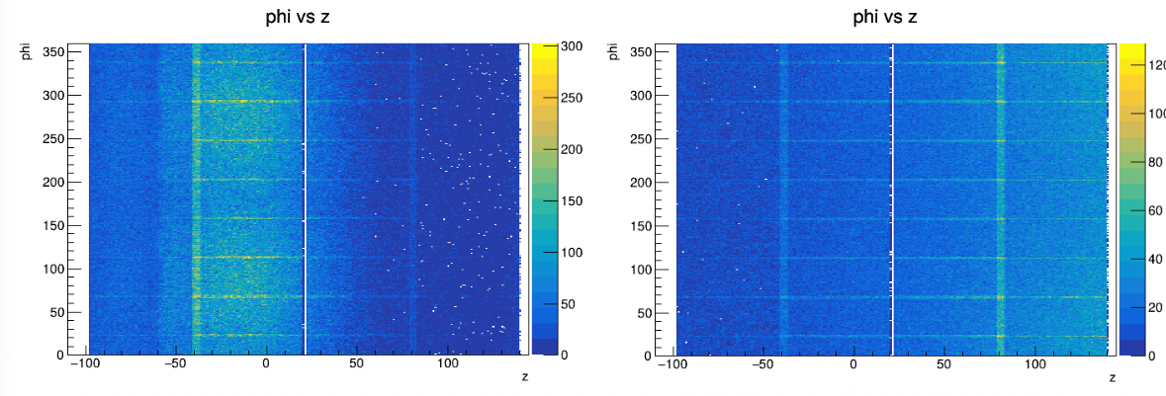
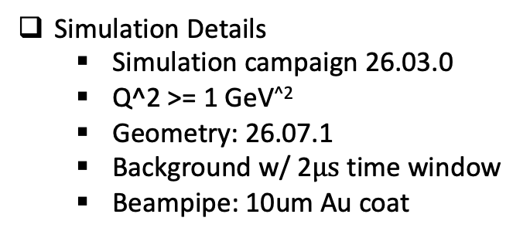
CyMBaL
CyMBal Module
CyMBaL = 32 modules
  8 modules in phi x 4 modules in z
Simulation Details
  Simulation campaign 26.03.0
  Q^2 >= 1 GeV^{^2}
  Geometry: 26.07.1
  Background w/ 2$μs$ time window
  Beampipe: 10um Au coat
CyMBal
Hit Distributions
With Background
Without Background

Slide 7
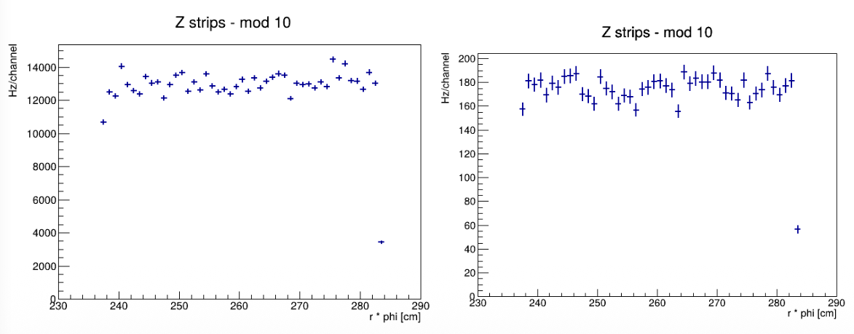
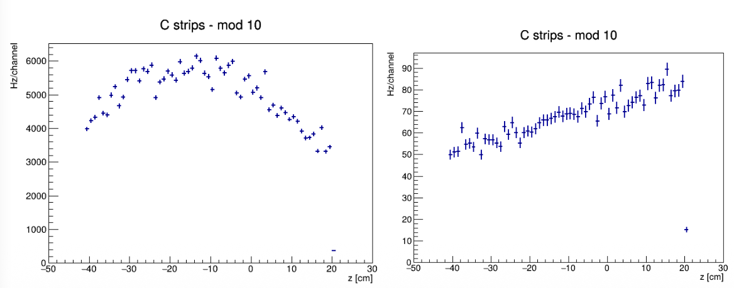
CyMBaL: Channel Rates
Hit rates are not uniform across CyMBaL
No cluster size is applied (multiply rates by ~5)
On Z strips (i.e. running along z) the hit rate is ~13 kHz/ch
On the C strip (orthogonal to z) the hit rate is ~6 kHz/ch
With background
Without background
No clustering effects are applied. Rates should be multiplied by ~5
With background
Without background

Slide 8
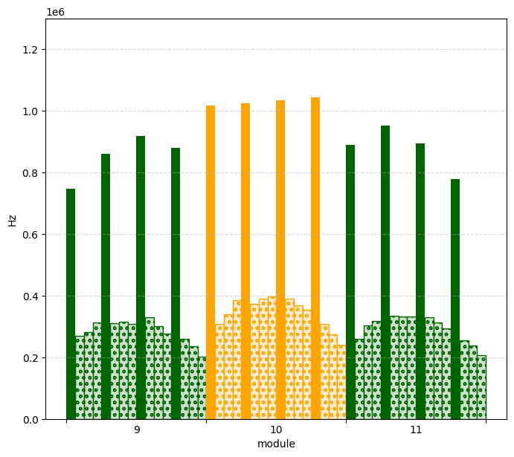
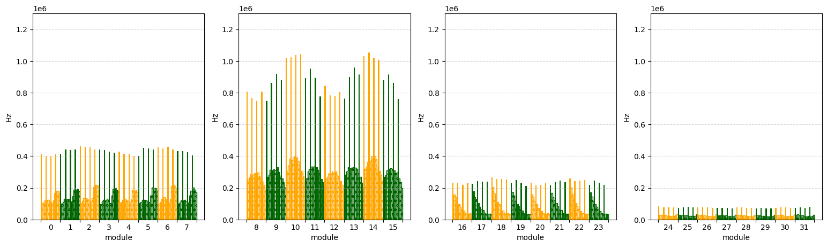
CyMBaL Module Rates: All Sources
Each bin is a Salsa chip (64 ch.)
Each color is a tile
  Filled colored bins = long Z strip
  Dotted bins = C strips
No clustering effects are applied. Rates should be multiplied by ~5
All Sources

Slide 9
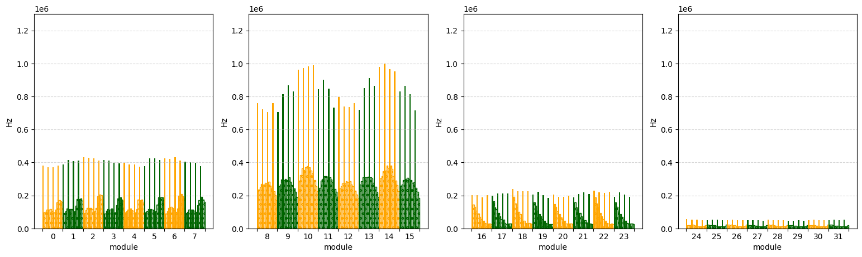
CyMBaL Module Rates: SR
SR
No clustering effects are applied. Rates should be multiplied by ~5

Slide 10
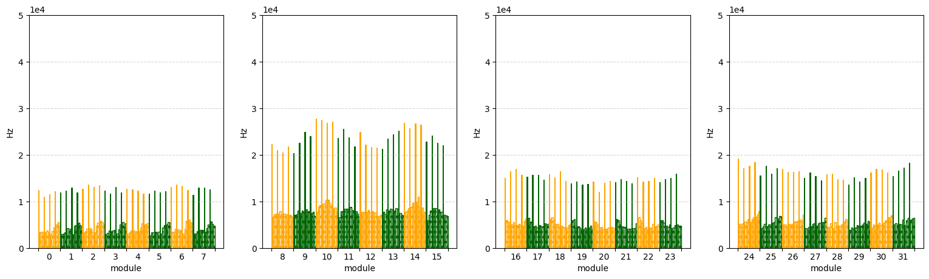
CyMBaL Module Rates: DIS
Note vertical scale value
DIS
No clustering effects are applied. Rates should be multiplied by ~5

Slide 11
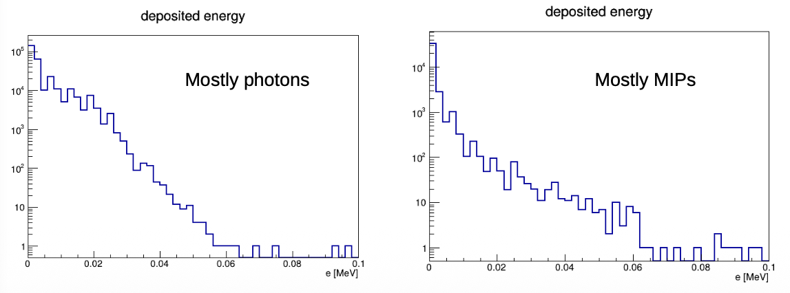
CyMBaL: Energy
Most background hits come from SR photons with energy less than 100 keV
With background
Without background

Slide 12
Backup

Slide 13
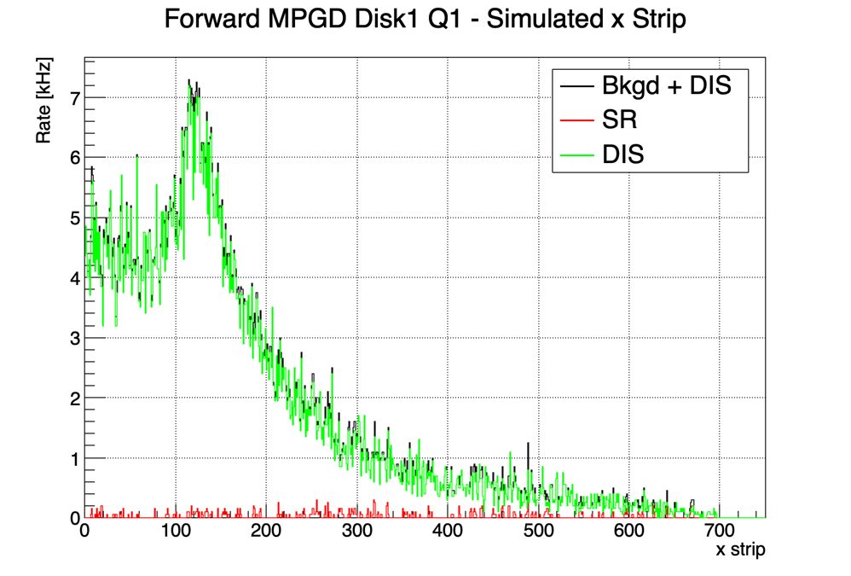

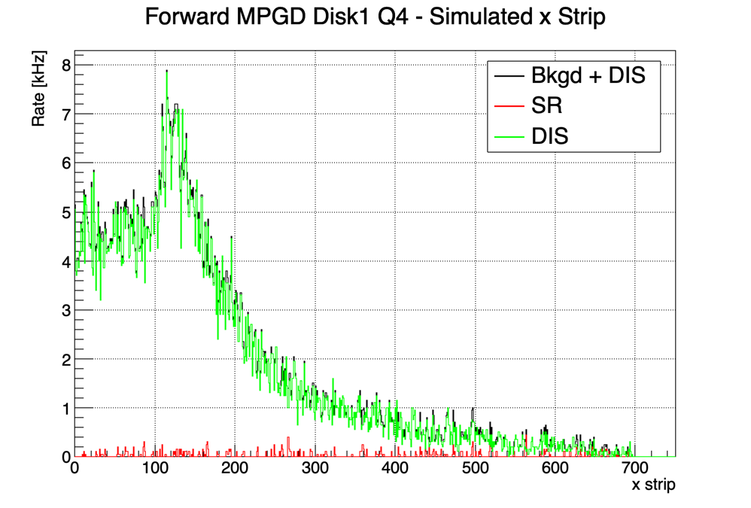
Forward ECT: Disk 1 X-Strip Rate
Disk 1 Quad 1
Disk 1 Quad 2
Disk 1 Quad 3
Disk 1 Quad 4

Slide 14
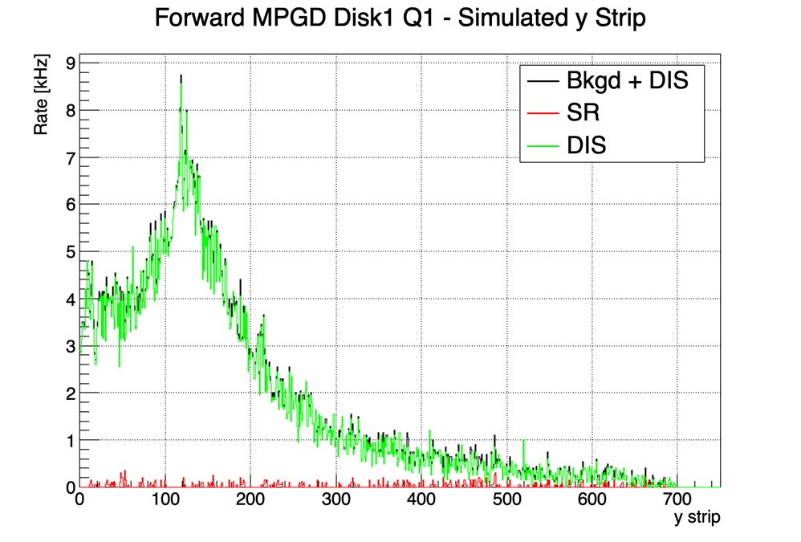
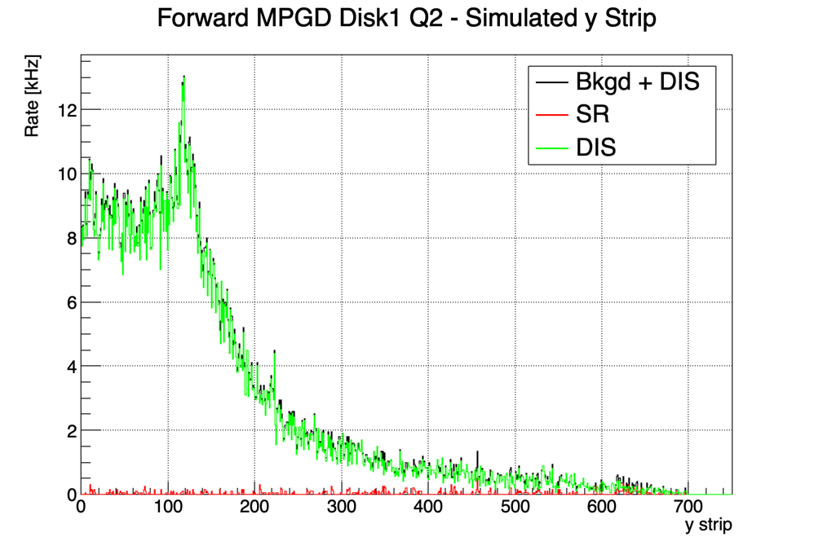
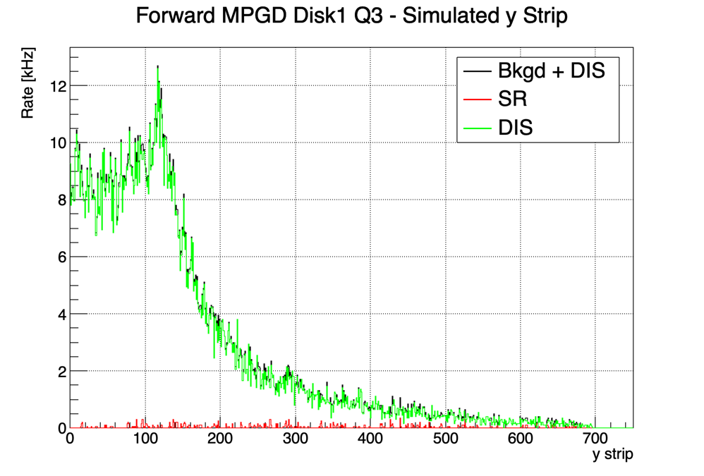

Forward ECT: Disk 1 Y-Strip Rate
Disk 1 Quad 1
Disk 1 Quad 2
Disk 1 Quad 3
Disk 1 Quad 4

Slide 15
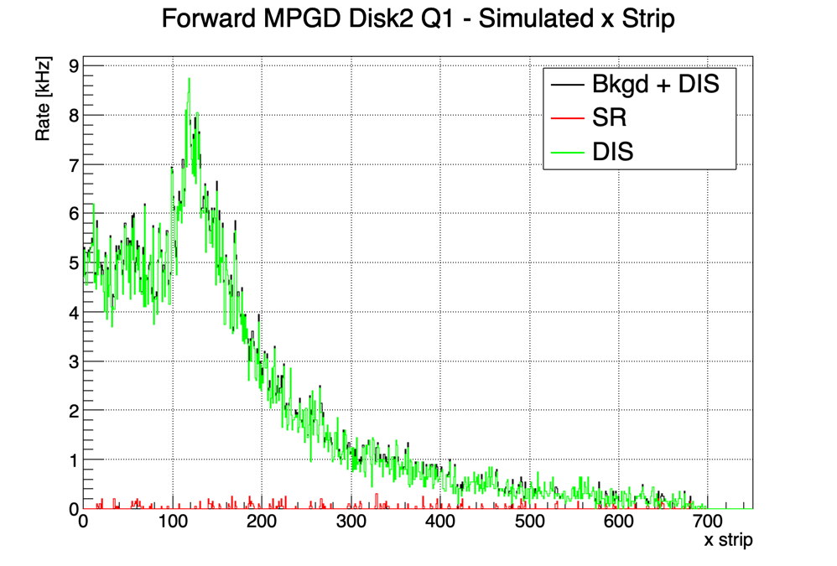
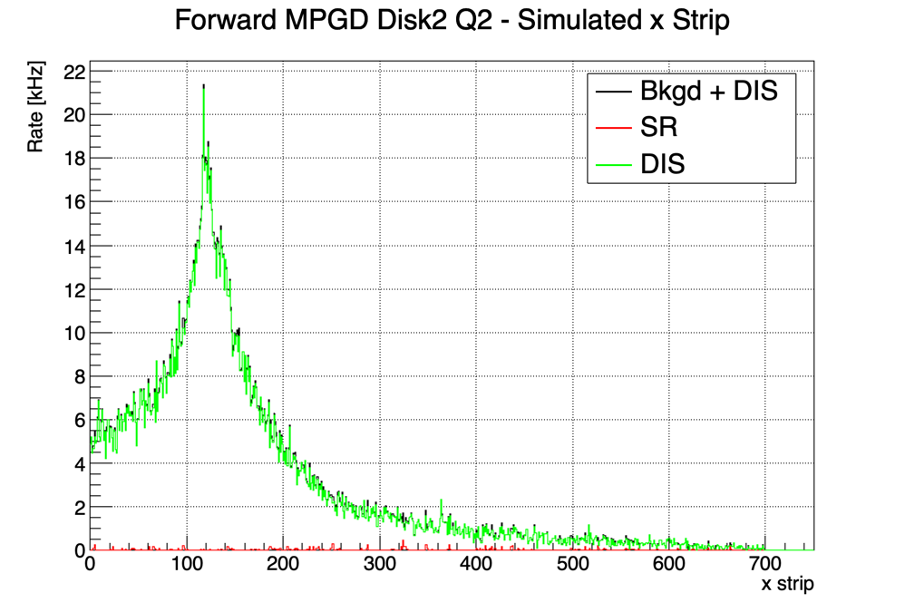

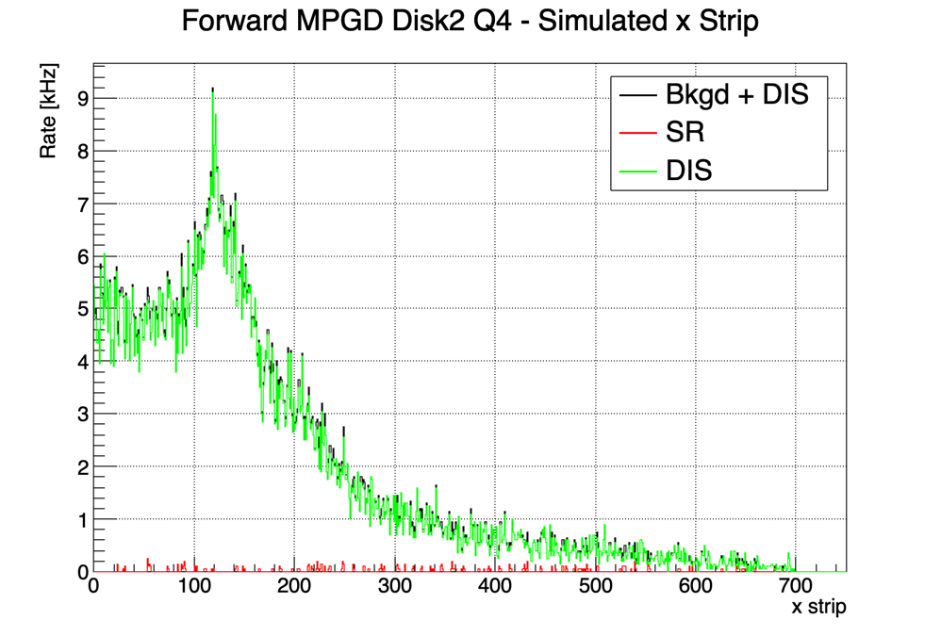
Forward ECT: Disk 2 X-Strip Rate
Disk 2 Quad 1
Disk 2 Quad 2
Disk 2 Quad 3
Disk 2 Quad 4

Slide 16

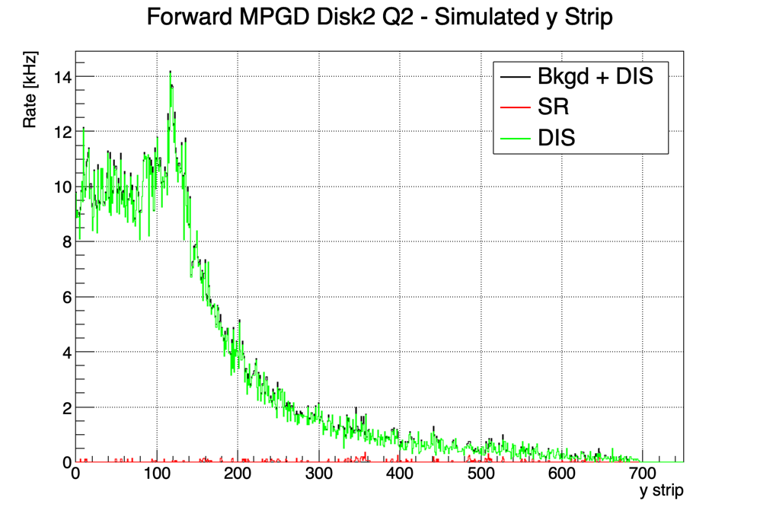
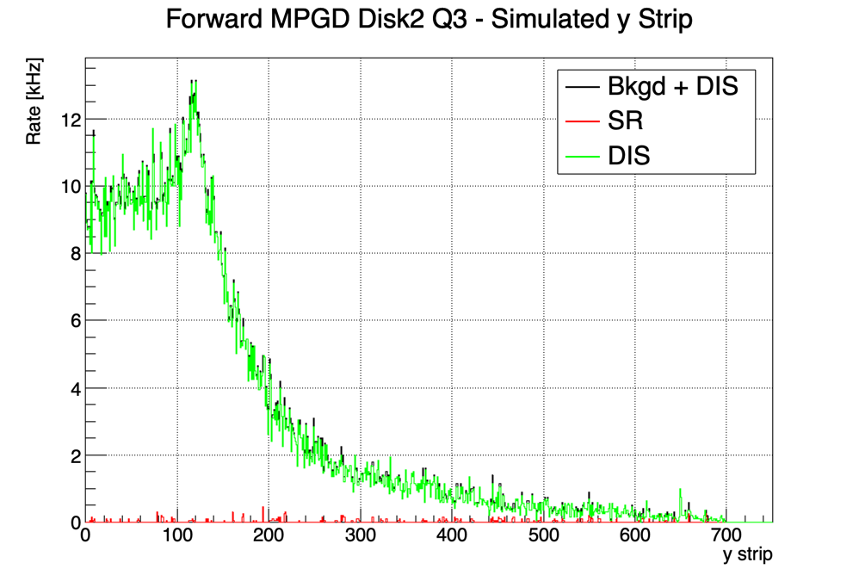
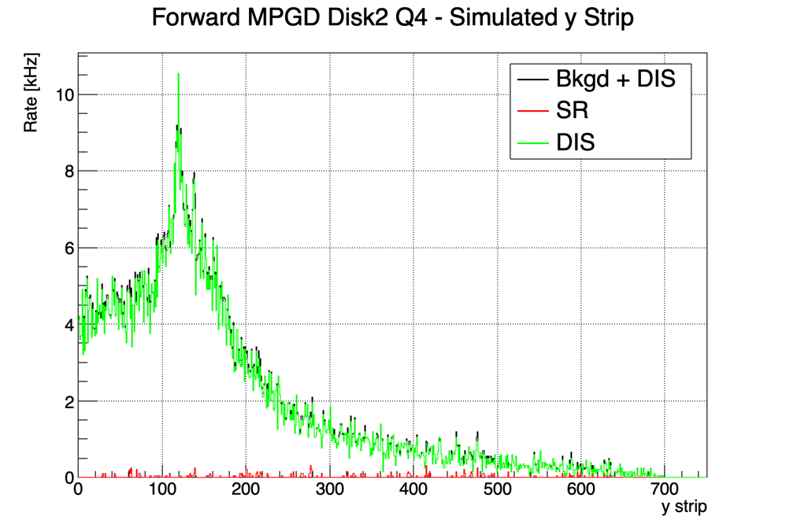
Forward ECT: Disk 2 Y-Strip Rate
Disk 2 Quad 1
Disk 2 Quad 2
Disk 2 Quad 3
Disk 2 Quad 4

Slide 17
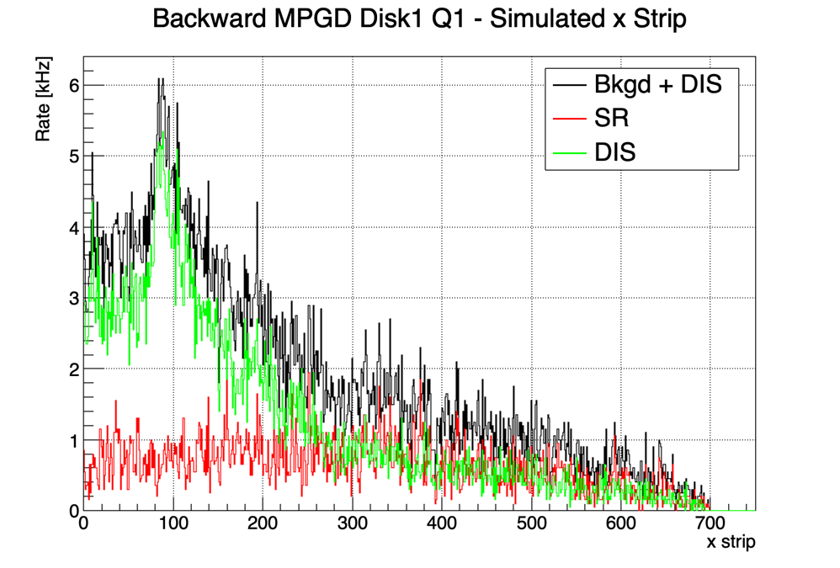
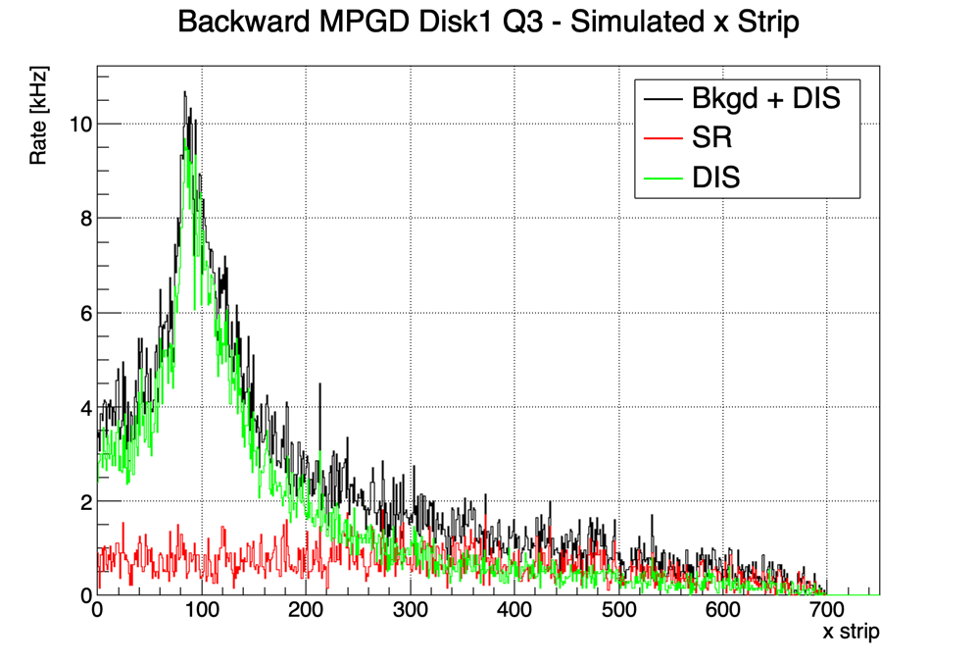
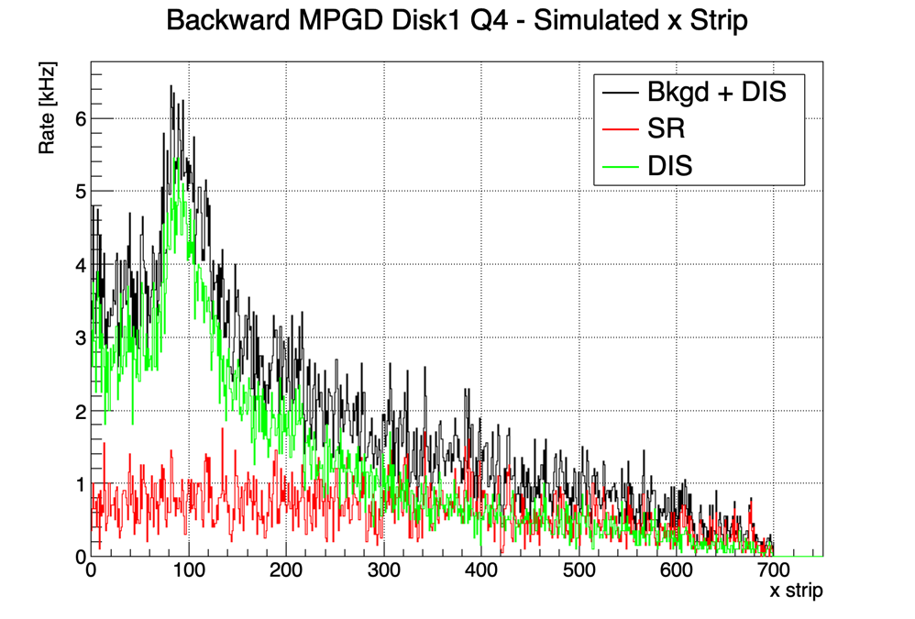
Backward ECT: Disk 1 X-Strip Rate
Disk 1 Quad 1
Disk 1 Quad 2
Disk 1 Quad 3
Disk 1 Quad 4

Slide 18

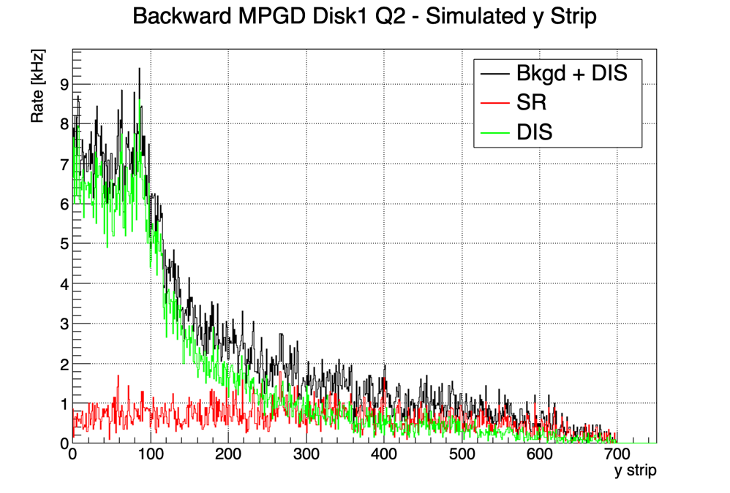
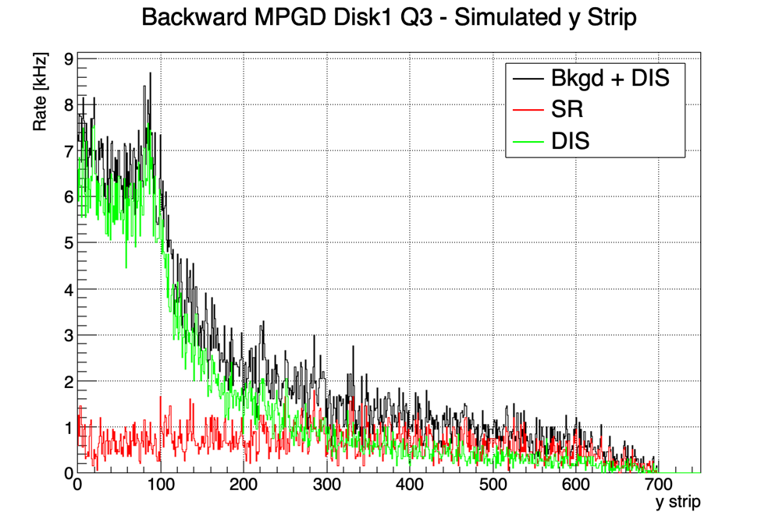

Backward ECT: Disk 1 Y-Strip Rate
Disk 1 Quad 1
Disk 1 Quad 2
Disk 1 Quad 3
Disk 1 Quad 4

Slide 19
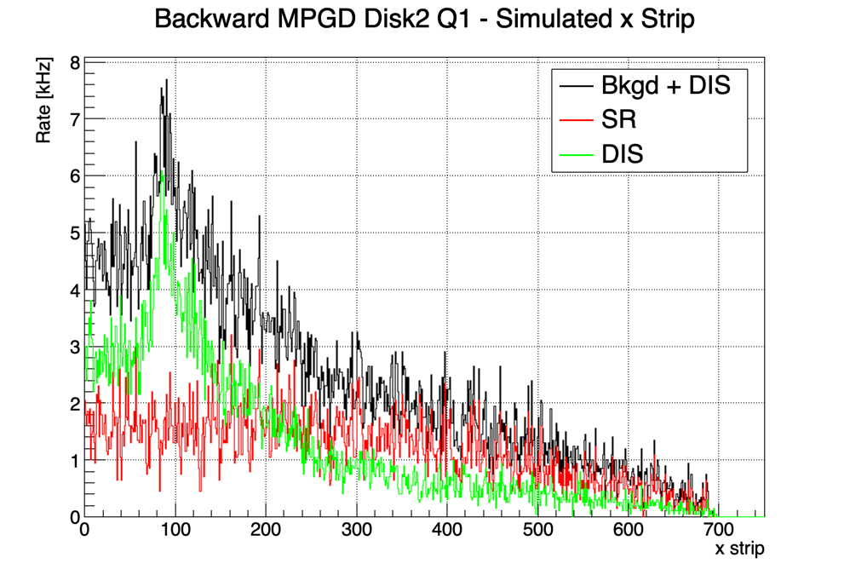
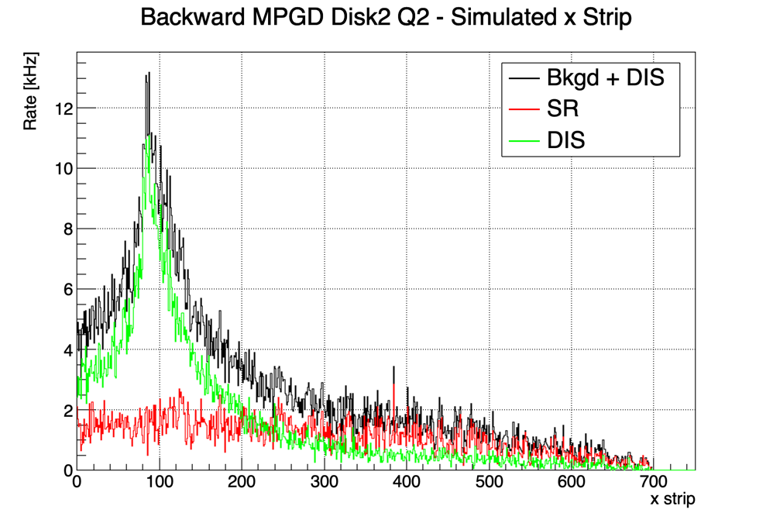
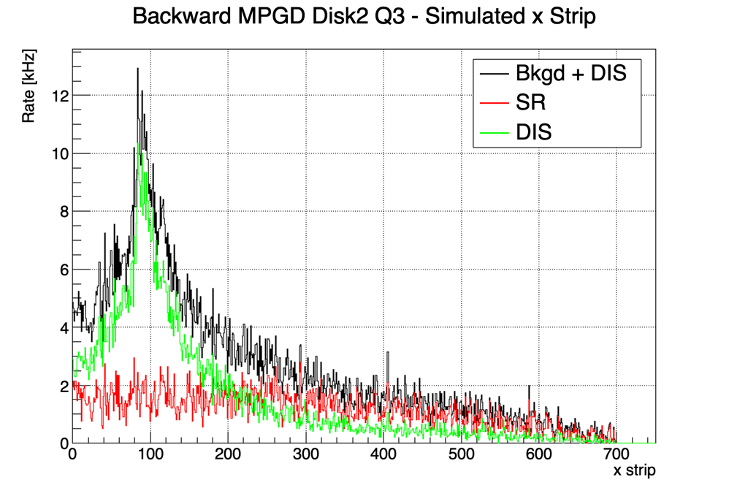
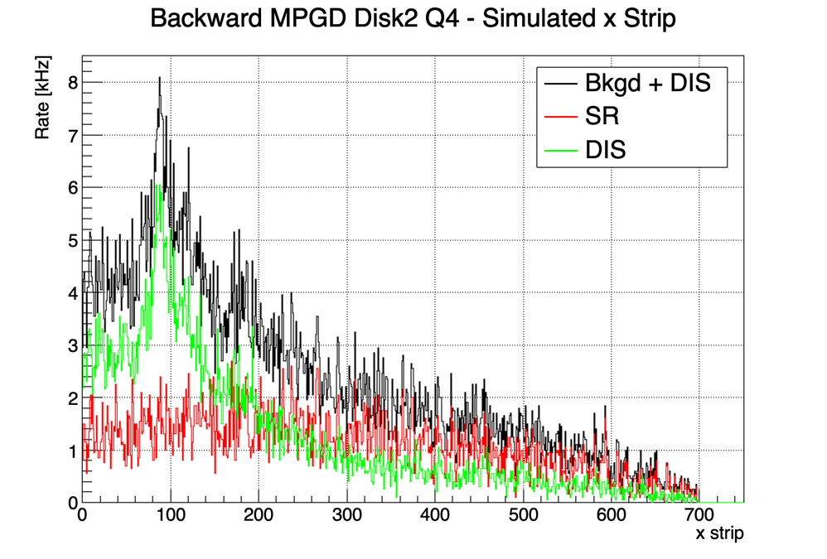
Backward ECT: Disk 2 X-Strip Rate
Disk 2 Quad 1
Disk 2 Quad 2
Disk 2 Quad 3
Disk 2 Quad 4

Slide 20
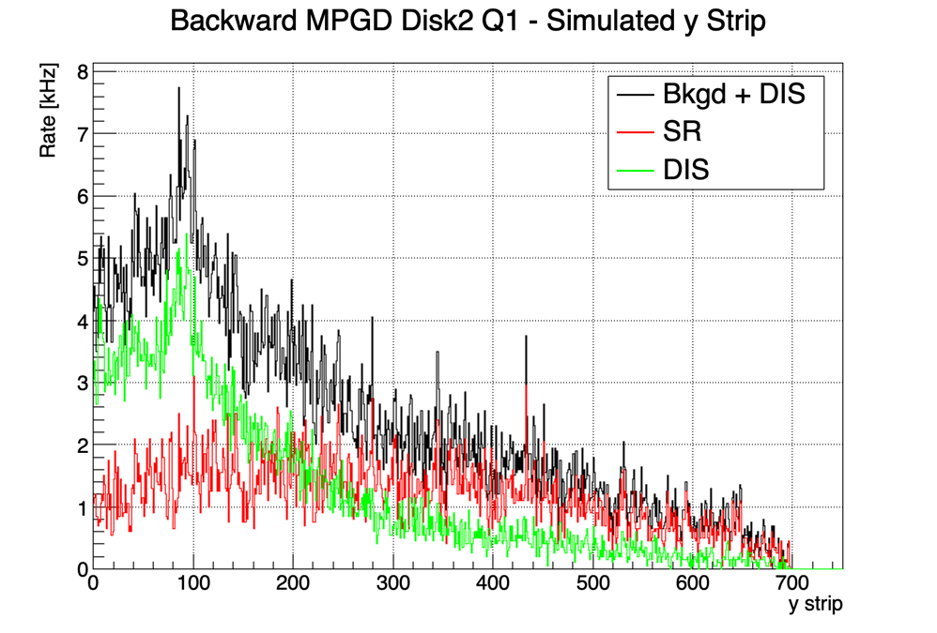
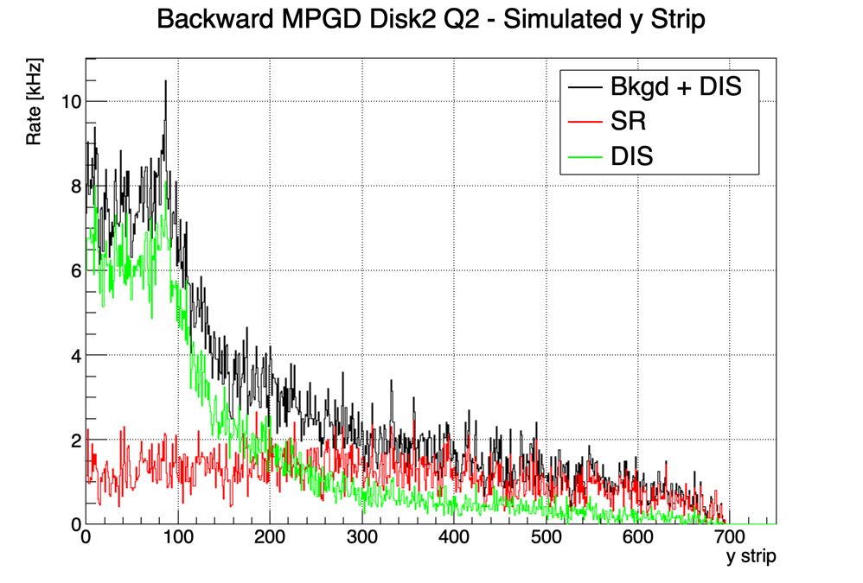
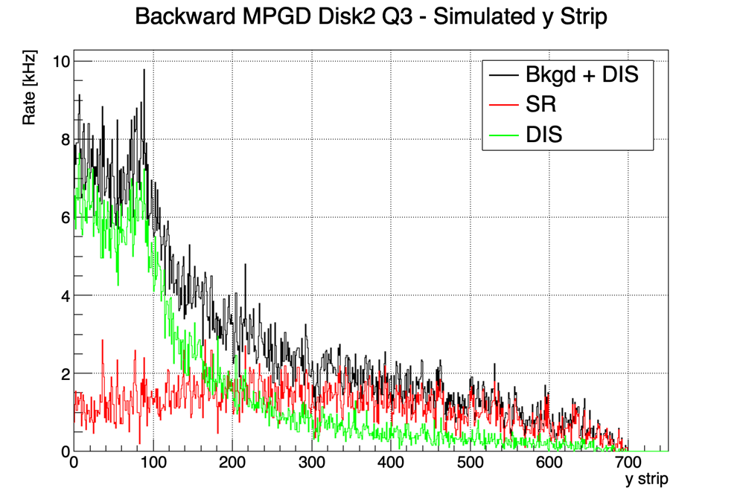
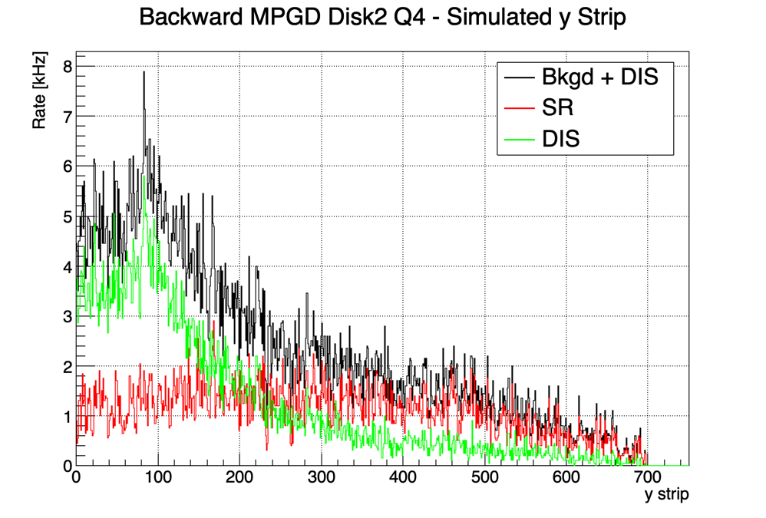
Backward ECT: Disk 2 Y-Strip Rate
Disk 2 Quad 1
Disk 2 Quad 2
Disk 2 Quad 3
Disk 2 Quad 4

Slide 21
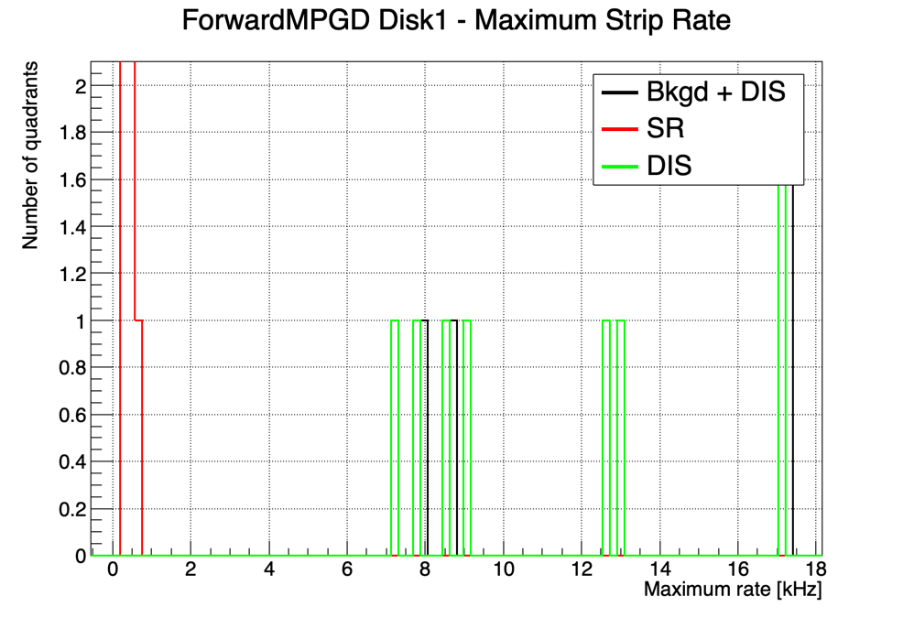
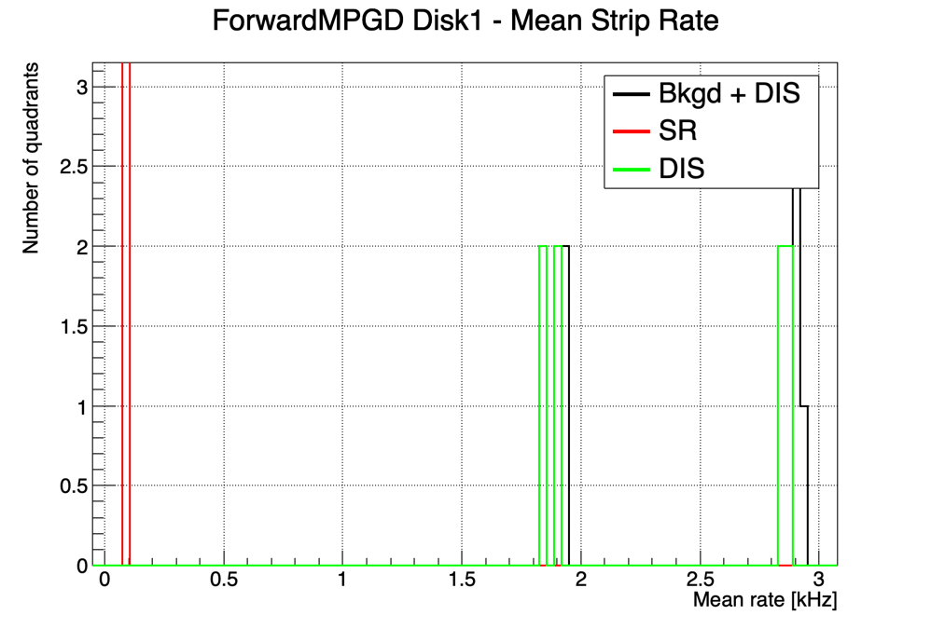
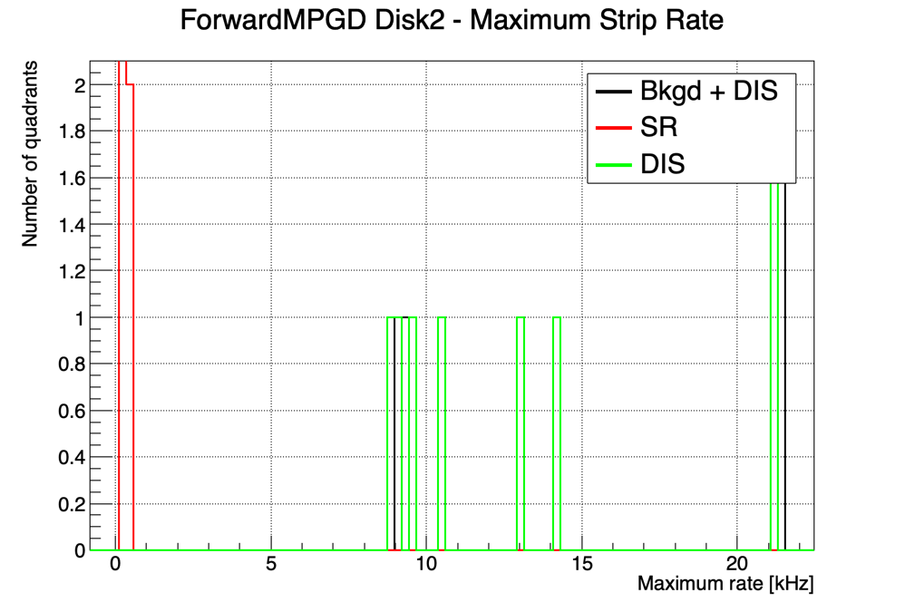
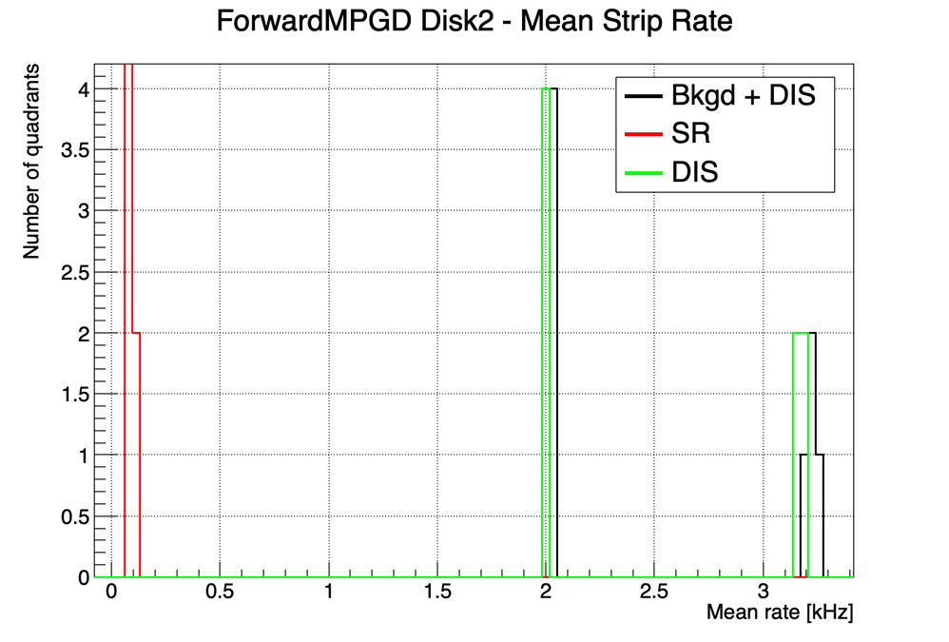
Forward ECT Stats

Slide 22




Backward ECT Stats

Slide 23


Calculating Rates
Z position used to select if what disk the hit belongs to
Example

Slide 24




Calculating Rates
Split each disk into quadrants
Quad. 2
Quad. 1
Quad. 3
Quad. 4
Example

Slide 25



Calculating Rates
Create “strips” by binning x and y detector hits into bins based on readout strip pitch:
  Pitch = 600 $μm$, MPGD radius = 450 mm,
  #Strips = MPGD Radius / Pitch = 750 strips (bins),
  Bin width = 1 strip
Strip Rate [kHz] = Strip Hits / #Events / 2$μs$ / 1e3
X Strip Rates
Y Strip Rates
Example
Example

