Slide 1
LFHCal calibration fits
Paul Nord
6 October 2026
Notes:
Integrated presentation: original F1 Yallfile workflow, discussion and interpretation, and all 53 plots from the supplied deck. New technical and discussion slides are editable. Plot images and their source notes are preserved. Observations and proposed validation steps are distinguished.

Slide 2
Main findings
Reanalysis of F2 agrees with Fredi’s calibration to better than 0.01% in all 380 calibrated channels.
- Same code. Likely machine precision differences.
Adaptive integration removes artificial wiggles from the fit function.
The new lower boundary improves many examples and can shift calibration values by a few percent.
A stable refinement history can still end at a poor fit.
F2 reproduction check: 17 September 2026
Notes:
F2 reproduction evidence: README(2).md, “LFHCAL FullSetF_2 calibration reproduction comparison,” 17 September 2026. Library source libfile_4a0bd56cf7a081919d18cb7bfc24cafe, file_00000000025881f9ab6dd034cf4a4e51. The final file is byte-identical to the user’s Imp5R output. All 380 positive HG MIP scales differ from Fredi’s reference by less than 0.01%, with median absolute relative difference 0.000003374% and maximum 0.005241889%. Both tables have the same four unavailable scales. This verifies the F2 constants comparison and is not an all-dataset reproduction claim.
Numerical wiggles: prior comparison of the fixed 100-point Legacy Langau evaluation with adaptive integration, and the E3 cell 1346 overlay in this deck. The physical Landau–Gaussian model is unchanged.
Range sensitivity: lfhcal-fit-range-report.pdf, 1 October 2026, Library source libfile_a0d224264fd481919be7135b0463c199. Fixed-histogram B1 controls shift 0 to -4.00% with the Adaptive evaluator when the window changes. The cleaner controls change less. The improvement statement is qualitative for selected examples, not an aggregate success rate. Both Legacy and Adaptive with the valley boundary remain candidates.
Convergence does not certify fit quality. The B2 cell 704 valley Adaptive example changes markedly between R7 and R8, and an unsuitable fit can also remain stable.

Slide 3
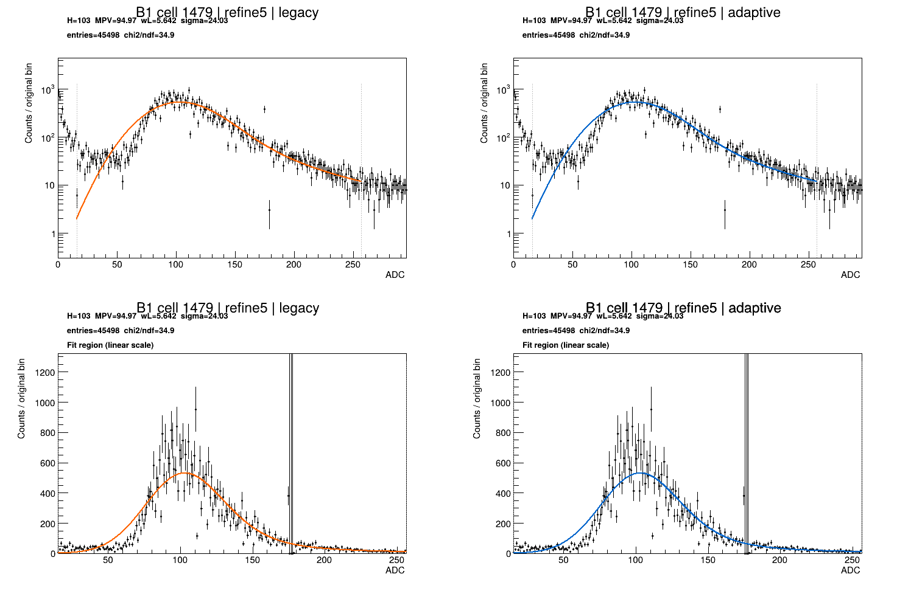
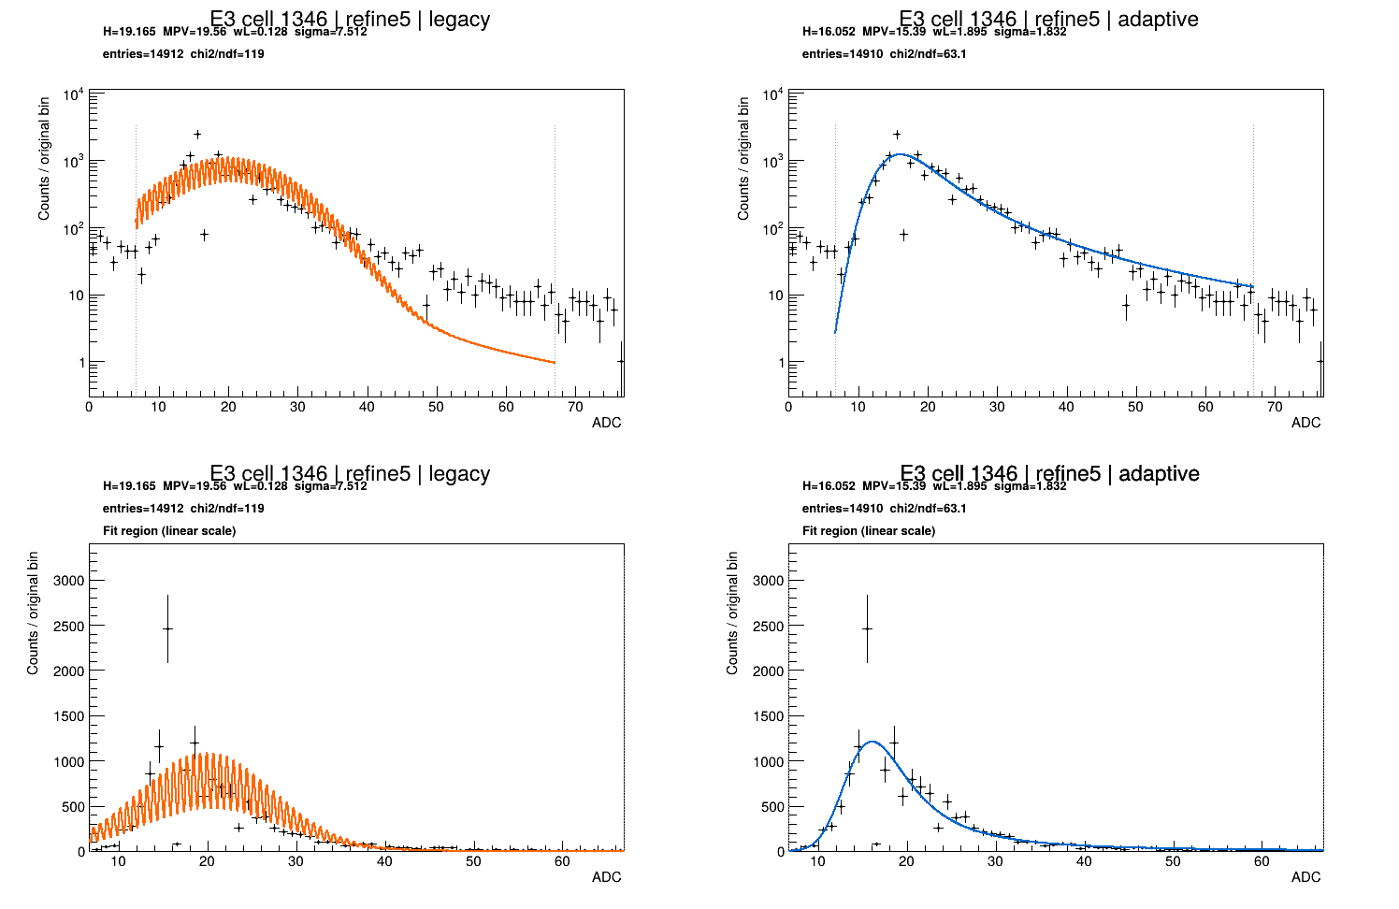
Study of 2 numerical fitting methods and 2 range selection methods
Fit method | Original lower boundary | Valley lower boundary
Legacy | Original numerical fit Original range choice | Same numerical fit New range choice
Adaptive | Adaptive evaluation Original range choice | Adaptive evaluation New range choice
Notes:
Study context and observations are from this conversation and the supplied BNL plots. Plot slides retain their original source notes. Original-boundary and valley-boundary results are distinct campaigns. Selected events were inherited separately for Legacy and Adaptive in the valley campaign. This is a refinement study, not a rerun of all upstream stages with the new boundary.

Slide 4
Plotting ALL fit parameters in one calibration flow plot
Each thin line follows one channel through the calibration stages.
The dark line shows the median.
Step plots: compare each channel with its own previous value. (e.g. R1-R2)
R5-reference plots: compare each channel with its Fredi’s calibration values.
A signed-log scale lets us see small differences and large jumps together.
Most channels settle down. B2 and a few channels in the E sets keep jumping.
Note: A stable calibration can still come from a poor fit.
Notes:
Study context and observations are from this conversation and the supplied BNL plots. Plot slides retain their original source notes. Original-boundary and valley-boundary results are distinct campaigns. Selected events were inherited separately for Legacy and Adaptive in the valley campaign. This is a refinement study, not a rerun of all upstream stages with the new boundary.
H denotes the stored high-gain MIP calibration scale, distinct from the Landau MPV parameter. The supplied plots include H, Landau MPV, Landau width, and Gaussian sigma. Inspect each plot’s title and axis labels before comparing panels. Median convergence cannot certify every channel. A carried-forward value is not a fresh successful fit.

Slide 5
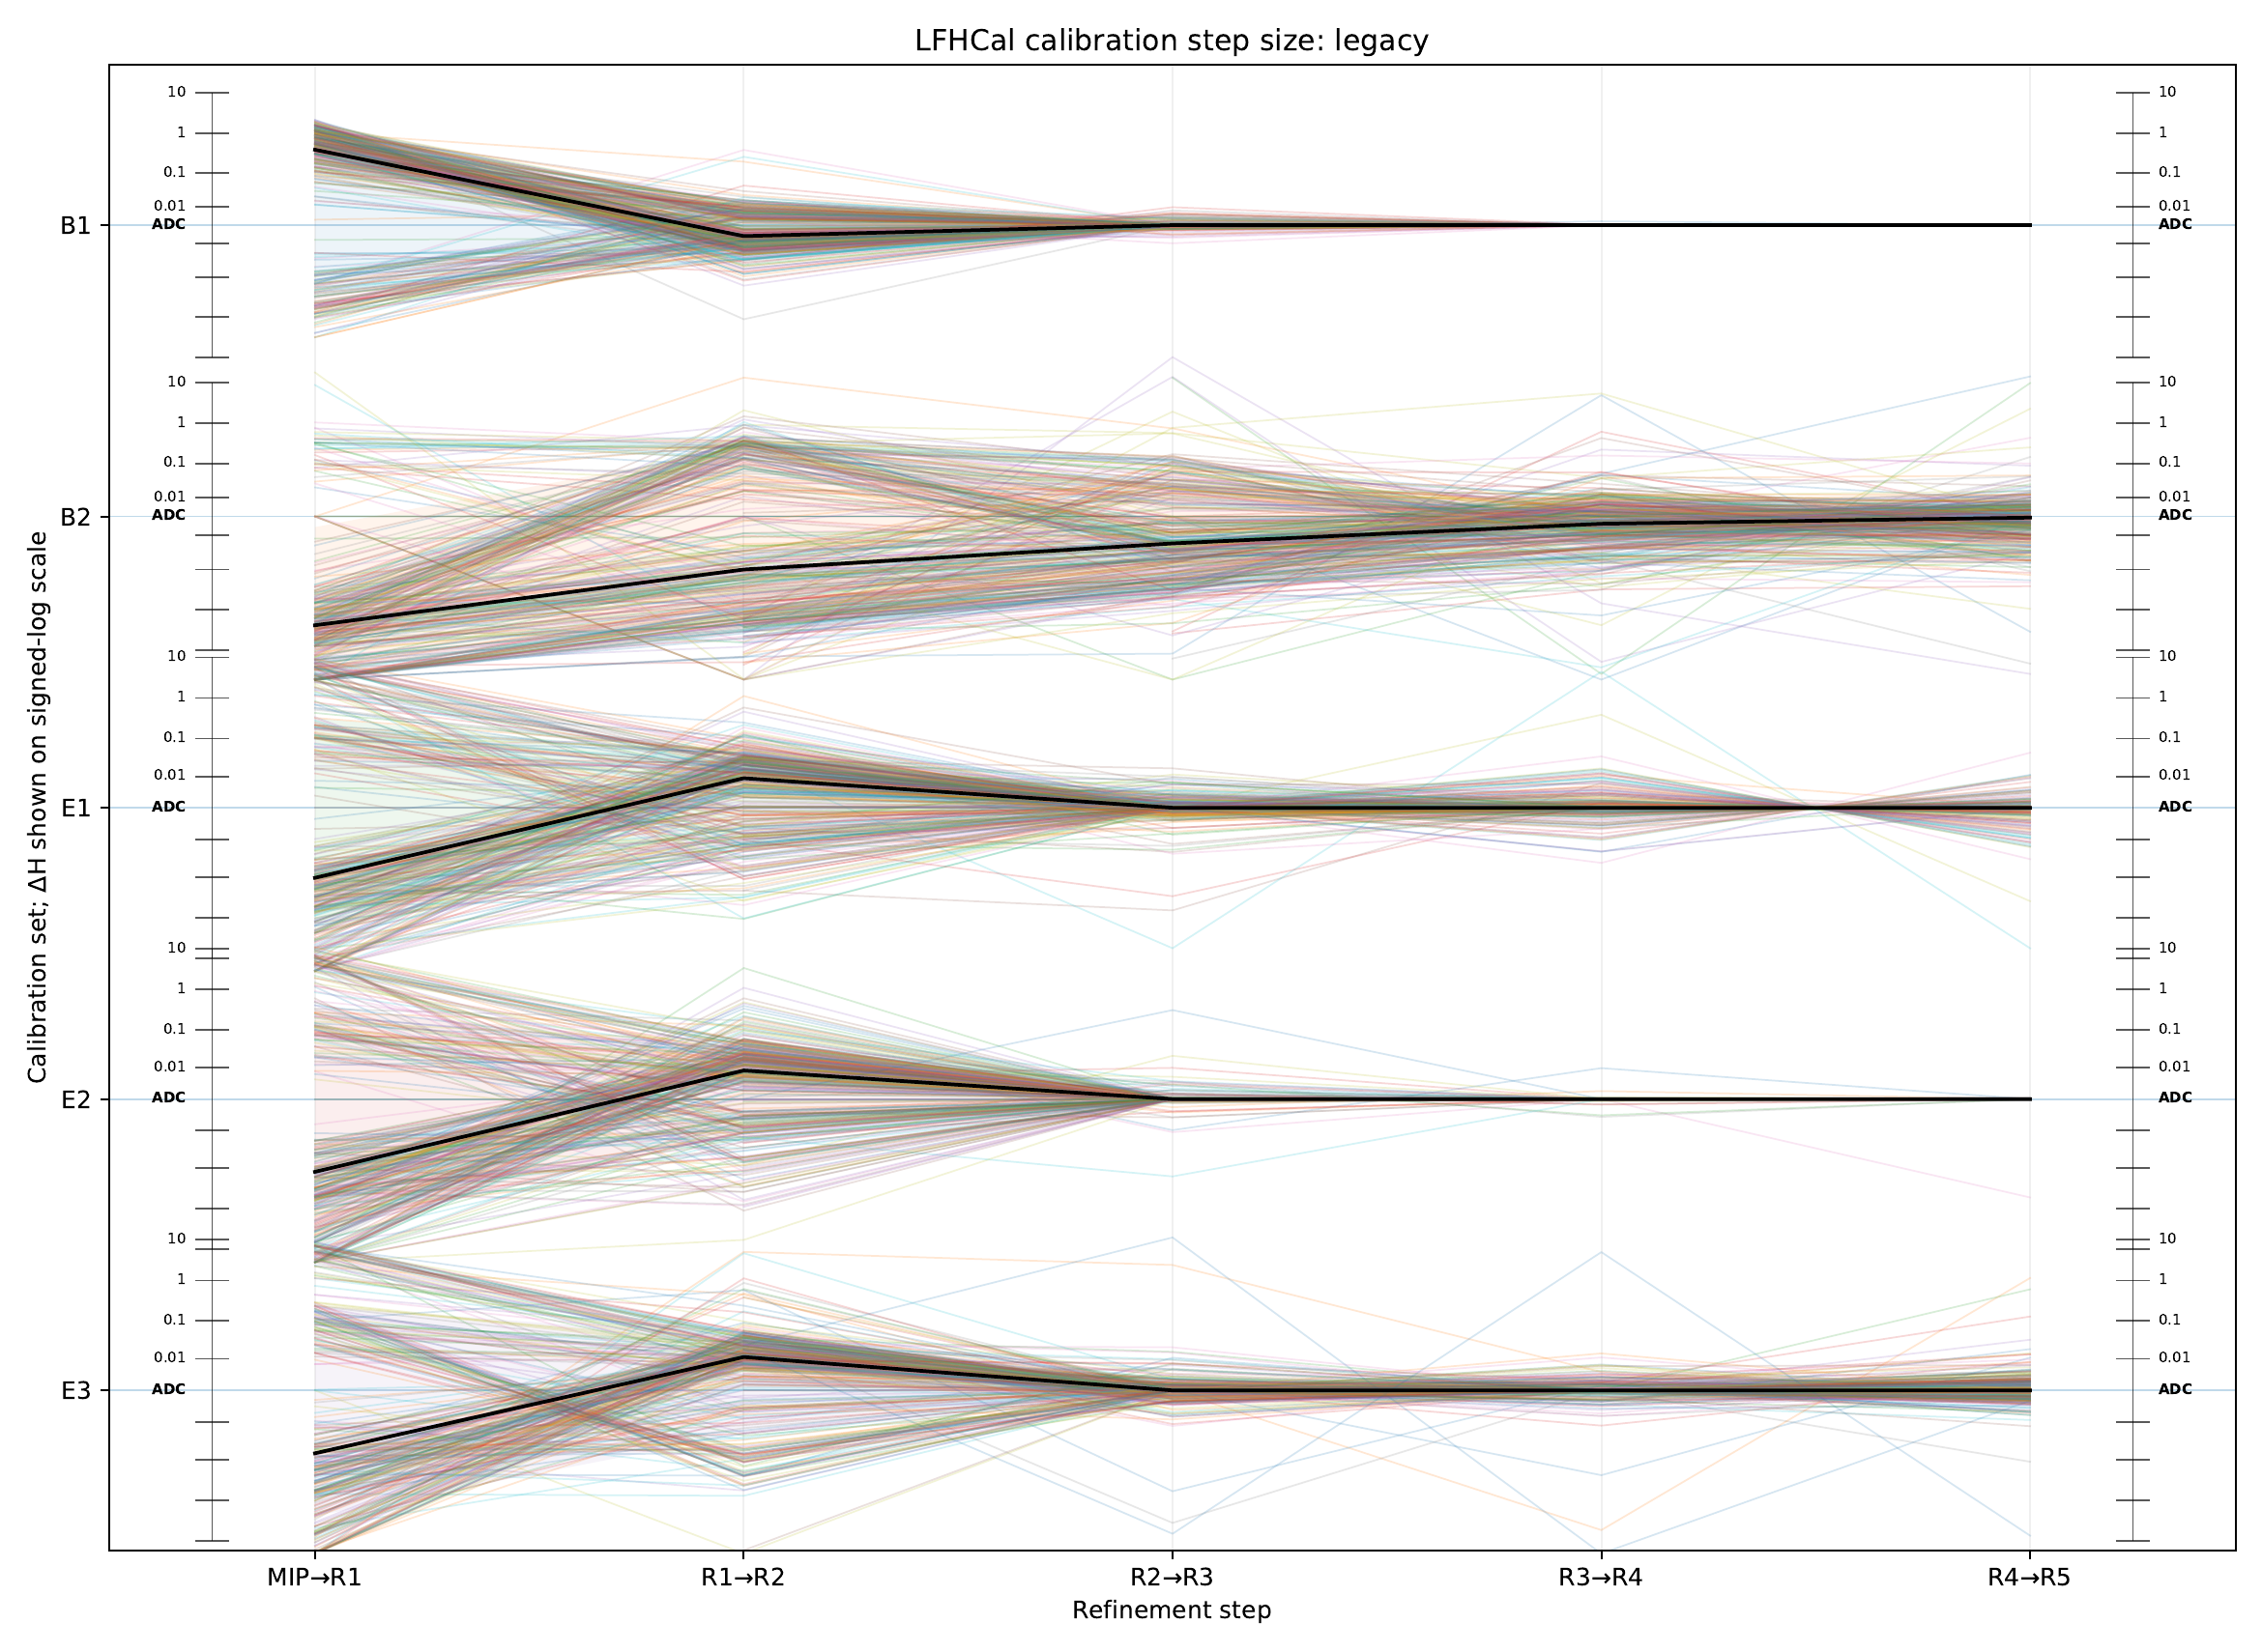
Calibration step size: Legacy (B and E sets)
Notes:
Source: lfhcal-step-convergence-focus-legacy.pdf, page 1
Section: Convergence
Original source path: /workspace/scratch/973a74c46106/upload/lfhcal-step-convergence-focus-legacy.pdf

Slide 6
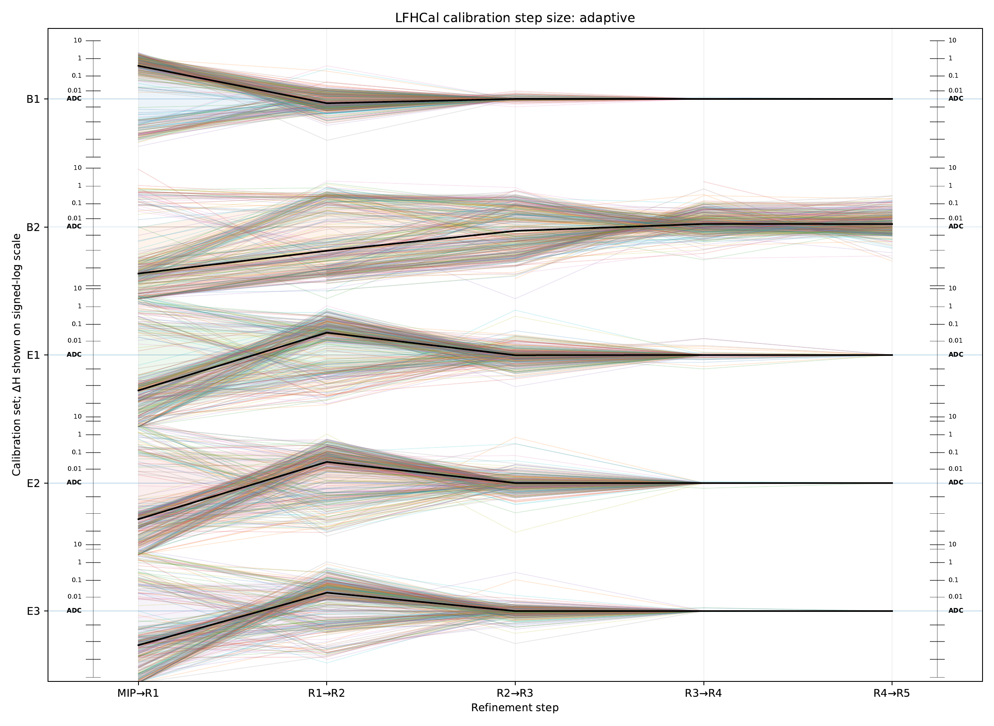
Calibration step size: Adaptive (B and E sets)
Notes:
Source: lfhcal-step-convergence-focus-adaptive.pdf, page 1
Section: Convergence
Original source path: /workspace/scratch/973a74c46106/upload/lfhcal-step-convergence-focus-adaptive.pdf

Slide 7
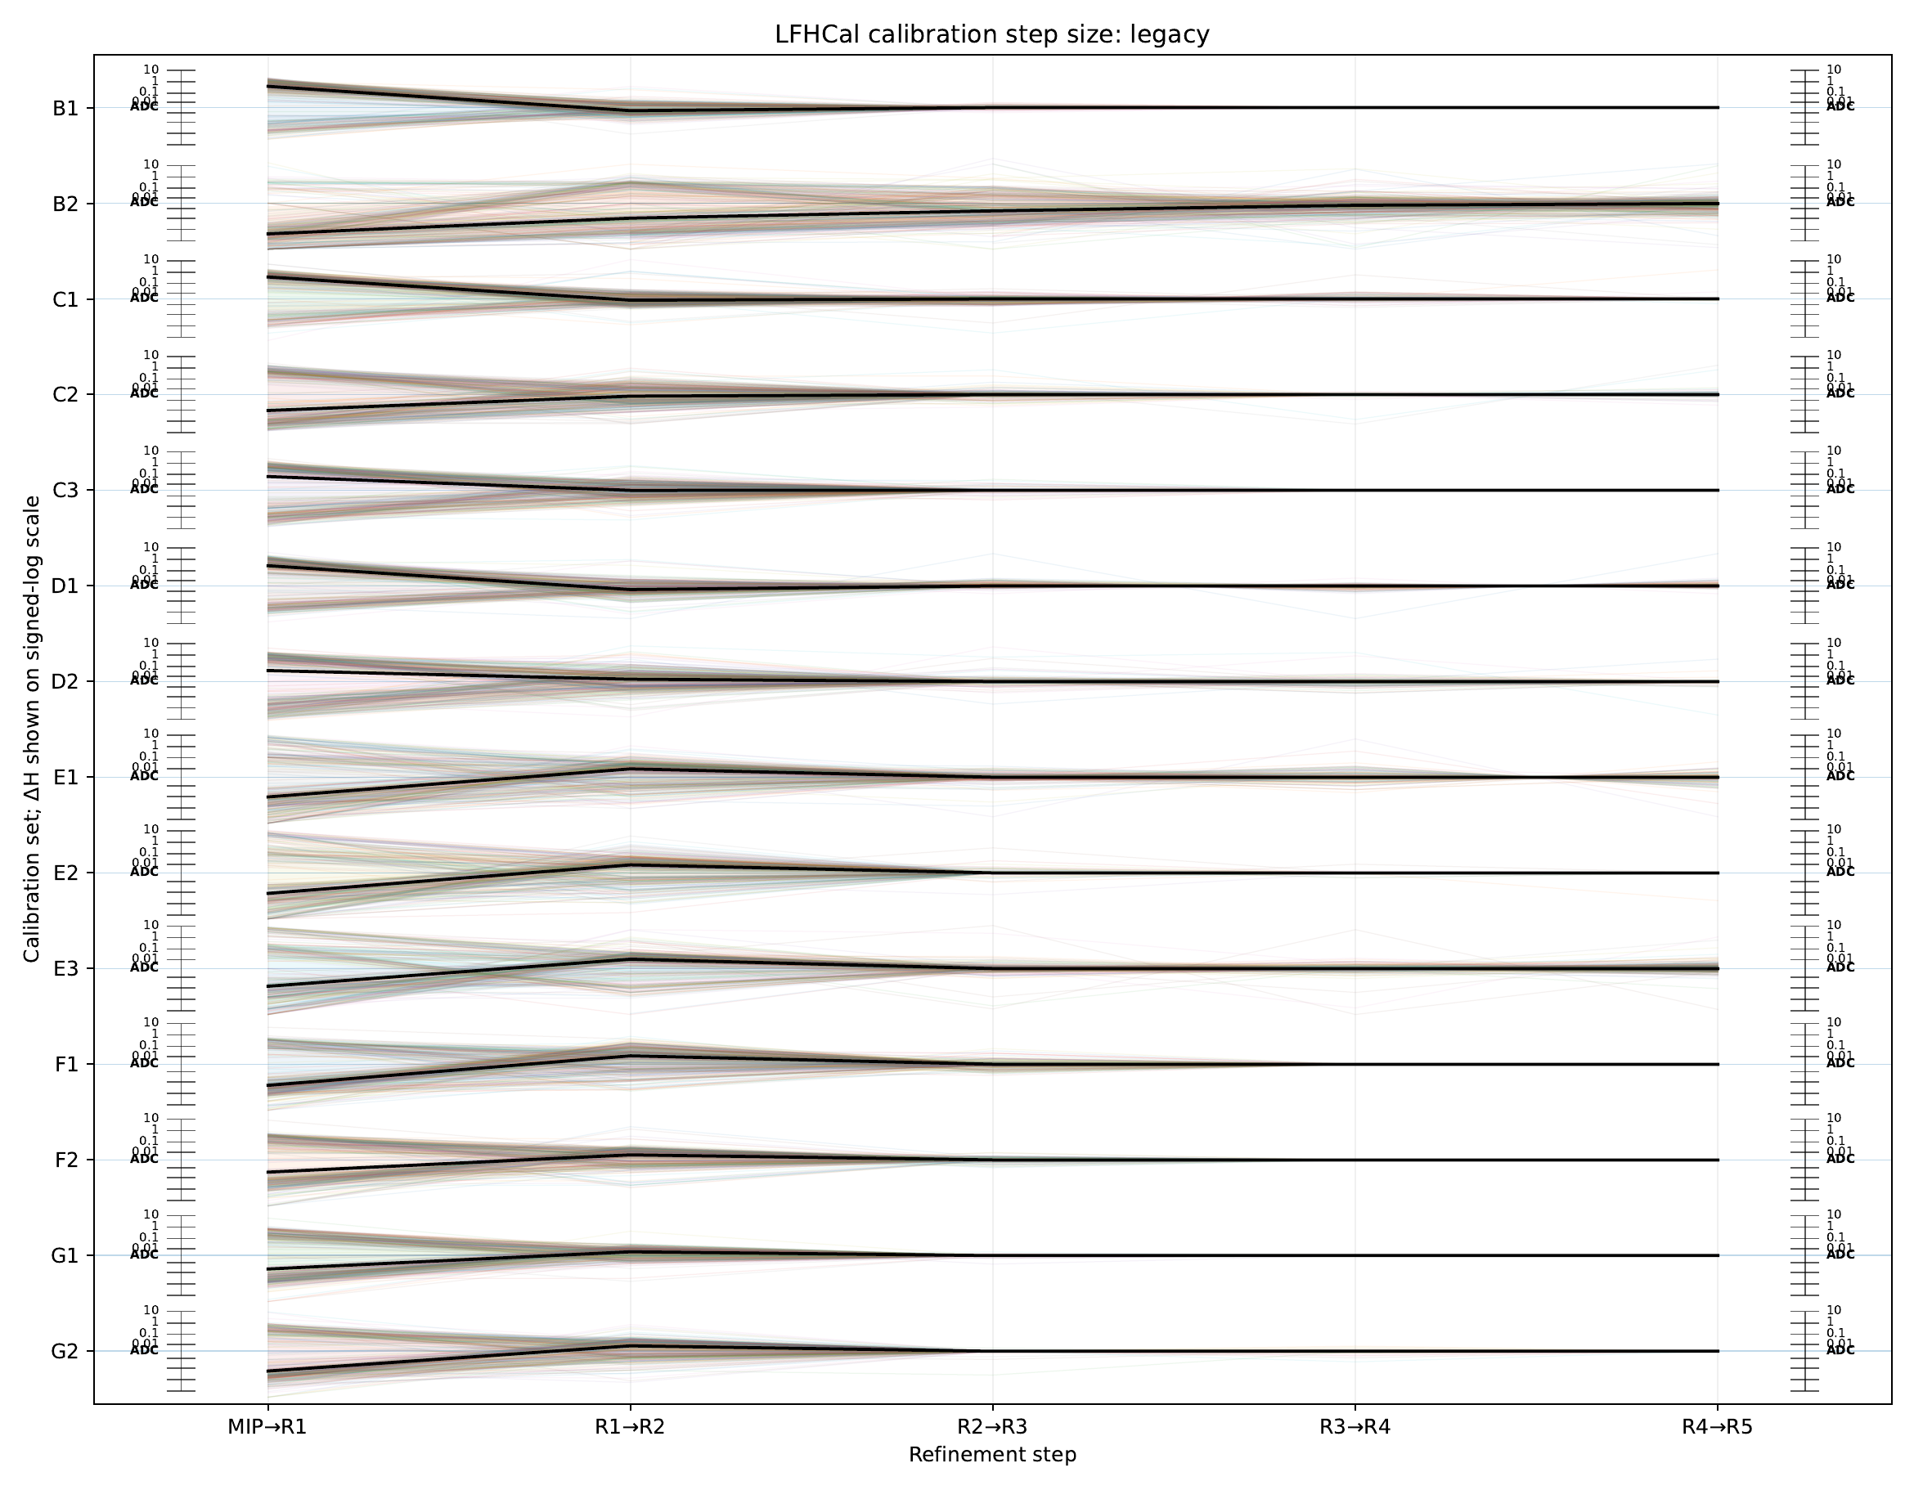
Calibration step size: Legacy
Notes:
Source: lfhcal-step-convergence-legacy.pdf, page 1
Section: Convergence
Original source path: /workspace/scratch/973a74c46106/upload/lfhcal-step-convergence-legacy.pdf

Slide 8
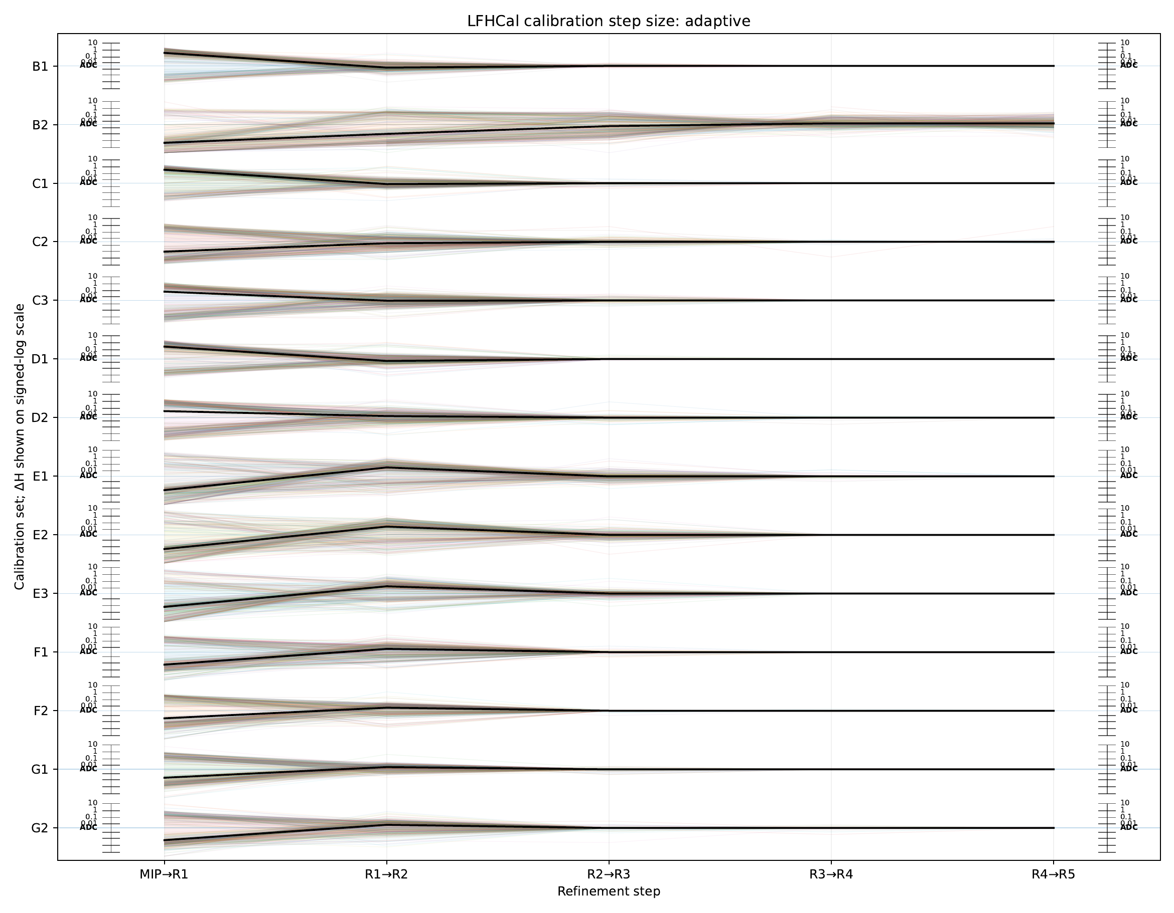
Calibration step size: Adaptive
Notes:
Source: lfhcal-step-convergence-adaptive.pdf, page 1
Section: Convergence
Original source path: /workspace/scratch/973a74c46106/upload/lfhcal-step-convergence-adaptive.pdf

Slide 9
B2 needs a data-quality check as well
B1 is comparatively stable, while B2 remains troublesome despite nominally similar configuration.
The run database labels two contributing B2 runs “dirty muon.”
That note motivates a run-level comparison, but does not establish the cause of the difficult spectra.
Inspect fit shape, parameter jumps, and fresh-fit coverage together before choosing a method.
Data quality is a hypothesis to investigate, not an explanation already proved
Notes:
Study context and observations are from this conversation and the supplied BNL plots. Plot slides retain their original source notes. Original-boundary and valley-boundary results are distinct campaigns. Selected events were inherited separately for Legacy and Adaptive in the valley campaign. This is a refinement study, not a rerun of all upstream stages with the new boundary.
Dirty-muon labels: https://github.com/paulnord/epic-lfhcal-tbana/blob/924ad82de6d150534b4d7684b5638df92c0a2016/configs/TB2026/DataTakingDB_TBSPSH2_202605_HGCROC.csv
The B2 merge list includes the two labelled runs. Acquisition run identifiers intentionally omitted. The database annotation alone does not establish the contamination mechanism or its fraction after selection. B1/B2 configuration similarity is the working context supplied by the user.

Slide 10
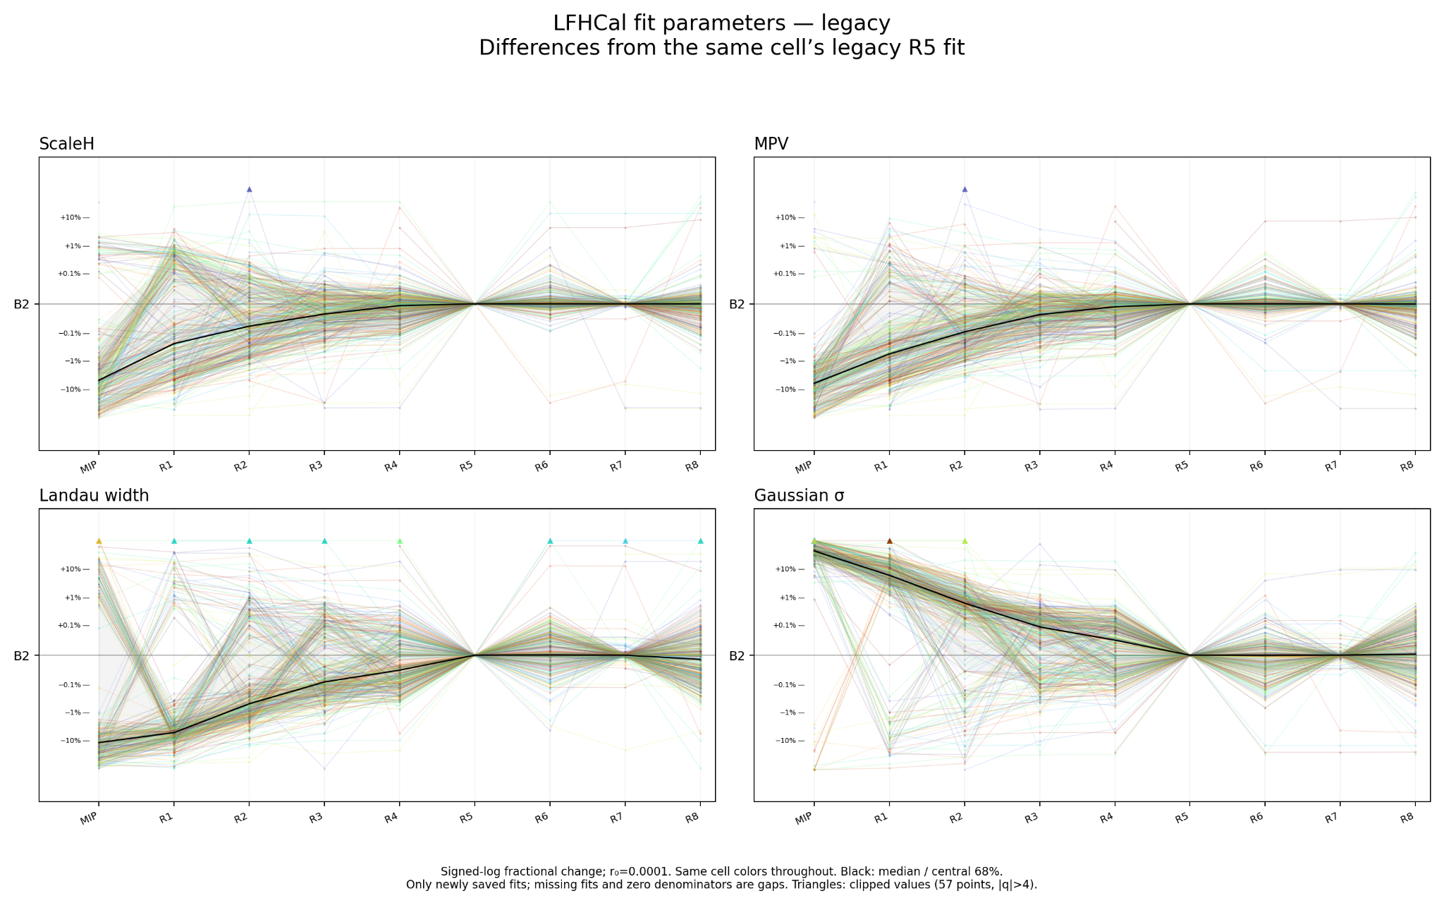
B2: Legacy relative to Legacy R5
Notes:
Source: b2-legacy-r5-legacy.png
Section: Selected examples
Original source path: /workspace/scratch/973a74c46106/upload/b2-legacy-r5-legacy.png

Slide 11
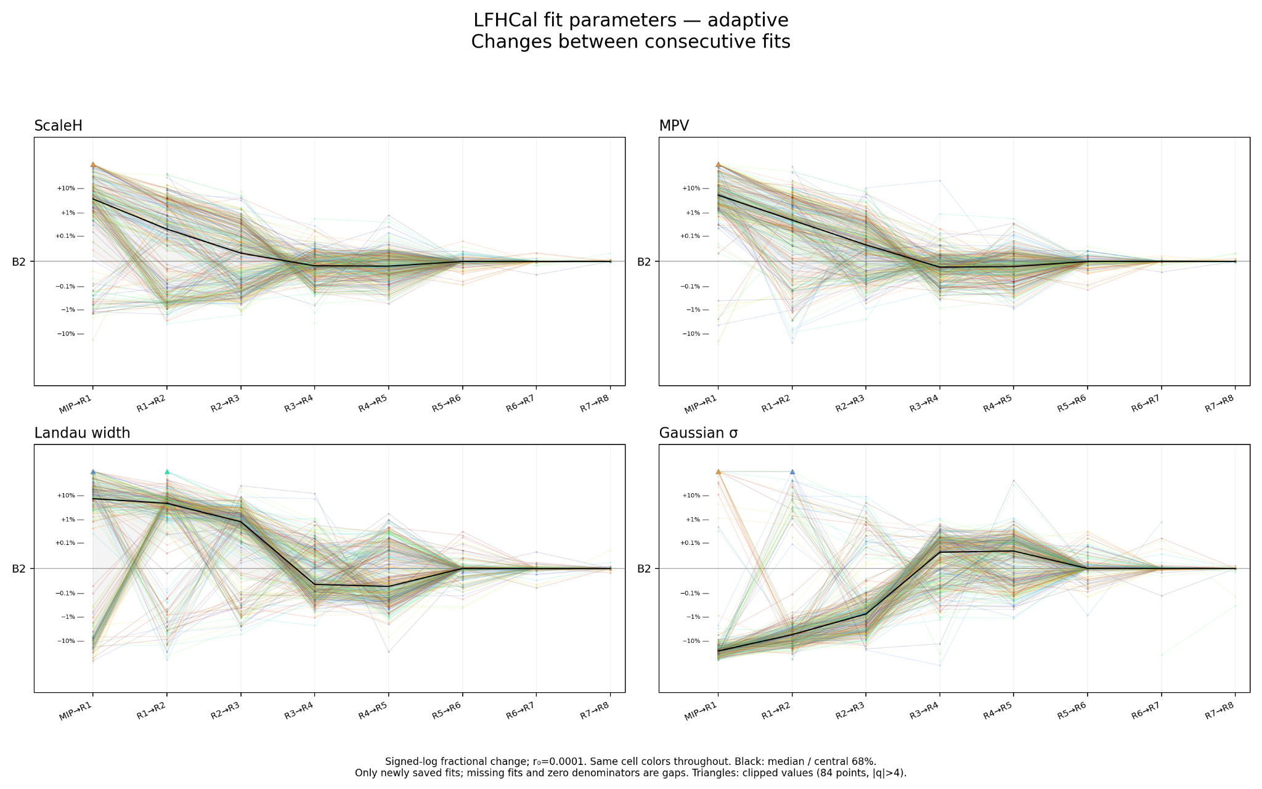
B2: Adaptive step changes
Notes:
Source: b2-step-adaptive(1).png
Section: Selected examples
Original source path: /workspace/scratch/973a74c46106/upload/b2-step-adaptive(1).png

Slide 12
Why change the lower fit boundary?
Some fits extend too far into the low-ADC region and miss the visible MIP peak.
A boundary controlled by one low bin can be sensitive to statistical fluctuations.
A fitted valley uses the surrounding shape to choose a more stable lower edge.
A rejected valley candidate can fall back to the original boundary, so the reported status matters.
Boundary-selection study
Notes:
Study context and observations are from this conversation and the supplied BNL plots. Plot slides retain their original source notes. Original-boundary and valley-boundary results are distinct campaigns. Selected events were inherited separately for Legacy and Adaptive in the valley campaign. This is a refinement study, not a rerun of all upstream stages with the new boundary.
The lower-edge study was motivated by the supplied histogram overlays and range-scan discussion. The valley procedure is a candidate boundary finder, not a guarantee that each fit uses a newly accepted valley. B2 cell 704 illustrates the minimum_at_boundary fallback. Do not infer that the procedure always excludes individual noisy bins.

Slide 13
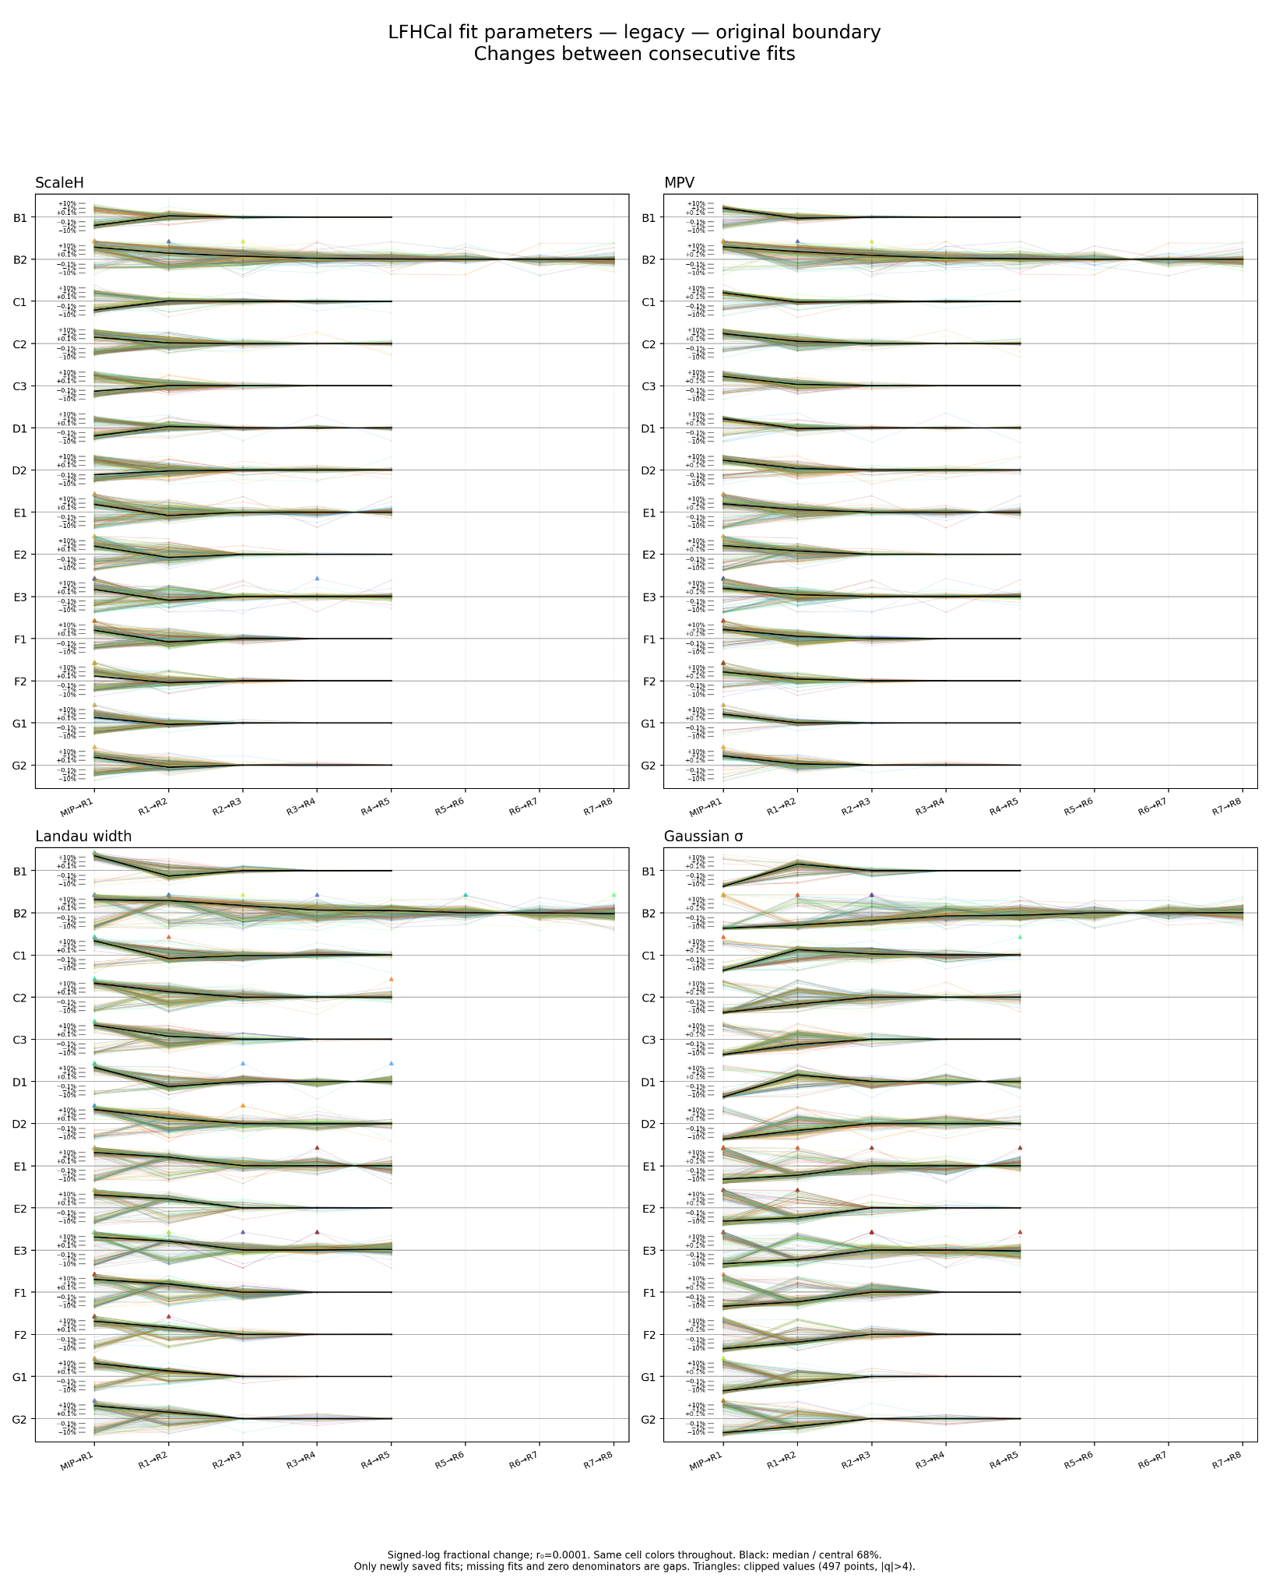
Old boundary: Legacy step changes
Notes:
Source: lfhcal-old-boundary-step-legacy(1).png
Section: Boundary comparison
Original source path: /workspace/scratch/973a74c46106/upload/lfhcal-old-boundary-step-legacy(1).png

Slide 14
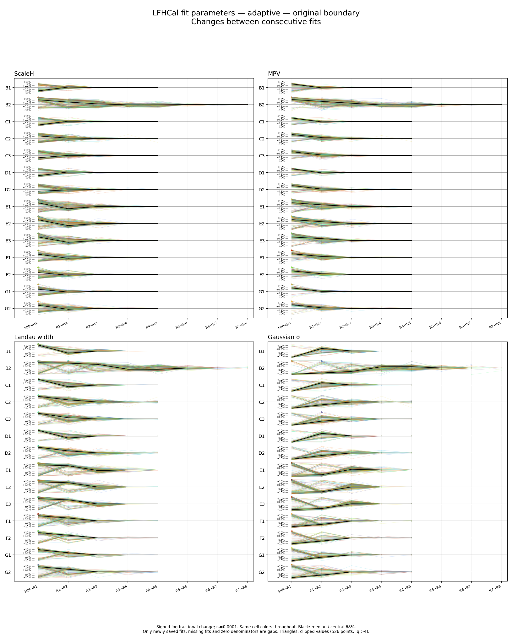
Old boundary: Adaptive step changes
Notes:
Source: lfhcal-old-boundary-step-adaptive(1).png
Section: Boundary comparison
Original source path: /workspace/scratch/973a74c46106/upload/lfhcal-old-boundary-step-adaptive(1).png

Slide 15
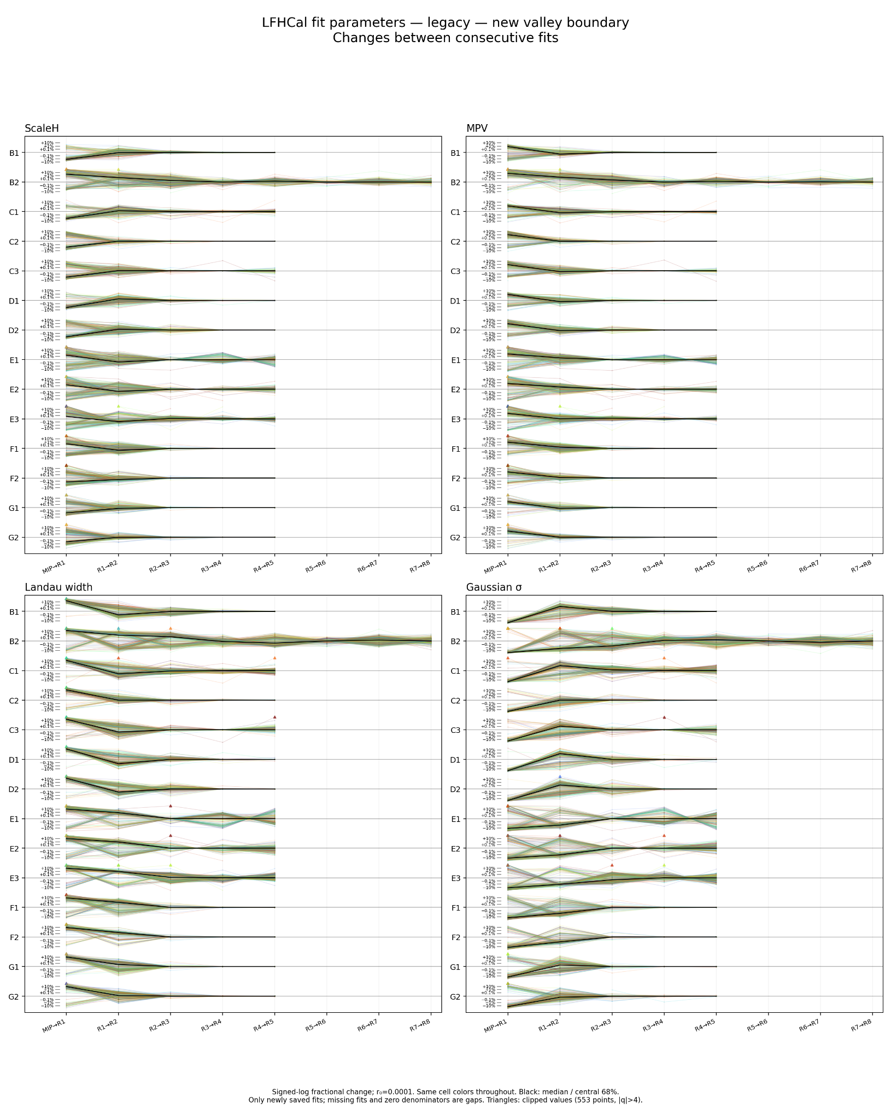
New boundary: Legacy step changes
Notes:
Source: lfhcal-new-boundary-step-legacy(1).png
Section: Boundary comparison
Original source path: /workspace/scratch/973a74c46106/upload/lfhcal-new-boundary-step-legacy(1).png

Slide 16
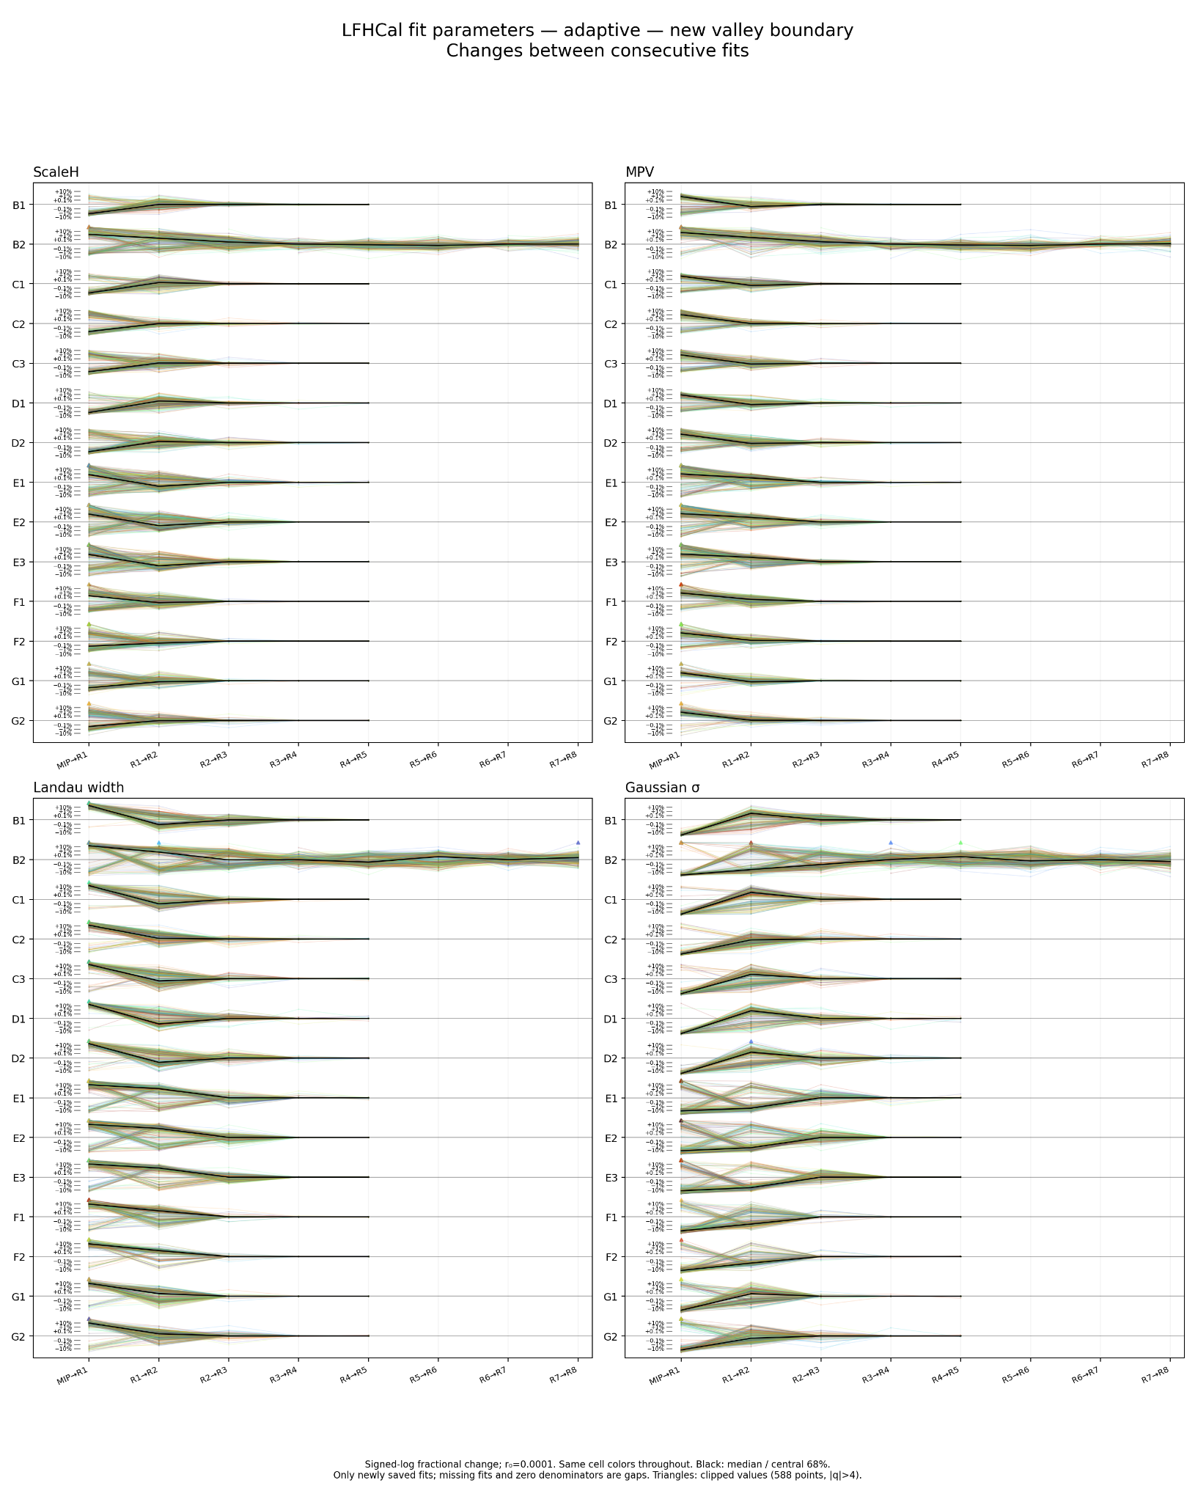
New boundary: Adaptive step changes
Notes:
Source: lfhcal-new-boundary-step-adaptive(1).png
Section: Boundary comparison
Original source path: /workspace/scratch/973a74c46106/upload/lfhcal-new-boundary-step-adaptive(1).png

Slide 17
Better-looking fits can shift the calibration
The new lower boundary improves several examples with both Legacy and Adaptive.
Legacy with the valley finder remains a candidate in the comparison.
Percent-level changes also occur in well-behaved channels. These are calibration changes that need validation.
Convergence and visual agreement are useful evidence, but neither establishes an unbiased scale.
Interpretation
Notes:
Study context and observations are from this conversation and the supplied BNL plots. Plot slides retain their original source notes. Original-boundary and valley-boundary results are distinct campaigns. Selected events were inherited separately for Legacy and Adaptive in the valley campaign. This is a refinement study, not a rerun of all upstream stages with the new boundary.
This is a qualitative interpretation of the reviewed examples and the range tests, not an aggregate success rate. The user specifically raised concern about shifts of two or three percent in controls. Avoid claiming that the new range is universally superior or that Legacy is ruled out.

Slide 18
E3 and B1: inspect the fitted shape
E3 cell 1346 makes the Legacy curve’s numerical structure visible in the overlay.
E3 cell 640 has an Adaptive fit at R5 where the original Legacy overlay has no saved fit.
B1 cell 1479 shows why a visible low bin and the lower edge deserve attention even in a stable set.
Use these overlays to identify questions for testing, rather than accepting a fit because it was saved.
Selected R5 overlays
Notes:
Study context and observations are from this conversation and the supplied BNL plots. Plot slides retain their original source notes. Original-boundary and valley-boundary results are distinct campaigns. Selected events were inherited separately for Legacy and Adaptive in the valley campaign. This is a refinement study, not a rerun of all upstream stages with the new boundary.
E3 cell 640: the Adaptive fit already exists in earlier passes and stabilizes before R5; do not say it is first recovered at R5. B1 cell 1479: the supplied slide is the original-boundary overlay. A valley overlay for this exact cell is not included in the supplied deck, so this slide does not claim a visual demonstration that the valley solved it.

Slide 19
E3 cell 1346: R5 fits
Notes:
Source: e3-refine5-cell1346.png
Section: Selected examples
Original source path: /workspace/scratch/973a74c46106/upload/e3-refine5-cell1346.png

Slide 20
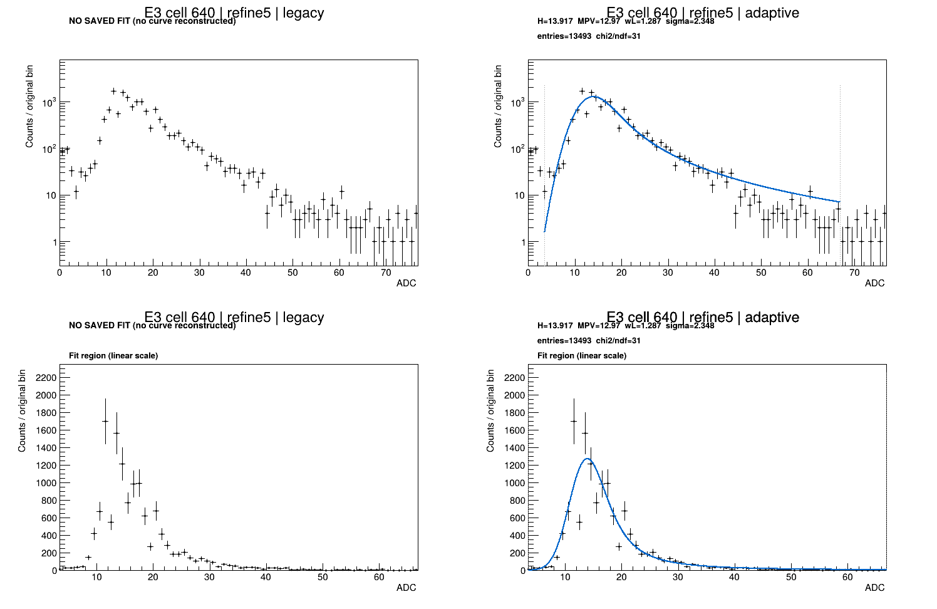
E3 cell 640: R5 fits
Notes:
Source: e3-refine5-cell640.png
Section: Selected examples
Original source path: /workspace/scratch/973a74c46106/upload/e3-refine5-cell640.png

Slide 21
B1 cell 1479: R5 fits
Notes:
Source: b1-refine5-cell1479.png
Section: Selected examples
Original source path: /workspace/scratch/973a74c46106/upload/b1-refine5-cell1479.png

Slide 22
B2 cell 704: a late pass can get worse
The valley-campaign Adaptive fit changes substantially between R7 and R8.
H falls while the Gaussian width collapses toward zero and the Landau width increases.
The reported boundary status is minimum_at_boundary. The lower edge remains at the fallback value.
A high bin may influence the result, but the overlay alone cannot establish the cause.
Inspect R6, R7, and R8 together
Notes:
Study context and observations are from this conversation and the supplied BNL plots. Plot slides retain their original source notes. Original-boundary and valley-boundary results are distinct campaigns. Selected events were inherited separately for Legacy and Adaptive in the valley campaign. This is a refinement study, not a rerun of all upstream stages with the new boundary.
From the supplied valley Adaptive panel: R7 H=27.962, MPV=23.643, wL=2.6192, sigma=14.357, range [7.5,176.23], chi2/ndf=2.1916. R8 H=21.134, MPV=21.134, wL=6.991, sigma=0.020334, range [7.5,176.41], chi2/ndf=3.3849. The lower edge remains 7.5 for R6–R8. These observations support an instability flag, not a unique causal explanation.
Plots omit nonfinite displayed errors while leaving bin counts unchanged. That presentation choice is not a repair of the underlying histogram error arrays.

Slide 23
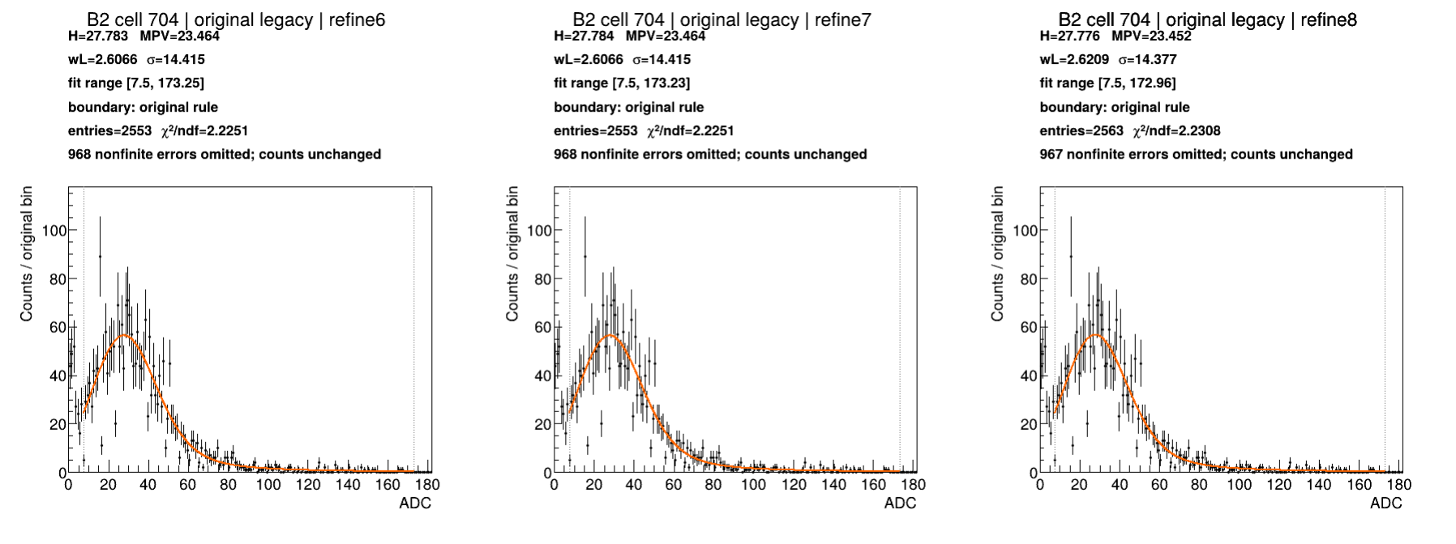
B2 cell 704: Original boundary, Legacy
Notes:
Source: b2-cases.pdf, page 1
Section: B2 interesting cases
Original source path: /workspace/scratch/973a74c46106/boundary-case-results-real/interesting-cases-pdfs/b2-cases.pdf
BNL source image: /gpfs/mnt/gpfs01/star/scratch/pnord/lfhcal/boundary-fullchains-20261002/interesting-cases/b2-cell704-original-legacy.png

Slide 24
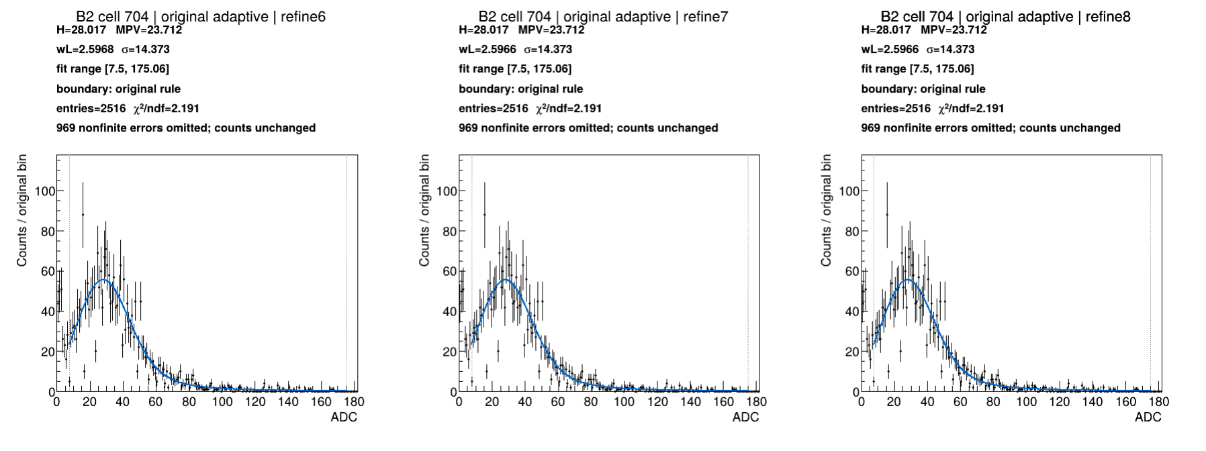
B2 cell 704: Original boundary, Adaptive
Notes:
Source: b2-cases.pdf, page 2
Section: B2 interesting cases
Original source path: /workspace/scratch/973a74c46106/boundary-case-results-real/interesting-cases-pdfs/b2-cases.pdf
BNL source image: /gpfs/mnt/gpfs01/star/scratch/pnord/lfhcal/boundary-fullchains-20261002/interesting-cases/b2-cell704-original-adaptive.png

Slide 25
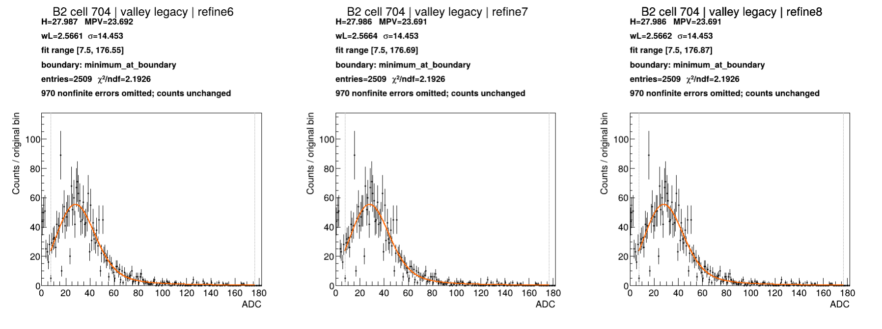
B2 cell 704: Valley boundary, Legacy
Notes:
Source: b2-cases.pdf, page 3
Section: B2 interesting cases
Original source path: /workspace/scratch/973a74c46106/boundary-case-results-real/interesting-cases-pdfs/b2-cases.pdf
BNL source image: /gpfs/mnt/gpfs01/star/scratch/pnord/lfhcal/boundary-fullchains-20261002/interesting-cases/b2-cell704-valley-legacy.png

Slide 26
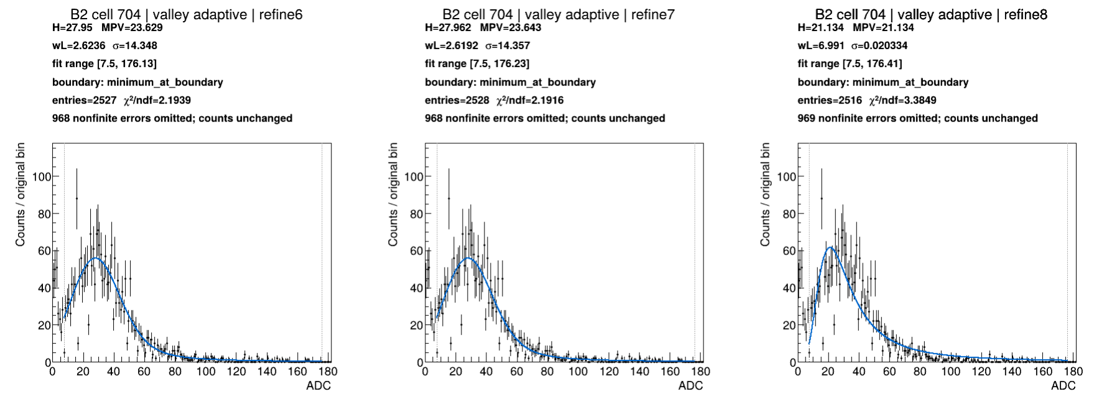
B2 cell 704: Valley boundary, Adaptive
Notes:
Source: b2-cases.pdf, page 4
Section: B2 interesting cases
Original source path: /workspace/scratch/973a74c46106/boundary-case-results-real/interesting-cases-pdfs/b2-cases.pdf
BNL source image: /gpfs/mnt/gpfs01/star/scratch/pnord/lfhcal/boundary-fullchains-20261002/interesting-cases/b2-cell704-valley-adaptive.png

Slide 27
B2: remaining difficult channels
The next examples keep the same cell visible across both methods and both boundaries.
Check whether the peak position stabilizes, and whether the fit range follows the intended MIP feature.
Watch for a sudden exchange between Landau and Gaussian width as H changes.
A smoother function helps expose data structure, but cannot make an unsuitable spectrum well behaved.
B2 cells 579, 2562, 709, 2118, and 1287
Notes:
Study context and observations are from this conversation and the supplied BNL plots. Plot slides retain their original source notes. Original-boundary and valley-boundary results are distinct campaigns. Selected events were inherited separately for Legacy and Adaptive in the valley campaign. This is a refinement study, not a rerun of all upstream stages with the new boundary.

Slide 28
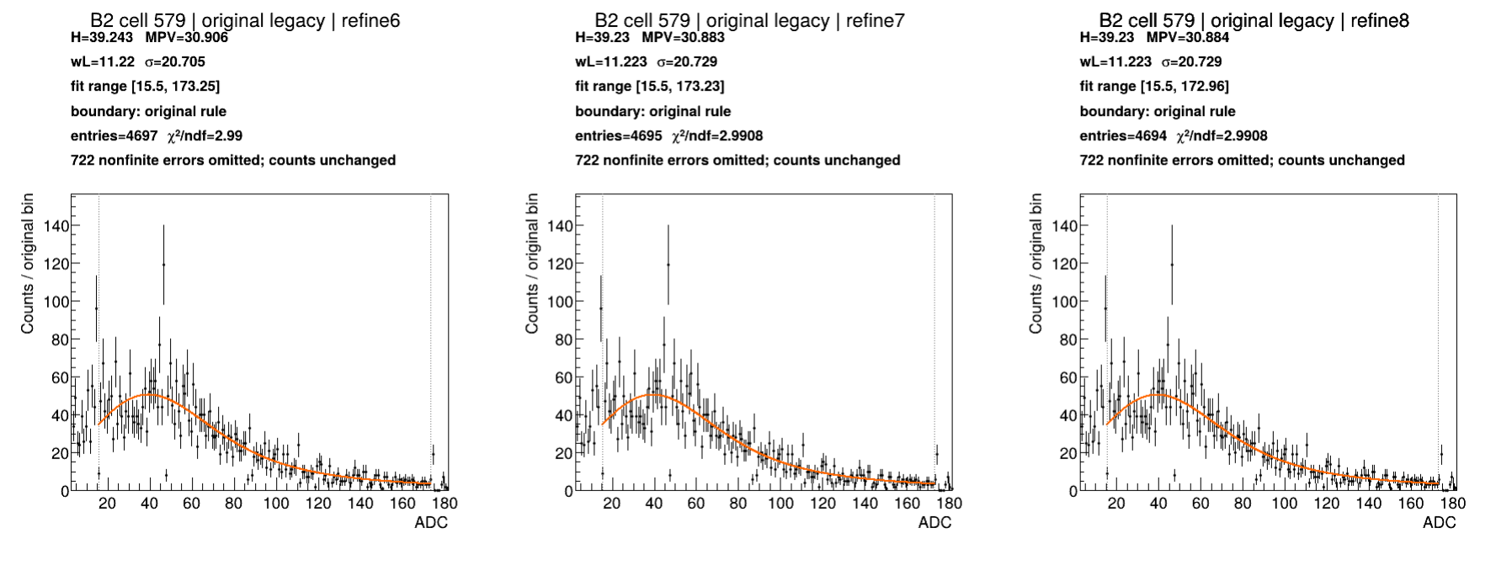
B2 cell 579: Original boundary, Legacy
Notes:
Source: b2-cases.pdf, page 5
Section: B2 interesting cases
Original source path: /workspace/scratch/973a74c46106/boundary-case-results-real/interesting-cases-pdfs/b2-cases.pdf
BNL source image: /gpfs/mnt/gpfs01/star/scratch/pnord/lfhcal/boundary-fullchains-20261002/interesting-cases/b2-cell579-original-legacy.png

Slide 29
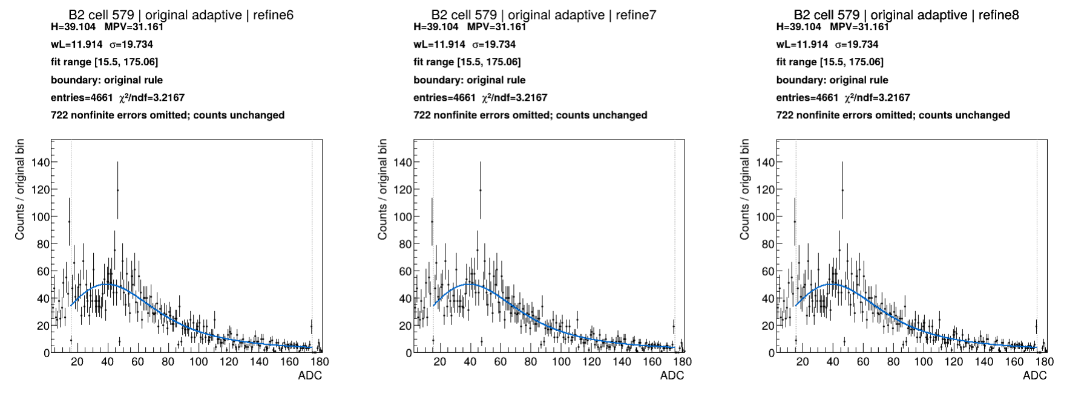
B2 cell 579: Original boundary, Adaptive
Notes:
Source: b2-cases.pdf, page 6
Section: B2 interesting cases
Original source path: /workspace/scratch/973a74c46106/boundary-case-results-real/interesting-cases-pdfs/b2-cases.pdf
BNL source image: /gpfs/mnt/gpfs01/star/scratch/pnord/lfhcal/boundary-fullchains-20261002/interesting-cases/b2-cell579-original-adaptive.png

Slide 30
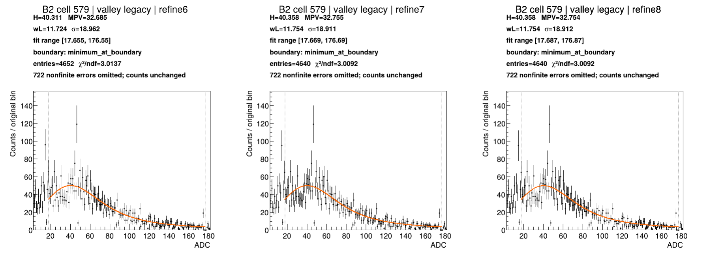
B2 cell 579: Valley boundary, Legacy
Notes:
Source: b2-cases.pdf, page 7
Section: B2 interesting cases
Original source path: /workspace/scratch/973a74c46106/boundary-case-results-real/interesting-cases-pdfs/b2-cases.pdf
BNL source image: /gpfs/mnt/gpfs01/star/scratch/pnord/lfhcal/boundary-fullchains-20261002/interesting-cases/b2-cell579-valley-legacy.png

Slide 31
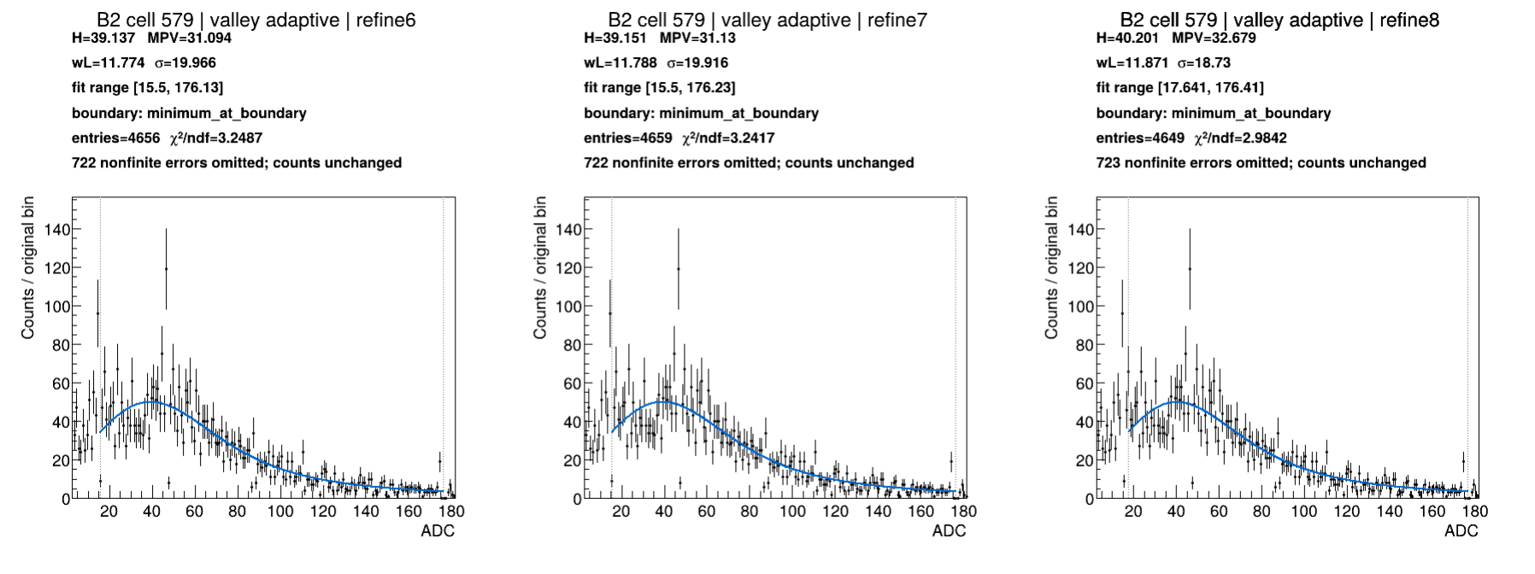
B2 cell 579: Valley boundary, Adaptive
Notes:
Source: b2-cases.pdf, page 8
Section: B2 interesting cases
Original source path: /workspace/scratch/973a74c46106/boundary-case-results-real/interesting-cases-pdfs/b2-cases.pdf
BNL source image: /gpfs/mnt/gpfs01/star/scratch/pnord/lfhcal/boundary-fullchains-20261002/interesting-cases/b2-cell579-valley-adaptive.png

Slide 32
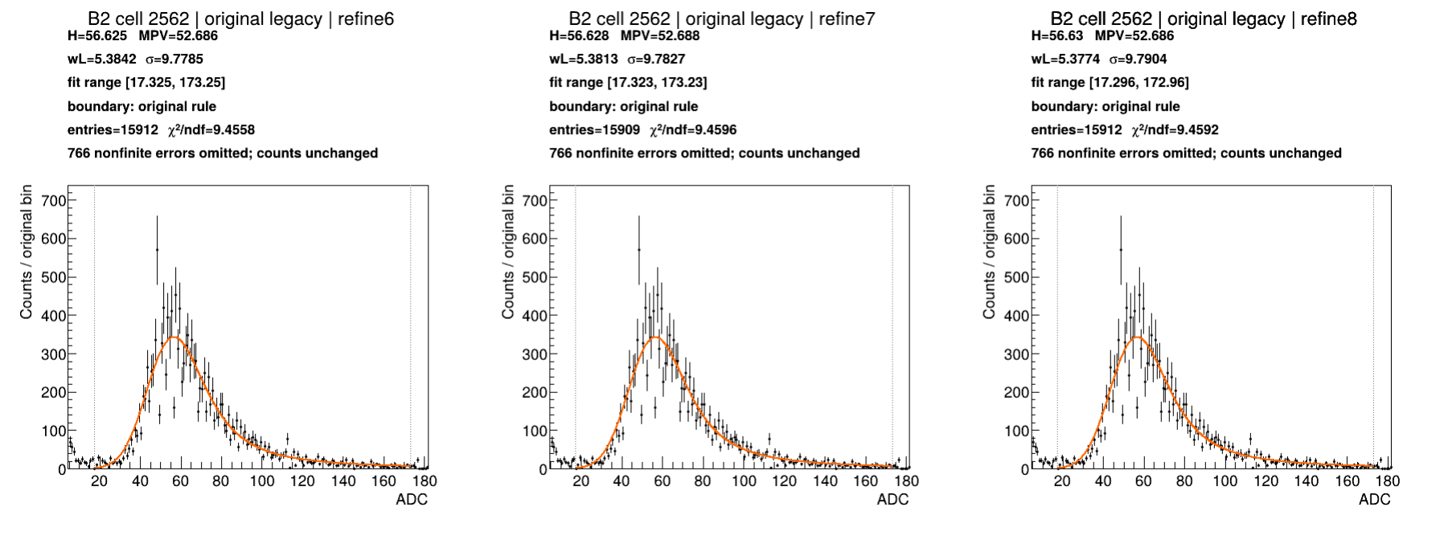
B2 cell 2562: Original boundary, Legacy
Notes:
Source: b2-cases.pdf, page 9
Section: B2 interesting cases
Original source path: /workspace/scratch/973a74c46106/boundary-case-results-real/interesting-cases-pdfs/b2-cases.pdf
BNL source image: /gpfs/mnt/gpfs01/star/scratch/pnord/lfhcal/boundary-fullchains-20261002/interesting-cases/b2-cell2562-original-legacy.png

Slide 33
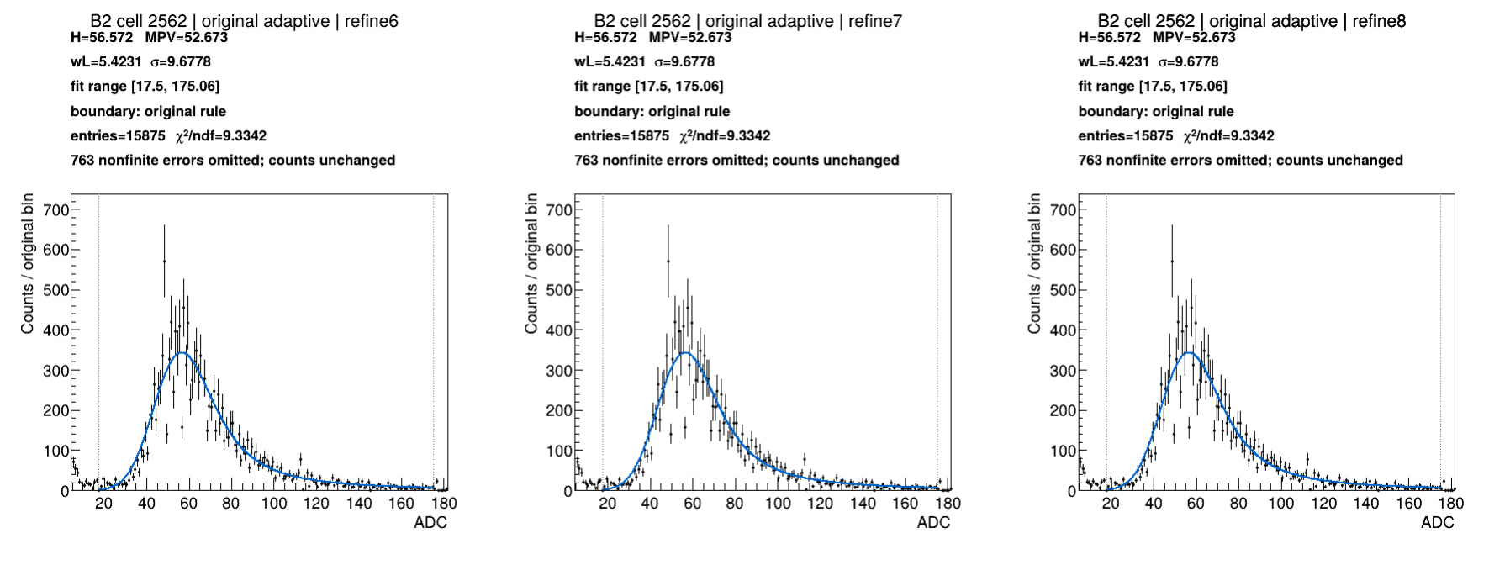
B2 cell 2562: Original boundary, Adaptive
Notes:
Source: b2-cases.pdf, page 10
Section: B2 interesting cases
Original source path: /workspace/scratch/973a74c46106/boundary-case-results-real/interesting-cases-pdfs/b2-cases.pdf
BNL source image: /gpfs/mnt/gpfs01/star/scratch/pnord/lfhcal/boundary-fullchains-20261002/interesting-cases/b2-cell2562-original-adaptive.png

Slide 34
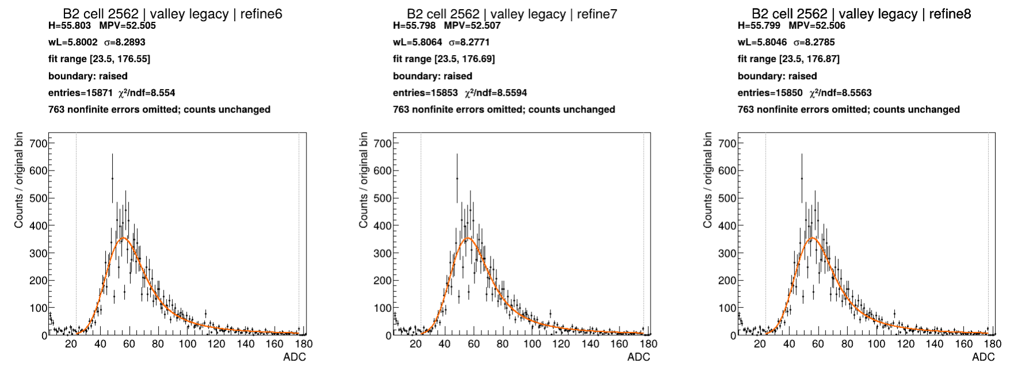
B2 cell 2562: Valley boundary, Legacy
Notes:
Source: b2-cases.pdf, page 11
Section: B2 interesting cases
Original source path: /workspace/scratch/973a74c46106/boundary-case-results-real/interesting-cases-pdfs/b2-cases.pdf
BNL source image: /gpfs/mnt/gpfs01/star/scratch/pnord/lfhcal/boundary-fullchains-20261002/interesting-cases/b2-cell2562-valley-legacy.png

Slide 35
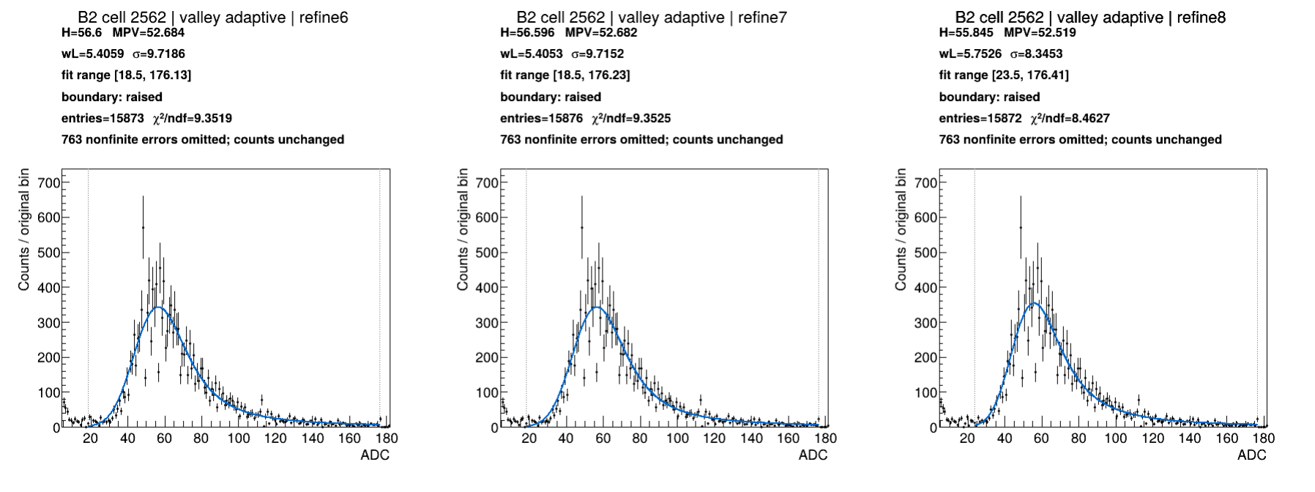
B2 cell 2562: Valley boundary, Adaptive
Notes:
Source: b2-cases.pdf, page 12
Section: B2 interesting cases
Original source path: /workspace/scratch/973a74c46106/boundary-case-results-real/interesting-cases-pdfs/b2-cases.pdf
BNL source image: /gpfs/mnt/gpfs01/star/scratch/pnord/lfhcal/boundary-fullchains-20261002/interesting-cases/b2-cell2562-valley-adaptive.png

Slide 36
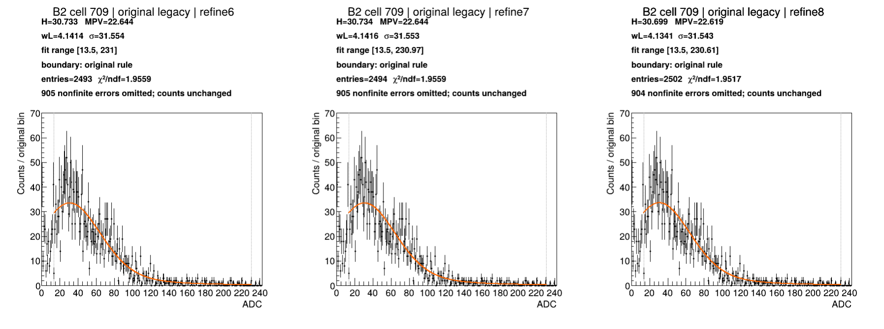
B2 cell 709: Original boundary, Legacy
Notes:
Source: b2-cases.pdf, page 13
Section: B2 interesting cases
Original source path: /workspace/scratch/973a74c46106/boundary-case-results-real/interesting-cases-pdfs/b2-cases.pdf
BNL source image: /gpfs/mnt/gpfs01/star/scratch/pnord/lfhcal/boundary-fullchains-20261002/interesting-cases/b2-cell709-original-legacy.png

Slide 37
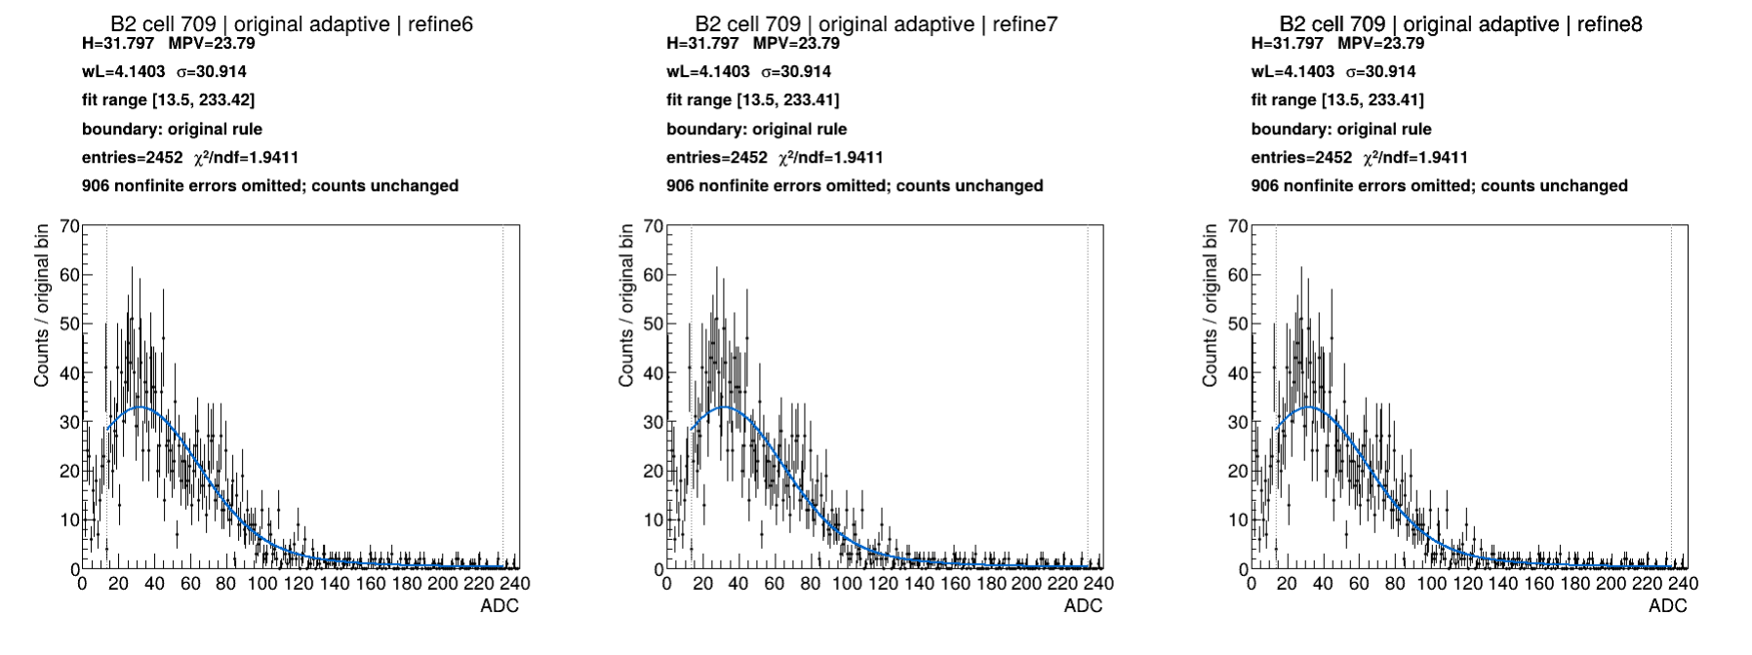
B2 cell 709: Original boundary, Adaptive
Notes:
Source: b2-cases.pdf, page 14
Section: B2 interesting cases
Original source path: /workspace/scratch/973a74c46106/boundary-case-results-real/interesting-cases-pdfs/b2-cases.pdf
BNL source image: /gpfs/mnt/gpfs01/star/scratch/pnord/lfhcal/boundary-fullchains-20261002/interesting-cases/b2-cell709-original-adaptive.png

Slide 38
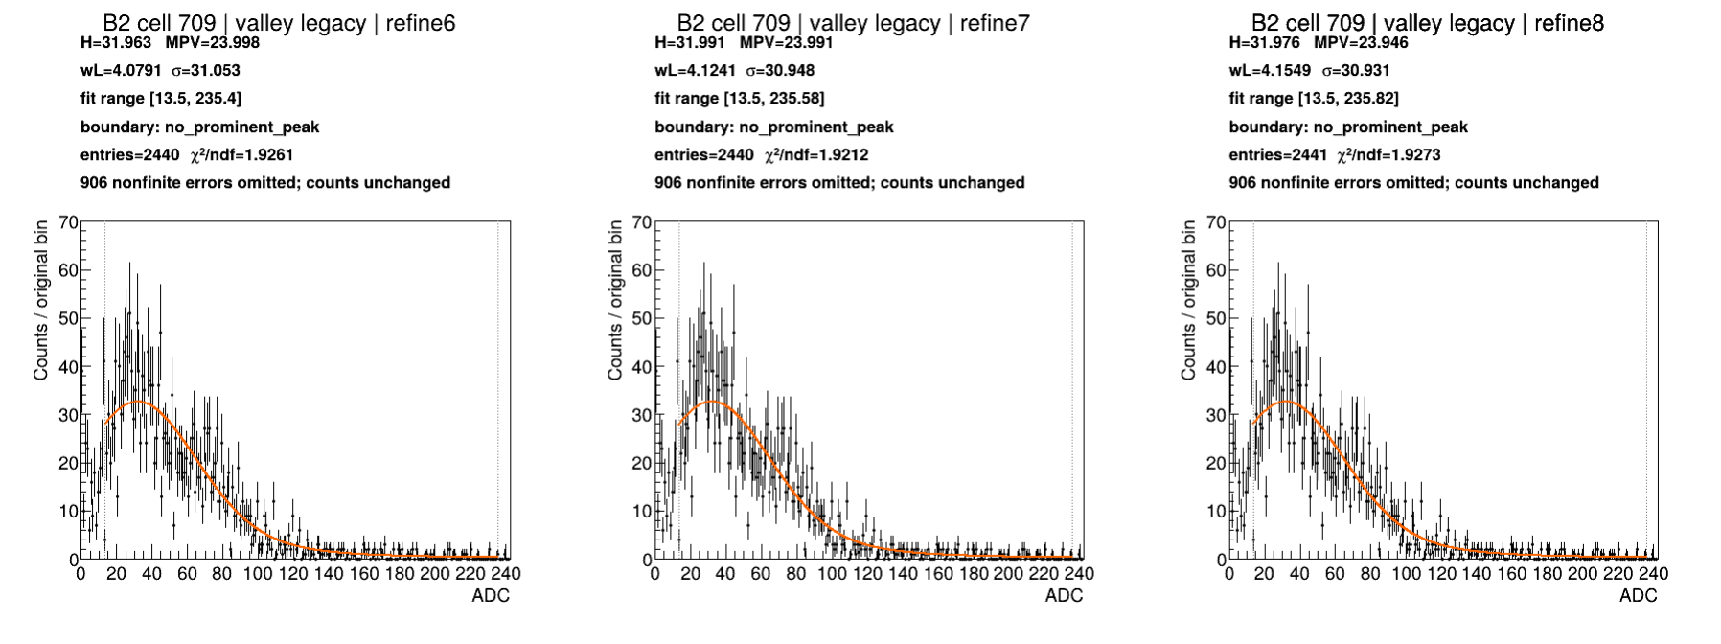
B2 cell 709: Valley boundary, Legacy
Notes:
Source: b2-cases.pdf, page 15
Section: B2 interesting cases
Original source path: /workspace/scratch/973a74c46106/boundary-case-results-real/interesting-cases-pdfs/b2-cases.pdf
BNL source image: /gpfs/mnt/gpfs01/star/scratch/pnord/lfhcal/boundary-fullchains-20261002/interesting-cases/b2-cell709-valley-legacy.png

Slide 39

B2 cell 709: Valley boundary, Adaptive
Notes:
Source: b2-cases.pdf, page 16
Section: B2 interesting cases
Original source path: /workspace/scratch/973a74c46106/boundary-case-results-real/interesting-cases-pdfs/b2-cases.pdf
BNL source image: /gpfs/mnt/gpfs01/star/scratch/pnord/lfhcal/boundary-fullchains-20261002/interesting-cases/b2-cell709-valley-adaptive.png

Slide 40
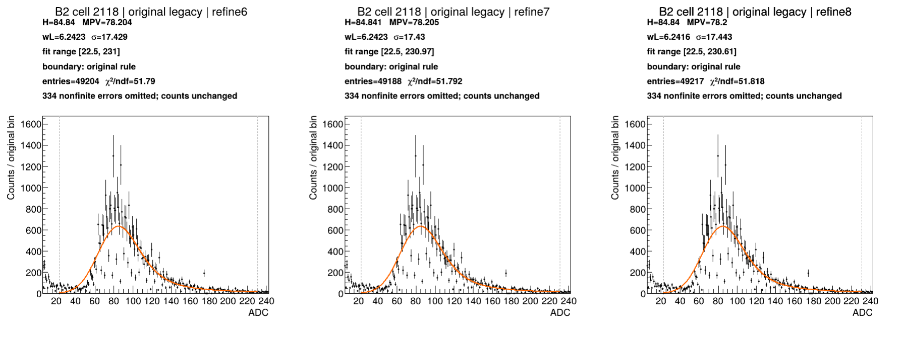
B2 cell 2118: Original boundary, Legacy
Notes:
Source: b2-cases.pdf, page 17
Section: B2 interesting cases
Original source path: /workspace/scratch/973a74c46106/boundary-case-results-real/interesting-cases-pdfs/b2-cases.pdf
BNL source image: /gpfs/mnt/gpfs01/star/scratch/pnord/lfhcal/boundary-fullchains-20261002/interesting-cases/b2-cell2118-original-legacy.png

Slide 41
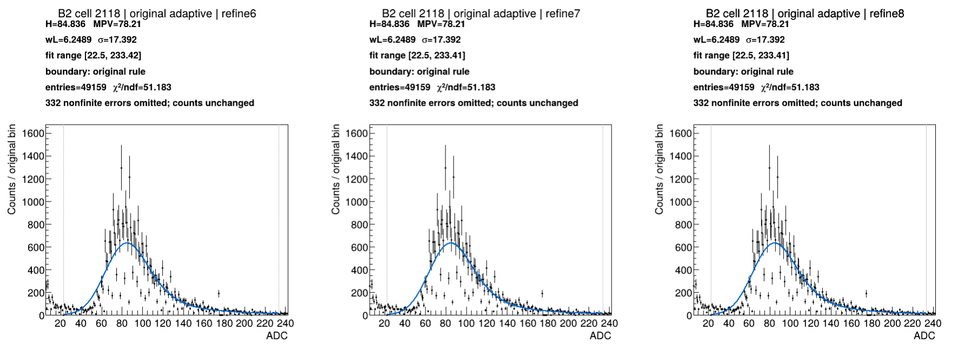
B2 cell 2118: Original boundary, Adaptive
Notes:
Source: b2-cases.pdf, page 18
Section: B2 interesting cases
Original source path: /workspace/scratch/973a74c46106/boundary-case-results-real/interesting-cases-pdfs/b2-cases.pdf
BNL source image: /gpfs/mnt/gpfs01/star/scratch/pnord/lfhcal/boundary-fullchains-20261002/interesting-cases/b2-cell2118-original-adaptive.png

Slide 42
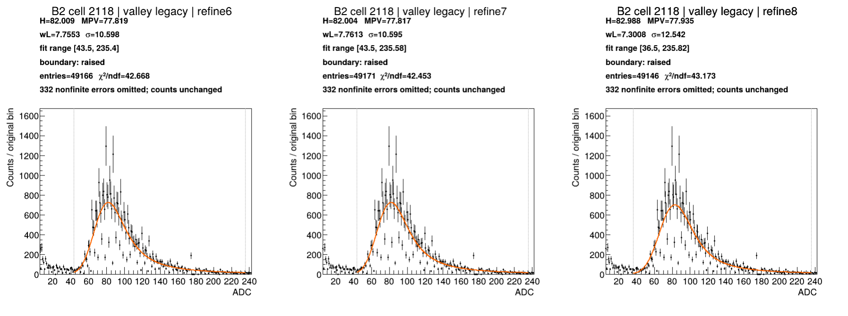
B2 cell 2118: Valley boundary, Legacy
Notes:
Source: b2-cases.pdf, page 19
Section: B2 interesting cases
Original source path: /workspace/scratch/973a74c46106/boundary-case-results-real/interesting-cases-pdfs/b2-cases.pdf
BNL source image: /gpfs/mnt/gpfs01/star/scratch/pnord/lfhcal/boundary-fullchains-20261002/interesting-cases/b2-cell2118-valley-legacy.png

Slide 43
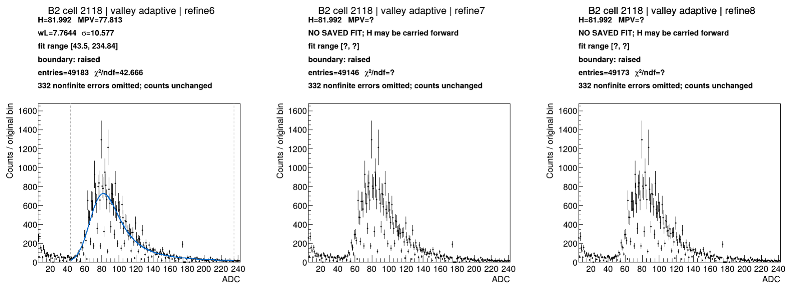
B2 cell 2118: Valley boundary, Adaptive
Notes:
Source: b2-cases.pdf, page 20
Section: B2 interesting cases
Original source path: /workspace/scratch/973a74c46106/boundary-case-results-real/interesting-cases-pdfs/b2-cases.pdf
BNL source image: /gpfs/mnt/gpfs01/star/scratch/pnord/lfhcal/boundary-fullchains-20261002/interesting-cases/b2-cell2118-valley-adaptive.png

Slide 44
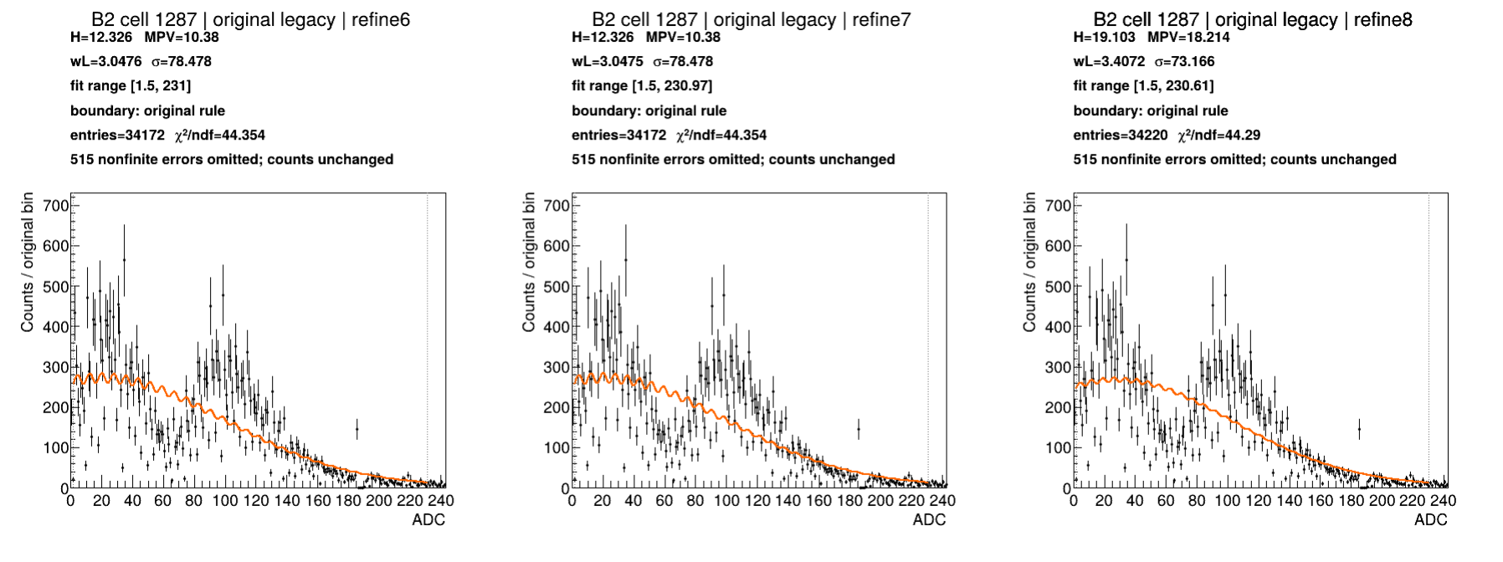
B2 cell 1287: Original boundary, Legacy
Notes:
Source: b2-cases.pdf, page 21
Section: B2 interesting cases
Original source path: /workspace/scratch/973a74c46106/boundary-case-results-real/interesting-cases-pdfs/b2-cases.pdf
BNL source image: /gpfs/mnt/gpfs01/star/scratch/pnord/lfhcal/boundary-fullchains-20261002/interesting-cases/b2-cell1287-original-legacy.png

Slide 45
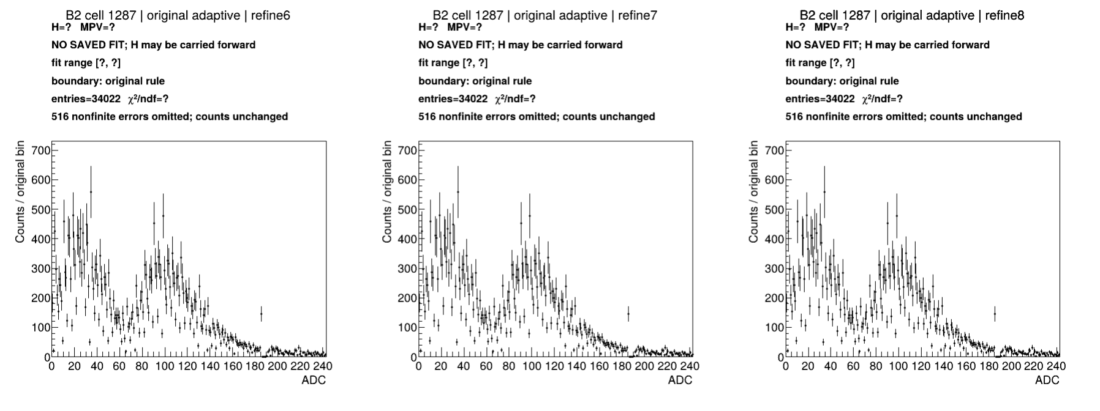
B2 cell 1287: Original boundary, Adaptive
Notes:
Source: b2-cases.pdf, page 22
Section: B2 interesting cases
Original source path: /workspace/scratch/973a74c46106/boundary-case-results-real/interesting-cases-pdfs/b2-cases.pdf
BNL source image: /gpfs/mnt/gpfs01/star/scratch/pnord/lfhcal/boundary-fullchains-20261002/interesting-cases/b2-cell1287-original-adaptive.png

Slide 46
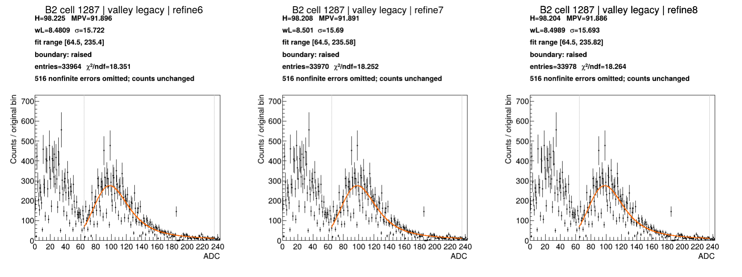
B2 cell 1287: Valley boundary, Legacy
Notes:
Source: b2-cases.pdf, page 23
Section: B2 interesting cases
Original source path: /workspace/scratch/973a74c46106/boundary-case-results-real/interesting-cases-pdfs/b2-cases.pdf
BNL source image: /gpfs/mnt/gpfs01/star/scratch/pnord/lfhcal/boundary-fullchains-20261002/interesting-cases/b2-cell1287-valley-legacy.png

Slide 47
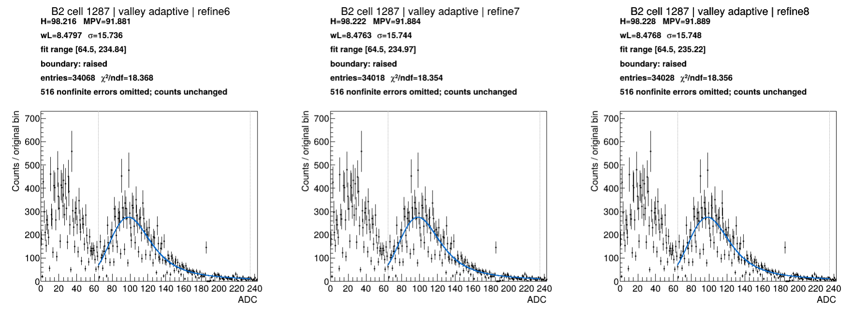
B2 cell 1287: Valley boundary, Adaptive
Notes:
Source: b2-cases.pdf, page 24
Section: B2 interesting cases
Original source path: /workspace/scratch/973a74c46106/boundary-case-results-real/interesting-cases-pdfs/b2-cases.pdf
BNL source image: /gpfs/mnt/gpfs01/star/scratch/pnord/lfhcal/boundary-fullchains-20261002/interesting-cases/b2-cell1287-valley-adaptive.png

Slide 48
E1: check how general the improvement is
Compare the same E1 channels with both numerical methods and both lower boundaries.
Look for agreement in peak location as well as differences in width and fit range.
These examples help test whether an improvement extends beyond the B2 spectra that motivated it.
E1 cells 196 and 1348
Notes:
Study context and observations are from this conversation and the supplied BNL plots. Plot slides retain their original source notes. Original-boundary and valley-boundary results are distinct campaigns. Selected events were inherited separately for Legacy and Adaptive in the valley campaign. This is a refinement study, not a rerun of all upstream stages with the new boundary.

Slide 49
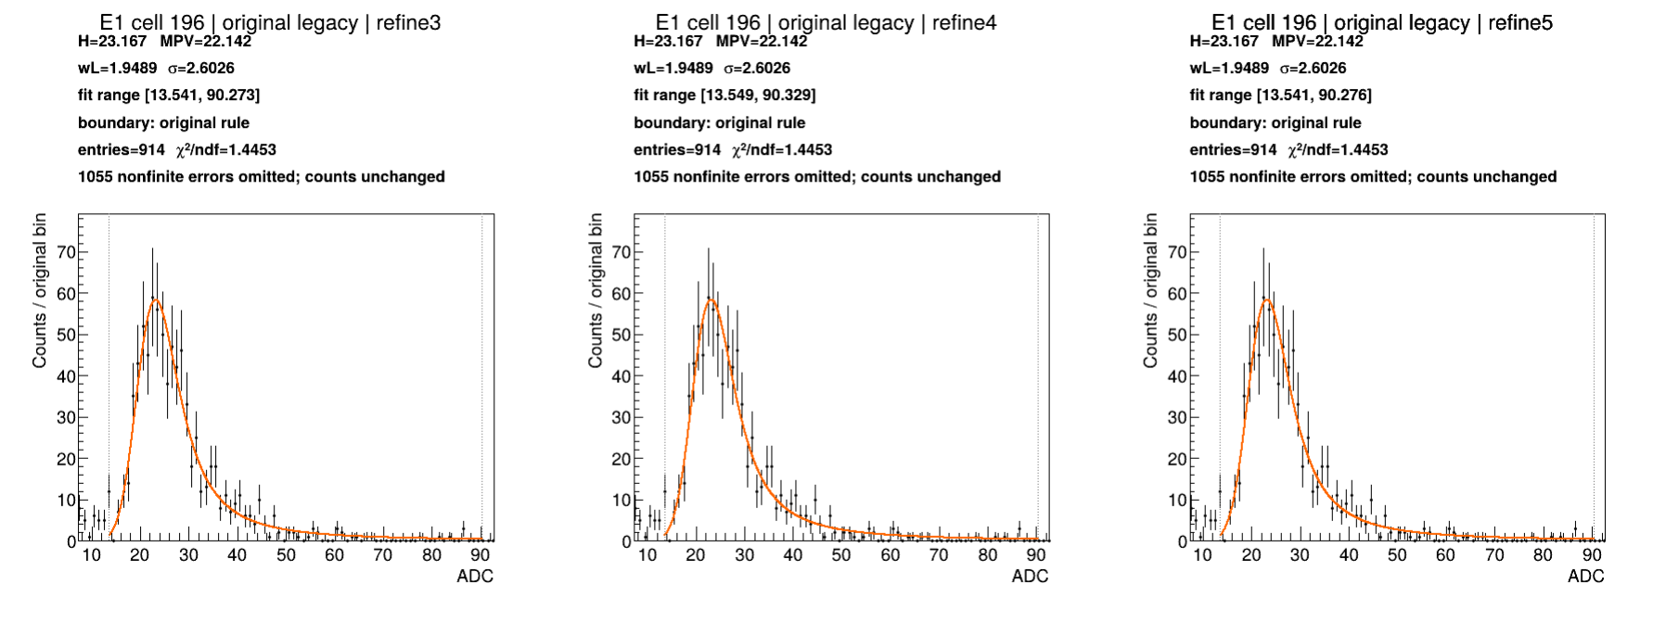
E1 cell 196: Original boundary, Legacy
Notes:
Source: e1-cases.pdf, page 1
Section: E1 interesting cases
Original source path: /workspace/scratch/973a74c46106/boundary-case-results-real/interesting-cases-pdfs/e1-cases.pdf
BNL source image: /gpfs/mnt/gpfs01/star/scratch/pnord/lfhcal/boundary-fullchains-20261002/interesting-cases/e1-cell196-original-legacy.png

Slide 50
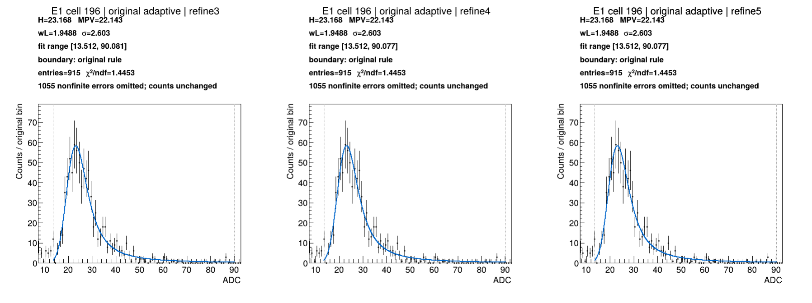
E1 cell 196: Original boundary, Adaptive
Notes:
Source: e1-cases.pdf, page 2
Section: E1 interesting cases
Original source path: /workspace/scratch/973a74c46106/boundary-case-results-real/interesting-cases-pdfs/e1-cases.pdf
BNL source image: /gpfs/mnt/gpfs01/star/scratch/pnord/lfhcal/boundary-fullchains-20261002/interesting-cases/e1-cell196-original-adaptive.png

Slide 51
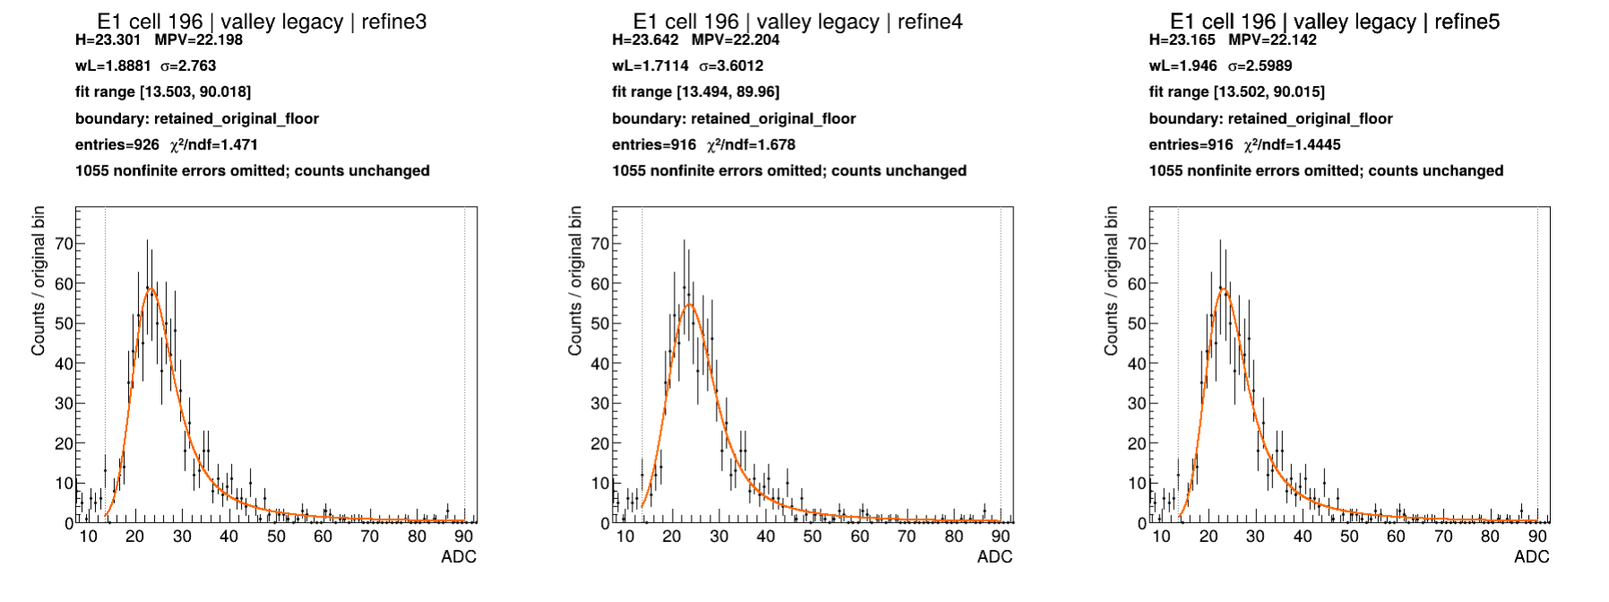
E1 cell 196: Valley boundary, Legacy
Notes:
Source: e1-cases.pdf, page 3
Section: E1 interesting cases
Original source path: /workspace/scratch/973a74c46106/boundary-case-results-real/interesting-cases-pdfs/e1-cases.pdf
BNL source image: /gpfs/mnt/gpfs01/star/scratch/pnord/lfhcal/boundary-fullchains-20261002/interesting-cases/e1-cell196-valley-legacy.png

Slide 52
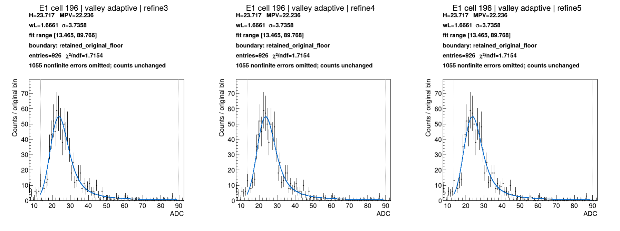
E1 cell 196: Valley boundary, Adaptive
Notes:
Source: e1-cases.pdf, page 4
Section: E1 interesting cases
Original source path: /workspace/scratch/973a74c46106/boundary-case-results-real/interesting-cases-pdfs/e1-cases.pdf
BNL source image: /gpfs/mnt/gpfs01/star/scratch/pnord/lfhcal/boundary-fullchains-20261002/interesting-cases/e1-cell196-valley-adaptive.png

Slide 53
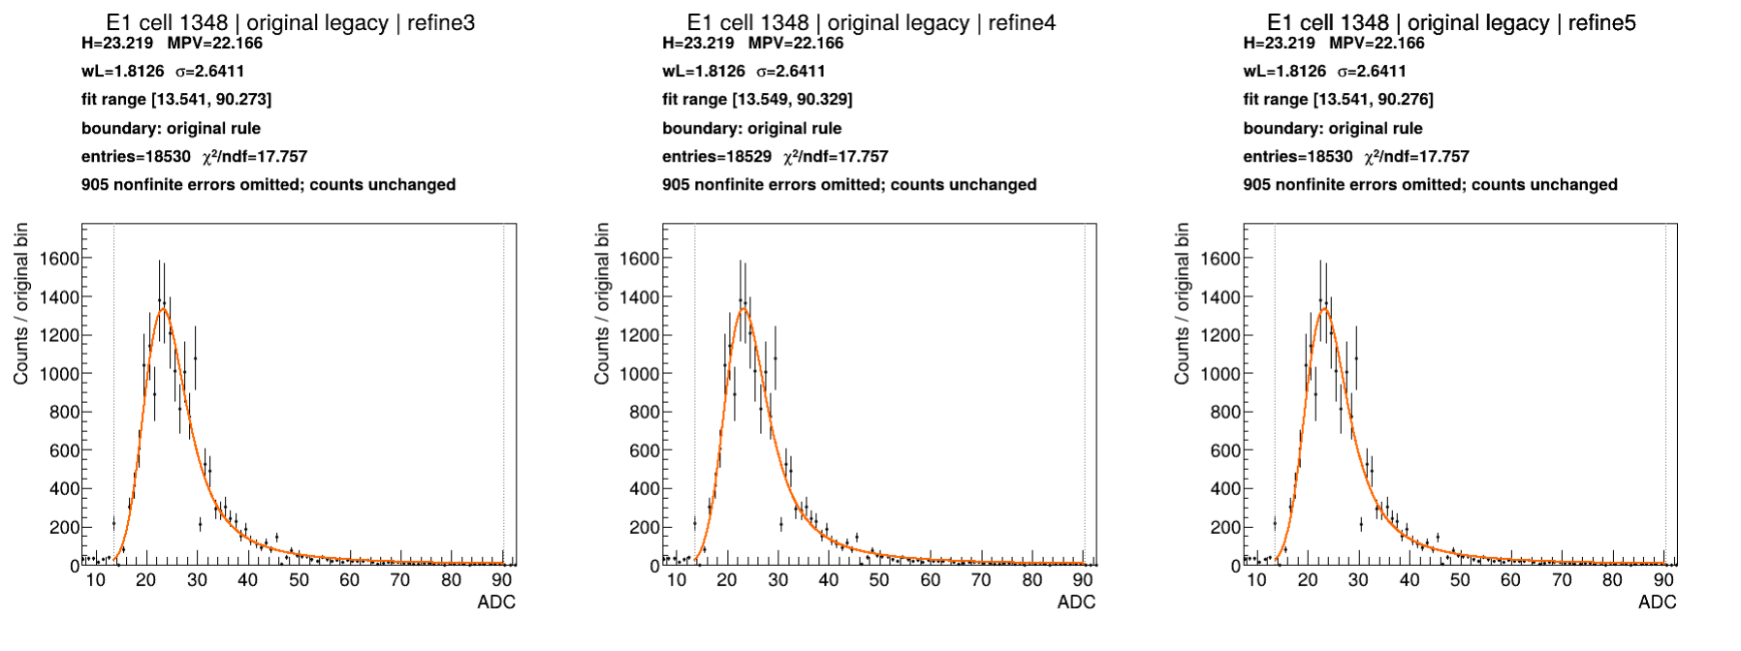
E1 cell 1348: Original boundary, Legacy
Notes:
Source: e1-cases.pdf, page 5
Section: E1 interesting cases
Original source path: /workspace/scratch/973a74c46106/boundary-case-results-real/interesting-cases-pdfs/e1-cases.pdf
BNL source image: /gpfs/mnt/gpfs01/star/scratch/pnord/lfhcal/boundary-fullchains-20261002/interesting-cases/e1-cell1348-original-legacy.png

Slide 54
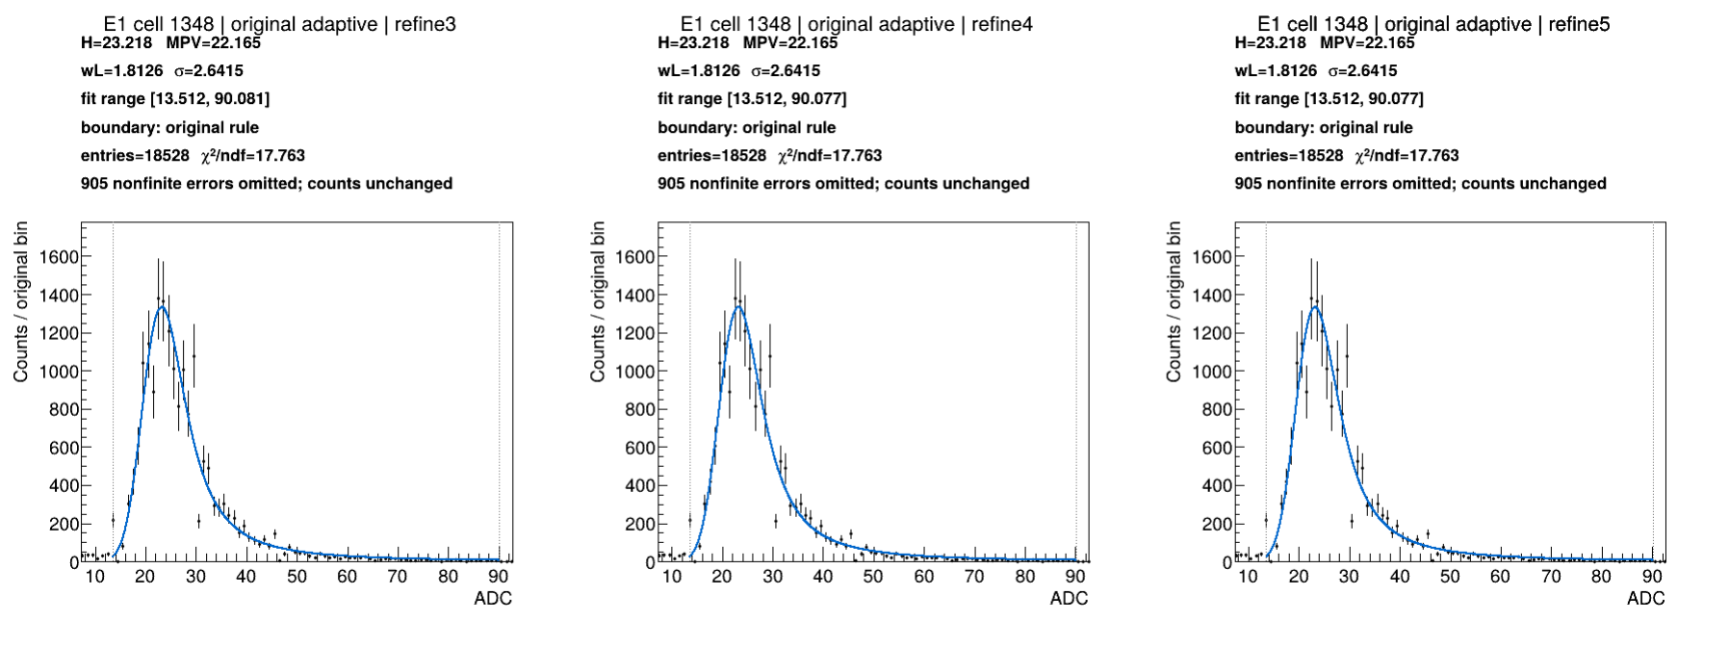
E1 cell 1348: Original boundary, Adaptive
Notes:
Source: e1-cases.pdf, page 6
Section: E1 interesting cases
Original source path: /workspace/scratch/973a74c46106/boundary-case-results-real/interesting-cases-pdfs/e1-cases.pdf
BNL source image: /gpfs/mnt/gpfs01/star/scratch/pnord/lfhcal/boundary-fullchains-20261002/interesting-cases/e1-cell1348-original-adaptive.png

Slide 55
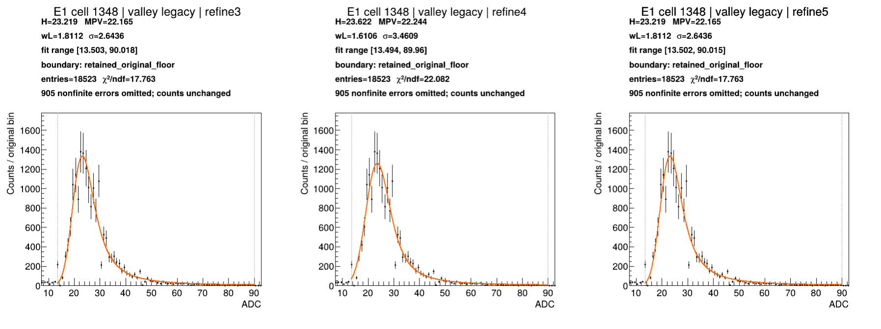
E1 cell 1348: Valley boundary, Legacy
Notes:
Source: e1-cases.pdf, page 7
Section: E1 interesting cases
Original source path: /workspace/scratch/973a74c46106/boundary-case-results-real/interesting-cases-pdfs/e1-cases.pdf
BNL source image: /gpfs/mnt/gpfs01/star/scratch/pnord/lfhcal/boundary-fullchains-20261002/interesting-cases/e1-cell1348-valley-legacy.png

Slide 56
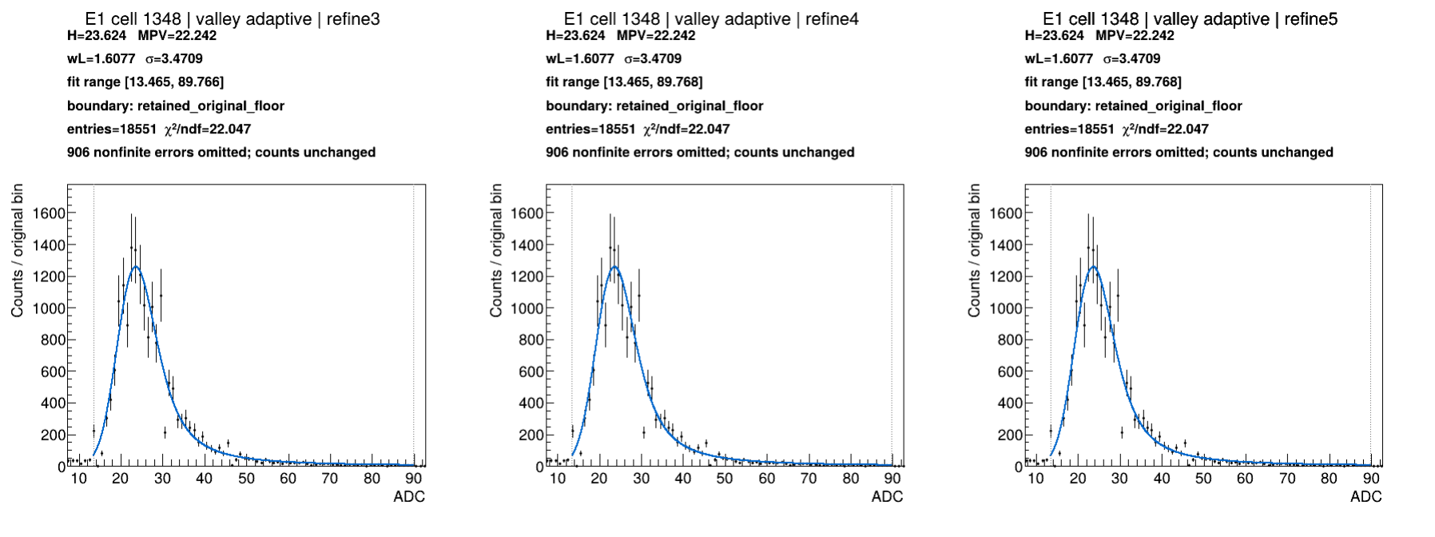
E1 cell 1348: Valley boundary, Adaptive
Notes:
Source: e1-cases.pdf, page 8
Section: E1 interesting cases
Original source path: /workspace/scratch/973a74c46106/boundary-case-results-real/interesting-cases-pdfs/e1-cases.pdf
BNL source image: /gpfs/mnt/gpfs01/star/scratch/pnord/lfhcal/boundary-fullchains-20261002/interesting-cases/e1-cell1348-valley-adaptive.png

Slide 57
B1 controls: measure the cost of a change
Compare B1 and B2 at the same channel identifiers to separate channel-specific and sample-specific behavior.
A well-behaved control should retain a plausible peak and stable refinement history.
Any systematic movement of H in these controls belongs in the calibration uncertainty study.
B1 cells 704 and 1287
Notes:
Study context and observations are from this conversation and the supplied BNL plots. Plot slides retain their original source notes. Original-boundary and valley-boundary results are distinct campaigns. Selected events were inherited separately for Legacy and Adaptive in the valley campaign. This is a refinement study, not a rerun of all upstream stages with the new boundary.

Slide 58
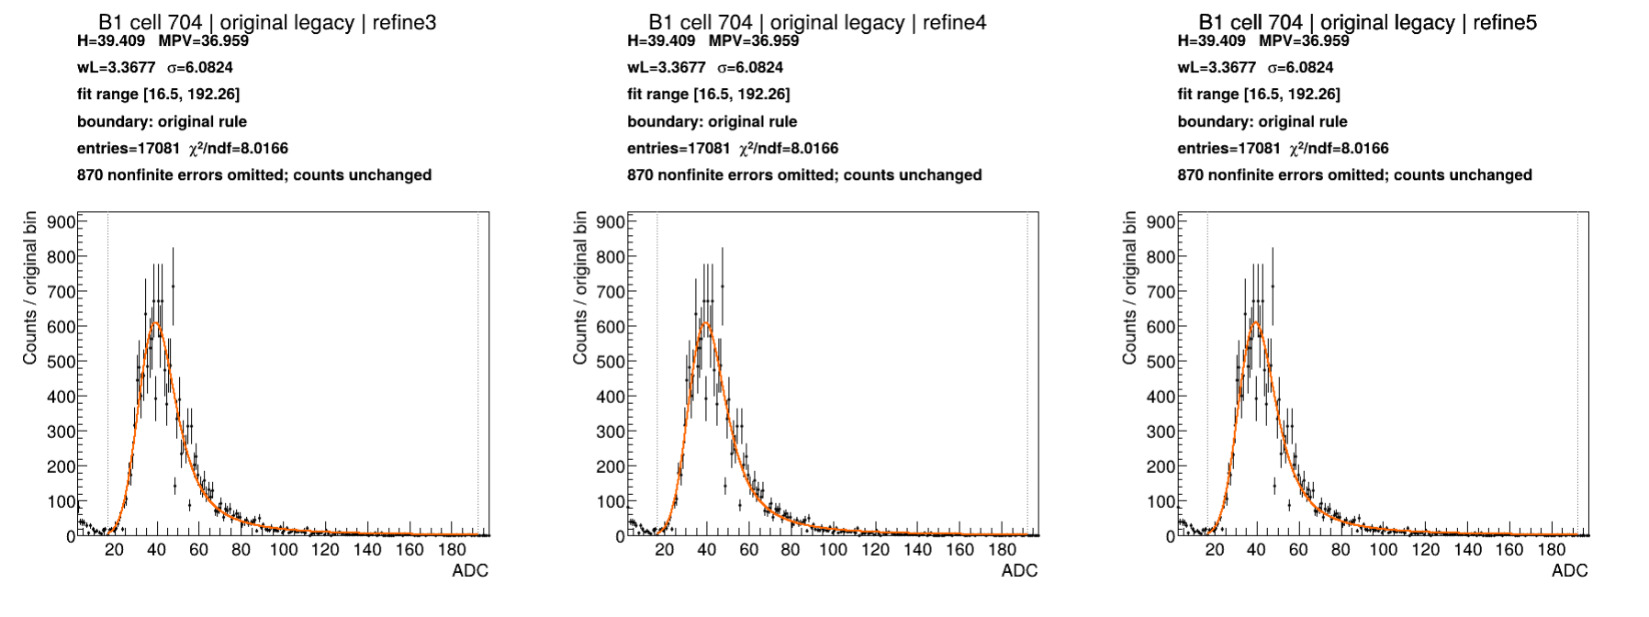
B1 cell 704: Original boundary, Legacy
Notes:
Source: b1-cases.pdf, page 1
Section: B1 interesting cases
Original source path: /workspace/scratch/973a74c46106/boundary-case-results-real/interesting-cases-pdfs/b1-cases.pdf
BNL source image: /gpfs/mnt/gpfs01/star/scratch/pnord/lfhcal/boundary-fullchains-20261002/interesting-cases/b1-cell704-original-legacy.png

Slide 59
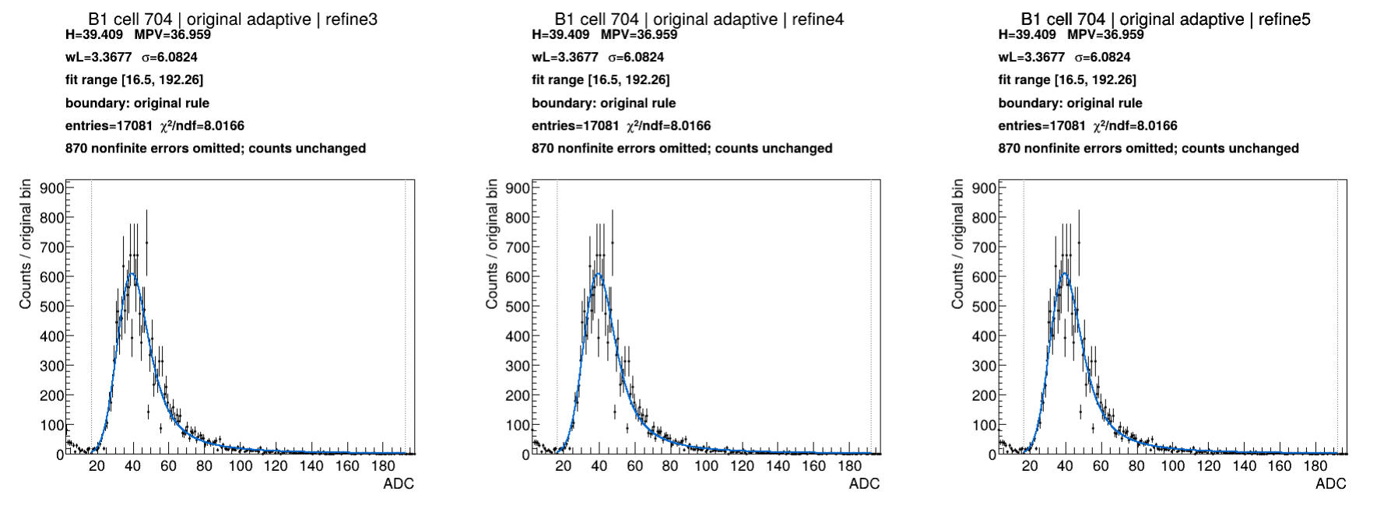
B1 cell 704: Original boundary, Adaptive
Notes:
Source: b1-cases.pdf, page 2
Section: B1 interesting cases
Original source path: /workspace/scratch/973a74c46106/boundary-case-results-real/interesting-cases-pdfs/b1-cases.pdf
BNL source image: /gpfs/mnt/gpfs01/star/scratch/pnord/lfhcal/boundary-fullchains-20261002/interesting-cases/b1-cell704-original-adaptive.png

Slide 60
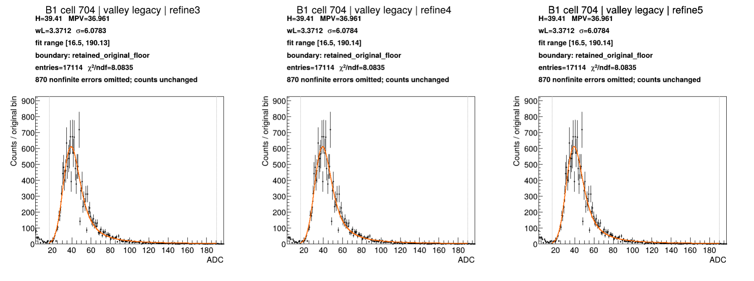
B1 cell 704: Valley boundary, Legacy
Notes:
Source: b1-cases.pdf, page 3
Section: B1 interesting cases
Original source path: /workspace/scratch/973a74c46106/boundary-case-results-real/interesting-cases-pdfs/b1-cases.pdf
BNL source image: /gpfs/mnt/gpfs01/star/scratch/pnord/lfhcal/boundary-fullchains-20261002/interesting-cases/b1-cell704-valley-legacy.png

Slide 61
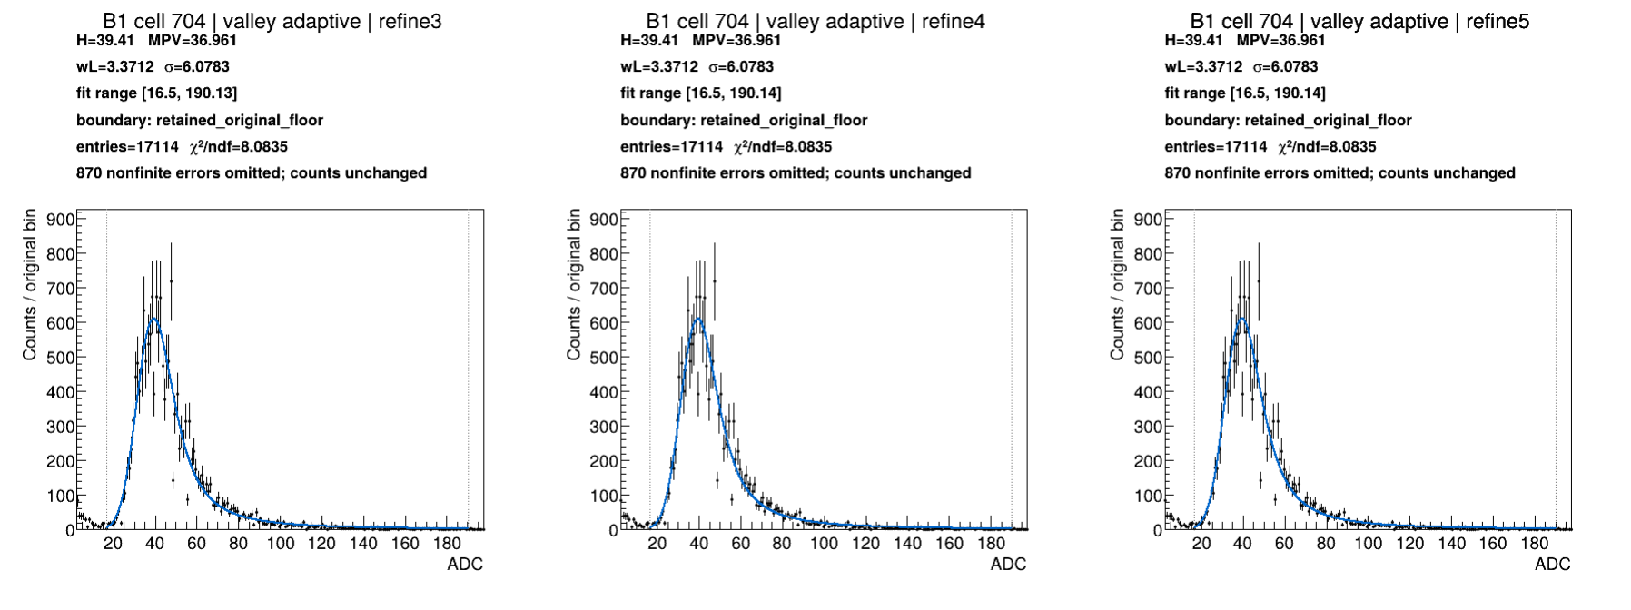
B1 cell 704: Valley boundary, Adaptive
Notes:
Source: b1-cases.pdf, page 4
Section: B1 interesting cases
Original source path: /workspace/scratch/973a74c46106/boundary-case-results-real/interesting-cases-pdfs/b1-cases.pdf
BNL source image: /gpfs/mnt/gpfs01/star/scratch/pnord/lfhcal/boundary-fullchains-20261002/interesting-cases/b1-cell704-valley-adaptive.png

Slide 62
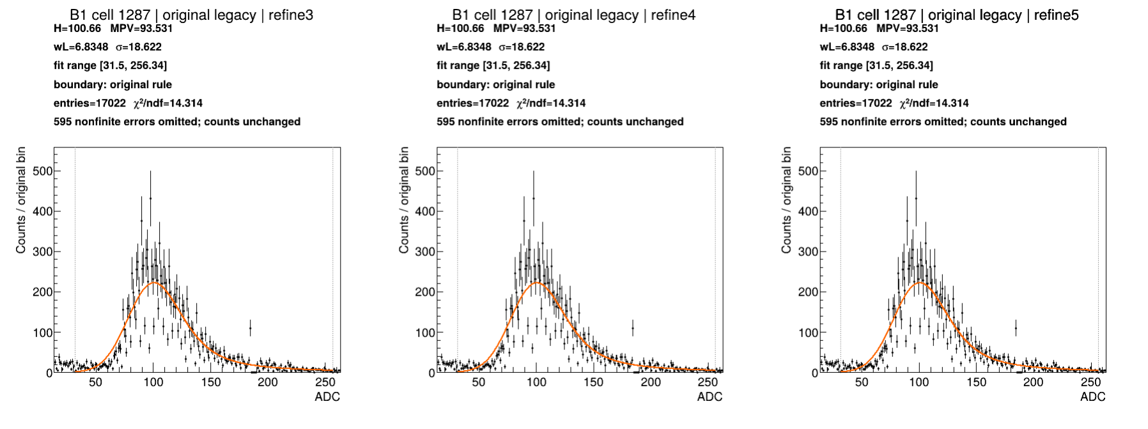
B1 cell 1287: Original boundary, Legacy
Notes:
Source: b1-cases.pdf, page 5
Section: B1 interesting cases
Original source path: /workspace/scratch/973a74c46106/boundary-case-results-real/interesting-cases-pdfs/b1-cases.pdf
BNL source image: /gpfs/mnt/gpfs01/star/scratch/pnord/lfhcal/boundary-fullchains-20261002/interesting-cases/b1-cell1287-original-legacy.png

Slide 63
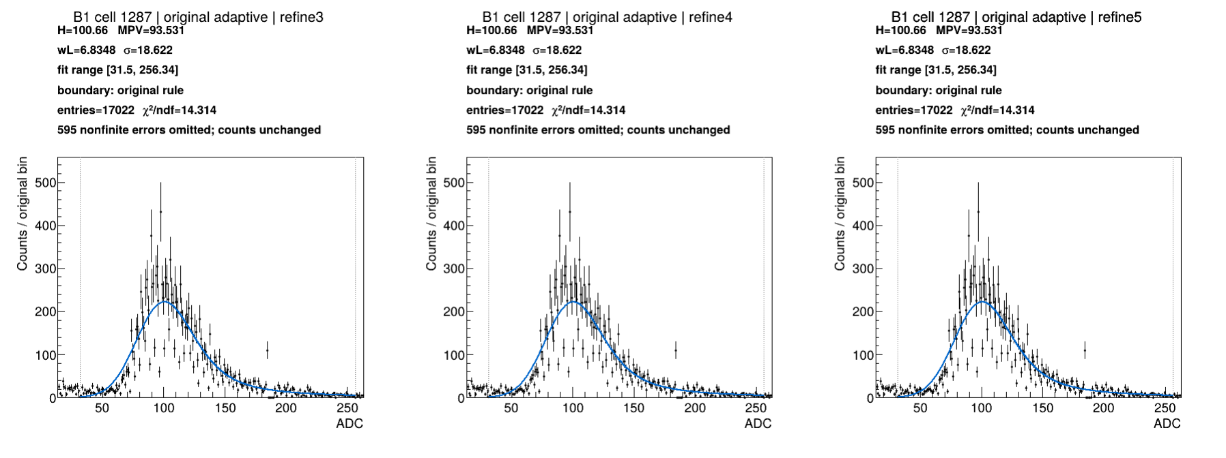
B1 cell 1287: Original boundary, Adaptive
Notes:
Source: b1-cases.pdf, page 6
Section: B1 interesting cases
Original source path: /workspace/scratch/973a74c46106/boundary-case-results-real/interesting-cases-pdfs/b1-cases.pdf
BNL source image: /gpfs/mnt/gpfs01/star/scratch/pnord/lfhcal/boundary-fullchains-20261002/interesting-cases/b1-cell1287-original-adaptive.png

Slide 64

B1 cell 1287: Valley boundary, Legacy
Notes:
Source: b1-cases.pdf, page 7
Section: B1 interesting cases
Original source path: /workspace/scratch/973a74c46106/boundary-case-results-real/interesting-cases-pdfs/b1-cases.pdf
BNL source image: /gpfs/mnt/gpfs01/star/scratch/pnord/lfhcal/boundary-fullchains-20261002/interesting-cases/b1-cell1287-valley-legacy.png

Slide 65

B1 cell 1287: Valley boundary, Adaptive
Notes:
Source: b1-cases.pdf, page 8
Section: B1 interesting cases
Original source path: /workspace/scratch/973a74c46106/boundary-case-results-real/interesting-cases-pdfs/b1-cases.pdf
BNL source image: /gpfs/mnt/gpfs01/star/scratch/pnord/lfhcal/boundary-fullchains-20261002/interesting-cases/b1-cell1287-valley-adaptive.png

Slide 66
What we’ve learned
The new boundary gives better fits in many of these examples.
Both Legacy and Adaptive still have troublesome cases.
More refinement steps do not always give a better answer.
A stable calibration can still come from a poor fit.
Conclusions from the examples
Notes:
These are qualitative conclusions from the reviewed histogram overlays and convergence plots, not a measured success rate over every channel. Legacy with the new boundary remains a candidate. The B2 late-pass examples show why convergence and fit quality need separate checks. No claim of a universally best method is made.

Slide 67
Flagging channels for review
With tens of thousands of channels, we need an automatic way to find the bad and funky ones.
Flag failed fits, large calibration jumps, and unusual spectra.
Show the histogram and fit overlay for human review.
A procedure for the full detector
Notes:
Proposed next step: build an automated flagging procedure and review the flagged channels with their fit overlays. The thresholds and criteria still need study. Reports should distinguish fresh fits, carried-forward calibrations, and missing calibrations. This is a proposal, not a statement that the procedure is already implemented.
Detector scale: hundreds of thousands of physical scintillator tiles/SiPMs feed tens of thousands of summed readout channels. Do not equate tiles with calibration channels. The June 2026 LFHCal design uses eight longitudinal readout segments per tower; older seven-segment inventories should not be presented as a current exact total. Source: Emily Pottebaum, CALOR 2026, 1 June 2026, slides 12–23, https://zenodo.org/records/21478358 .

Slide 68
What to try next
Check how much the calibration changes when we move the fit range.
Understand how to handle undercounted and overcounted bins.
Remove the runs marked “dirty muon” and refit.
Compare with a few well-behaved channels as controls.
Proposed tests
Notes:
These are proposed tests, not results or jobs already submitted. Quantify calibration sensitivity to lower-edge selection, including shifts in well-behaved controls. Investigate the source and treatment of undercounted/overcounted bins before choosing a correction or masking procedure. For the dirty-muon test, compare the full sample with a refit excluding the labelled runs, keeping the fit procedure fixed. The label alone does not establish the cause of the difficult spectra. The test needs suitable inputs and run-level identification; availability must be checked because some pre-MIP files were missing.

Slide 69
Appendix: the original F1 recipe
The dataset recipes came from Fredi’s calibration post and the 2026 test-beam helper scripts.
The original F1 Yallfile makes the processing order and DataPrep switches explicit.
The later Python runner organized the larger comparison campaigns.
ROOT fit functions and minimizer options are implemented inside DataPrep’s C++ routines.
Recipe provenance • source links in notes
Notes:
Original F1 Yallfile: https://github.com/paulnord/epic-lfhcal-tbana/blob/yall-integration/examples/yall/fullset-f1-repro/Yallfile
Retrieved Yallfile blob SHA: f5d614d41f6d8de0f3dc311dbcfe42349e377859. The source is the original yall-integration F1 recipe, not the later Python campaign wrapper.
Implementation cross-check: https://github.com/paulnord/epic-lfhcal-tbana/blob/924ad82de6d150534b4d7684b5638df92c0a2016/NewStructure/DataPrep.cc
https://github.com/paulnord/epic-lfhcal-tbana/blob/924ad82de6d150534b4d7684b5638df92c0a2016/NewStructure/Analyses.cc
https://github.com/paulnord/epic-lfhcal-tbana/blob/924ad82de6d150534b4d7684b5638df92c0a2016/NewStructure/TileSpectra.cc
Specific acquisition run numbers intentionally omitted.
Fredi’s calibration post: https://indico.bnl.gov/event/34397/
F1 calibration presentation: https://indico.bnl.gov/event/34397/contributions/129732/subcontributions/4734/attachments/72620/124340/2026_SPS_Analysis_Status_FullSetF.pdf
Helper script: https://github.com/paulnord/epic-lfhcal-tbana/blob/924ad82de6d150534b4d7684b5638df92c0a2016/NewStructure/helperCalibHGCROC.sh
The post establishes the dataset recipe provenance. The exact commands here are grounded in the Yallfile and code, not claimed to be a command log of the published calibration PDFs.

Slide 70
Original F1 Yallfile: the complete workflow
Stage | Program / switches | Purpose
Convert | Convert -c -w | Decode raw data with mapping and run metadata
Merge | hadd -f | Combine the converted muon runs
Pedestal fits | DataPrep -p | Fit the pedestal spectrum and waveform baseline
Transfer | DataPrep -P -B -G | Attach pedestal, bad-channel map, and TOA offsets
Initial MIP | DataPrep -s | Estimate MIP scales and refit locally selected hits
Event selection | DataPrep -X | Skim events that contain a TOA signal
Refine 1–5 | DataPrep -S -x -k from refine 2 | Refit the selected sample with updated calibration
Final products | Copy refine 5 outputs | Copy final ROOT and text calibration files
F1 sequence • run numbers omitted
Notes:
Original F1 Yallfile: https://github.com/paulnord/epic-lfhcal-tbana/blob/yall-integration/examples/yall/fullset-f1-repro/Yallfile
Retrieved Yallfile blob SHA: f5d614d41f6d8de0f3dc311dbcfe42349e377859. The source is the original yall-integration F1 recipe, not the later Python campaign wrapper.
Implementation cross-check: https://github.com/paulnord/epic-lfhcal-tbana/blob/924ad82de6d150534b4d7684b5638df92c0a2016/NewStructure/DataPrep.cc
https://github.com/paulnord/epic-lfhcal-tbana/blob/924ad82de6d150534b4d7684b5638df92c0a2016/NewStructure/Analyses.cc
https://github.com/paulnord/epic-lfhcal-tbana/blob/924ad82de6d150534b4d7684b5638df92c0a2016/NewStructure/TileSpectra.cc
Specific acquisition run numbers intentionally omitted.

Slide 71
F1 setup and event preparation
Declare data, work, and eic-shell locations, plus mapping and run-database inputs.
Run through the eic-shell wrapper with ROOT and OpenMP restricted to one thread.
Create the output directories, then convert pedestal and muon data separately.
Merge only the muon files. Keep the dedicated pedestal sample for the pedestal task.
Yall dependencies connect each task to the files produced by the preceding tasks.
Original F1 recipe
Notes:
Original F1 Yallfile: https://github.com/paulnord/epic-lfhcal-tbana/blob/yall-integration/examples/yall/fullset-f1-repro/Yallfile
Retrieved Yallfile blob SHA: f5d614d41f6d8de0f3dc311dbcfe42349e377859. The source is the original yall-integration F1 recipe, not the later Python campaign wrapper.
Implementation cross-check: https://github.com/paulnord/epic-lfhcal-tbana/blob/924ad82de6d150534b4d7684b5638df92c0a2016/NewStructure/DataPrep.cc
https://github.com/paulnord/epic-lfhcal-tbana/blob/924ad82de6d150534b4d7684b5638df92c0a2016/NewStructure/Analyses.cc
https://github.com/paulnord/epic-lfhcal-tbana/blob/924ad82de6d150534b4d7684b5638df92c0a2016/NewStructure/TileSpectra.cc
Specific acquisition run numbers intentionally omitted.
Default task resources: 1 CPU, 4 GB memory, 8 GB disk, 2 h. Wrapper sets ROOT_MAX_THREADS=1 and OMP_NUM_THREADS=1. Convert command: Convert -d 0 -f -w -c INPUT -o OUTPUT -m MAPPING -r RUNDB. Merge command: hadd -f OUTPUT MUON_PARTS. Inputs are table-driven and include muon and pedestal rows.

Slide 72
F1 pedestal step: two fits per channel
Fit | Procedure | Saved information
Pedestal spectrum | Gaussian seed fit Repeat within mean ± 2σ ROOT option: QNSWW | Gaussian mean Gaussian width
Waveform baseline | Constant (pol0) over samples Rebin waveform Y axis by 4 ROOT option: QRMNE0 | Constant level Uncertainty on that level
The pedestal task writes calibration constants, histograms,
and diagnostic plots for the next stage.
DataPrep -p • ROOT options live in C++, not in the Yallfile
Notes:
Original F1 Yallfile: https://github.com/paulnord/epic-lfhcal-tbana/blob/yall-integration/examples/yall/fullset-f1-repro/Yallfile
Retrieved Yallfile blob SHA: f5d614d41f6d8de0f3dc311dbcfe42349e377859. The source is the original yall-integration F1 recipe, not the later Python campaign wrapper.
Implementation cross-check: https://github.com/paulnord/epic-lfhcal-tbana/blob/924ad82de6d150534b4d7684b5638df92c0a2016/NewStructure/DataPrep.cc
https://github.com/paulnord/epic-lfhcal-tbana/blob/924ad82de6d150534b4d7684b5638df92c0a2016/NewStructure/Analyses.cc
https://github.com/paulnord/epic-lfhcal-tbana/blob/924ad82de6d150534b4d7684b5638df92c0a2016/NewStructure/TileSpectra.cc
Specific acquisition run numbers intentionally omitted.
GetPedestal configures Minuit2/Migrad and calls FitNoise, followed by FitPedConstWave for HGCROC.
Gaussian: https://github.com/paulnord/epic-lfhcal-tbana/blob/924ad82de6d150534b4d7684b5638df92c0a2016/NewStructure/TileSpectra.cc#L276-L328
Waveform constant: https://github.com/paulnord/epic-lfhcal-tbana/blob/924ad82de6d150534b4d7684b5638df92c0a2016/NewStructure/TileSpectra.cc#L933-L972
FitNoise requires valid successful fits. The first QNSWW fit does not contain the R option, so the TF1 constructor interval must not be presented as an enforced first-fit range. FitPedConstWave accepts a valid result with status 0 or 4000, excluding values at the parameter limits. The pedestal routine can retain a channel when one of the two fits succeeds.
HGCROC stores the Gaussian mean/sigma in PedestalMeanH/PedestalSigH and the constant/error in PedestalMeanL/PedestalSigL. These slot names should not be interpreted as a second independent low-gain noise distribution.

Slide 73
F1 transfer and initial MIP extraction
Operation | Switches | Effect
Calibration transfer | -P -B -G | Load pedestal constants, bad-channel map, and TOA offsets
Initial MIP extraction | -s | Fit the spectra and establish MIP calibration scales
Local muon refinement | Part of -s | Use local trigger information for a subsequent MIP fit
Calibration and plots | -a -e | Write text calibration and extended diagnostics
These are DataPrep switches. The ROOT fit options are set inside the fitting code.
Original F1 recipe • helper-script modes and Yallfile agree
Notes:
Original F1 Yallfile: https://github.com/paulnord/epic-lfhcal-tbana/blob/yall-integration/examples/yall/fullset-f1-repro/Yallfile
Retrieved Yallfile blob SHA: f5d614d41f6d8de0f3dc311dbcfe42349e377859. The source is the original yall-integration F1 recipe, not the later Python campaign wrapper.
Implementation cross-check: https://github.com/paulnord/epic-lfhcal-tbana/blob/924ad82de6d150534b4d7684b5638df92c0a2016/NewStructure/DataPrep.cc
https://github.com/paulnord/epic-lfhcal-tbana/blob/924ad82de6d150534b4d7684b5638df92c0a2016/NewStructure/Analyses.cc
https://github.com/paulnord/epic-lfhcal-tbana/blob/924ad82de6d150534b4d7684b5638df92c0a2016/NewStructure/TileSpectra.cc
Specific acquisition run numbers intentionally omitted.
Pedestal invocation: DataPrep -a -d 1 -p -i INPUT -f -o OUTPUT -O PLOTS -r RUNDB -F pdf. Transfer invocation: DataPrep -d 1 -e -f -P PEDESTAL -i INPUT -o OUTPUT -O PLOTS -r RUNDB -B BADMAP -G TOAOFFSETS. Initial MIP invocation: DataPrep -a -f -d 1 -e -s -i INPUT -o OUTPUT -O PLOTS -r RUNDB.
-a writes text calibration, -e requests extended plotting, -f allows overwrite, -d controls diagnostic output, -O chooses the plot location. DataPrep -e is not the ROOT fit-option E.
The original F1 recipe does not enable the separate -D data-rejection option or -n pedestal re-evaluation option.

Slide 74
F1 selection, refinement, and final outputs
DataPrep -X writes a skim of HGCROC events with a TOA signal.
Refine 1 runs DataPrep -S -x using calibration already stored in that selected ROOT file.
Refine 2–5 read the same event file and load the preceding text calibration with -k.
-S updates the MIP calibration. -x suppresses writing another event tree. -a saves text constants.
The final task copies the refine 5 ROOT and text outputs. It does not perform another fit.
Original F1 recipe
Notes:
Original F1 Yallfile: https://github.com/paulnord/epic-lfhcal-tbana/blob/yall-integration/examples/yall/fullset-f1-repro/Yallfile
Retrieved Yallfile blob SHA: f5d614d41f6d8de0f3dc311dbcfe42349e377859. The source is the original yall-integration F1 recipe, not the later Python campaign wrapper.
Implementation cross-check: https://github.com/paulnord/epic-lfhcal-tbana/blob/924ad82de6d150534b4d7684b5638df92c0a2016/NewStructure/DataPrep.cc
https://github.com/paulnord/epic-lfhcal-tbana/blob/924ad82de6d150534b4d7684b5638df92c0a2016/NewStructure/Analyses.cc
https://github.com/paulnord/epic-lfhcal-tbana/blob/924ad82de6d150534b4d7684b5638df92c0a2016/NewStructure/TileSpectra.cc
Specific acquisition run numbers intentionally omitted.
Selection: DataPrep -f -d 1 -X -i INPUT -o OUTPUT. Refinement: DataPrep -x -a -f -d 1 -S -i SELECTED_ROOT -o OUTPUT -O PLOTS -r RUNDB, adding -k PREVIOUS_CALIB for passes 2–5.
The -X TOA skim is not a guarantee of a pure muon sample. Event-tree membership is fixed through refinement, while local trigger selection can change with the calibration. A new calibration is passed forward even though the event file is reused.

