Slide 1

AncASIC_XT011
MPW3 Submission for Fabrication and Overview
09/2026
G.W. Deptuch, gdeptuch@bnl.gov
ePIC SVT DSC meeting, 09/29/2026

Slide 2
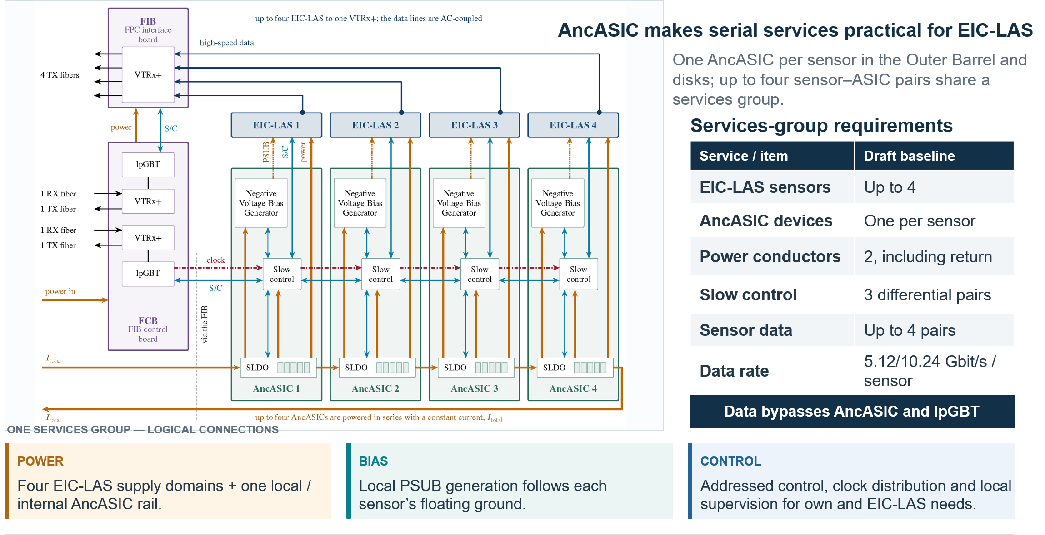
Where is AncASIC in the ePIC SVT Detector?

Slide 3
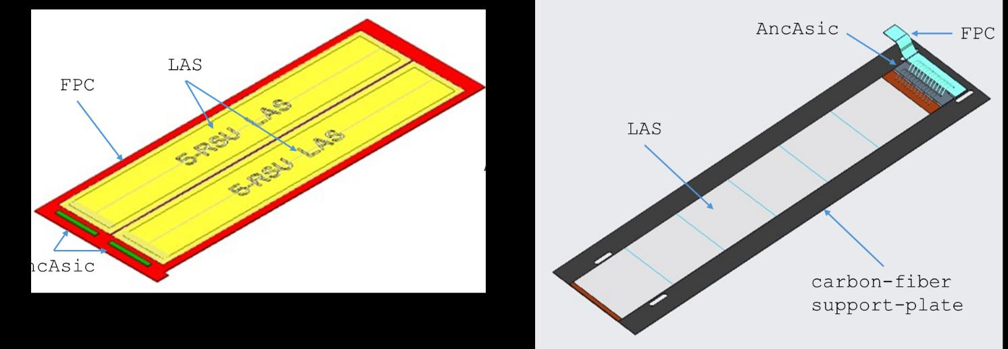
AncASIC location w.r.t. MAPS sensors
FPC bridge direct connection to MOSAIX/EIC-LAS interface

Slide 4
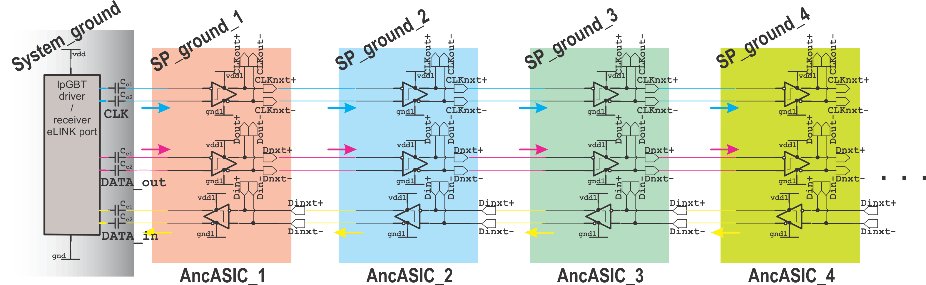
Physical connection to lpGBT
Summary of ePortTX.pptx / ePortRx.pptx functionality
where AC and DC coupling
    AC-coupled only to lpGBT (up-link and down-link), with coupling capacitors next to lpGBT
    DC-coupled down from first AncASIC in chain

Slide 5
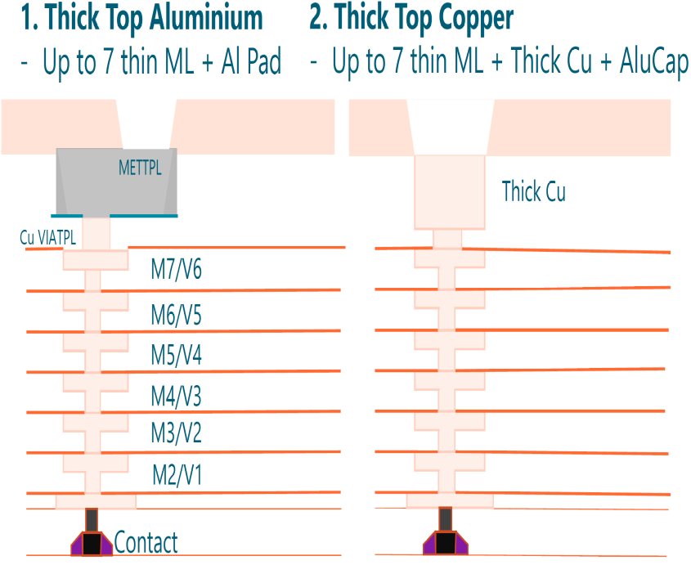
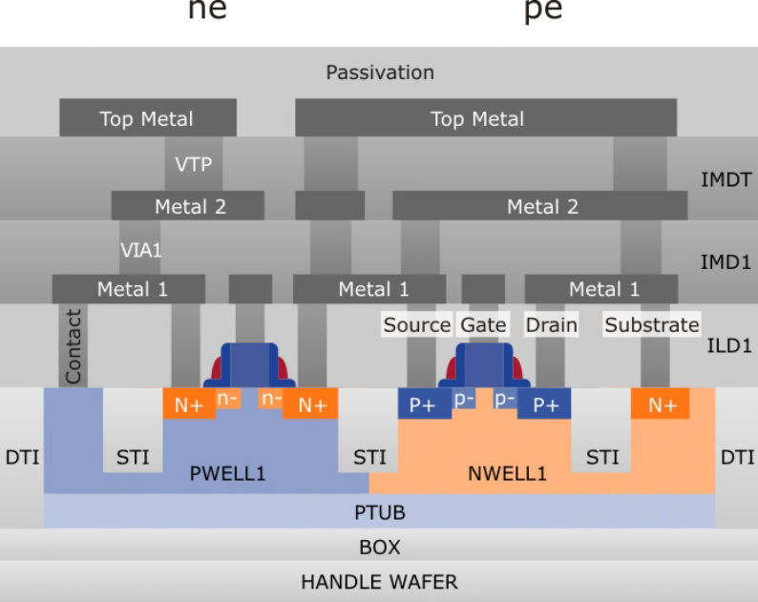
Fabrication Process and System Constraints
Parameter | Draft requirement / choice
Process | X-FAB XT011, 110 nm (BCD) Partially-Depleted Silicon-on-Insulator; Automotive quality with extended temperature range -40°C …. 175°C, t_{ox} for 1.5 V transistors 3.5nm/3.5nm; (Suitable for high currents in voltage regulation)
TID | Up to 10⁶ rad (1 Mrad)
NIEL | ≈10¹² neq/cm²
AncASIC maximum T | 80 °C
Maximum ΔT | 10 °C
3,740 nm
4.5 m Ω/□
400 nm
62 m Ω/□
400 nm
400 nm
400 nm
400 nm
400 nm
Process: XT011A0770, 31+1 Mask Layers, 31+1 Process Layers
Modules: MOS5, METAL1, METAL2, MOSLP, LVT, DTI, PSUB, METAL3, METAL4, METAL5, COPTHK, ALUCAP + DEPL

Slide 6
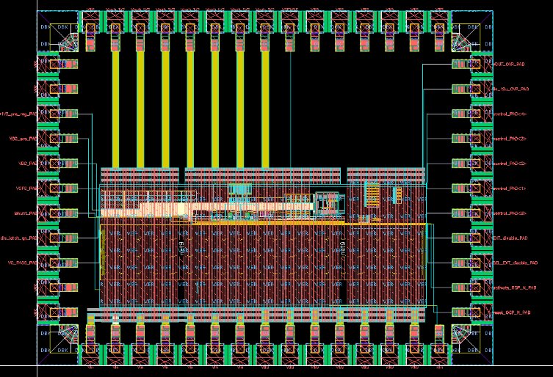
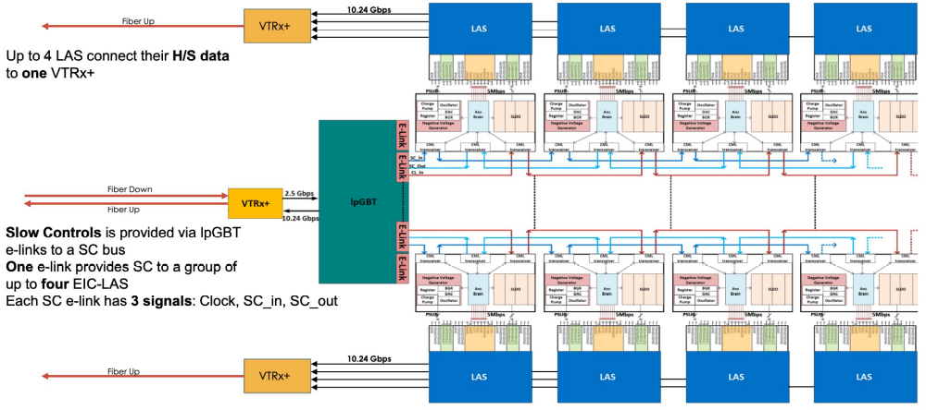
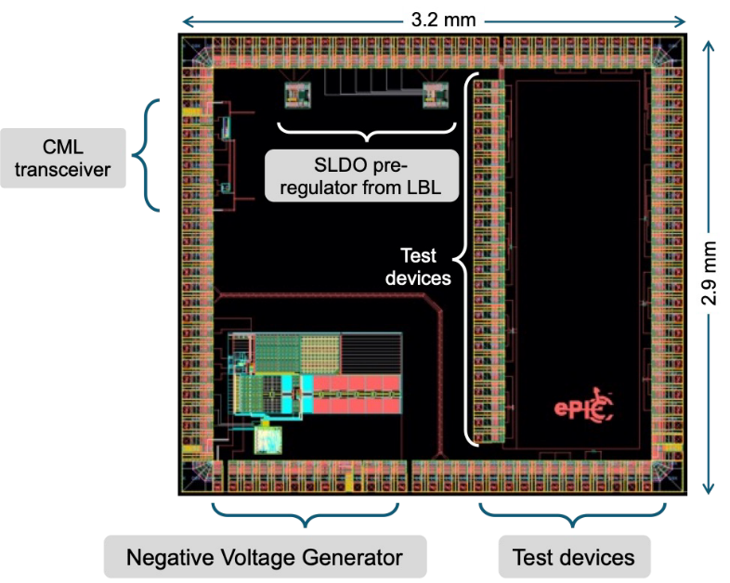
Starting point fro September MPW
AncASIC = Interface chip
• Main functional blocks:
  • Shunt LDOs (SLDO) – MPW2
  • Negative Voltage Bias Generator (NVG) – MPW1
  • AncBrain: SC communication; operation heartbeat
Single SLDO and single section NVBG prototypes fabricated on the MPW run in March 2025;
MPW2
Main addition in the MPW run in September 2026;
MPW1
tactical objectives set at the Oxford ePIC SVT Working Meeting in Dec. 2025 achieved in MPW run September 2026

Slide 7
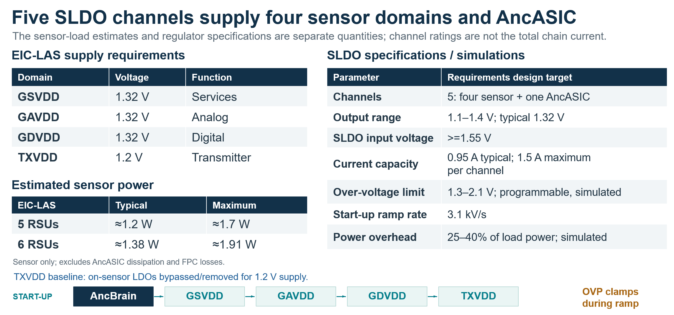
Power Management

Slide 8
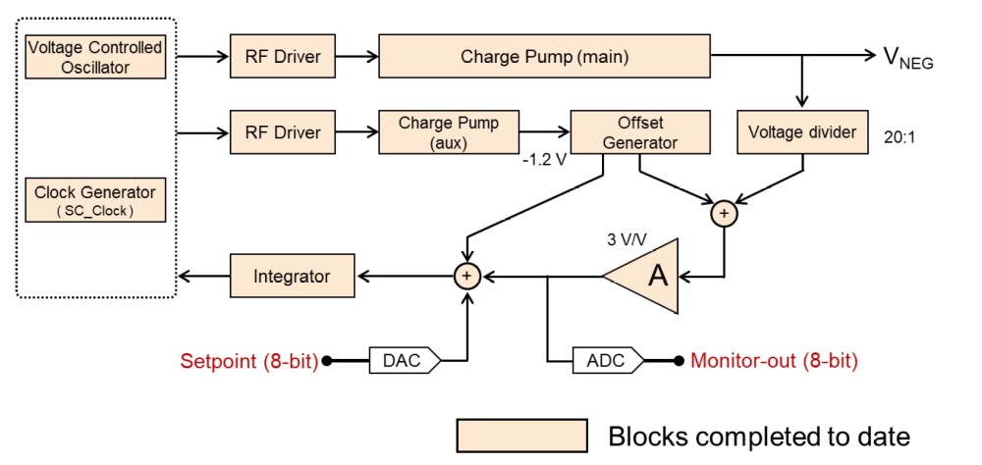
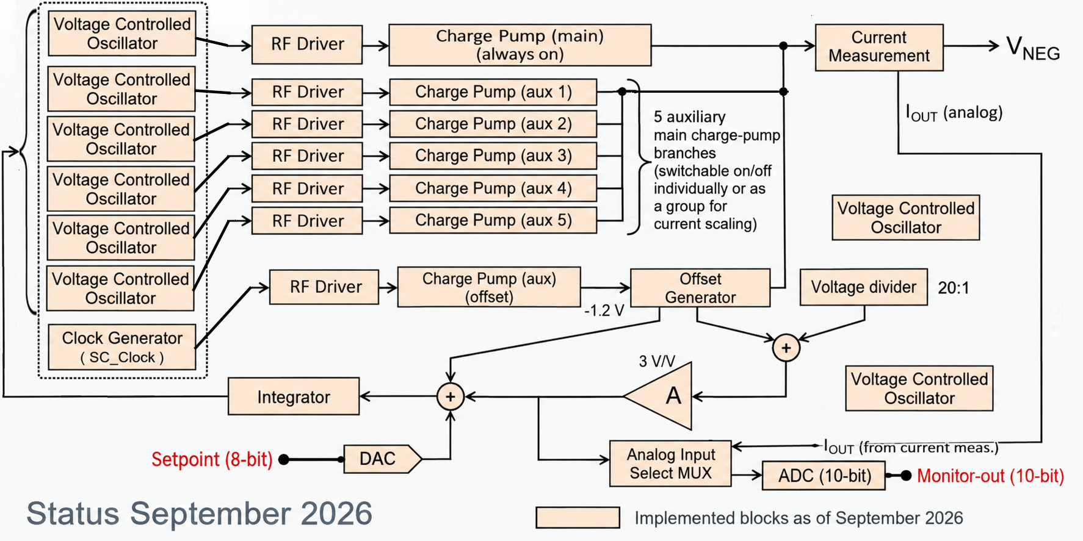
Negative Bias Management
Negative bias for MAPS sensors referred to local ground,
The NVBG follows the sensor’s local ground; ground-level variation of order 6–8 V along the serial-powering chain.
NVBG block specifications / simulations
Parameter | Value reported in the draft
Supply | 1.2 V ±10% (provided by 1st SLDO)
Output range | <−1 up to −5 V relative to local ground; 0 V mode
Reference DAC | 8 bit for V_{ref}
Output-current capability | ≈1 mA / section (6 sections: 1 Main + 5 Auxiliary) ; ≈200 µA nominal reference load/section
Output ripple | <0.15 mV; simulated
Power consumption | <15 mW; ≈11 mW at −1.5 V
Main charge pump | 16 selectable parallel branches / section
Status MPW2

Slide 9
Anc Brain – Slow Control Management (1)
Bridge between lpGBT and sensor control and monitoring
Interfaces and protocol — system baseline
Local management
Interface / function | Specification
lpGBT grouping | One slow-control e-link per group of up to 4 EIC-LAS 16 groups possible, while planned 12
Group signals | Command input, status output and clock: 3 differential pairs
Sensor-side protocol | 5 Mbit/s, Manchester encoded
Transaction protection | 40-bit data frame; CRC-16 protected
Sensor-side functions | Global clock, reset and synchronization; service and core slow control
Sequence supplies
Enable the four sensor rails after AncBrain start-up.
Program power and bias
Set SLDO and NVBG operating parameters.
Monitor operating nodes
ADC monitoring and over-temperature protection.
Handle faults
Centralized error handler and watchdog supervision.
Orchestrate MAPS operation
Autonomous synchronization of Strobe sequences (delay, frequence, duration).
SINGLE-DEVICE INTERFACE
Program and monitor MAPS
160 Mbit/s | 160 MHz
Rx/Tx e-links | common clock
One AncASIC connected to one lpGBT ePort
Loads and reads configuration.
The input e-link and the sensor-side slow-control link have different rates and formats.

Slide 10
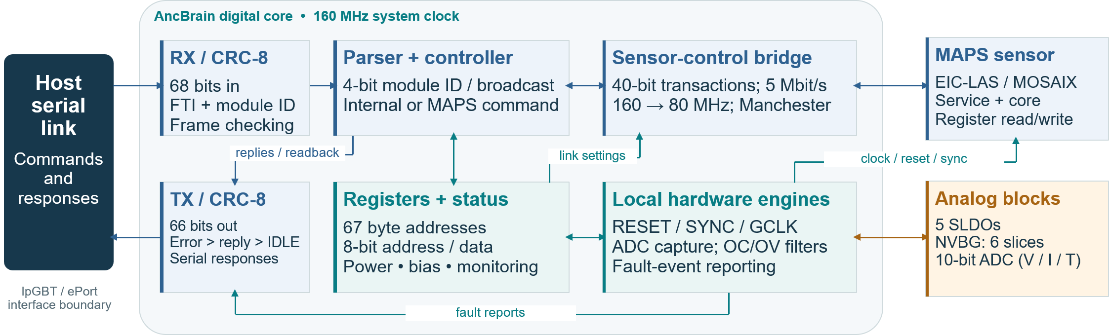
Anc Brain – Slow Control Management
Programmable settings plus hardware engines for sensor transactions, timing, ADC capture and fault reporting.
CONFIGURE
ACT
OBSERVE & RECOVER
Set supply and substrate-bias levels;
write and read the sensor registers.
Generate delayed RESET / GCLK;
start periodic SYNC by broadcast.
Capture ADC data; report faults;
issue commanded OCP-reset pulses.
Scope: no watchdog, TMR or autonomous temperature shutdown is instantiated; the final daisy-chain wrapper is outside this core.

Slide 11
AncASIC_XT011 sent for fabrication 09/2026
MPW run September 2026; expected delivery mid-February 2027; order 100 regular + 100 extra die
2,626.2 µm
GSVDD
GSVDD
GSVDD
GSVDD
16,446.2 µm
AncASIC_XT011
provides power, bias and slow control management for the two outer barrel layers and electron and hadron direction disks in the ePIC SVT detector, where serial powering has been adopted.
designed by the team of ASIC designers from BNL, RAL (UK) and LBL.

Slide 12
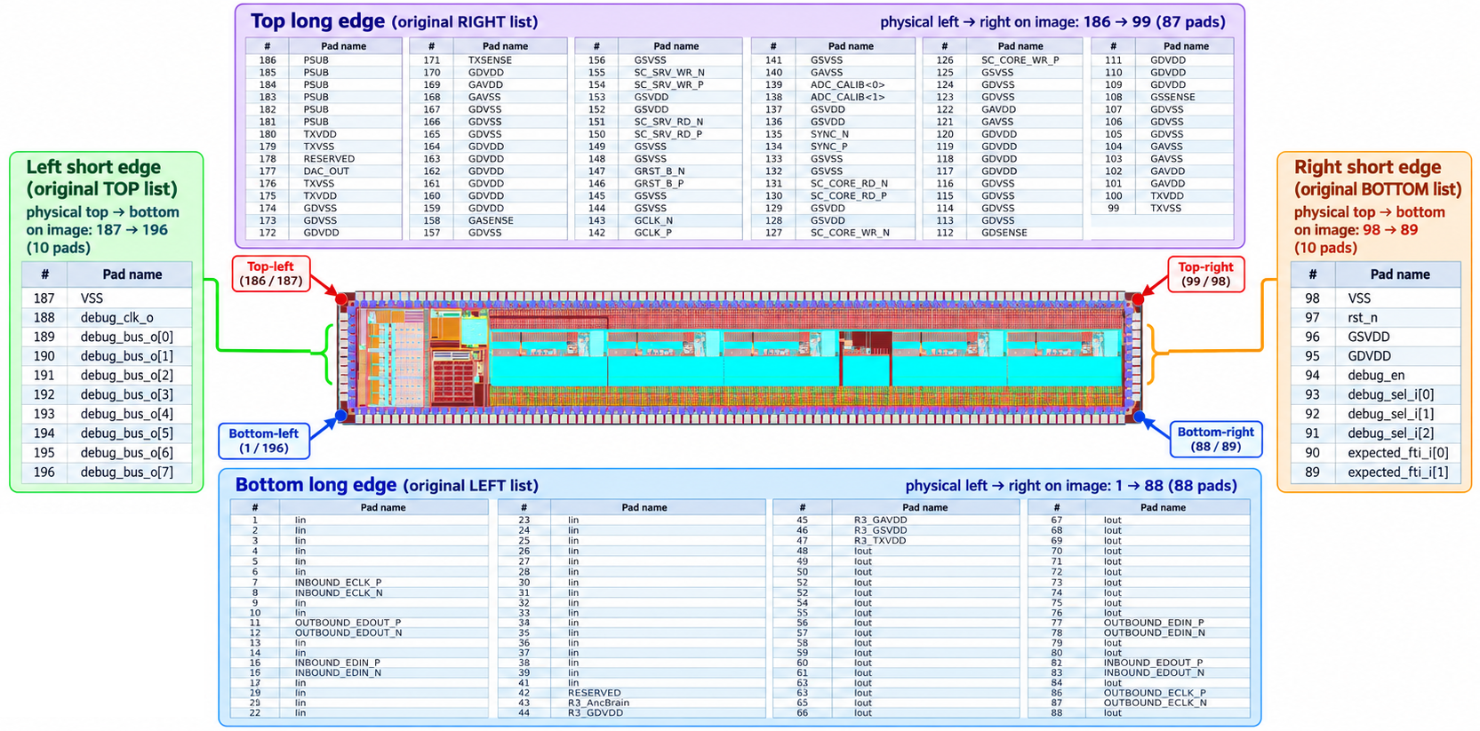
Description of Pads
Pads on both short sides are mostly for debugging in the current version of the ASIC only

Slide 13
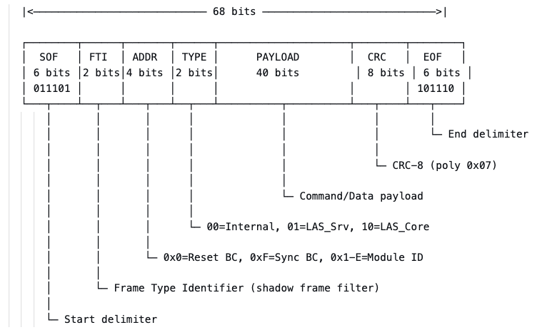
AncBrain: In/Out Frame Definition (1)
68 – bit AncBrain frame; lpGBT transparent to transmitted data and its format

Slide 14
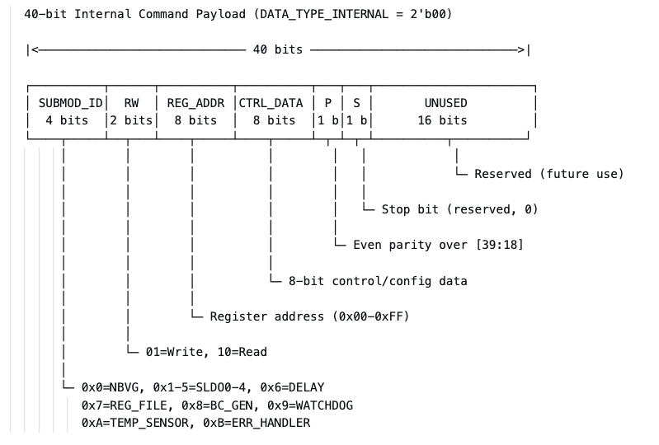
AncBrain: In/Out Frame Definition (2)
40 – bit AncBrain internal payload format

Slide 15
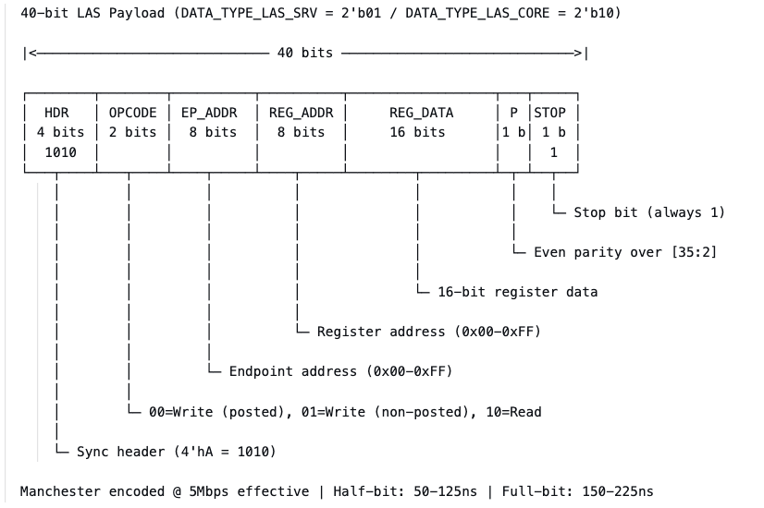
AncBrain: In/Out Frame Definition (3)
40 – bit MOSAIX interface payload format

Slide 16
AncBrain: In/Out Frame Definition (4)
Outbound IDLE frame for improving DC balancing in natural transmission
Idle frames are generated when no other frame is ready for outbound transmission.
Transmission of IDLE frames is enabled by default on startup
  can be disabled by writing 0x00 to register 0x0B (TX_IDLE_CTRL)
IDLE frames take the lowest priority in the TX queue (Error > Core > IDLE)
  Error and Core packets preempt IDLE at the next available TX slot
IDLE frames are structured as follows:
  They can be filtered by Type field = 2'b11
  The Payload alternates between two 40b words to attempt a balanced 0,1 population (DC balancing)
65 60 59 56 55 54 53 14 13 6 5 0
+------------+--------------+----------+----------------------------------------------+-----------+------------+
| SOF (6b) | ModAddr (4b) | Type(2b) | 40-bit IDLE Payload | CRC (8b) | EOF (6b) |
| 6'b011101 | module_id | 2'b11 | 36'hAAAAAAAAA + toggle_q (1b) + 3'b010 | CRC-8 | 6'b101110 |
+------------+--------------+----------+----------------------------------------------+-----------+------------+
[0x1D] [chip_id] [RESERVED] [Alternates 0xAAAAAAAAAA / 0xAAAAAAAAA2] [CCITT-8] [0x2E]

Slide 17
Summary of AncASIC submission Sept. 2026
Area | Submitted / reported status | Remaining work / next implementation
Analog integration | Five SLDOs + NVBG; monitoring ADC, temperature sensor and BGR-based pre-regulators for ADC and integrated with SLDOs | Coexistence, ground bounce at variable load conditions of MAPS sensors, load changes and protection behavior to be tested
Communication / digital integration | One AncASIC ↔ lpGBT ePort; 160 Mbit/s e-links and 160 MHz clock | Daisy-chain wrapper: buffering, retiming and response arbitration
Radiation / faults | Pad-clamp issues in MPW2 corrected – new simplified and reliability pads conceived | Holistic confirmation of radiation hardness, SEE cross-section testing; logic triplication and non-maskable interrupt handling
Verification | Mixed-level verification advanced, | Complete models, FPC mock-up populated with AncASIC, operating procedures for SC for DAQ group and chip documentation
BNL: Leonardo Cecconi, Grzegorz W. Deptuch, Dominik Gorni, Syed Hassan, Arif Iqbal, Soumyajit Mandal, Joao de Melo, Prafull Purohit, Nicholas St. John,
RAL: Iain Sedgwick, University of Oxford: Jaya John John, Roy Wastie,
LBL: Amanda Krieger

Slide 18
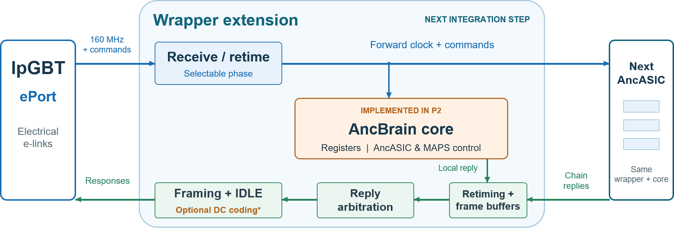
AncBrain: Wrapper to enable daisy chaining
A system-integration layer for daisy chaining and DC-balanced transmission
FOUNDATION
WRAPPER EXTENSION
Core control + single-device ePort interface
Daisy-chain transport around the same core

Slide 19
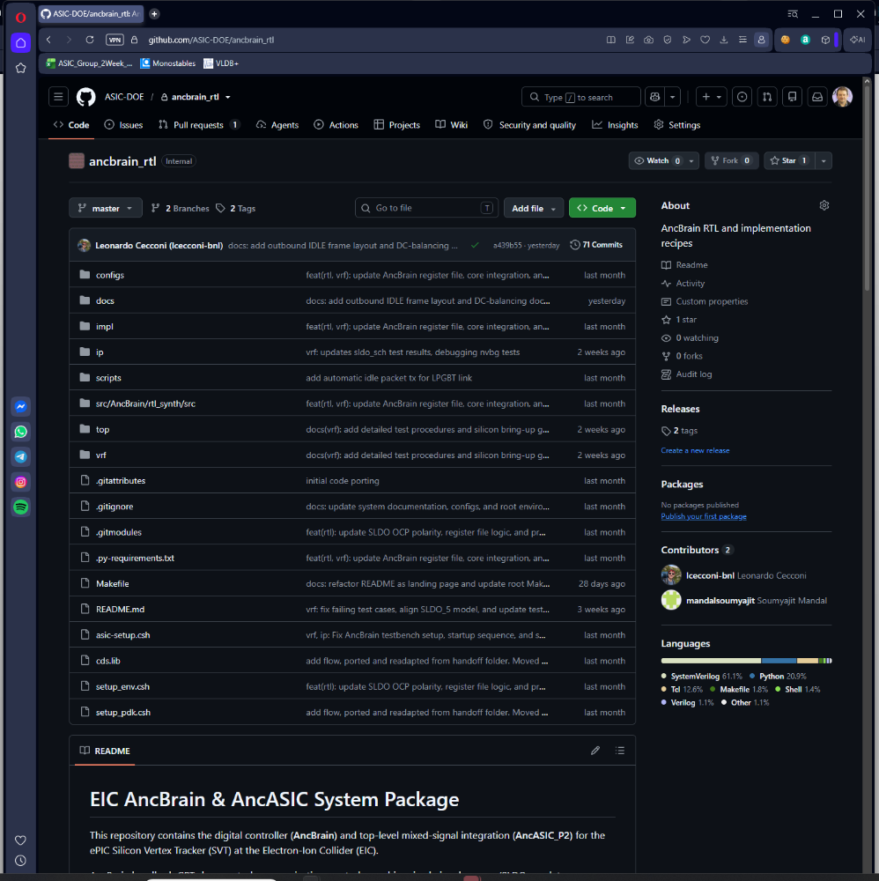
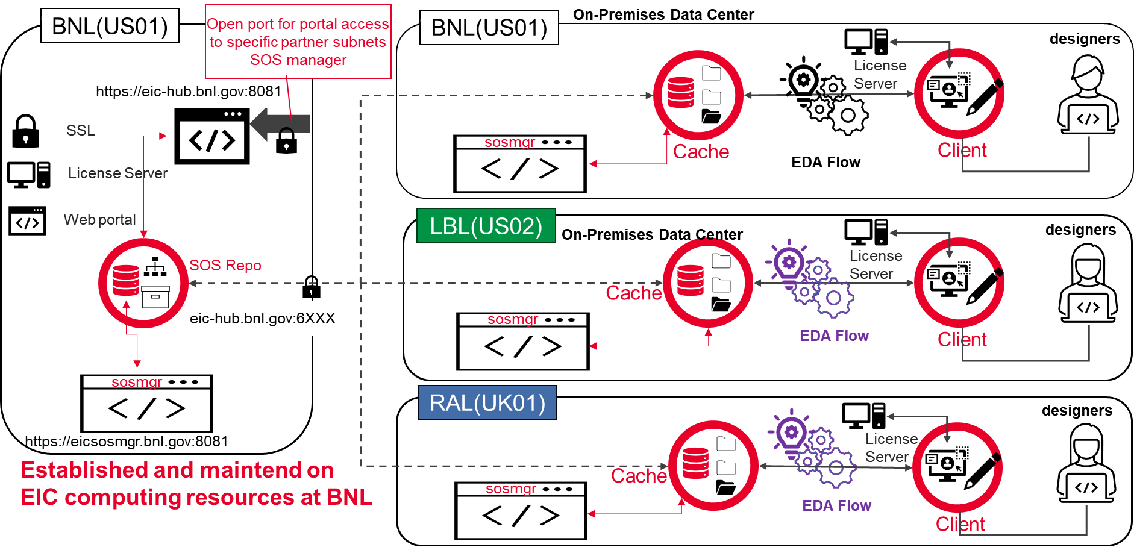

Shared design infrastructure
AncASICXT011_P1
AncASICXT011_P2
AncASICXT011_P3
AncASICXT011_E1
Two collaboration platforms connected ASIC, providing shared design resources and traceable contributions across institutions.
  Keysight SOS (formerly Cliosoft) — design-data management integrated with CAD/EDA tools,
  GitHub Enterprise — controlled repositories for AncBrain RTL, verification, implementation scripts and documentation,
Established and maintained through BNL ITD,
EIC_LASTPSCo_P1
EIC_LASTPSCo_P2
EIC_LASTPSCo_E1
GitHub Enterprise Cloud is FedRAMP-certified at the Low-impact level; use remains subject to institutional authorization and information-handling requirements.

Slide 20
Backup

Slide 21
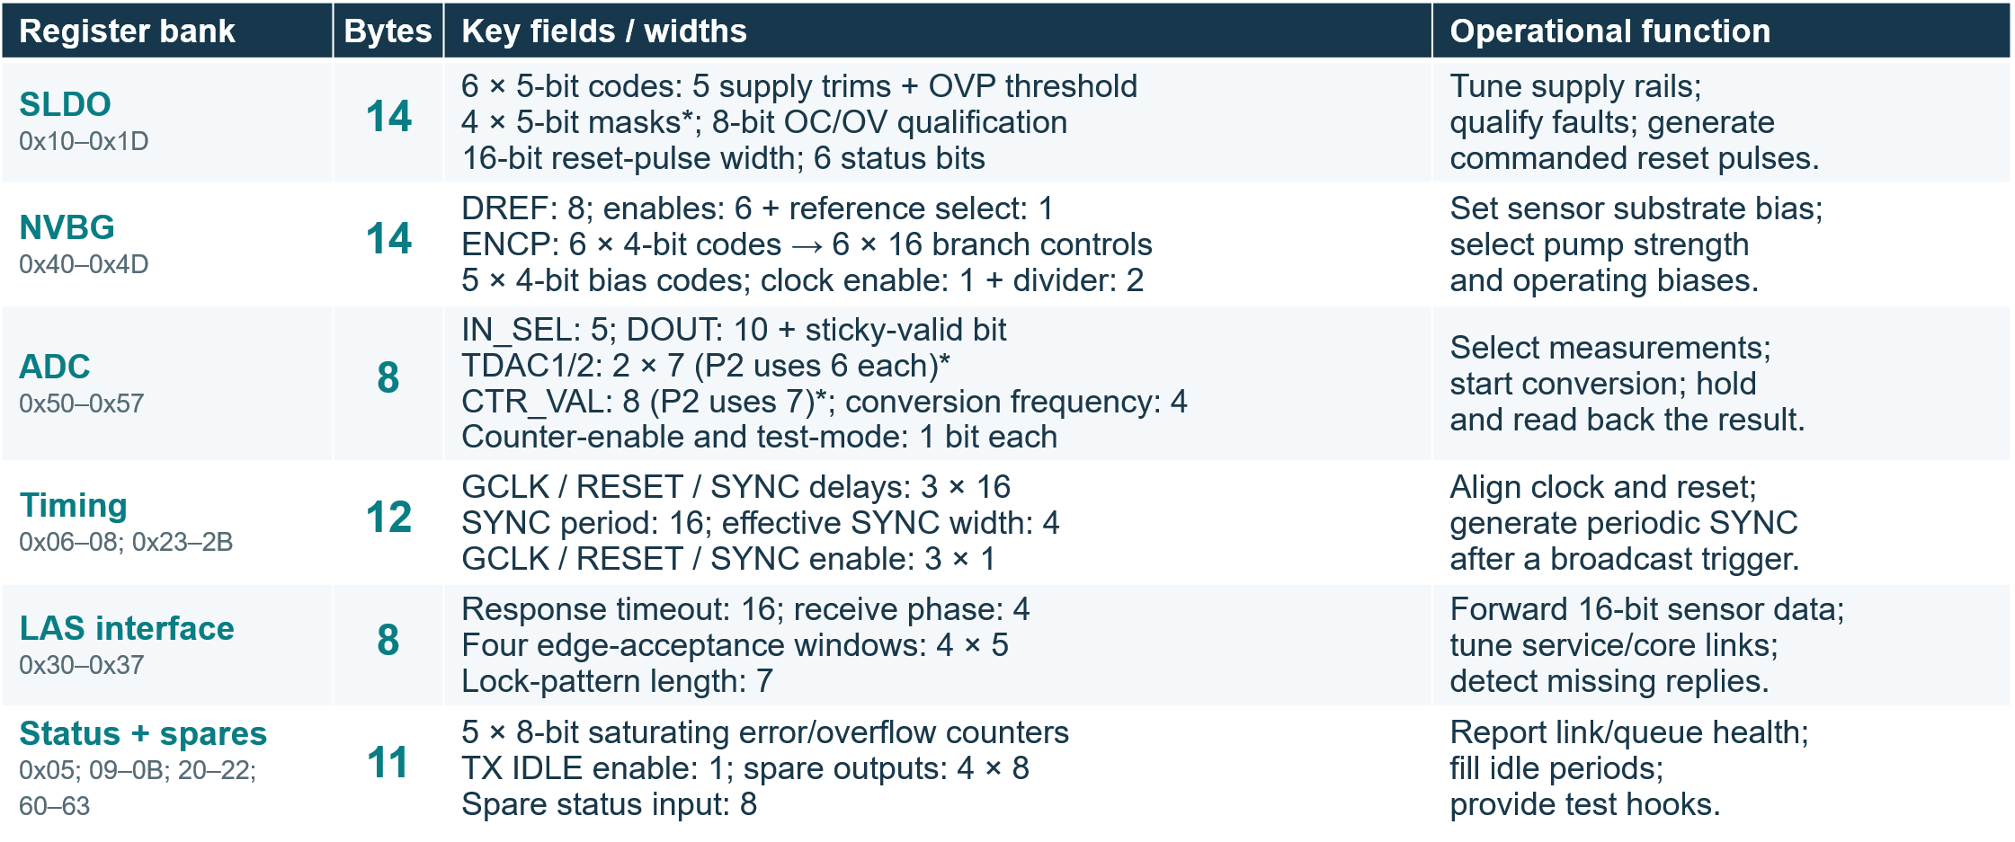
Anc Brain – Registers: settings, actions and readback
67 defined byte addresses • 8-bit address + 8-bit data • Field widths below are in bits.
*ADC trims use 6 of 7 bits; CTR_VAL uses 7 of 8. SLDO EXT/SEL masks exist in the core but are unconnected.
ADC readback: read 0x53 before 0x54; reading 0x54 clears held data, valid and conversion enable. Error/overflow counters clear on write.

Slide 22
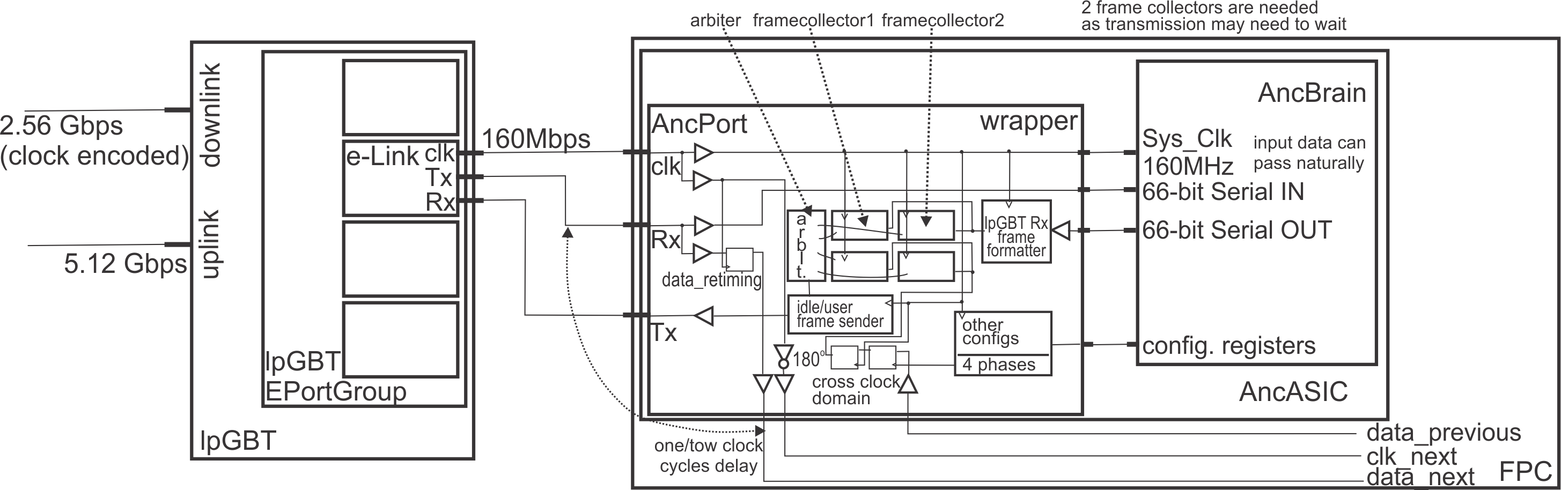
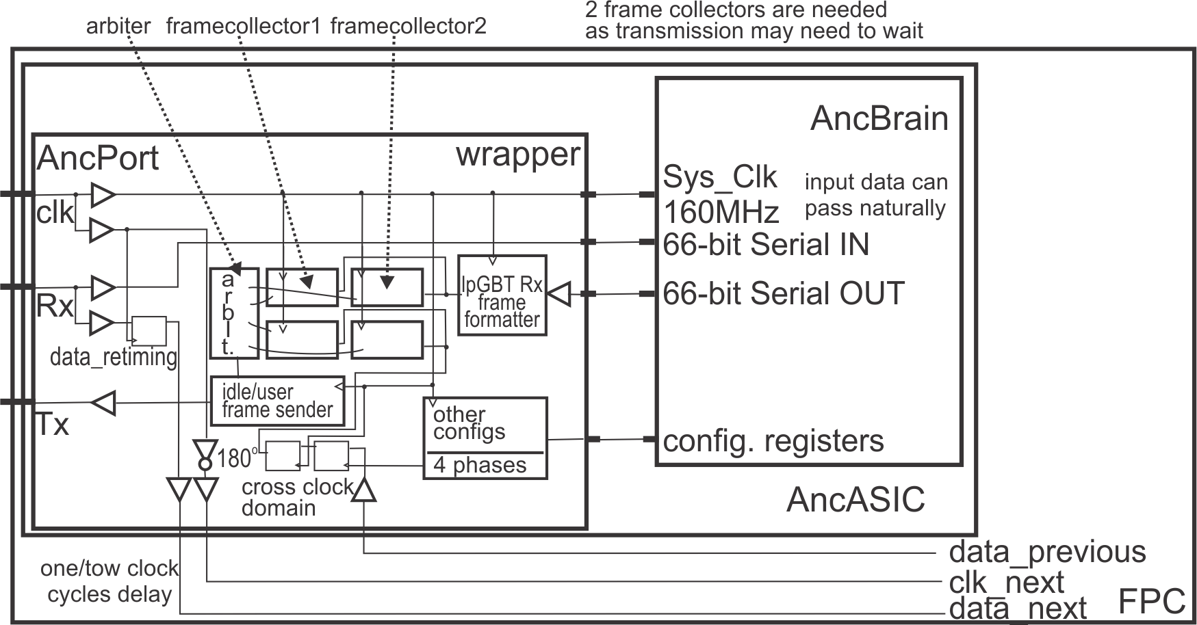
AncBrain - wrapper

