Slide 1
Transmission Dynode LDRD
Sept. 30, 2026
B. Azmoun, A. Kiselev (BNL)

Slide 2
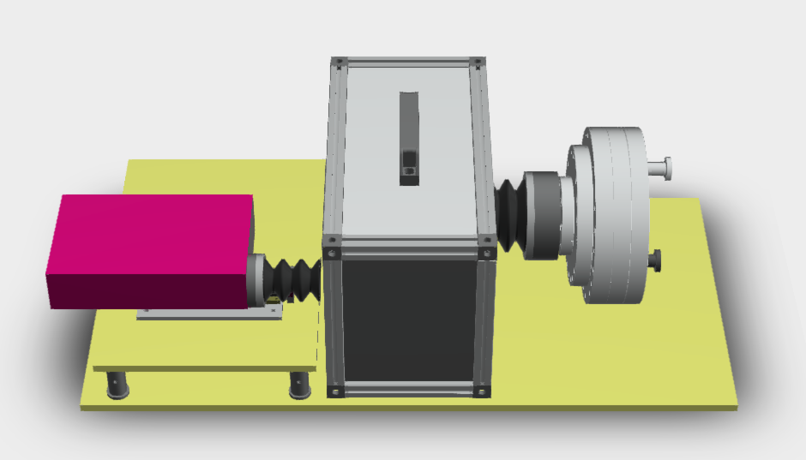
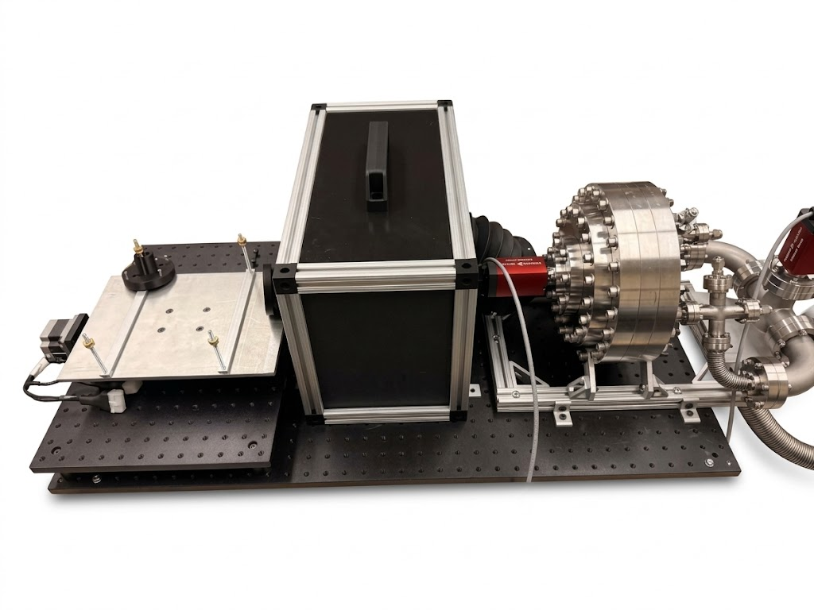
Apparatus
Model
As Built (so far)
Dark box for beam steering optics
Vacuum vessel
Laser
(free-space)
Bellows beam conduit
Window replaced by gauge for testing

Slide 3
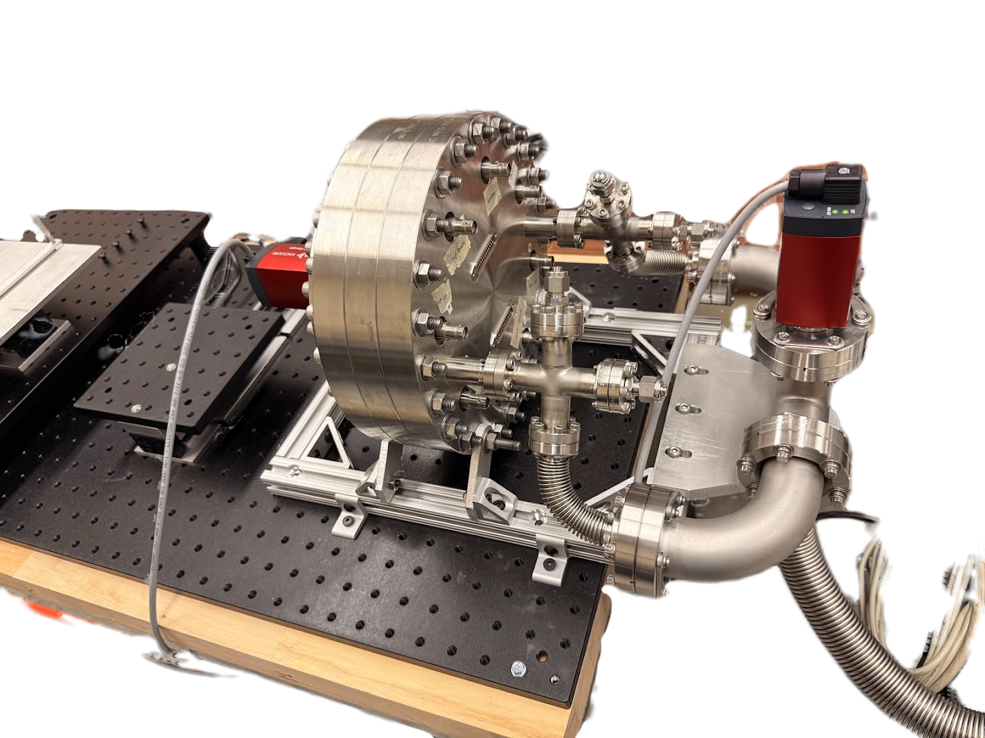
Vacuum Vessel
HV feed-thru (SHV x 8)
Signal pins (DB25 x 2)
Ports for RTD & gas in/out valves
Dual gauge (for test only)
Vessel
Dual gauge (permanent)
Vacuum manifold

Slide 4
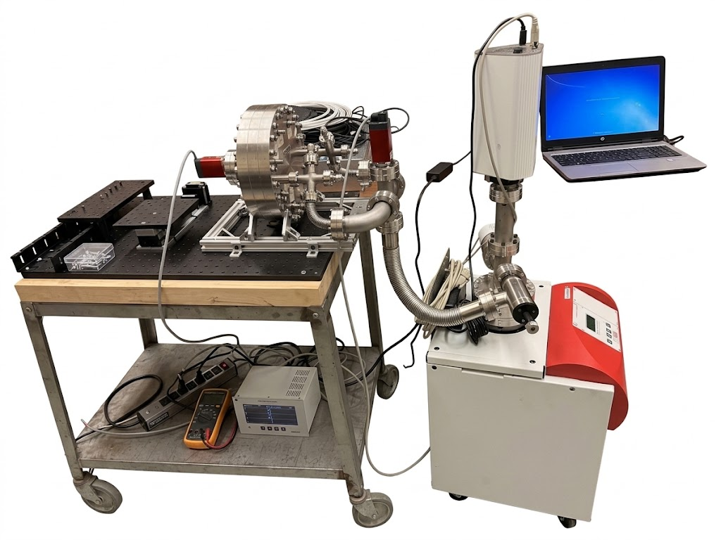
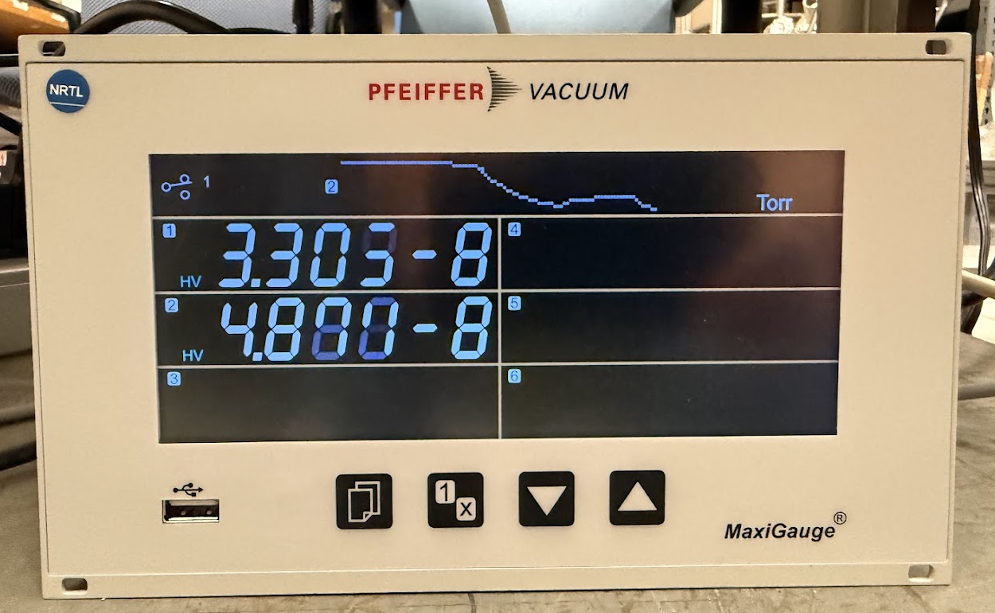
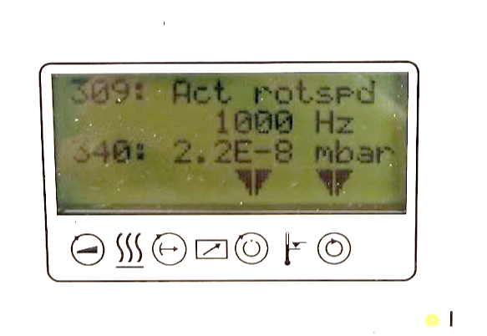
Vacuum
Pressure gauges
RGA
No baking
Pump duration: 5days
Pressure: ~5E-8 Torr
Turbo pump

Slide 5
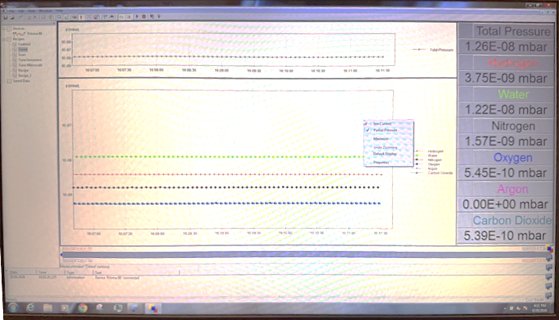
RGA
Water is the dominant component of trace residuals

Slide 6
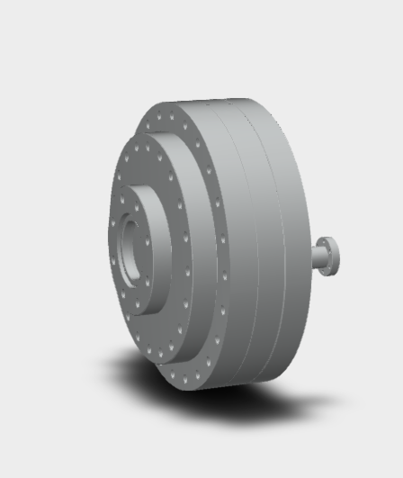
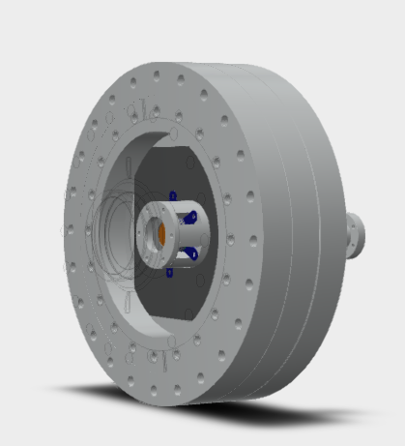
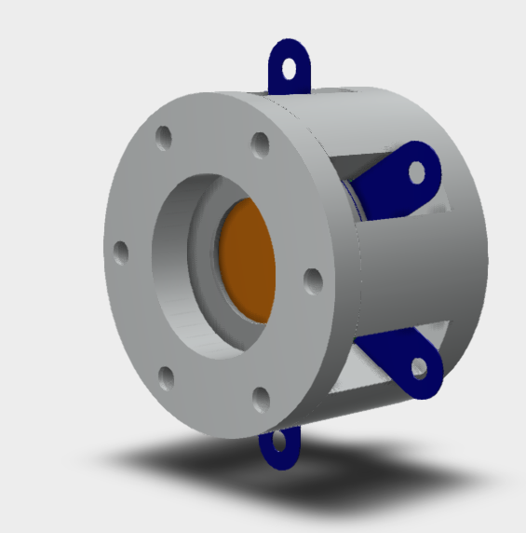
Vessel layout
HV pigtails bridge HV tabs to SHV feed-thru pins
Ceramic detector fixture
MgF2 window
Lid
Signal cables pass through bottom plate to feed-thru connector on rear
Distance to window is adjustable

Slide 7
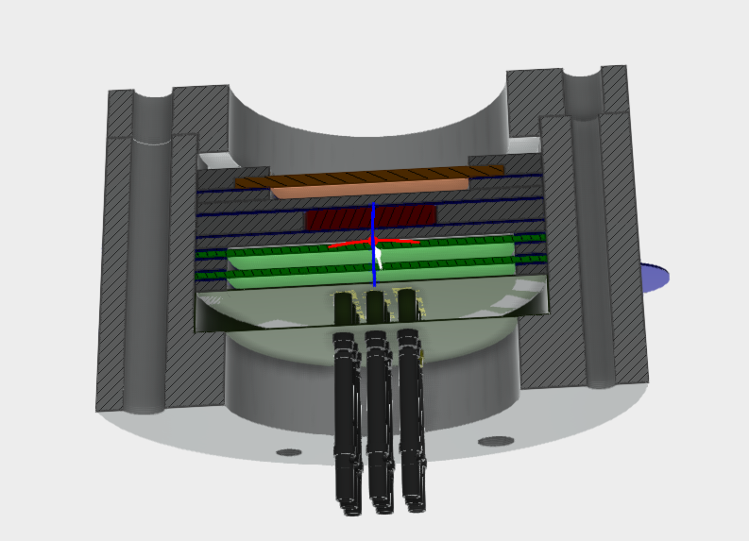
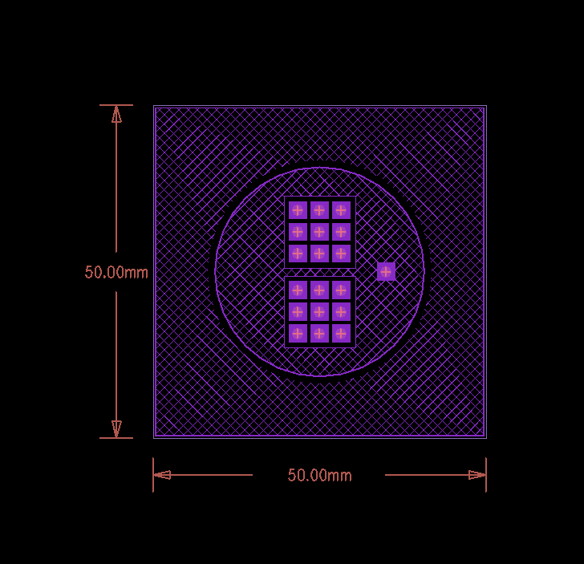
Detector stack-up
Gray: Ceramic mounting fixture and spacers
Blue: HV contacts
Mesh Anode (~90% trans., 70lpi Ni mesh /19µm LW)
Mesh PC (Al plated, 55% trans., 750lpi Ni /9µm LW, 2 x 5mm aperture )
Trans. Dynode / hole
MCP-1
MCP-2
Readout PCB
Signal pins
Readout PCB
Dual 3 x 3 pixel array (dynode/hole)
Rogers 3000 (UHV)
UHV coax cable x 10 bundle w/pin connectors

Slide 8
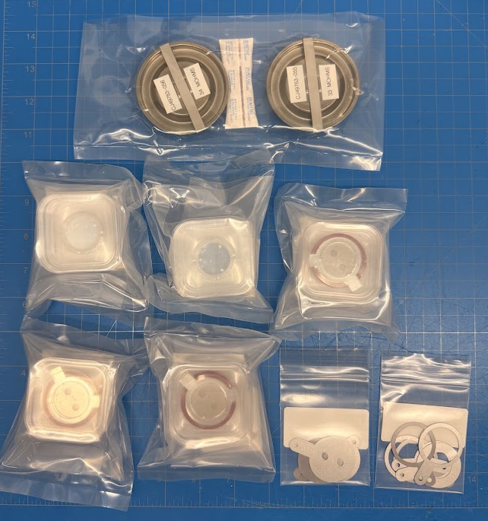
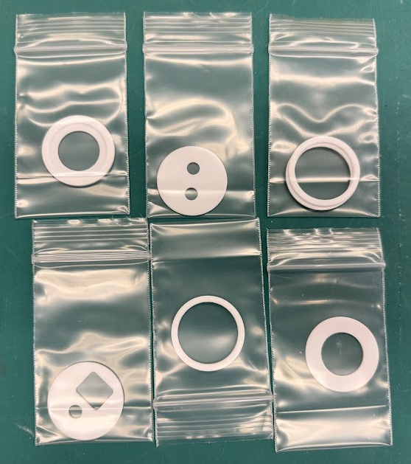
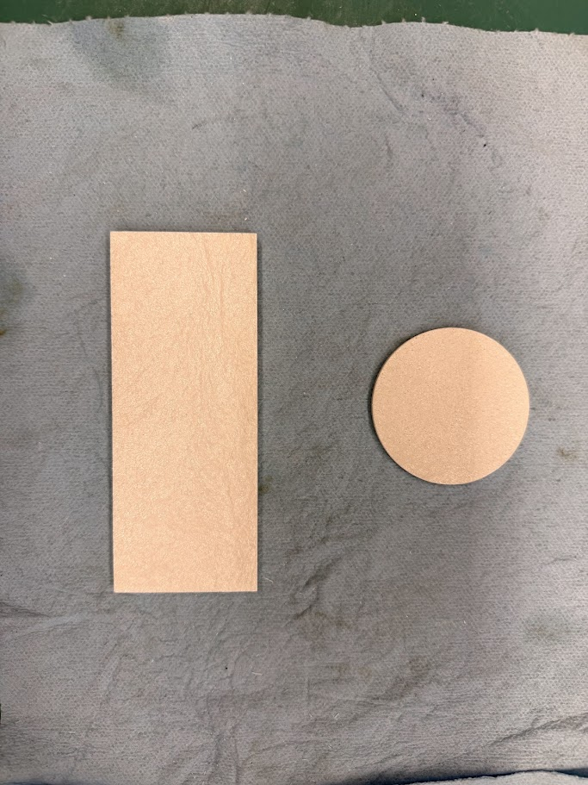
Procurement list
Custom ceramic spacers and cradles
(machined in house)
In hand:
MCP disks x2
Anode
PC (Al, Ni)
Dynode holder
HV contacts
Ceramic hardware
Standoffs
Vented screws
Purchase
Custom spring loaded HV contacts
Bottom plate
Fixture top

Slide 9
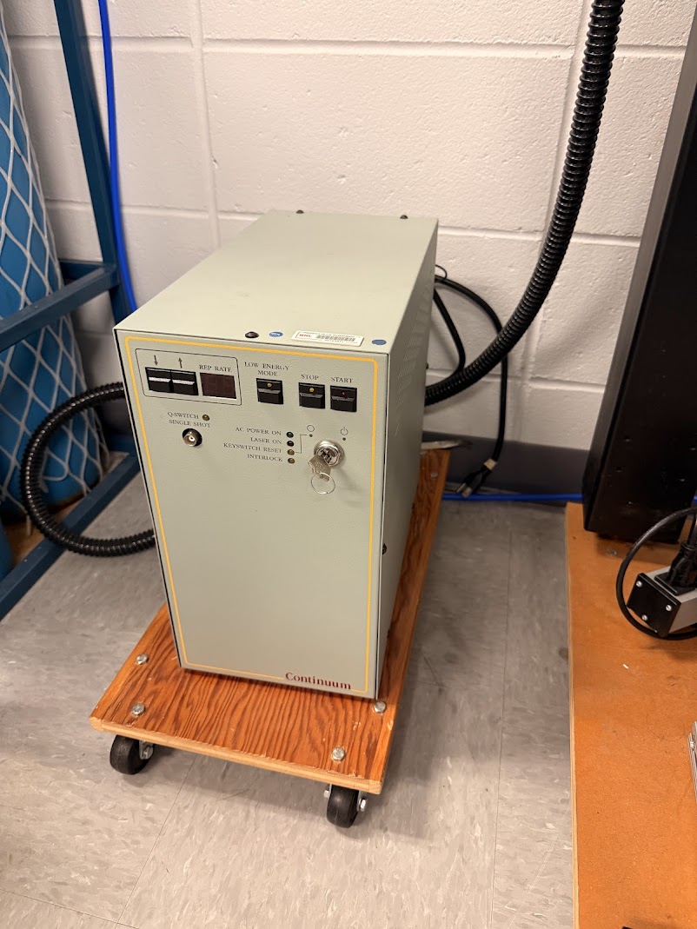
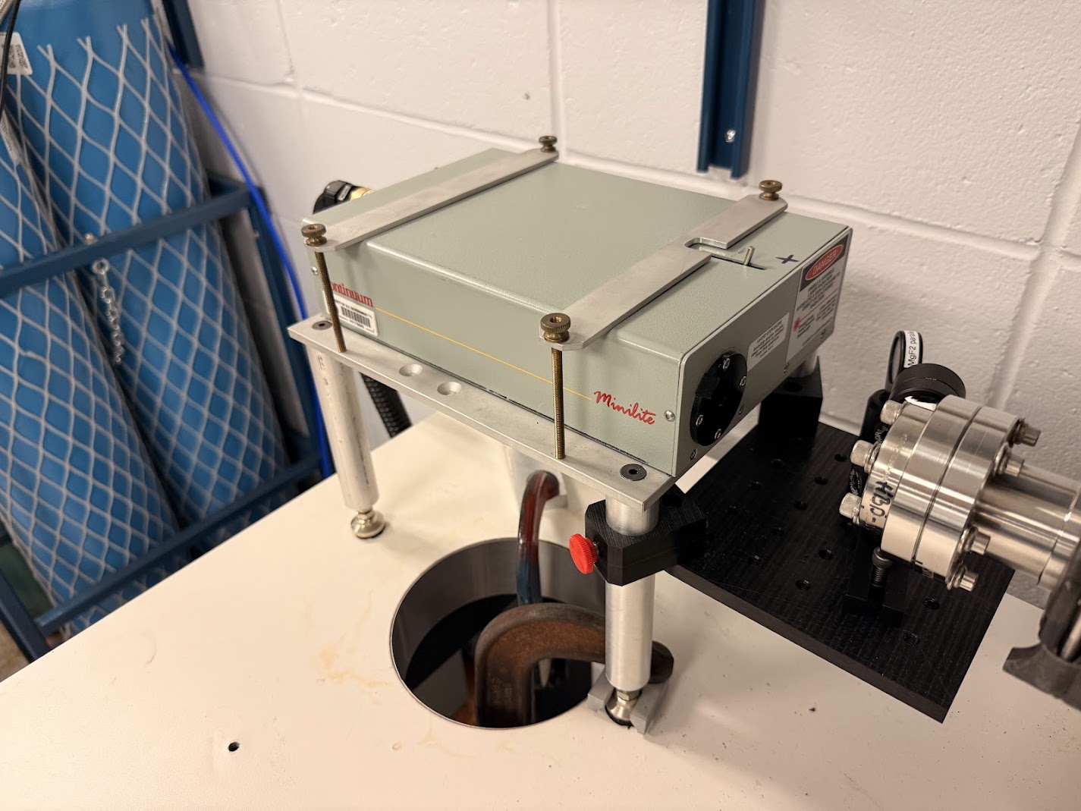
High Energy Laser
Initial studies
266nm (4.7eV) YAG (4th harmonic)
4mJ/pulse, 10Hz max rep rate
4ns pulse width
Jitter: O(1ns)
Free-space beam (diam. ~3mm)
Use lens to focus/defocus beam onto target focal plane

Slide 10
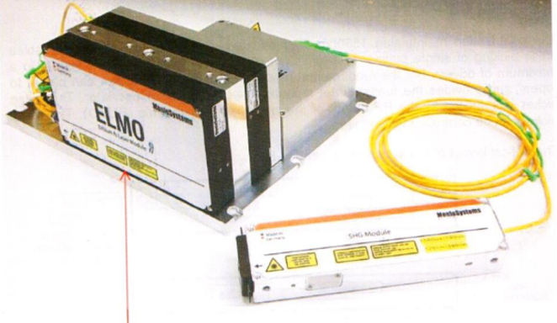
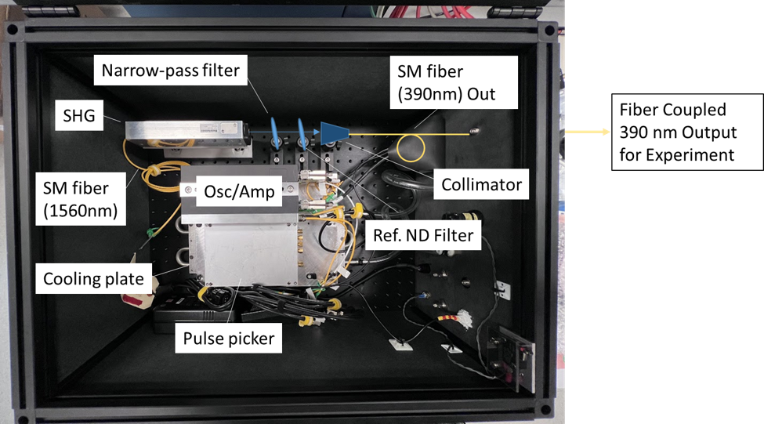
Femto-second Laser
Timing studies
780nm (1.6eV) Erbium doped fiber
(2nd harmonic)
0.63nJ/pulse, 50MHz max rep rate
<140fs pulse width
Jitter: O(100fs)
Fiber coupled beam
Use lens + collimator to focus beam onto focal plane
Exploit 3-photon absorption: 3 x 1.6eV = 4.8eV
(Al Work Fcn ~ 4.0 - 4.3eV)

