Slide 1
BTOF resolution update
10/1/2026

Slide 2
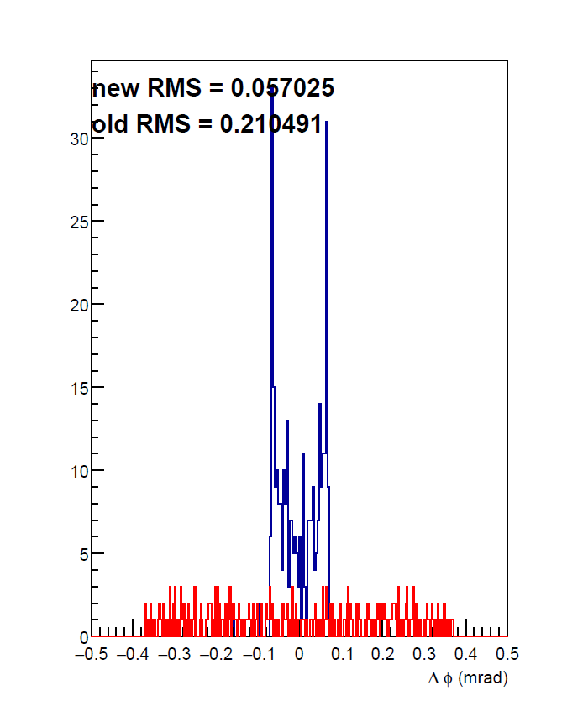
Questions raised in the reconstruction meeting.
Why is the shape of phi_reco – phi_truth so weird with 2 peaks?
Does TOF resolution in simulation agree with beam test data?

Slide 3
Questions raised in the reconstruction meeting.
Why is the shape of phi_reco – phi_truth so weird with 2 peaks?
  A: It is expected. Will show.
Does TOF resolution in simulation agree with beam test data?
  A: No, beam test result is better. Can recreate in simulation under certain circumstances.

Slide 4

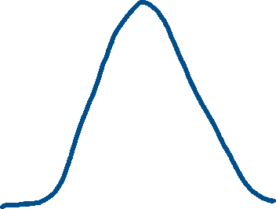













x_reco – x_truth(phi_reco – phi_truth)
Forget eicrecon. Do something simple.
X_reco = (-2*Integral(-3, -1) + 2*Integral(1, 3))/Integral(-3, 3)
X_true is uniformly distributed from –1 to 1.
-3
-1
1
3

Slide 5
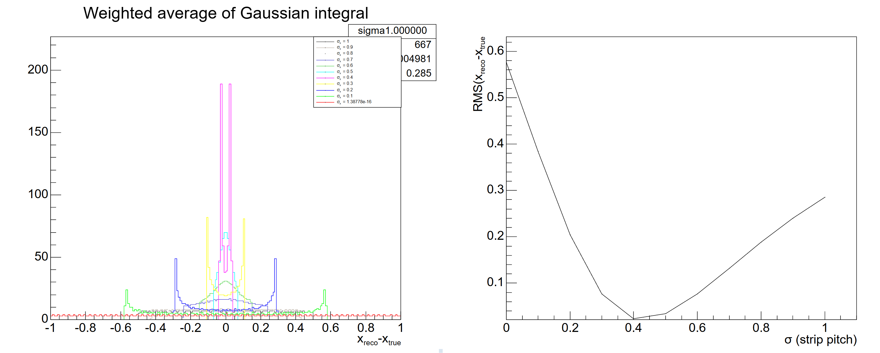
x_reco – x_truth(phi_reco – phi_truth)
Only consider 3 strips
Also see the two peaked distribution!

Slide 6
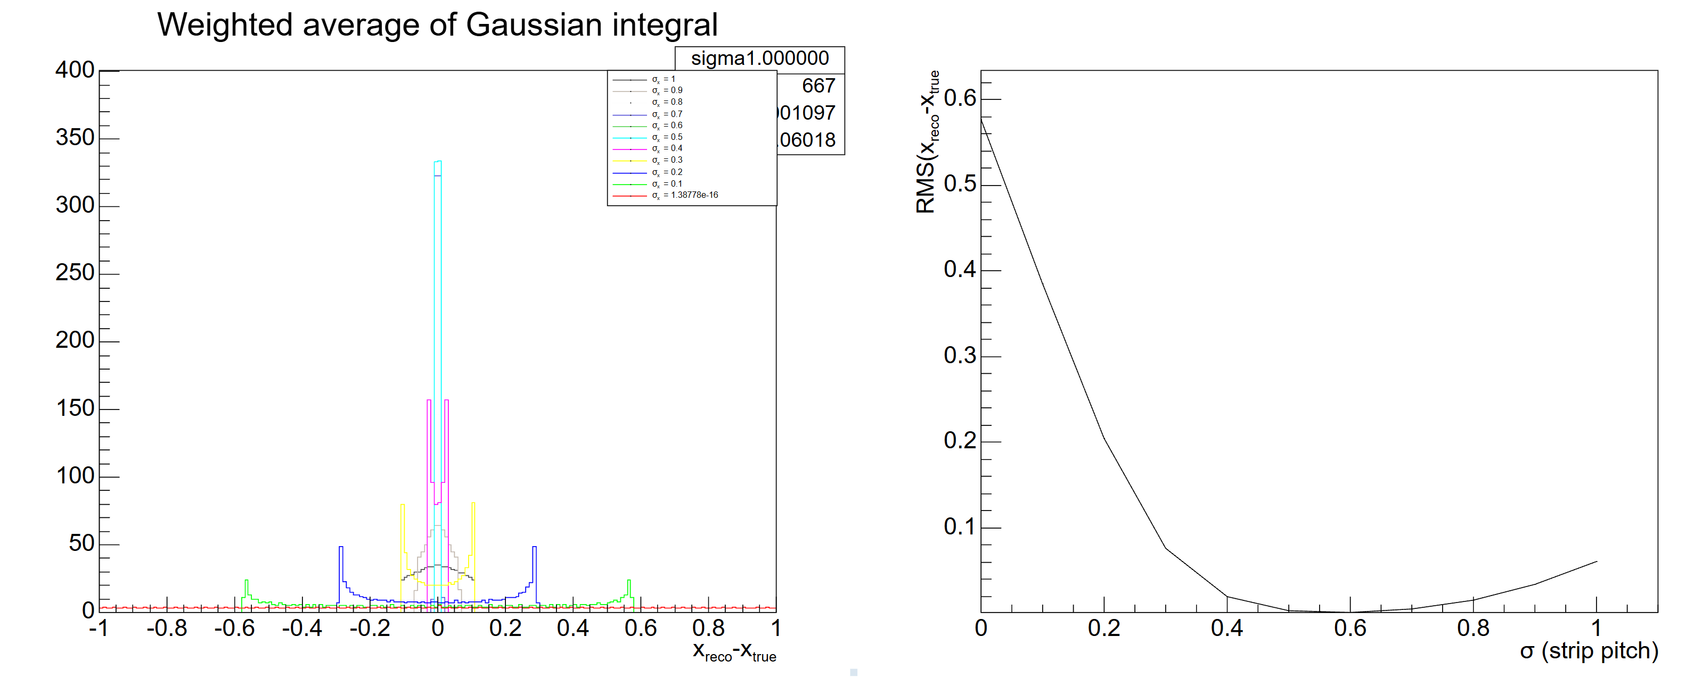
x_reco – x_truth(phi_reco – phi_truth) consider 5 strips
Also see the two peaked distribution!

Slide 7
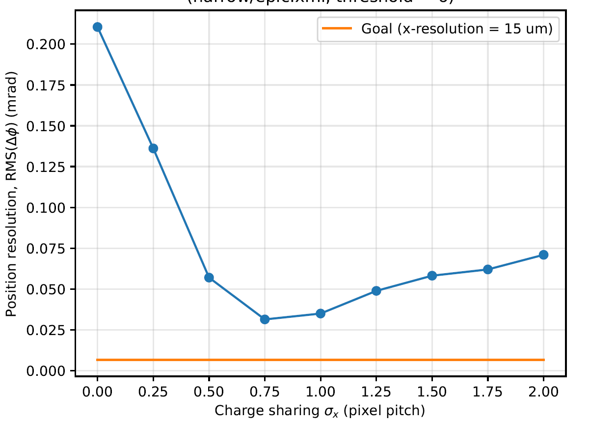
X(phi) resolution vs sigma
Simple model vs EICrecon
Only consider hits with total Edep > 6 keV

Slide 8
But position resolution in simulation is still too bad.
Only consider hits with total Edep > 6 keV

Slide 9
Differences between simple model and EICrecon
EICrecon discard cells whose Edep < 6 keV.
Edep is digitized into units of 1 keV, e.g. 6.7 keV edep is truncated to 6 keV.
Edge effect.
Angular effect: test beams are shot perpendicular to the sensors. In simulation, 50 < theta < 130 deg.

Slide 10
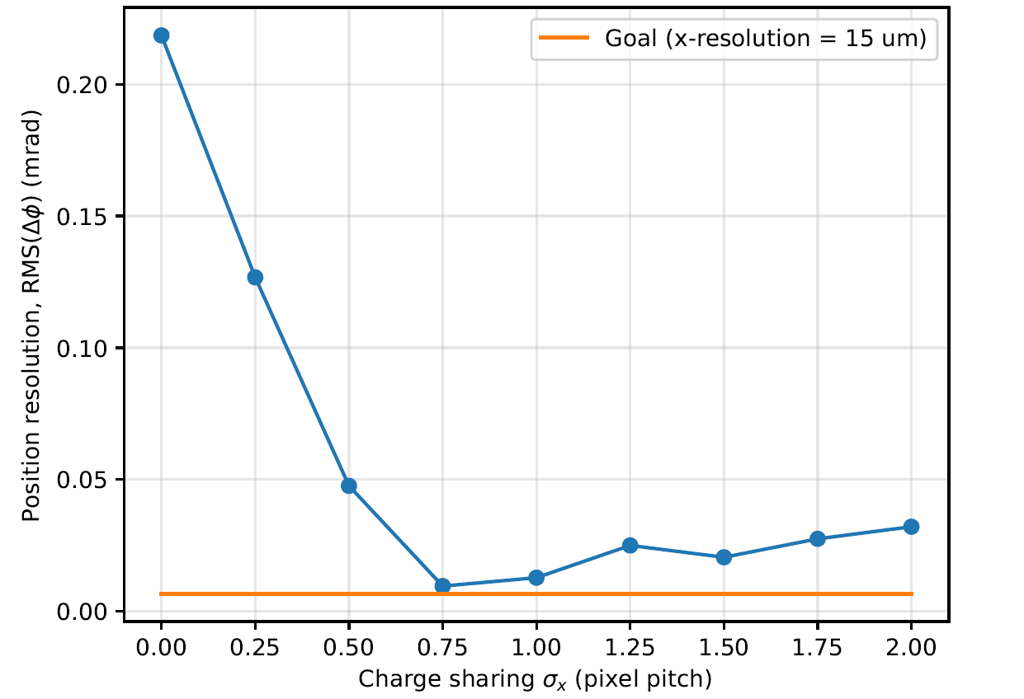
Focus on |loc.x| < 10 mm (width of sensor is 30 mm).
BTOF sensor illustration
Threshold = 6 keV
10 mm
15 mm

Slide 11
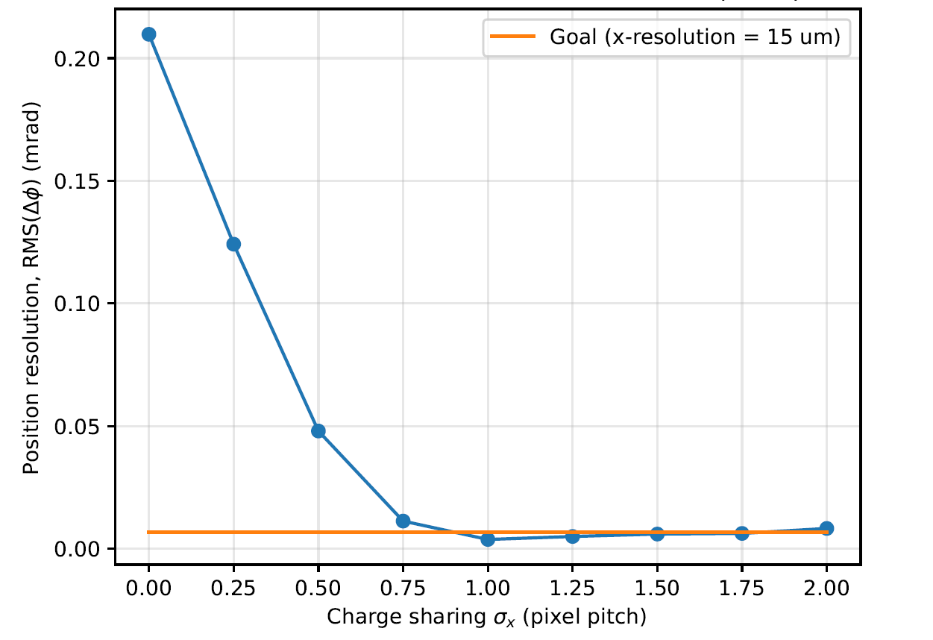
Focus on |loc.x| < 10 mm (width of sensor is 30 mm).
BTOF sensor illustration
Threshold = 600 eV
10 mm
15 mm
Sigma = 0.9*pixel pitch

Slide 12
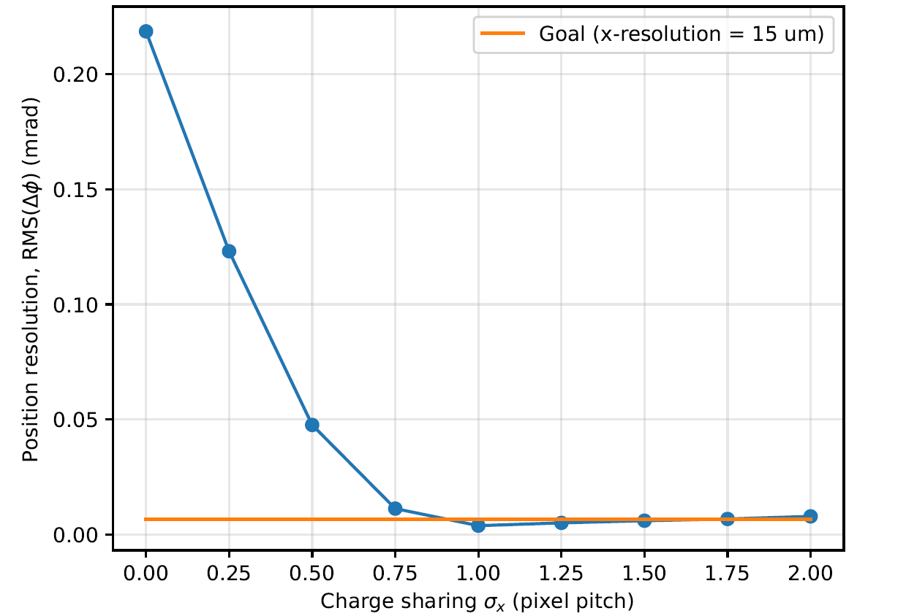
Focus on |loc.x| < 10 mm (width of sensor is 30 mm).
BTOF sensor illustration
Threshold = 6 eV
10 mm
15 mm
Sigma = 0.9*pixel pitch

Slide 13
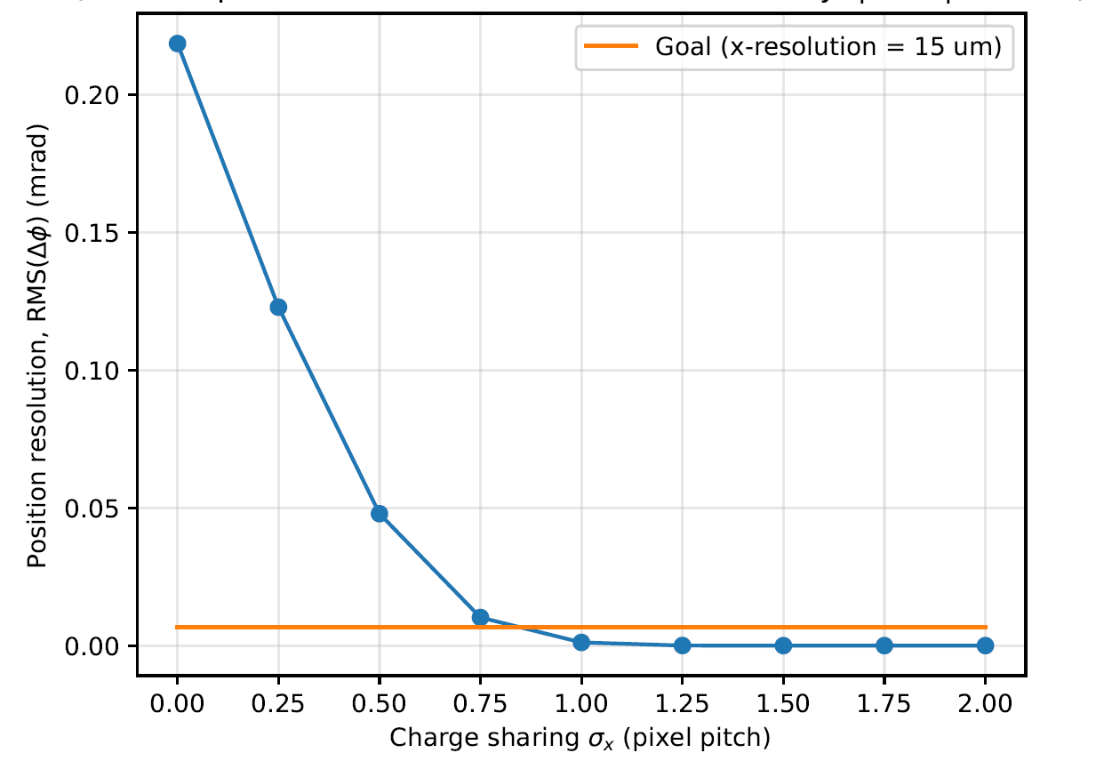
Focus on |loc.x| < 10 mm (width of sensor is 30 mm).
Digitization NO channels increase by 1000 times, Threshold = 6 eV
BTOF sensor illustration
10 mm
15 mm

Slide 14
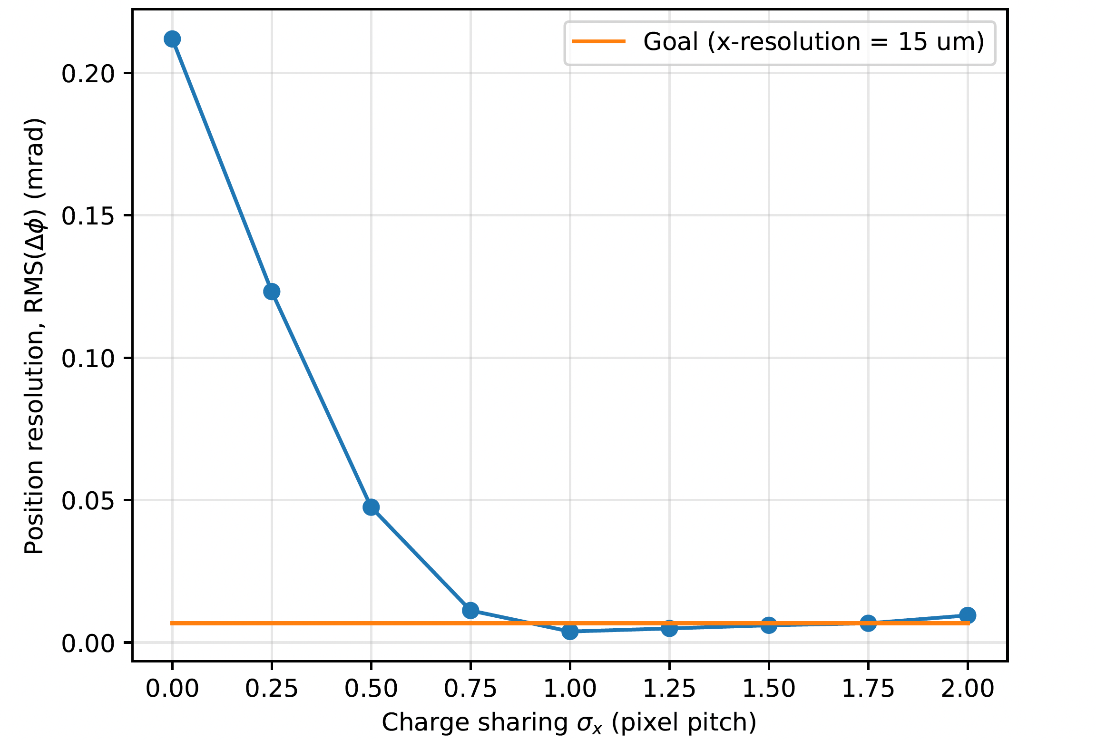
Focus on |loc.x| < 14 mm (width of sensor is 30 mm).
Total resolution is being weighed down by hits at the 1mm edges!
BTOF sensor illustration
Threshold = 6 eV
14 mm
15 mm

Slide 15
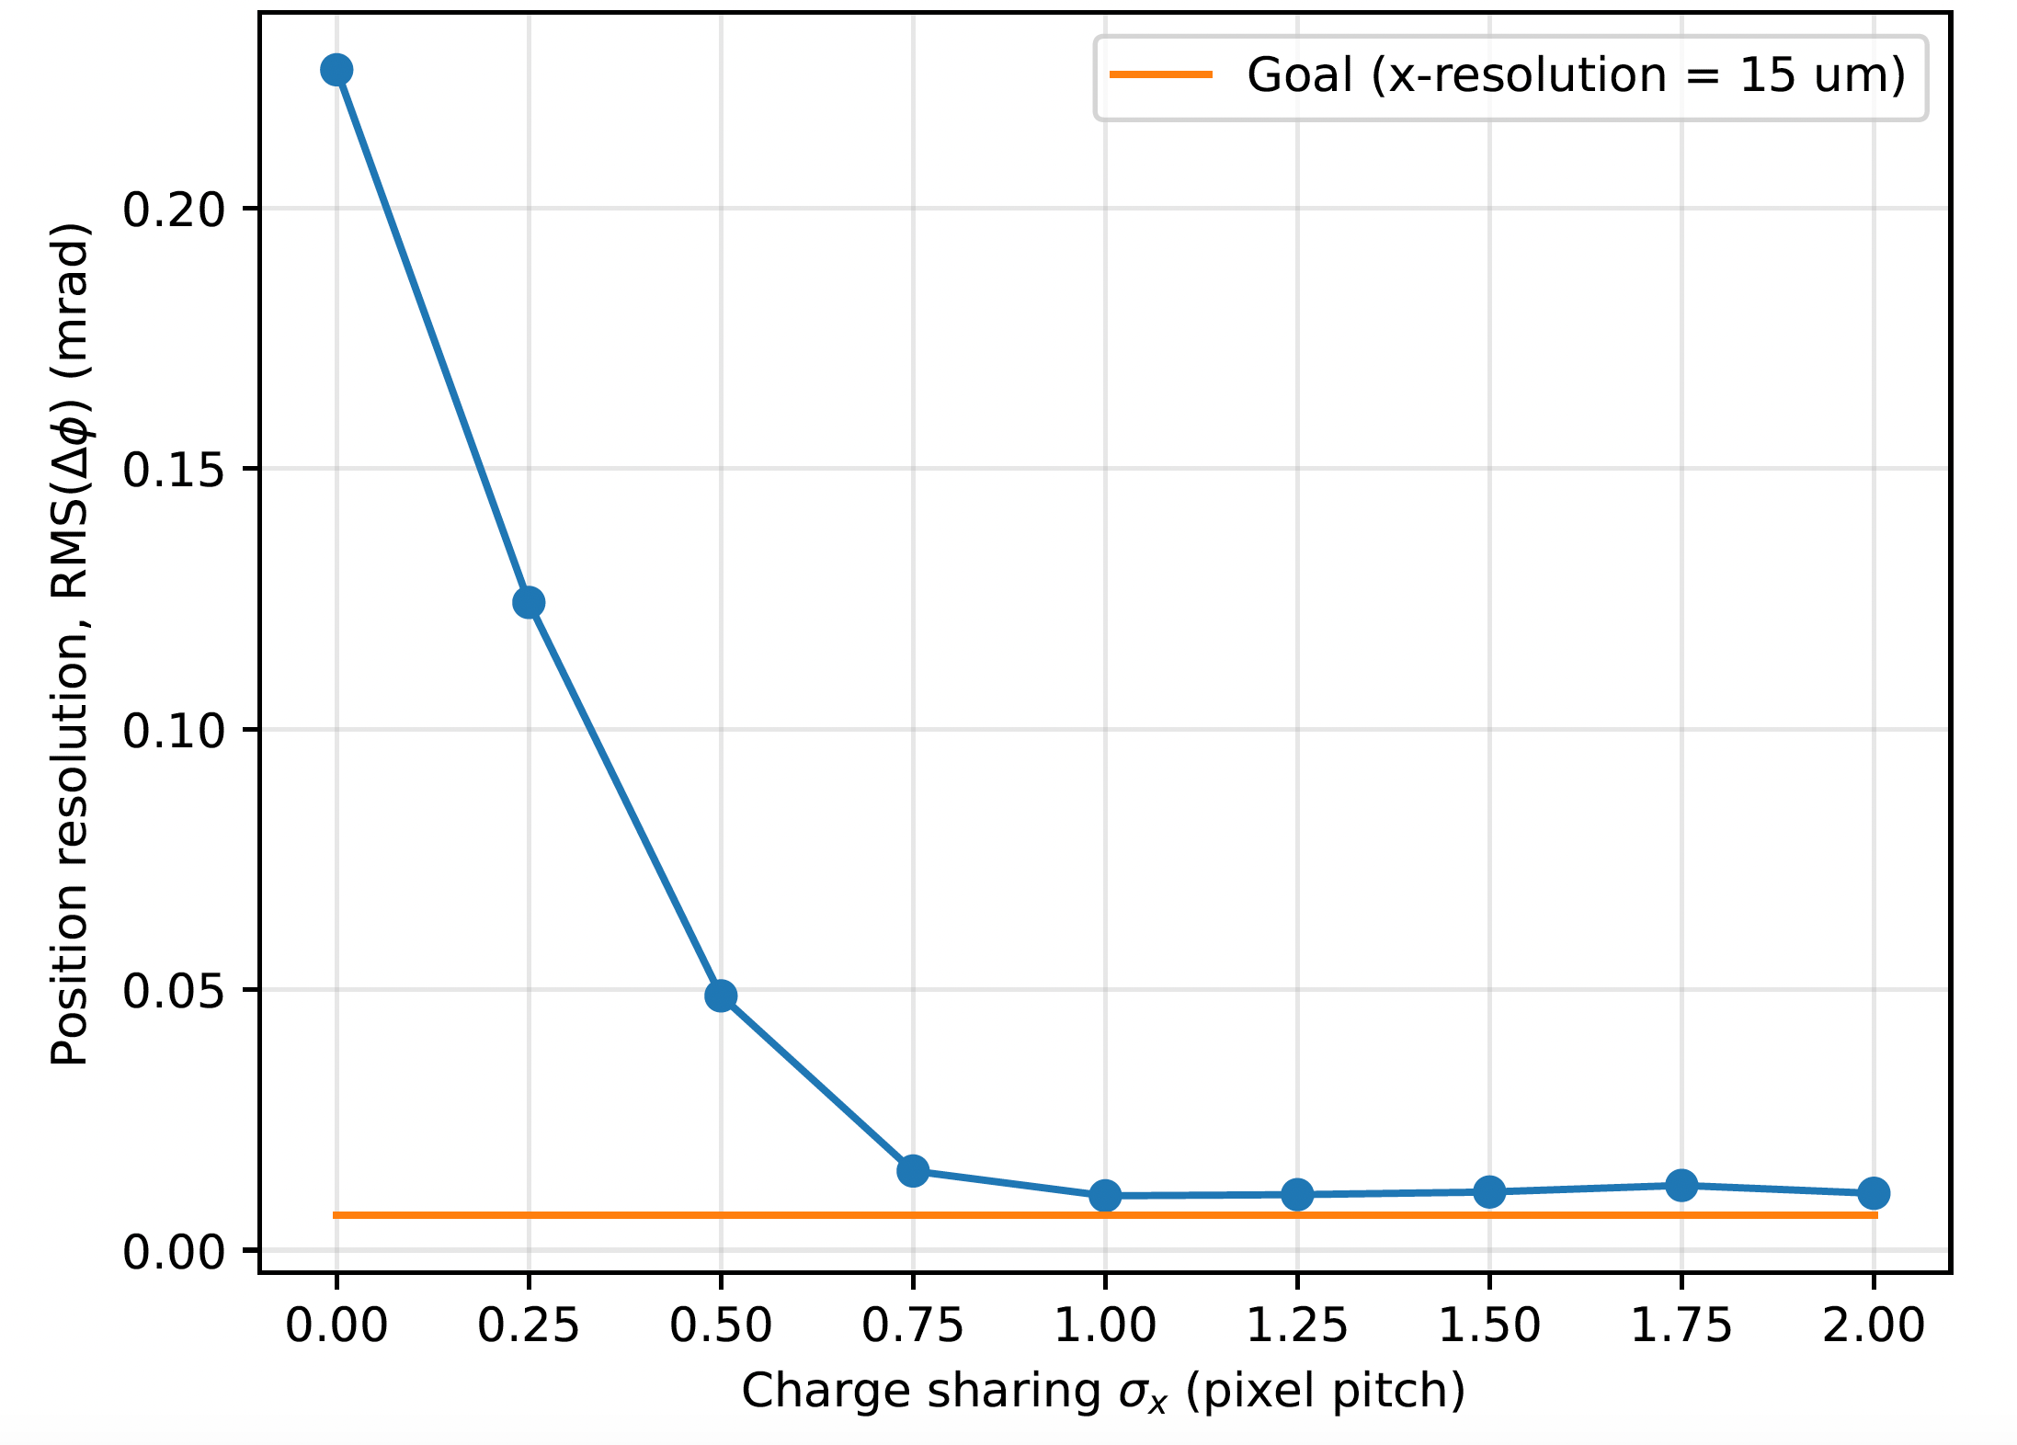
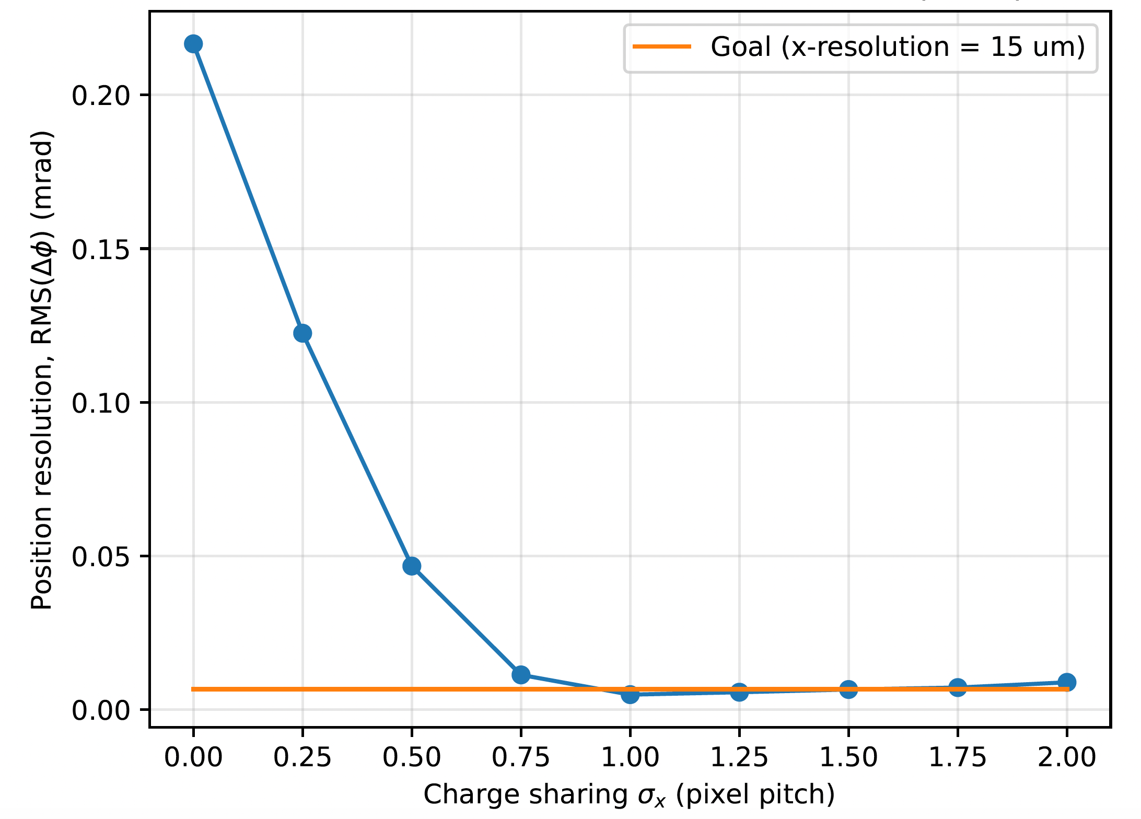
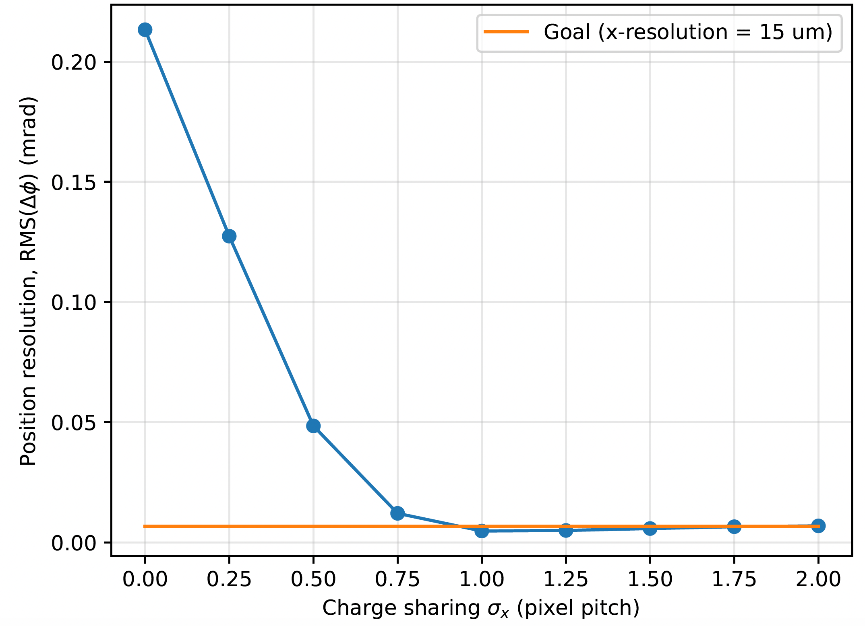
Angular dependence
BTOF sensor illustration
Threshold = 600 eV
10 mm
15 mm
Theta = 30 deg
Theta = 50 deg
Theta = 70 deg
Theta = 90 deg

Slide 16
Conclusion
To recreate beam test resolution, sigma_x = 0.9*pixel pitch.
To increase position resolution,
  Reduce thresholds
  Increase NO ADC channels
Resolution from realistic events will be worse because:
  Edge effect of sensors.
  Beam not entering perpendicular to the sensor (i.e. theta != 90 deg).
  Digitization error in energy.

Slide 17
Backup slides
50 < theta < 130 deg.

Slide 18
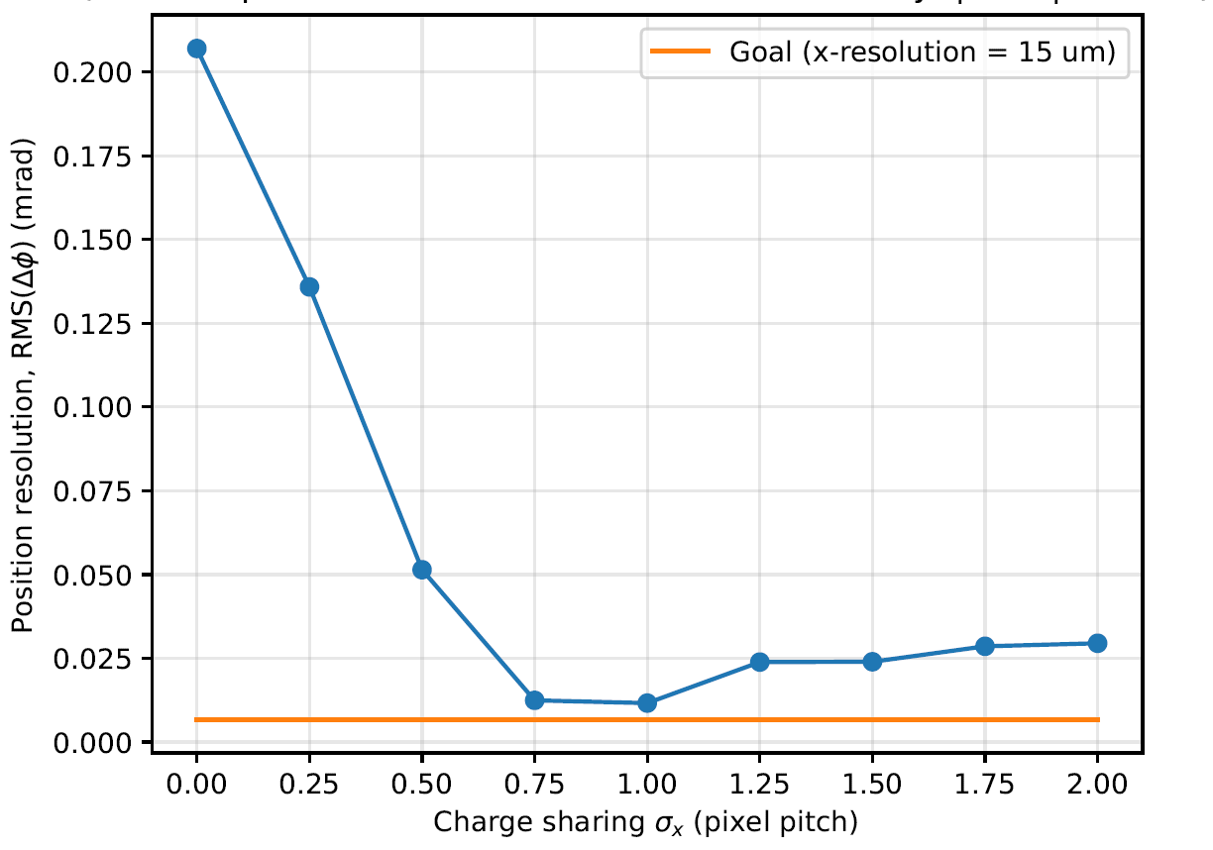
Focus on |loc.x| < 5 mm (width of sensor is 30 mm).
BTOF sensor illustration
15 mm
5 mm

Slide 19
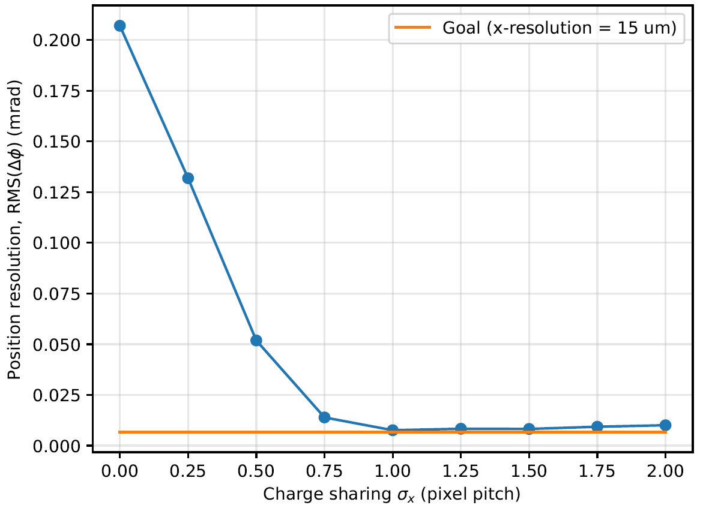
Focus on |loc.x| < 5 mm (width of sensor is 30 mm), lowered thresholds to 0
BTOF sensor illustration
15 mm
5 mm

Slide 20
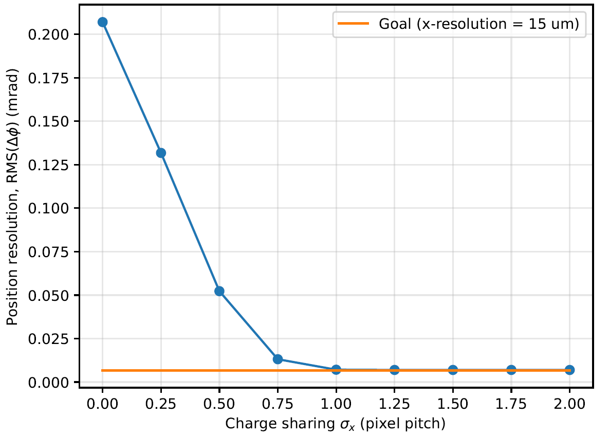
Focus on |loc.x| < 5 mm (width of sensor is 30 mm), lowered thresholds to 0, increase digitization fidelity by factor of 100
BTOF sensor illustration
15 mm
5 mm

Slide 21
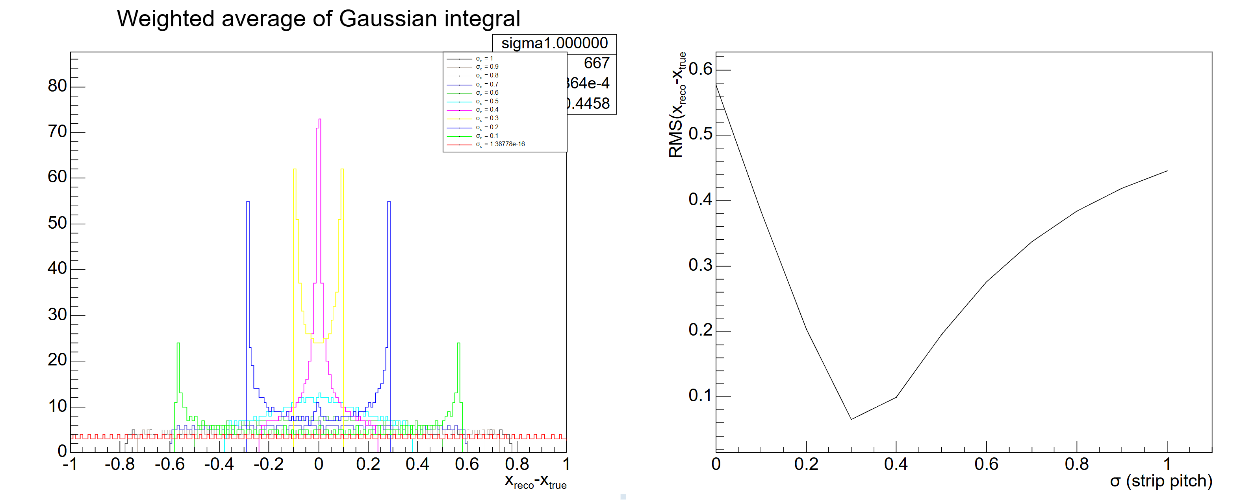
x_reco – x_truth(phi_reco – phi_truth)
Only linear interpolate 2 strips
Also see the two peaked distribution!

