Slide 1
Vacuum Production Update
Connie-Rose Deane
07.17.26

Slide 2
Prototype Test - Production
Produce four beam screens to be laser welded for blue ring test
  Lessons learned:
  Profile dimensions at raw material stage, after bandsaw, after squaring the ends, and after drilling holes
  Difficulty maintaining profile dimensions – mostly from orbitalum or squaring process
  Sanding blocks were used to square the ends after the bandsaw cut – sufficient results
  Clamp was used to reshape beam screen ends – successful with welding vendor
  Will test run production when pause work lifts with unslotted beam screens
    Compare profile dimensions from first prototype runs
eTravelersPoint
  Used Surface Pro to demo system
  Robust digital tool that’s used as a check list
  Users log in with BNL credentialsCould be used as a communication hub
  Delegating tasks

Slide 3
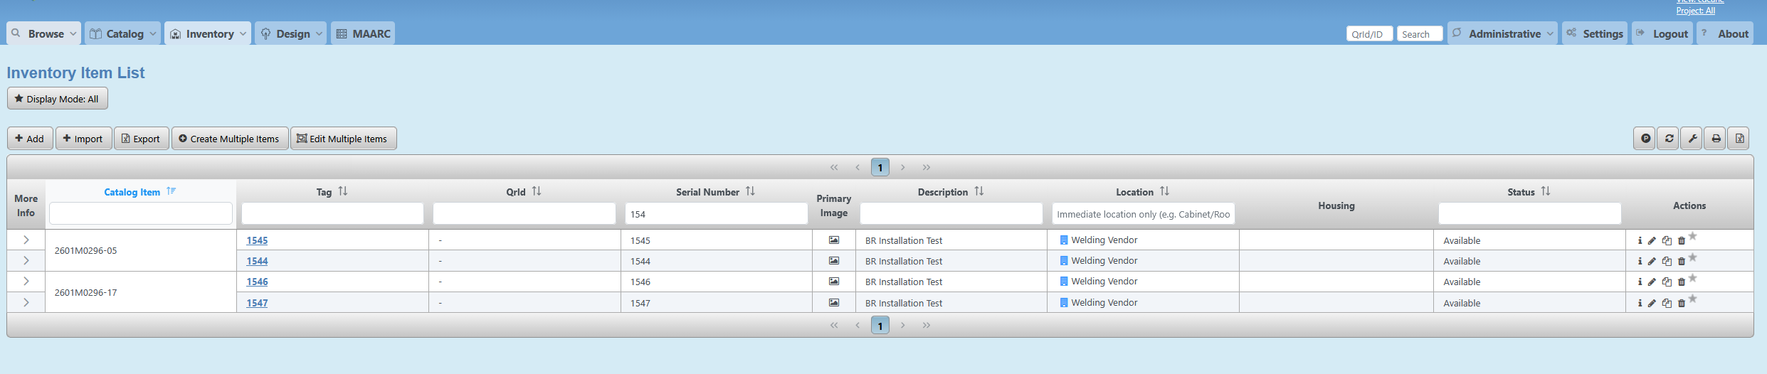
Component Database
VPN Required, no log-in necessary, public information
https://cdb.eic.bnl.gov/cdb/views/itemDomainInventory/list
Prototype beam screens can be searched by their “Serial Number”
Specific beam screens can be clicked on by “Tag”
  Serial number and Tag are ID’ed the same

Slide 4
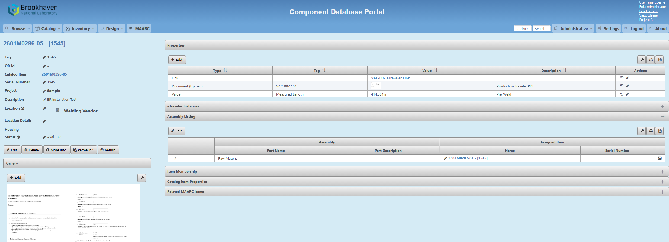
Component Database – Beam screen
Properties: Production eTraveler link, Travler PDF, Measured Length (input)
Assembly listing: link to raw material item (hierarchy of information)

Slide 5
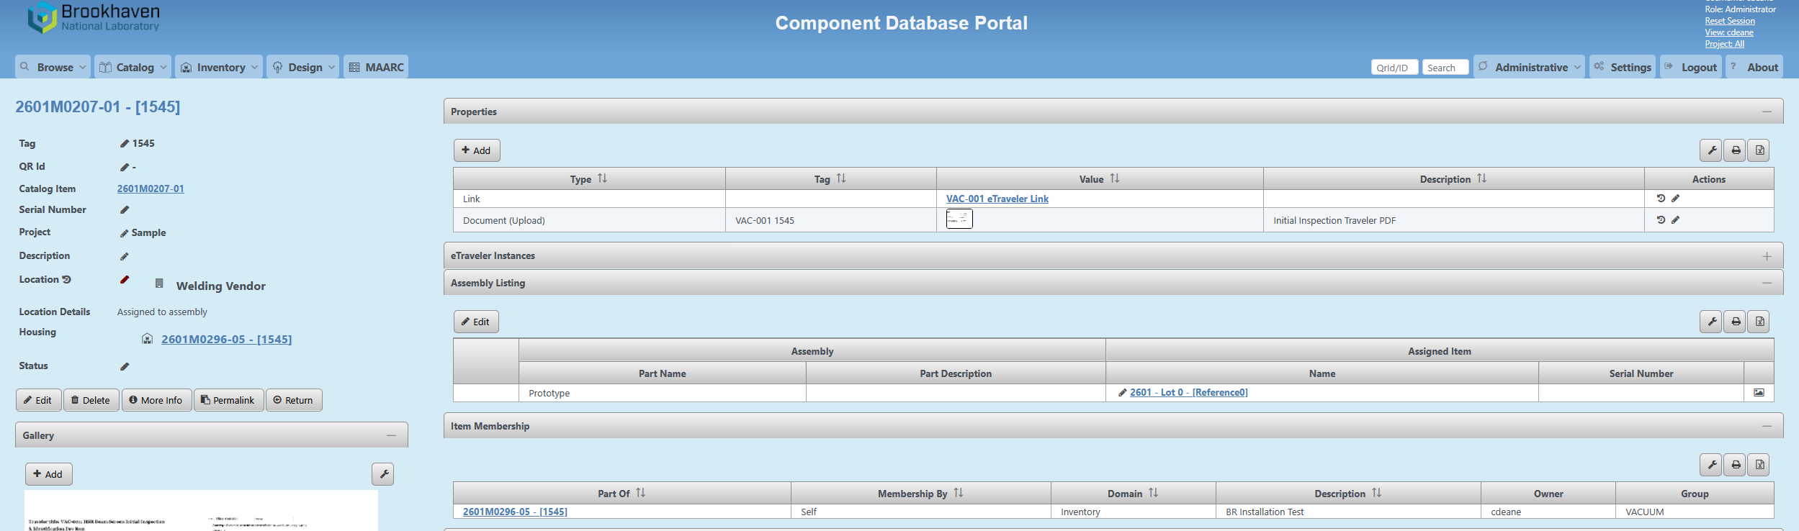
Component Database – Raw Material
Serial Number: Not defined – not searchable
Properties: Inspection eTraveler link, Travler PDF
Assembly listing: link to Source – Lot #

Slide 6
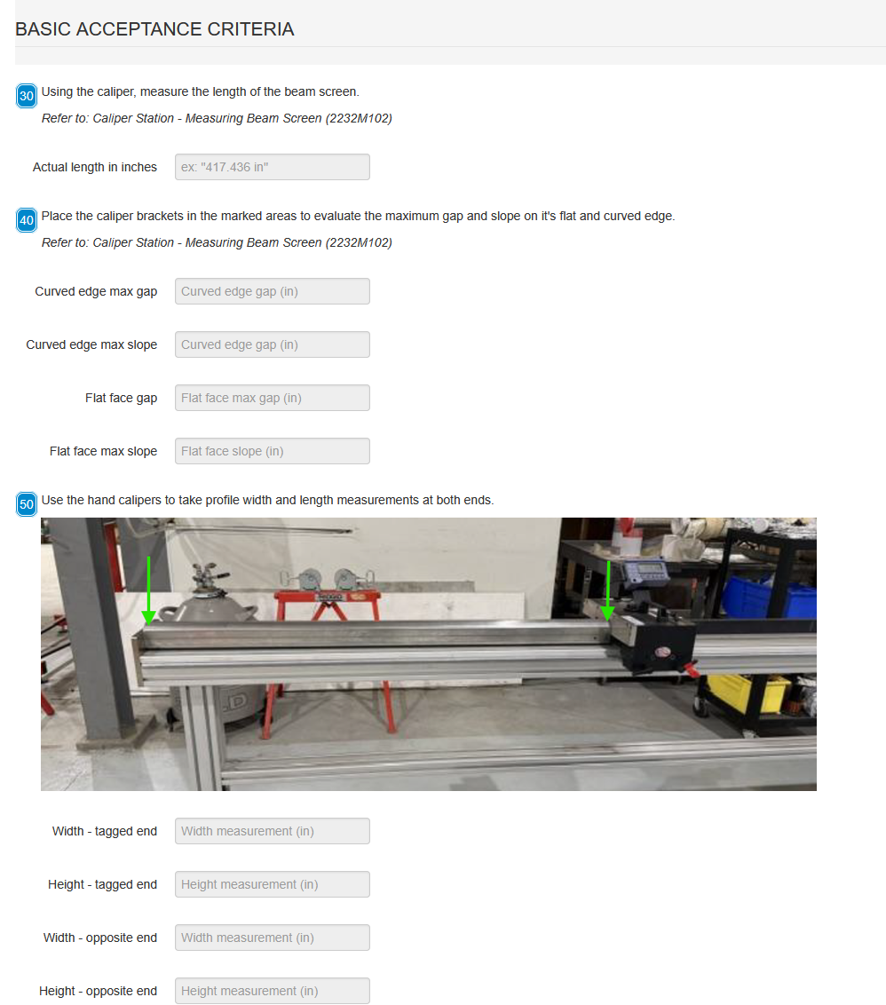
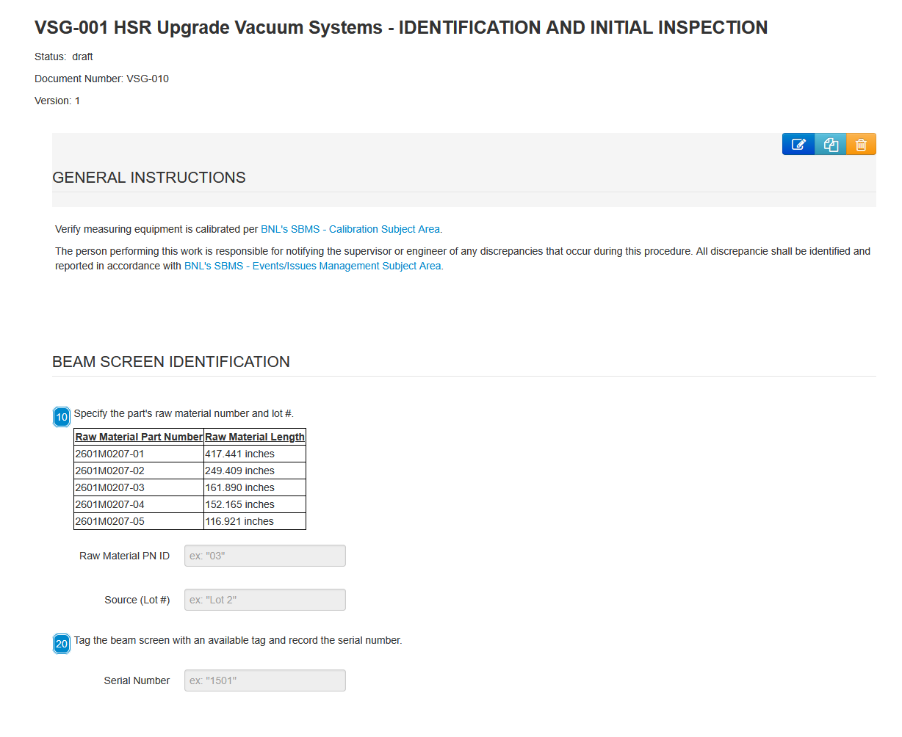
Initial Inspection - eTravler
http://demo04.eic.bnl.gov:3001/forms/6a4c061a3fae0ff110fd4f42/

Slide 7
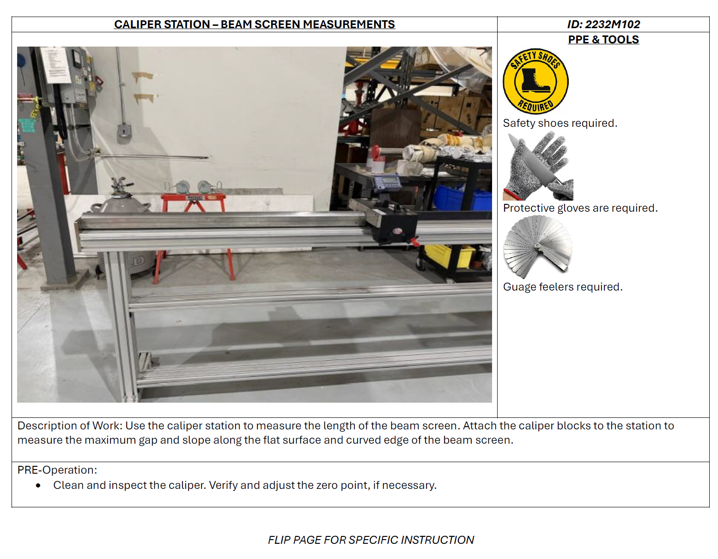
Info Cards – Caliper Station

Slide 8
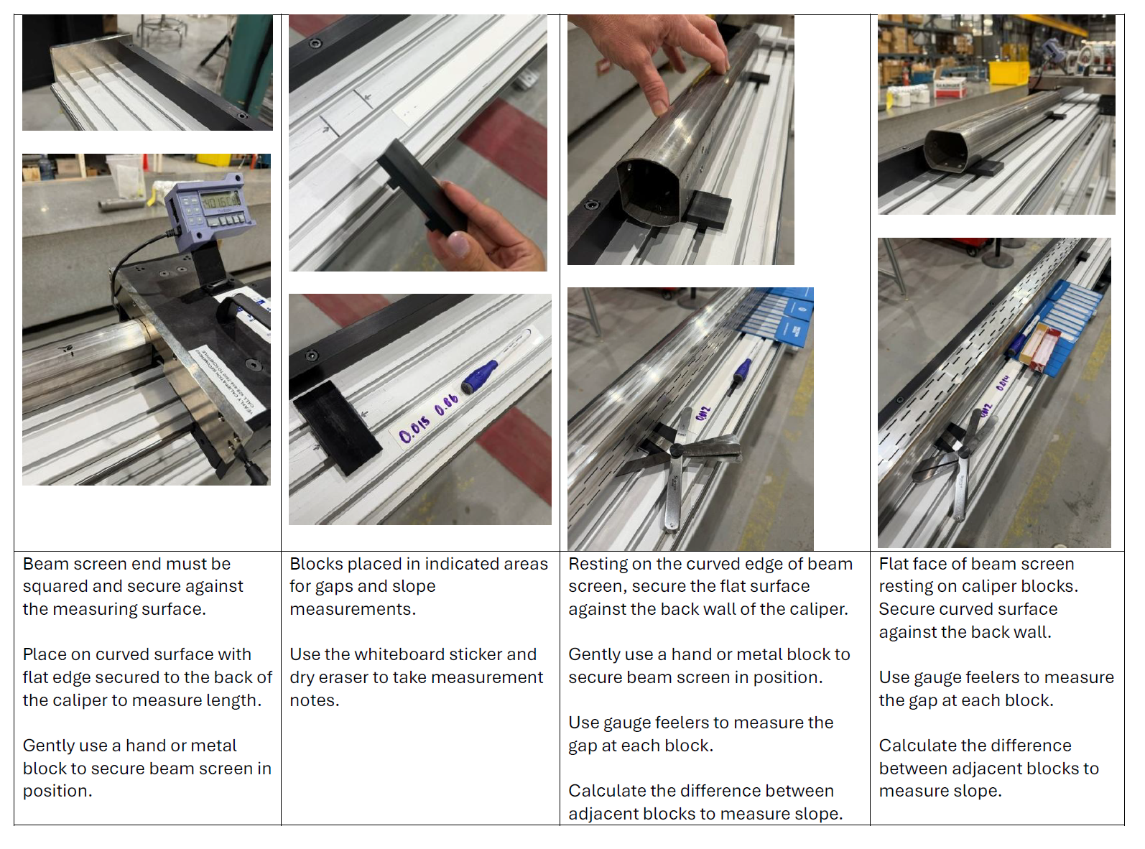
Info Cards – Instruction

Slide 9
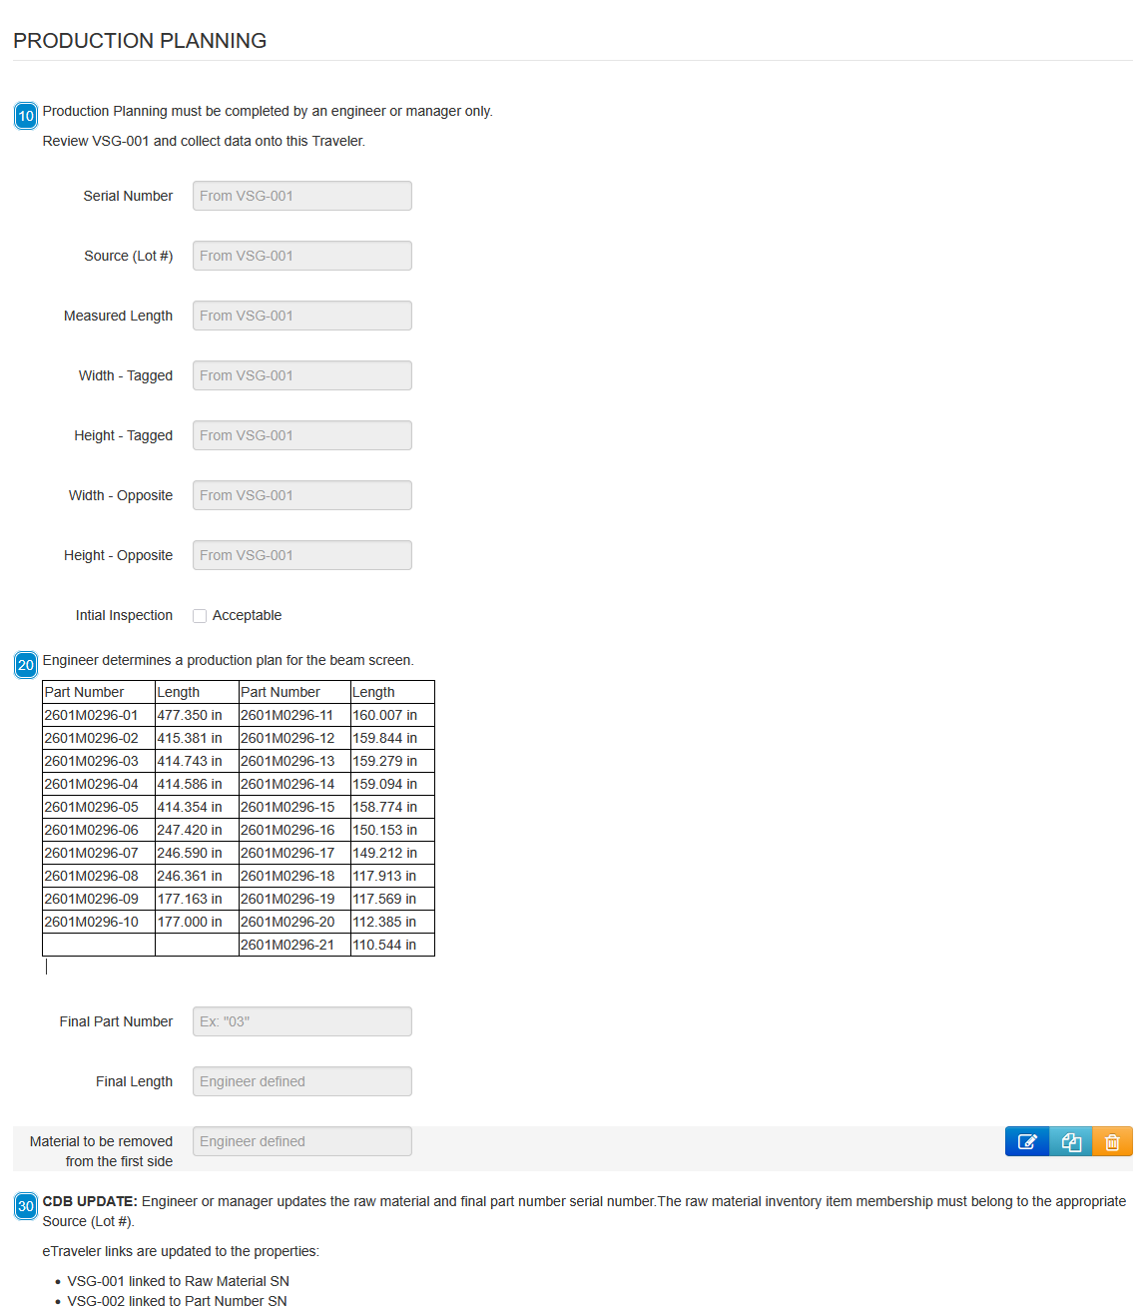
Production - eTraveler
Engineer/manager initiates
Follows production until ready to ship to vendor
http://demo04.eic.bnl.gov:3001/forms/6a56789802b9fe9dc8351a75/

Slide 10
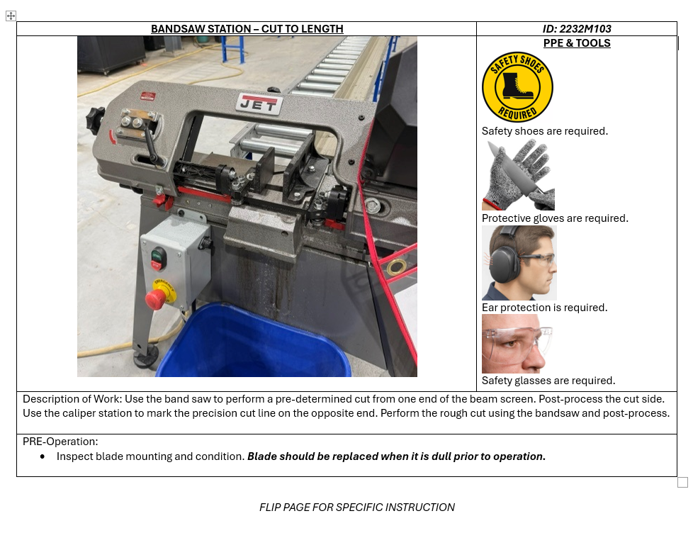
Info Card – Bandsaw Station

Slide 11
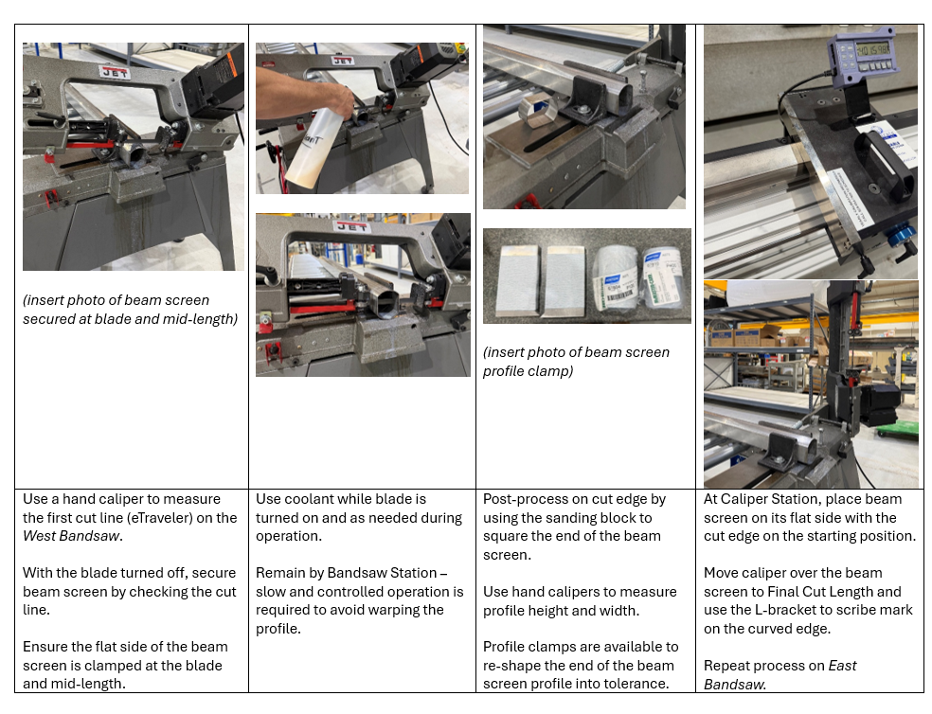
Info Card - Instruction

Slide 12
Magnet Upgrade - eTraveler
Engineer/manager initiates
Notify different groups
All magnet upgrade activities
http://demo04.eic.bnl.gov:3001/forms/6a56789802b9fe9dc8351a75/

