Slide 1
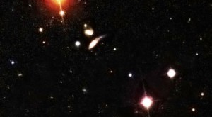
Welcome to BNL
Dark Interactions Workshop
2018
S. Dawson, BNL

Slide 2
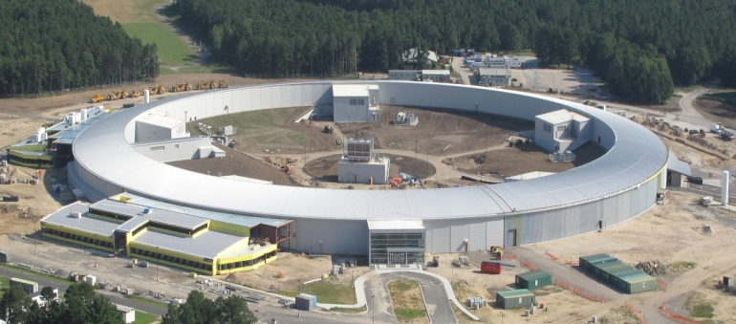
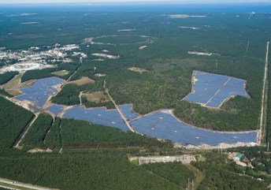
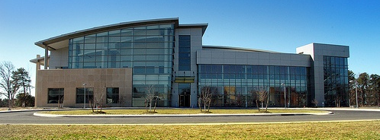
Many things going on at BNL
NSLS-II
Solar Farm
Center for Functional Nanomaterials

Slide 3
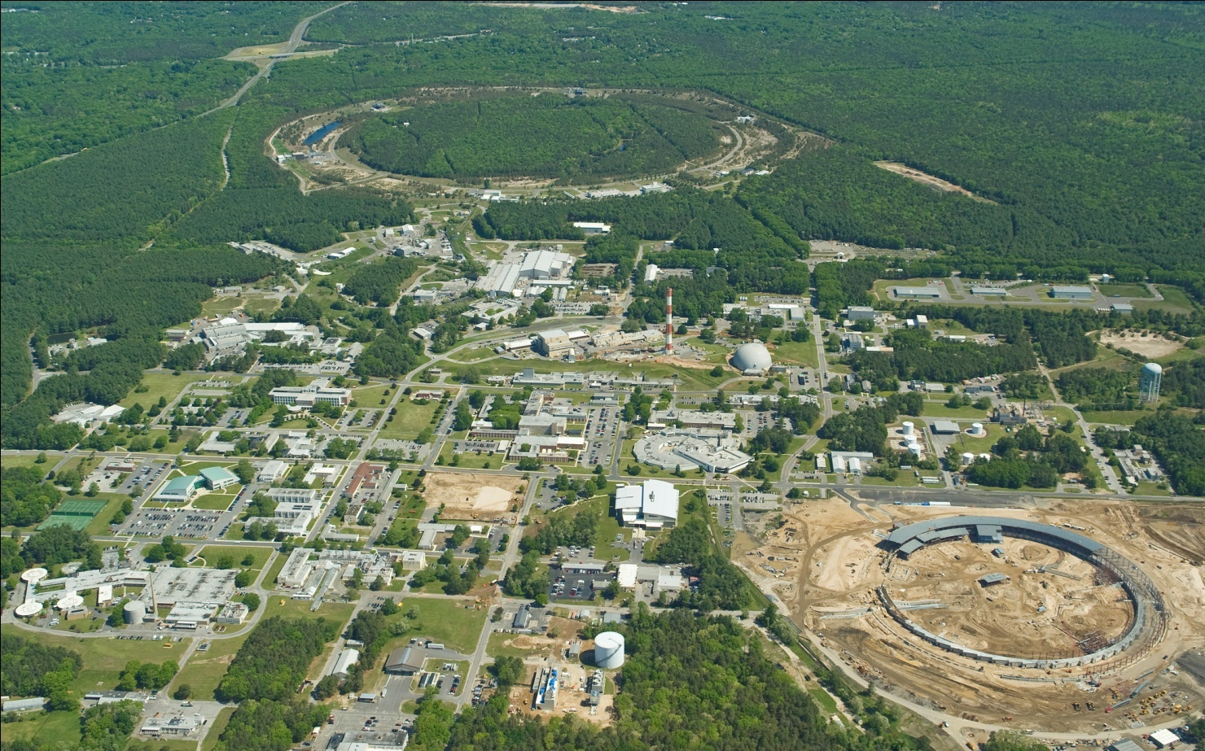
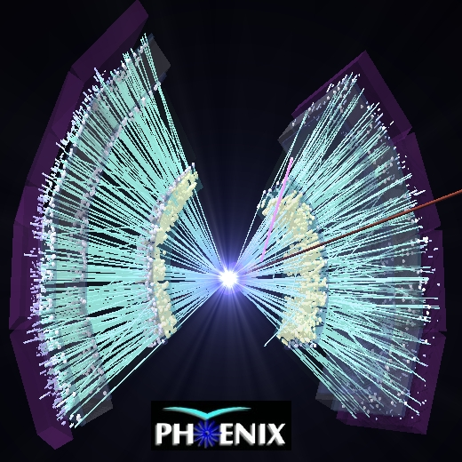
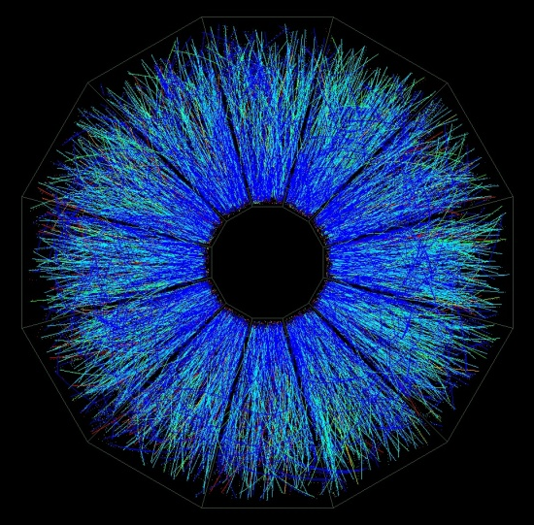
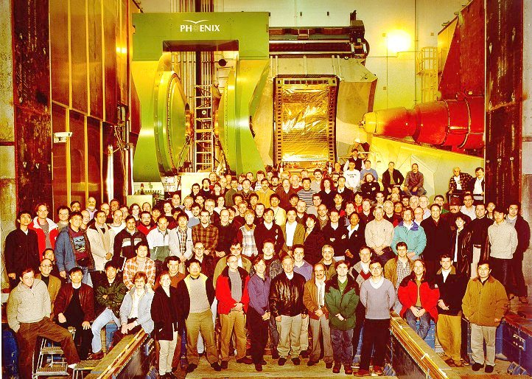

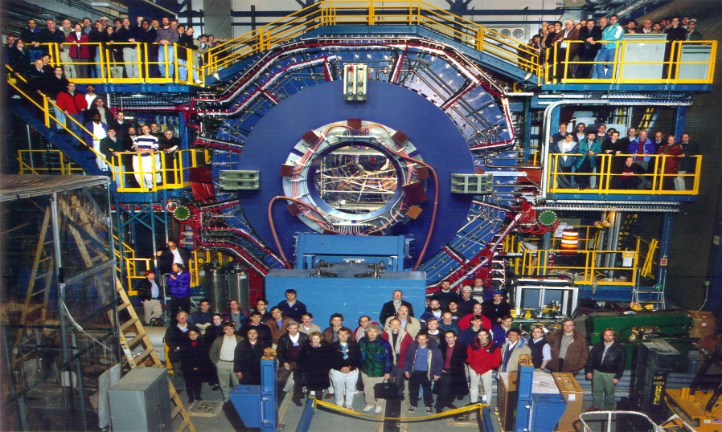
RHIC Collider is only US collider
Star and PHENIX (sPHENIX) probe the properties of strongly interacting matter
Relativistic Heavy Ion Collider (RHIC)
STAR

Slide 4
Major Efforts in High Energy Physics at BNL
ATLAS, DUNE, Daya Bay
BOSS, LSST…..
Theory (phenomenology, lattice)

Slide 5
Why are we here?
The Standard Model looks depressingly….. Like the Standard Model
Theory/ experiment agreement over many orders of magnitude

Slide 6
We know the Standard Model is incomplete
Standard Model doesn’t explain:
  Neutrino masses
  The pattern of fermion masses
  Dark matter
  Baryon asymmetry
Dichotomy: How can the Standard Model work so well, yet leave so many big questions unanswered?

Slide 7
Maybe we’re looking in the wrong places
In many cases, limits are above 1 TeV

Slide 8
We need to be creative
Look in new places both theoretically and experimentally
Maybe the new physics is light
Maybe the new physics is “dark”
Many possibilities to be discussed this week at Dark Interactions Workshop

Slide 9
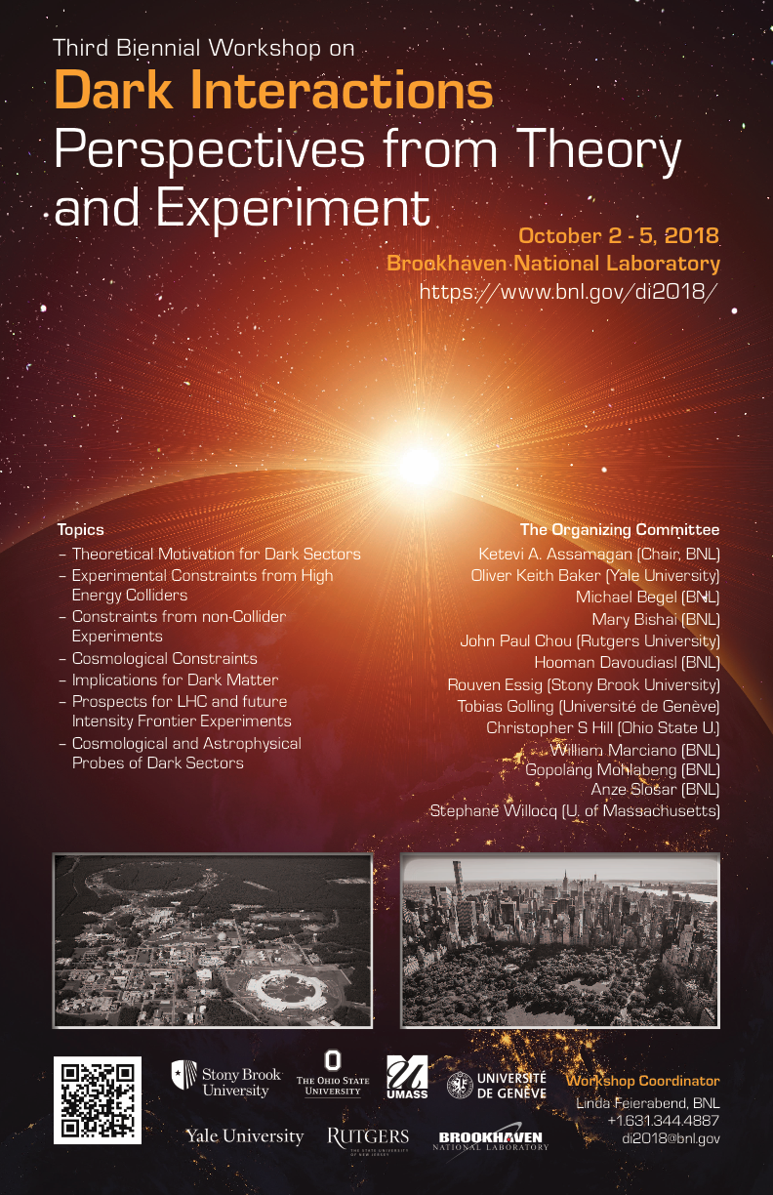
Many exciting talks in the next few days!
I’m looking forward to hearing about a lot of new ideas this week
If you need help, just ask any BNL person
Remember the important stuff: Cafeteria stops serving lunch at 1:30 and Starbucks is open 7am to 5 pm with 24 hour food at mini-mart

