Slide 1
Millicharged Particles in Neutrino Experiments
arXiv:1806.03310 (submitted to PRL)
Yu-Dai Tsai, Fermilab
with Gabriel Magill, Ryan Plestid, and Maxim Pospelov

Slide 2
Outline
Motivations
Millicharged Particle (mCP) & Neutrino Experiments
Bounds & Sensitivity Reaches
Discussion
Yu-Dai Tsai, Fermilab @ BNL 2018

Slide 3
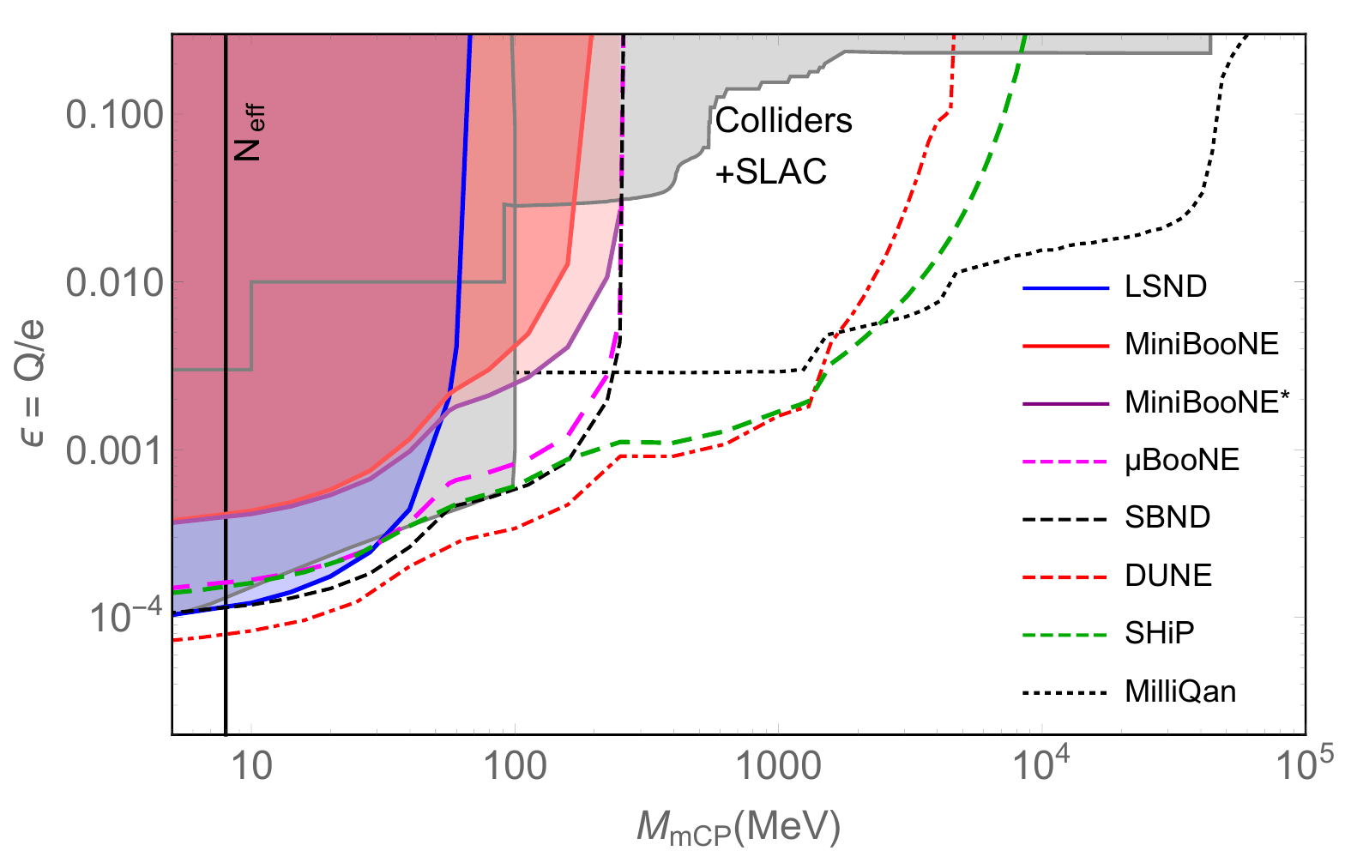
Preview
Magill, Plestid, Pospelov, YT, 1806.03310
Solid: current bounds
Dashed: future sensitivity
General review on other bounds: Andy Haas, Fermilab, 2017

Slide 4
Millicharged Particles Is electric charge quantized? Models & Implications
Also see yesterday’s talk by Tracy & Jae Hyeok
Yu-Dai Tsai, Fermilab @ BNL 2018

Slide 5
Finding Minicharge
Is electric charge quantized?
U(1) group allows arbitrarily small charges. Why don’t we see them in electric charges? This motivated Dirac monopole, Grand Unified Theory (GUT), etc
Practically, searching for millicharge is a test of e/3 charge quantization, and this could imply something more significant
Could have natural link to dark sector (e.g. dark photon)
Could account for DM (WIMP-like or other scenarios)
Used to explain the cooling of gas temperature to explain the EDGES result [EDGES collab., Nature, (2018), Barkana, Nature, (2018)]. Only ~ 1% of the DM allowed to explain the “anomaly” given other constraints (see talk by Tracy Slatyer)

Slide 6
Neutrino Experiments
Neutrinos are weakly interacting particles. Just like Millicharged particles
High statistics, e.g. LSND has ${10}^{23}$ Protons on Target (POT)
Shielded/underground: low background (e.g. solar v programs)
There are many of them existing and many to come: strength in numbers
Produce hidden particles without DM assumptions: more “direct” than cosmology/astrophysics probes, DM direct detections, etc.

Slide 7
Dark Matter/Hidden Particles Exploration
Ultralight DM, Axions, and ALPs
SIMPs/ELDERs
ELDER: Eric Kuflik, Maxim Perelstein, Rey-Le Lorier, and Yu-Dai Tsai (YT) PRL ‘16, JHEP ‘17
US Cosmic Visions 2017
Proton fix-target/neutrino experiments are important for MeV ~ GeV!
Golowich and Robinett, PRD 87
Babu, Gould, and Rothstein, PLB 94
Gninenko, Krasnikov, and Rubbia, PRD 07, …

Slide 8
v Hopes for New Physics: Personal Trilogy
︙
Light Scalar/Dark Photon at Borexino & LSND (Pospelov & YT, 1706.00424)
Dipole Portal Heavy Neutral Lepton (Magill, Plestid, Pospelov & YT, 1803.03262)
Millicharged Particles in Neutrino Experiments (Magill, Plestid, Pospelov & YT, 1806.03310)
Inspired by …
deNiverville, Pospelov, Ritz, ’11,
Kahn, Krnjaic, Thaler, Toups, ’14, …
︙
Yu-Dai Tsai,
Fermilab

Slide 9
v Hopes for New Physics: Anomalies
︙
Light Scalar/Dark Photon at Borexino & LSND Proton charge radius anomaly
Dipole Portal Heavy Neutral Lepton LSND/MiniBooNE anomaly
Millicharged Particles in Neutrino Experiments EDGES 21-cm measurement anomaly
We can chat about these over coffee
︙
Yu-Dai Tsai,
Fermilab

Slide 10
Millicharged Particle: Models
Yu-Dai Tsai, Fermilab @ BNL 2018

Slide 11
mCP Model
Small charged particles under U(1) hypercharge
Can just consider this effective lagrangian term by itself (no extra mediator, i.e., dark photon)
Or this could be from Kinetic Mixing - give a nice origin to this term - an example that gives rise to dark sector - easily compatible with GUT - I will not spend too much time on the model

Slide 12
Kinetic Mixing
See, Holdom, 1985
Field redefinition into a more convenient basis for massless $B^{′}$,
Getting rid of the mixing term, $B^{′}$ decouple from SM
After EWSB the new fermion acquires an small EM charge $Q$ (the charge of mCP ψ):
.

Slide 13
The Rise of Dark Sector
ε
e.g. mCP
Yu-Dai Tsai, Fermilab @ BNL 2018

Slide 14
IMPORTANT NOTE
Our search is simply a search for particles (fermion χ) with {mass, electric charge} =
Minimal theoretical inputs/parameters
mCPs do not have to be DM in our searches
The bounds we derive still put constraints on DM as well as dark sector scenarios.
Not considering bounds on dark photon (not necessary for mCP particles)
Similar bound/sensitivity applies to scalar mCPs

Slide 15
Millicharged Particle: Signature
Yu-Dai Tsai, Fermilab @ BNL 2018

Slide 16
MCP: production & detection
Target
production: meson decays
detection: scattering electron
BR(π⁰→2γ) = 0.99
BR(π⁰→γ$e^{−}e^{+}$) = 0.01
BR(π⁰→$e^{−}e^{+}$) = ${6∗10}^{−6}$
BR(J/ψ→$e^{−}e^{+}$) = 0.06
Heavy measons are important for higher mass mCP’s in high enough beam energy (see 1806.03310 vs 1809.06388)

Slide 17
MCP Signals
signal events $sig$
detection efficiency
${\text{N}}_{\text{χ}}$(${\text{E}}_{\text{i}}$) represents the number of mCPs with energy ${\text{E}}_{\text{i}}$ arriving at the detector. ${\text{N}}_{\text{χ}}$(${\text{E}}_{\text{i}}$) is a function of both the branching ratio and geometric losses which can vary significantly between experiments
$N_{e}$: total number of electrons inside the active volume of the detector
Area: the active volume divided by the average length traversed by particles inside the detector (“effective area”).
${\text{σ}}_{\text{e}\text{χ}}$(${\text{E}}_{\text{i}}$) is the detection cross section consistent with the angular and recoil cuts in the experiment

Slide 18
MCP productions
For η & ${\text{π}}^{\text{0}}$, Dalitz decays: ${\text{π}}^{\text{0}}$/η → γ χ $\overline{\text{χ}}$ dominate
For J/ψ & Υ, direct decays: J/ψ, Υ → χ $\overline{\text{χ}}$ dominate. Important for high-mass mCP productions!
The branching ratio for a meson, M, to mCPs is given roughly by
M: the mass of the parent meson, X:any additional particles, f(${\text{m}}_{\text{χ}}$/M): phase space factor as a function of ${\text{m}}_{\text{χ}}$/M.
Also consider Drell-Yan production of mCP from q q-bar annihilation.
Yu-Dai Tsai, Fermilab @ BNL 2018

Slide 19
MCP Detection
Detection signature: elastic scattering with electrons.
Look for single-electron events
The dominance of electron scattering as a detection signal is related to the low- $Q^{2}$ sensitivity of the scattering cross section. ($Q^{2}$ is the squared 4-momentum transfer)
Explicitly, in the limit of small electron mass, we have

Slide 20
MCP Detection
Integrate over momentum transfers, the total cross section will be dominated by the small $Q^{2}$ contribution, we have ${\text{σ}}_{\text{eχ}}$= 4π ${\text{α}}^{2}{\text{ɛ}}^{2}$/${Q_{min}}^{2}$.
We can relate $Q_{min}$ in the lab frame to the recoil energy of the electron via $Q^{2}$ = 2$m_{e}$ ($E_{e}$ − $m_{e}$).
An experiment's recoil energy threshold, ${E_{e}}^{(min)}$ sets the scale of the detection cross section
Yu-Dai Tsai, Fermilab @ BNL 2018

Slide 21
MCP Detection
Sensitivity to mCPs can be greatly enhanced by accurately measuring low energy electron recoils
An important feature for search strategies at future experiments for mCP’s and LDM-electron scattering
Demonstrated in Magill, Plestid, Pospelov, YT, 1806.03310 & (for sub-GeV DM) deNiverville, Frugiuele, 1807.06501

Slide 22
MCP Signals Recap
Detection efficiency
$sig$ $\text{∝}$ ${\text{ɛ}}^{4}$
For most of the mCP parameter space under consideration, electromagnetic decays of mesons provide the dominant flux contribution
Drell-Yan production (DYP) dominates for the large mCP masses that are only accessible at DUNE and SHiP.
For DYP, we integrate over the full production phase-space using MSTW parton distribution functions [Martin, Stirling, Thorne, Watt, 2009]
Yu-Dai Tsai, Fermilab @ BNL 2018

Slide 23
MCP Bound/Sensitivity
signal events $s_{event}$
Our sensitivity curves are obtained by performing a standard sensitivity analysis [PDG, PLB 2010]:
Given a number of background events b and data n, the number of signal events $s_{event}$ . The (1 − α) credibility level is found by solving the equation α = Γ(1 + n, b + sup)/Γ(1 + n, b), where Γ(x, y) is the upper incomplete gamma function.
Throughout this paper, we choose a credibility interval of 1 − α = 95% (~ 2 sigma)
Roughly, ${\text{ε}}_{sensitivity}$ ∝ $E_{e, R, min}^{1/4}$ ${Bg}^{1/8}$

Slide 24
Background Estimation for Future Measurements
Single-electron background for ongoing/future experiments for MicroBooNE, SBND, DUNE, and SHiP?
We consider two classes of backgrounds:
1) Coming from neutrino fluxes (calculable) [i.e. νe → νe and νn → ep], we sum over the
neutrino-flux contributions from each collaboration and account for the detection efficiencies.
2) Other sources such as
beam related: dirt related events, mis-id particles
external: cosmics, etc

Slide 25
Background Reduction
For neutrino-caused backgrounds, large background reduction is obtained by imposing the maximum electron recoil energy cuts $E_{e}$(max).
This do not significantly affect the mCP signal (which is dominated by low electron recoils from low-$Q^{2}$), but significantly reduce charged and neutral current neutrino backgrounds.
Yu-Dai Tsai, Fermilab @ BNL 2018

Slide 26
Estimation of Other Background
Liquid Argon Time Projection Chamber (LArTPC) can use timing information as vetoes to reduce backgrounds, Therefore, we multiply our neutrino induced backgrounds by a factor of 10 for LArTPC detectors (MicroBooNE, SBND, and DUNE)
For a nuclear emulsion chamber detector, we times a factor of 25 for the background (SHiP);
These increase in the backgrounds decreases our sensitivity to ɛ by 20 − 30%
Our results can be easily revised for different background assumptions, roughly, ε ∝ ${Bg}^{1/8}$.

Slide 27
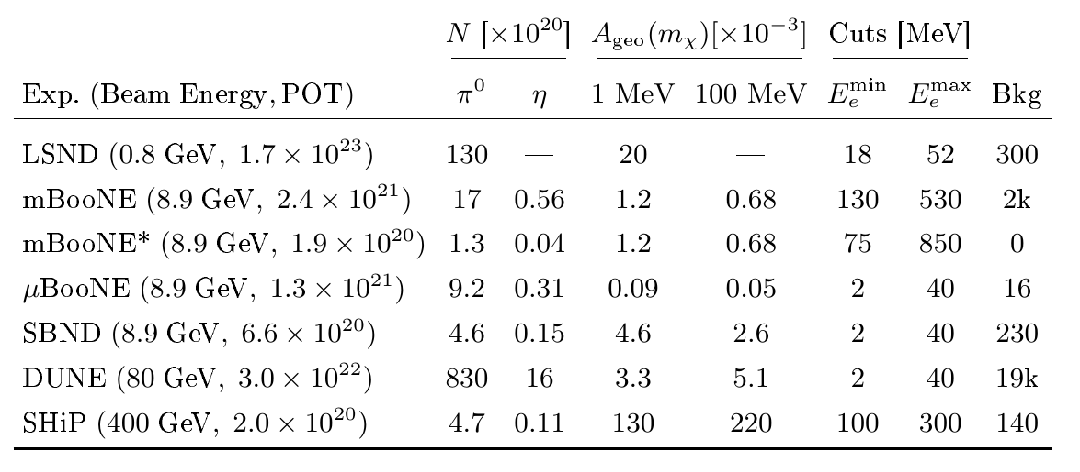
Summary Table
Existing
Future
ε ∝ $E_{e, R, min}^{1/4}$ ${Bg}^{1/8}$
cos θ > 0 is imposed (∗except for at MiniBooNE's dark matter run where a cut of cos θ > 0.99 effectively reduces backgrounds to zero [Dharmapalan, MiniBooNE, (2012)]).
efficiency of 0.2 for Cherenkov detectors, 0.5 for nuclear emulsion detectors, and 0.8 for liquid argon time projection chambers.

Slide 28
Recasting Existing Analysis:
LSND, MiniBooNE, and MiniBooNE* (DM Run)
LSND: hep-ex/0101039. Measurement of electron-neutrino electron elastic scattering
MiniBooNE: arXiv:1805.12028. Electron-Like Events in the MiniBooNE Short-Baseline Neutrino Experiment, combines data from both neutrino and anti-neutrino runs and consider a sample of 2.4 × ${10}^{21}$POT for which we take the single electron background to be 2.0 × ${10}^{3}$events and the measured rate to be 2.4 × ${10}^{3}$
MiniBooNE* (DM run): arXiv:1807.06137 (came out after our v1). Electron recoil analysis, details see talk by Dr. Remington We did not include their timing cuts in our calculations, since they were optimized by the MiniBooNE collaboration to the signal's timing profile (see talk by Remington Tyler Thornton).

Slide 29
Summary Table
ε ∝ $E_{e, R, min}^{1/4}$ ${Bg}^{1/8}$
At LArTPC, the wire spacing is about 3 mm, the ionization stopping power is approximately 2.5 MeV/cm: electrons with total energy larger than at least 2 MeV produce tracks long enough to be reconstructed across two wires.

Slide 30
Probes of mCPs
Solid: current bounds
Dashed: future sensitivity
Heavy neutral meson production turns on in large enough beam energy. Extend mCP mass above 200 MeV
ε ∝ $E_{e, R, min}^{1/4}$ ${Bg}^{1/8}$ for future experiments

Slide 31
Existing Bounds & MilliQan
MilliQan: Haas, Hill, Izaguirre, Yavin, 15, + (LOT arXiv:1607.04669)
$N_{eff}$: Bœhm, Dolan, and McCabe, (2013)
Colliders/Accelerator: Davidson, Hannestad, Raffelt 2000 + refs within.
SLAC mQ: Prinz el al, PRL (1998); Prinz, Thesis, (2001).

Slide 32
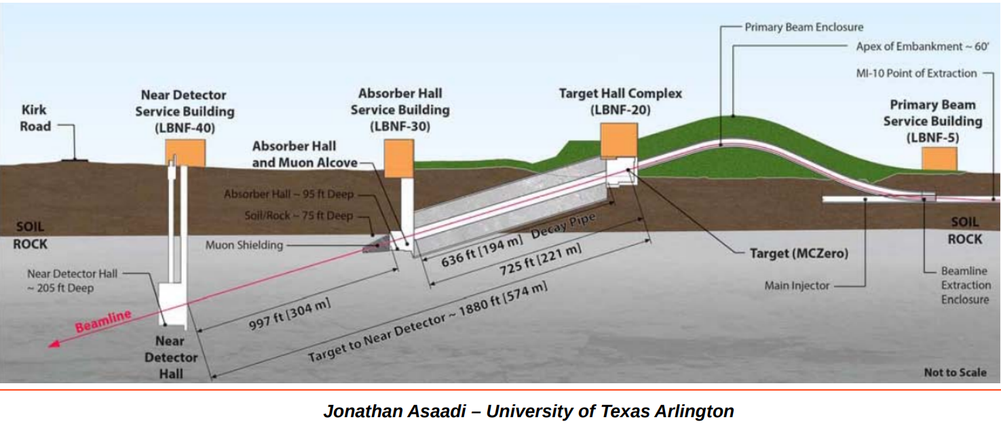
DUNE Near Detector

Slide 33
Remarks and Outlook
Out technique can be applied to more generic light dark matter and other weakling interacting particles
For MCP, and generically light dark matters
- Production from heavy neutral mesons important
- Signature favor low electron-recoil energy threshold
Discussing with DUNE/SBN experimentalists about realistic background, $E_{e, R, min}^{}$cut, and better simulation (adding heavy mesons)
Sensitivity (along with other new physics scenarios) from NuMI beam in off-axis detectors? High energy, lower neutrino background, but also lower statistics (Yun-Tse Tsai, YT, + … just started)

Slide 34
To Do List
Millicharged particles in electron-based experiments (electron collisions + fixed target experiments), (Blinov, Krnjaic, YT, in progress) including BaBar, Belle II, BDX, etc.
(LDMX sensitivity already set by Berlin, Blinov, Krnjaic, Schuster, Toro, 18)
soon after our paper
Dark Sector Bremsstrahlung (Chang, YT, just started)
A lot more to do! Let’s chat more during the coffee time.
Yu-Dai Tsai, Fermilab @ BNL 2018

Slide 35
Thank You! Thanks for the conference!
Yu-Dai Tsai, Fermilab @ BNL 2018

Slide 36
MCP Exisiting bounds
A recent analysis looking for low ionizing particles in CMS excluded particles: charge ±e/3 for MmCP < 140 GeV & particles:charge ±2e/3 for MmCP < 310 GeV [CMS, PRD (2013)].
mCP coupling to the Z is suppressed by sin(θW)
LEP invisible Z width: mCP not contribute more than the 2σ width at LEP. [Davidson, Hannestad, Raffelt, 2000]:

Slide 37
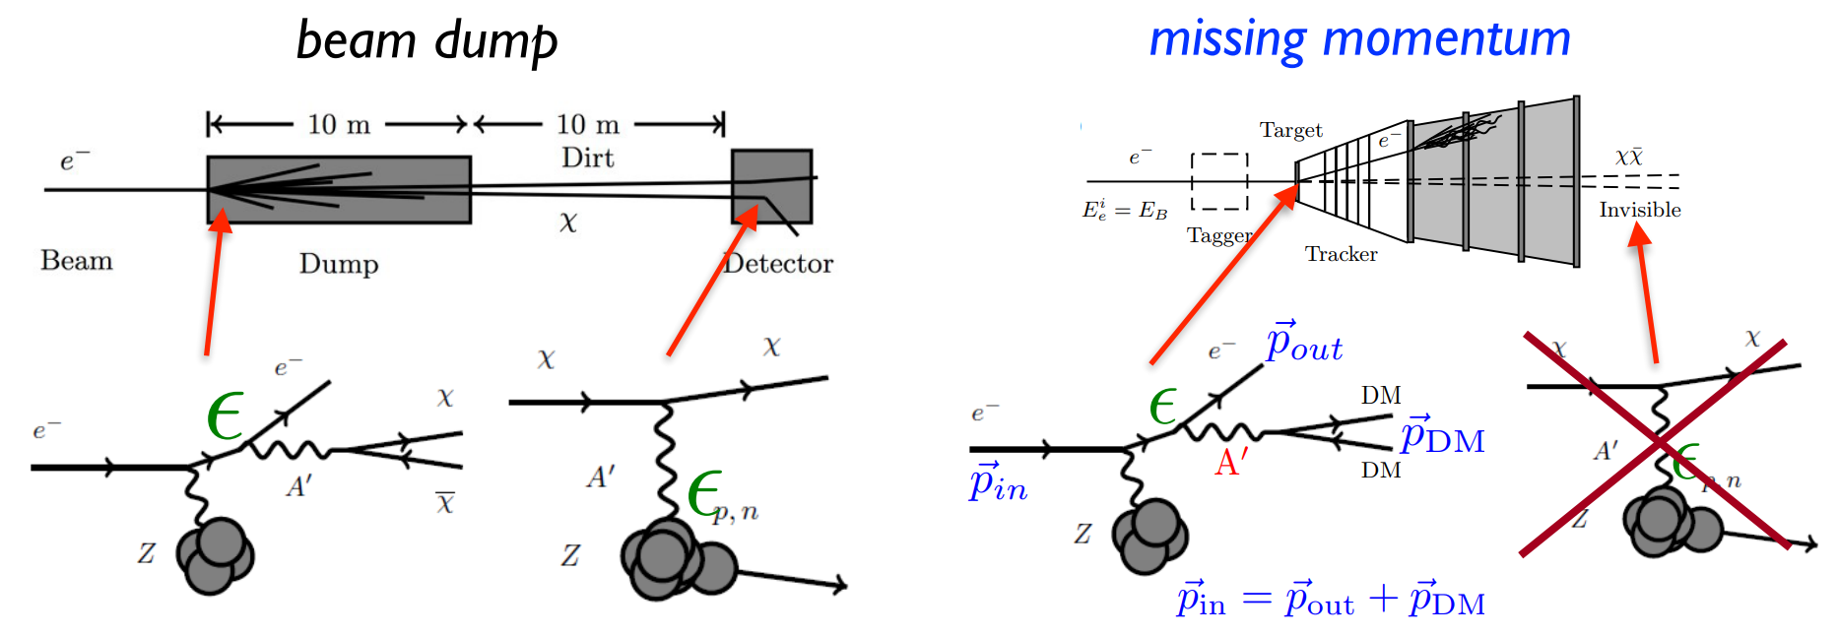
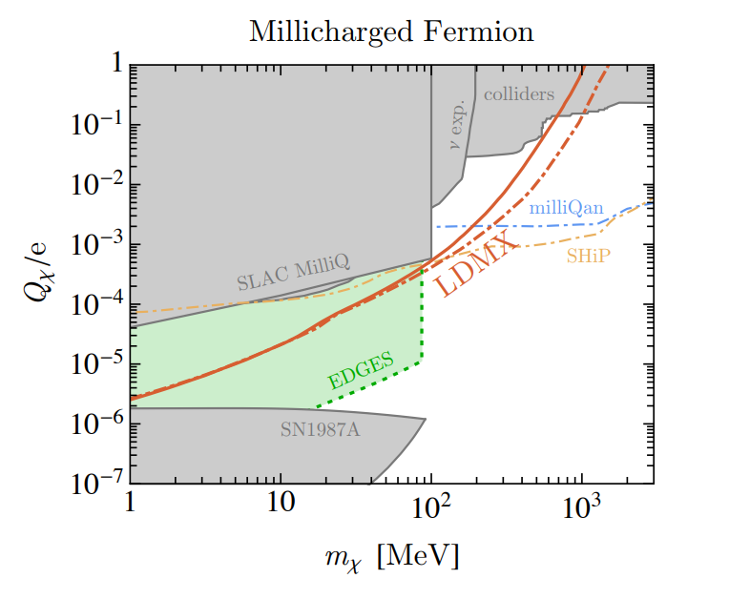
LDMX @ SLAC
Tim Nelson, for LDMX, 2017
From Berlin, Blinov, Krnjaic, Schuster, Toro, 18

Slide 38
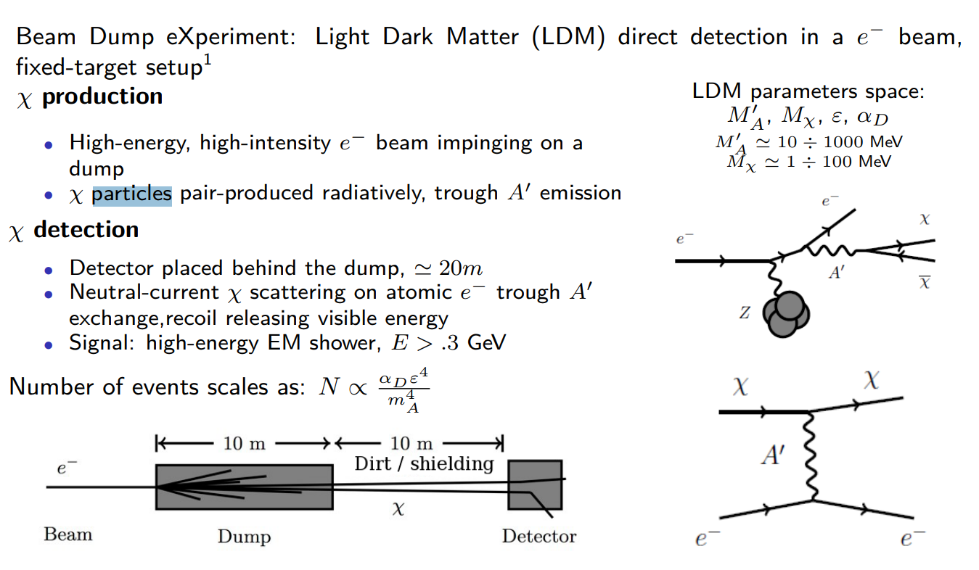
BDX @ BNL
Andrea Celentano, INFN-Genova, 2017

Slide 39
Meson Production List!
At LSND, the π0 (135 MeV) spectrum is modeled using a Burman-Smith distribution
Fermilab's Booster Neutrino Beam (BNB): π0 and η (548 MeV) mesons. π0's angular and energy spectra are modeled by the Sanford-Wang distribution. η mesons by the Feynman Scaling hypothesis.
SHiP/DUNE: pseudoscalar meson production using the BMPT distribution, as before, but use a beam energy of 80 GeV
J/ψ (3.1 GeV), we assume that their energy production spectra are described by the distribution from Gale, Jeon, Kapusta, PLB ‘99, nucl-th/9812056.
Upsilon, Y (9.4 GeV): Same dist. , normalized by data from HERA-B, I. Abt et al., PLB (2006), hep-ex/0603015.

Slide 40
Meson Production Check!
Using this, we have reproduced the Pb rates in [NA50, EPJ ‘06, nucl-ex/0612012] for J/Ψ, and for Υ, we reproduced the Pt rates in [Herb et al., PRL ‘77].
Yu-Dai Tsai, Fermilab @ BNL 2018

Slide 41
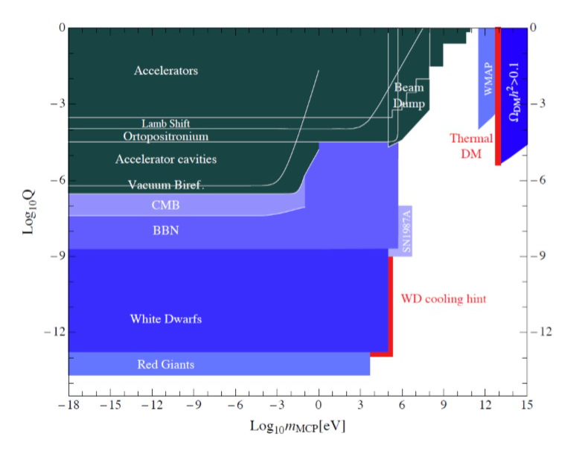
Other Broader Constraints
Andy Haas, Fermilab, 2017
Beware of the different assumptions
Badertscher et al, PRD (2007)
Gl¨uck, Rakshit, Reya, PRD (2007)

Slide 42
Other Constraints
Astrophysics: Cooling/energy loss bounds from stars and SN
Cosmology: BBN/CMB Neff
Laboratory:
Invisitble decay of ortho-positronium
Lamb Shift
Accelerators: E613, ASP, LEP, etc
Andy Haas, Fermilab, 2017

Slide 43
MCP production
Significant branching ratios of electromagnetic decays to lepton pairs implies an corresponding decay to pairs of mCPs, resulting in a significant flux of mCPs, even with small charges.
Fixed target neutrino experiments: produce neutrinos from weak decays of charged pions. Similar spectrum of ${\text{π}}^{\text{0}}$ is produced (inferred by comparing the production of ${\text{π}}^{\text{0}}$ and ${\text{π}}^{\text{+}}$ in pp and pn collisions ( [Teis et al, 1996]), or by using counting arguments on the number of production [Norbury & Townsend, NIM B, 2007].
For large enough beam energies, other neutral mesons (e.g. η, Υ, J/ψ) are also produced.

Slide 44
Backup: MilliQan at CERN

Slide 45
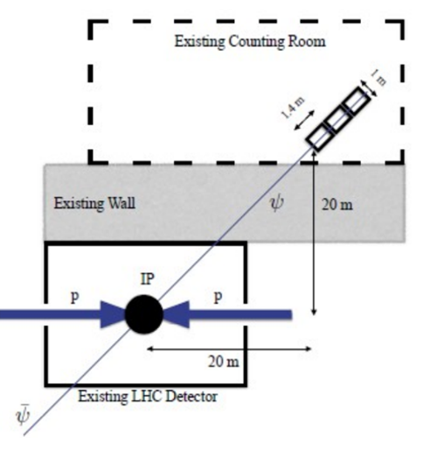
MilliQan Brief Review
~ 1 photo-electron observed per 1 long scintillator
Require triple incidence in time window
Moving in CMS “drainage gallery” at P5
Andrew Haas, Fermilab (2017)
MilliQan: Haas, Hill, Izaguirre, Yavin, 15, + (LOT arXiv:1607.04669)

