Slide 1
pfRICH Subcomponent Review: HRPPDs
Brian Page
pfRICH DSC Meeting
October 8, 2026

Slide 2
Questions to Address
What is the status of the component?
What are the major outstanding issues to be addressed to reach 90% design maturity? Do you understand:
  Overall design and necessary parts
  Interfaces between the component and the rest of the pfRICH / the wider detector
  Assembly and integration into pfRICH
  QA/QC
  Procurement / shipping / storage
  ES&H
Do you have timelines for the above?
Are there dependencies on other components that are (or will be) blocking further development?
Do you have the resources needed to advance to 90% maturity?

Slide 3
Component Status
The HRPPDs recently (Sept. 1) passed an FDR for use in the pfRICH and hpDIRC – this was part of an effort for the sensors to be included in the recently proposed CD-3C LLP package
Final performance parameters will be set after upcoming engineering run which will yield 2+6 tiles

Slide 4
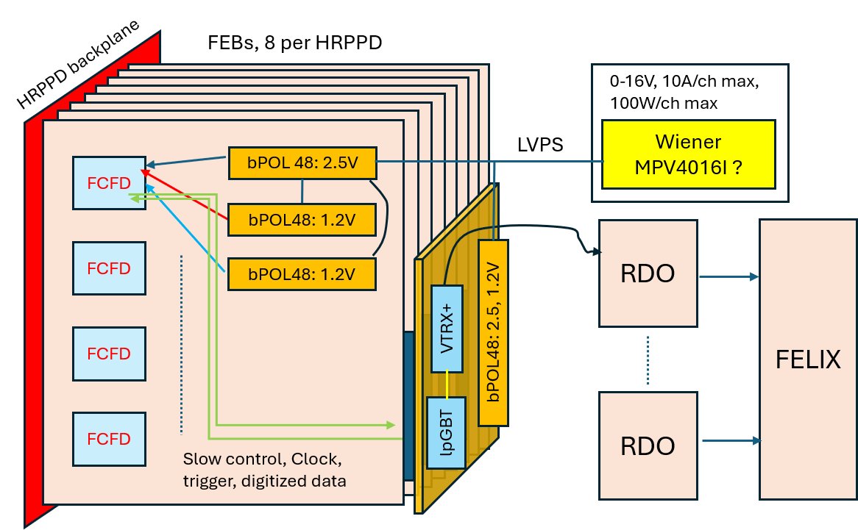
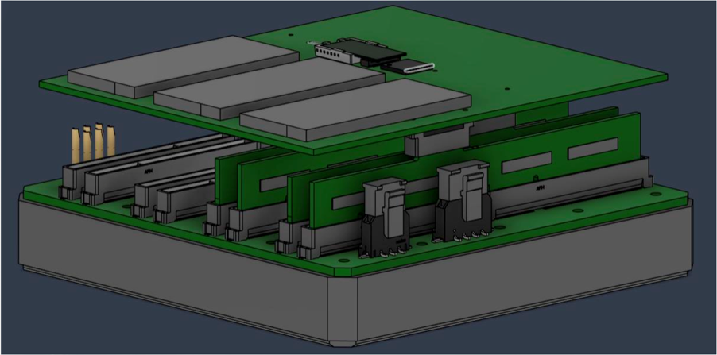
Interfaces
With ASIC design / properties coming into better focus, backplane design is advancing and will define service interfaces
HV/LV power, cooling, and data needs are known and detailed cabling / routing plans for these services are being developed and included in the integration model

Slide 5
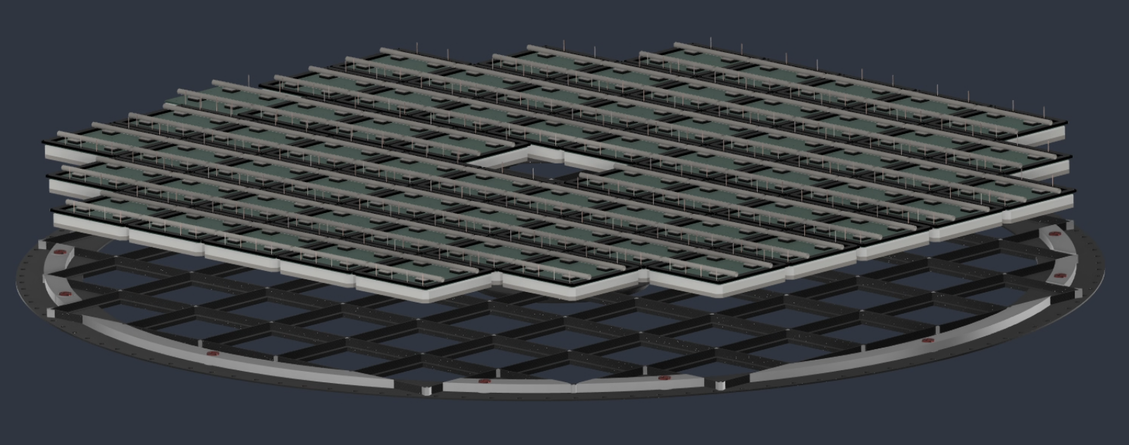

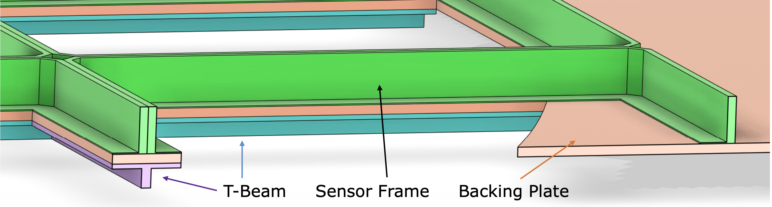
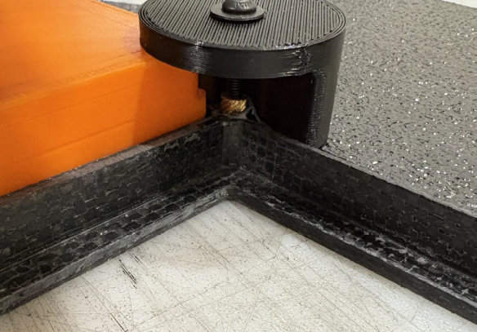
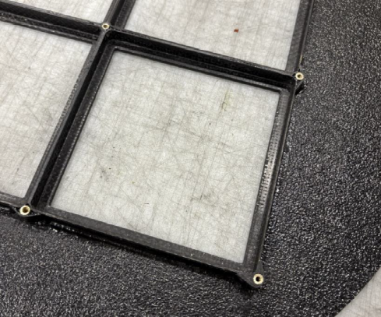
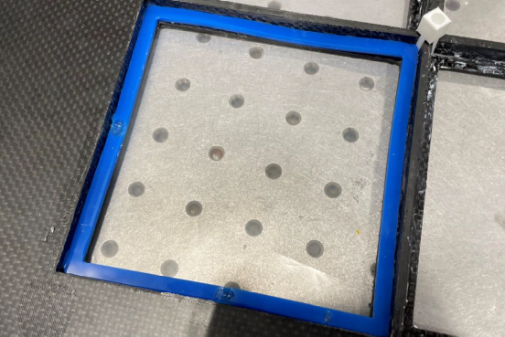
Integration
Sealing Surface
HRPPD mechanical integration has progressed through prototype development, with representative sensor-plate, sealing, and clamping concepts fabricated and evaluated.
Prototype results have established a clear path toward the final sensor-plane design, including the mechanical interface, sealing approach, sensor constraint strategy, and assembly methodology.
Sealing Surface
Sealing Surface
Sealing Surface
Threaded Inserts
Prototype Hold-Downs
Prototype 2x2 Plane
Sealing Studies

Slide 6
Additional Points
Necessary components well understood. Ceramic anode plate and PCB backplane designed. HRPPD tile + backplane (with interposers) will be assembled by manufacturer
QA plan is formally documented – final details on testing locations being worked out
SOW is being drafted which will define procurement and shipping procedures
ES&H considerations are addressed in QA plan

Slide 7
Timeline / Dependencies / Resources
Timelines for HRPPD SOW/procurement dependent on CD-3C approval
No fixed timeline for remaining design work – progress is ongoing
No significant dependencies – exact performance parameters in SOW may depend on testing of sensors from the upcoming engineering run
Engineering support exists for remaining interface/integration design work, but we note that they also support another subsystem that is likely on the same timeline, which may introduce delay

