Slide 1
DAC Review
Satoshi YANO

Slide 2
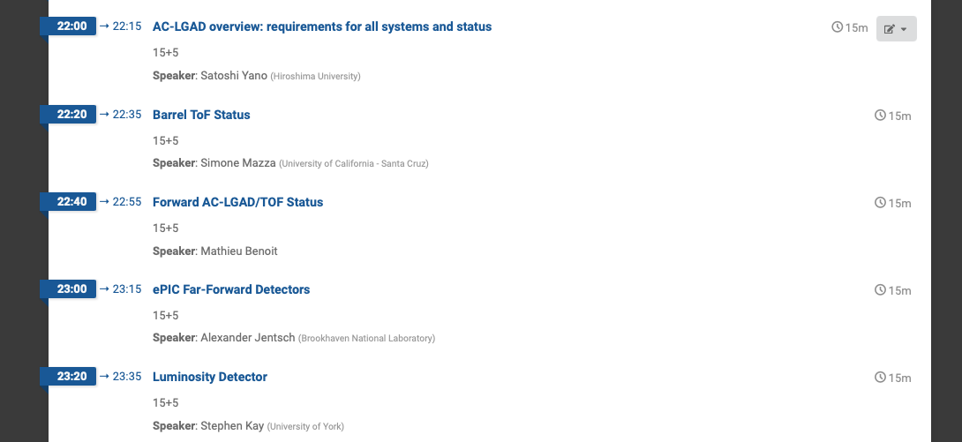
11th DAC Review
We have DAC review on October 28th – 30th
  Rehearsal will be on 14th – 16th

Slide 3
Last Review Comments/Recommendations
Peer Review of the EIC Particle Identification Detectors based on AC-LGAD | December 3, 2025 | No | External |  | 1270 | The preparation of a document including the details about the interfaces of the single parts of the project (for instance the geometry envelope) would be beneficial. | R. Ent / E. Aschenauer |  | Agreed. | Two document have been devlopped. A top level document containing all detector systems Det-Interfaces-Current.pdf (https://brookhavenlab.sharepoint.com/:b:/r/sites/eRHIC/bnl%26slac/experimental%20equipment/CAM%20Info/Subproject-CD2/Assessment%20Review/PreBrief/Detector-Subproject/Interfaces/DET-Interfaces-Current.pdf?csf=1&web=1&e=KYVlzb) and separately an individual document pertaining all PID detector with resepct to the whole detector (https://brookhavenlab.sharepoint.com/:w:/r/sites/eRHIC/bnl%26slac/experimental%20equipment/CAM%20Info/Subproject-CD2/Assessment%20Review/PreBrief/Detector-Subproject/Interfaces/Interface%20%20Control%20Documents/DET-DS-PID-Internal-ICD.docx?d=wf07db500cad94f8696f76d2fd7c1ba55&csf=1&web=1&e=GCkvEB) and a second with respect to the IR and accelerator systems (https://brookhavenlab.sharepoint.com/:w:/r/sites/eRHIC/bnl%26slac/experimental%20equipment/CAM%20Info/Subproject-CD2/Assessment%20Review/PreBrief/Detector-Subproject/Interfaces/Interface%20%20Control%20Documents/DET-DS-PID-Internal-ICD.docx?d=wf07db500cad94f8696f76d2fd7c1ba55&csf=1&web=1&e=GCkvEB) | in progress | 2025/12/10
Polarimeter PDR | January 18, 2023 | No | External |  | 949 | An alternative detector concept based on Silicon strip detector should be developed. (ESR) | R. Ent / E. Aschenauer / D. Gaskell |  | While certain Si detectors would be able to meet the timing requirements for EIC, the radiation hardness will be a problem and frequent refurbishment will be necessary. | Looked at AC-LGADS. Satisfy timing requirements, but radiation hardness uncertain. Good to 1 MGy --> 1-2 weeks of running at EIC. Diamond is the only practical option at this time. This will be explained in CDR. | closed | 2024/9/3
Peer Review of the EIC Particle Identification Detectors based on AC-LGAD | December 3, 2025 | No | External |  | 1267 | Inclusion of additional simulation work on PCB design for transmission lines, to define the technical performance and in particular for the resistivity on the Barrel TOF. | R. Ent / E. Aschenauer |  | Agreed | The Japanese group has started simulating on flex PCB transmission line design, which will then be cross checked by JLAB electrical engineer. | in progress | 2026/1/10
Peer Review of the EIC Particle Identification Detectors based on AC-LGAD | December 3, 2025 | No | External |  | 1267 | Inclusion of additional simulation work on PCB design for transmission lines, to define the technical performance and in particular for the resistivity on the Barrel TOF. | R. Ent / E. Aschenauer |  | Agreed | The Japanese group has started simulating on flex PCB transmission line design, which will then be cross checked by JLAB electrical engineer. | in progress | 2026/1/10
Peer Review of the EIC Particle Identification Detectors based on AC-LGAD | December 3, 2025 | No | External |  | 1269 | An estimation of the manpower needed and the one available with a trend for the future phases of the project. | R. Ent / E. Aschenauer |  | Agreed | There is a very good idea about how much FTEs will be needed for multiple tasks associated with both BTOF and FTOF, P^ is resource loaded for both systems. Significant person power for BTOF will be through in-kind by Japan. | in progress | 2026/1/10
Peer Review of the EIC Particle Identification Detectors based on AC-LGAD | December 3, 2025 | No | External |  | 1268 | A clearer power budget estimation and cooling design strategy. | R. Ent / E. Aschenauer |  | Agreed. | Work is in progress but it is tied to the progress in the ASICs design. Cooling design strategy is also in progress. | in progress | 2026/1/10
Directors Review of the Electron Ion Collider (EIC) Project | March 9, 2026 | No | External |  | 1491 | Finish testing ASICs, then ASICs together with their FEBs, and produce a brief summary of the testing results. Update the P6 baseline based on the results in case of needing further prototyping steps. | R. Ent / E. Aschenauer / F. Barbosa |  | Agreed partially | Each of the ASICs are tested during their development and as various versions become available. These tests employ custom developed test PCBs for testing with sensors and/or charge injection mechanisms and the results are presented at ASIC monthly updates. The test instrumentation may include scopes and/or COTS FPGA redout PCBs as substitutes for DAQ. The ASIC custom designed test PCBs will inform the FEB designs as development progresses and the pinout and functionality become better defined and stable. All the ASICs continue to be tested during their development with their respective sensors: EICROC with AC-LGAD pixel; CALOROC with SiPMs; ALCOR with SiPMs; FCFD with AC-LGAD strip; and SALSA with MPGDs. P6 has been updated with input from the most recent ASIC Peer Review, completed in May 2026. | in progress | 2026/6/29
EIC PID ePIC Time of Flight PDR | June 3, 2026 | No | External |  | 1536 | Include precise statements on the acceptance criteria for component quality assurance (e.g., on alignment, glue fill factor, dead channels). | R. Ent / E. Aschenauer / S. Tarafdar |  | Agreed | Existing acceptance criteria for other susbsytem has been circulated amongst the TOF group which will serve as guideline for preparing TOF susbsystem component acceptance criteria document. TOF consortium has already started working on it, | in progress | 2026/6/29

Slide 4
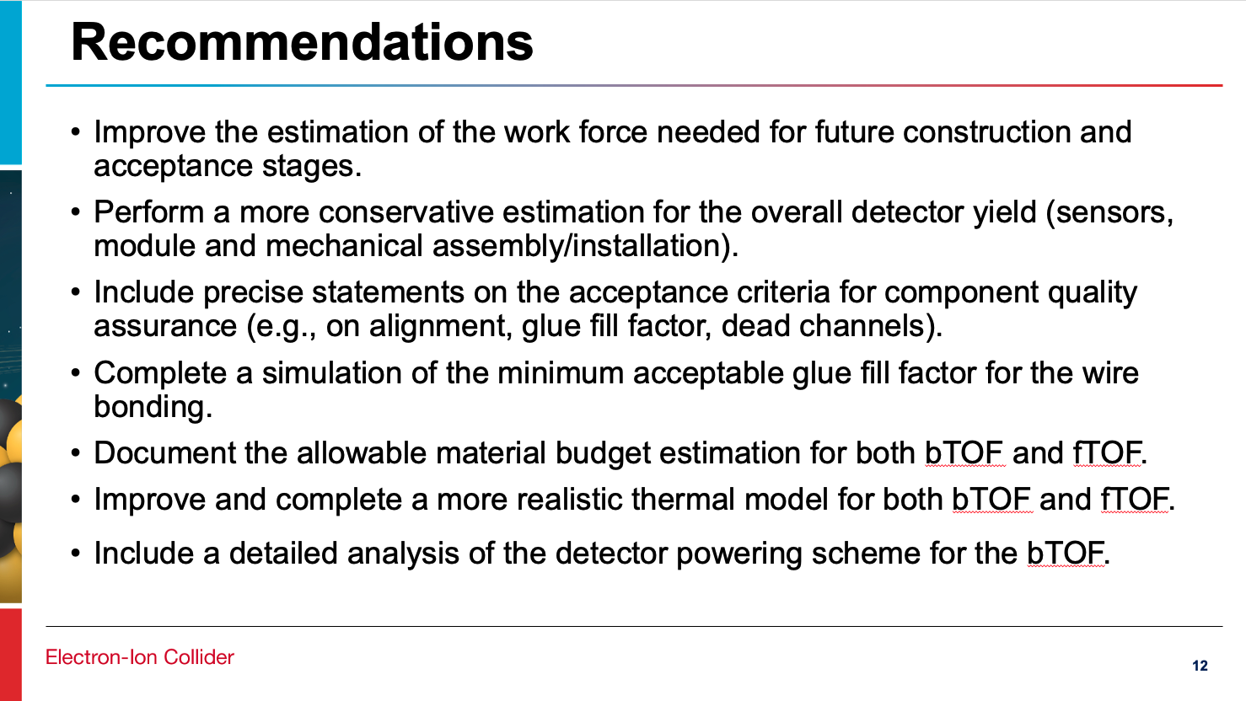
Management
Mechanics
Simulation
Mechanics
Electronics

Slide 5
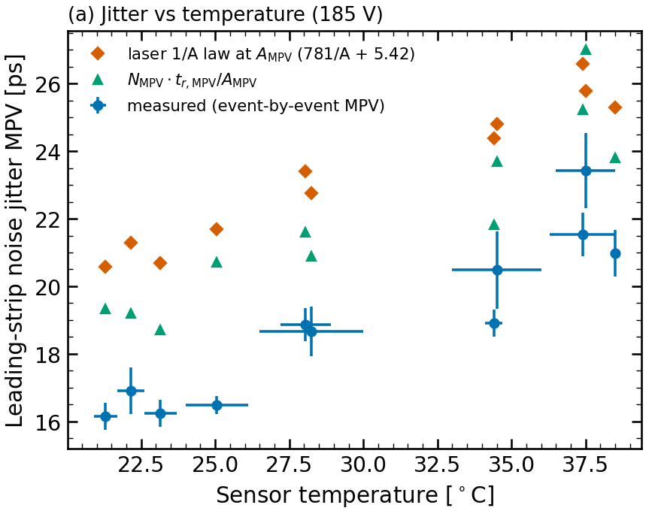
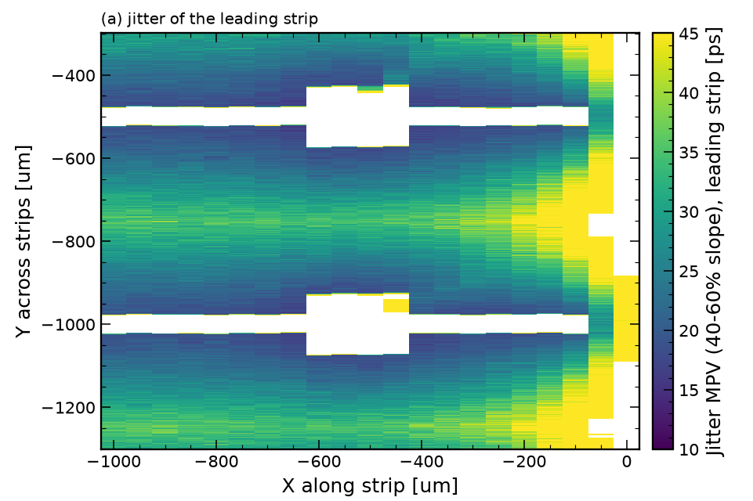
News Since Last Review

Slide 6
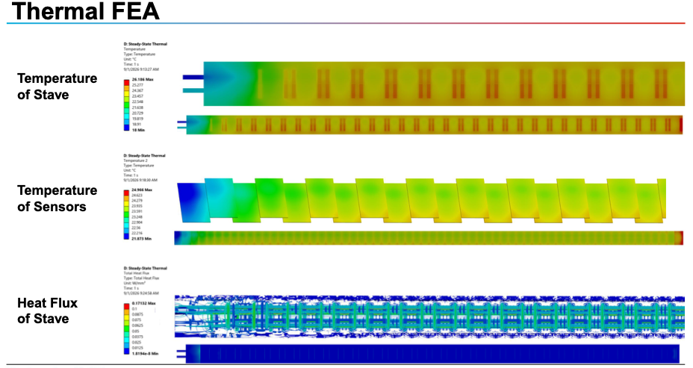

Slide 7
FPC
TO BE UPDATED

Slide 8
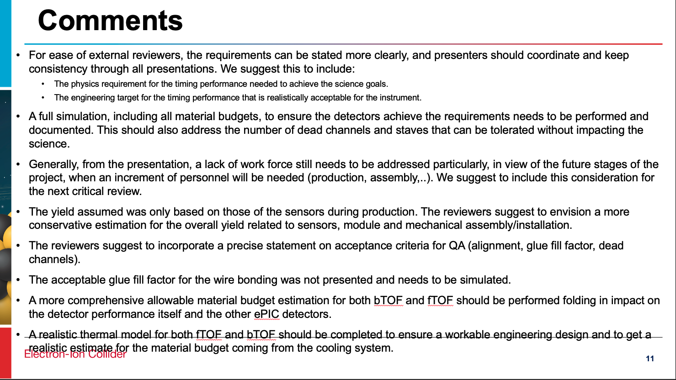
Simulation
Management
Mechanics
Simulation
Mechanics

