Slide 1

Routing Studies for ETA2
Stefano Gramigna (sgramigna@roma2.infn.it)
Oct 9th, 2026 – ECT Meeting

Slide 2
Outline
ETA1 Reverse Engineering
ETA2 Routing Hypotheses

Slide 3
ETA1 Reverse Engineering

Slide 4
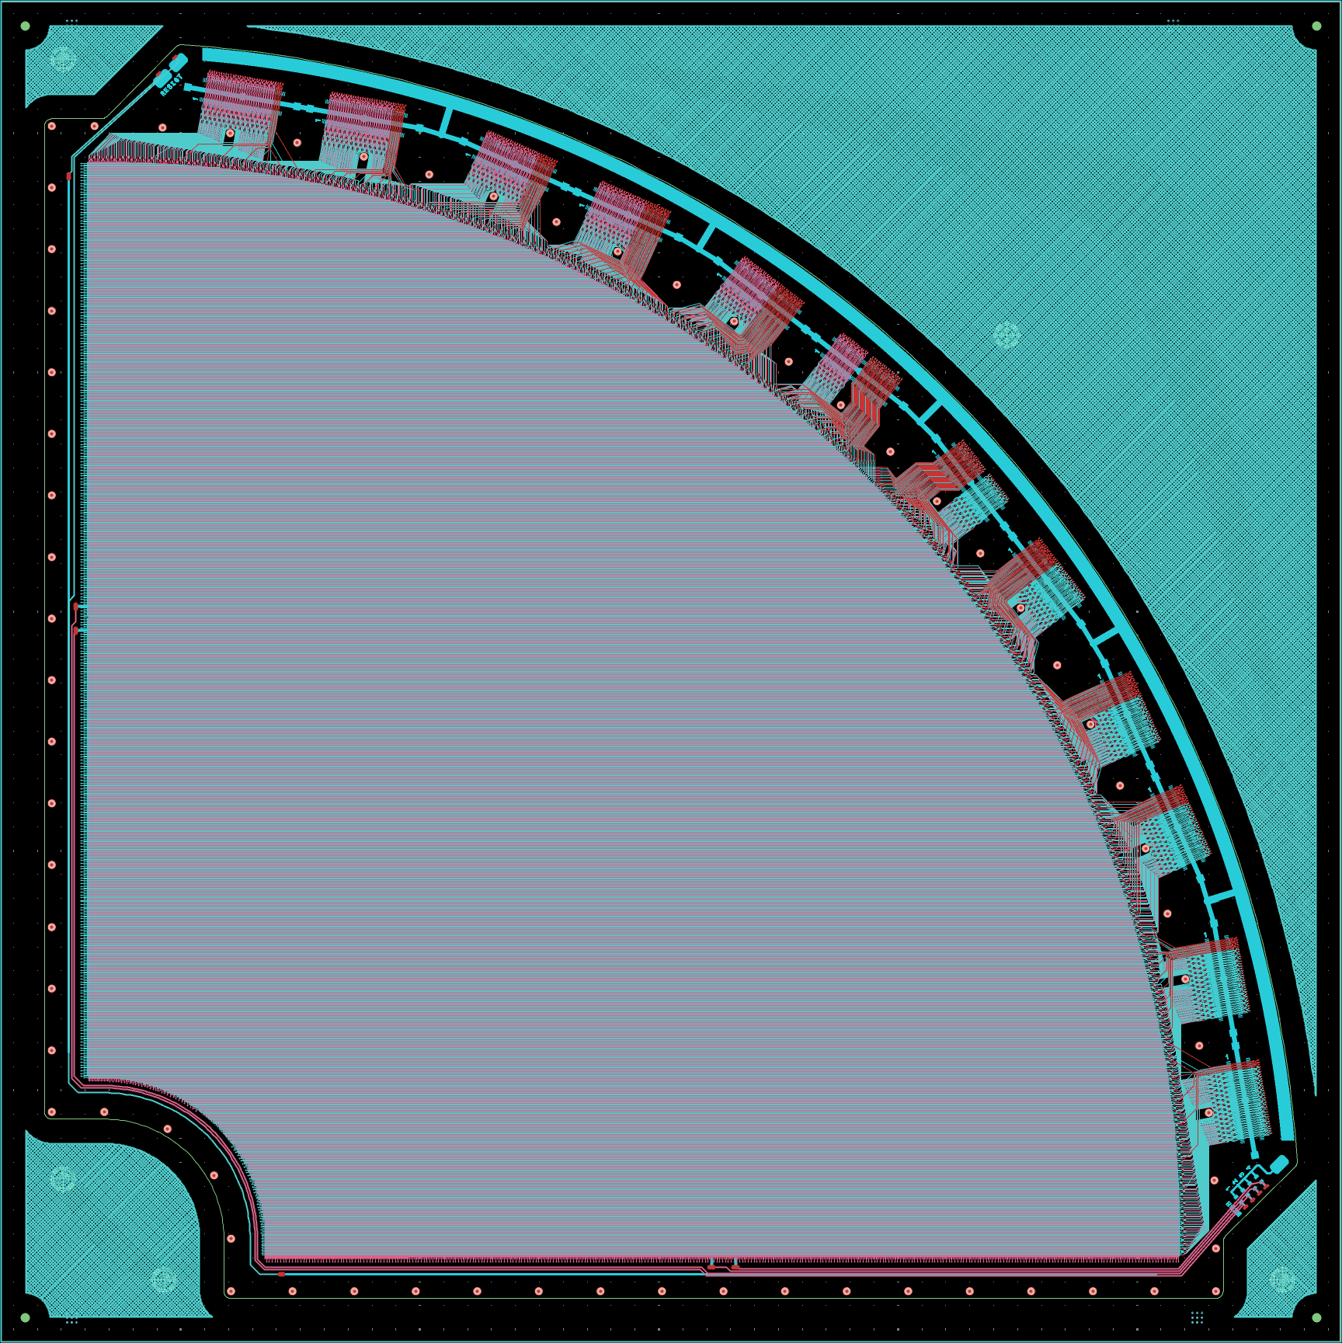
General Considerations
1
6 FEBs
12 Connectors
More X than Y
to connectors
600 µm
pitch
X strips go like this
Routing is symmetric
w.r.t. 45° axis
More Y than X
to connectors
X1
12
Y strips go like this
Y1

Slide 5
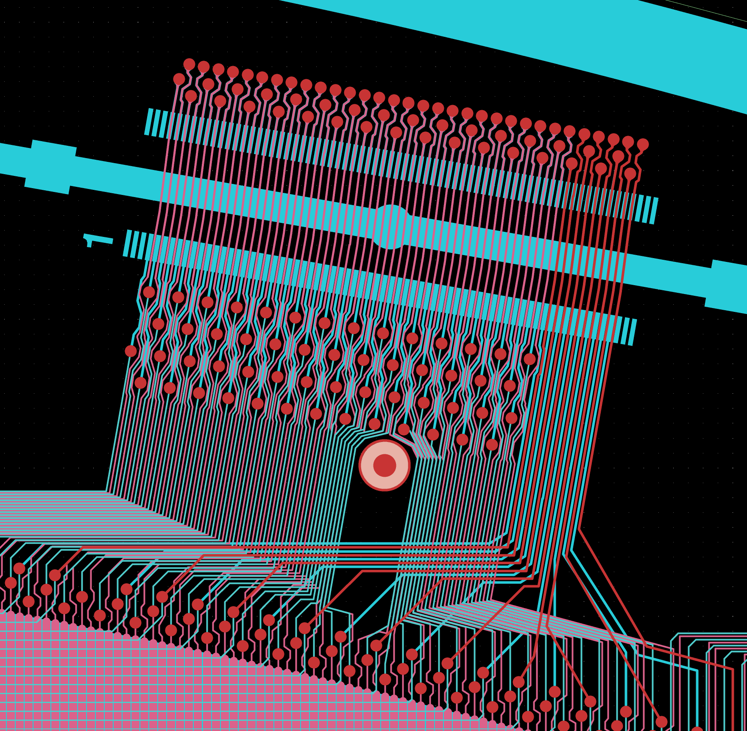
At Connector Level…
Each FEB carries 2× HIROSE FX20-140P connectors
140 pins available on each connector, max 128 used

Slide 6
At Connector Level…
X
Each FEB carries 2× HIROSE FX20-140P connectors
140 pins available on each connector, max 128 used
X and Y can (or have to) share the same connector
Y

Slide 7
At Connector Level…
SALSA 1
Each FEB carries 2× HIROSE FX20-140P connectors
140 pins available on each connector, max 128 used
X and Y can (or have to) share the same connector
Most straightforward connection to SALSA channels splits the connector down the middle:
Salsa 1 pins 1-70 (max 64 connected to SALSA)
Salsa 2 pins 71-140 (max 64 connected to SALSA)
SALSA 2

Slide 8
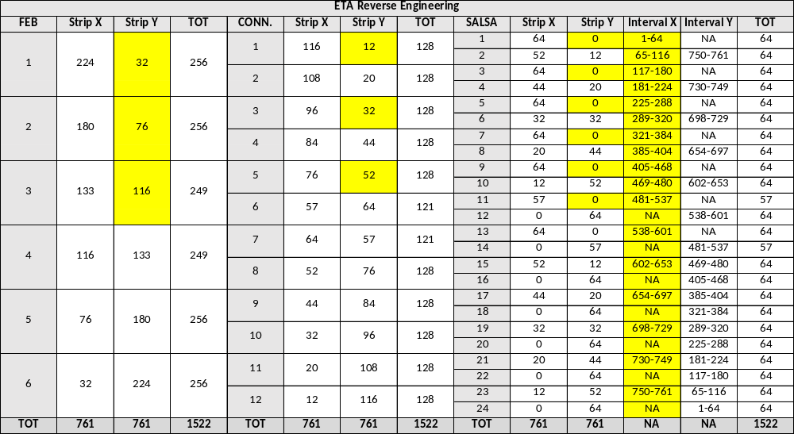
ETA Strip Lookup Table

Slide 9
ETA Strip Distributions

Slide 10
ETA2 Routing Hypotheses

Slide 11
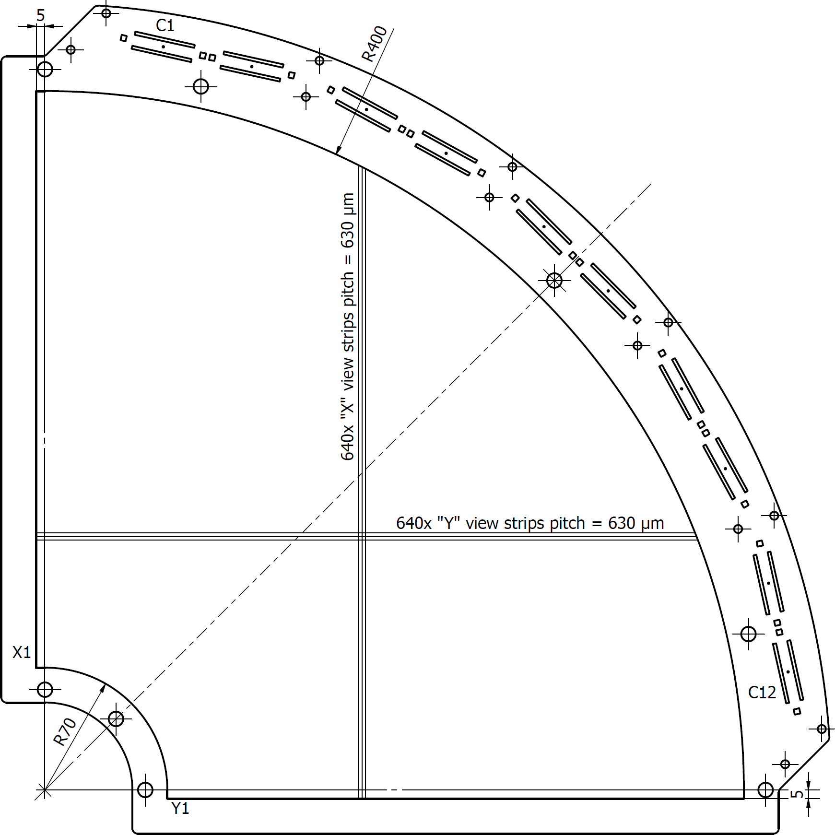
Geometrical Constraints

Slide 12
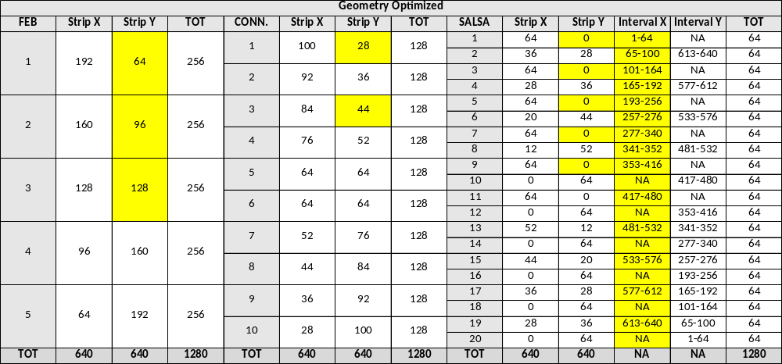
“Geometry Optimized” Strip Lookup Table
Views “fragmented” in low density regions → Common mode corrections less effective (?)

Slide 13
“Geometry Optimized” Strip Distributions
Strip distributions well match results from ETA reverse engineering

Slide 14
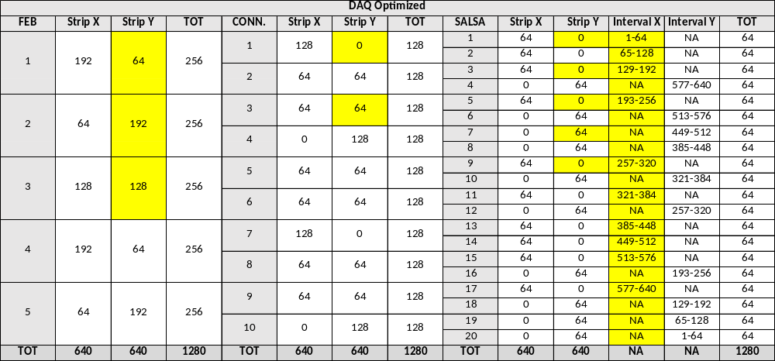
“DAQ Optimized” Strip Lookup Table
Fragmentation is removed → Each SALSA handles only 1 view … but is it feasible?

Slide 15
“DAQ Optimized” Strip Distributions
Strip distributions look very different, routing lines might get excessively long and/or overlap AA

Slide 16
Conclusions
The ETA Gerber files were studied to extract strip distributions, as examples of “common practice” in routing strips to connectors
Two hypotheses were formulated for routing of the preproduction prototypes
  The “geometry optimized” hypothesis favors geometrical constraints and natural strip distributions
  The “DAQ optimized” hypothesis tries to take advantage as much as possible of SALSA’s common mode corrections by grouping neighboring regions of the readout circuit on the connector
The electronic designer AKA Bertrand (CERN MPT Workshop) will ultimately have to evaluate these options when completing the design
The “Geometry Optimized” routing seems the most rational option (in my opinion) and the logical starting point for studies on SALSA rates

Slide 17
Thanks for your attention!
Questions?

Slide 18
Backup Slides
(Mostly slides from the January 2026 meeting)

