Slide 1
Status of FUDGE GNDS support and processing
CSEWG, Nov. 7 2017
Bret Beck

Slide 2
Outline
  Overview of FUDGE
  Translation of ENDF/ENDL to GNDS
  FUDGE GNDS processing example for transport codes
  Common processing
    Reconstructing cross section, heating cross sections, calculating average product data, etc.
  Monte Carlo processing
    pdf/cdf and gridded cross sections
  Deterministic processing
    Multi-group structures
    Multi-grouping data
  Testing via GIDI/MCGIDI
  Future work

Slide 3
Overview of FUDGE
FUDGE
  Originally named “For Updating Data and Generating ENDL”
  Changed to “For Updating Data and Generating Evaluation”
Started around 2002 to manage, manipulate, view and process ENDL data
Updated to translate ENDL and ENDF to GNDS and GNDS to ENDF
Updating to manage, manipulate, view, check and process GNDS data
Download fudge via https://ndclx4.bnl.gov/gf/project/gnd/
  Now includes all deterministic processing
  Python 2.7

Slide 4
Translation of ENDF/ENDL to GNDS
ENDL translation complete
Of the following ENDF sub-libraries, FUDGE translates all. But definition for nfy and sfy still not complete in GNDS
FUDGE handles all properly formatted ENDF-6 formatted files except for the new fission stuff
  ENDF/B-VII.1, VIII.0-beta5
The following sub-libraries can be processed
neutrons protons deuterons tritons
helium3s gammas photoat standards
electrons decay atomic_relax thermal_scatt
nfy sfy
neutrons protons deuterons tritons
gammas helium3s photoat standards

Slide 5
FUDGE GNDS processing example for transport codes
FUDGE command to process a GNDS file for deterministic and Monte Carlo transport at 3 temperatures
  Default temperature unit is MeV/K (--temperatureUnit)
  processProtare.py can be user modified
File contains
  evaluation data
  average product data
  pdf/cdf data for distributions (e.g., P(E’|E))
  heated cross sections
  Common grid heated cross section (for Monte Carlo)
  multi-group data
bin/processProtare.py --energyUnit MeV -mc -mg -t 2.58522e-08 -t 1e-07 -t 1e-4 gnds.file.xml

Slide 6
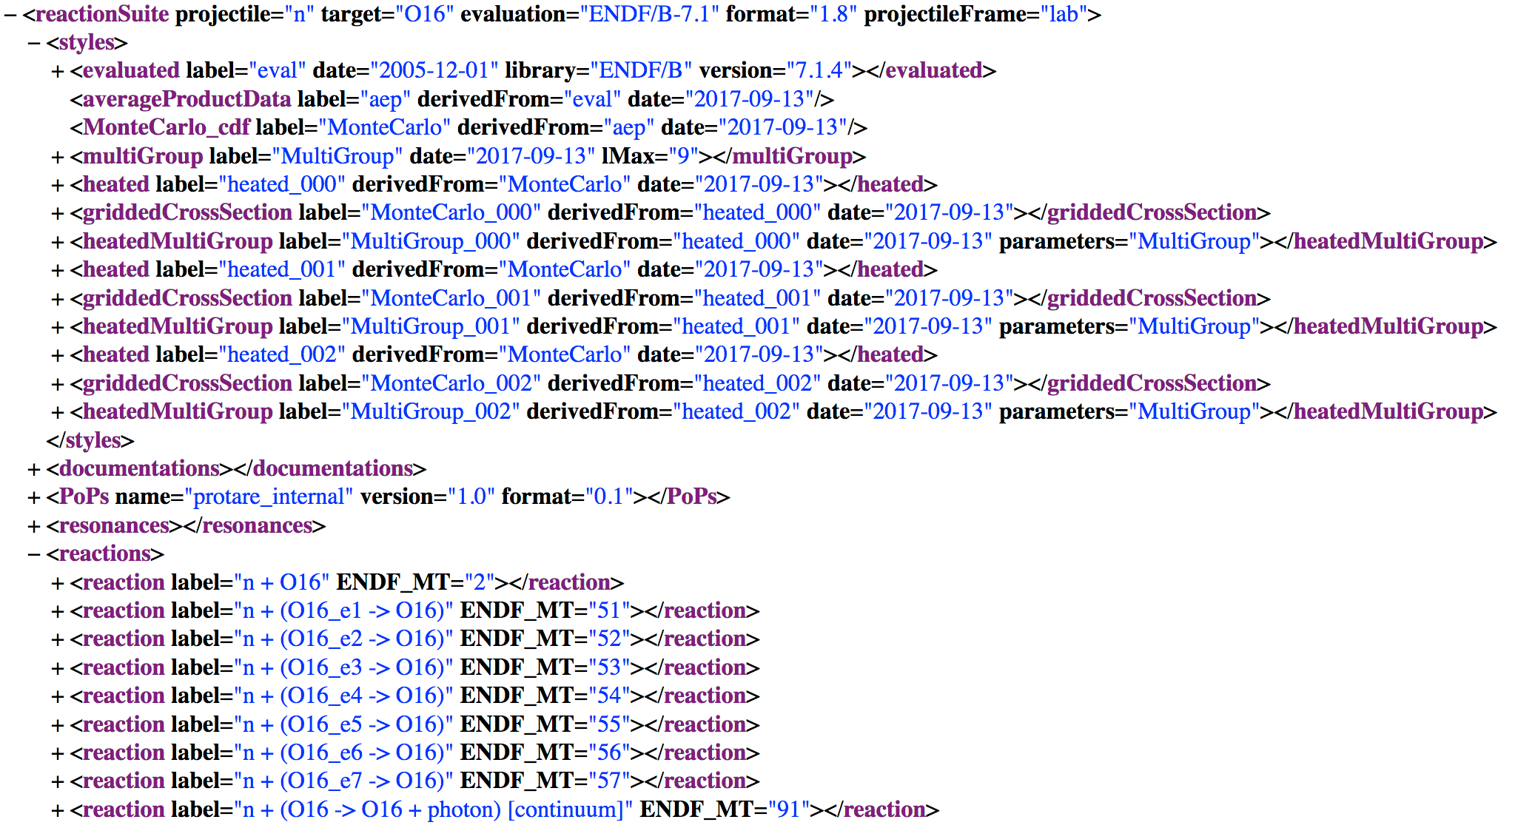
Top level of GNDS file

Slide 7
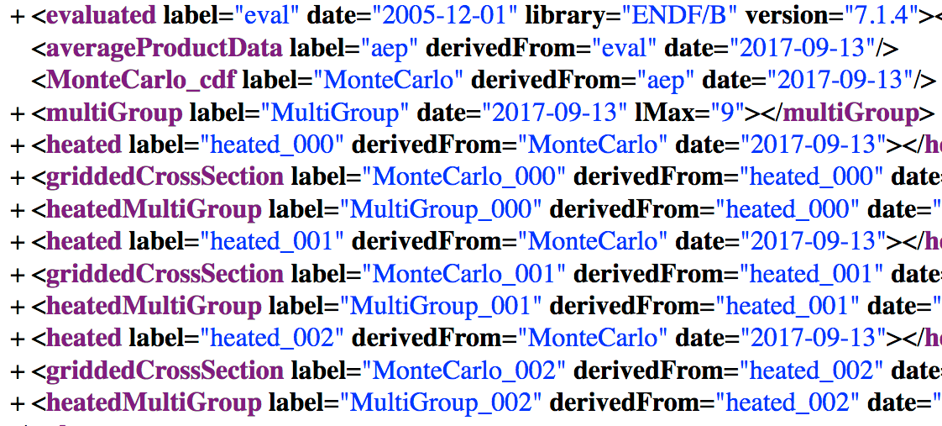
Characteristics about data are given by various styles
This is a floater style. It has no ‘derivedFrom’ style but is used by all ‘heatedMjultiGroup’ styles to define the group structure for all particles for multi-grouping.
This GNDS file contains data for 3 temperatures for both Monte Carlo and deterministic transport.

Slide 8
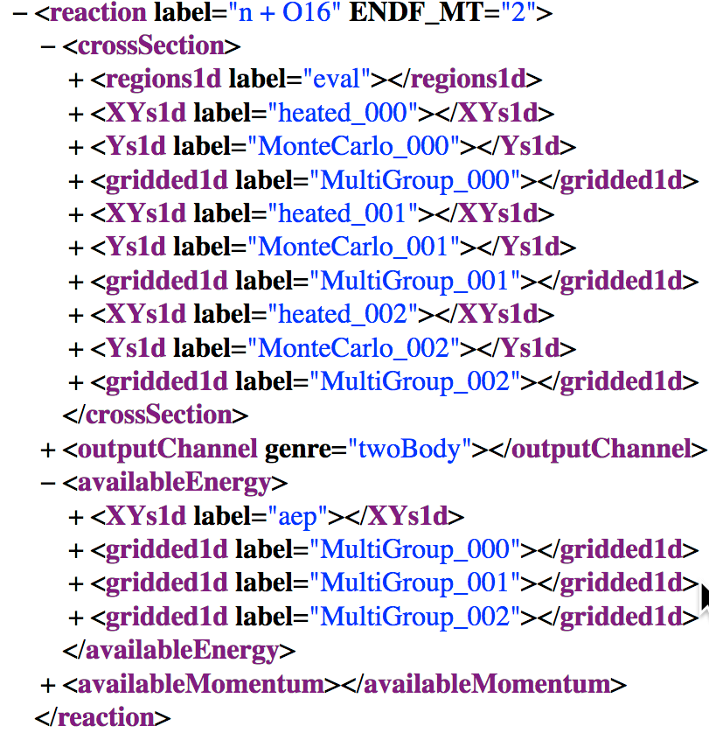
Different forms for crossSection and availableEnergy
Cross section weighted

Slide 9
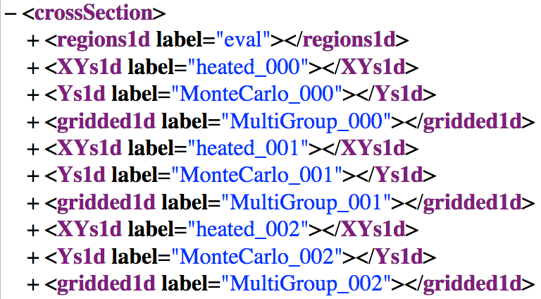
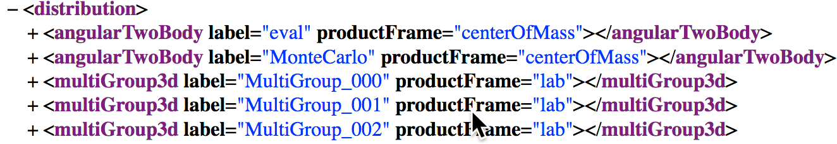
Different forms for distribution
multiGroup3d nodes are transfer matrices and include the products multiplicity.

Slide 10
Common processing: use by multi-group and MC processing
Reconstruct cross section
Heat cross sections (incident neutrons only)
Calculate cross section from photo-atomic coherent and incoherent scattering double differential cross section
Energy (eV)

Slide 11
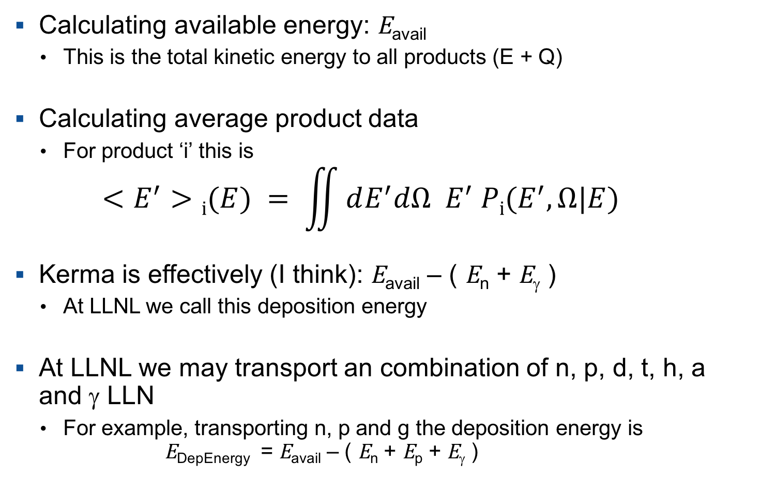
Common processing 2: Product energy and momentum
Calculating available energy: E_{avail}
  This is the total kinetic energy to all products (E + Q)
Calculating average product data
  For product ‘i’ this is
  $<E^{′}>i(E) = \iint{dE^{′}dΩ E^{′} Pi(E^{′},Ω|E})$
Kerma is effectively (I think): E_{avail} – ( E_{n} + E_{γ} )
  At LLNL we call this deposition energy
At LLNL we may transport an combination of n, p, d, t, h, a and γ LLN
  For example, transporting n, p and g the deposition energy is
  E_{DepEnergy} = E_{avail} – ( E_{n} + E_{p} + E_{γ} )

Slide 12
Monte Carlo processing
For product distributions
  converts pdf to GNDS pdf/cdf
  Calculates Kalbach/Mann a(E,E’) function if missing
For each temperature, puts cross sections on a common energy grid
To do:
  Implement upscattering (i.e., target thermal motion)
  Charged-Particle Elastic Scattering (ENDF MF=6/LAW=5)?
  Handle photo-atomic data

Slide 13
Deterministic processing
Uses heated cross section to multi-group per reaction
  cross sections
  Q-values on a per channel basis
  multiplicities on a per product basis
  available energy/momentum on a per product basis
  average product energy/momentum
  distributions (transfer matrices) on a per product basis
To do:
  Implement upscattering
  Charged-Particle Elastic Scattering

Slide 14
Testing via GIDI/MCGIDI
GIDI: General Interaction Data Interface
  C++ API to read GNDS files for transport codes
  Multi-group collapsing
  Calculates multi-group energy deposition
  Nearly complete
MCGIDI: Monte Carlo GIDI
  C++ API to store and sample for Monte Carlo transport codes
  Uses GIDI to read data, then puts it into better form for MC needs
  Handles point-wise cross sections and pdf/cdf distributions
  Working on
    point-wise energy deposition
    multi-group and fixed-grid support for cross sections, deposition energy, etc.
    angle biasing

Slide 15
Testing via GIDI/MCGIDI
LLNL transport codes are implementing GIDI/MCGIDI
  Ardra (deterministic) and
  Mercury (MC) transport codes
See Marie-Anne Descalle criticality tests
  Talk Monday 14:25
  Various versions of ENDF including ENDF/B-VIII.beta5
Transfer matrices
  See Caleb Mattoon about comparison to NJOY and AMPX

Slide 16
Future work
Upscattering (i.e., target thermal motion)
Neutron thermal scattering law
Unresolved resonance probability tables
Multi-band
GNDS to ACE, NDI, etc.
  Need a “python” script to split an ACE into directories by MT (e.g., reaction) and data type
MT_2/ MT_5/ MT_51/ MT_52/ …
crossSection # One E_{i}, σ(E_{i}) pair per line
neutron_1/ # Data for outgoing neutron

