Slide 1
Fission Yields Data Needs
A.A. Sonzogni, E.A. McCutchan
National Nuclear Data Center

Slide 2
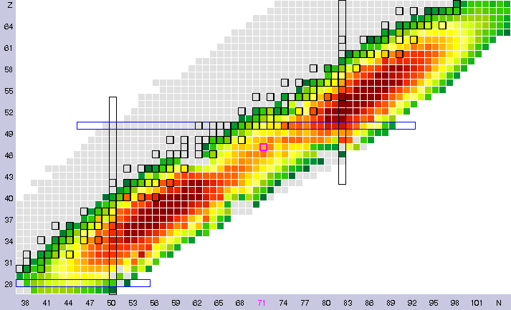
Fission Yield Data
on the market:
ENDF/B, USA, released in 1992
JENDL, Japan, very similar to ENDF/B, somewhat updated.
JEFF-3.1.1, Europe (UK), released in 2009, source and methods are proprietary information.
Format is the same from ENDF/B-V, just a list of independent and cumulative fission yields with uncertainty.

Slide 3
ENDF/B
Some yields need corrections.
Isomeric ratios could be updated.
Yields are not compatible with modern decay data.
All the experimental data published from the late 1980s have not been incorporated in the ENDF/B yields!

Slide 4
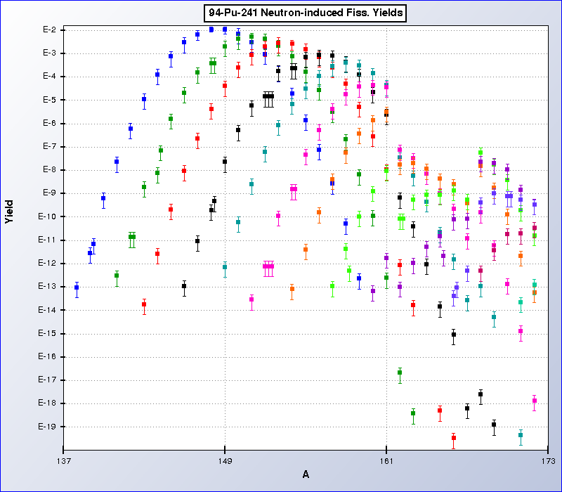
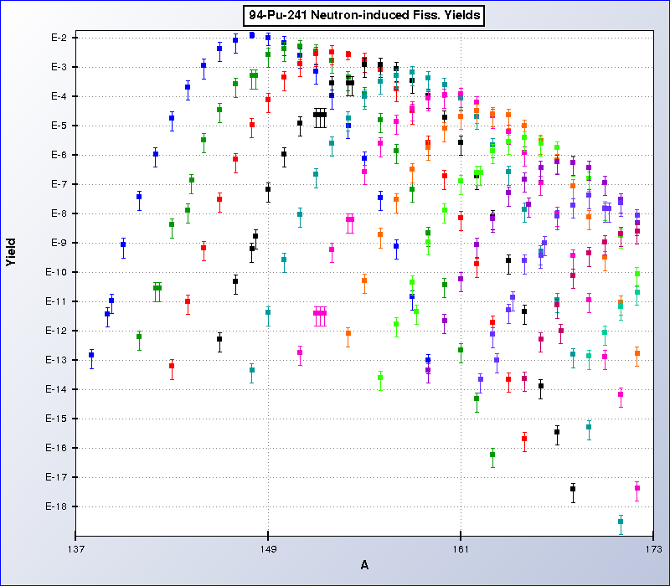
Example of corrections needed.

Slide 5
⁹⁶Y, example of compatibility issues with current decay data
ENDF/B-VII.1 Fission Yields (1992)
ENSDF (Current)
3
β- 100%
8+
IT 100%
0
0-
β- 100%
⁹⁶Y
⁹⁶Y

Slide 6
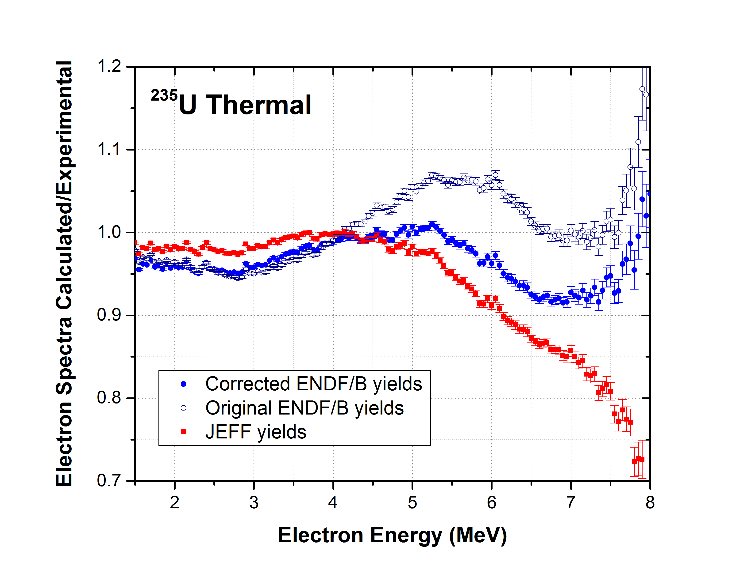
Example on updating ENDF yields
Corrected yields:
No electron excess.
Better agreement with JEFF.
A.A. Sonzogni, E.A. McCutchan, T.D. Johnson, P. Dimitriou, PRL 116, 132502 (2016).

Slide 7
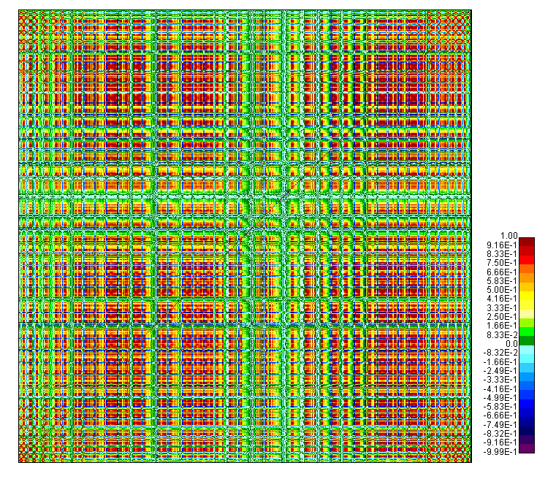
Cumulative Fission Yields Correlations
CFY= A IFY
Matrix A obtained from the ENDF/B-VIII.0 decay data sub-library.
Needed to understand uncertainty quantification in reactor antineutrino problems.

Slide 8
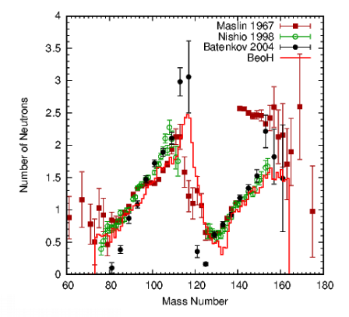
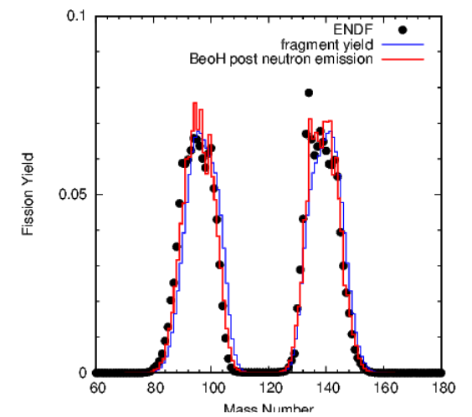
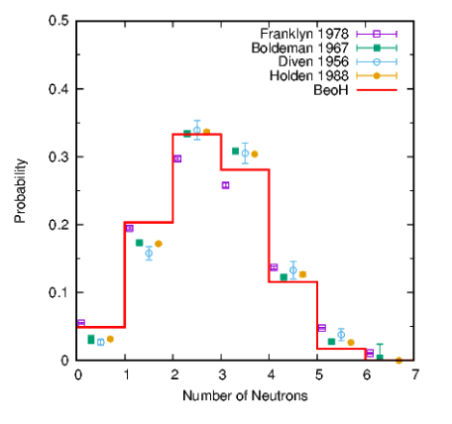
Considerable Theoretical Progress
From T. Kawano, USNDP meeting, BNL, 11/2017.

Slide 9
We need to recover fission yield evaluation capabilities in the US:
Critical compilation of all fission yield data.
Development of fission yield theory and codes
Production and maintenance of recommended fission yield data.
Expansion of the format to accommodate other quantities such as:
Y(A) pre and post neutron emission
Nu-bar(A)
Correlation matrices
BNL, LANL, LLNL & ORNL have expressed interest in this task.
Upcoming IAEA CRP on fission yields (around 2019).

