Slide 1
Decay Data Needs

Slide 2
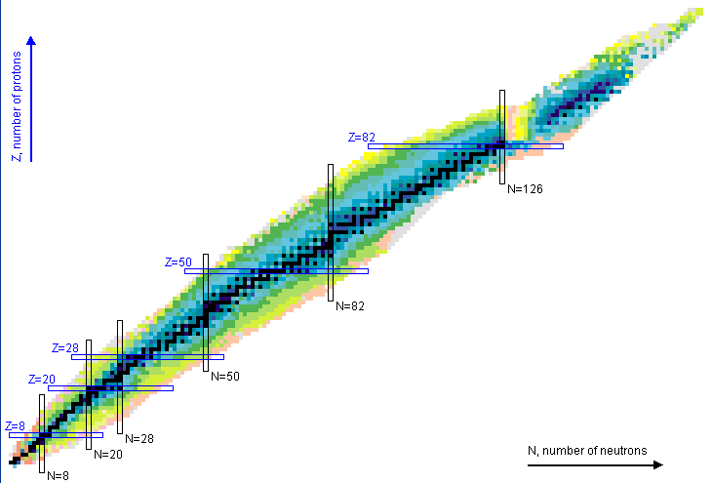
Evaluated Nuclear Structure Data File
ENSDF
3,325 nuclides
18782 datasets
~4,200 Decay Datasets

Slide 3
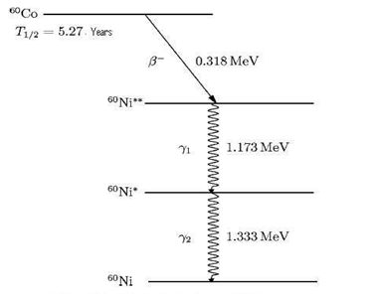
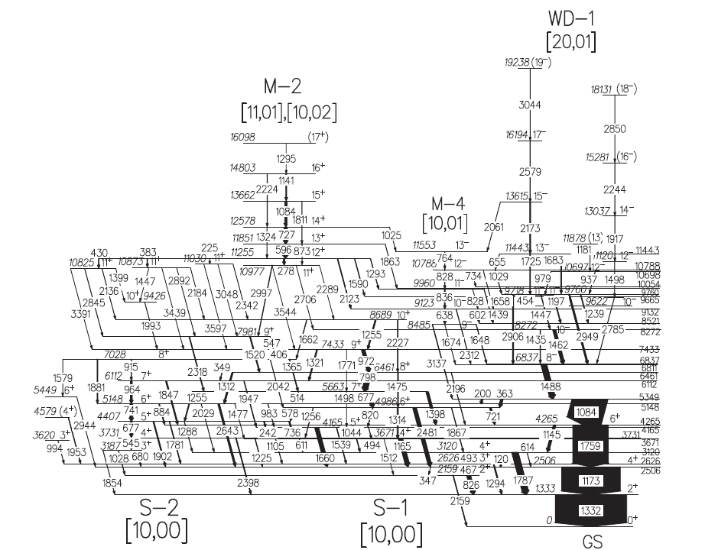
Nuclear Data in a Nutshell
Nuclei Themselves
And their decay properties
⁶⁰Ni
Level energies, spin, parity, half-life, …
Radiation energies, intensities …
Gamma-ray energies, intensities, …
ENSDF: Evaluated Nuclear Structure Data File

Slide 4
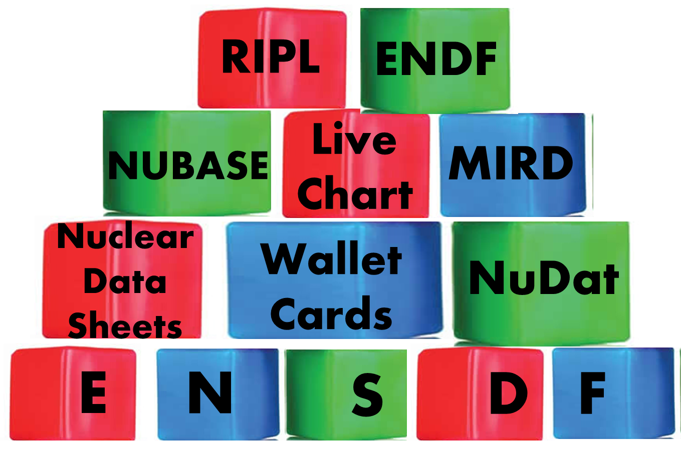
ENSDF is the Foundation
It is Unique: Only Nuclear Database continuously updated
It is Complete: All nuclei and all level and radiation properties
It is Versatile: Feeds back into both basic and applied sciences

Slide 5
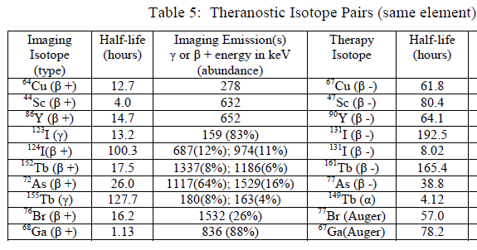

Why Decay Data ?
Forms foundation for many applications:
Nuclear Medicine
Nuclear Forensics
Reactor Decay Heat and Antineutrinos
Non-destructive Assay
Gamma-ray intensities frequently used to determine cross sections
Over half were last studied >30 years ago !!

Slide 6
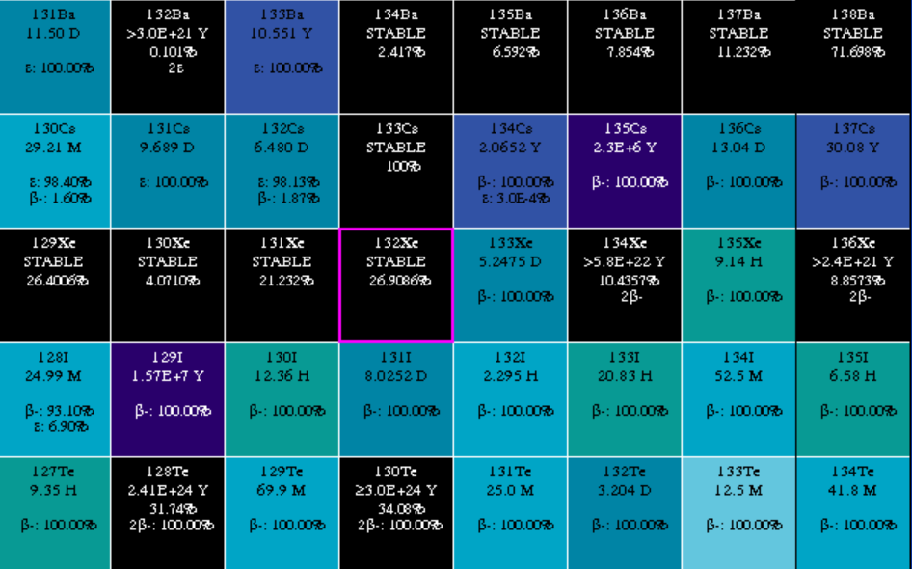
Why Decay Data ?
Blocked Cs and I yields (relative to well know 99Mo) retain fission information
INS 1976 Ann.Rept., p.47 (1977)
M.Ohshima, Y.Itoh, S.Hayashibe, M.Fujioka, N.Kawamura, T.Ishimatsu
The Low-Lying Level Structure of ¹³⁶Ba
Presented by A. Hayes at NDNCA

Slide 7
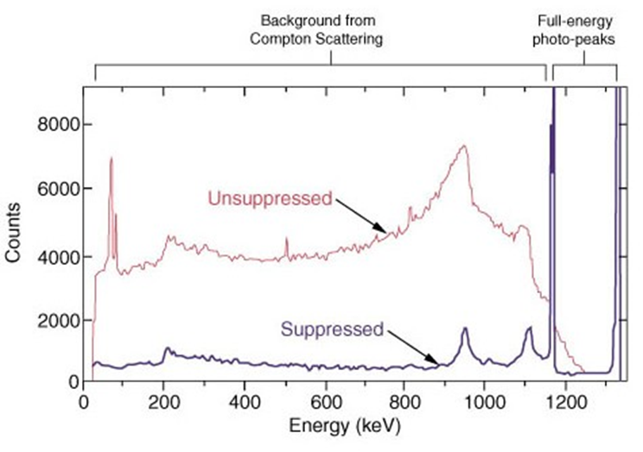
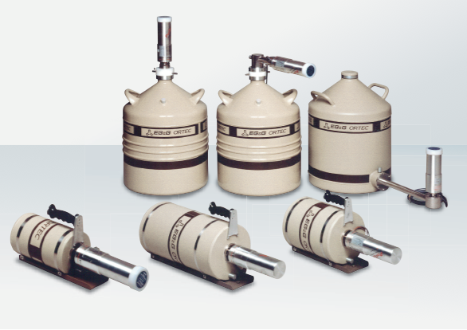
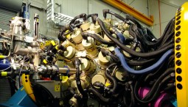
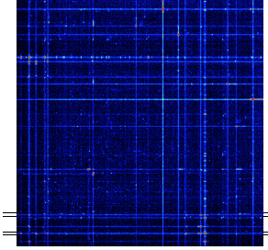
Capitalizing on advances in γ-ray spectroscopy
Compton suppression
30 Years ago: 1-2 small detectors
Present: 10-100 detectors
γγ coincidences

Slide 8
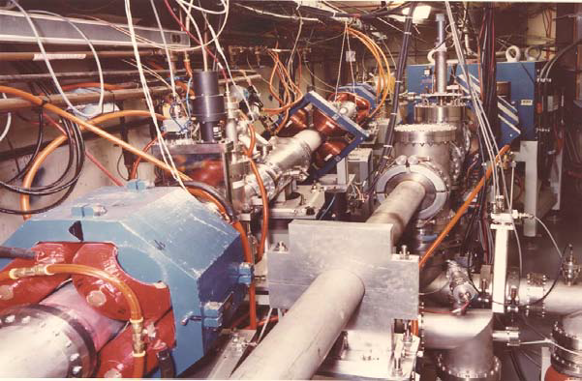
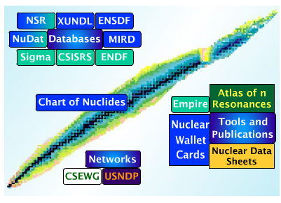
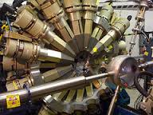
Decay studies of Medical Isotopes
Combine expertize in all skills needed to develop a world-class program to enhance production and application of radioisotopes
Target design
Radiochemistry
Medical relevance
Structure & Decay Data
Reaction Data
Reaction Modeling
γ-ray spectroscopy
State-of-the-art detector systems
UofWisc
BLIP
USNDP
ANL
UMASS

Slide 9
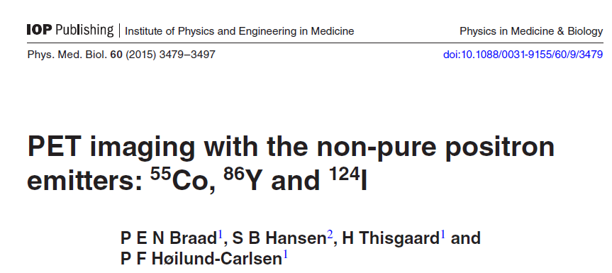
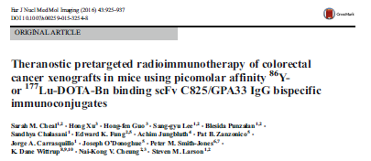
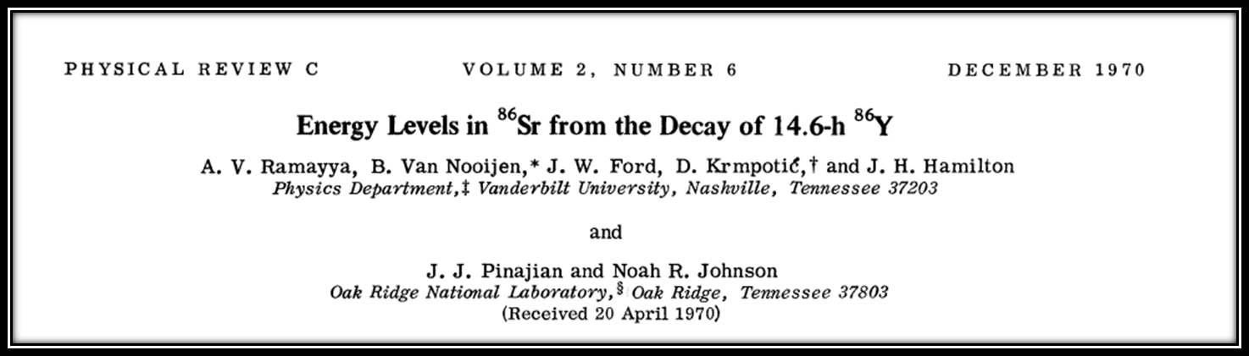
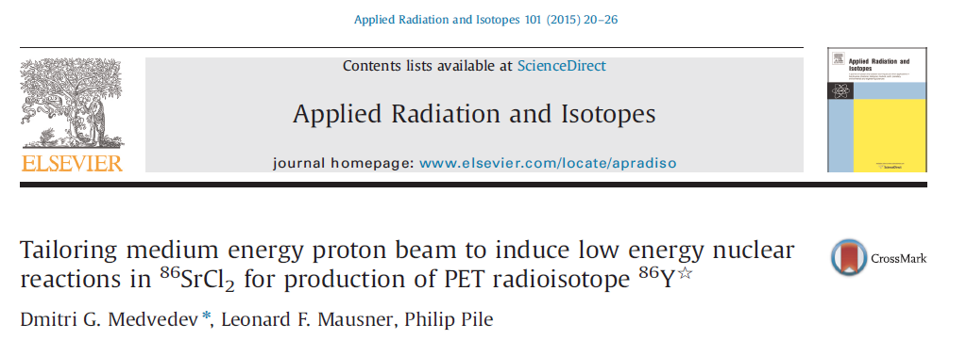
Non-conventional PET agents : ⁸⁶Y

Slide 10
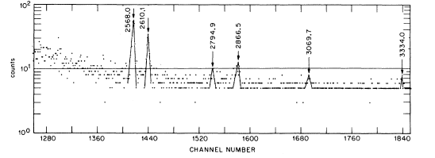
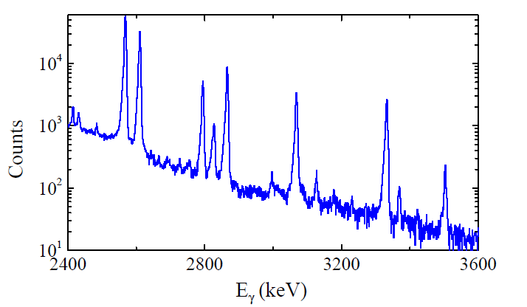
Results on ⁸⁶Y
Gate on 2⁺→0⁺
Gammasphere

Slide 11
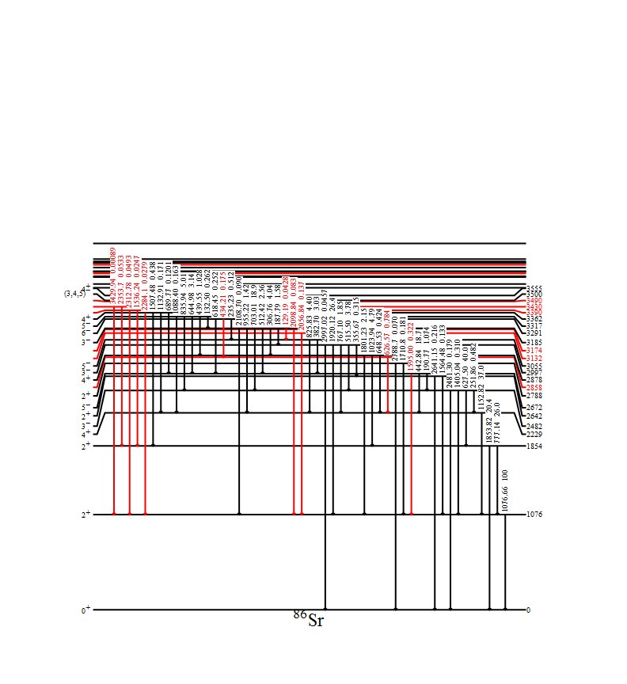
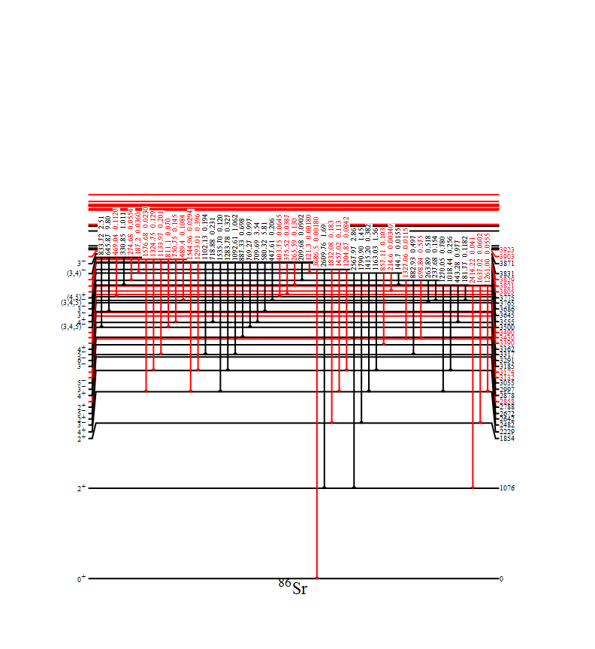
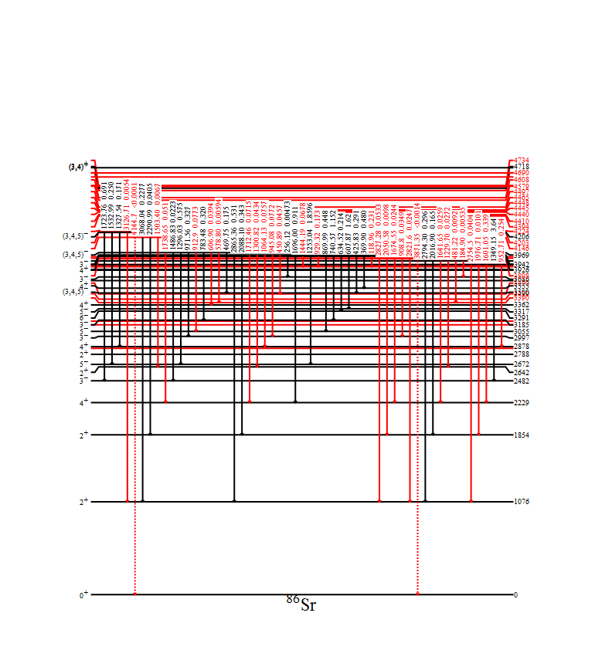
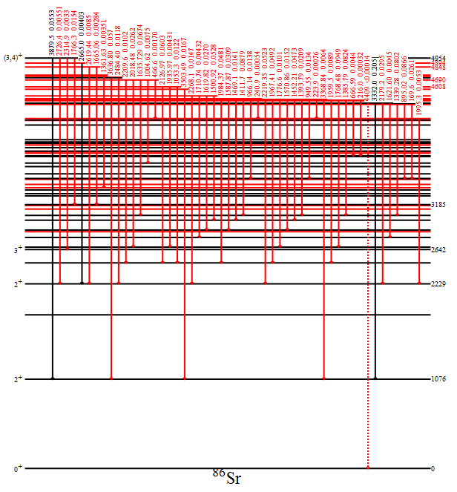
Revised Decay Scheme for ⁸⁶Y
Confirmed
New
Identified over 100 new transitions
511-keV intensity decreases by 20% !

Slide 12
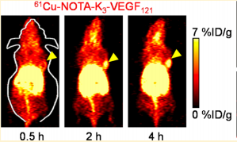
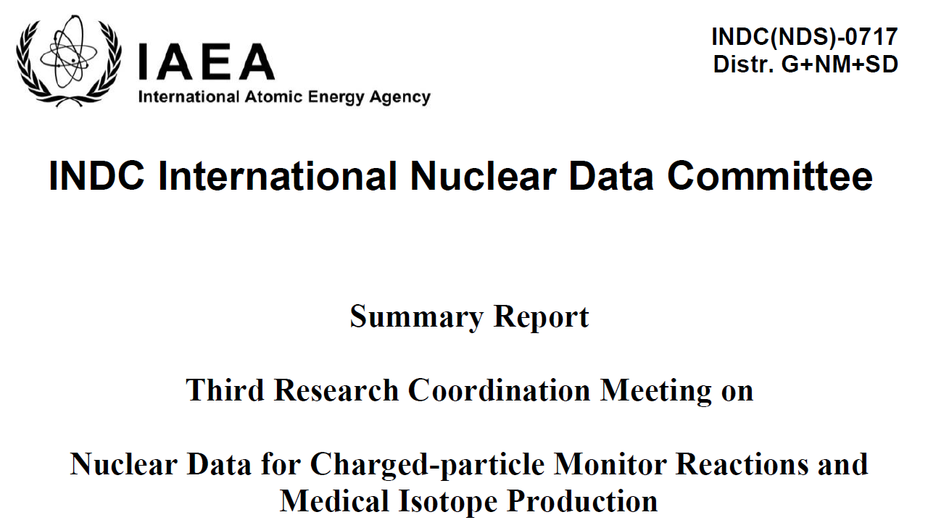
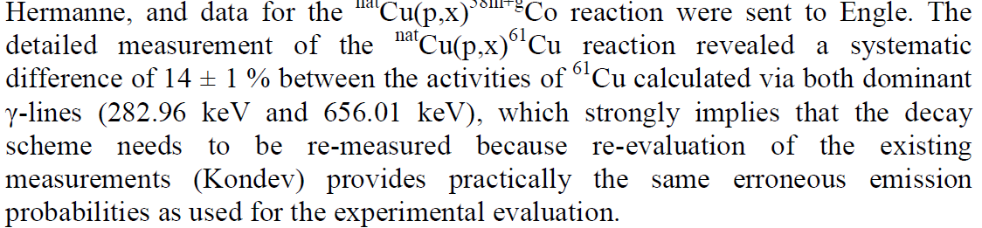
Study of ⁶¹Cu
Motivation
Commonly used in tumor hypoxia imaging

Slide 13
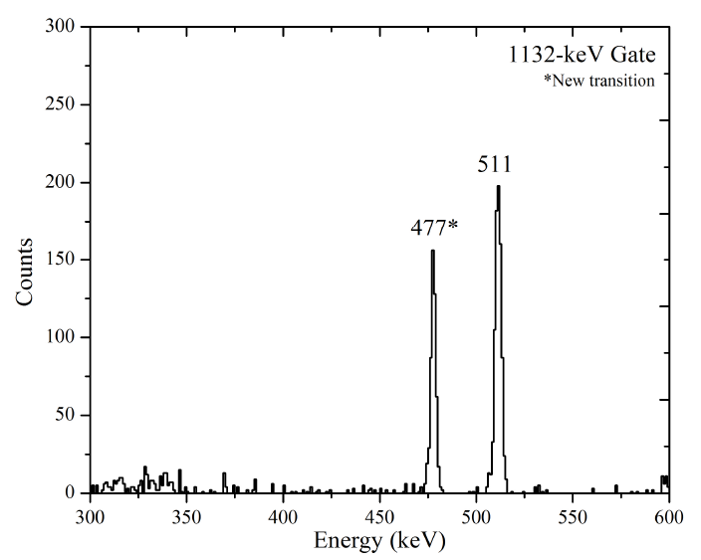
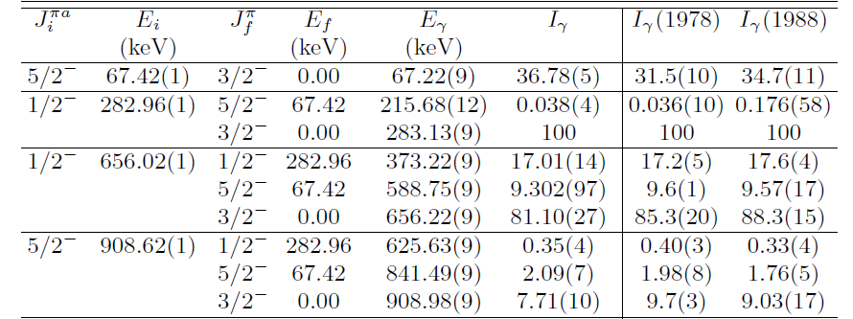
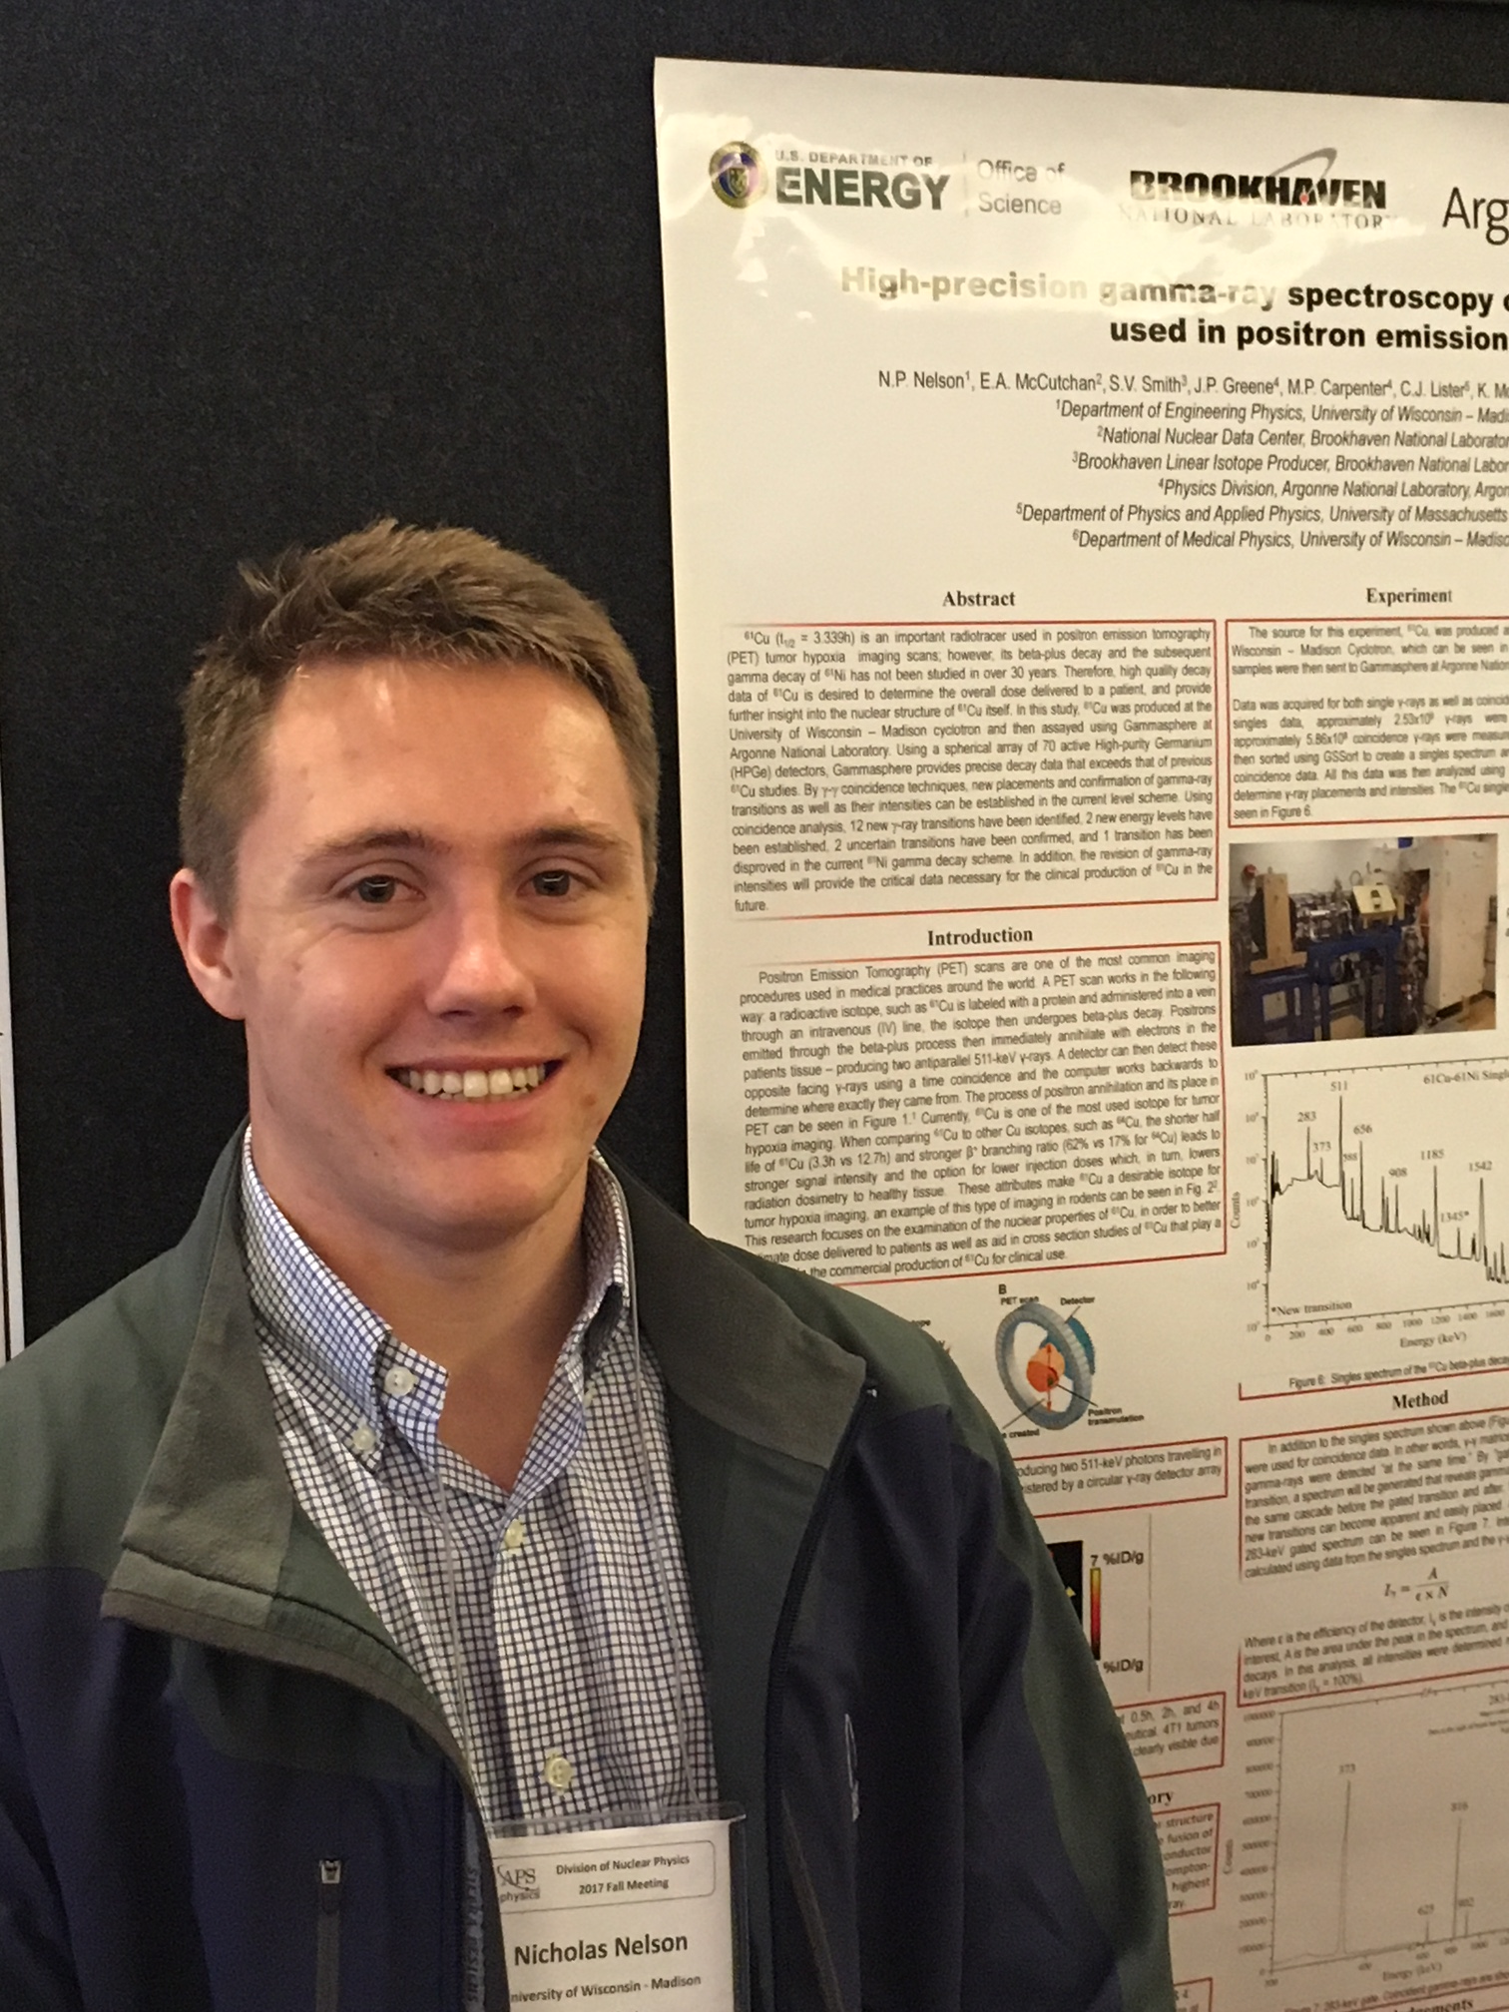
⁶¹Cu analysis
Only a few additions to the decay scheme
Clear, systematic decrease in all measured intensities of strong gammas

Slide 14
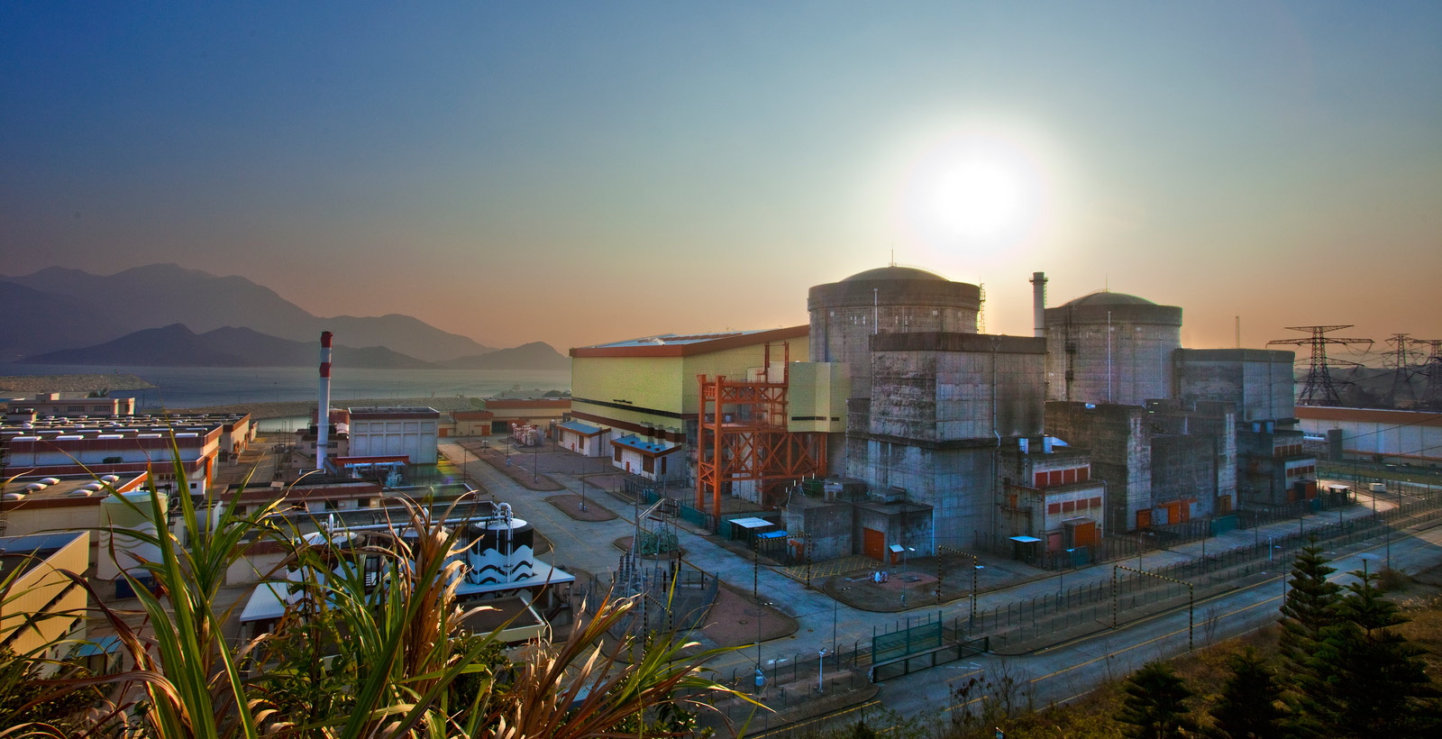
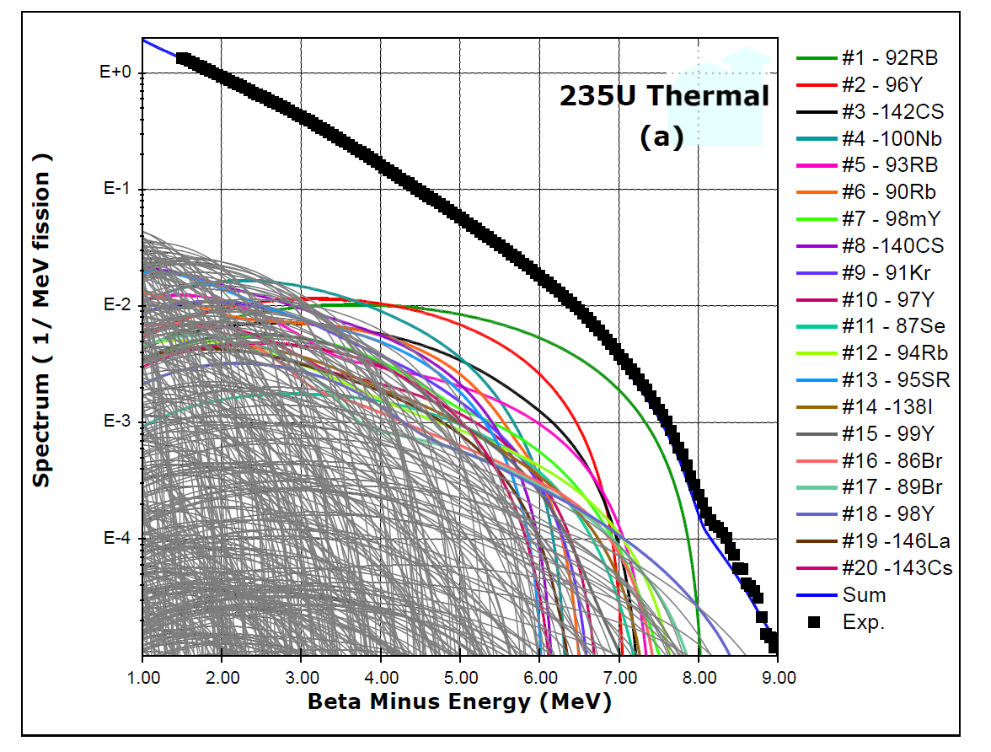
Antineutrinos From a Reactor
Daya Bay
F.P. An et al, Phys. Rev. Lett. 108, 171803 (2012)
A.A. Sonzogni, T.D. Johnson, E.A. McCutchan, Phys. Rev. C 91, 011301(R) (2015).

Slide 15
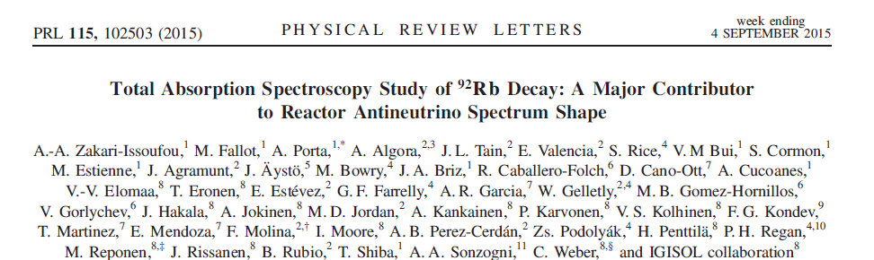
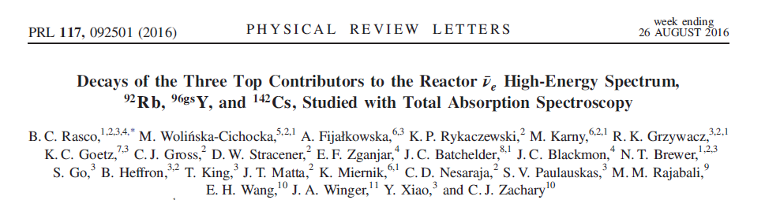
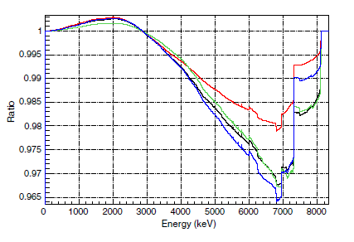
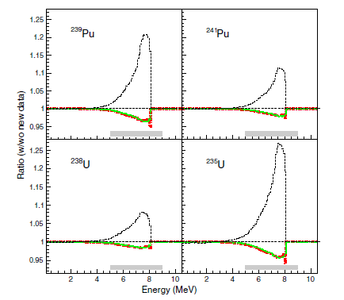
The ⁹²Rb race : TAGS results
G.S. Branch 87.2 (25)%
G.S. Branch 91 (3) %

Slide 16
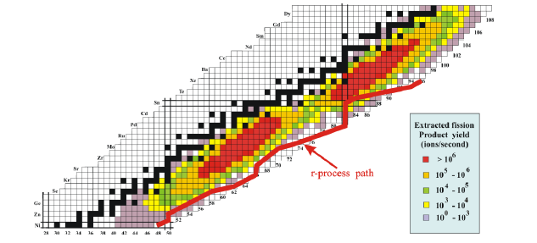
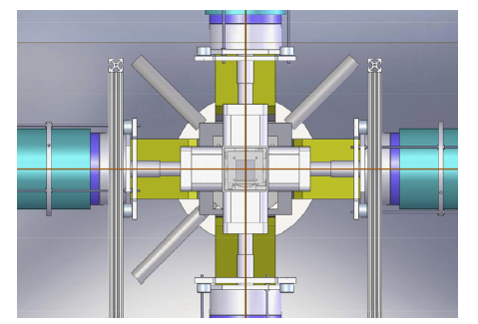
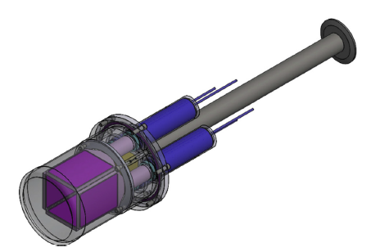
The ⁹²Rb race : βγ experiment
NNDC, LLNL, ANL collaboration
CARIBU
⁹²Rb beam
~1000 ions/s
X- Array
SATURN

Slide 17
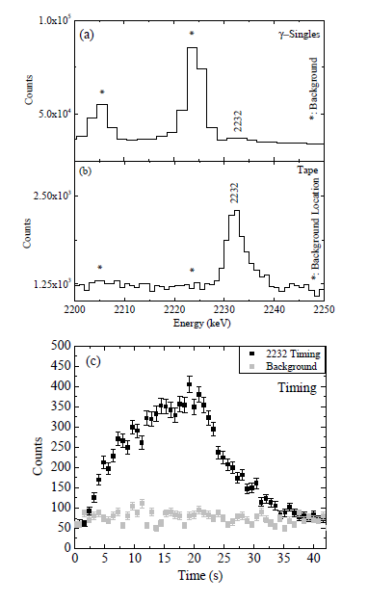
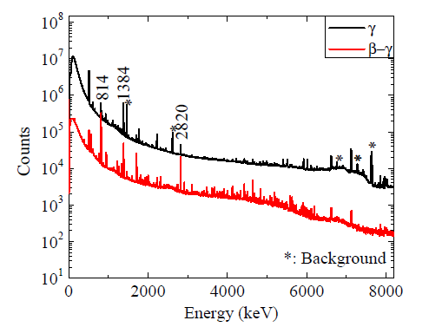
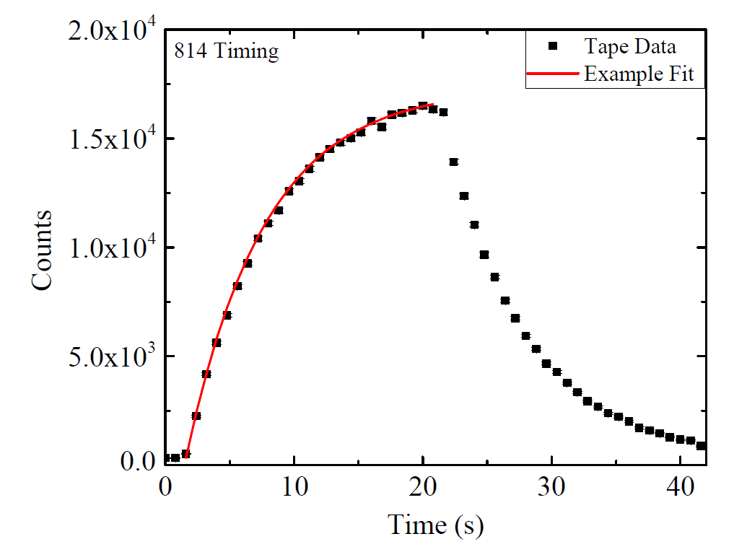
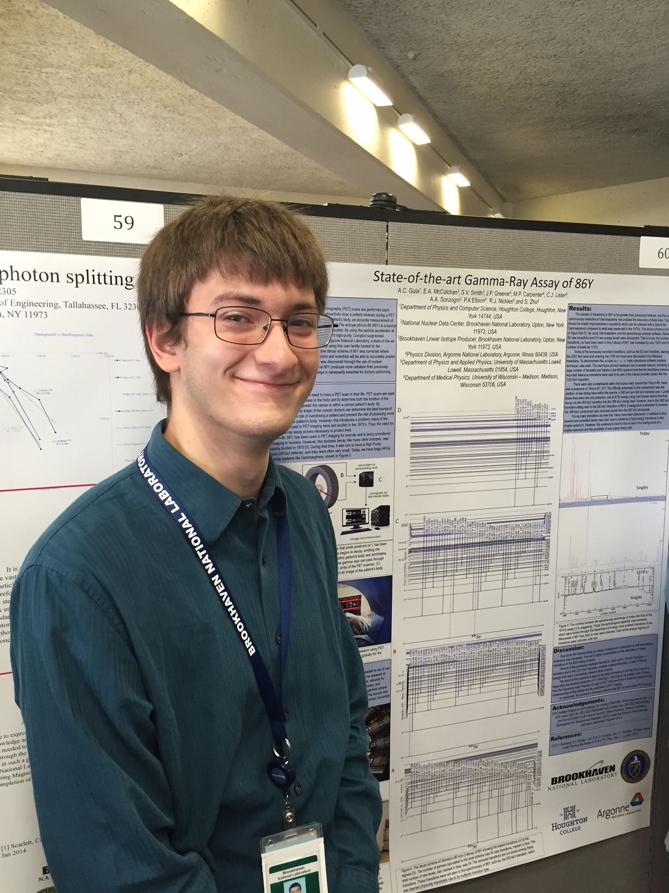
Few experimental examples

Slide 18
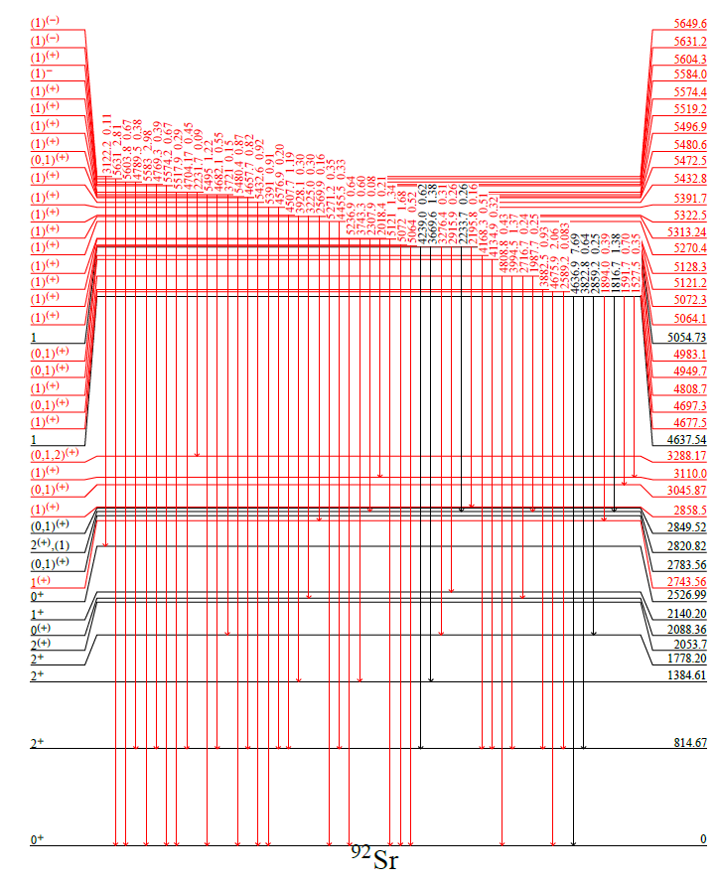
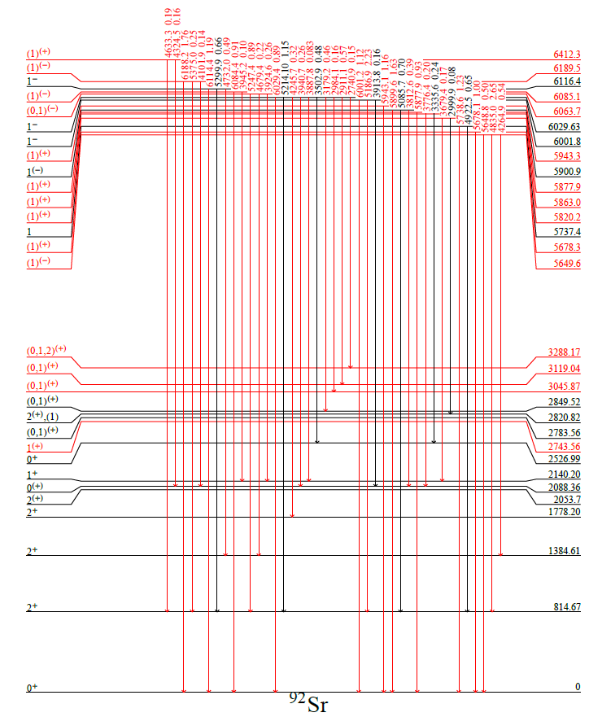
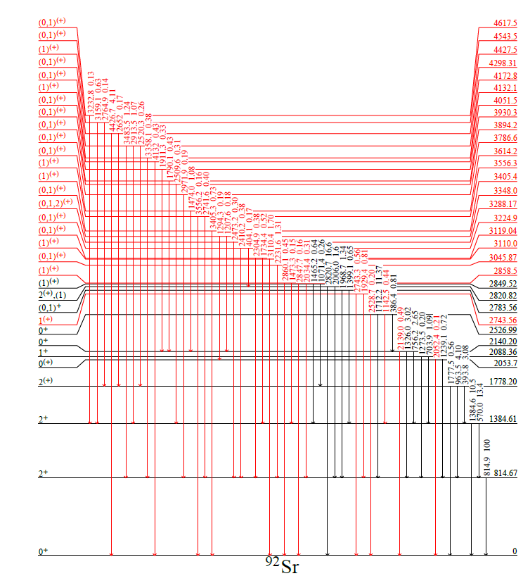
Revised level scheme
52 New Levels (17 previously known)
Iβ to g.s. = 91 (1) % (agrees with ORNL result)
Literature: R. J. Olson et al., PRC 5, 2095 (1972)

Slide 19
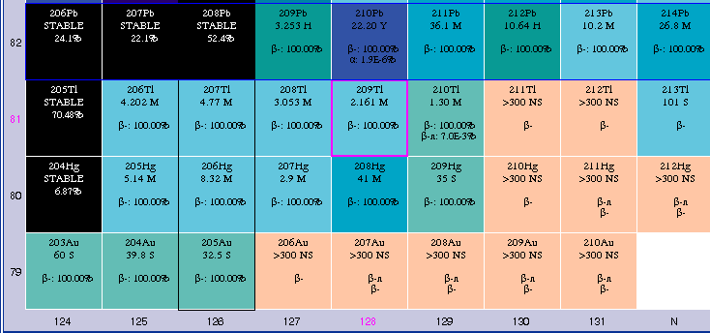
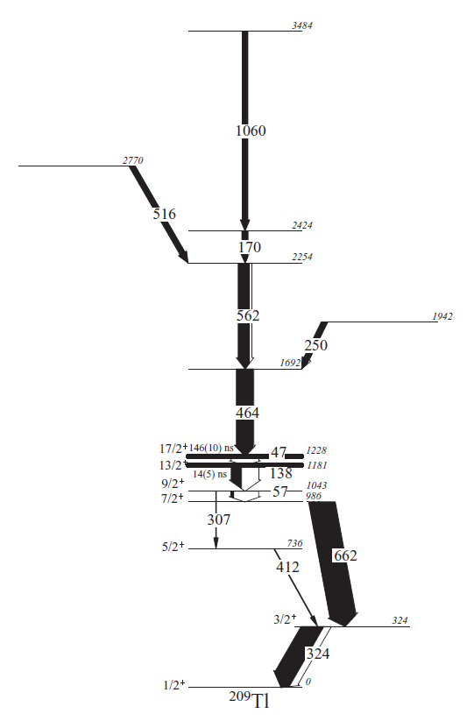
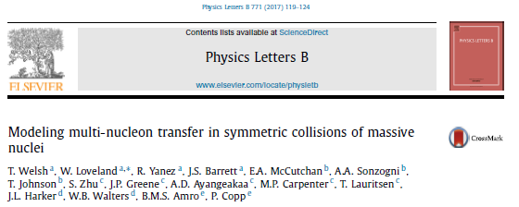
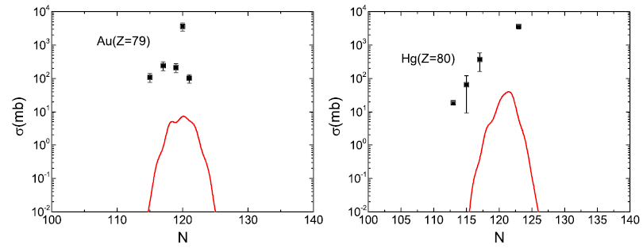
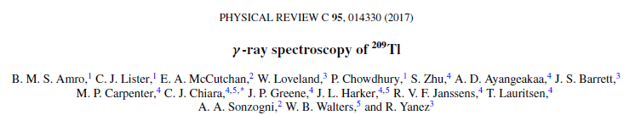
Southeast of ²⁰⁸Pb
Data below ²⁰⁸Pb get very sparse very quickly
Probe using ²⁰⁴Hg+²⁰⁸Pb, ¹³⁶Xe+²⁰⁸Pb, ¹³⁶Xe+¹⁹⁸Pt and Gammasphere

Slide 20










High-spin Isomers in Ir
Does a high-spin isomer persist in 198Ir?

Slide 21


¹⁹⁸Pt populated by decay of ¹⁹⁸Ir isomer
High J decays

Slide 22
Collaborators
A.A. Sonzogni, A. Gula, N. Nelson, K. McKillop, E. Gass
Brookhaven National Laboratory
R.J. Nickles, P. Ellison
University of Wisconsin
J.P. Greene, M.P. Carpenter, G. Savard, J. Clark, S. Zhu
Argonne National Laboratory
N. Scielzo, S. Pagdett, K. Kolos
LLNL
K. Moran, P. Copp
University of Massachusetts, Lowell

Slide 23



Intriguing population of beam-like products
Double gate in ¹⁴⁷Sm
This is huge for 8 protons away from beam, is it
Transfer?
Reaction on C,O in target
???

Slide 24



Along the way, some beautiful data to test shell model
Data analysis in progress
As are shell model calcs
¹⁴⁷Sm
¹⁴¹Ce

Slide 25




Isotope Production Experts
Brookhaven Linac Isotope Producer (BLIP)
University of Wisconsin
Institute for Medical Research
16 MeV proton GE PETrace cyclotron
11 MeV proton CTI RDS 112 cyclotron

Slide 26


Gammasphere at Argonne National Lab
100 HPGe detectors
Compton-suppressed
Digital or analog DAQ

Slide 27




Sample spectra for ⁷⁶Br
Gate on 2⁺→0⁺

Slide 28


Sample level scheme for ⁷⁶Br
Previously ~125 placed gamma transitions
Now, 450 placed gamma transitions

Slide 29

Ground state feeding determination
Link to absolute intensities known in daughter decay
Easy
Not a direct measurement
Absolute beta-gamma measurement
Efficiencies difficult
Direct measurement
Simulations underway
Iβ to g.s. = 91 (1) %

