Slide 1
US National Nuclear Data Week 2017
November 6 – 10, 2017 • Brookhaven National Laboratory, Upton, NY, USA
Thermal Neutron Scattering in Graphite
Ayman I. Hawari
Nuclear Reactor Program
Department of Nuclear Engineering
North Carolina State University
Raleigh, North Carolina, USA

Slide 2
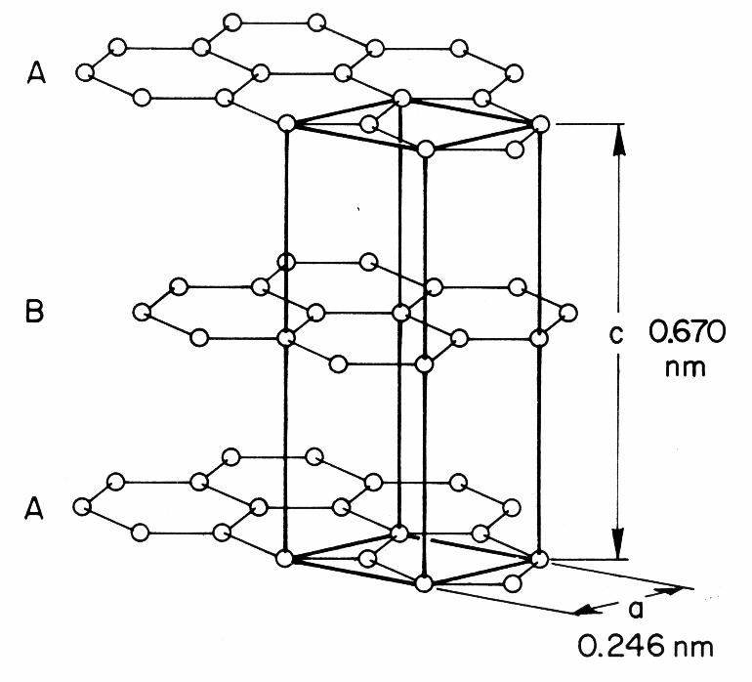
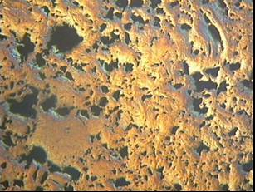
Graphite
Ideal “crystalline” graphite consists of planes (sheets) of carbon atoms arranged in a hexagonal lattice. Covalent bonding exits between intraplaner atoms, while the interplaner bonding is of the weak Van der Waals type. The planes are stacked in an “abab” sequence.
Hexagonal Structure
4 atoms per unit cell
a = b = 2.46 Å
c = 6.7 Å
Density = 2.25 g/cm³
Reactor graphite consists of ideal graphite crystallites (randomly oriented) in a carbon binder. It is highly porous structure with porosity level ranging between 10% and 30%.
Nuclear Graphite (SEM at NCSU)
Density = 1.5 – 1.8 g/cm³

Slide 3
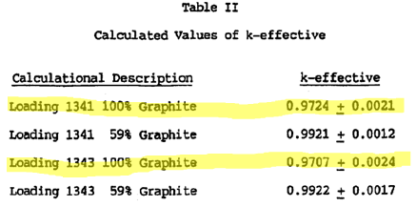
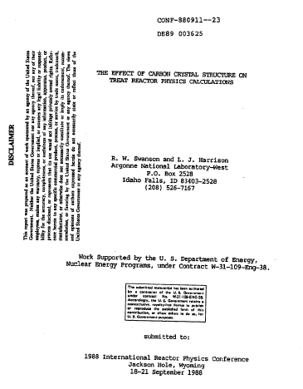
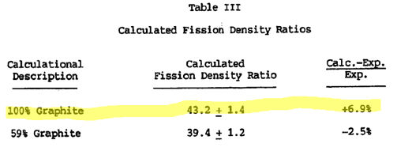
Thermalization in Graphite
TREAT Reactor
Highlighted values are calculated using ENDF/B-VII.1 type S(α,β) libraries

Slide 4
Thermalization in Graphite

Slide 5
Thermalization in Graphite

Slide 6
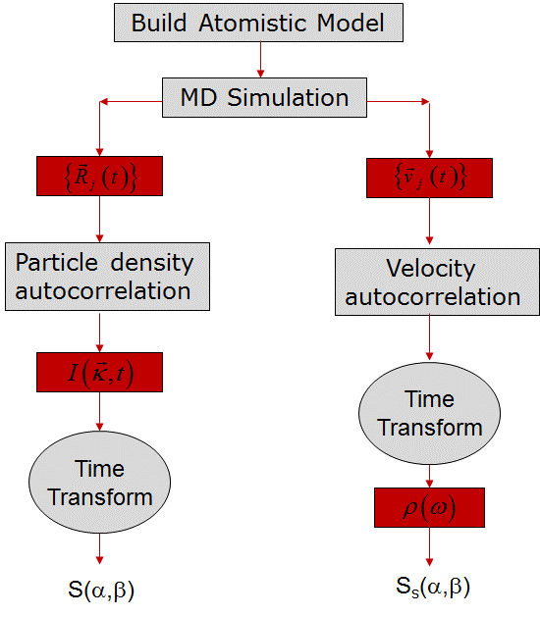
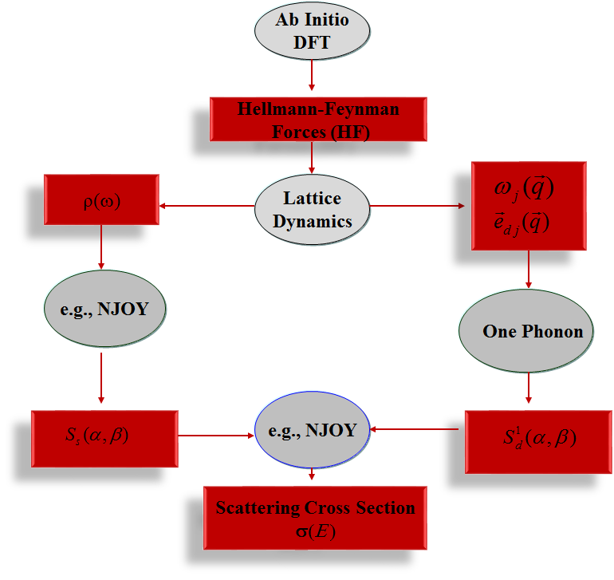
Methods
A. I. Hawari, “Modern Techniques for Inelastic Thermal Neutron Scattering Analysis,” Nuclear Data Sheets, Vol. 118, 172, 2014.

Slide 7
Graphite TSL 2016-2017
Material | Method | Comments
Beta4 crystalline graphite | DFT/LD | NJOY inelastic + hexagonal coherent elastic model
Beta4 reactor graphite (10% porosity) | MD | NJOY inelastic + hexagonal coherent elastic model
Beta5 crystalline graphite | DFT/LD | NJOY inelastic + hexagonal coherent elastic model (supersedes Beta4)
Beta5 reactor graphite (10% porosity) | MD | NJOY inelastic + hexagonal coherent elastic model (supersedes Beta4)
Crystalline graphite | DFT/LD | NJOY (inelastic + elastic cubic approximation)
Reactor graphite (10% and 30% porosity) | MD | NJOY (inelastic + elastic cubic approximation)

Slide 8
Graphite TSL 2016-2017
Material | Method | Comments
Beta5 crystalline graphite | DFT/LD | NJOY inelastic + hexagonal coherent elastic model (supersedes Beta4)
Beta5 reactor graphite (10% porosity) | MD | NJOY inelastic + hexagonal coherent elastic model (supersedes Beta4)
Crystalline graphite | DFT/LD | NJOY (inelastic + elastic cubic approximation)
Reactor graphite (10% and 30% porosity) | MD | NJOY (inelastic + elastic cubic approximation)

Slide 9
Graphite Thermal Scattering Cross Sections

Slide 10
Experimental Setup – NIST NG #6

Slide 11
Graphite Thermal Scattering Cross Sections

Slide 12
Graphite Thermal Scattering Cross Sections

Slide 13
Summary - Graphite
Graphite is not a unique material
  Ideal “crystalline” graphite density = 2.25 g/cm3
  “Reactor” graphite density = 1.5-1.8 g/cm3
The total thermal scattering cross section of graphite depends on the specifics of graphite manufacturing
Transmission measurements below the Bragg cutoff (E < 0.002 meV) are useful to test various types of graphite

Slide 14
Graphite AILD Model
VASP and PHONON codes
4 × 4 × 4 supercell (256 atoms)
4× 4 × 2 k-mesh
650 eV plane wave cutoff
GGA density functional
VDW interactions

Slide 15
Graphite Thermal Scattering Cross Sections

Slide 16
Graphite Thermal Scattering Cross Sections

Slide 17
SANS in Graphite
SANS is an experimental artifact
Must be removed (by design) to measure the true total (inelastic) thermal scattering cross section below the Bragg cutoff
If not removed, it will artificially inflate the total cross section below the Bragg cutoff
Its impact is reduced as the neutron wavelength increases

Slide 18
Graphite Thermal Scattering Cross Sections

Slide 19
Graphite Thermal Scattering Cross Sections

Slide 20
Graphite Thermal Scattering Cross Sections

Slide 21
Reactor Graphite Model
Construct an atomistic model of a carbon structure that contains a porosity concentration consistent with “reactor graphite”
  Molecular dynamics ideal graphite supercell
  Removed single vacancies randomly to reach various porosity levels
  Obtained velocity autocorrelation function (VACF)
  From VACF obtained the density of states (i.e., phonon spectrum)
  Used phonon spectrum in NJOY/LEAPR and/or FLASSH to calculate TSL, inelastic cross section, and elastic cross sections

Slide 22
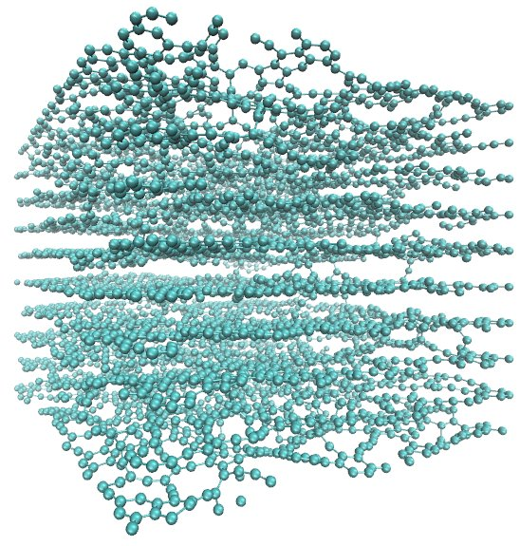
Reactor Graphite MD Models
8000 atoms
300 K
10%-30% porosity
Notes:
.

Slide 23
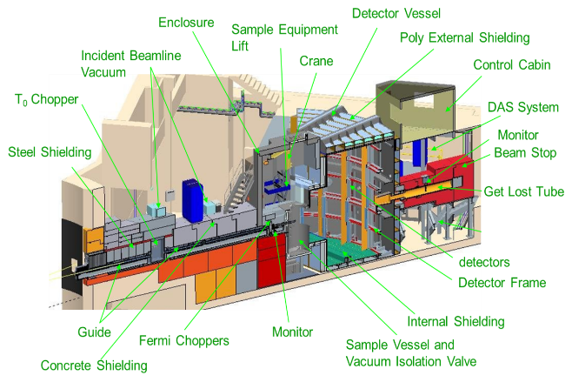
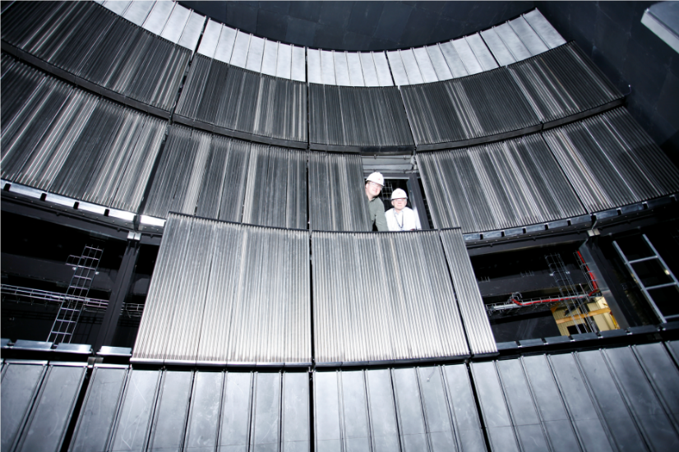
SNS Measurements
Notes:
.

Slide 24
Graphite Thermal Scattering Cross Sections

Slide 25
Graphite Thermal Scattering Cross Sections

Slide 26
Graphite Thermal Scattering Cross Sections

Slide 27
Graphite Thermal Scattering Cross Sections

Slide 28
Benchmarks
Material | Method | Comments
Beta5 crystalline graphite | DFT/LD | NJOY inelastic + hexagonal coherent elastic model (supersedes Beta4)
Beta5 reactor graphite (10% porosity) | MD | NJOY inelastic + hexagonal coherent elastic model (supersedes Beta4)
Crystalline graphite | DFT/LD | NJOY (inelastic + elastic cubic approximation)
Reactor graphite (10% and 30% porosity) | MD | NJOY (inelastic + elastic cubic approximation)

Slide 29
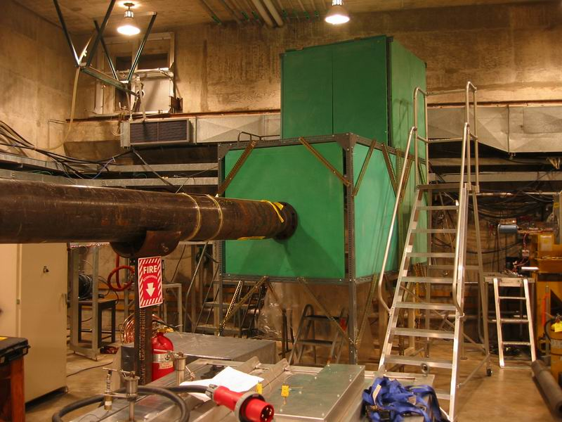
Notes:
The focusing effect is because the high energy neutron will have more collision v*Sigma than the low energy neutron, therefore high energy neutrons will be slowed down faster than low energy neutrons.
Only the no absorption xsec and almost constant elastic xsec moderator will have this effect.

Slide 30
ORELA TSL Benchmark – Top Detector

Slide 31
ORELA TSL Benchmark – Top Detector

Slide 32
ORELA TSL Benchmark – Top Detector

Slide 33
ORELA TSL Benchmark – Back Detector

Slide 34
ORELA TSL Benchmark – Back Detector

Slide 35
ORELA TSL Benchmark – Back Detector

Slide 36
Summary
ORELA TSL Benchmark
Use of “reactor graphite” libraries improves the agreement between calculated and measured detector responses in the ORELA experiment.
The improvement is most noticeable when 30% porosity cubic data is used.
  No hexagonal 30% porosity model TSL library was generated!
For the 10% porosity data, the hexagonal version seems to shift the predicted detector response towards lower energies.
  Correlates with trend in the total cross section

Slide 37
LEU_COMP_THERM_060 Benchmark

Slide 38
LEU_COMP_THERM_060 Benchmark

Slide 39
LEU_COMP_THERM_060 Benchmark

Slide 40
HEU_COMP_THERM_016 Benchmark

Slide 41
HEU_COMP_THERM_016 Benchmark

Slide 42
HEU_COMP_THERM_016 Benchmark

Slide 43
TREAT M2 Experiment

Slide 44
TREAT M2 Experiment

Slide 45
TREAT M2 Experiment

Slide 46
Benchmarks Summary
For the LEU Benchmark, the Beta5 and cubic graphite TSL libraries show improvement relative to ENDF/B-VII.1.
For the HEU Benchmark, the Beta5 reactor graphite library falls above the uncertainty band. However, the cubic libraries fall in the band or are close to it.
For TREAT M2 experiment model, the Beta5 and cubic graphite TSL libraries yield larger keff relative to ENDF/B-VII.1.

Slide 47
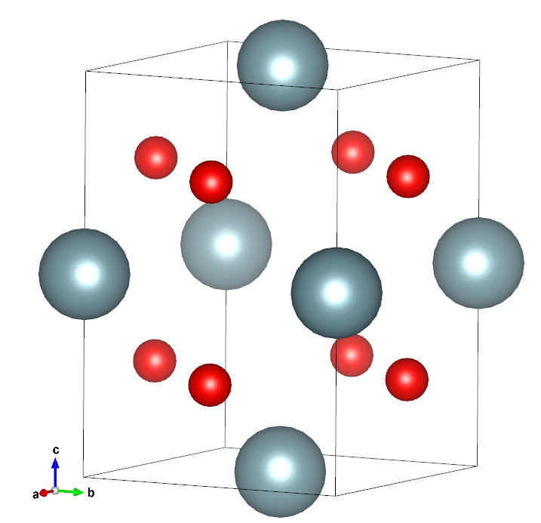
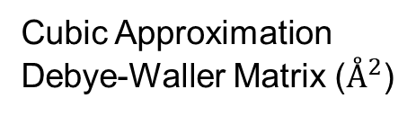
UO₂
Tetragonal System
3.21E-3 | 0 | 0
0 | 3.21E-3 | 0
0 | 0 | 3.21E-3
Cubic Approximation
Debye-Waller Matrix ($Å^{2}$)

Slide 48
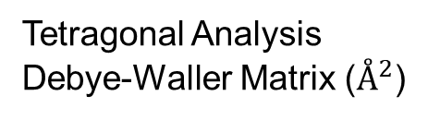
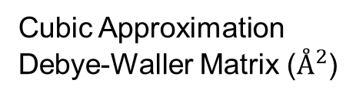
UO₂
Tetragonal System
3.19E-3 | 1.62E-6 | 9.03E-7
1.62E-6 | 3.19E-3 | -3.48E-7
9.03E-7 | -3.48E-7 | 3.22E-3
3.21E-3 | 0 | 0
0 | 3.21E-3 | 0
0 | 0 | 3.21E-3
Difference
Tetragonal Analysis
Debye-Waller Matrix ($Å^{2}$)
Cubic Approximation
Debye-Waller Matrix ($Å^{2}$)
-0.62% | - | -
- | -0.62% | -
- | - | +0.31%

Slide 49
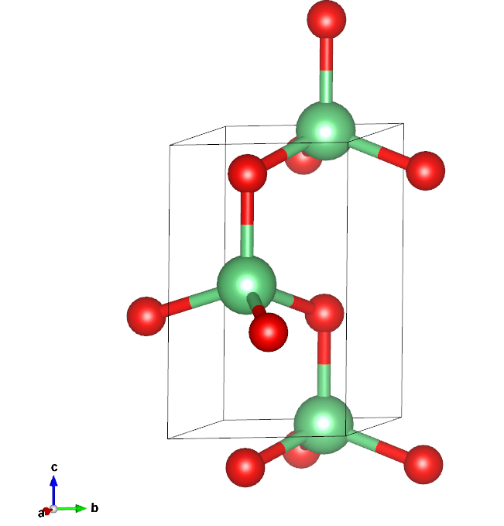
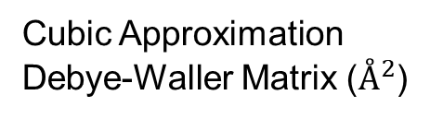
Beryllium Oxide
Hexagonal System
4.14E-3 | 0 | 0
0 | 4.14E-3 | 0
0 | 0 | 4.14E-3
Cubic Approximation
Debye-Waller Matrix ($Å^{2}$)

Slide 50
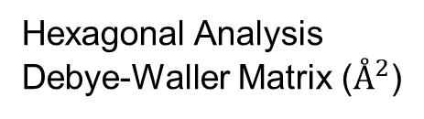
Beryllium Oxide
Hexagonal System
4.22E-3 | -7.88E-5 | -1.22E-5
-7.88E-5 | 4.12E-3 | 1.75E-7
-1.22E-5 | 1.75E-7 | 4.42E-3
4.14E-3 | 0 | 0
0 | 4.14E-3 | 0
0 | 0 | 4.14E-3
Difference
Hexagonal Analysis
Debye-Waller Matrix ($Å^{2}$)
Cubic Approximation
Debye-Waller Matrix ($Å^{2}$)
+1.93% | - | -
- | -0.48% | -
- | - | +6.76%

Slide 51
Summary
Graphite TSL investigation at NCSU has been an intensive computational and experimental effort.
Graphite is an a complex material. Its thermal neutron scattering depends on its manufacturing details (e.g., porosity).
  Total cross section (transmission) measurements especially below the Bragg cutoff may help.
Slowing down experiments (without fuel) are very useful in isolating thermalization effects.
In the current situation, the outcome of transmission measurements, ORELA slowing down measurements, and the computational benchmarks, seem to correlate best for the “cubic” treatment of crystalline and reactor graphite TSL libraries.

Slide 52
Summary
Motivated the development of modern predictive methods for thermal neutron cross section calculations based on the use of atomistic simulations
  Ab initio lattice dynamics
  Molecular dynamics (ab initio and classical)
Many TSL evaluations contributed to ENDF/VIII
  Many are coming
Motivated FLASSH: a new thermal scattering analysis platform that uses a generalized theoretical approach for TSL calculations.

