Slide 1
TUNL Contributions in the US Nuclear Data Program
J.H. Kelley - USNDP Structure Group Leader: (6 months FTE),
J. Purcell (emeritus 0.1 FTE), and G. Sheu (Adm. Assist. 0.75 FTE)
(Kent Leung (post doc 0.5 FTE))
2017 USNDP Meeting

Slide 2
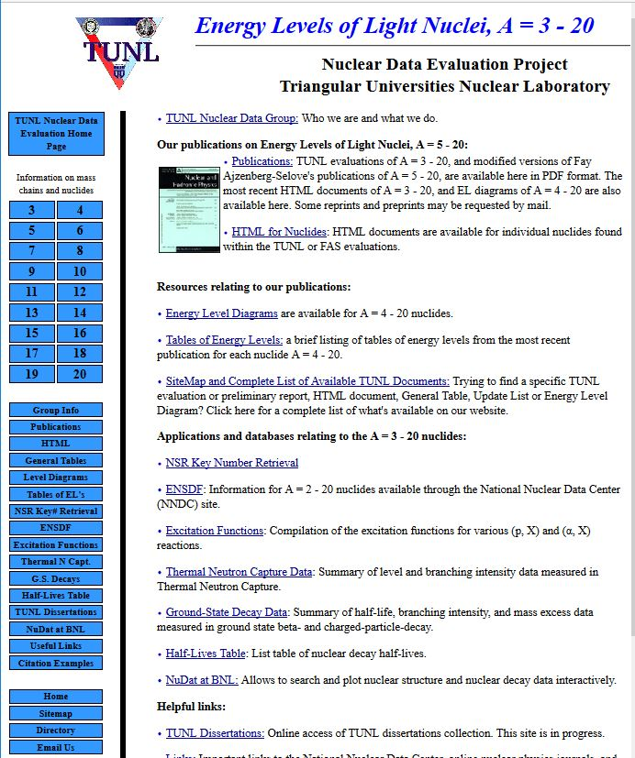
TUNL Primary Responsibilities
We are responsible for nuclear structure evaluation in the A=2-20 mass region
Energy Levels of Light Nuclei reviews published in Nuclear Physics A
ENSDF files for A=2-20
XUNDL from A=2-20
Web interface for A=3-20 Information
2017 USNDP Meeting

Slide 3
Future of A=2-20 evaluations
TUNL assumed responsibility for producing evaluations in the nuclear mass region A=3-20 in 1993 following the retirement of Fay Ajzenberg-Selove, and we continued publications in the “Energy Levels of Light Nuclei” series. However we have not matched her pace of reviewing about three mass-chains per year at any time.
With serious reflection the only feasible direction for our future evaluations is to focus solely on ENSDF reviews to be published in the Nuclear Data Sheets. Moving forward, we will produce only the more focused ENSDF format nuclear structure data reviews for the light mass region.
2017 USNDP Meeting

Slide 4
Evaluation Activities
Published “Energy Levels of Light Nuclei: A=12”
Prepared/updated ENSDF datasets for
⁴n,⁶H,²⁰C, ¹⁰N, ¹¹O, ¹⁷Na
Updated β-n datasets in ENSDF
β-n: ¹⁷B, ¹⁷C,¹⁸C
β-decay lifetimes
Work in progress:
Finalizing A=12 ENSDF file
Preparing Nuclear Data Sheets (ENSDF) articles on A=2 and A=13
2017 USNDP Meeting

Slide 5
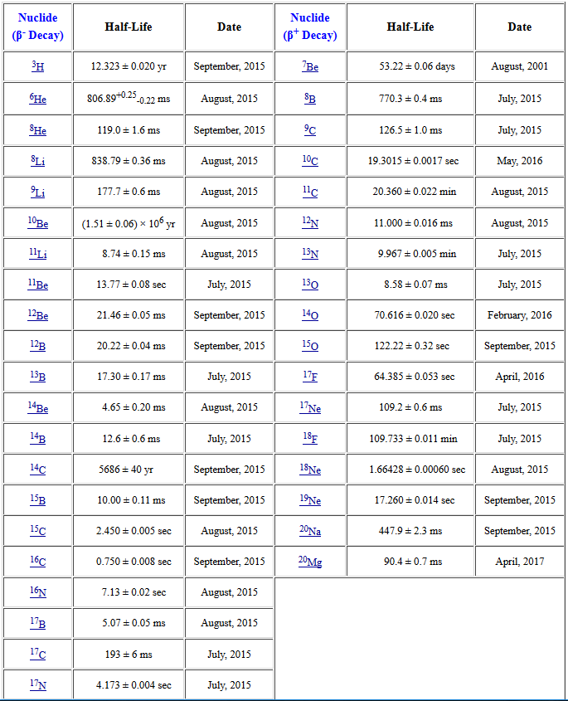
Comments on β-decay lifetimes
Research Experience for Undergraduate Project (Susan Olmstead) in 2015:
Compiled relevant articles
Use McMaster data group’s Java averaging program
Evaluated lifetimes using a variety of averaging methods
Produced a table of recommended values
Poster at CEU
2017 USNDP Meeting

Slide 6
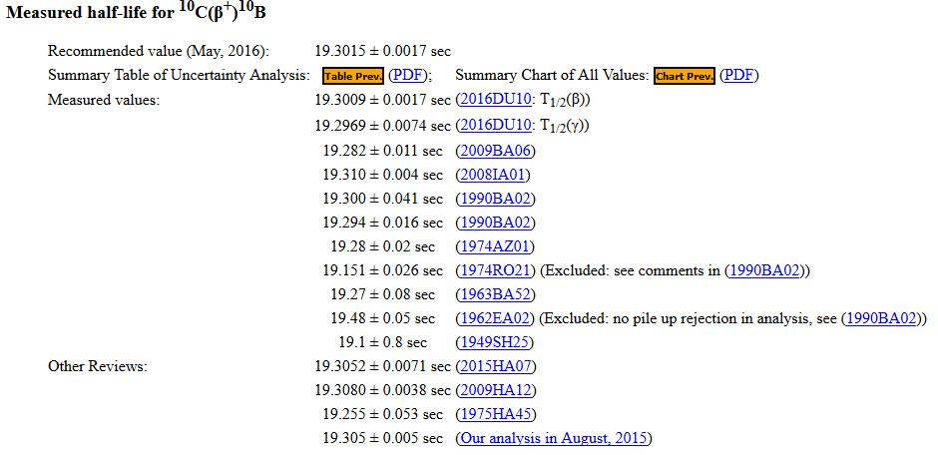
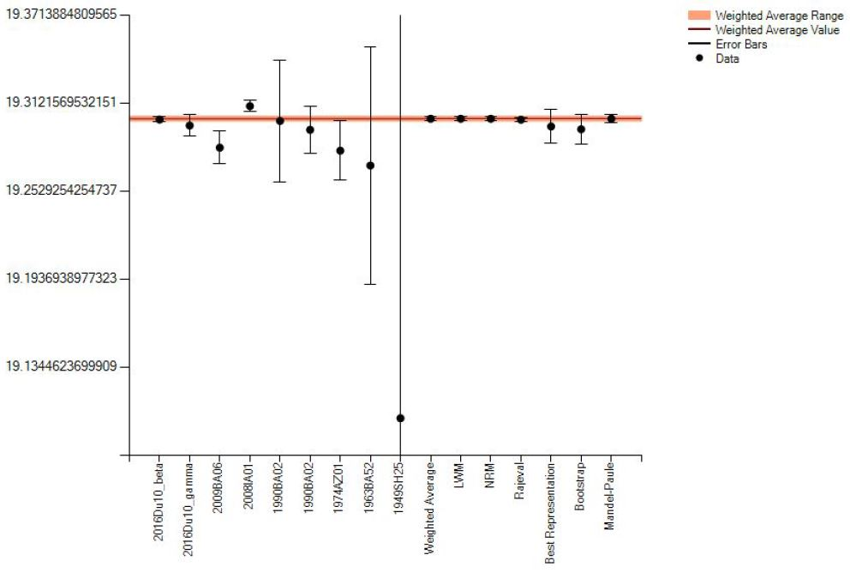
β-decay lifetimes -continued
2017 USNDP Meeting

Slide 7
Compilation Activities
eXperimental Unevaluated Nuclear Data Library
60-65 data sets/year (5-6/month)
Compilation of ground state decay & β-decay references and data
Compilation of (p,X) and (α,X) excitation functions
Compilation of thermal neutron capture references and data
TUNL Dissertations-
2017 USNDP Meeting

Slide 8
Website metrics (April 2002-present)
2017: Σ=117.2 k
Using Analog - finding issues with excluding new search engine "robots"
2017 USNDP Meeting

Slide 9
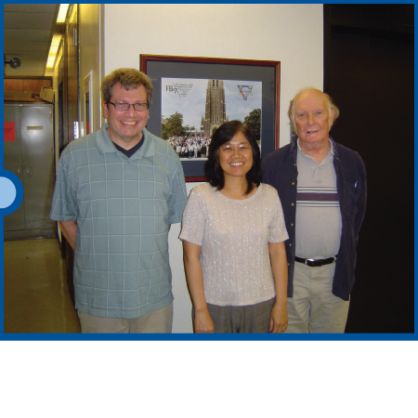
2017 USNDP Meeting

