Slide 3
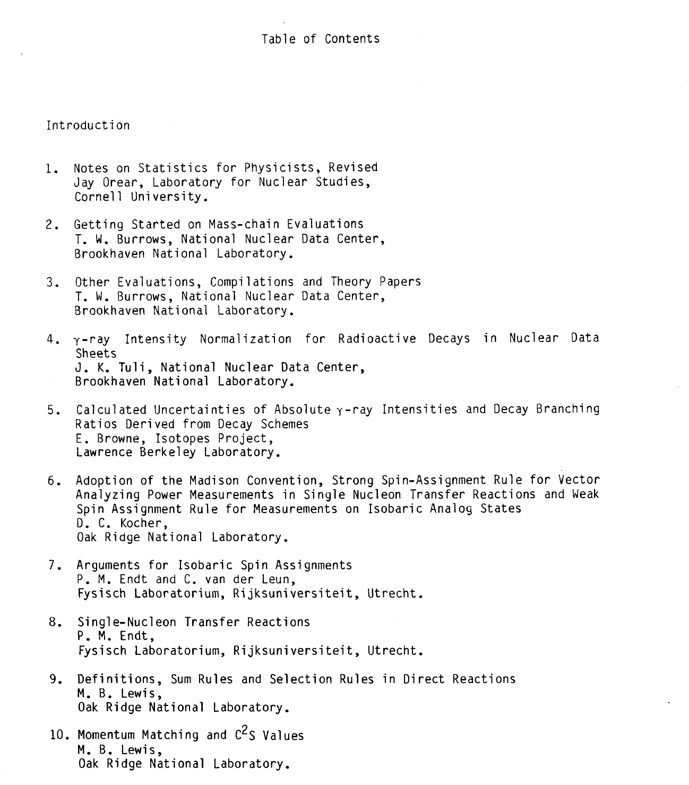

Slide 6
What’s missing?
Normalization for delayed particle decay
Spin and mult assignments from gamma(theta), gamma-gamma(theta) etc.
Half-life evaluation guidelines (Balraj and Alan)
Resonances

