Slide 1
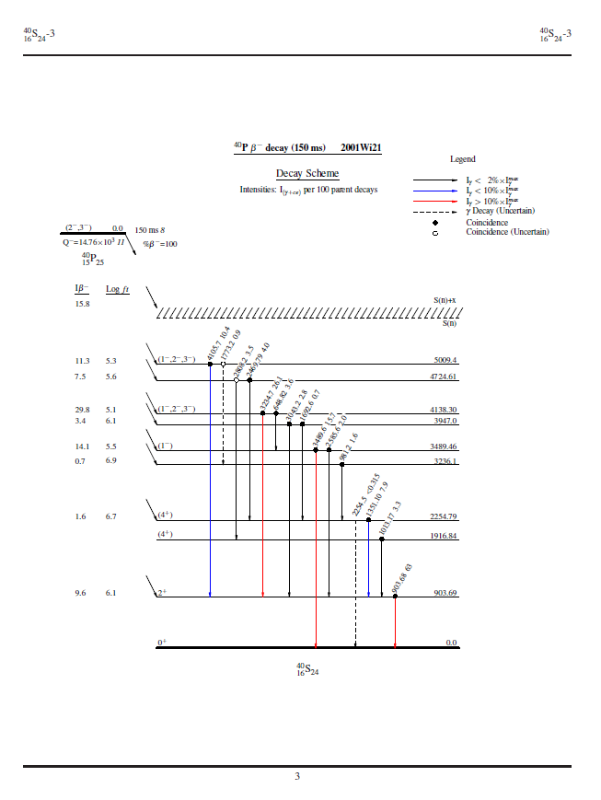
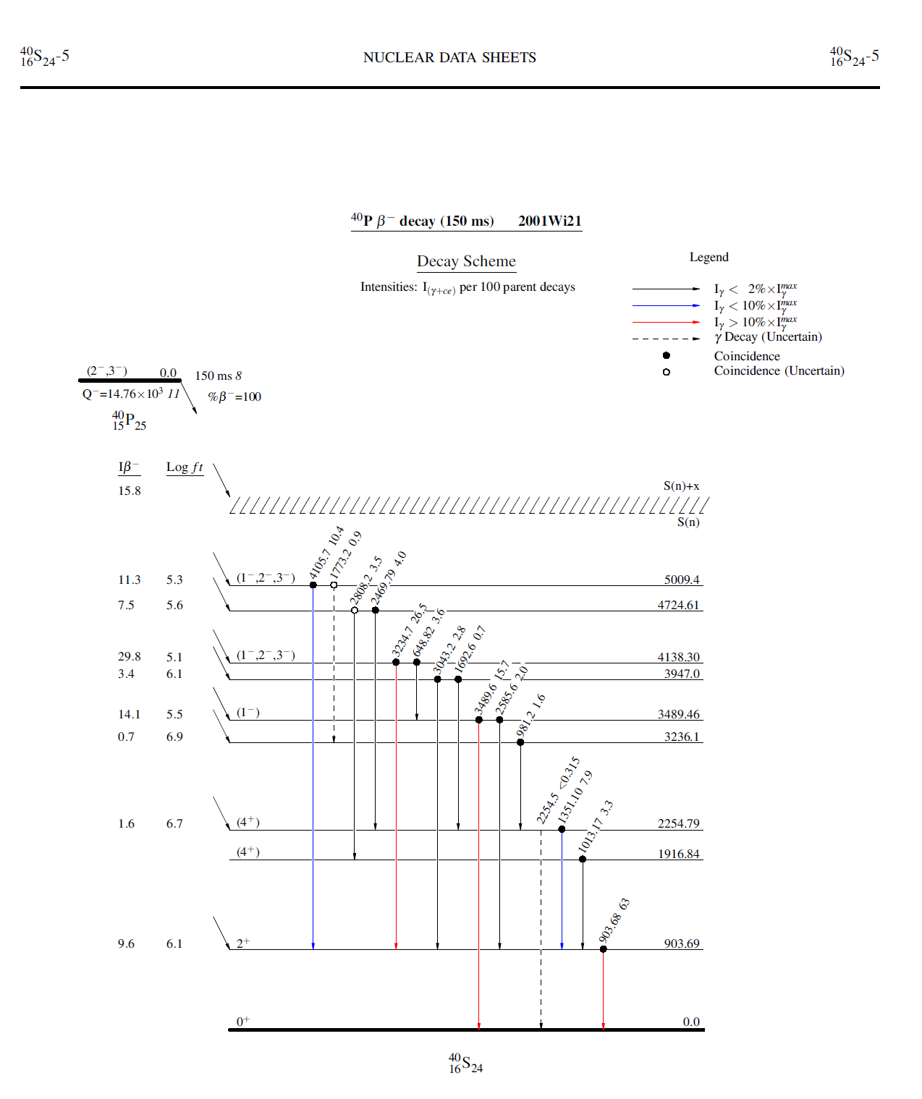
Changes to the header?
ENSDF- Experimental Nuclear Data File

Slide 2
Expansion of the History Record
This evaluation considers all data in the literature up to September 30, 2015.
To cite this evaluation please use: J. Chen, Nuclear Data Sheets 140, 1 (2017).

Slide 3
$COM=Corrected spin-parity of 175LU 1112.2-keV level as (9/2-) from incorrect one (19/2-)$

Slide 4
Should Document records be retrievable through the pdf? (Web based version)

Slide 5
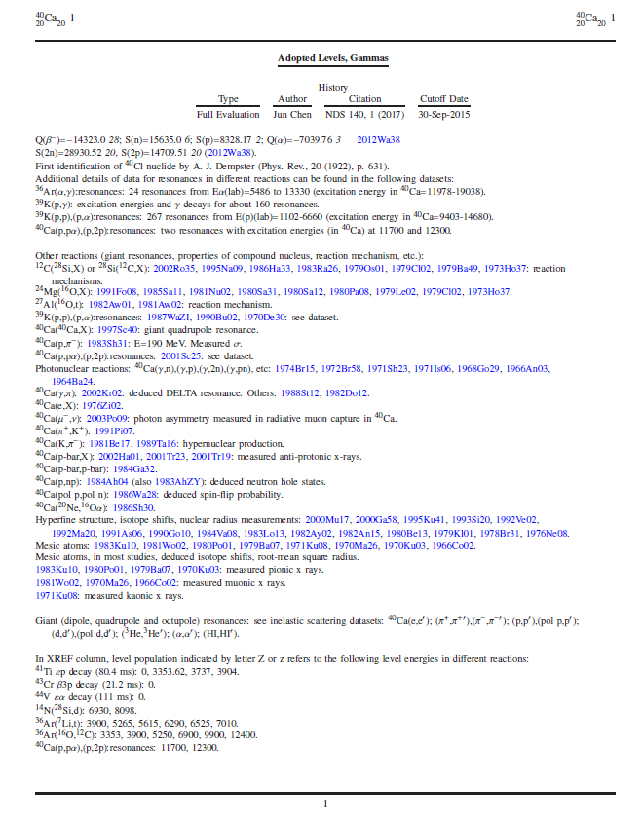
25 pages to reach the Gamma table. Can Gamma (and Level) be made “clickable” so that one can easily go back and forth?

