Slide 1
BNL Experimental Activities

Slide 2
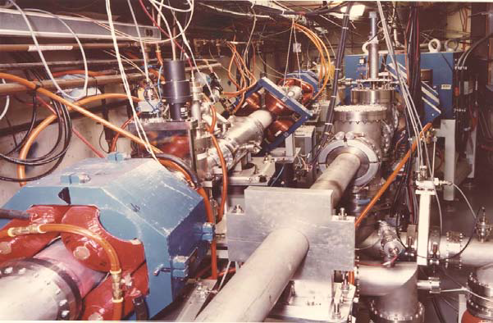
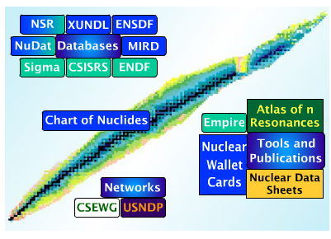
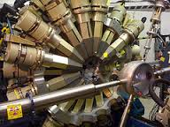
Decay studies of Medical Isotopes
Combine expertize in all skills needed to develop a world-class program to enhance production and application of radioisotopes
Target design
Radiochemistry
Medical relevance
Structure & Decay Data
Reaction Data
Reaction Modeling
γ-ray spectroscopy
State-of-the-art detector systems
UofWisc
USNDP
ANL

Slide 3

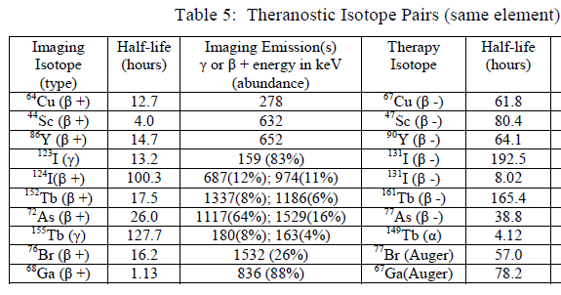
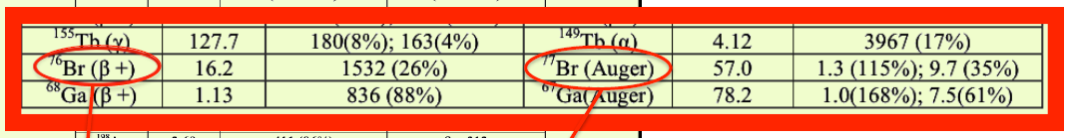
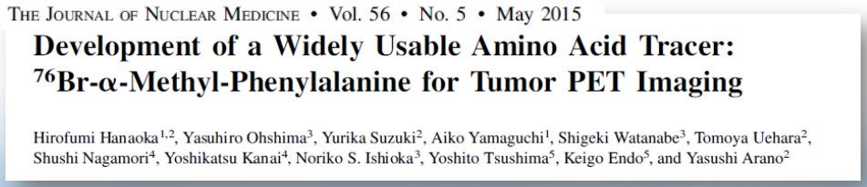
Why Decay Data ?
Essential for determining:
Overall dose
Specific dose
Imaging background
Gamma-ray intensities usually used to determine cross sections

Slide 4
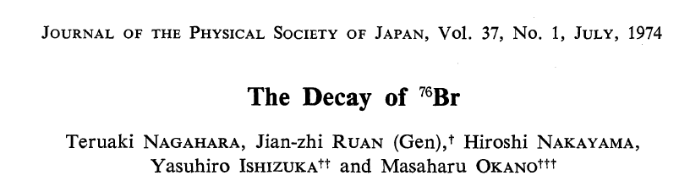
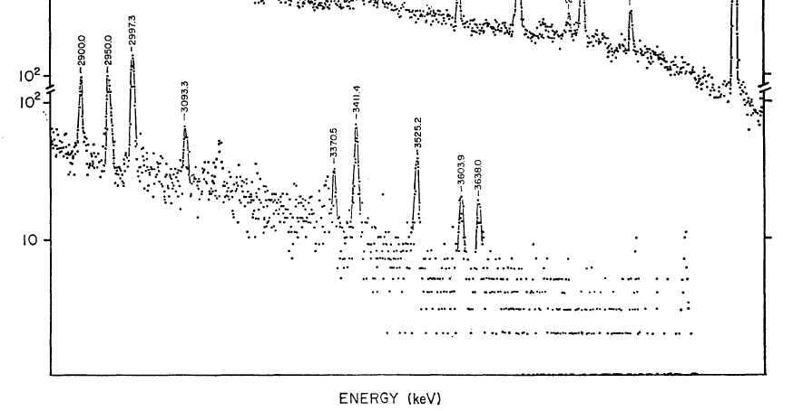
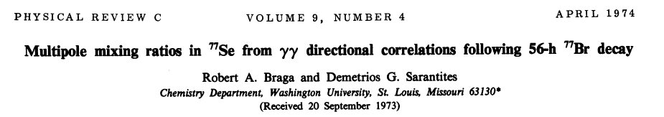
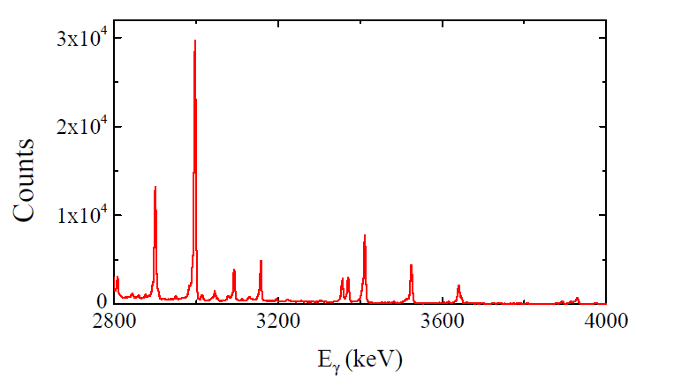
Sample spectra for ⁷⁶Br
Gate on 2⁺→0⁺

Slide 5
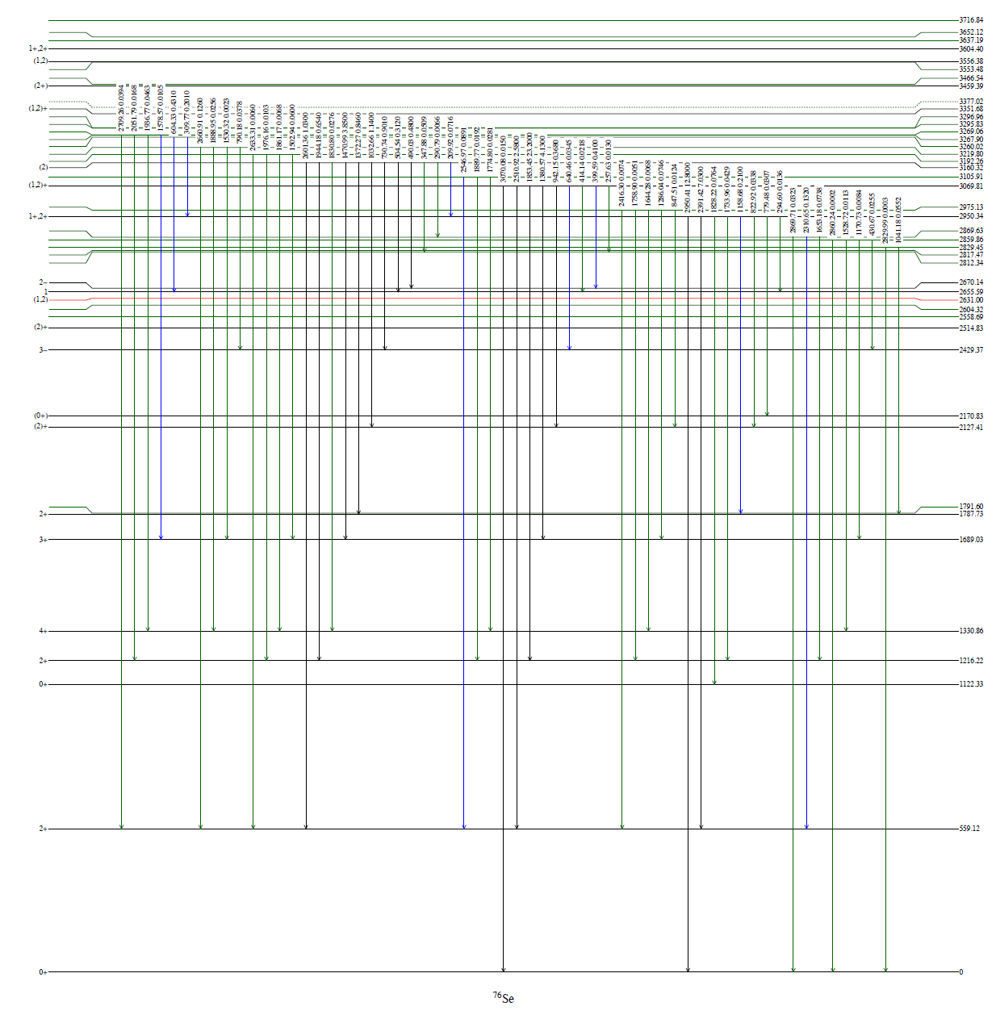

Sample level scheme for ⁷⁶Br
Previously ~125 placed gamma transitions
Now, 450 placed gamma transitions

Slide 6
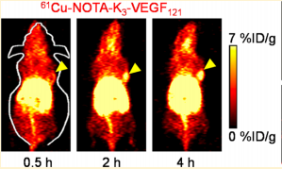
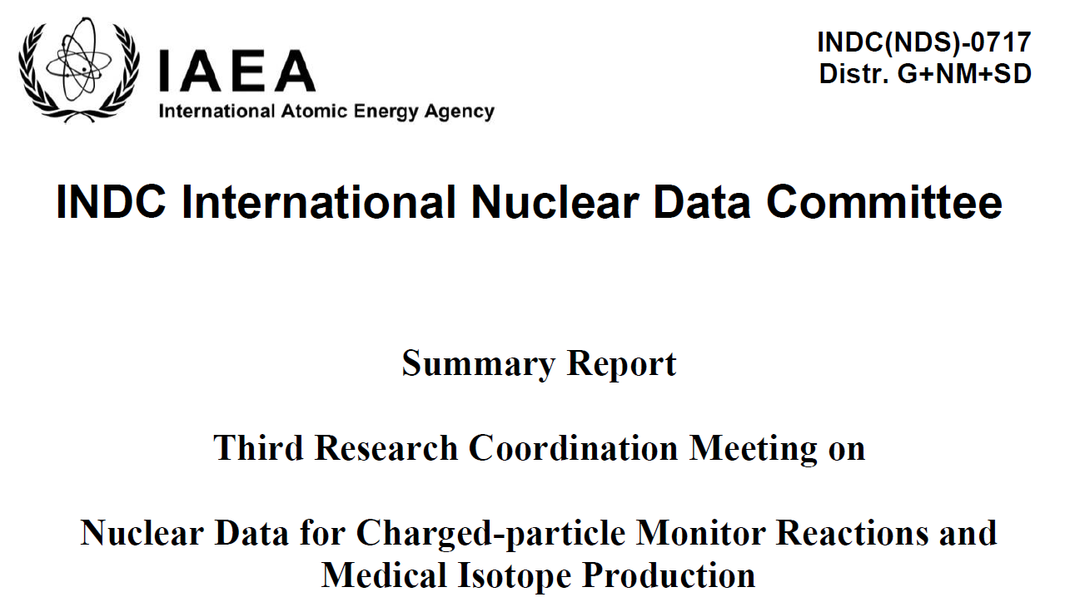
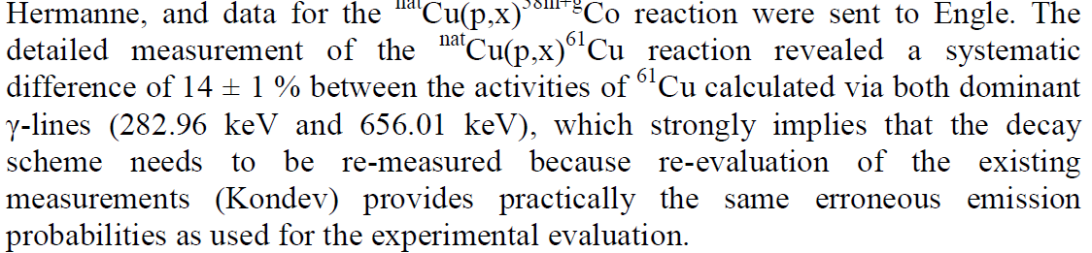
Study of ⁶¹Cu
Motivation
Commonly used in tumor hypoxia imaging

Slide 7
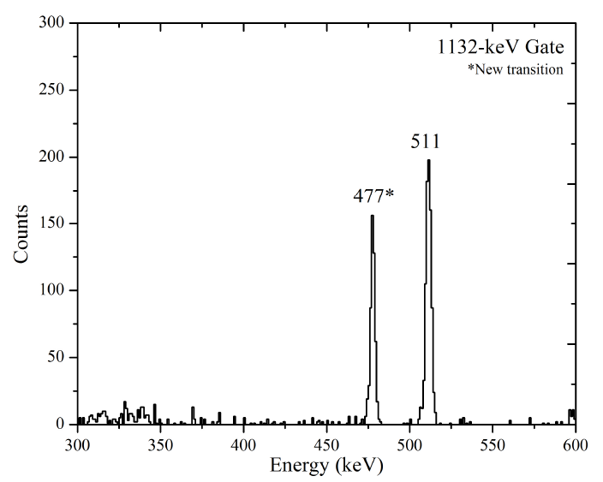
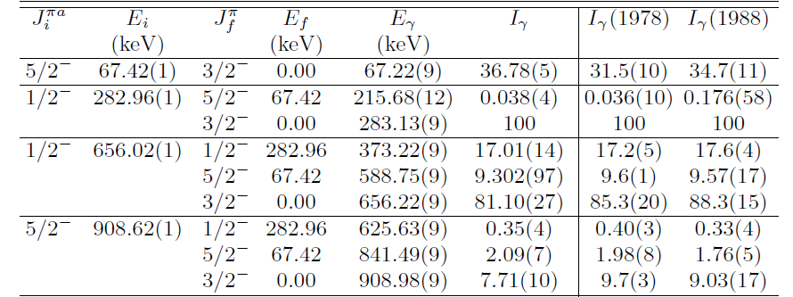
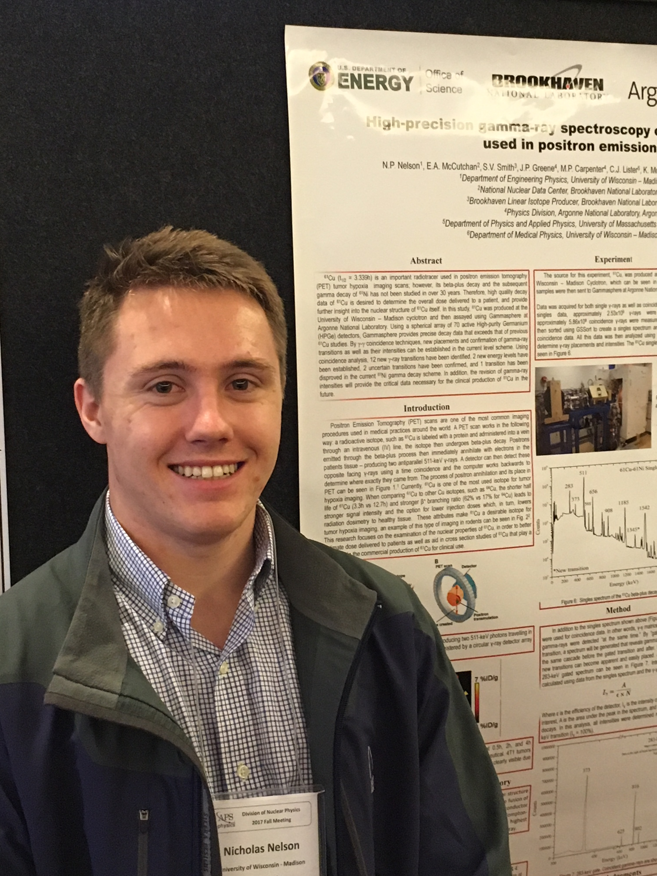
⁶¹Cu analysis
Only a few additions to the decay scheme
Clear, systematic decrease in all measured intensities of strong gammas

Slide 8
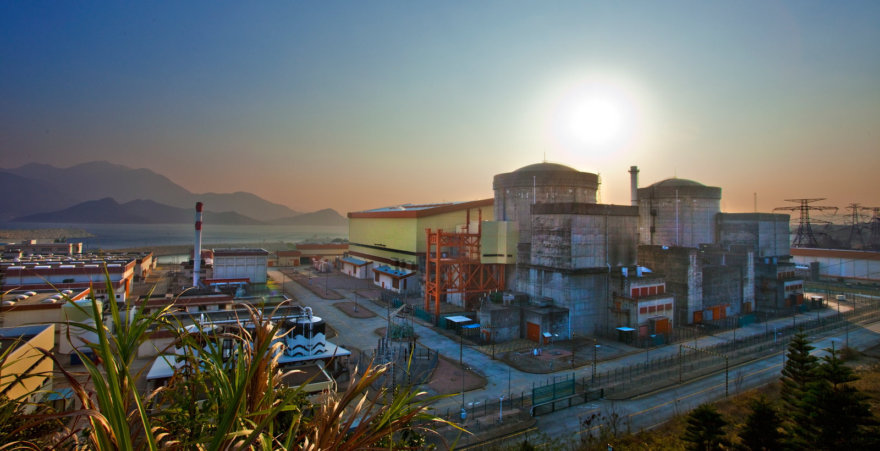
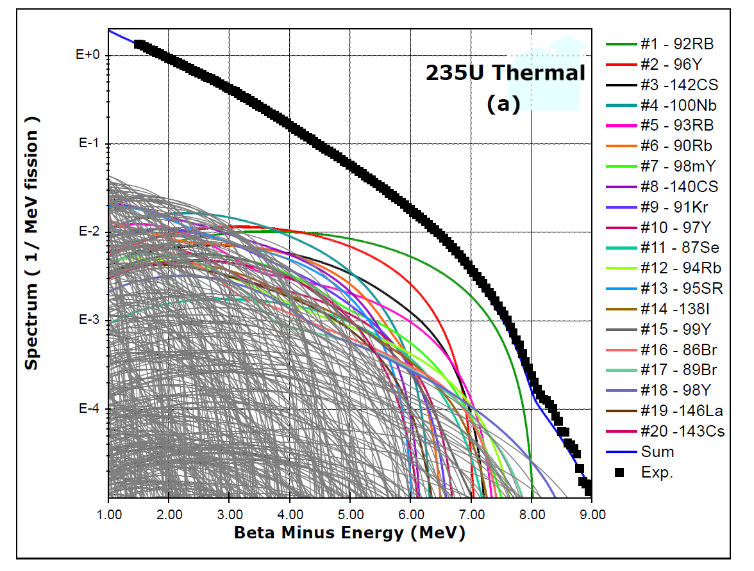
Antineutrinos From a Reactor
Daya Bay
F.P. An et al, Phys. Rev. Lett. 108, 171803 (2012)
A.A. Sonzogni, T.D. Johnson, E.A. McCutchan, Phys. Rev. C 91, 011301(R) (2015).

Slide 9
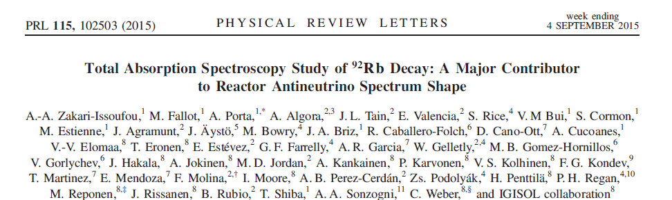
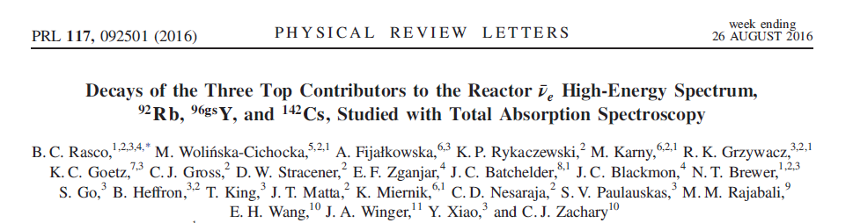
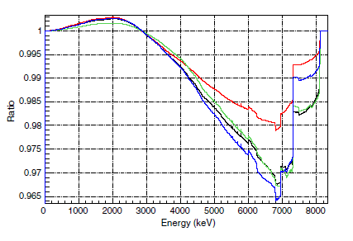
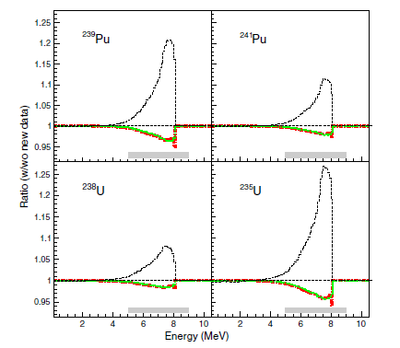
The ⁹²Rb race : TAGS results
G.S. Branch 87.2 (25)%
G.S. Branch 91 (3) %

Slide 10
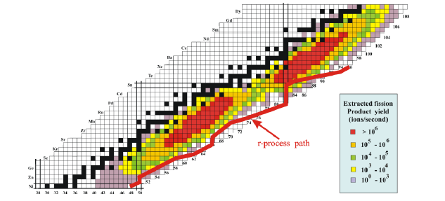
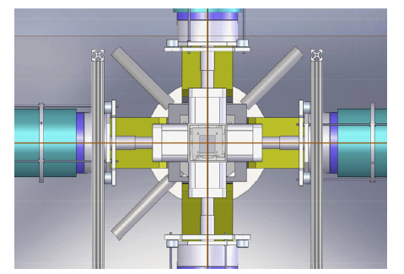
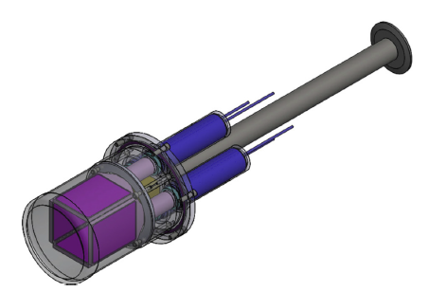
The ⁹²Rb race : βγ experiment
NNDC, LLNL, ANL collaboration
CARIBU
⁹²Rb beam
~1000 ions/s
X- Array
SATURN

Slide 11
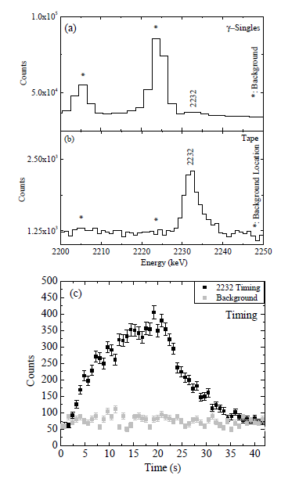
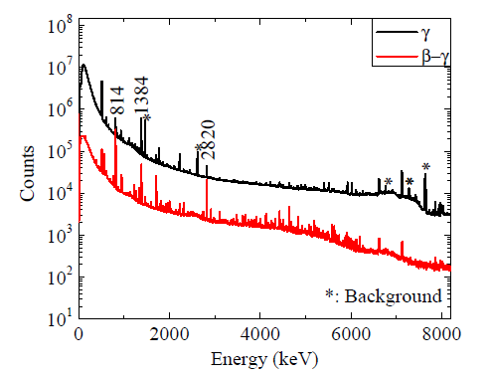
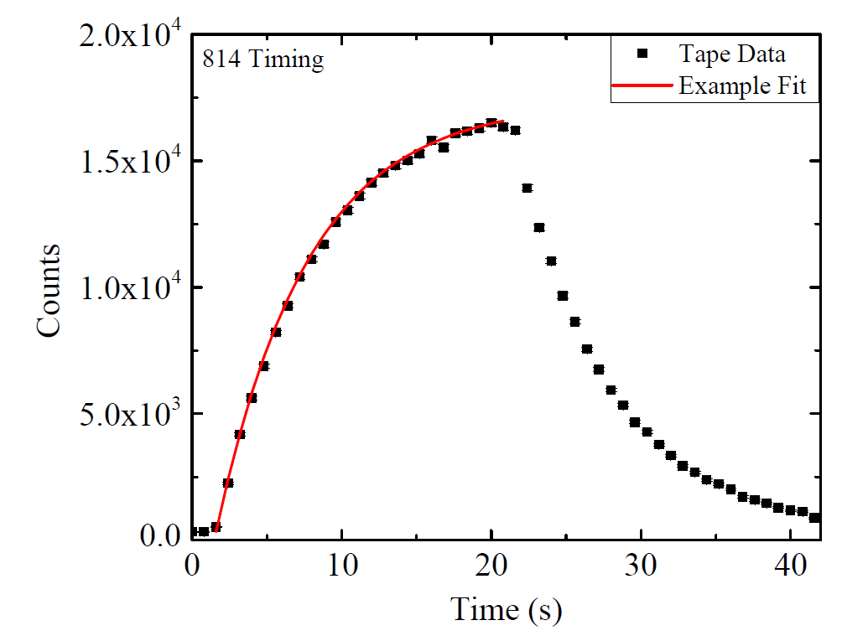
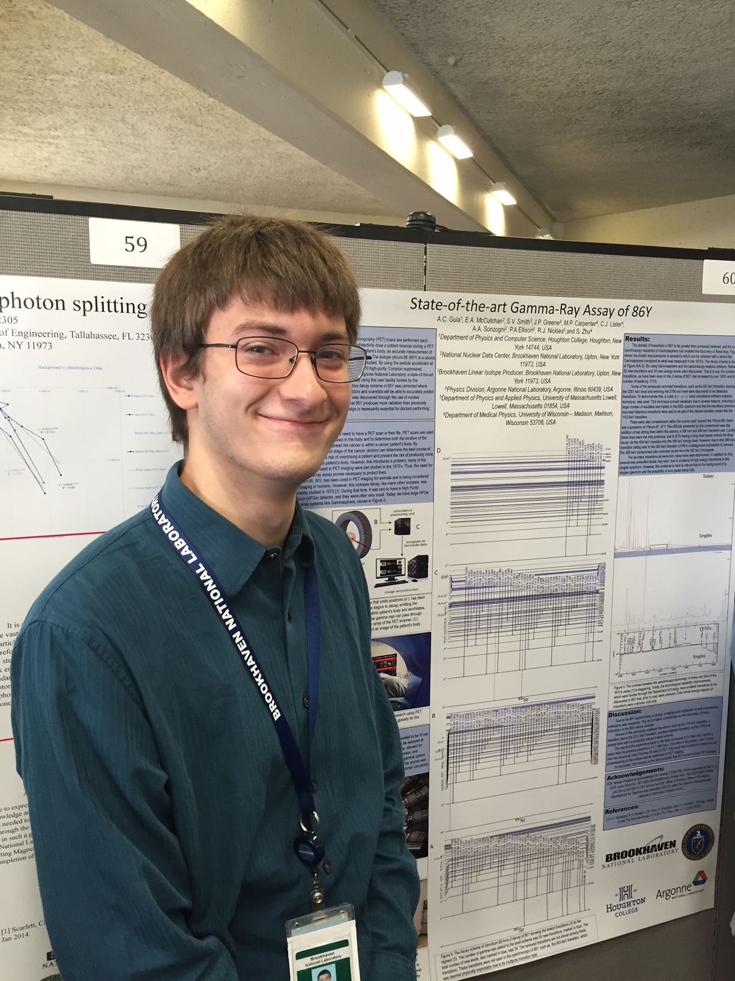
Few experimental examples

Slide 12
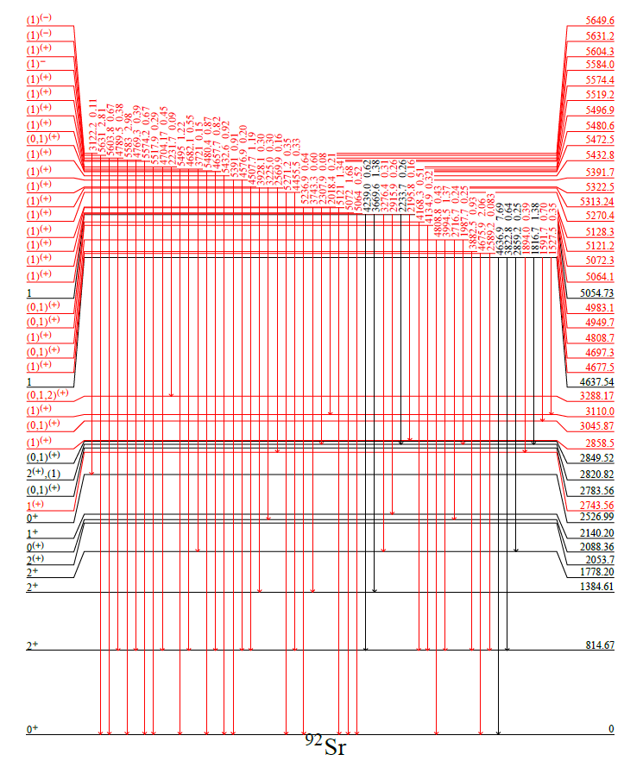
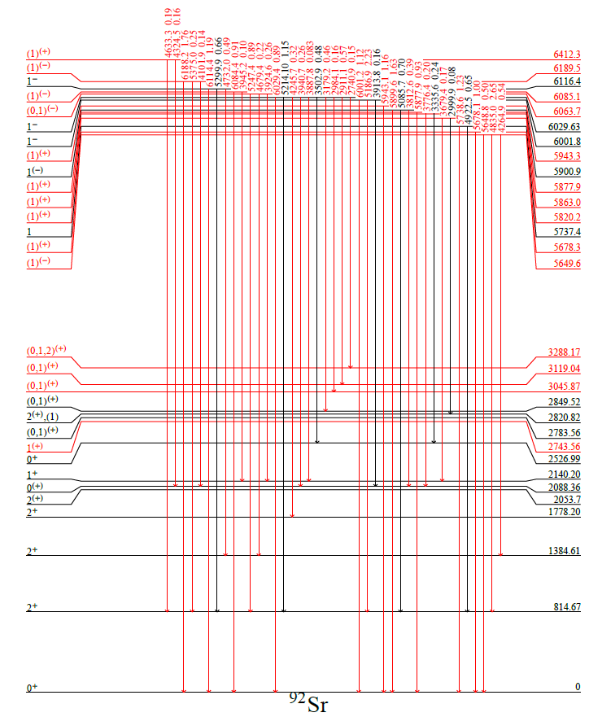
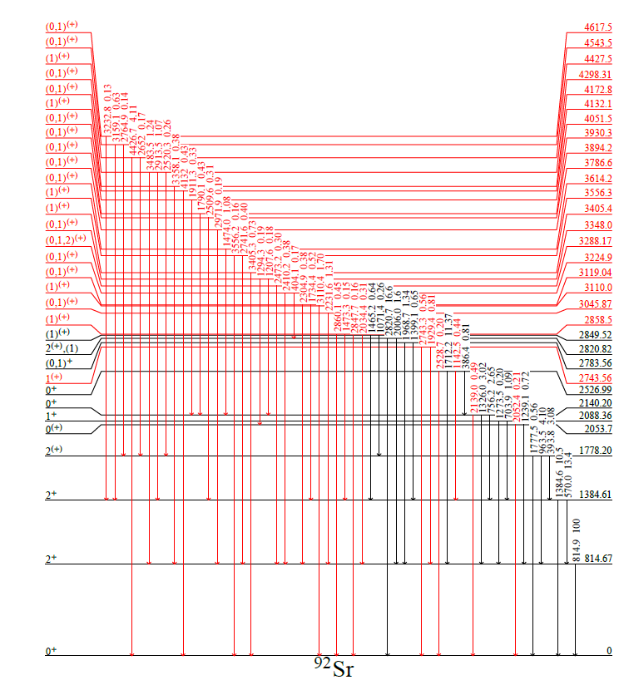
Revised level scheme
52 New Levels (17 previously known)
Literature: R. J. Olson et al., PRC 5, 2095 (1972)

Slide 13
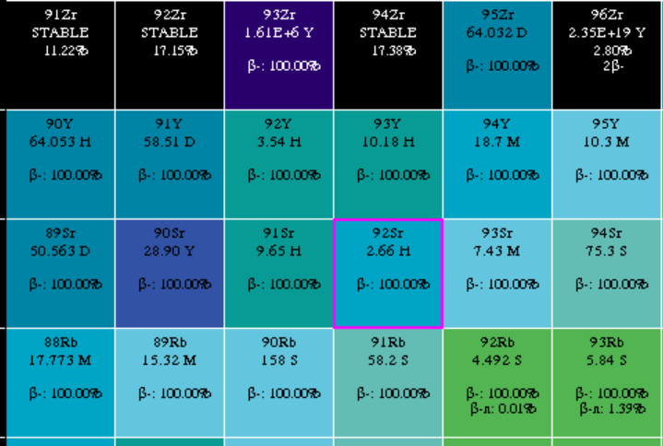
Ground state feeding determination
Link to absolute intensities known in daughter decay
Easy
Not a direct measurement
Absolute beta-gamma measurement
Efficiencies difficult
Direct measurement
Simulations underway
Iβ to g.s. = 91 (1) %

Slide 14
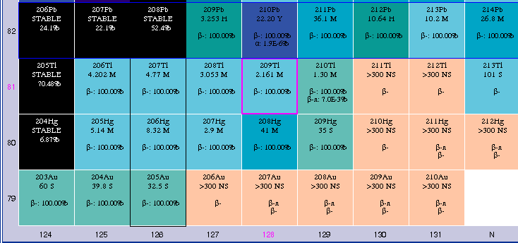
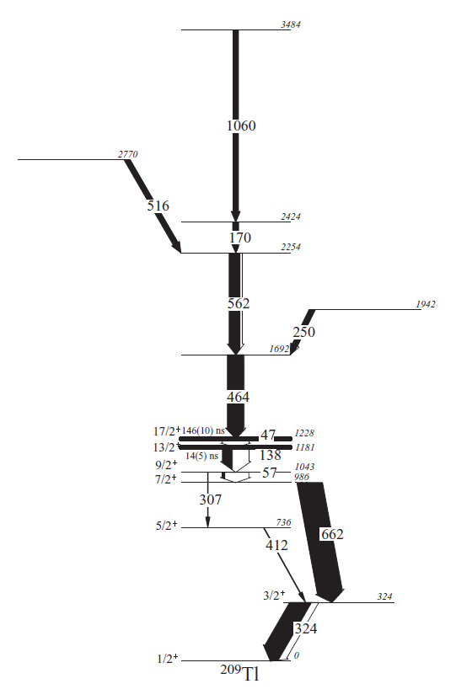
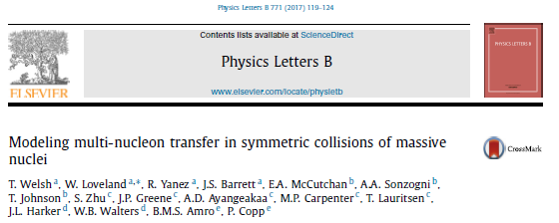
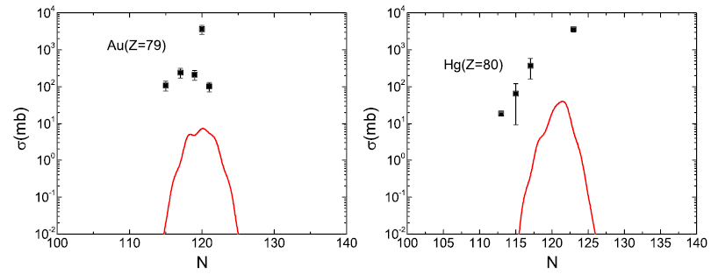
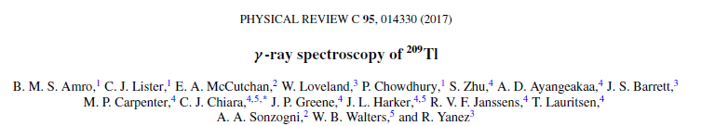
Southeast of ²⁰⁸Pb
Data below ²⁰⁸Pb get very sparse very quickly
Probe using ²⁰⁴Hg+²⁰⁸Pb, ¹³⁶Xe+²⁰⁸Pb, ¹³⁶Xe+¹⁹⁸Pt and Gammasphere

Slide 15
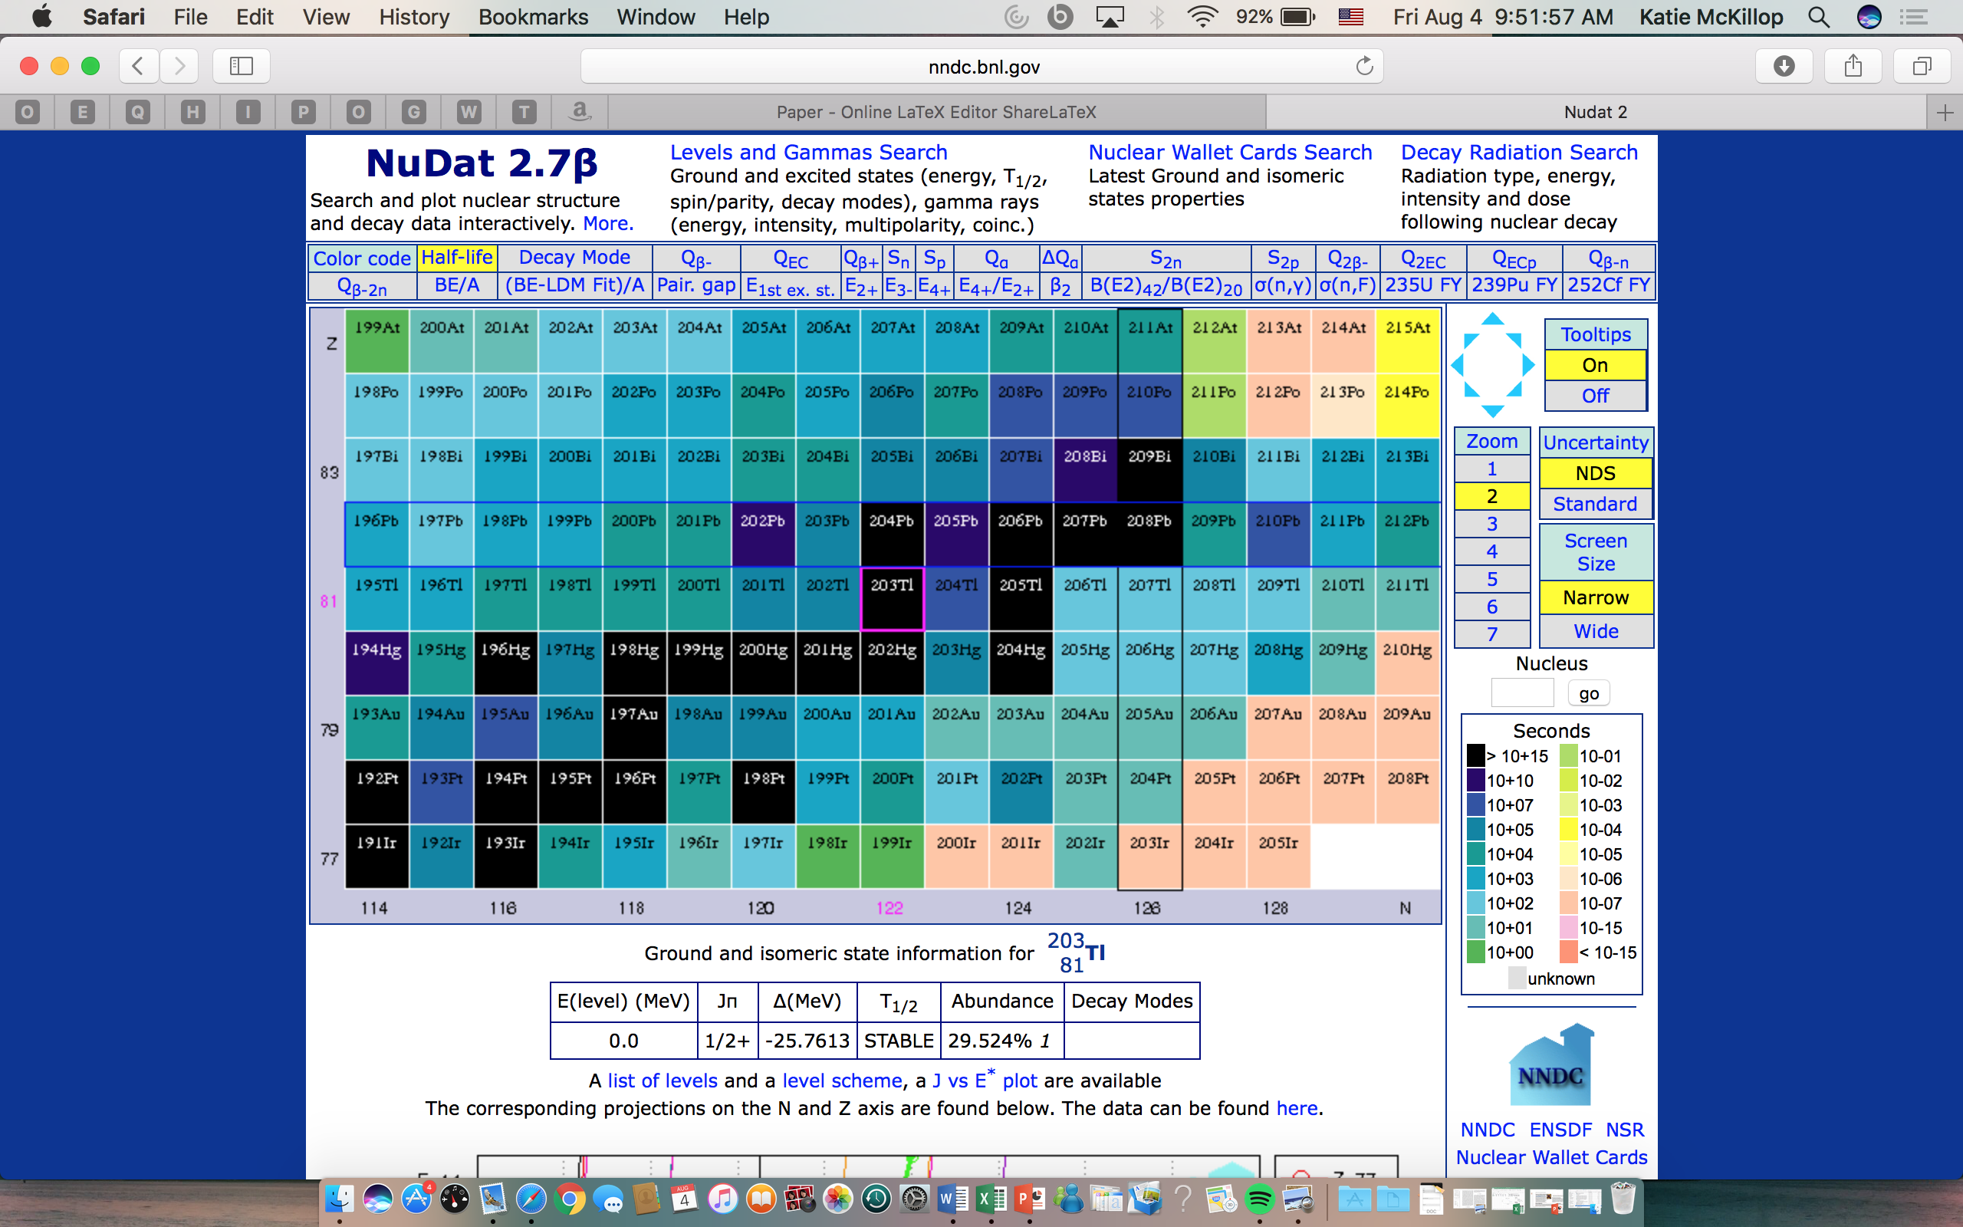
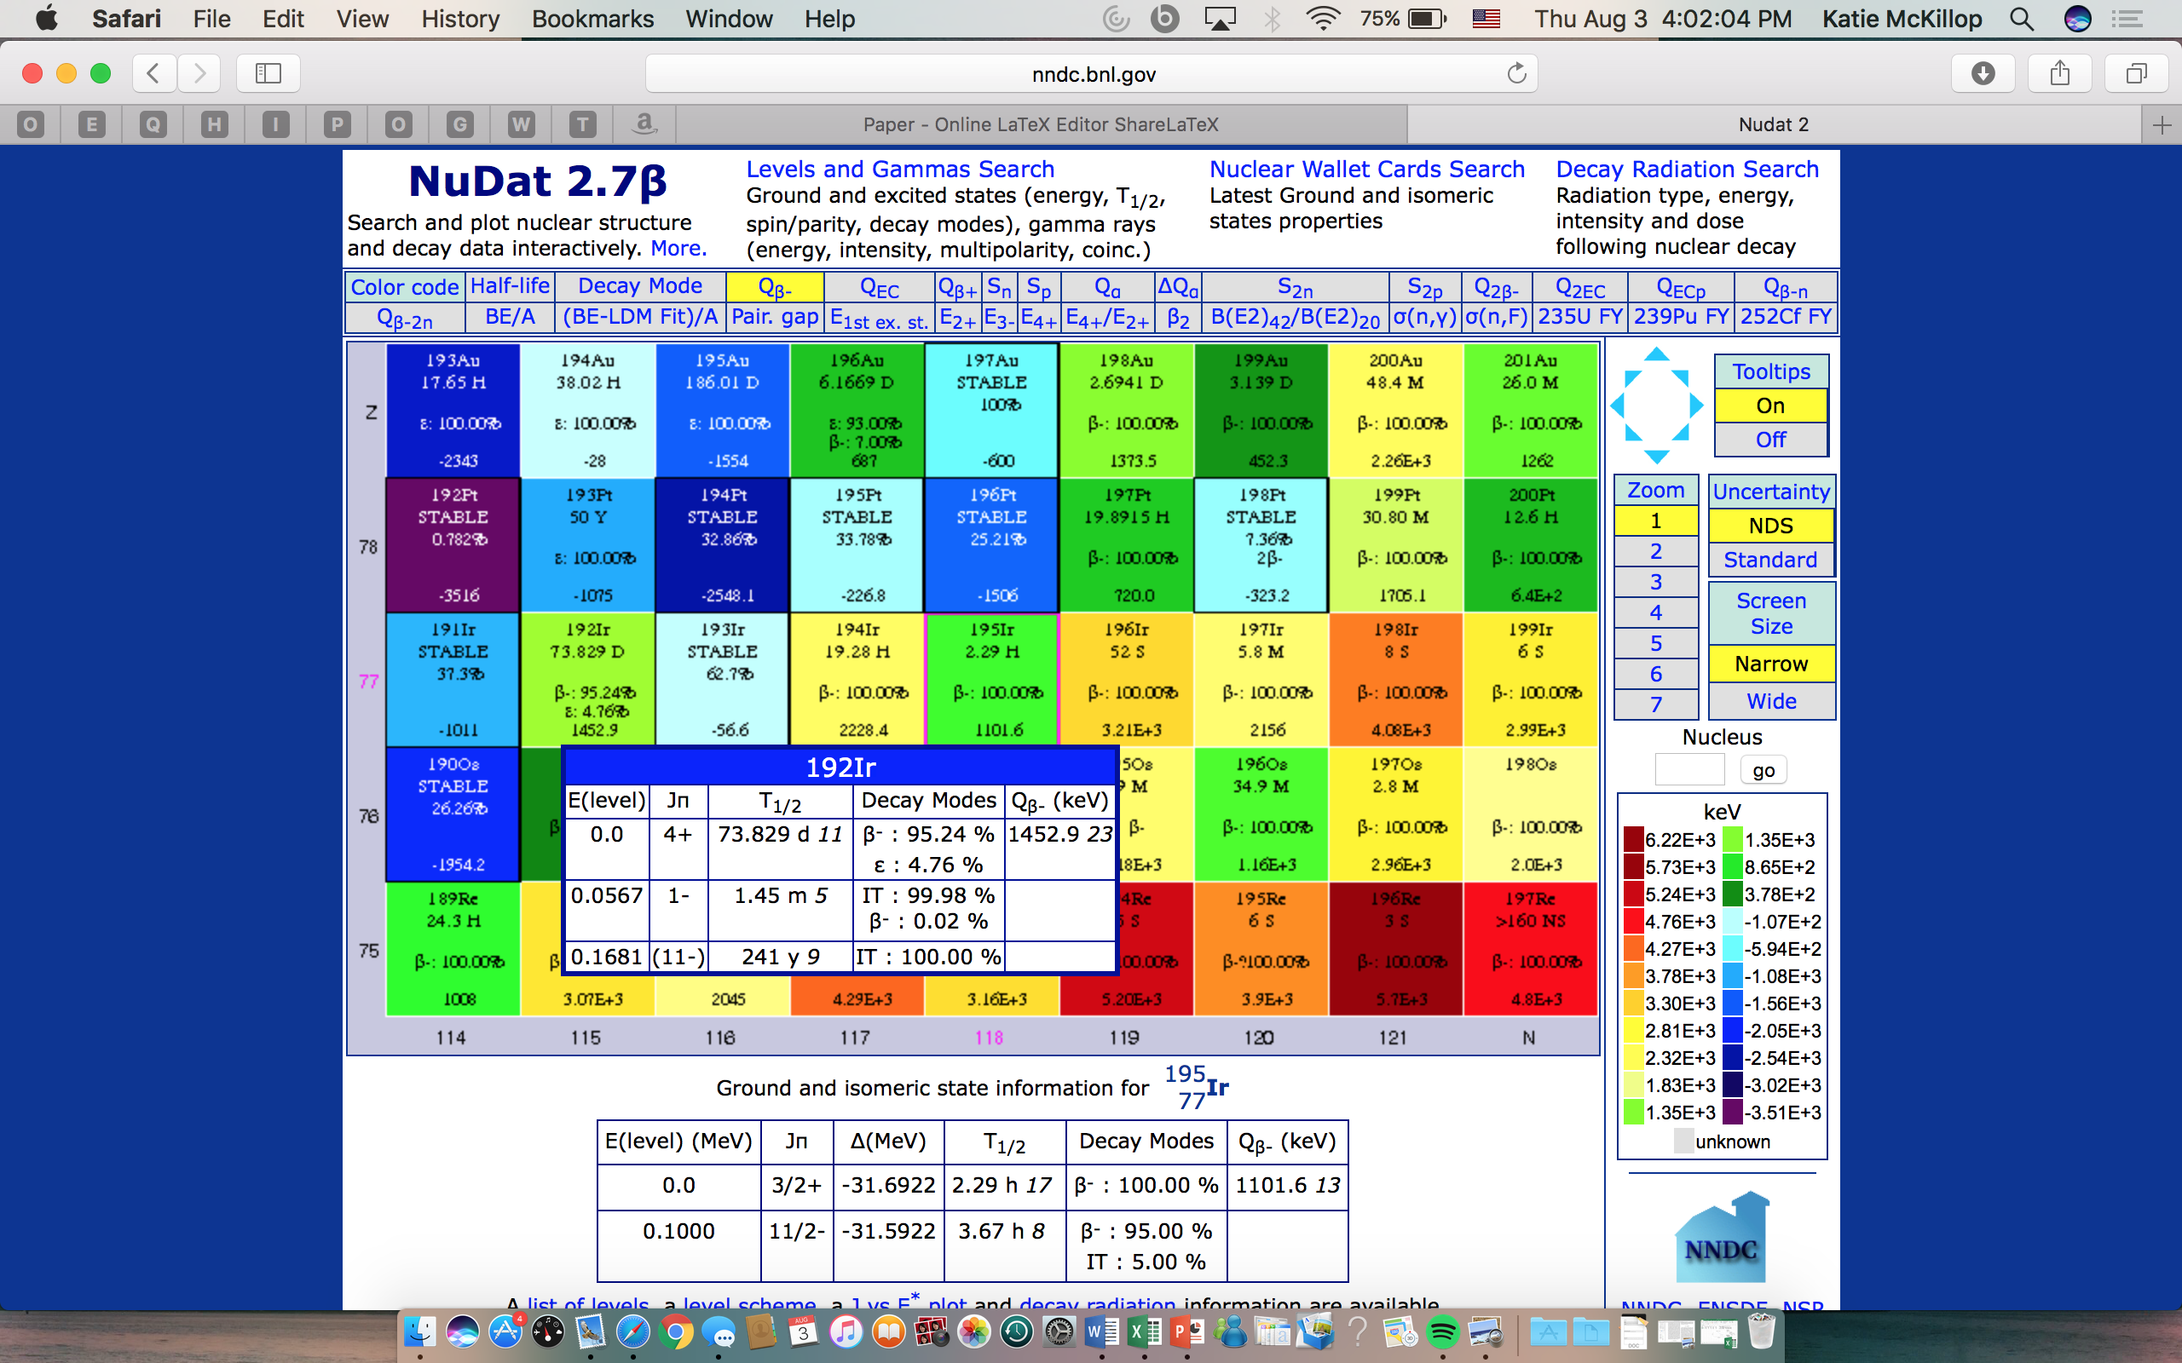
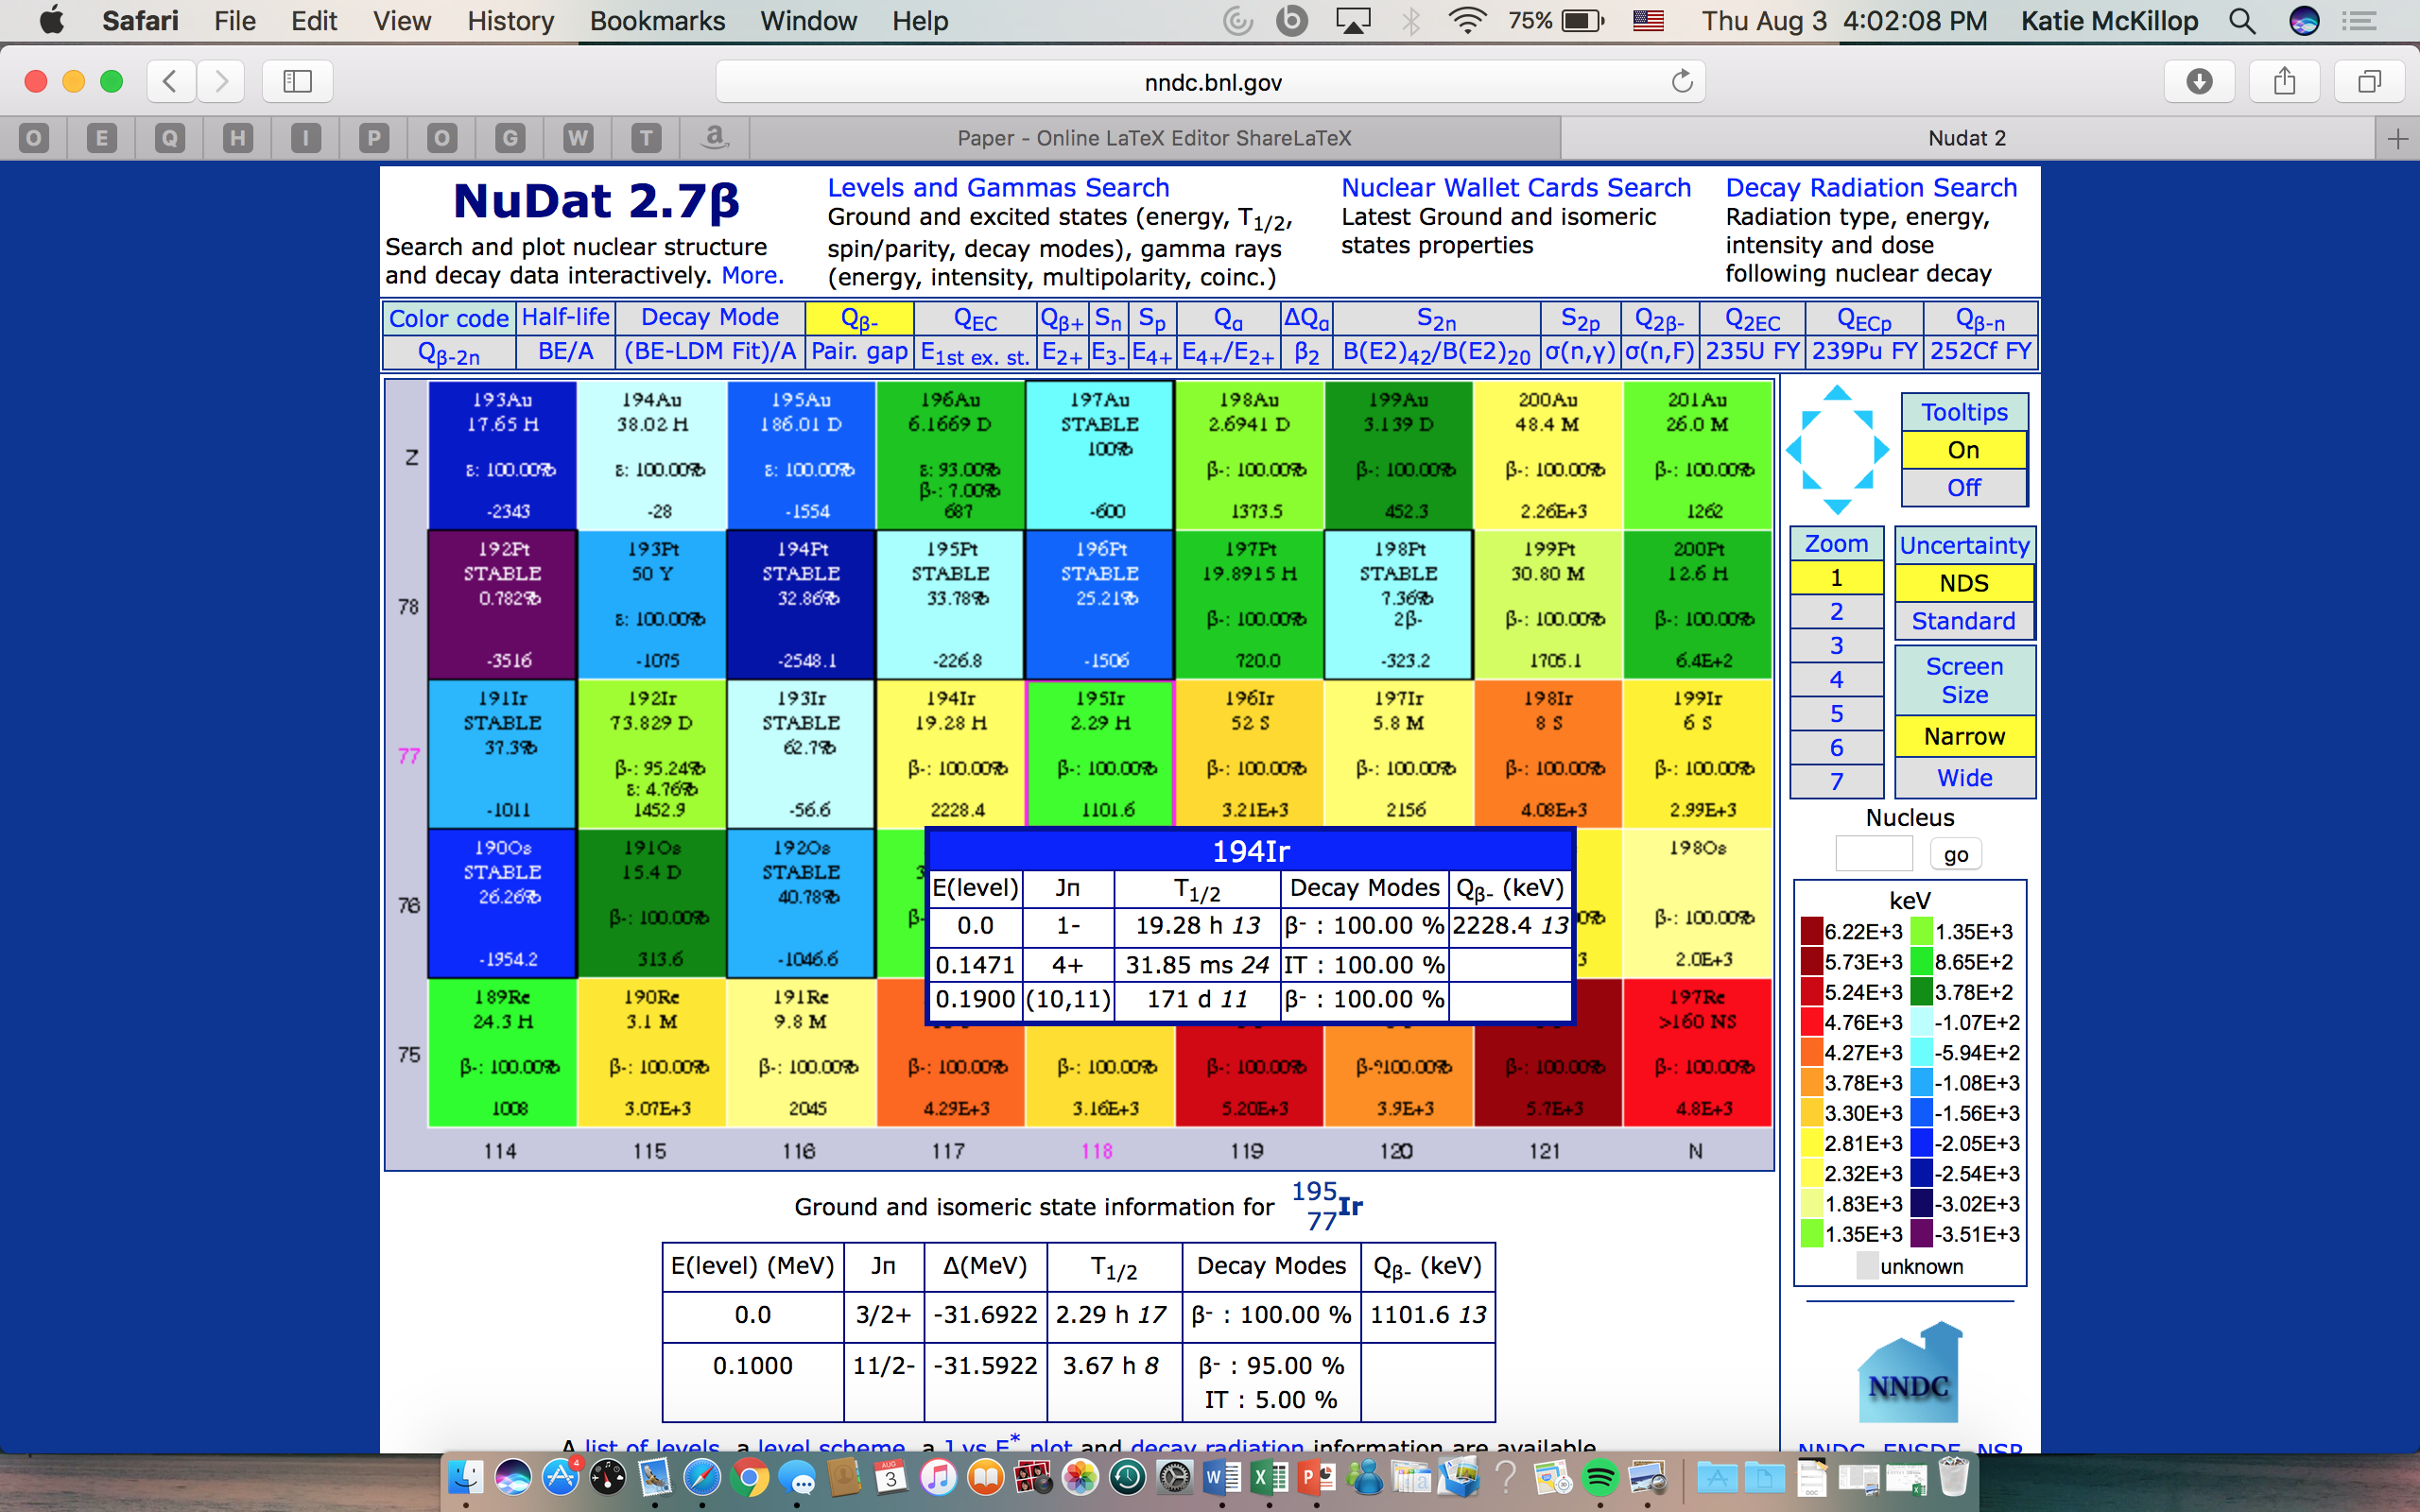
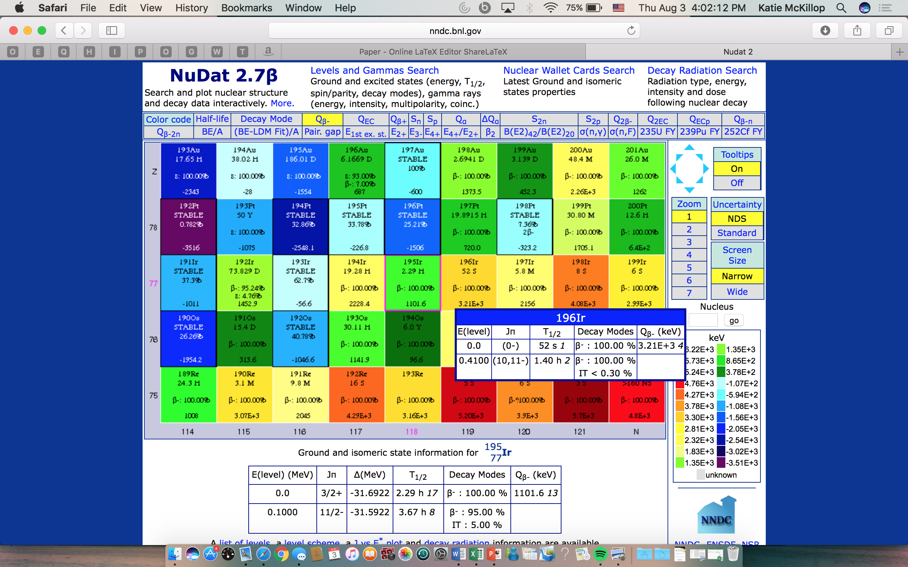
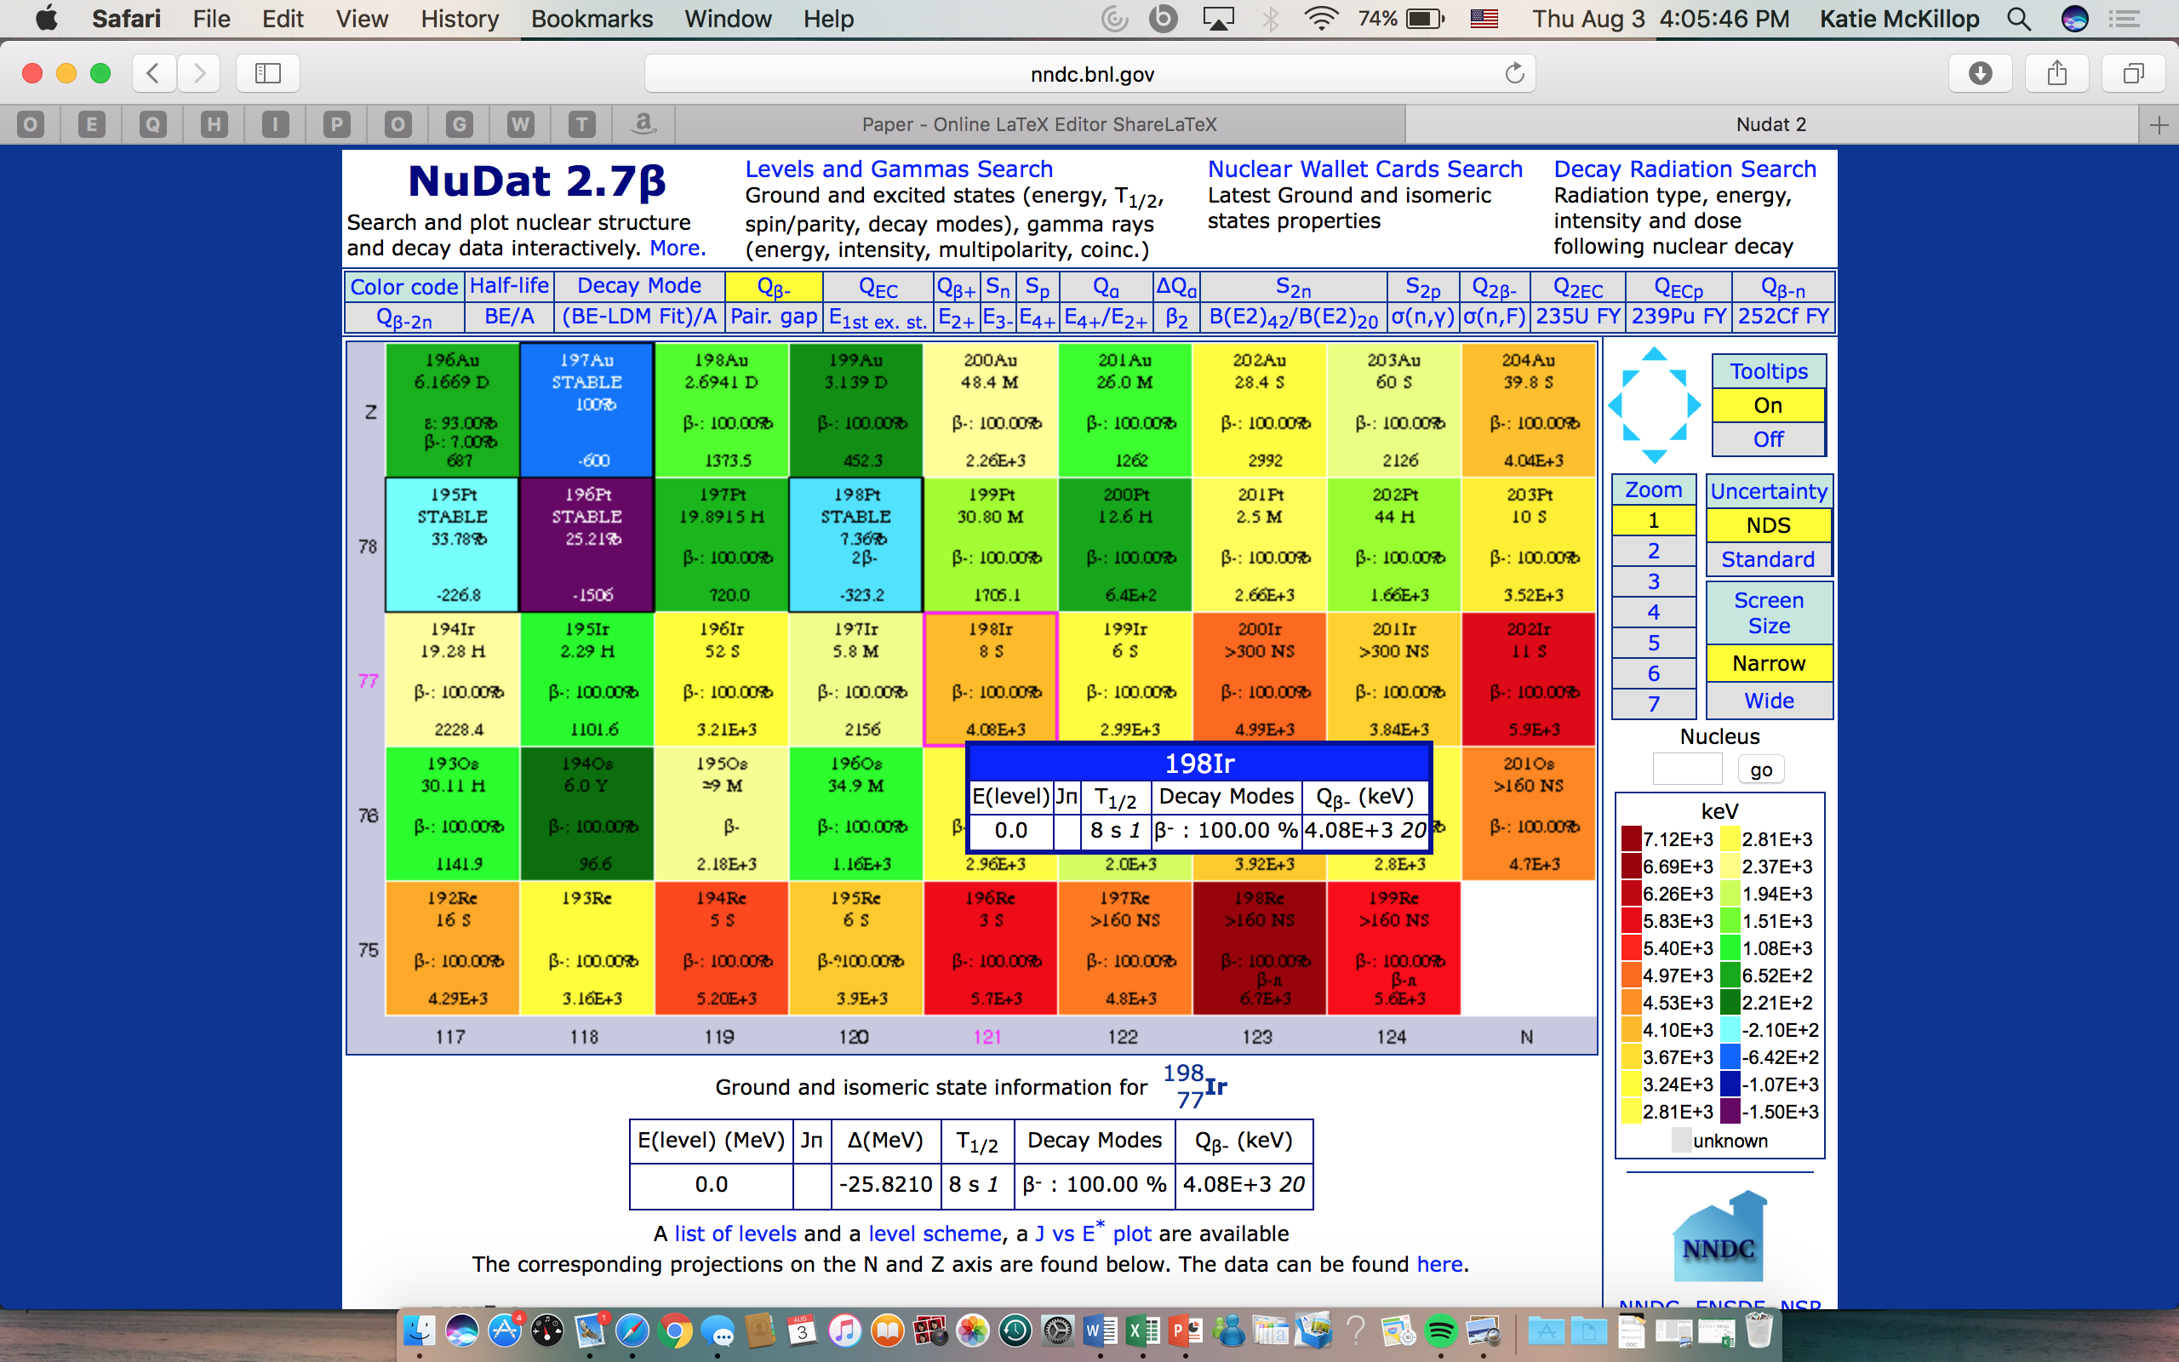
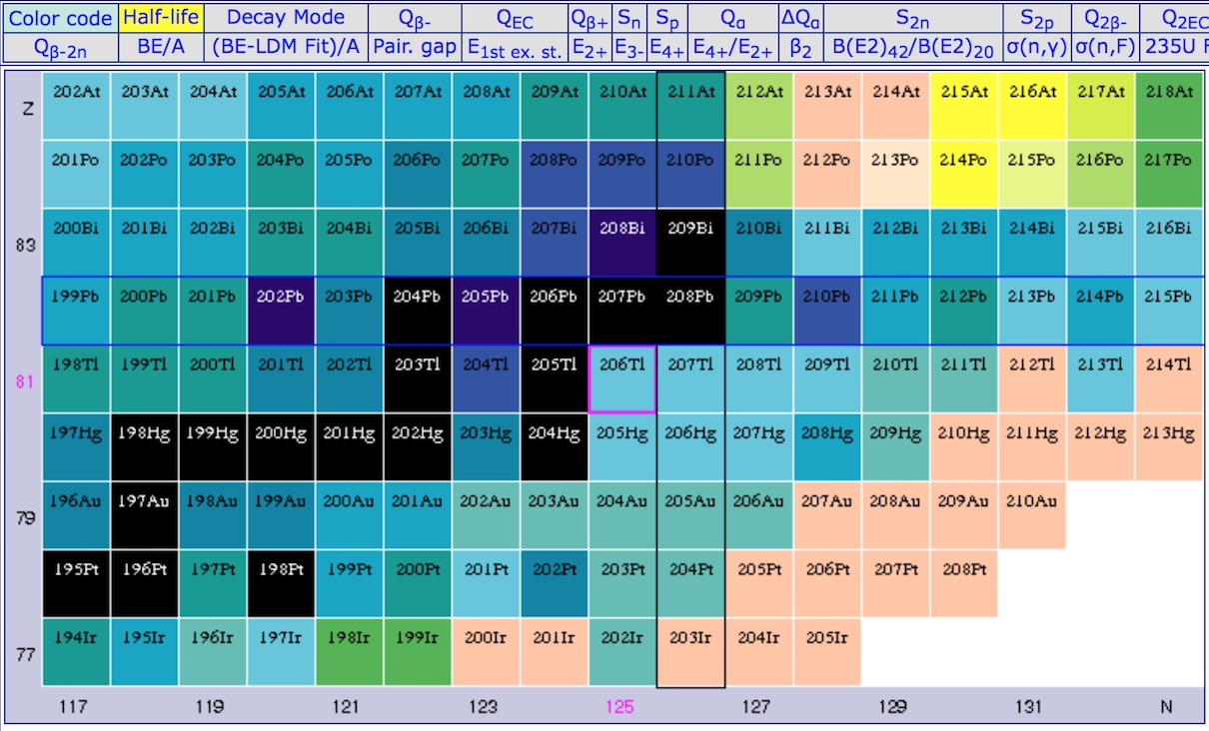
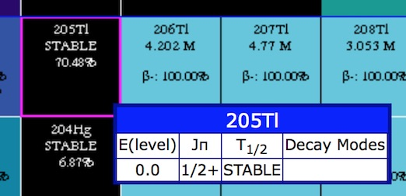
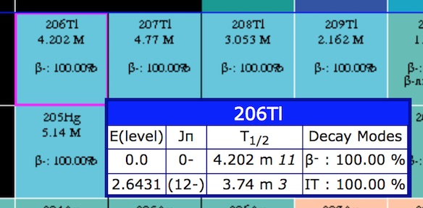
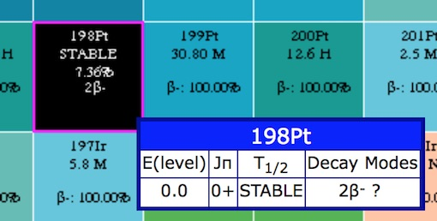
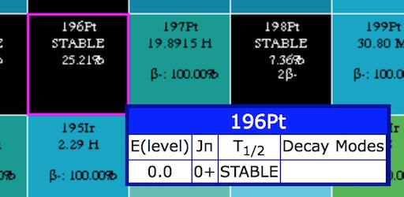
High-spin Isomers in Ir
Does a high-spin isomer persist in 198Ir?

Slide 16
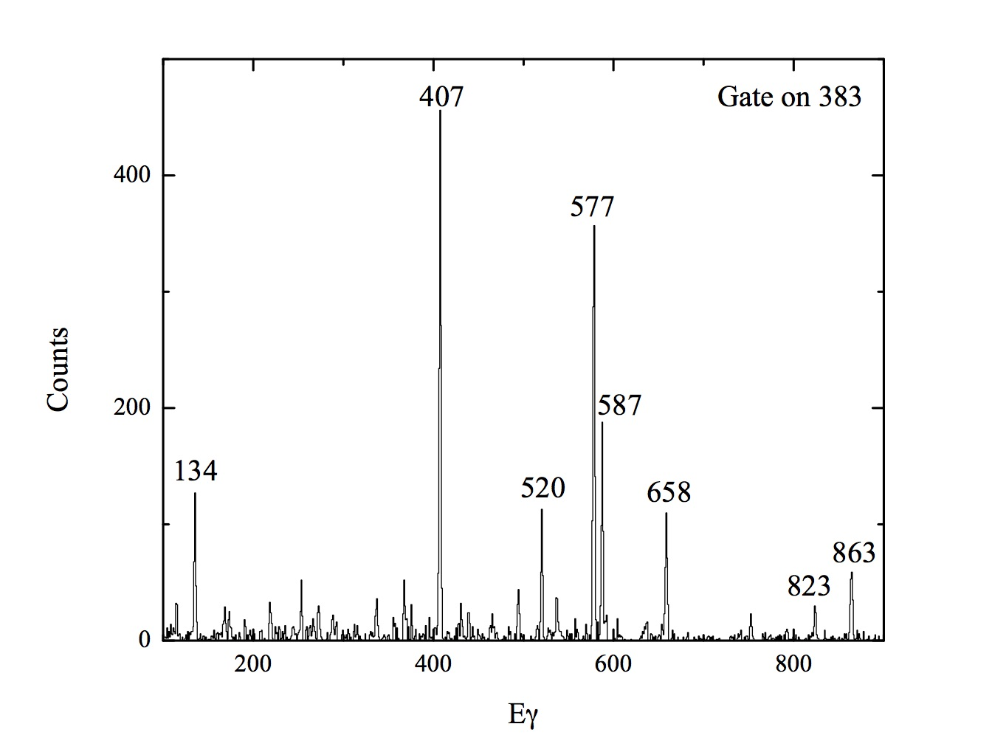

¹⁹⁸Pt populated by decay of ¹⁹⁸Ir isomer
High J decays

Slide 17



Intriguing population of beam-like products
Double gate in ¹⁴⁷Sm
This is huge for 8 protons away from beam, is it
Transfer?
Reaction on C,O in target
???

Slide 18



Along the way, some beautiful data to test shell model
Data analysis in progress
As are shell model calcs
¹⁴⁷Sm
¹⁴¹Ce

Slide 19
Collaborators
A.A. Sonzogni, A. Gula, N. Nelson, K. McKillop, E. Gass
Brookhaven National Laboratory
R.J. Nickles, P. Ellison
University of Wisconsin
J.P. Greene, M.P. Carpenter, G. Savard, J. Clark, S. Zhu
Argonne National Laboratory
N. Scielzo, S. Pagdett, K. Kolos
LLNL
K. Moran, P. Copp
University of Massachusetts, Lowell

Slide 20




Isotope Production Experts
Brookhaven Linac Isotope Producer (BLIP)
University of Wisconsin
Institute for Medical Research
16 MeV proton GE PETrace cyclotron
11 MeV proton CTI RDS 112 cyclotron

Slide 21



Gammasphere at Argonne National Lab
100 HPGe detectors
Compton-suppressed
Digital or analog DAQ

