Slide 1
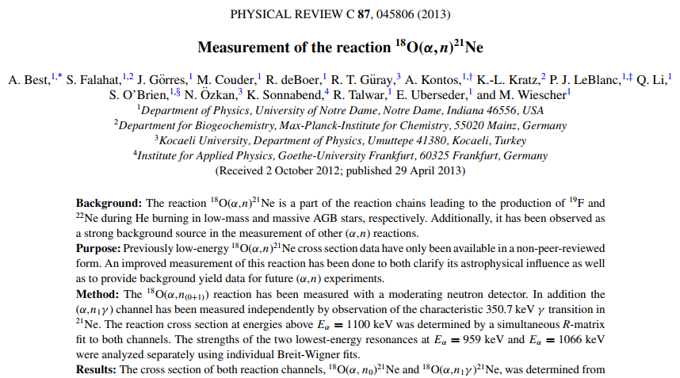
XUNDL and some thoughts
M.S. Basunia
2013Be12
USNDP meeting, BNL, Oct 31-Nov 3, 2017

Slide 2
In Nuclear Data Sheets
USNDP meeting, BNL, Oct 31-Nov 3, 2017

Slide 3
Received e-mail
From 1st author of 2013Be12
USNDP meeting, BNL, Oct 31-Nov 3, 2017

Slide 4
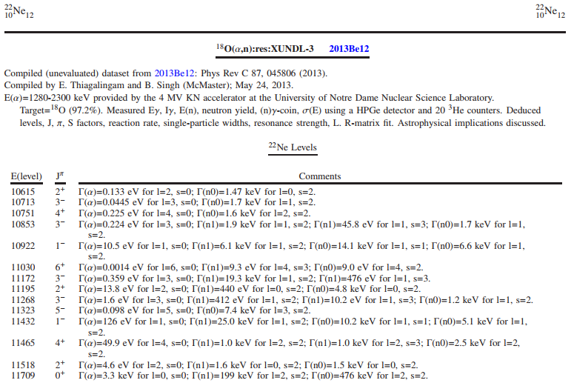
XUNDL – 2013Be12
USNDP meeting, BNL, Oct 31-Nov 3, 2017

Slide 5
Thoughts
Would it be a good practice -
After XUNDL data set compilation - sending to 1st author for checking and feedback with a time limit.
Benefits:
1. Outreach
2. Corrections
3. Save review time
USNDP meeting, BNL, Oct 31-Nov 3, 2017

