Slide 1


Cross Section Measurements at LBNL and UC-Berkeley
Lee Bernstein
Nuclear Science Division
Lawrence Berkeley National Laboratory
Department of Nuclear Engineering
University of California - Berkeley

Slide 2
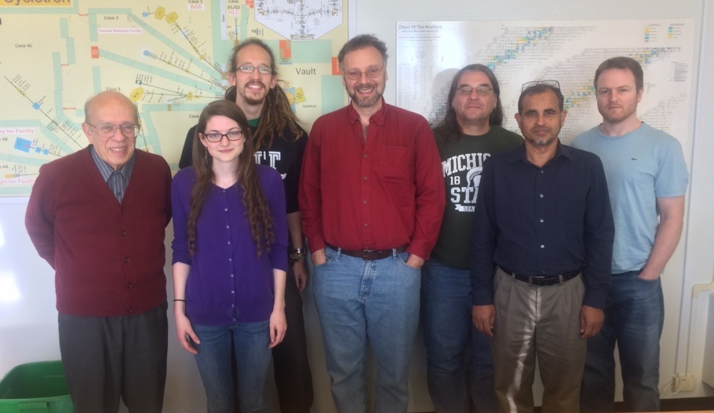

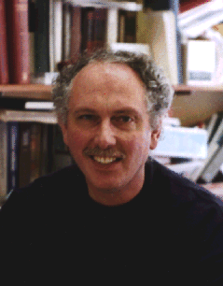


The LBNL/UCB Nuclear Data Group*
E. Matthews
E. Browne
A. Springer
J. Batchelder
A. Hurst
R. B. Firestone
L. Kirsch
A. Voyles
A. Lewis
M. Basunia
Our goal is to address the data needs of the applied and basic nuclear science community while training the next generation of nuclear scientists and engineers in the process
Notes:
We do this by bringing together young…and other…scientists and engineers

Slide 3
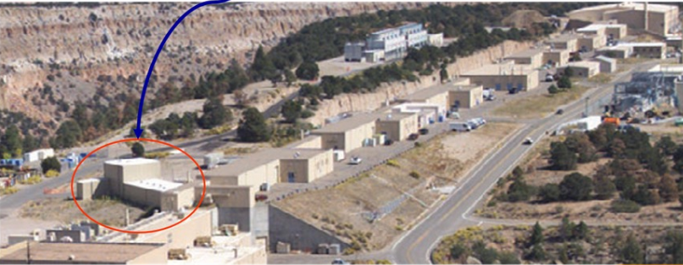
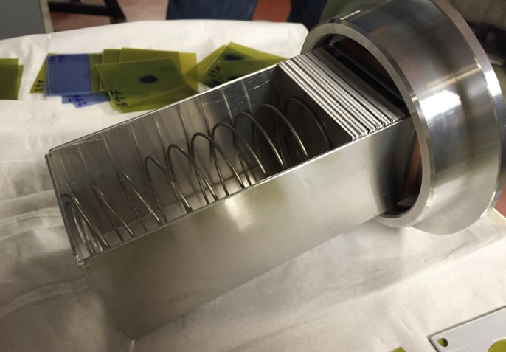
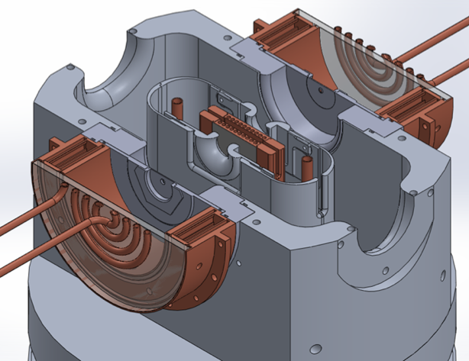
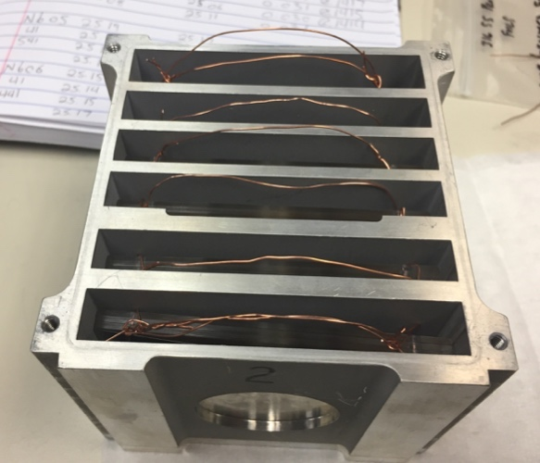
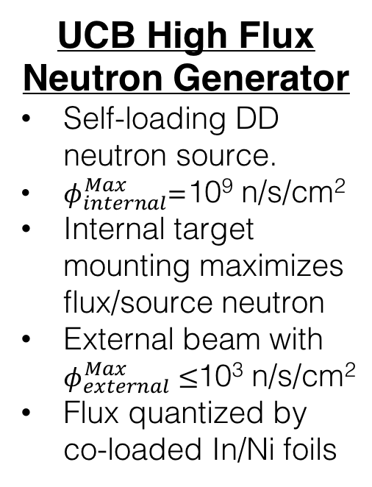
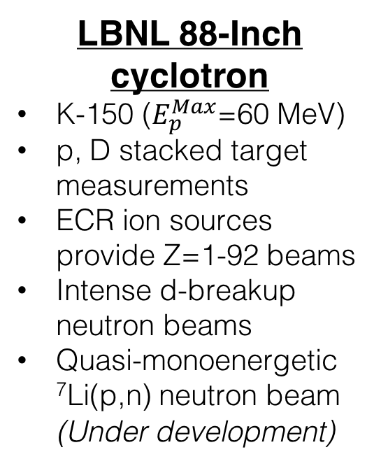
Experimental facilities utilized
LBNL 88-Inch cyclotron
  K-150 ($E_{p}^{Max}$=60 MeV)
  p, D stacked target measurements
  ECR ion sources provide Z=1-92 beams
  Intense d-breakup neutron beams
  Quasi-monoenergetic ⁷Li(p,n) neutron beam (Under development)
UCB High Flux Neutron Generator
  Self-loading DD neutron source.
  $φ_{internal}^{Max}$=10⁹ n/s/cm²
  Internal target mounting maximizes flux/source neutron
  External beam with $φ_{external}^{Max}≤$10³ n/s/cm²
  Flux quantized by co-loaded In/Ni foils
LANL Isotope Production Facility
  100 MeV proton linac
  Stacked target experiments using state-of-the-art counting facility
  µA to mA currents

Slide 4
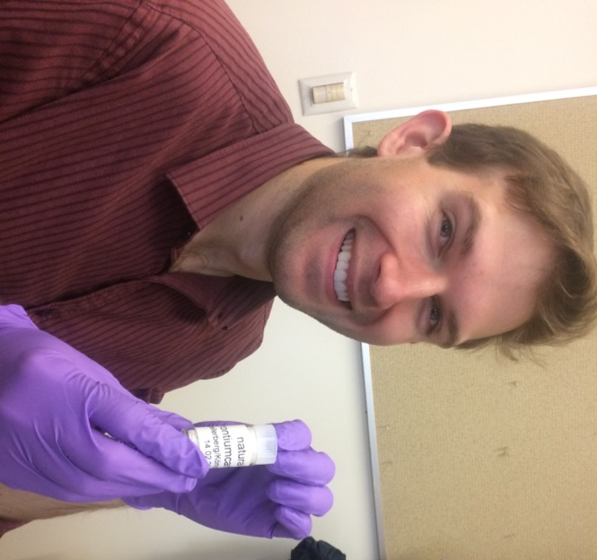

Targeted Cross Section Measurements using the HFNG
  Said Qaim called for measurements of (n,p) cross sections for the production of non-standard β—emitters at NDNCA
  We published our first results in September*, introducing a neutron utilization parameter (η_{ν}) which characterizes the effectiveness of a neutron generator as an isotope generator
³²S(n,p)³²P; ⁴⁷Ti(n,p)⁴⁷Sc, ⁶⁴Zn(n,p)⁶⁴Cu; ⁶⁷Zn(n,p)⁶⁷Cu; ⁸⁹Y(n,p)⁸⁹Sr;
¹⁰⁵Pd(n,p)¹⁰⁵Rh; ¹⁴⁹Sm(n,p)¹⁴⁹Pm, ¹⁵³Eu(n,p)¹⁵³Sm,
¹⁵⁹Tb(n,p)¹⁵⁹Gd; ¹⁶¹Dy(n,p)¹⁶¹Tb; ¹⁶⁶Er(n,p)¹⁶⁶Ho; ¹⁶⁹Tm(n,p)¹⁶⁹Er;
¹⁷⁵Lu(n,p)¹⁷⁵Yb; ¹⁷⁷Hf(n,p)¹⁷⁷Lu, and several other reactions
Andrew Voyles
*“Measurement of the ⁶⁴Zn, ⁴⁷Ti(n,p) cross sections using a DD neutron generator for medical isotope studies”, Nuclear Instruments and Methods in Physics Research B 410 (2017) 230–239

Slide 5
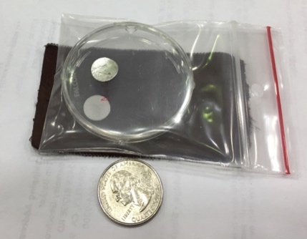
The HFNG was also use to perform a targeted measurement of the ³⁵Cl(n,p) cross section for molten salt reactors
The ³⁵Cl(n,p) cross section is thought to be too large at fission energies (≈1 MeV) to allow for natural salt to be used in molten salt reactors, but there are no measurements between 100 keV and 14 MeV
The first measurement of the ³⁵Cl(n,p) and (n,α) cross sections were performed via activation in ratio to ¹¹⁵In(n,n’) at 2.7 MeV at the HFNG.
DOE-NE is funding this measurement in FY18
This work
New 5 target holder covers
2.4-2.76 MeV
^{nat}In + NaCl samples mounted in the HFNG
The lower (n,p) cross section means that less ³⁵Cl enrichment may be needed for MSRs
HFNG Measurement
MSR
spectrum
HFNG
Thanks to J.C. Batchelder and S.A. Chong

Slide 6
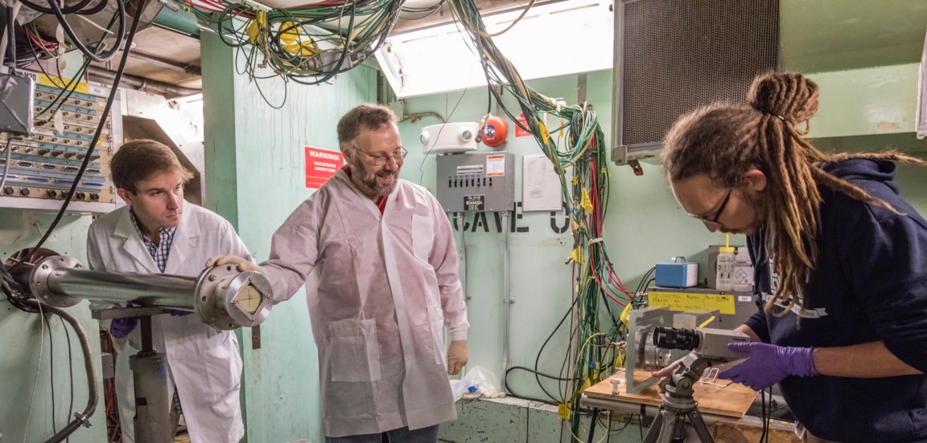
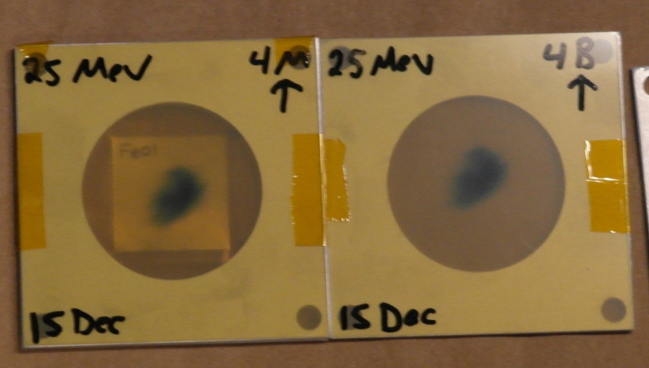

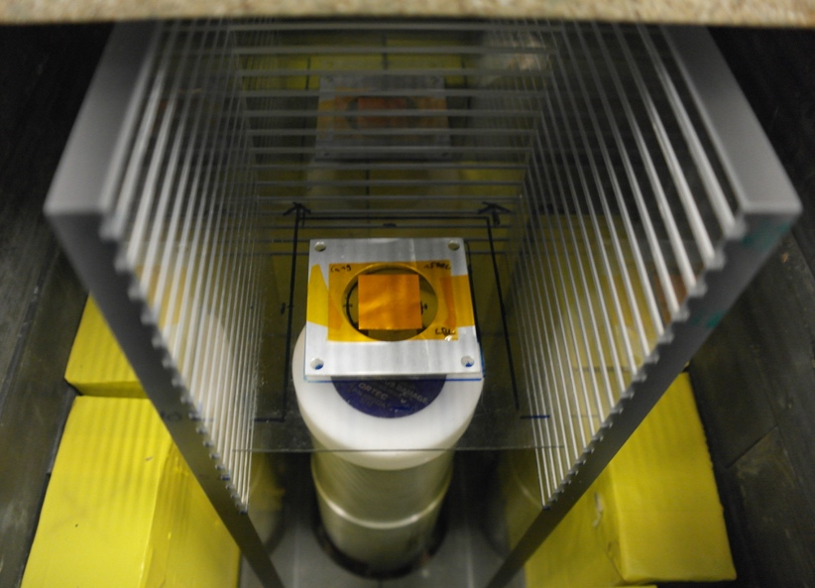
88-Inch cyclotron experimental procedure
Stacked targets using Ti, Cu & Al monitor foils
Beam-line electrically isolated/magnetically suppressed
Post-irradiation counting using HPGe detector
Transport through stack modeled using MCNP
Measurements made on Zr, Fe, La

Slide 7
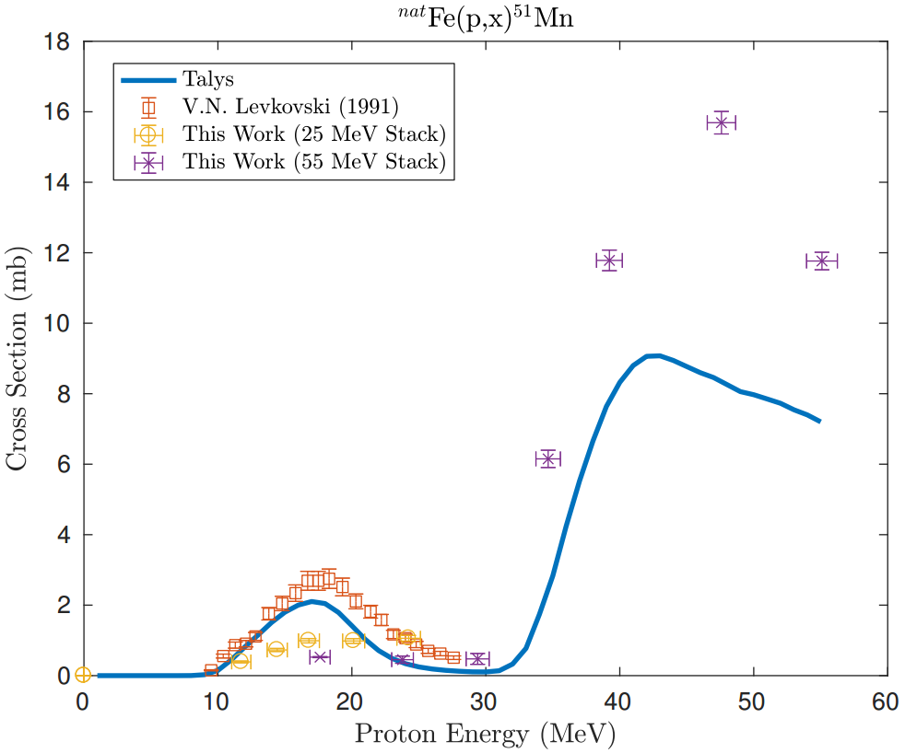
First LBNL Results: ^{nat}Fe(p,x)^{51,52g,52m}Mn
2⁺
21.1(2) m
6⁺
5.591(3) d
⁵²Mn
⁵²Cr

Slide 8
First LBNL Results: ^{nat}Fe(p,x)^{51,52g,52m}Mn
These results provide insight into ρ(J) while improving our knowledge of the production cross section for two promising new PET nuclides

Slide 9
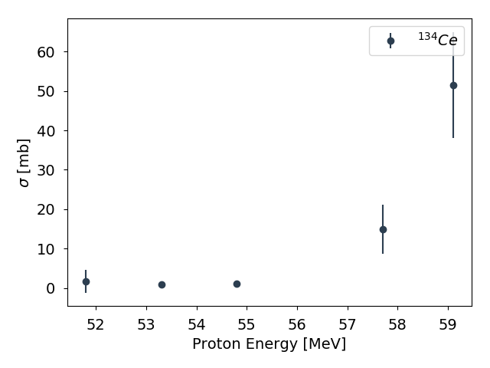
The production of ¹³⁴Ce for tracking the motion of the promising targeted alpha-therapy radionuclide ²²⁵Ac
Initial results indicate that EMPIRE is more successful at reproducing the ¹³⁹La(p,6n) channel than TALYS.
A new high energy mark was set for the 88-Inch cyclotron (E_{p}=60 MeV)
¹³⁷Ce has an isomer and ground state that will allow for ρ(J) studies in the same way as ^{52m,g}Mn.
New UC student
Jon Morrell

Slide 10
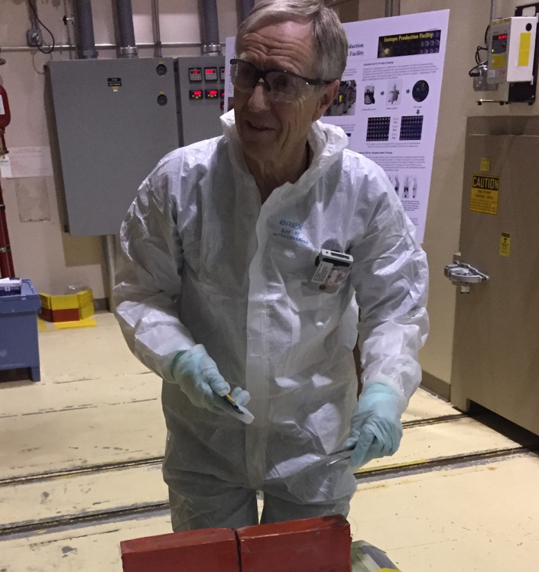
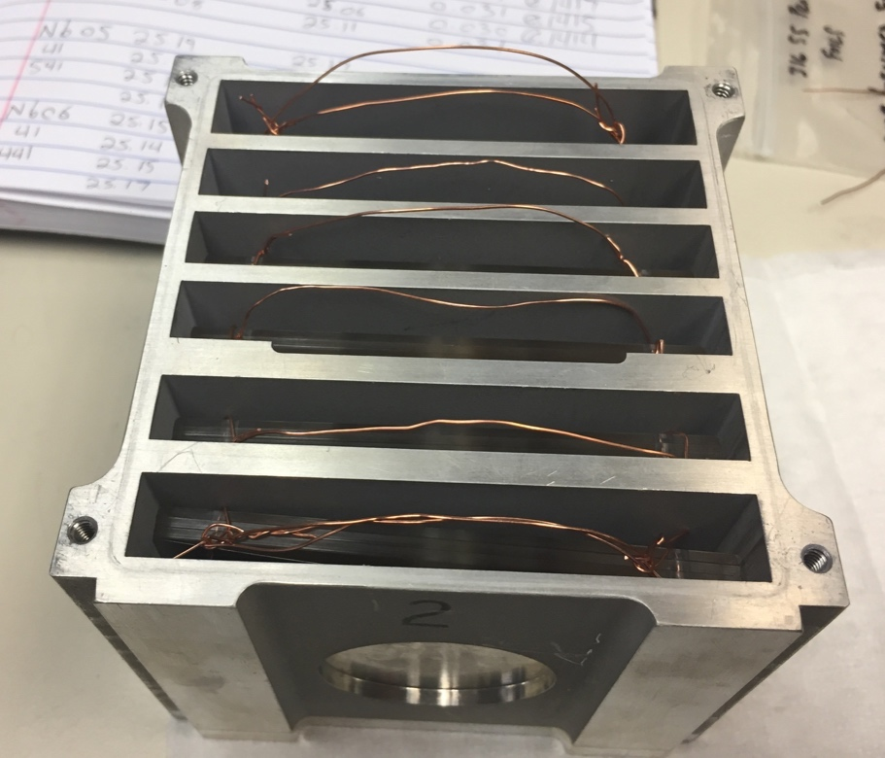
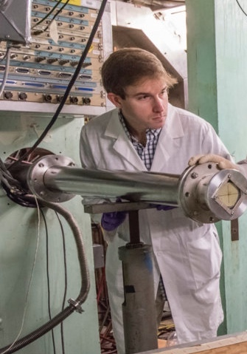
We are working with LANL and Wisconsin to develop ⁹³Nb(p,x)⁹⁰Mo as a high energy proton dosimetry standard
  LANL Isotope Production Facility: 100 MeV proton linac
  Stacked target experiments using state-of-the-art counting facility
M. Nortier
A. Voyles
See P. Griffin NDNCA, CSEWG talks

Slide 11
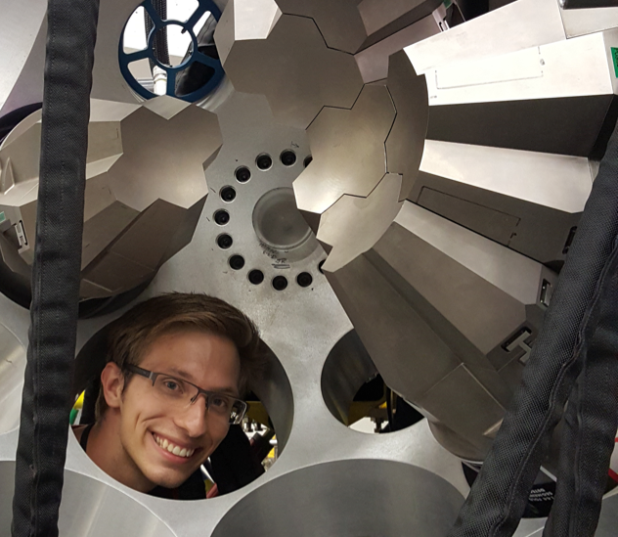
We have used (p,pγ) at GRETINA to measure the lifetime of Quasi-continuum states in ⁵⁶Fe (L. Kirsch)
Mr. Kirsch’s experiment involves the first measurement of lifetimes in the nuclear quasi-continuum (QC) via DSAM following population in a direct reaction – ⁵⁶Fe(p,p’γ) using GRETINA coupled to a phoswich wall
The low-energy enhancement in the RSF is
evident as additional slowing in
τ_{QC}
Upbend in RSF validated
Thanks to H.L. Crawford, A.O. Macchiavelli and M.D. Jones

Slide 12
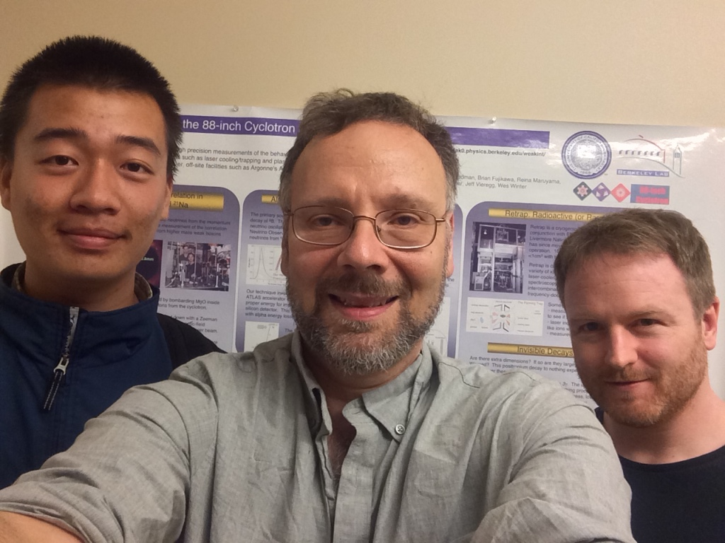
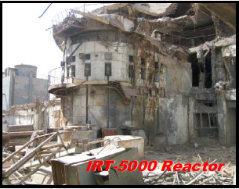
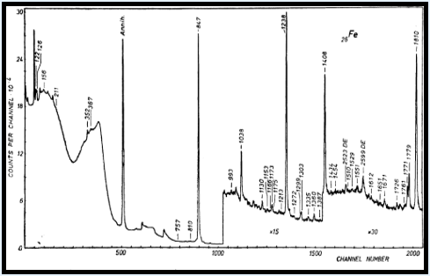
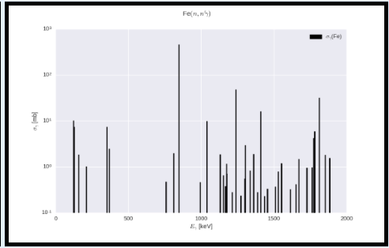
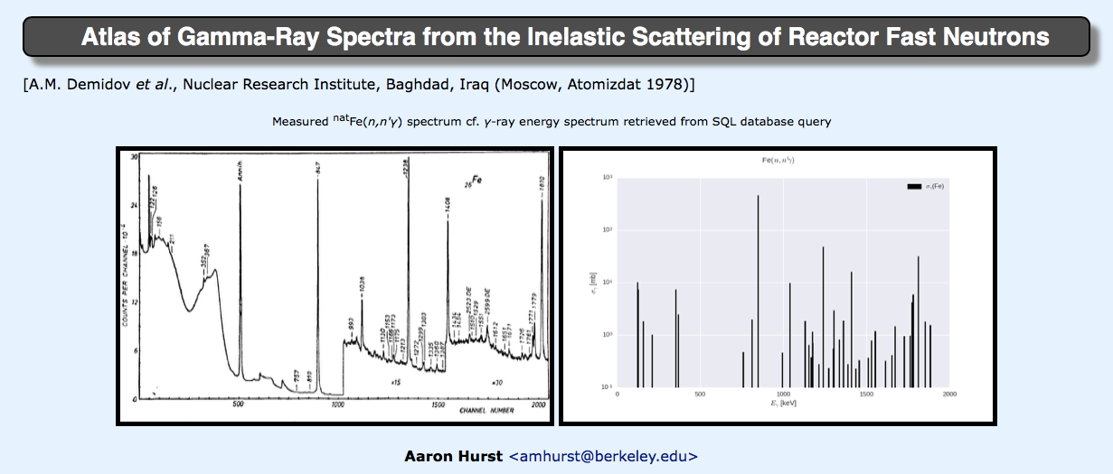
Aaron Hurst and Kaixin Song –
(n,n’γ) data for improved non-destructive assay and forensics
A. Hurst
The “Baghdad Atlas” of (n_{fast},n’γ)
(7090 γ-rays on 75 elements)
K. Song
Iraqi Reactor “Decommissioned” by USAF in 1991
Data rescued by the IAEA and sent to LBNL/UCB
Compiled into SQL database by Hurst and UC students¹
We are bringing the E_{x}, J^{π} data into agreement with modern ENSDF.
All data compiled to EXFOR* (Voyles)
*thanks to Boris Pritychenko!
¹http://nucleardata.berkeley.edu

Slide 13
Summary
Our group mentors non-USNDP supported graduate students from the UC-Berkeley Department of Nuclear Engineering to lead on targeted cross section measurements
  Isotope production: ⁶⁴Cu, ⁴⁷Sc, ¹³⁴Ce (Voyles, Morrell)
  Nuclear energy system design: ³⁵Cl(n,p) (Chong)
  New dosimetry standards: ⁹⁰Mo (Voyles)
These students also help in the evaluation, compilation and dissemination of nuclear data
  EXFOR compilation of the Baghdad Atlas (Voyles, Song)
  ²³⁹Pu(n,x) for ENDF with BNL, KAPL (Lewis)
All of our experiments are guided by nuclear data needs documents and papers.

