Slide 1
NSR & EXFOR Compilation Databases
Boris Pritychenko
National Nuclear Data Center, BNL, Upton, NY 11973

Slide 2
Compilation Databases
There are three major and two minor compilation databases at NNDC: NSR, EXFOR, XUNDL and B(E2)↑, ββ-decay.
We will concentrate on NSR and EXFOR databases:
Nuclear Science References (NSR): all low- and intermediate-energy references for a broad use, not just nuclear structure and decay as before 90ies.
Experimental Nuclear Reaction Data (EXFOR): all low- and intermediate-energy reaction data sets for neutron-, charged- and photo-induced reactions, not just neutron-induced as before 80ies.
The compilation scope and quality controls for NSR and EXFOR database have evolved over the many years of operation. These facts plus lack of advanced computer tools in the past are responsible for missing references and data sets.

Slide 3
NSR Compilations
U.S. Nuclear Data Program Nuclear Science References database compilations create a foundation for nuclear structure, decay and reaction data efforts and impact research activities.
Value: ¹³⁷Cs T_{1/2} -140,000 hits by Google and 34 articles in NSR. It also simplifies NDS journal citations.
NSR team: 1.5 NNDC (B. Pritychenko, J. Totans), 2 NNDC contractors (B. Singh, E. Betak) and 1 IAEA collaborator (V. Zerkin).
Our goal is provide the coverage of nuclear physics publications.
Our major requirement is speed, prompt creation of entries for ENSDF: NSR is always up-to-date (2-3 times a week): FY 2017 issues of PRC including keywords are in the database; October 2017 PRC will be added tomorrow.
NSR Quality Assurance: Manager + Users + Evaluators + Compilers inputs. We do not have a bug database, we just fix bugs immediately.
Direct communication with Phys. Rev. C: ~15% of authors submit keywords to NSR.

Slide 4
FY 2017 NSR Statistics
NSR References:
3,277 new article entries, total NSR: 225,695 (10 times bigger than EXFOR)
1025 modified (corrected) article entries
1825 keyworded article abstracts
NSR Dictionary updates:
1,813 new authors, total NSR: 98,273
3 new journals, total NSR: 519
265 new reactions, total NSR: 8,168
592 new nuclides, total NSR: 6,867
NSR Database updates: 132 in FY 2017
NSR Web retrievals: 316,147

Slide 5
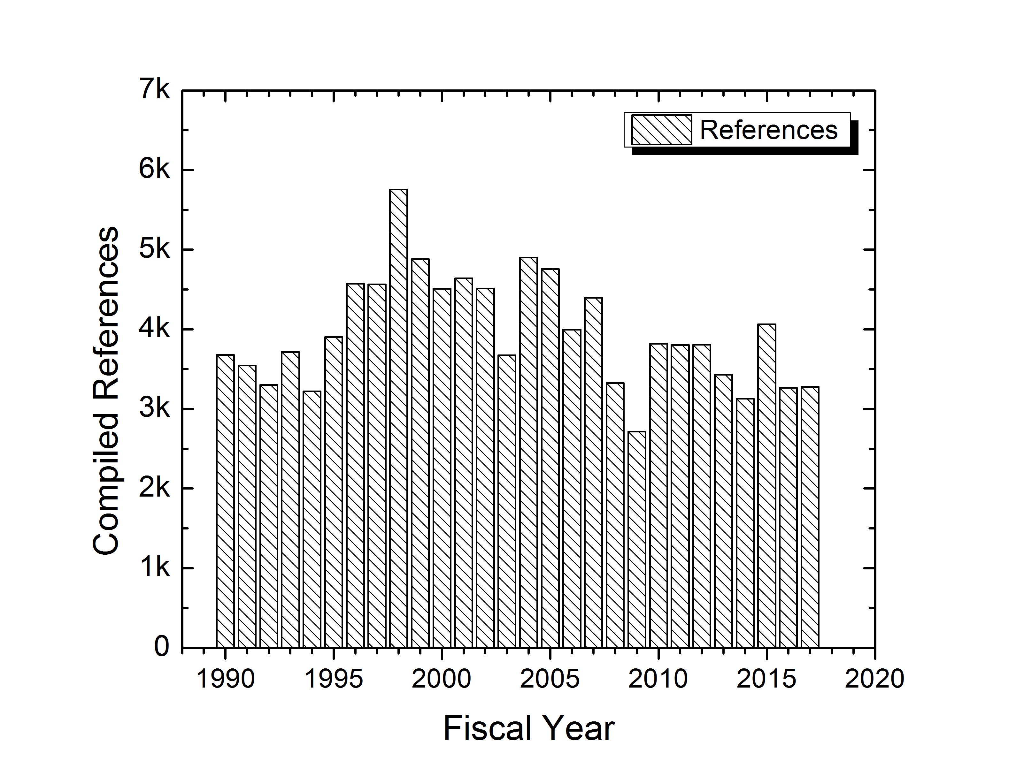
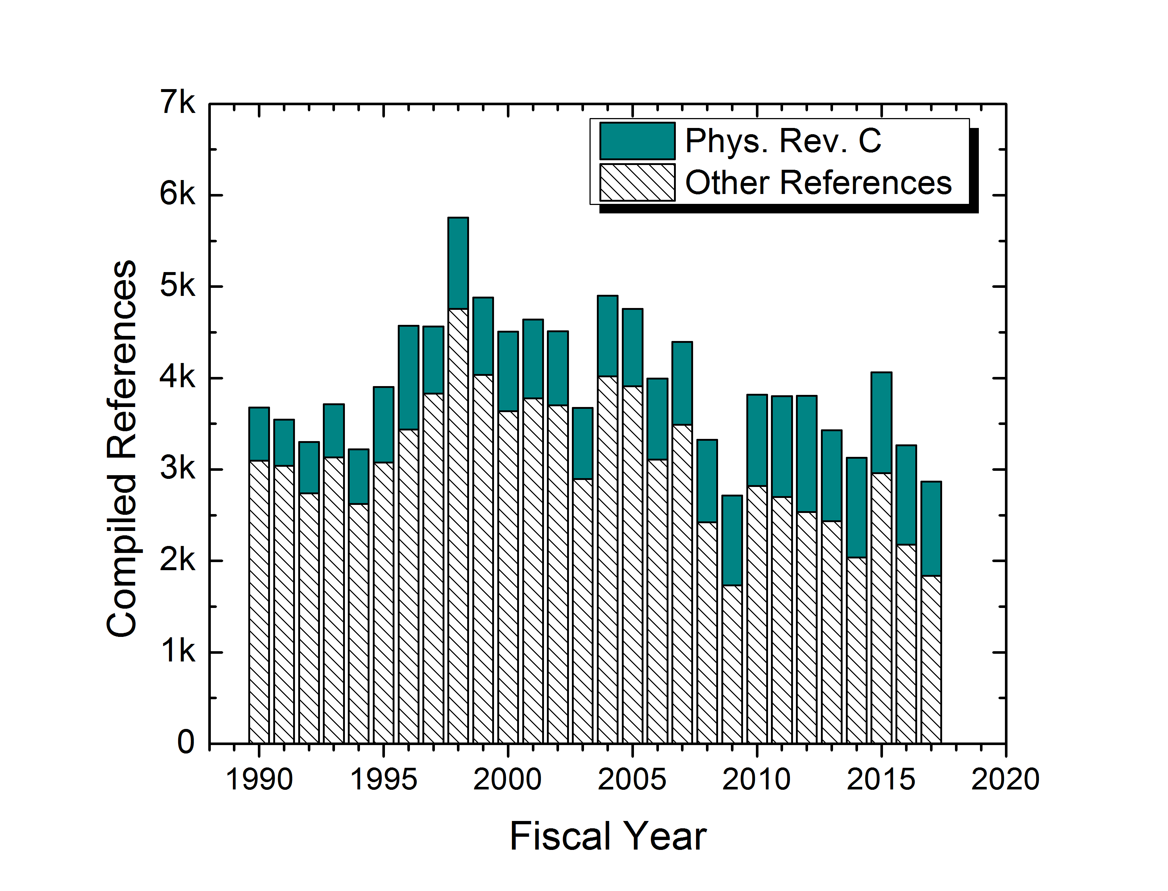
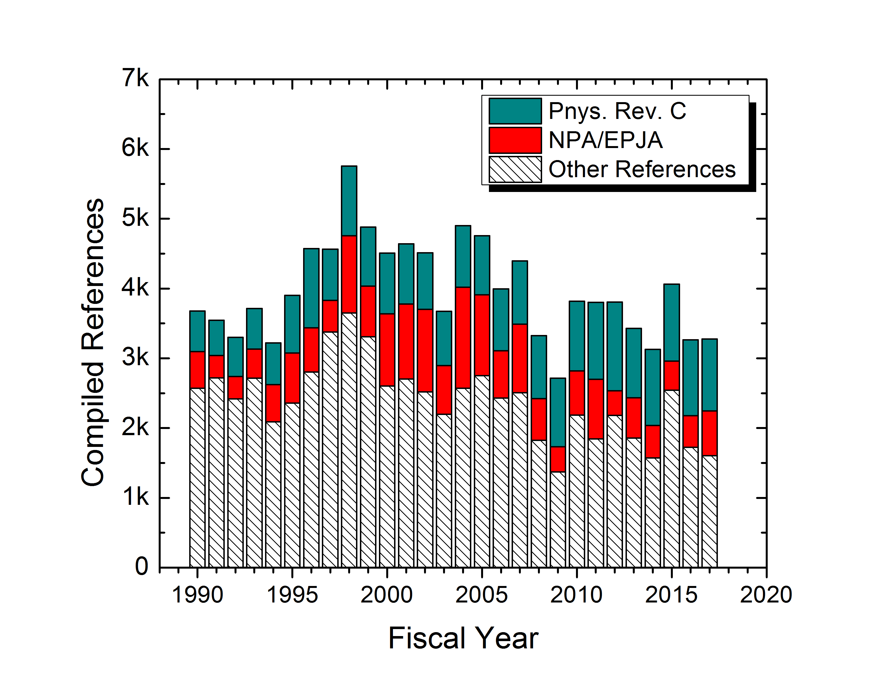
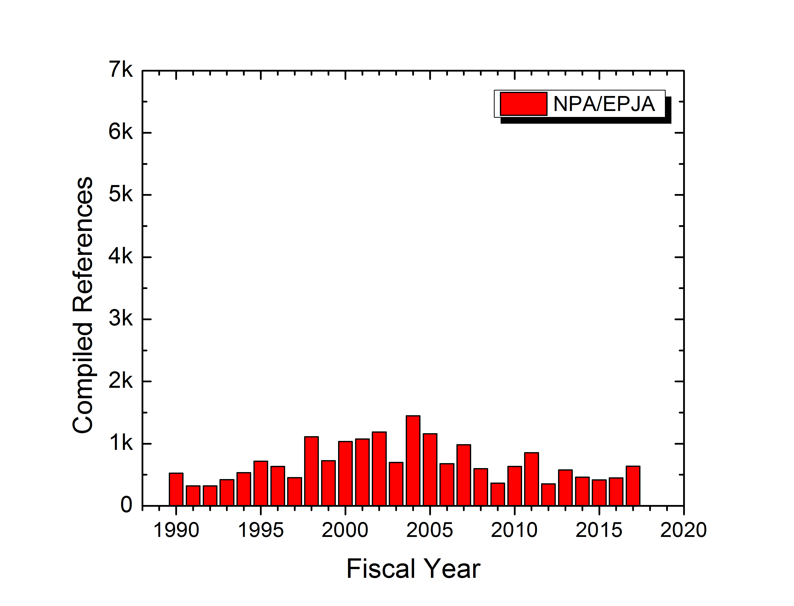
Analysis of NSR Compilation Statistics for the last 25 Years
Presently we compile about ~3,100 references per year.
Is this number reasonable? Previously we had years with 4,000+ entries?
We have a slight increase in Physical Review C compilations.
While Nuclear Physics A number of articles fluctuates wildly due to conference publications.
All articles from PRC & NPA are within NSR compilation scope and affect annual statistics.

Slide 6
Nuclear Physics Conferences
Too many physics journals are publishing conferences, useful contents are buried in unrelated contents that journals have to publish in order to fill the pages. Very slow websites & 100s of conferences.
AIP conferences proceedings: 2 in the last two years, the slowest website and plenty of unrelated contents.
Journal of Physics, Conference Series: 5 in the last two years.
EPJ Web Conf.: 6 in the last two years (ND 2016), no unrelated to physics conferences + NASA ADS Abstract Service.
Positive: Open Access for many conferences.
Please let us know if we missed something!!!!

Slide 7
New Elements
IUPAC assigned names to Z=113, 115, 117 and 118 as Nh, Mc, Ts and Og, respectively, on November 30, 2016.
As of January 5, 2017 these changes were implemented in NSR.
594 entries and keywords were identified and modified to reflect the latest naming convention.
This project helped to increase the total number of modified entries to 1,025.

Slide 8
NSR Citation & Coding Issues
Last year we had an official recommendation to cite NSR, XUNDL and previous evaluations in ENSDF evaluations.
All articles from the Nuclear Data Sheets journal are compiled in NSR: We have 7 citations and 9 articles.
PRC & NPA publishes articles on production of LAMBDAs, ETTAs, … and it takes time to code it and update the database dictionaries properly with limited benefits for USNDP.
Do we need coding for particle production …. ????
NDS Issue | Number of Articles | Number of citations
December 2016 | 1 | 1
February 2017 | 1 | 1
March 2017 | 2 | 2
May-June 2017 | 1 | 1
July-August 2017 | 1 | 1
September-October 2017 | 2 | 1
November 2017 | 1 | 0

Slide 9
Area #1 EXFOR Effort
EXFOR is an international project under the auspices of the IAEA.
NNDC is responsible for experimental nuclear reaction data compilation and dissemination in the Area #1 (US and Canada).
EXFOR Team: B. Pritychenko, S. Hlavac, O. Schwerer (BNL) and V. Zerkin (IAEA).
NNDC: Overall database and contracts management, website support, compilation and correction of missing and older references.
Bratislava: New references compilation.
Vienna: Overall quality assurance and transmission handling.
IAEA: Web and database development.
Smooth operation based on efforts of BNL stuff, contractors and collaborators.
Contractors (S. Hlavac and O. Schwerer) are essential for the overall success of the NNDC EXFOR effort.

Slide 10
X4 Statistics
New entries: 46 + 52 (BNL) = 98
Corrected entries: 45 + 50 (BNL) = 95
Large numbers of charged particle and photonuclear experiments are still missing in EXFOR, many existing compilations are incomplete.
Web retrievals using the IAEA system of counting:
EXFOR: 37,753
ENDF: 96,844
CINDA: 1,522
More compilation details in the IAEA system based on calendar years: http://www-nds.iaea.org/exfor-master/x4compil/

Slide 11
X4 Highlights
Smooth EXFOR operation between NNDC staff and contractors.
Large data sets from K. Guber’s measurements (14324, Cr data are crucial for ENDF/B-VIII release) have been compiled and submitted to the database, finally, have been accepted as thin target approximation cross sections not reaction yields or raw data.
It is very important to code nuclear reaction strings in the way that users will understand.
EXFOR Web application was upgraded in collaboration with the IAEA.
Database was updated 11 times in FY2017. We followed the IAEA releases.

Slide 12
Conclusions
NSR & EXFOR projects are in a good shape and we collaborate with the IAEA on these projects.
We will continue to support nuclear structure and reaction research, evaluations, and theory.
We add new and previously missing references to NSR & EXFOR databases.
Contractors are essential for the overall success of the NNDC compilation effort.
I apologize for not attending NSDD 2017 due to conflict with the NRDC (EXFOR) meeting. I hope that such scheduling conflict would not happen again and I will be able to attend the next meeting in two years from now.

