Slide 1
XUNDL-ENSDF-NDS Overview
Libby McCutchan
National Nuclear Data Center
Brookhaven National Laboratory, NY USA

Slide 2
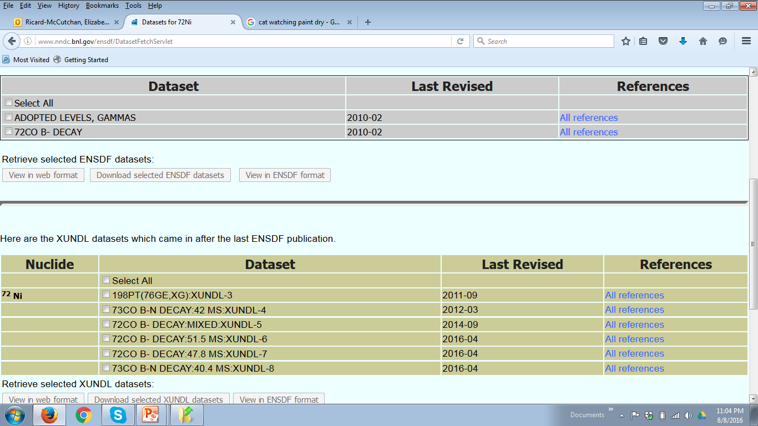
XUNDL
eXperimental Unevaluated Nuclear Data List
Critical compilation of recent nuclear structure publications
Continues to run smoothly
ENSDF Search for ⁷²Ni

Slide 3
XUNDL statistics
Compiled 710 datasets from 310 papers
(FY16 was 550 datasets from 289 papers)
Center | Papers | Datasets
McMaster | 137.5 | 275
TUNL | 38 | 60
ORNL | 11.5 | 15
MSU | 60 | 130
LBNL | 18 | 34
BNL | 31 | 67
ANL | 13 | 115
International* | 5 | 14
300 papers per year is reasonable estimate for effort assessment
Full database is 7605 datasets for 2542 nuclides
* Most of international contributions from Trieste WS split 50/50 with McMaster

Slide 4
XUNDL Productivity
Most contribute 0.1 -0.2 FTE, so 0.1 FTE is convenient unit
Compiler | Papers /0.1 FTE | Datasets/0.1 FTE
 | 68 | 138
 | 40 | 87
 | 38 | 60
 | 31 | 61
 | 23 | 43
 | 20 | 115
 | 11.5 | 15
Presented last year at NDAC
Still a wide range of productivity
Given ENSDF metrics, it may be wise to restructure

Slide 5
XUNDL Developments
G. Gurdal no longer under contract
Despite many attempts, contract for C. Chiara did not materialize
Please be more receptive to compiling for XUNDL in your mass region
Potentially some progress with PRC

Slide 6
ENSDF
Evaluated Nuclear Structure Data File
3,325 nuclides
18782 datasets

Slide 7
ENSDF statistics
Evaluated 237 nuclides, 11 mass chains
(FY15 was 220 nuclides, 12 mass chains)
Center | Nuclides | Adopted Levels | Mass Chains* | Reviews**
ANL | 60 | 125 | 0 | 1
BNL | 13 | 255 | 1 | 5
LBNL | 15 | 1043 | 1 | 1
McMaster | 104 | 595 | 5 | 0
MSU | 22 | 1456 | 2 | 1
ORNL | 0 | 0 | 0 | 2
TAMU | 0 | 0 | 0 | 0
TUNL | 9 | 42 | - | 0
CIAE | 14 | 667 | 1 | 0
*Trieste mass chain included as individual nuclides
** One additional review by E. Browne while under NNDC contract

Slide 8
ENSDF Productivity
Average contribution to ENDSF evaluations is 0.5 FTE
Evaluator | Nuclides /0.5 FTE | Adopted Levels/0.5 FTE
 | 130 | 745
 | 75 | 156
 | 22 | 425
 | 20 | 1325
 | 11 | 53
 | 9 | 740
 | 0 | 0
 | 0 | 0
Presented last year at NDAC
Still a wide range of productivity
Reiterate statement from USNDP 2016
Per 0.5 FTE, 1 “medium” sized mass chain (or ~15 nuclides and 1,000 levels is feasible)

Slide 9
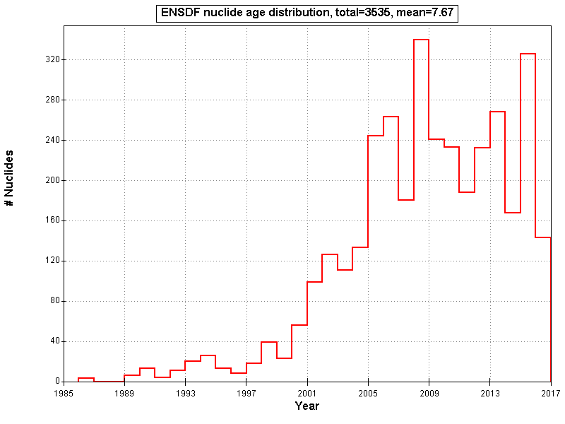
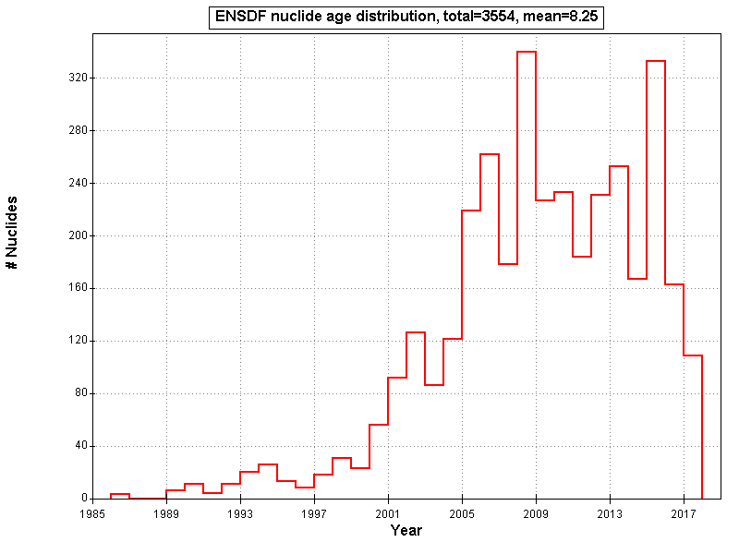
ENSDF Looking Forward
Yesterday
Average 8.3 years
December 2016
Average 7.7 years

Slide 10
ENSDF Major Development
JAVA-NDS is a success !!!
We have received only overwhelming positive comments
Owe a tremendous thank you to
Balraj for his vision and persistence
Jun for making this a reality

Slide 11
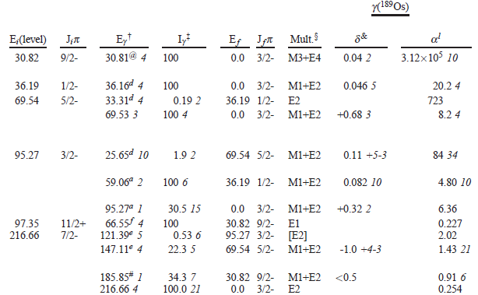
PDF’s using JAVA-NDS
NDS starting publishing in this format Feb 2017
Web followed in March 2017
Discussion on Thursday on additional changes

Slide 12
A new submission checklist
Per request, we have generated a submission checklist
Please ensure evaluation conforms to all points
Those that do not will be returned prior to sending for review
Some things to keep in mind
This is not an exhaustive list of everything that should be checked in an evaluation
Simple enough that NNDC can check compliance in short time
Requires elements which are necessary to the review process
Hopefully will then allow the review process to focus on physics, data selection, justifications, etc

Slide 13
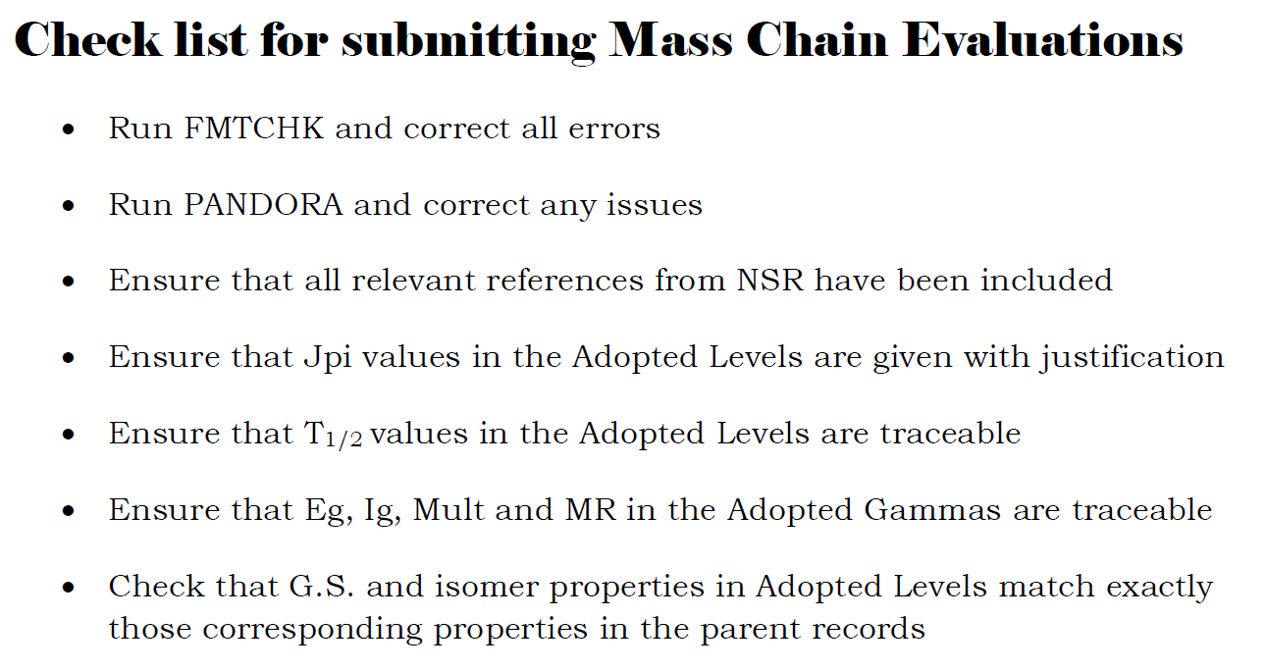

Slide 14
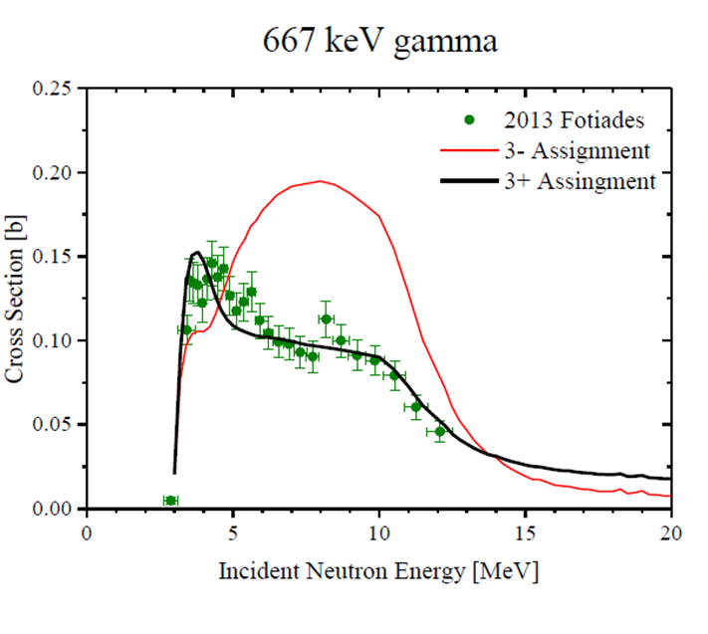
ENSDF Supplemental
Folder in NNDC Dropbox account
Updated with new supplemental information
You should have received link, if not contact me

Slide 15
Things don’t always work
Depending on mass region, evaluation is not good enough and we would appreciate if there is some way to post feedback.

Slide 16
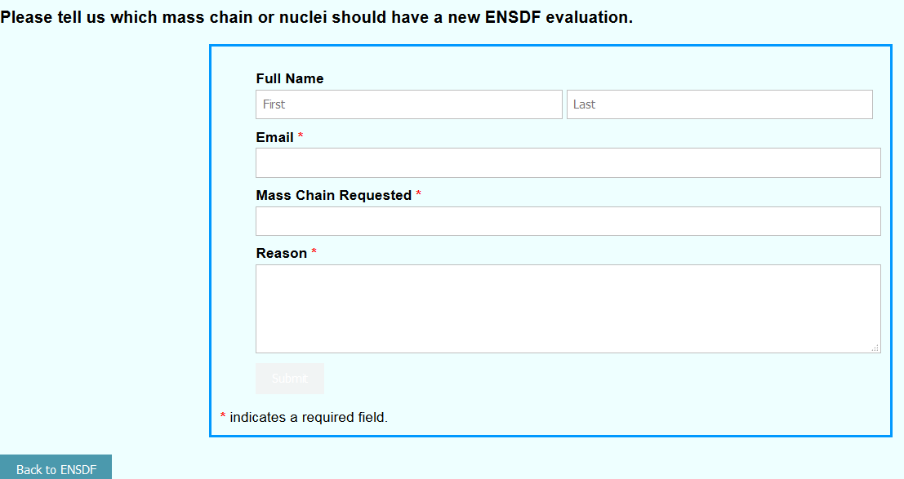
Community input to evaluation schedule

Slide 17
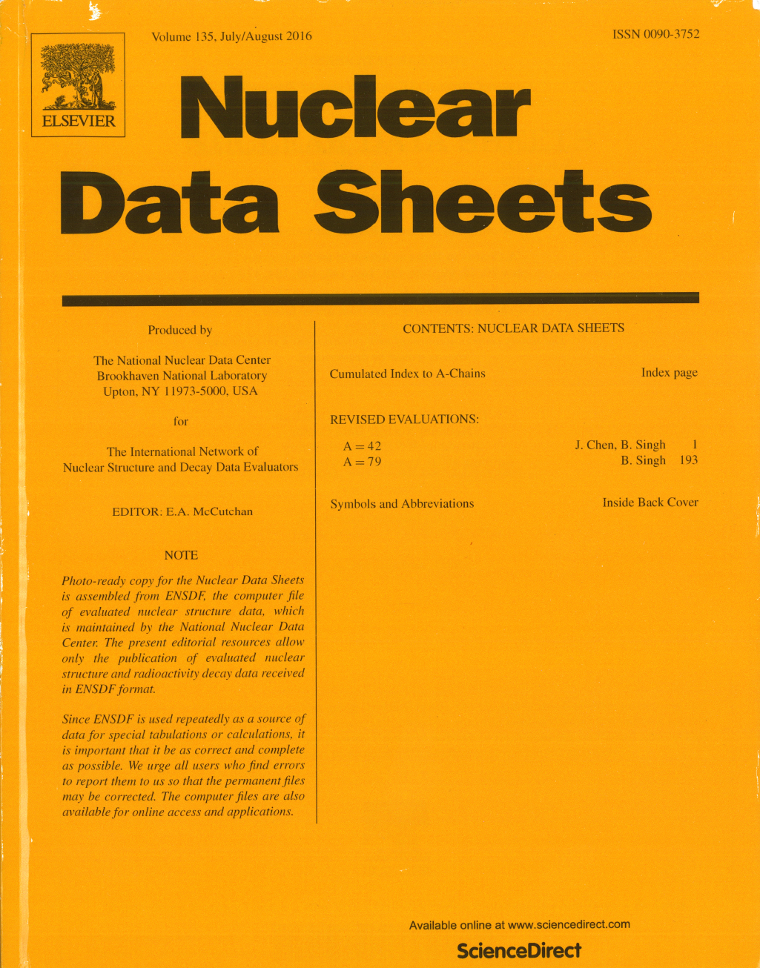
Nuclear Data Sheets Journal
In FY2017:
Published 8 issues
11 mass chain evaluations
1 issue devoted to nuclear reactions
This is down from 16 mass chains in 2016 !!!
Times during year with zero backlog

Slide 18
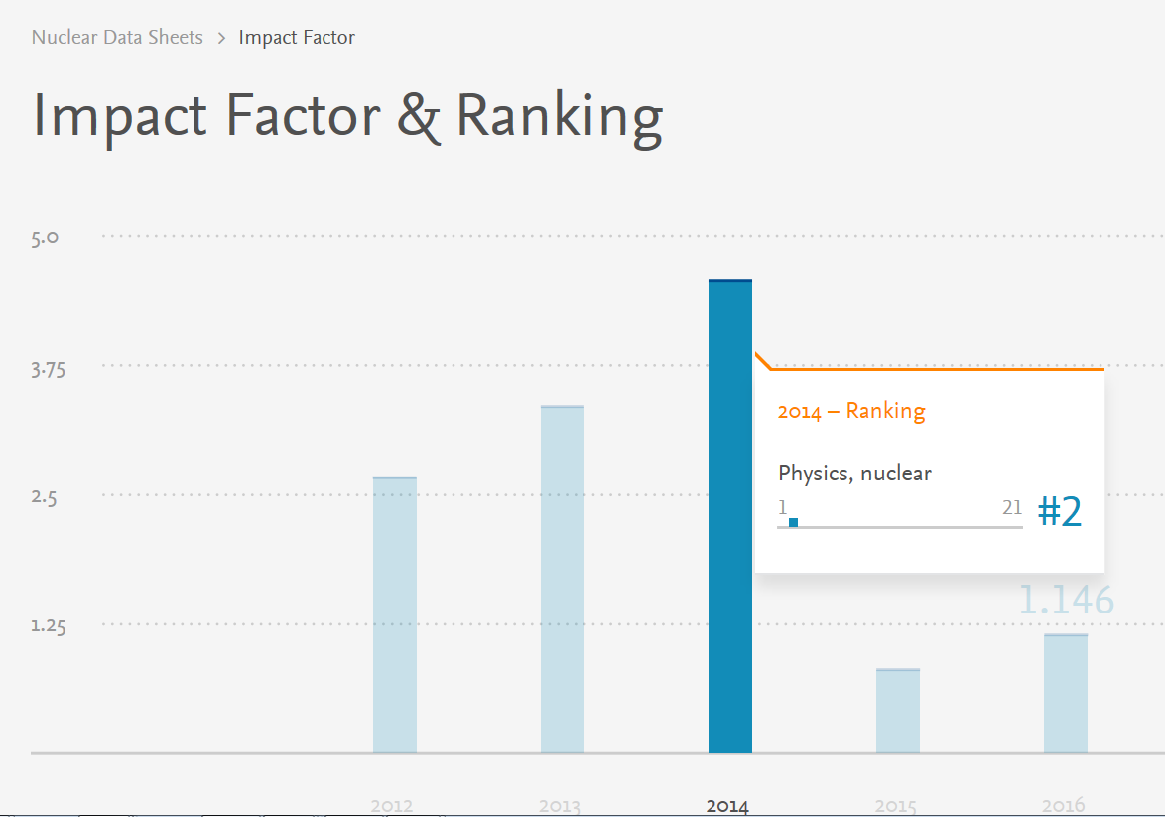
Nuclear Data Sheets Journal
Journal is important … not only for us but as a resource to the community
Elsevier visited last week
Recognize the value of NDS
Offered assistance in a few areas

Slide 19
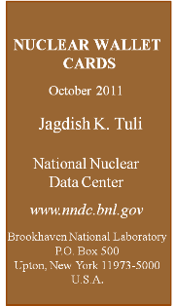
Wallet Cards
Approaching 6+ years old
Revision is clearly necessary
App or printed or both?
Following last weeks DNP meeting, we learned that printed is still desirable
Perform update of Wallet Cards (with changes)
ENSDF will be kept in-sync with Wallet Cards
Maintain on a 2 year schedule … relying heavily on XUNDL

Slide 20
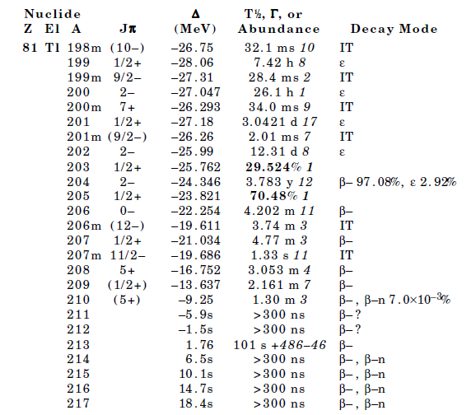
Wallet Card Changes
Some modifications clear…
others will require input from community
Systematic Values for T_{1/2} and %B-n
Uncertainties on all measured quantities
Additional quantities, like Q(decay) ??

Slide 21
Wallet Cards: A path forward
No need to re-invent the wheel
ENSDF cross referenced with XUNDL
T1/2 and Pn evaluation led by Balraj
T1/2 evaluation of light nuclei by John
Additions will require change of format
Plan to keep sync with ENSDF
Update every two years … with article in NDS detailing major changes

Slide 22
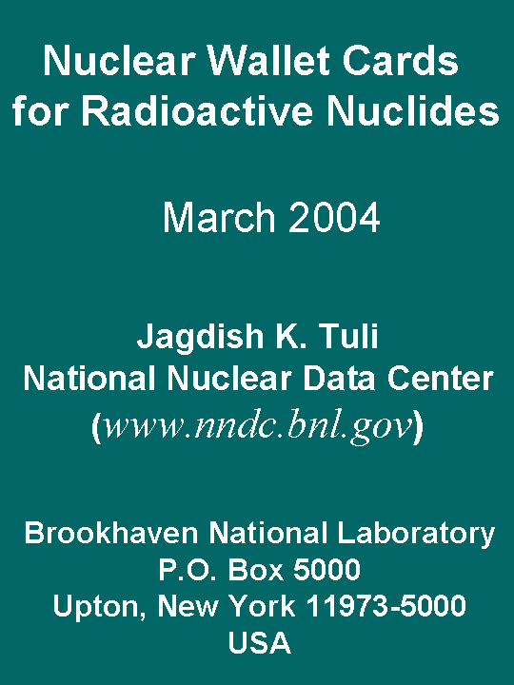
Revive the Table of Long-Lived Nuclides
Decay is one of most highly used components of ENSDF
Revisit and expand on Wallet cards for Radioactive Nuclides
Separate or Combined with Wallet Cards?
Corresponding NDS article?

Slide 23
Summary and Outlook
JAVA-NDS is a success
Community welcomes and appreciates changes
XUNDL operating smoothly
Opportunity to coordinate with PRC
All indicators point to declining ENSDF productivity

