Slide 1
Unrecognized systematic uncertainties
R. Capote*, V.G. Pronyaev, G. Hale, A.D. Carlson, A. Trkov
*Nuclear Data Section
International Atomic Energy Agency
Department for Nuclear Sciences and Applications
CSWEG 2017, BNL, Upton, NY, November 6-9 2017

Slide 2
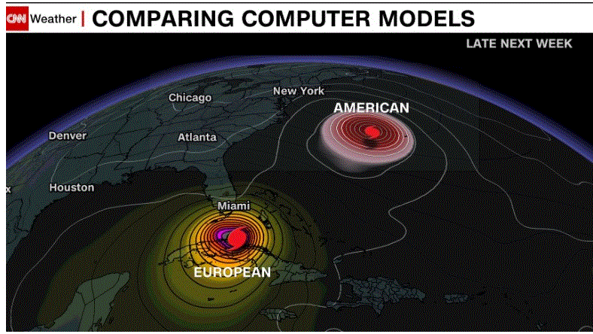
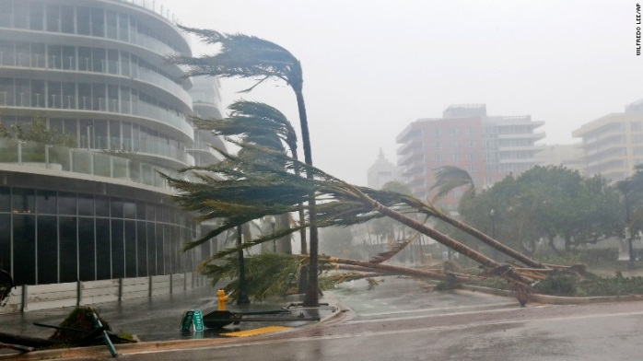
UQ impact: 6 mill. people evacuated
: IRMA
10/09/17
05/09/17

Slide 3
D. Rumsfeld stated:
“Reports that say that something hasn't happened are always interesting to me, because as we know, there are known knowns; there are things we know we know. We also know there are known unknowns; that is to say we know there are some things we do not know. But there are also unknown unknowns – the ones we don't know we don't know…, it is the latter category that tend to be the difficult ones.”
Why we got small uncertainties in previous standards?
unknown unknowns ?
Can we estimate unknown unknowns?
A new category? unknown knowns = USU

Slide 4
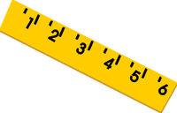
Unknown knowns: estimating the unrecognized systematic uncertainty?
Ruler uncertainties:
Type B uncertainty ~ 0.25-0.3
Independent of the number of measurements !!
Depends only on the measuring tool !
Can we estimate the 0.25 if we do not know it?
E.V. Gai & S. Badikov (2003-2007): USU
Our measuring TOOL
TOF, fiss.chambers, …
Tool uncertainties:
Partially unknown
syst. uncertainty

Slide 5
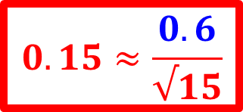
²⁵²Cf(sf) nubar measurements
unrecognized syst. uncertainty (USU) ?
111 | Boldeman | 1977 | 3.7549
116 | Spencer | 1982 | 3.7831
121 | Hopkins | 1963 | 3.7767
125 | Asplund | 1963 | 3.7910
127 | White | 1968 | 3.8194
128 | Axton | 1985 | 3.7547
129 | COLV/AXT | 1966 | 3.7299
130 | COLV/ULL | 1965 | 3.7405
138 | Alek-Rov | 1981 | 3.7618
139 | Smith | 1984 | 3.7678
140 | Edwards | 1982 | 3.7641
141 | Boz-nesh | 1977 | 3.7475
142 | DeVolpi | 1972 | 3.7507
143 | Zhang | 1981 | 3.7534
144 | Spiegel | 1981 | 3.7828
N=15
All measurements:
3.765 +/-0.023 (0.6%)
GMA value (GLSQ):
3.764 +/-0.005 (0.13%)
$$0.15≈\frac{0.6}{√15}$$
USU nubar: 0.4% (0.6%)

Slide 6
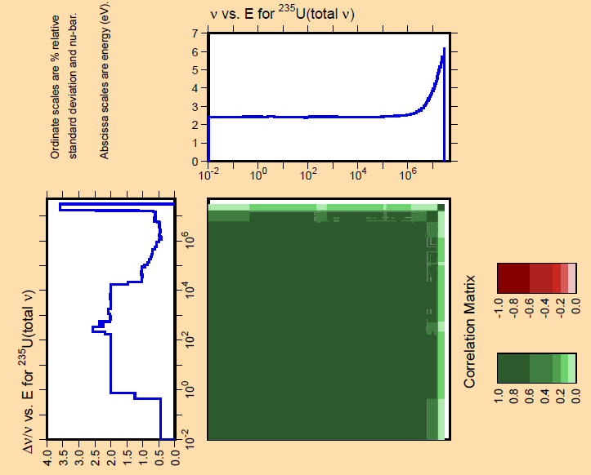
²³⁵U(n,f) nubar : IAEA CIELO covar.
USU:
0.4%
no data
2% fluct.

Slide 7
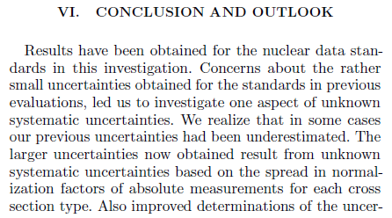
Unrecognized systematic uncertainty: Standards cross sections
¹H(n,n) : 0.34%
⁶Li(n,t) : 0.5 %
¹⁹⁷Au(n,γ) : 1.7 %
²³⁸U(n,γ) : 1.7-2.4 %
²³⁵U(n,f) : 1.2 %
valid for all actinides measured with fiss. chambers
C(n,n) : 0.8%
¹⁰B(n,α) : 0.5 %

