Slide 1
Present Status of B(E2) Project
Boris Pritychenko
National Nuclear Data Center, BNL, Upton, NY 11973
Balraj Singh
Department of Physics & Astronomy, McMaster University, Hamilton, Ontario L8S 4M1, Canada

Slide 2
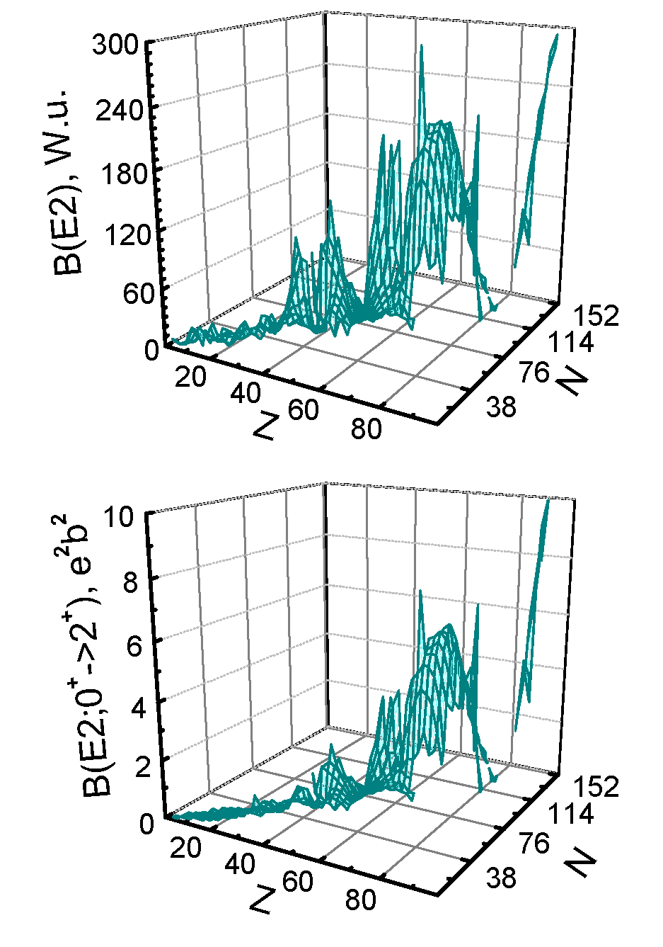
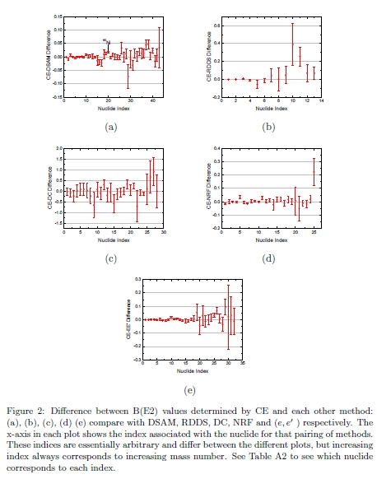
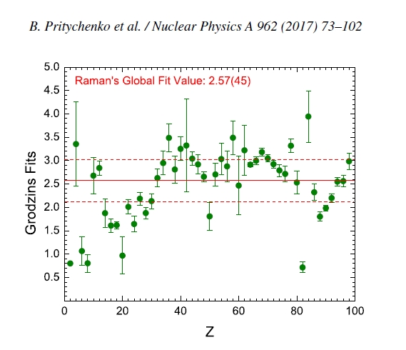
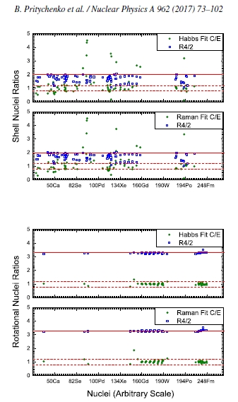
Present Status of B(E2) Project
Collectivities of nuclear states are essential in physics.
In recent years, BNL/McMaster University group is working on a comprehensive review of B(E2) data.
Recent deliverables:
B(E2) Compilation & Evaluation (ADNDT, 2016).
Analysis of experimental nuclear physics techniques (NP, 2016).
Analysis of the Grodzins systematics of B(E2) values (NP, 2017).

Slide 3
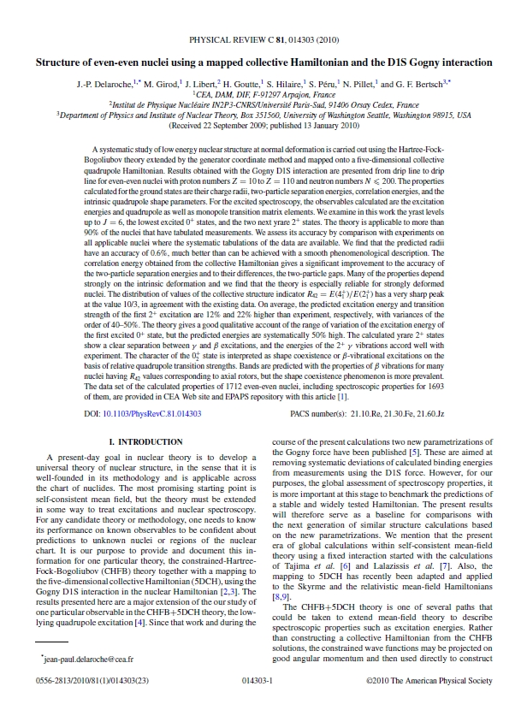
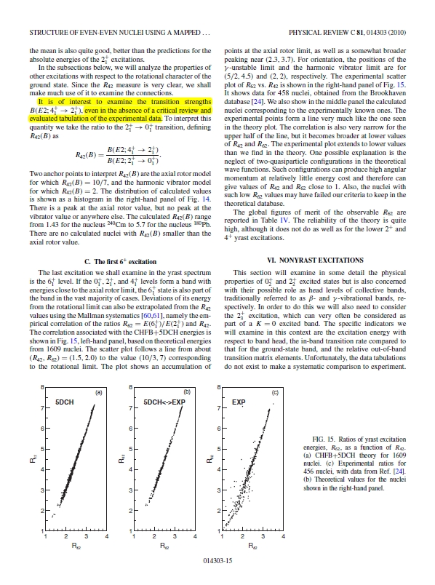
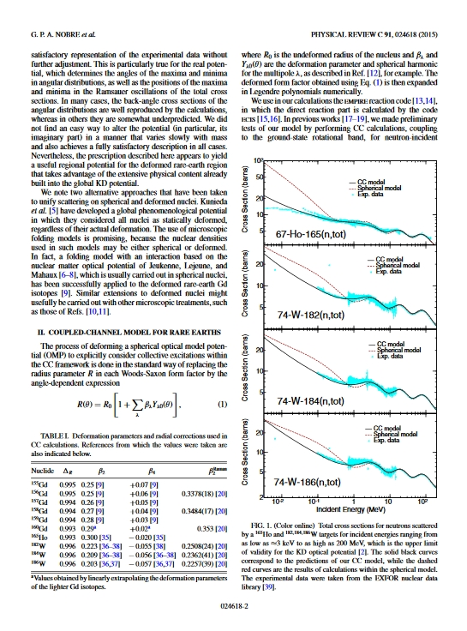
Properties of 4⁺₁ States
Working on Grodzins systematics we realized that one cannot explain situation there without energy ratios (E4⁺₁/E2⁺₁) and nuclear models.
Nuclear theory: J.-P. Delaroche,.., G. F. Bertsch, Phys.Rev. C 81, 014303 (2010). => No critical review of 4⁺ states.
Deformed optical model potential (ENDF library) requires quadrupole (β₂) and hexadecapole (β₄) deformation parameters.
Nuclear theory needs: B(E2;4⁺₁->2⁺₁)/ B(E2; 2⁺₁->0⁺₁), B(E4) and β₄.

Slide 4
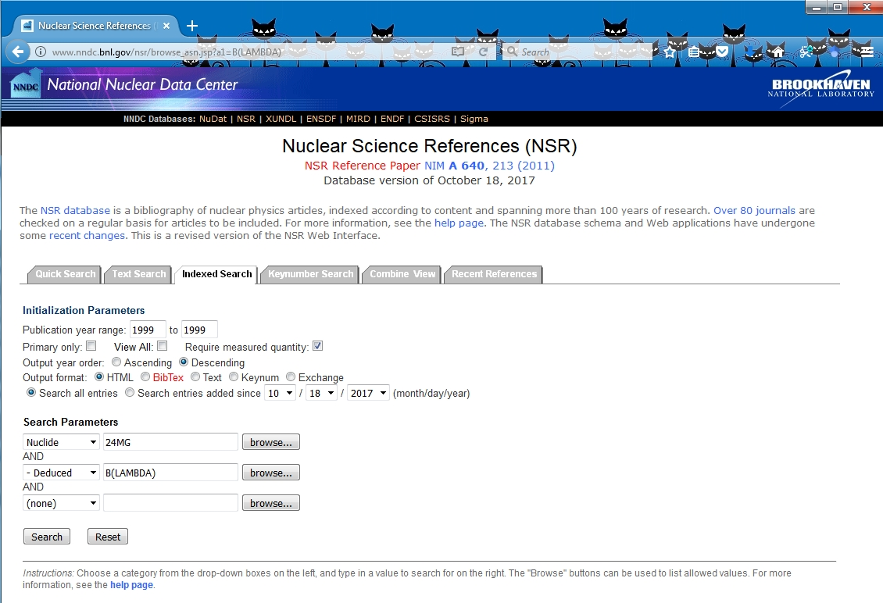
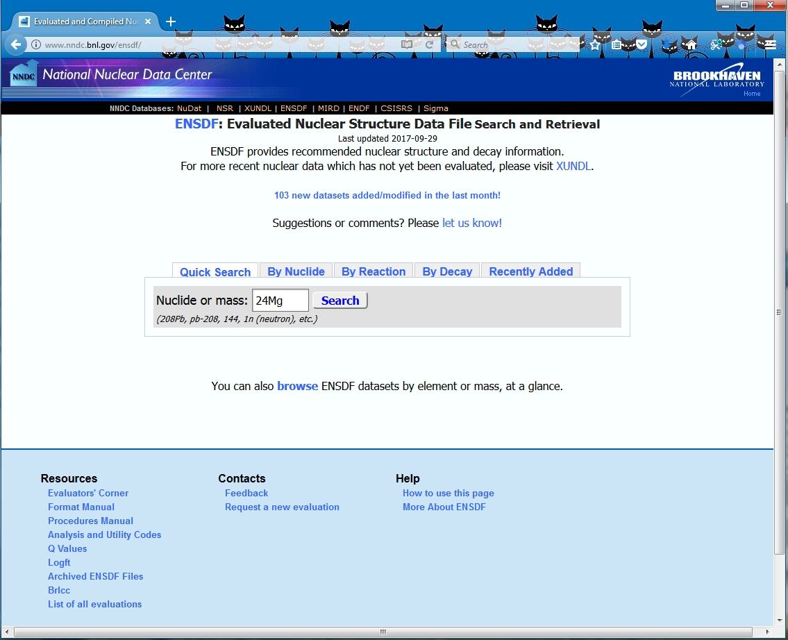
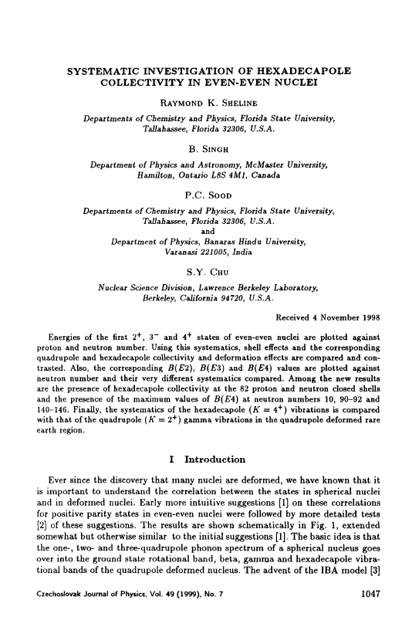
Compilation of Experimental Data
Experimental data have been compiled using NSR database indexed and text searches and contents of original articles.
These results were verified against ENSDF & R.K. Sheline, B. Singh, P.C. Sood, S.Y. Chu, ``Systematic Investigation of Hexadecapole Collectivity in Even-Even Nuclei,” Czech. J. Phys. 49, 1047 (1999).
Results for 1166 4⁺->2⁺ & 544 4⁺->0⁺ transitions have been found in 1077 publications. NSR total is ~226000 references. One year of work.
Current state: Preparation for a critical review and analysis of compiled data.

Slide 5
Complementary ENSDF Findings
ENSDF- Extensive testing of a new PDF version from J. Chen (MSU) :
XREF commas in continuation records create problems for ENSDF PDF version.
missing data sets (The requested URL /ensnds/84/Se/9be_197au_84se_84sePg.pdf was not found on this server.) J. Chen counted 212 potentially missing data sets, he is working with B. Singh on improvements.
Missing 118Te data in PDF version, 128La(EC), 252Cf(SF)??? (the logs with "Problem creating table".)
Missing XREFs in 4+, 154Gd,156Dy.
230Th reference displayed as ``19873be4up4” instead of ``1973Be44”. 232Th, 234U, 238,240,242,244Pu, 244Cm also have this issue.
1982Ow01 instead of 1975Jo07 listed as main reference for 4+ T1/2 in 232Th (Keynumber typo).
The majority of ENSDF users concentrate on adopted and does not check the individual data sets.
Quality assurance for a nice product.
J. Chen was responding in a few hours, and fixing the issues for the next week builds.
ENSDF library
1991WE15: NUCLEAR REACTIONS ¹¹⁰Cd, ^{104,106,108,110}Pd(e, e'), E=70-440 MeV; …. 5 nuclei, 4 mass chains (Only A=110,110Pd in ENSDF).
Five potential ENSDF deficiencies were found, more during the evaluations.
ENSDF for A=16,18 is not very complete from comparison of 1999Sh28 and ENSDF.
ENSDF comments were passed to L. McCutchan for further investigation and fixing.

Slide 6
Complementary NSR Findings
NSR additions: 1985CHZQ Nucl.Struct.Lab., Univ.Notre Dame, Ann.Rep., 1983/85 p.77 (1985) A.Chaudhury, M.W.Drigert, E.G.Funk, J.W.Mihelich, U.Garg, Lifetime Measurements in the Z > 50 Nuclei, NUCLEAR REACTIONS ¹⁰⁶Pd(¹⁶O, 3n), E=75 MeV; ¹⁰⁴Pd(¹⁹F, 3np), E=80 MeV; ¹⁰⁴Pd(¹⁹F, 2np), E=80 MeV; ¹⁰⁶Pd(¹⁶O, 2n), E=75 MeV; ¹⁰⁷Ag(¹⁶O, 2np), E=78 MeV; ¹⁰⁶Pd(¹⁹F, 3np), E=82 MeV; ¹⁰⁶Pd(¹⁹F, 2np), E=82 MeV; ¹¹⁵In(¹¹B, 4n), E=44 MeV; ¹¹⁵In(¹¹B, 3n), E=44 MeV; ¹⁰⁸Pd(¹⁹F, 3np), E=81 MeV; ¹⁰⁶Pd(¹⁹F, 4n), E=82 MeV; ¹⁰⁸Pd(¹⁹F, 4n), E=81 MeV; ¹⁰⁶Pd(¹⁶O, 2np), E=75 MeV; ¹⁰⁴Pd(¹⁹F, 2n2p), E=80 MeV; measured reaction products, Eγ, Iγ. ^{119,120,121,122,123}Xe, ^{121,123}Cs, ¹¹⁹I; deduced γ-ray energies, lifetimes, B(E2). RDDS measurements, comparison with theoretical calculations. Ph.D. thesis that was never published, Notre Dame biannual report was quoted at least twice. Data were recovered using the help of Prof. M. Wiescher.
NSR corrections, for example: 1986DR05 J.Phys.(London) G12, L97 (1986) G.D.Dracoulis, A.E.Stuchbery, A.P.Byrne, A.R.Poletti, S.J.Poletti, J.Gerl, R.A.Bark
Shape Coexistence in Very Neutron-Deficient Pt Isotopes
NUCLEAR STRUCTURE ^{176,178,182,184,186,188}Pt; analyzed data; deduced shape coexistence evidence.
NUCLEAR REACTIONS ¹⁴⁴Sm(³⁵Cl, 2np), (³⁷Cl, 2np), E not given; calculated γγ-, γ(X-ray)-coin. ^{176,178}Pt
deduced levels, J, π, yrast band structure, shape coexistence.
doi: 10.1088/0305-4616/12/3/005
Energies: 173, 170 MeV; T1/2 (lifetimes), B(E2); measured not calculated!!!
NSR was updated.
PDF library additions (1,217 files were added)

Slide 7
Present State of the ββ-decay Data
There is a very strong interest in ββ decay worldwide.
``It took time for us to understand that measuring nothing can be as important as measuring something.” D. Kovar, DNP meeting, East Lansing, MI (2011).
~1 ton scale Majorana experiment in USA, ⁷⁶Ge ββ(0ν) is currently under development; see DNP 2017 presentations.
NNDC ββ−decay compilations in FY 2017: 9 nuclides, 16 transitions.
It will be nice to combine the current effort and the KINR (Kyiv, Ukraine) compilation and produce a first comprehensive data review that would include compiled and evaluated values.
Theory connection: Nuclear matrix elements require effective Hamiltonian that depends on nuclear structure parameters ( …, B(E2), E(2⁺), …).

Slide 8
Conclusions
B(E2; 4⁺₁->2⁺₁), B(E4) & β₄ data compilation and evaluation project is in a good shape.
It will make an impact in nuclear structure and reaction fields.
Compilation of experimental results is completed.
Critical review and analysis in preparation; Work on the development of evaluation strategies.
Large number of complementary findings relevant to NSR & ENSDF projects already made an impact.
ββ-decay effort is very important.
Nuclear collectivities are needed for ββ-decay for nuclear matrix elements; both projects are complementary.

