Slide 1
Evaluations of ⁸⁶Kr and ¹⁸¹Ta
Amanda Lewis
November 08, 2017
Nuclear Data Week 2017 - CSWEG

Slide 2
This presentation shows some work from two recent evaluation projects
Summer 2016 – worked on the evaluation of ⁸⁶Kr at the NNDC with Dave Brown, using EMPIRE
Summer 2017 – worked on the evaluation of ¹⁸¹Ta at the Naval Nuclear Laboratory with Devin Barry, also using EMPIRE
November 08, 2017 | Nuclear Data Week 2017
1

Slide 3
EMPIRE calculates compound capture, but not direct or semi-direct capture
Direct capture – one step gamma transition from the scattering state to the bound state
Semi-direct capture – two step transition of exciting the GDR and a gamma transition to the bound state
The reaction code CoH was used for the direct and semi-direct components
  Semi-direct parameters V₁ and W₁ in the particle-vibration coupling function were taken from work on ²⁰⁸Pb and ²³⁸U
T. Wantabe, L. Bonneau, T. Kawano, “Direct and Semidirect Radiative Capture of Nucleons with Hartree-Fock BCS Theory”, 11th International Conference on Nuclear Reaction Mechanisms (2006)
November 08, 2017 | Nuclear Data Week 2017
2
Notes:
208Pb and 238U are even-even, which 181Ta is not, so ideally data points would be taken across the energy region where semi-direct is opening to ensure that the fit is good
V1 = 75 MeV, W = 140 MeV

Slide 4
Direct and semi-direct capture were calculated separately and added to compound capture cross section
⁸⁶Kr capture
November 08, 2017 | Nuclear Data Week 2017
3
Notes:
Empire does not calculate direct or semi-direct capture processes
They can be insignificant in some cases, but here, were not
The compound capture clearly can’t reproduce the shape of the cross section
All different level density and gamma strength functions were tried by Meghan , none helped
So instead, we tried calculating the direct and semi-direct cross sections using CoH

Slide 5
Direct and semi-direct capture were calculated separately and added to compound capture cross section
⁸⁶Kr capture
November 08, 2017 | Nuclear Data Week 2017
3

Slide 6
Direct and semi-direct capture were calculated separately and added to compound capture cross section
¹⁸¹Ta capture
November 08, 2017 | Nuclear Data Week 2017
4
Notes:
So then this past summer, when the empire calculation of the capture was also the wrong shape, we suspected that direct/semi-direct might be the issue.
So calculated again using CoH

Slide 7
Direct and semi-direct capture were calculated separately and added to compound capture cross section
¹⁸¹Ta capture
November 08, 2017 | Nuclear Data Week 2017
4
Notes:
And again, matched the experimental data.
These are both relatively small channels, but this is a very quick and easy method to improve the fit.

Slide 8
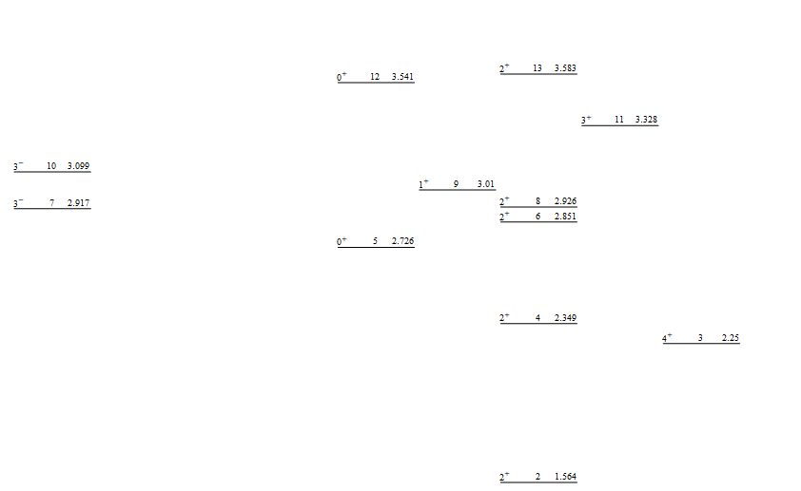
Inelastic scattering partial gamma cross sections were used to help pin down level assignments
⁸⁶Kr partial level scheme
November 08, 2017 | Nuclear Data Week 2017
5

Slide 9
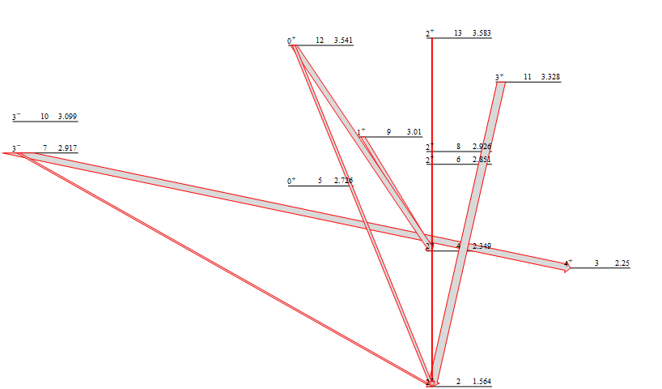
Inelastic scattering partial gamma cross sections were used to help pin down level assignments
⁸⁶Kr partial level scheme
November 08, 2017 | Nuclear Data Week 2017
5

Slide 10
For the excited state at 3585 keV, there was no experimental data to use to make an assignment
ENSDF assignment was (0⁺:4⁺)
RIPL file had 2⁺
4⁺ fit the data
2019 keV gamma
November 08, 2017 | Nuclear Data Week 2017
6

Slide 11
For the excited state at 3328 keV, experimental data suggested either 4⁺ or (≤3)⁺ assignments
ENSDF assignment was (3, 4)⁺
RIPL had 3⁺
4⁺ fit the data
This opened up a new M1 transition of comparable strength
1763 keV gamma
November 08, 2017 | Nuclear Data Week 2017
7
Notes:
proton inelastic scattering suggested 4+
(t,a) on 87Rb suggested (<=3)+
Measured 1763 gamma became E2 to 1st excited state
Opened new M1 to 4+ state (2nd excited state)

Slide 12
For the excited state at 2916 keV, the 1972 Table of Isotopes assigned 3⁻
667 keV gamma
The 2013 Fotiades data was referenced in the evaluation as suggesting (3,4)⁺
ENSDF assignment was (3⁻)
RIPL had 3⁻
3⁺ fit the data
1353 keV gamma
November 08, 2017 | Nuclear Data Week 2017
8

Slide 13
These cross sections suggested changes to five of the level assignments
⁸⁶Kr partial level scheme
November 08, 2017 | Nuclear Data Week 2017
9

Slide 14
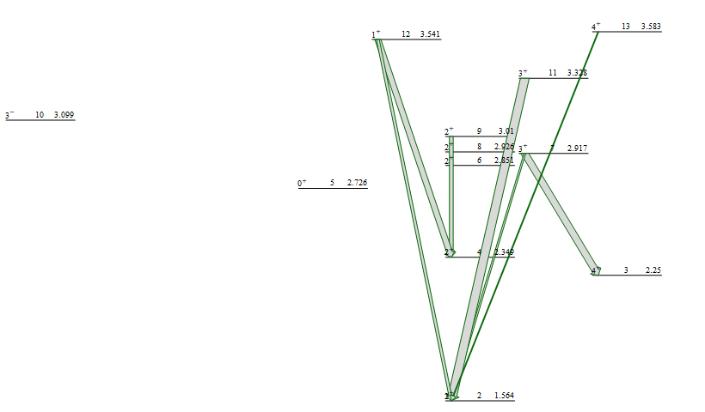
These cross sections suggested changes to five of the level assignments
⁸⁶Kr partial level scheme
November 08, 2017 | Nuclear Data Week 2017
9

Slide 15
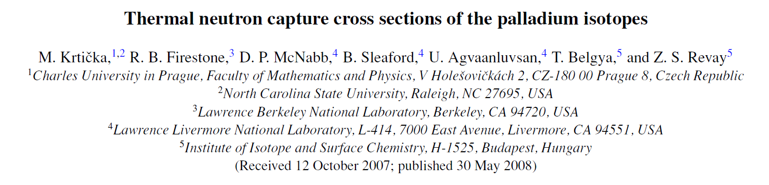
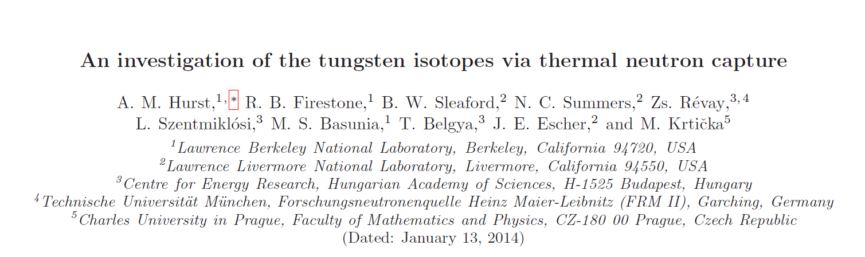
These cross sections suggested changes to five of the level assignments
⁸⁶Kr partial level scheme
Similar work has been done using thermal capture gamma cross sections, modeled with DICEBOX
November 08, 2017 | Nuclear Data Week 2017
9

Slide 16
The ⁸⁶Kr evaluation is finished but will require some work to get into ENDF format
total cross section
November 08, 2017 | Nuclear Data Week 2017
10

Slide 17
The ⁸⁶Kr evaluation is finished but will require some work to get into ENDF format
total cross section
capture cross section
November 08, 2017 | Nuclear Data Week 2017
10
Notes:
Capture had components calculated separately

Slide 18
The ⁸⁶Kr evaluation is finished but will require some work to get into ENDF format
1565 keV (2→1) partial gamma cross section
total cross section
capture cross section
November 08, 2017 | Nuclear Data Week 2017
10
Notes:
Inelastic was determined by partial gammas

Slide 19
The ⁸⁶Kr evaluation is finished but will require some work to get into ENDF format
1565 keV (2→1) partial gamma cross section
total cross section
capture cross section
(n,2n) isomer cross section
November 08, 2017 | Nuclear Data Week 2017
10
Notes:
Isomeric cross section was important

Slide 20
The ¹⁸¹Ta evaluation still needs work on some of the charged particle production cross sections
total cross section
November 08, 2017 | Nuclear Data Week 2017
11

Slide 21
The ¹⁸¹Ta evaluation still needs work on some of the charged particle production cross sections
total cross section
capture cross section
November 08, 2017 | Nuclear Data Week 2017
11
Notes:
The capture has been well fit with the addition of direct and semi-direct

Slide 22
The ¹⁸¹Ta evaluation still needs work on some of the charged particle production cross sections
total cross section
(n,p) cross section
capture cross section
(n,t) cross section
November 08, 2017 | Nuclear Data Week 2017
11
Notes:
However some of the channels aren’t well fit at higher energies
The (n,t) and (n,p) calculations are too high at this energy

Slide 23
Acknowledgements
This project was supported in part by the U.S. Department of Energy, Office of Science, Office of Workforce Development for Teachers and Scientists (WDTS) under the Science Undergraduate Laboratory Internships Program (SULI). This research was performed under appointment to the Rickover Fellowship Program in Nuclear Engineering sponsored by Naval Reactors Division of the U.S. Department of Energy.
And thanks to: D.Brown, D.Barry, G.Nobre
November 08, 2017 | Nuclear Data Week 2017
12

