Slide 1
Current status of the EXFOR project
Boris Pritychenko
National Nuclear Data Center, BNL, Upton, NY 11973

Slide 2
EXFOR Effort in the U.S. and Canada
EXFOR Team: B. Pritychenko, S. Hlavac, O. Schwerer and V. Zerkin (IAEA).
NNDC: Overall database and contracts management, website support, compilation and correction of missing and older references.
Bratislava: New references compilation.
Vienna: Overall quality assurance and transmission handling.
IAEA: Web and database development.
Smooth operation based on efforts of BNL stuff, contractors and collaborators.
Contractors (S. Hlavac and O. Schwerer) are essential for the overall success of the NNDC EXFOR effort.

Slide 3
X4 Statistics
New entries: 46 + 52 (BNL) = 98
Corrected entries: 45 + 50 (BNL) = 95
Large numbers of charged particle and photonuclear experiments are still missing in EXFOR, many existing compilations are incomplete.
Web retrievals using the IAEA system of counting:
EXFOR: 37,753
ENDF: 96,844
CINDA: 1,522
More compilation details in the IAEA system based on calendar years: http://www-nds.iaea.org/exfor-master/x4compil/

Slide 4
X4 Highlights
Smooth EXFOR operation between NNDC staff and contractors.
Large data sets from K. Guber’s measurements (14324, Cr data are crucial for ENDF/B-VIII release) have been compiled and submitted to the database, finally, have been accepted as thin target approximation cross sections not reaction yields or raw data.
It is very important to code nuclear reaction strings in the way that users will understand.
EXFOR Web application was upgraded in collaboration with the IAEA.
Database was updated 11 times in FY2017. We followed the IAEA releases.

Slide 5
EXFOR Reaction Strings
(SF1(SF2,SF3)SF4,SF5,SF6,SF7,SF8,SF9)
(24-CR-53(N,G)24-CR-54,,SIG,,TTA) ORNL data were coded as Thin Target Approximation (SF8=TTA) cross sections.
(26-FE-0(N,EL)26-FE-0,,DA,,SPA)
Proper reaction string coding. Wrongly added SF8=SPA (spectrum average) forced evaluators to ignore the good data for Fe (#20743).
Please always remember about SF5=PAR for partial cross sections in EXFOR. SF5 is blank for total cross sections.
Finally, please read the papers if you are confused.

Slide 6
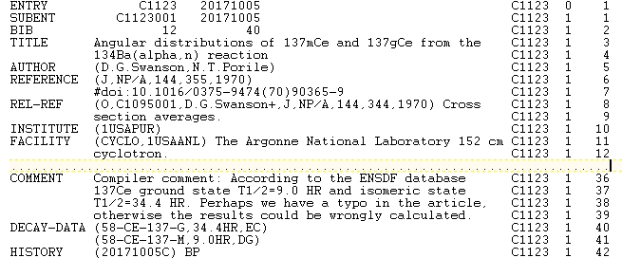
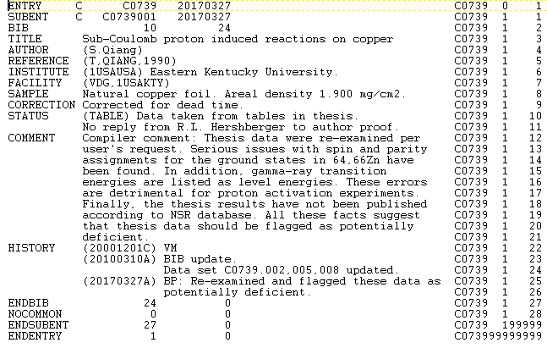
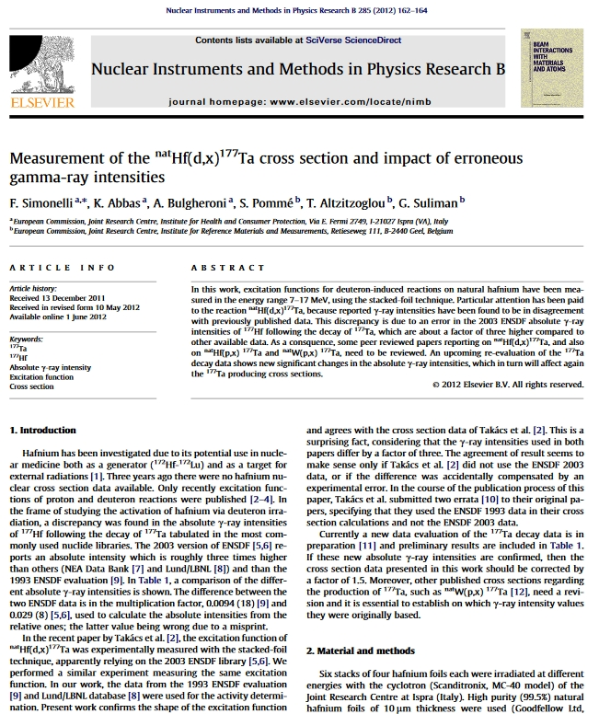
Activation Cross Sections Issues
I got an Email from data users about potentially deficient activation cross sections (thesis,C0739): ^{64,66}Zn ground states are not 1⁺, …
Correct ground and isomeric state half-lives are crucial in activation experiments (C1123 decay data contradicts ENSDF).
Erroneous ENSDF entry was behind the problematic ¹⁷⁷Ta cross sections.
Wrong nuclear structure & decay information is a key factor behind the bad activation cross sections.
Please double check DECAY-DATA in EXFOR compilations, consult with ENSDF/XUNDL databases and the current literature values.

Slide 7
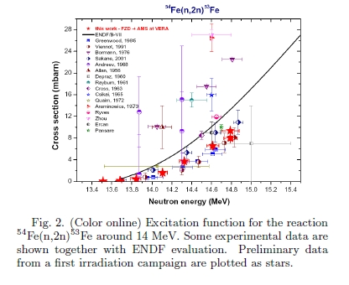
EXFOR Compilation Rules
Sometimes researchers and data users interests collide.
Researcher told EXFOR compilers that his article was published in a conference proceedings and compiled in EXFOR without his approval. Six years later it was rejected by PRC because it was already in EXFOR.
NRDC secretary has suggested to introduce 5 years moratorium on conference proceedings to avoid such cases.
Unintended impact: evaluators were working on ⁵⁶Fe evaluation and missed a ND2010 paper of A. Wallner et al. in EXFOR.
Do we have to abolish 5 year moratorium on published conference data???

Slide 8
Conclusions & Outlook
NNDC EXFOR compilation effort is complex and well-organized.
We address compilation of current articles, correct previous entries and add missing articles.
Direct contacts with the authors for new article compilations is a requirement.
EXFOR contractors are essential for the current operation.
We continue to use modern computer tools and technologies in EXFOR compilation process.
It is a team effort that is conducted in close cooperation with the IAEA.

Slide 9
Impact of Compilation Work
Release of ENDF/B-VIII library provides an additional attention to EXFOR compilation process.
Compilations of experimental papers are often done once while evaluations are revisited on 5-10 year basis.
EXFOR compilers are working hard, however, we are not perfect.
EXFOR database still has many issues due to scope change, lack of advanced computer technologies in the past, sloppiness and desire to exceed the performance expectations by some compilers.
CSEWG should pay attention to the original publications and EXFOR data.

