Slide 1
Nuclear Data Group
Lawrence Berkeley National Laboratory
Status Report: Oct 2016 – Sept 2017
M. Shamsuzzoha Basunia
USNDP meeting, BNL, Oct 31-Nov 2, 2017

Slide 2
FY 2017 Staff
LBL+UCB
Total FTE: 1.75 + 2.23 = 3.98
LBNL
L. A. Bernstein – 0.75 FTE (ND experiment, Coordination)
M. S. Basunia – 1 FTE (ENSDF, XUNDL, ND experiment)
UCB
J. C. Batchelder – 0.75 (ENSDF, ND Experiment)
A. M. Hurst – 0.60 FTE (EGAF, ENSDF)
R. B. Firestone – 0.47 (γ strength function, EGAF)
E. Browne – 0.25 FTE (ENSDF) (since January, 2017)
J. K. Tuli – 0.16 FTE (ENSDF) (since June, 2017 at 0.475 FTE level)

Slide 3
ENSDF
ENSDF
    Responsibility: 33 mass chains - 21-30, 81, 83, 90-93, 166-171, 184, 186, 187, 191-193, 210-214
Status (Partial):
Mass chain | cut-off date | xundl datasets | Age
 |  | 5/15/2017 | (year)
23 | 1-Feb-06 | 36 | 11.28
24 | 3-Oct-06 | 32 | 10.61
186 | 4-Apr-03 | 28 | 14.11
30 | 30-Jun-10 | 27 | 6.87
171 | 5-Aug-02 | 26 | 14.78
USNDP meeting, BNL, Oct 31-Nov 2, 2017

Slide 4
Evaluations/Compilations
  ENSDF
    Submitted A = 59 (12 nuclides) - Basunia
    Nuclides: ²³O, ¹⁶⁷Re, and ¹⁹⁶Os - Basunia
    In Progress:
      A = 186 - Batchelder and Hurst
      A = 82 – Browne and Tuli
      A = 23 - Basunia and Chakraborty (India)
    NSD production line activities:
      A = 193 (pub) – Basunia
      A = 99 (pub) - Browne and Tuli
      A = 170 – Baglin - Browne addressed reviewer’s comments
      A = 174 – (Dy, Ho, Er, Tm after review) - Browne, Kibedi, and Tuli
  XUNDL
    Compiled 34 datasets from 18 papers - Basunia, Hurst
  Mass chain review:
    1 (Basunia)
USNDP meeting, BNL, Oct 31-Nov 2, 2017

Slide 5
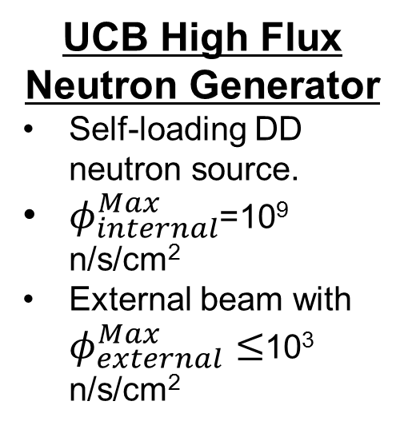
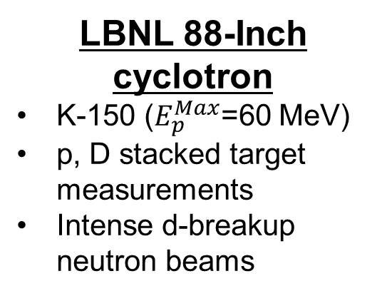
Experimental facilities
LBNL 88-Inch cyclotron
  K-150 ($E_{p}^{Max}$=60 MeV)
  p, D stacked target measurements
  Intense d-breakup neutron beams
UCB High Flux Neutron Generator
  Self-loading DD neutron source.
  $φ_{internal}^{Max}$=10⁹ n/s/cm²
  External beam with $φ_{external}^{Max}≤$10³ n/s/cm²
LANL Isotope Production Facility
  100 MeV proton linac
  Stacked target experiments using state-of-the-art counting facility
  µA to mA currents
Budapest Nuclear Research Reactor
  Guided neutron beam - 1.2×10⁸ n/s/cm²
Our group mentors non-USNDP supported graduate students from Dept. Nucl. Eng.,
UCB to lead targeted cross section measurements. Students also
participate in compilation and dissemination activities.
USNDP meeting, BNL, Oct 31-Nov 2, 2017

Slide 6
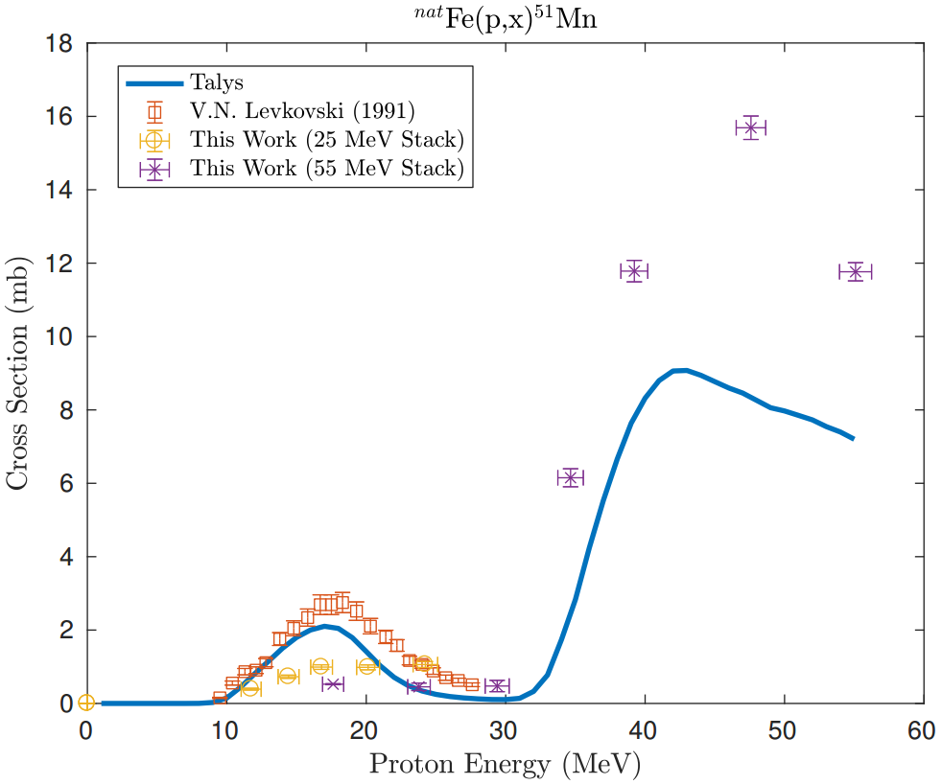
Experiments
  At 88-Inch Cyclotron
  Production cross section measurements for two PET nuclides – Springer (visiting student from Germany) (led by Bernstein)
    ^{nat}Fe(p,x)^{51,52g,52m}Mn
  ¹³⁴Ce production cross section for potential α-therapy nuclide ²²⁵Ac tracking – Morrell (led by Bernstein/Basunia)
    ¹³⁹La(p,6n)¹³⁴Ce
  Cross section evaluation of Y radioactive isotopes for medical applications – Zaneb (vising student from Pakistan) (led by Bernstein/Basunia)
    ^{nat}Zr(d,x)^{86,87,88}Y
USNDP meeting, BNL, Oct 31-Nov 2, 2017

Slide 7
Experiments
At DD neutron generator:
³⁵Cl(n,p) cross section for molten salt reactors - Su-Ann Chong (Led by Batchelder)
First NG measurement publication: (led by Bernstein)
“Measurement of the ⁶⁴Zn, ⁴⁷Ti(n,p)
cross sections using a DD neutron
generator for medical isotope
studies”
Andrew Voyels, et al.
Nuclear Instruments and Methods in
Physics Research B 410 (2017) 230
³⁵Cl(n,p)³⁵S
⁶⁴Zn(n,p)⁶⁴Cu
USNDP meeting, BNL, Oct 31-Nov 2, 2017

Slide 8
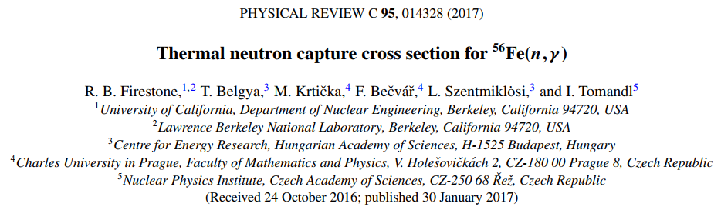
Experiments
A detailed level scheme of 448 γ rays from 97 levels
≈99% of the total transition intensity has been placed
%Iγ (352) = 11.90 ± 0.07 per 100 neutron captures
σ₀ = 2.394 ± 0.019 b
Sn (⁵⁷Fe) = 7646.183 ± 0.018 keV; 7646.07 0.04 (2017Wa10)
USNDP meeting, BNL, Oct 31-Nov 2, 2017

Slide 9
IAEA CRP/Databases
R.B. Firestone
IAEA CRP on Photon Strength Functions
  Berkeley nuclear data group is responsible for providing a systematic study of M1, E1, and E2 photon strengths for this IAEA CRP. Preliminary results were presented at the 2nd RCM, October 16-20, 2017 in Vienna.
  Database of Thermal (EGAF) and Resonance (Literature) primary γ-ray photon strengths. ≈14,000 γ-ray measurements.
  Database of Average Resonance Capture (ARC) photon strengths – ≈2000 ARC measurements
  Database of binned average photon strengths from the thermal and ARC databases - ≈2,500 values
USNDP meeting, BNL, Oct 31-Nov 2, 2017

Slide 10
Systematics of Photon Strength
R.B. Firestone
Average primary γ-ray photon strength increases with decreasing N, Z, and E_{γ}.
The photon strength also increases near the doubly magic ²⁰⁸Pb closed shell.
USNDP meeting, BNL, Oct 31-Nov 2, 2017

Slide 11
Comparison of ⁵⁷Fe data with Oslo (³He,³He’) measurements
R.B. Firestone
Published an extensive measurement of ⁵⁶Fe(n,γ) capture γ-rays* and determined average photon strengths from 0-7.65 MeV for M1, E1, E2, and M2 multipolarities. These photon strengths are corrected for missing transitions using the CT level density model and for missing strength assuming a Porter-Thomas distribution.
The summed photon strength is in good agreement with previous Oslo measurements and confirms the low-energy upbend in photon strength.
This work represents the first complete determination of the multipolarity composition of total photon strength.
*R.B. Firestone et al, Phys. Rev. C 95, 014328 (2017).
USNDP meeting, BNL, Oct 31-Nov 2, 2017

Slide 12
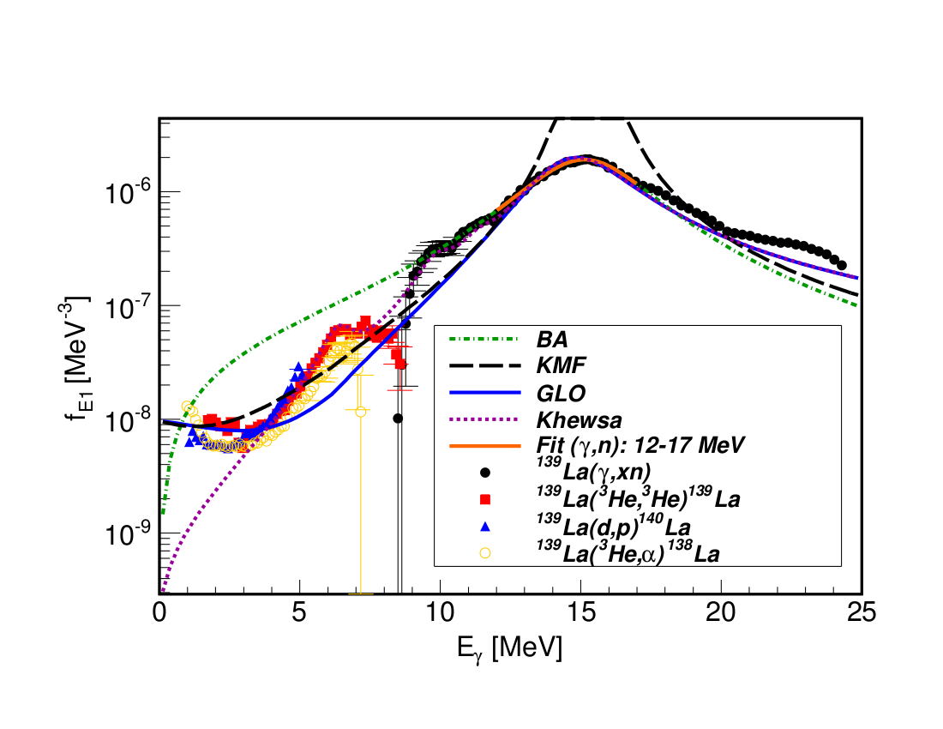
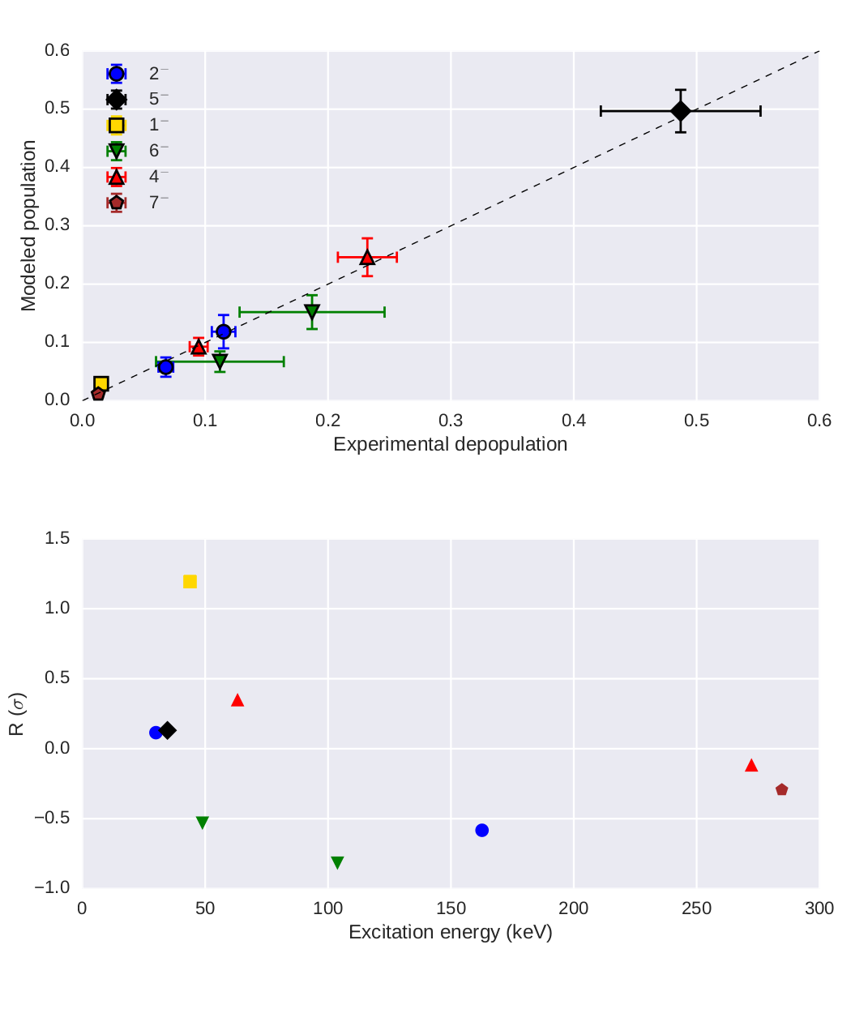
¹³⁹La(n,γ): Radiative neutron capture
A.M. Hurst
Ureche (led by Hurst)
Statistical model: assess role PSF
Dependence upon additional “temperature”
(θ) parametrization + E_{γ} to reproduce observed
γ-ray yields up to Ecrit
Measured σ_{γ} for 356 γ rays: 201 secondary +
155 primary gammas
Total σ₀ = 9.50(79) b (consistent cf. adopted)
Confirmed J^{π} for 10 levels < Ecrit; constrained
J ^{π} for ~100 levels > Ecrit
Independent measurement for S_{n} cf. AME
USNDP meeting, BNL, Oct 31-Nov 2, 2017

Slide 13
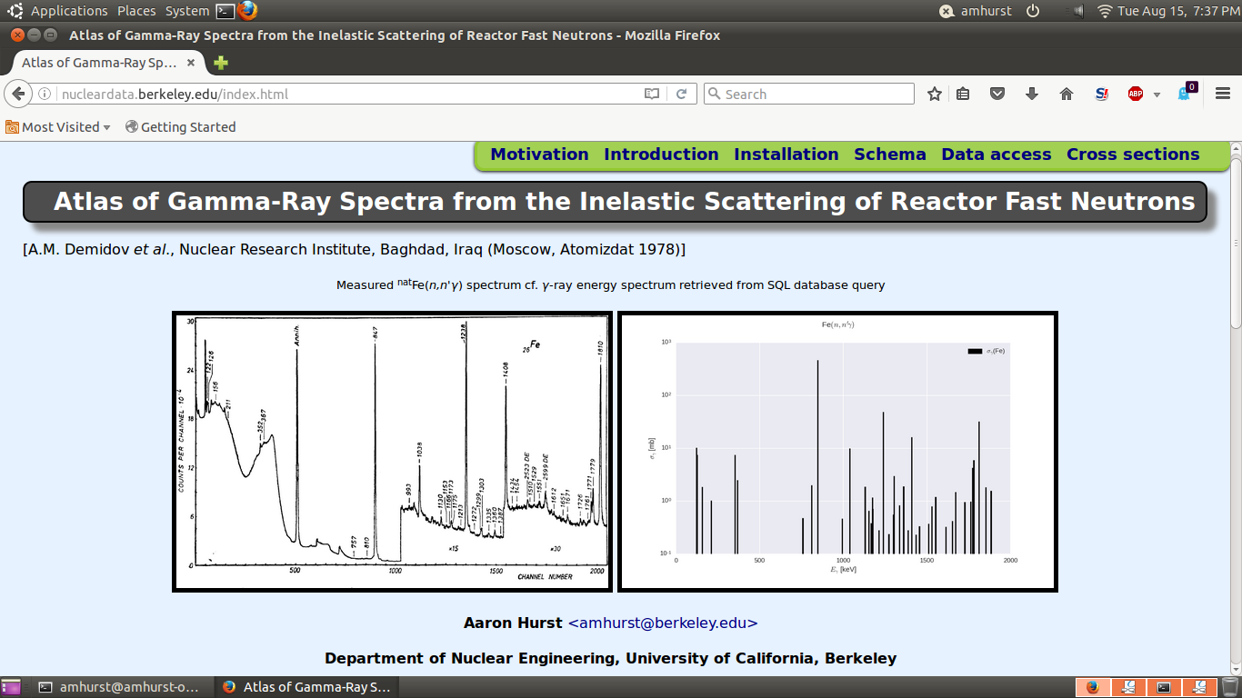
Inelastic neutron-scattering (n,n'γ) data
A.M. Hurst
Berkeley Nuclear Data Group: http://nucleardata.berkeley.edu
105 data sets: ~7000 γ rays from 76 natural + 29 enriched targets acquired on
fast-neutron beam line at the IRT-5000 reactor (Al-Tuwaitha facility, Baghdad, Iraq)
Software platform to build relational database (SQL) downloadable from:
NNDC and NSSC websites; Report Number LBNL-1007529
USNDP meeting, BNL, Oct 31-Nov 2, 2017

Slide 14
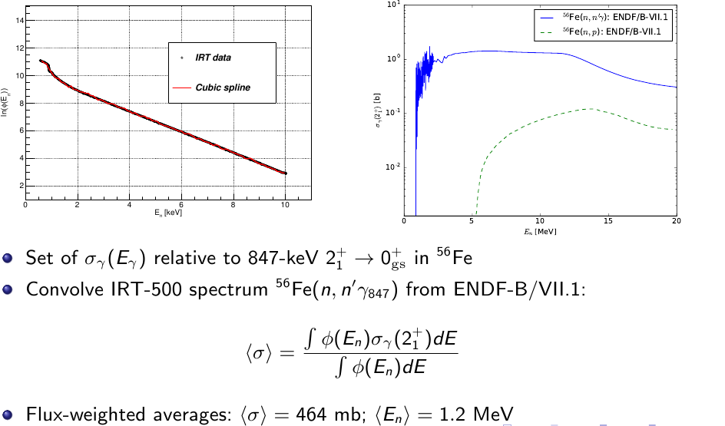
Cross-section normalization: (n,n'γ) data
A.M. Hurst
USNDP meeting, BNL, Oct 31-Nov 2, 2017

Slide 15
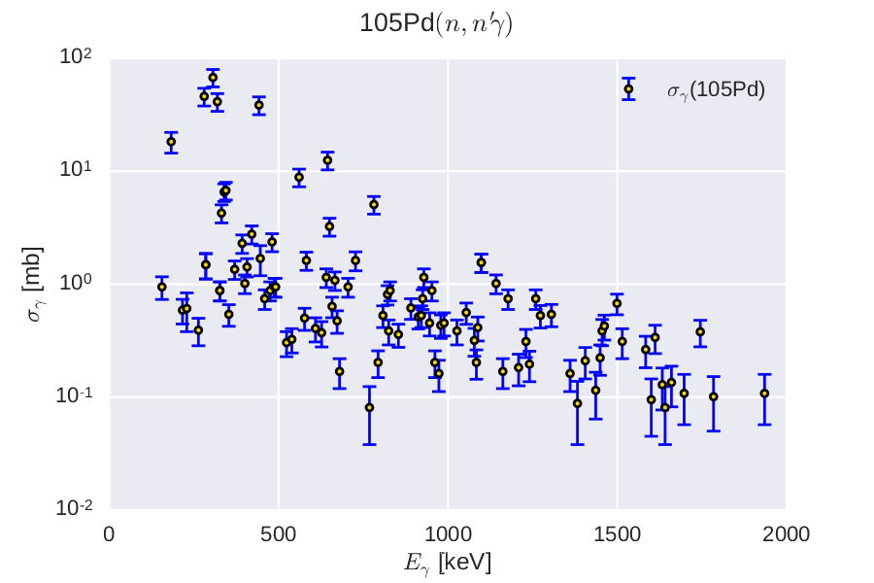
Interacting with the (n,n'γ) database
A.M. Hurst
SQL scripts and a Jupyter Notebook are provided as reference illustrating
methods for data retrieval and analysis:
sqlite3 engine: terminal-based front-end to SQLite libraries.
Evaluate SQL queries interactively or through batch processing.
Automated procedures for generating γ-ray cross-section data
for specified target are provided in Jupyter Notebook, e.g. ¹⁰⁵Pd(n,n'γ)
Andrew Voyles (GS, UCB) generated
cross-section results for all 105 (n,n'γ)
measurements via queries to the Atlas
database
Processed 105 EXFOR compilations
Currently working with
Boris Pritychenko (NNDC) to
validate data sets.
USNDP meeting, BNL, Oct 31-Nov 2, 2017

Slide 16
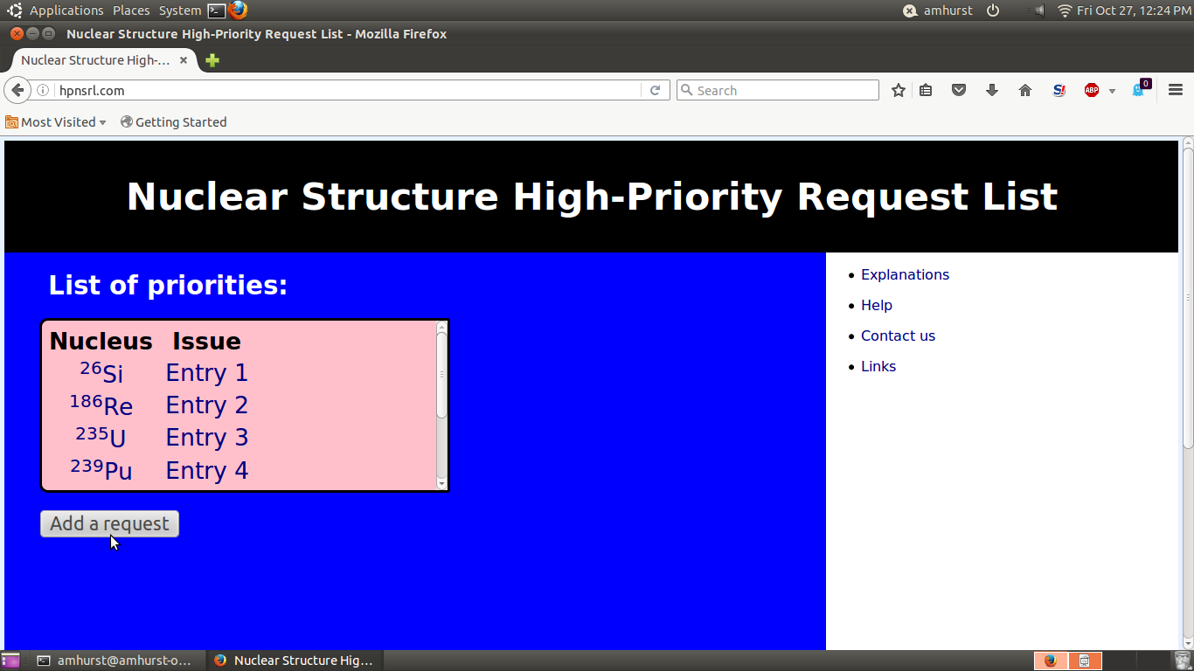
High-Priority Nuclear Structure Request List
A.M. Hurst
HTML code and PHP scripts successfully developed and demonstrated on local Apache2 Web Server
Virtual host: http://hpnsrl.com
USNDP meeting, BNL, Oct 31-Nov 2, 2017

Slide 17

Others activities:
  Update of PANDORA – Tuli and Zerkin, IAEA
  Submitted three NDIWG proposals – L.A. Bernstein
  Hosted the 22nd Int. Nuclear Structure and Decay Data (NSDD) meeting, LBNL, May 22nd – 26, 2017
    Co-sponsored by Nuclear Science and Security Consortium at UC Berkeley. Attended 32 participants and 5 UC graduate student observers from 25 institutions of 13 countries
USNDP meeting, BNL, Oct 31-Nov 2, 2017

Slide 18
Publications/Report/Invited talk/Honor
Published: 14 articles (2 earlier and 4 listed here - significant effort)
1. 2017Br15 Nuclear Data Sheets 145, 25 (2017) – E. Browne, J.K.Tuli – Nuclear Data Sheets
for A=99
2. 2017Ba21 Nuclear Data Sheets, 143, 1 (2017) - M. S. Basunia - Nuclear Data Sheets for
A=193
3. doi.org/10.1051/epjconf/201714609008 Eur. Phys. J. Web of Conferences 146, 09008 (2017)
- A.M. Hurst, R.B. Firestone, et al. - Developments in capture-gamma libraries for
nonproliferation applications
4. doi: 10.1140/epja/i2017-12253-2 Applied Radiation and Isotopes, Volume 125, Pages 124–
128 (2017) - Cory Waltz, Mauricio Ayllon, Tim Becker, Lee Bernstein, et al. - Beam-induced
back-streaming electron suppression analysis for an accelerator type neutron generator
designed for ⁴⁰Ar/³⁹Ar geochronology.
Report: 1
1. Report Number LBNL-1007259 (2017)
Aaron Hurst, Lee Bernstein, Su-Ann Chong
Compilation of the “Atlas of Gamma-rays from the Inelastic Scattering of Reactor Fast Neutrons” (1978DE41)
Invited talk: 8
Bernstein (3), Firestone (3), Hurst (2)
Honor
R.B. Firestone elected a Fellow of the American Physical Society
USNDP meeting, BNL, Oct 31-Nov 2, 2017

Slide 19
Backup slides
USNDP meeting, BNL, Oct 31-Nov 2, 2017

Slide 20
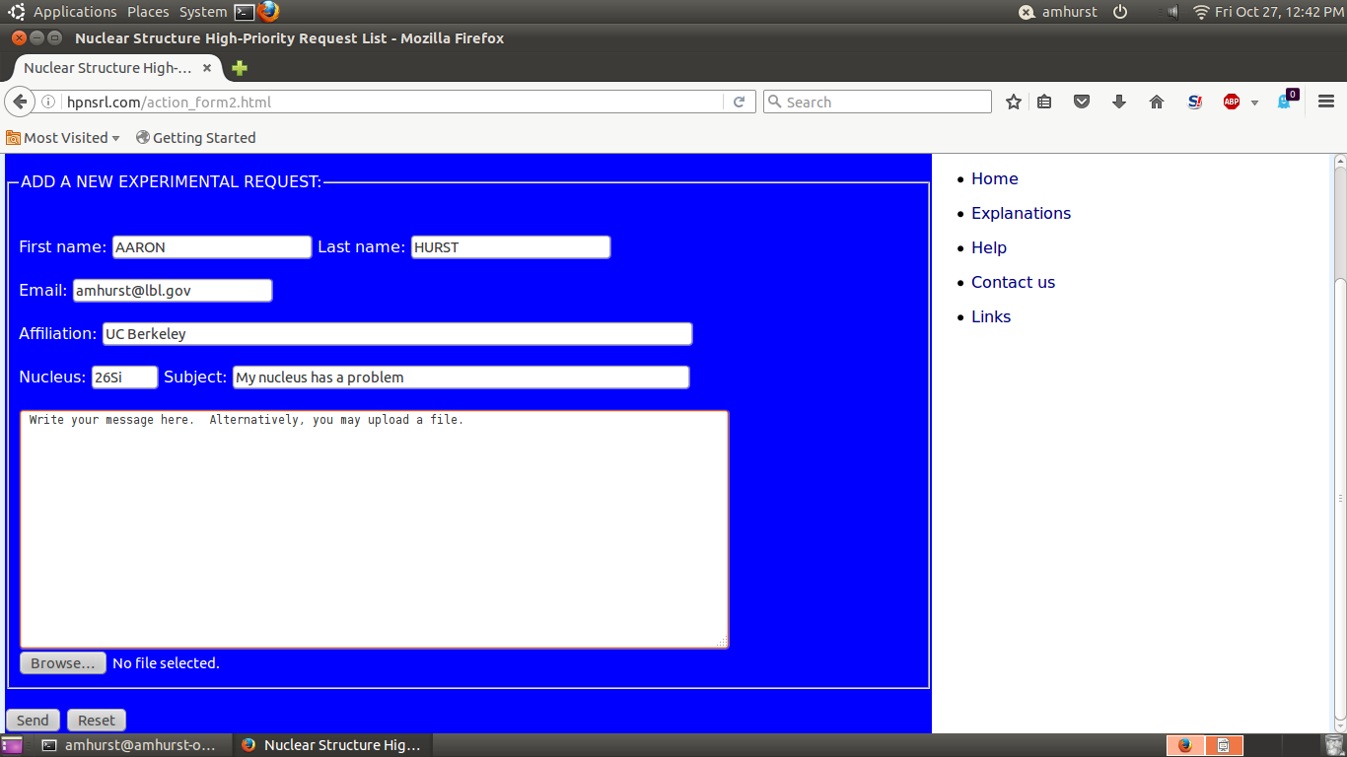
Add a request
A.M. Hurst
USNDP meeting, BNL, Oct 31-Nov 2, 2017

Slide 21
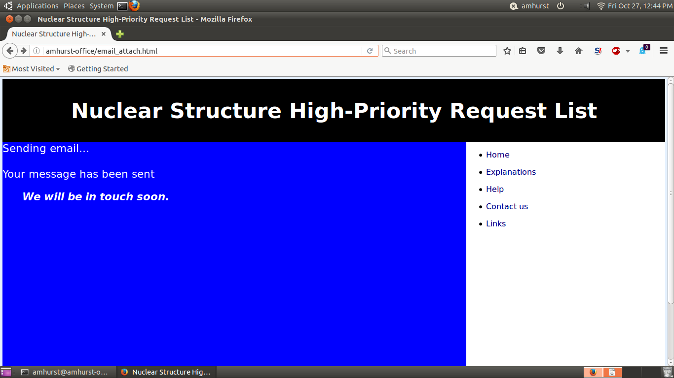
Email sent
A.M. Hurst
Server-side PHP scripts able to process email requests with attachments
USNDP meeting, BNL, Oct 31-Nov 2, 2017

Slide 22
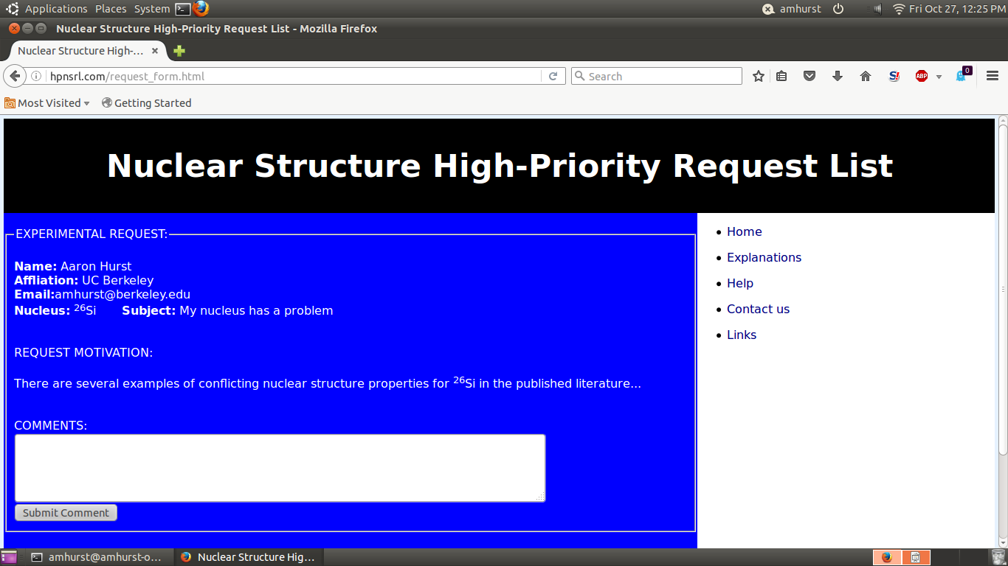
View current experimental requests
A.M. Hurst
- HTML template developed for experimental requests
- Other users can also submit comments: await moderation prior to posting
USNDP meeting, BNL, Oct 31-Nov 2, 2017

Slide 23
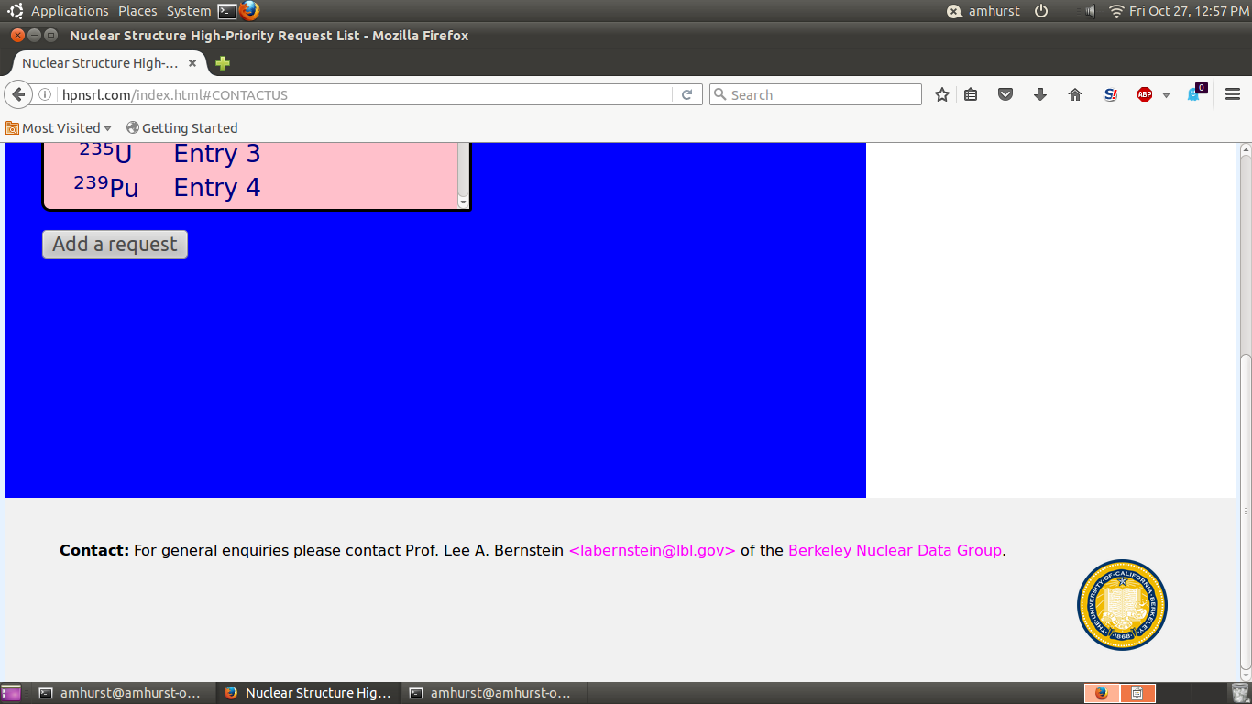
Contact information
A.M. Hurst
USNDP meeting, BNL, Oct 31-Nov 2, 2017

Slide 24
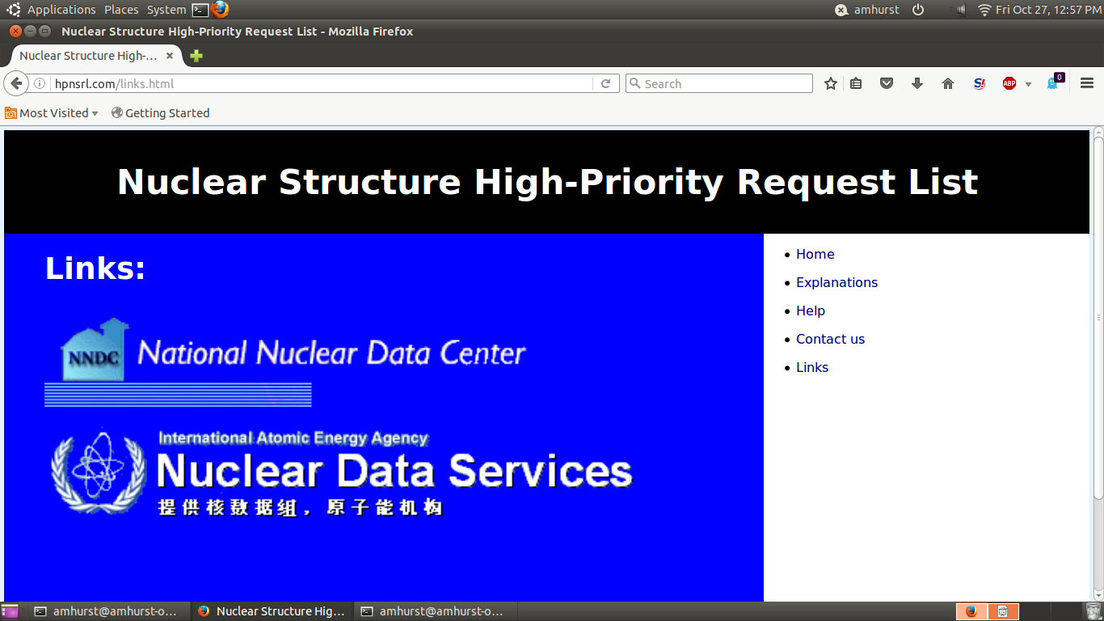
Links
A.M. Hurst
- Added NNDC and NDS,IAEA links
- Any additional links?
USNDP meeting, BNL, Oct 31-Nov 2, 2017

