Slide 1
Fission Yields and Antineutrinos
A.A. Sonzogni¹, M. Nino², E.A. McCutchan¹
¹ National Nuclear Data Center
² Hofstra University (SULI student)

Slide 2
ENDF/B Decay Data Sub-library work:
Added Beta intensities from TAGS/Rudstam to many decay datasets.
Used x-ray energies from NIST binding energies for actinides.
Corrected some errors/bugs.

Slide 3
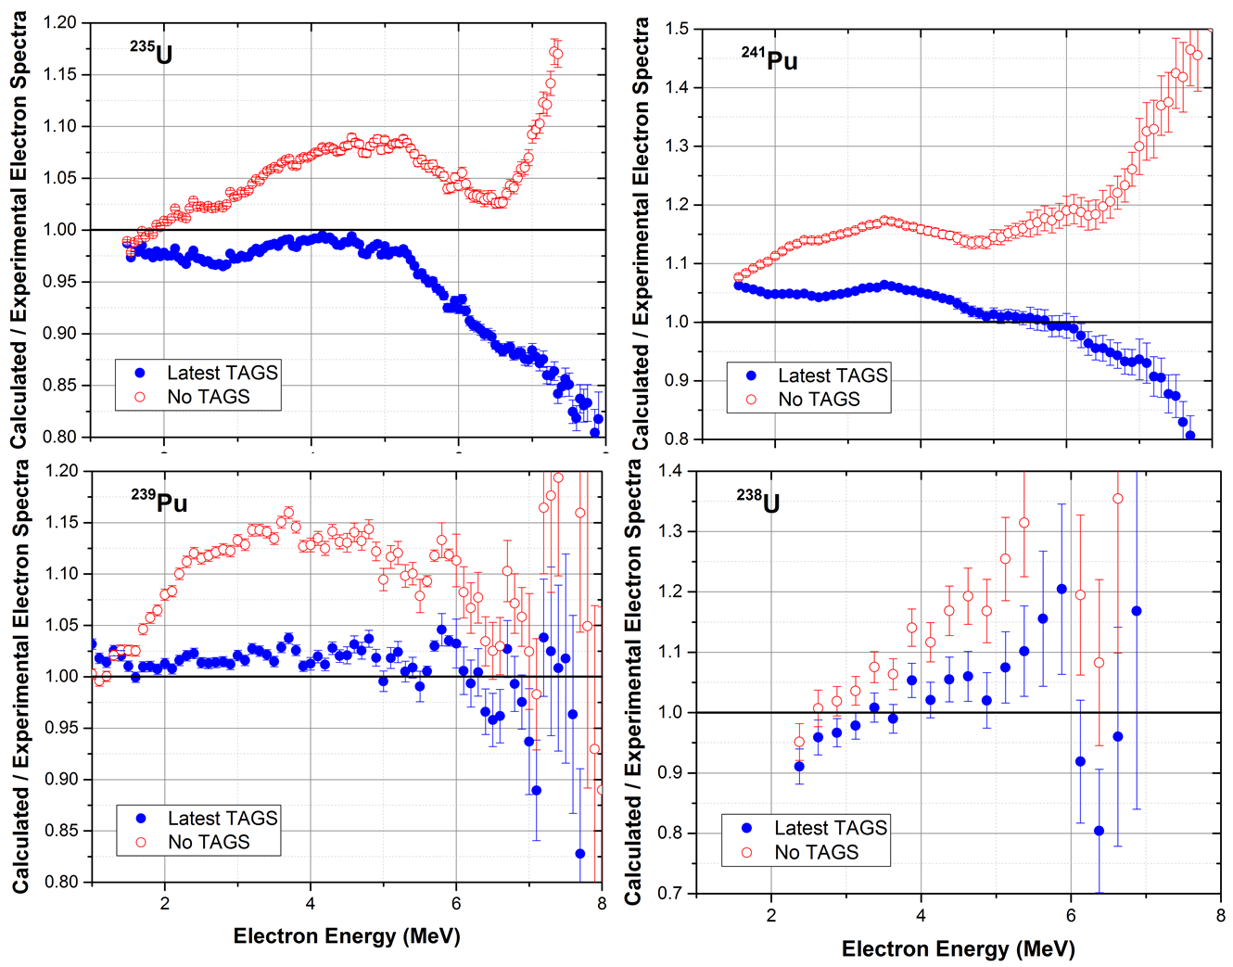
Effect of TAGS data on electron spectra

Slide 4
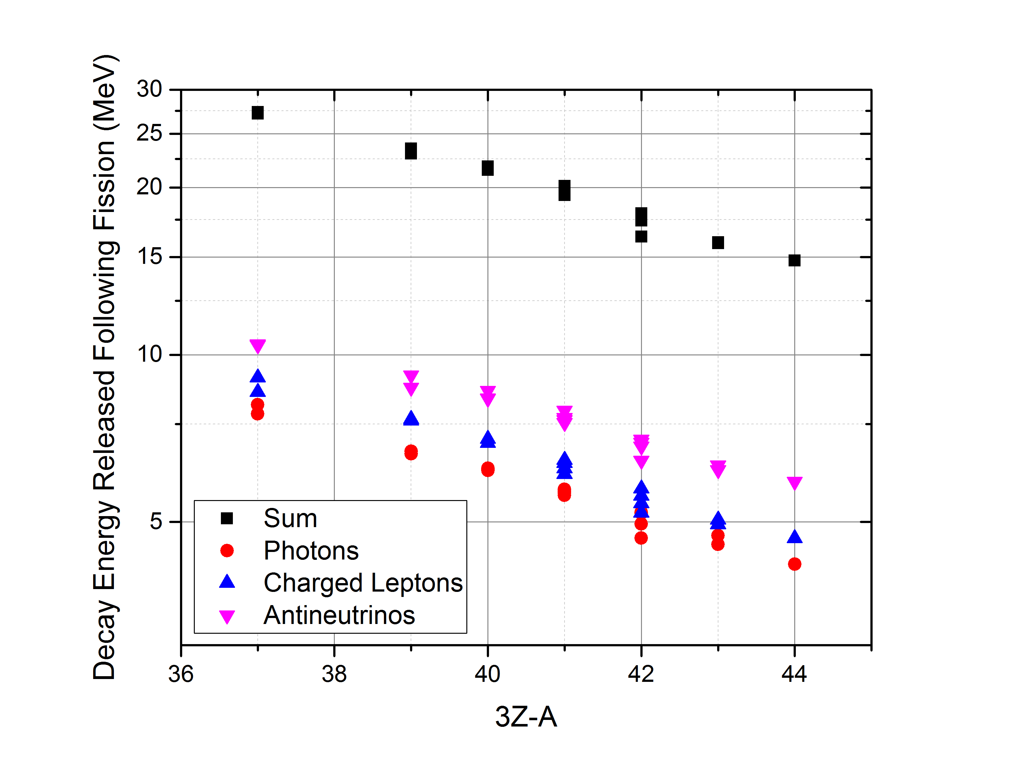
Systematics of average decay energies

Slide 5
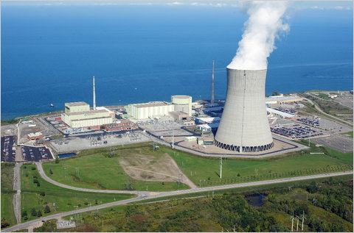
Nuclear reactors
About 6 antineutrinos are produced per fission.
Each fission ~200 MeV*
or
~5 x 10²⁰ antineutrinos/second for a 1 GWe reactor.
Antineutrinos interact through the weak interaction, very small cross sections, σ ~ 5x10⁻¹⁹ barns
Because of the tiny cross sections, antineutrinos can not be shielded.
*: 1 eV= 1.610⁻¹⁹ J, 200 MeV= 3.2 10⁻¹¹ J

Slide 6
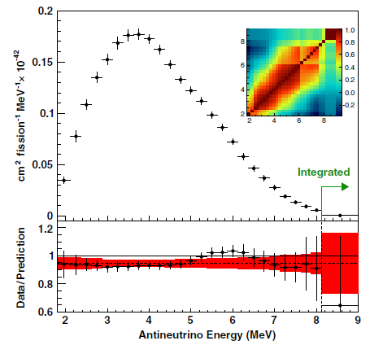
Neutrinos are hot right now!
Latest Daya Bay Antineutrino Spectrum
Missing 5.4 +- 2.2% of the total number of electron antineutrinos at around 500m from the reactor with respect to the Huber-Mueller predictions. Consistent with earlier analysis of reactor experiments.
This deficit is not accounted for in the three flavors oscillations.
There is a distortion in the energy spectrum with respect to the Huber-Mueller prediction.
F.P. An et al, PRL 116, 061801 (2016)

Slide 7
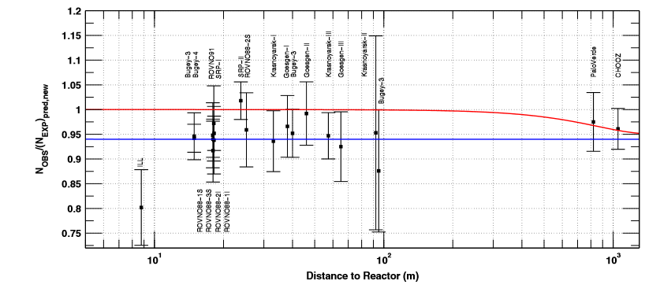
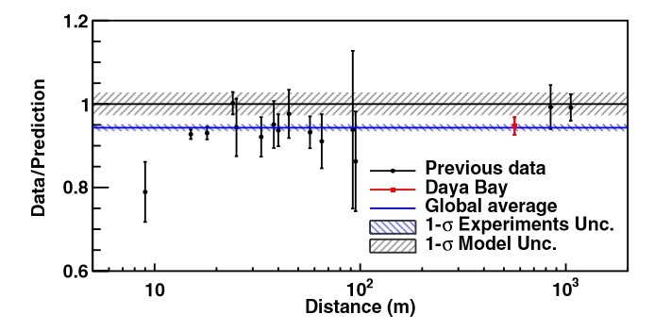
Reactor Antineutrino Anomaly
Average 5.7 +-2.3% deficit of IBD antineutrino yield for a series of reactor experiments
G. Mention et al, PRD 83, 073006 (2011)
Including the 2016 Daya Bay point.
F.P. An et al, PRL 116, 061801 (2016).
Evidence for new Leptons?

Slide 8
How to Calculate a Reactor Antineutrino Spectrum
Know the composition of the core in terms of fission fractions
²³⁵U: 0.586, ²³⁸U: 0.076, ²³⁹Pu: 0.288, ²⁴¹Pu: 0.050
Spectrum (reactor)=f₅ x Spectrum(²³⁵U) +
f₈ x Spectrum(²³⁸U) +
f₉ x Spectrum(²³⁹Pu) +
f₁ x Spectrum(²⁴¹Pu)
The ²³⁵U, ^{239,241}Pu spectra are obtained from the ILL electron spectra measurements (Conversion).
For ²³⁸U, using fission yield and decay databases (Summation).

Slide 9
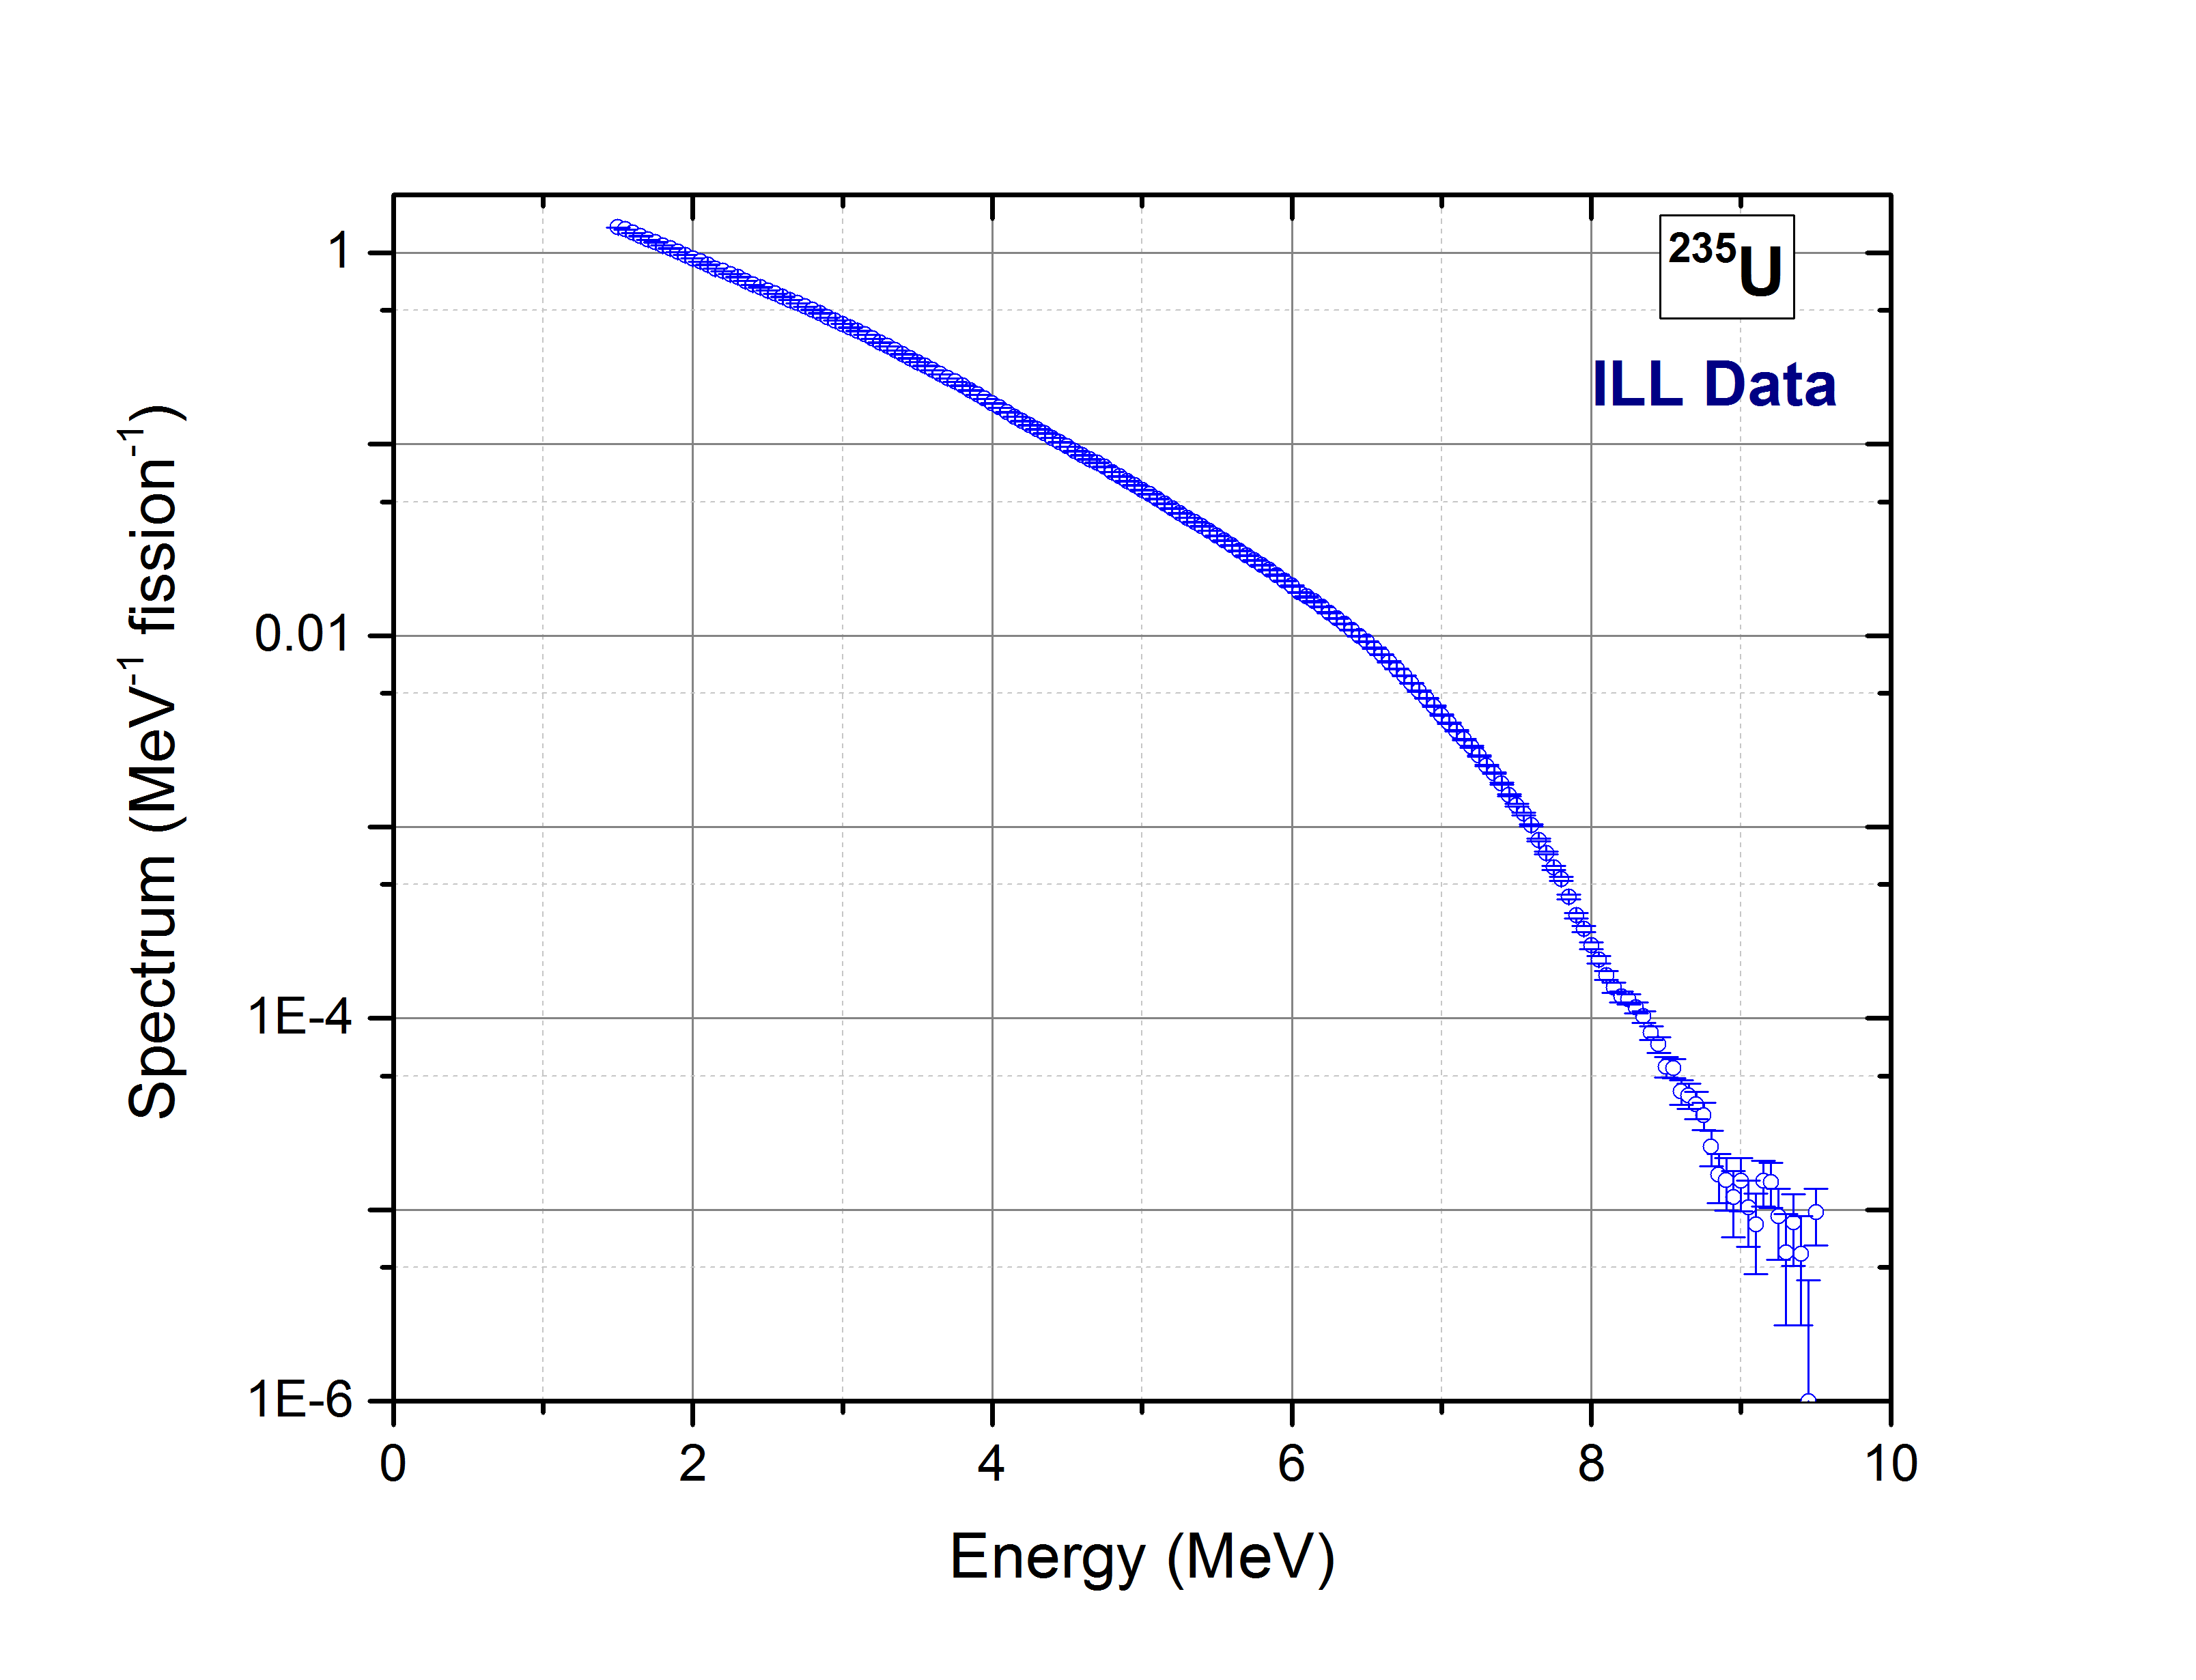
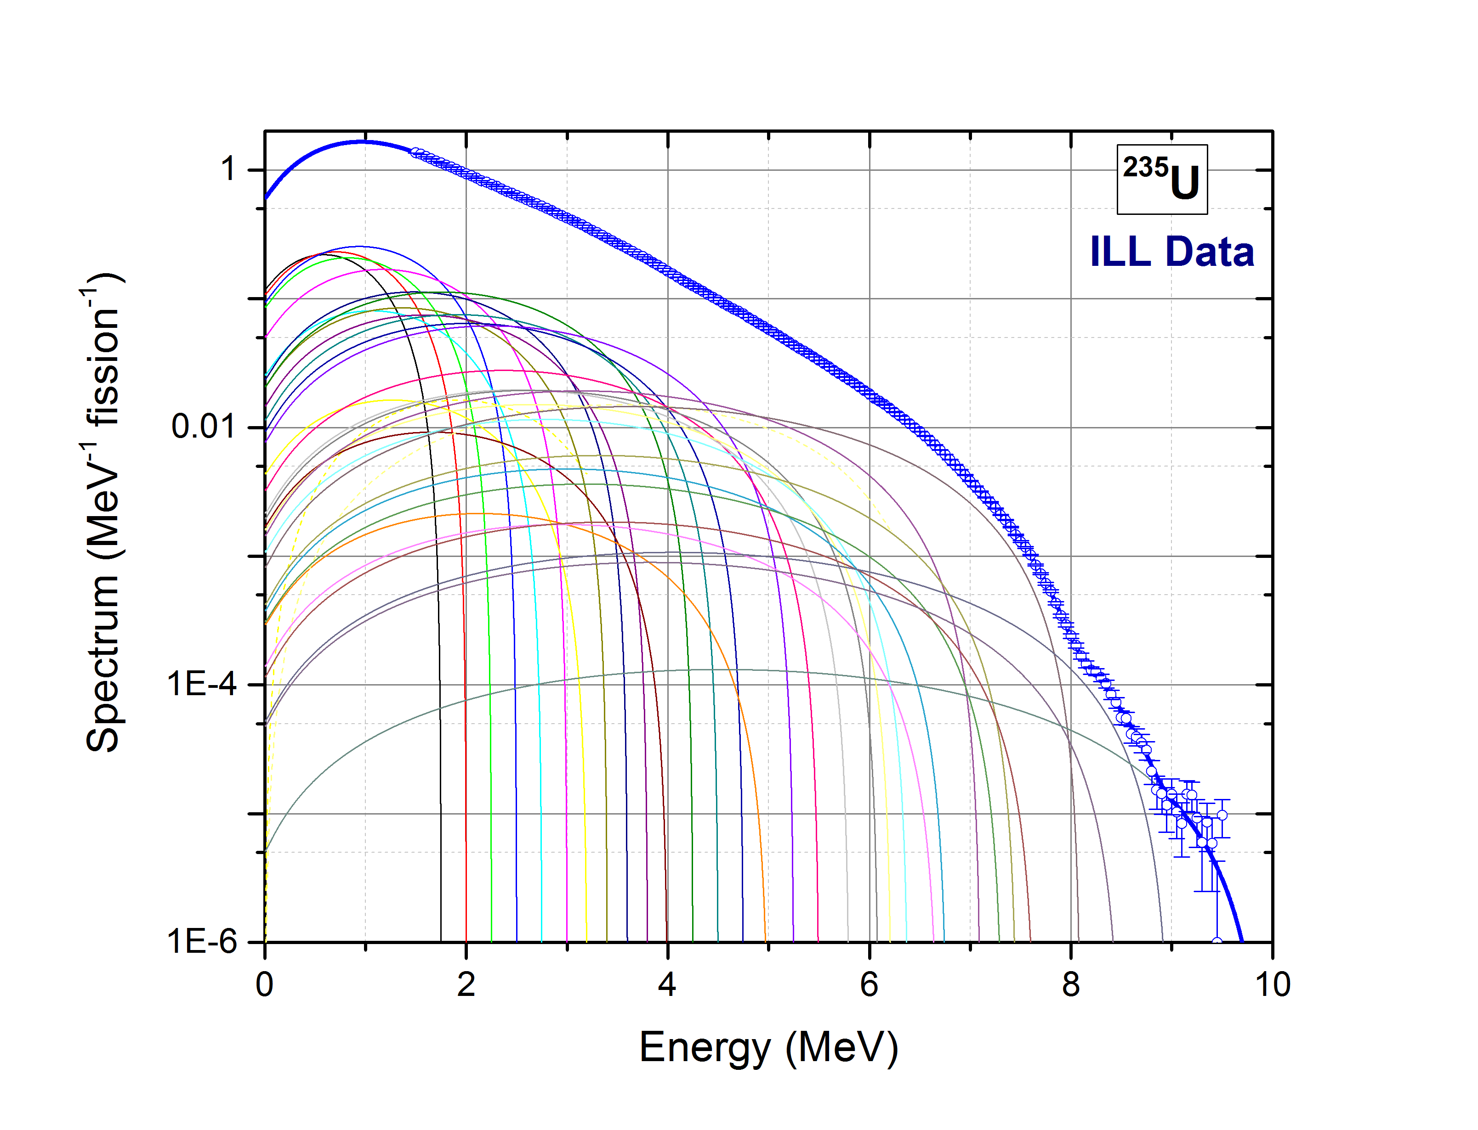
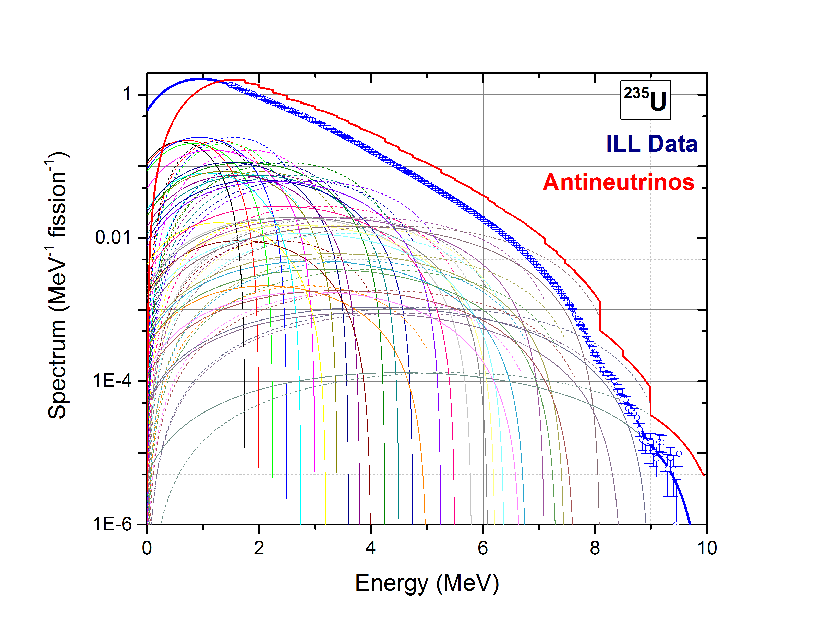
Conversion Method

Slide 10
Summation Method
The fission products form a decay network satisfying:
where IFY_{i} are the independent fission yields.
In equilibrium, that is,
, the total antineutrino spectrum is:
Where S(E) are the individual electron/antineutrino spectra obtained from the ENDF/B-VIII.0 decay data sub-library and CFY are the JEFF-3.1 cumulative yields.
Summation method is also used to obtain the effective Z for conversion.
The conversion method gives more precise antineutrino ²³⁵U, ^{239,241}Pu spectra, but the summation allows you to study the physics

Slide 11
Correlations!
Integrated IBD yield:
Explicitly including the contributions from each beta branch in the fission products:
Uncorrelated, small, possibly unknown, variance
Very correlated
Very correlated

Slide 12
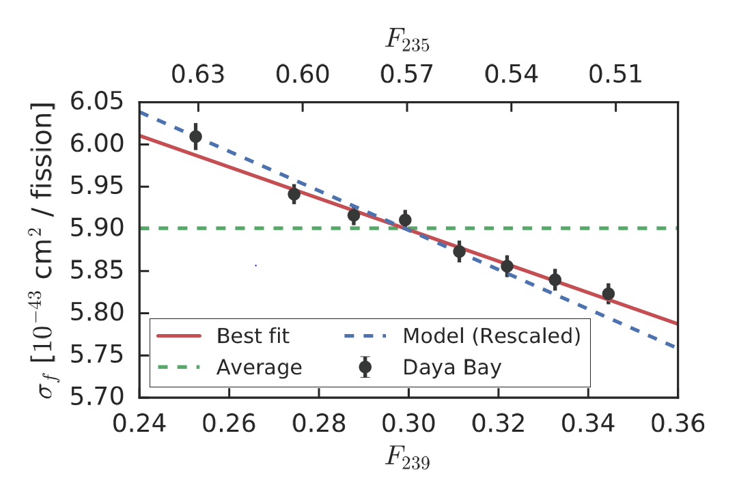
Antineutrino yield (σ) for each fissile nuclide
0.2% precision points!!!!
F.P. An et al,
PRL 118, 251801 (2017).
σ values (10⁻⁴³ cm²/fission)
Nucleus | Daya Bay 17 | Huber/Mueller | Summation
235U | 6.17+-0.17 | 6.69+-0.15 | 6.49
239Pu | 4.27+-0.26 | 4.36+-0.19 | 4.49
238U |  | 10.1+-1.17 | 10.2
241Pu |  | 6.04+-0.19 | 6.41
Must have CFY correlations for Summation uncertainties!

Slide 13
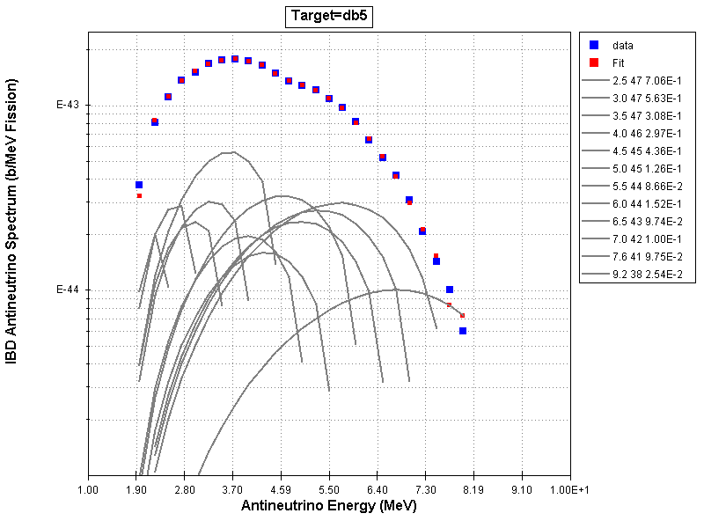
Naïve consequences…
If the Huber ^{239,241}Pu and Mueller ²³⁸U spectra are correct, we can obtain an effective ²³⁵U IBD spectrum.
This effective ²³⁵U antineutrino spectrum can be fitted with average branches (reverse conversion) to obtain an effective electron spectrum, which can be compared to the ILL one.

Slide 14
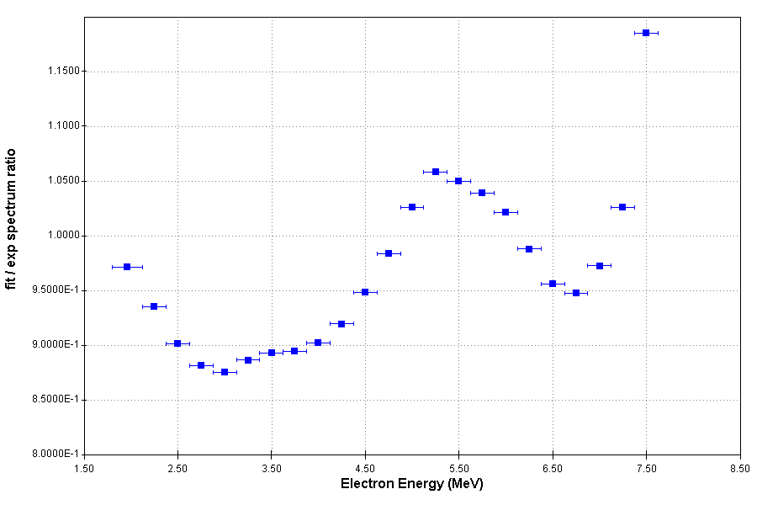
Effective vs ILL ²³⁵U electron spectrum
~+5% higher
~-12% lower

Slide 15
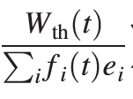
Average energy released in fission
The experimental IBD antineutrino spectrum has a normalization term
Where W_{th} is the thermal power, f_{i} are the fission fractions and e_{i} the average energies converted in heat for ²³⁵U, ²³⁸U, ²³⁹Pu and ²⁴¹Pu.
In 2016, Daya Bay used the e_{i} values from V.Kopeikin, L.Mikaelyan, and V.Sinev, Phys. At. Nucl. 67, 1892 (2004).
In 2017, Daya Bay used those from X. B. Ma, Phys. Rev C 88, 014605 (2013).

Slide 16
Average energy released in fission
e_{i}=M_{i} +(1-nu-bar)M_{n} -Σ CFY_{i} M_{i} - <E_{ν}> - E_{long-lived}+ E_{neutron-capture}
Where the sum over cumulative fission yields is performed for a single A value nuclides near the valley of stability.
Using 2016 Atomic Mass Evaluation, and adding CFY_{i} uncertainties in quadrature, we obtain for ²³⁵U:
Work | Σ CFY_{i} M_{i} | % uncertainty
2004 Kopeikin | -173.430+- 0.050 | 0.0288
2013 Ma | -173.859+-0.062 | 0.0357
2017 ENDF/B corrected | -173.197+-0.213 | 0.123
2017 JEFF | -173.272+-0.486 | 0.281

Slide 17
Average energy released in fission
²³⁵U
Work | e_{i} | % uncertainty
2004 Kopeikin | 201.92+-0.46 | 0.228
2013 Ma | 202.36+-0.26 | 0.128
2017 ENDF/B corrected | 201.84+-0.68 | 0.339
2017 JEFF | 201.91+-0.81 | 0.402
²³⁹Pu
Work | e_{i} | % uncertainty
2004 Kopeikin | 209.99+-0.60 | 0.286
2013 Ma | 211.12+-0.34 | 0.161
2017 ENDF/B corrected | 210.87+-1.20 | 0.568
2017 JEFF | 210.61+-1.61 | 0.766

Slide 18
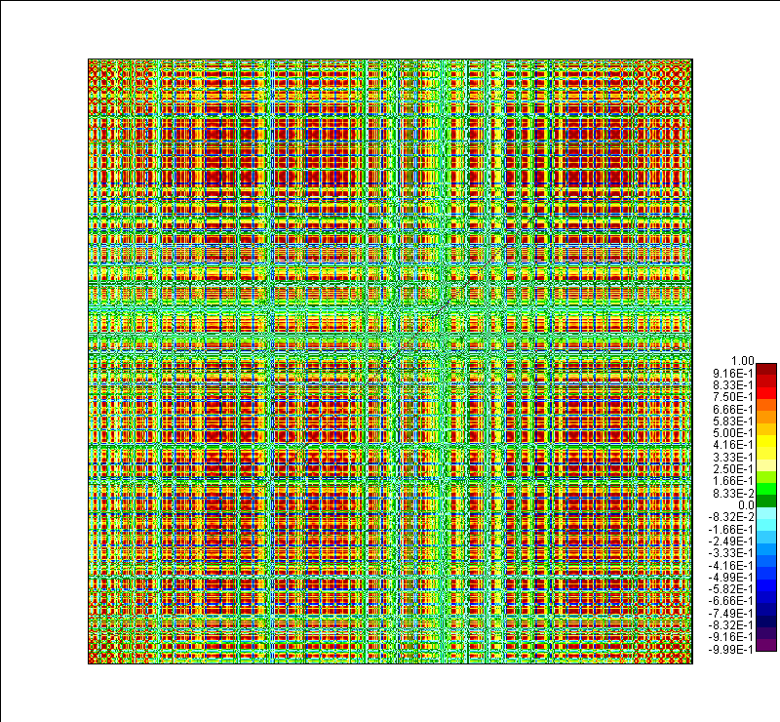
Independent Fission Yields Covariances
IFY(Z,A,liso)=( 5 Gaussians(A) ) x nu-bar(A) x Gaussian(Z) x Gaussian(Isomeric ratio)
Parameters obtained from fitting JEFF IFY values.
Then obtain correlations with a MC method.

Slide 19
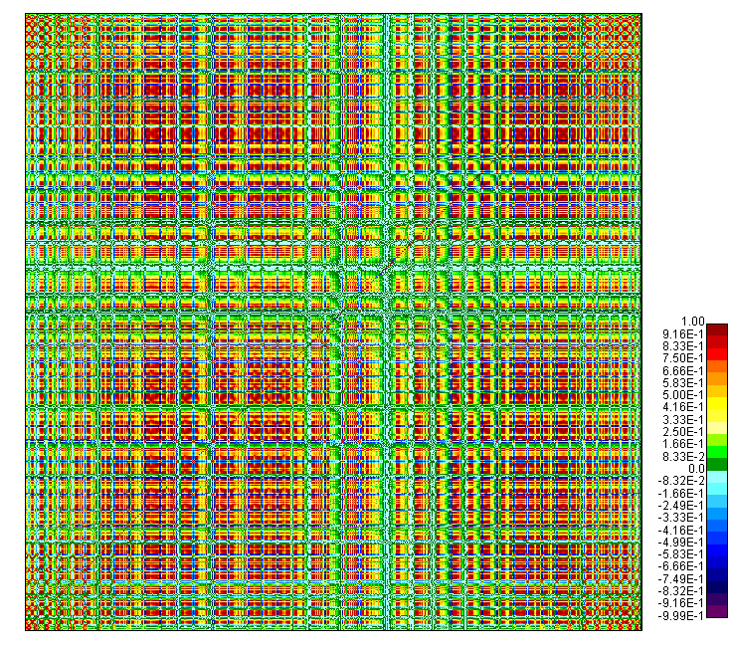
Cumulative Fission Yields Covariances
CFY= A IFY
Matrix A obtained from the ENDF/B-VIII.0 decay data sub-library.
MC method taking into account that %B- (1.0) and %B-n (1.5) are for our practical matters fully correlated.
Our preliminary results are that off-diagonal terms are less than 5% important for ei and σ calculations

Slide 20
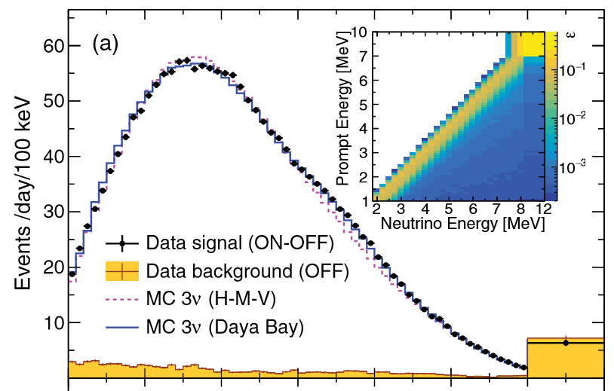
Fine Structure
NEOS data, 30 m from a power reactor
There seems to be structure?
Ko et al, PRL 118, 121802 (2017)

Slide 21
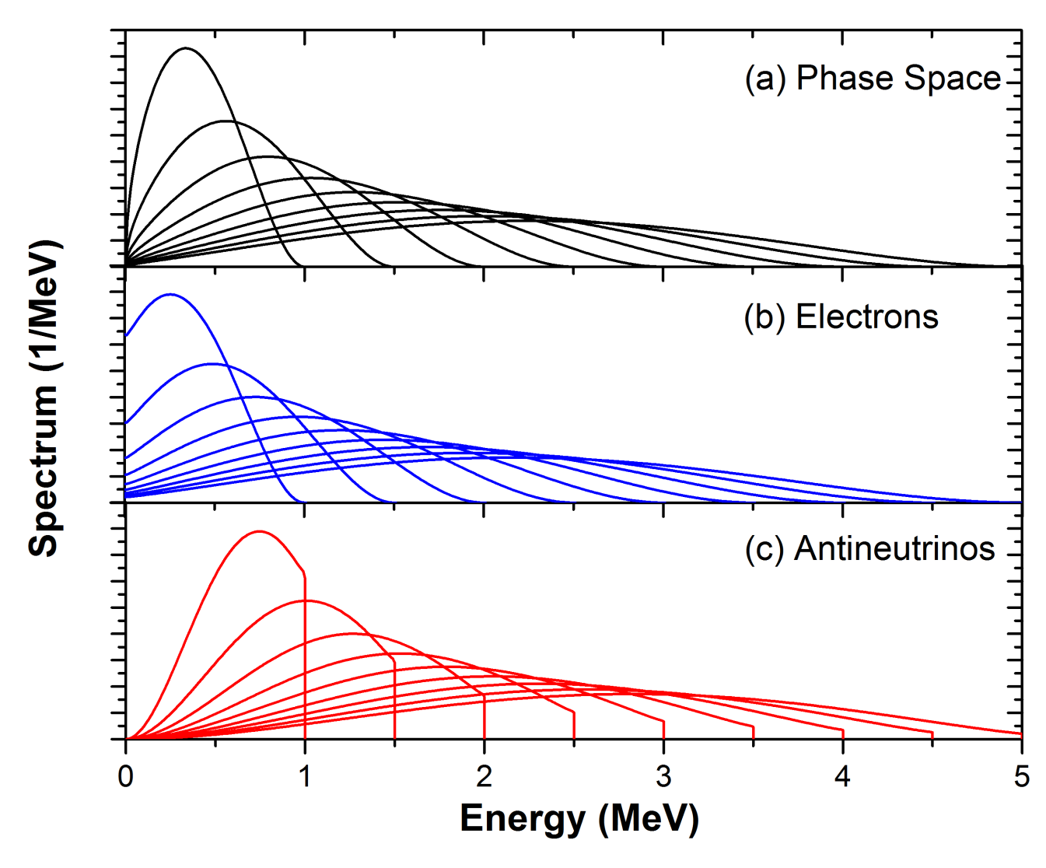
Electron spectra given by:
Wx(W²-1)^{1/2}x(W-Wo)²: Phase space
F(Z,W): Fermi Function
C(Z,W): Additional corrections
Rugged structure in the antineutrino spectrum due to Coulomb effects (Fermi function)

Slide 22
Fine Structure
As the reactor spectrum is the sum of ~800 individual spectra, can we seen individual effects?
Sharp cutoffs that can be seen with 0.1 MeV binning or less
Shoulder spanning several 100s keV

Slide 23
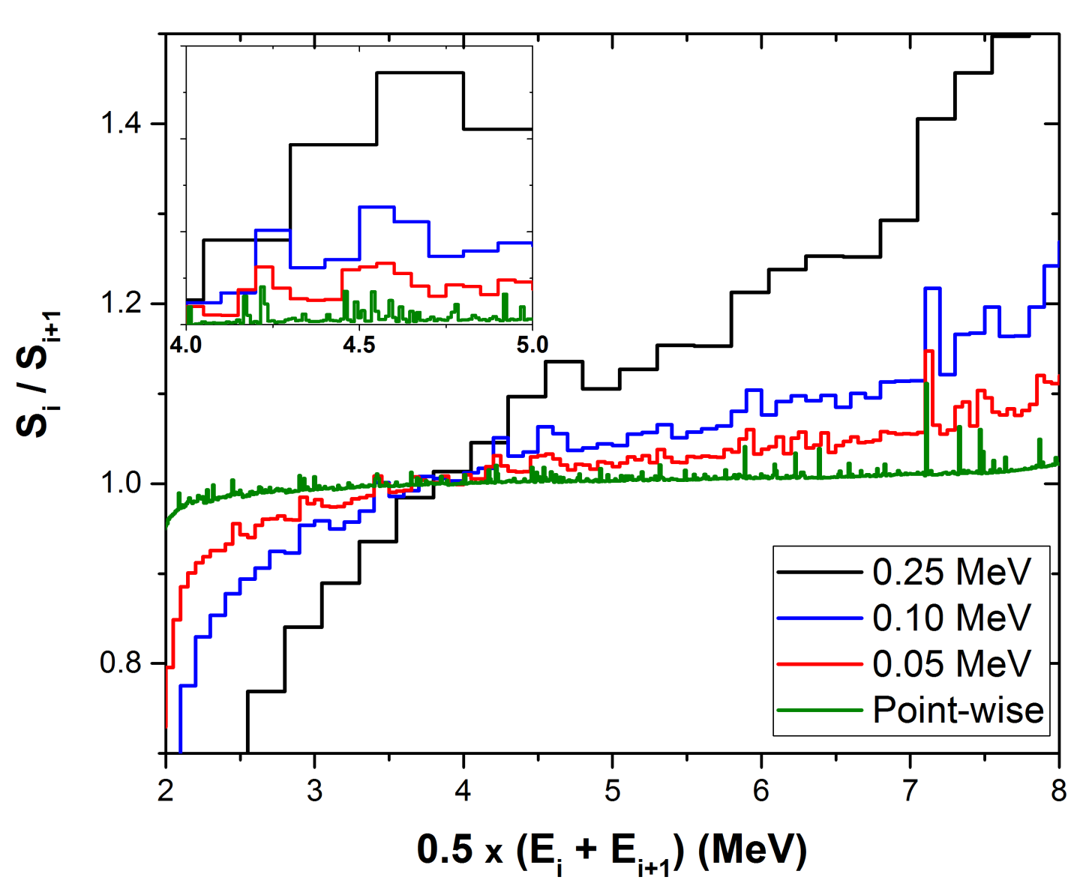
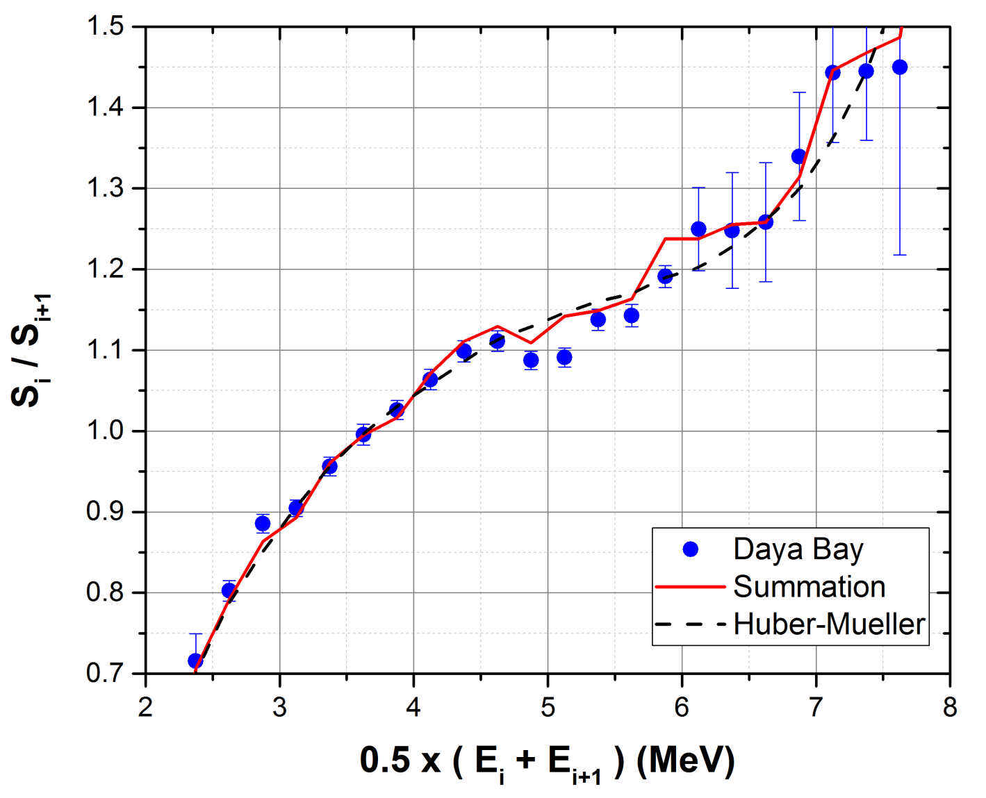
How to reveal Fine Structure?
Ratio of adjacent points:
R_{i}=S_{i}/S_{i+1}
Surprisingly, even with a 0.25 MeV binning a structure can be seen.
Structure observed in Daya Bay data, covariance matrix crucial for analysis.

Slide 24
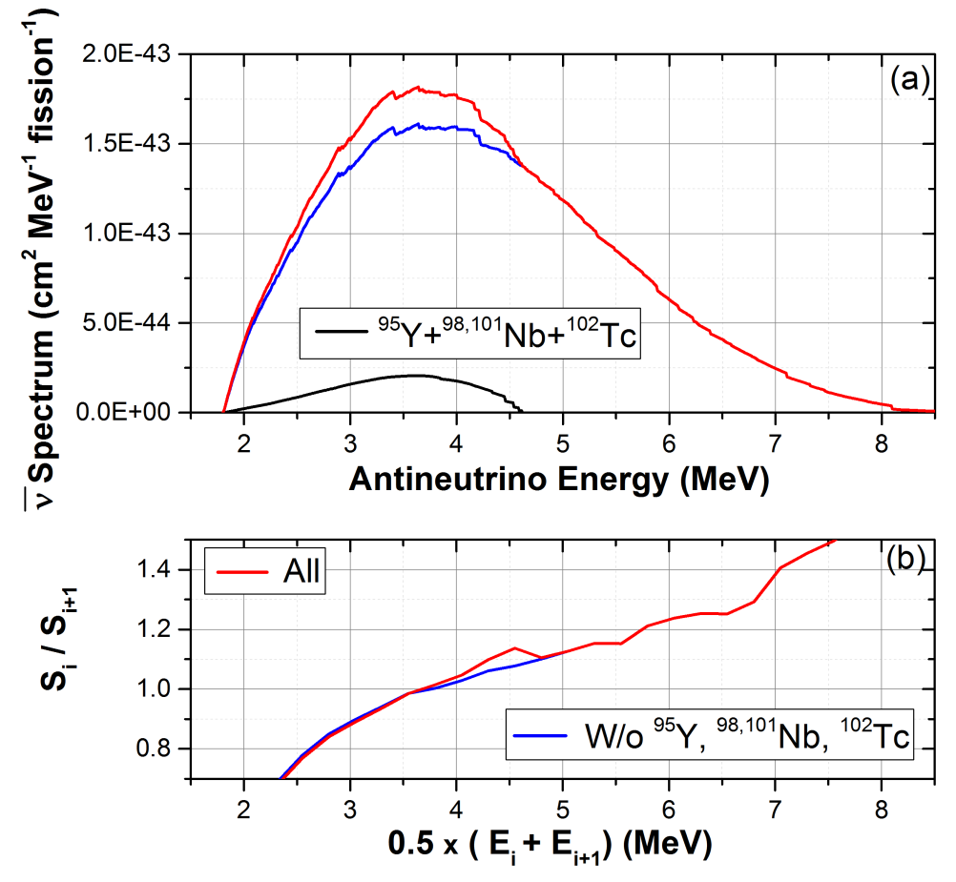
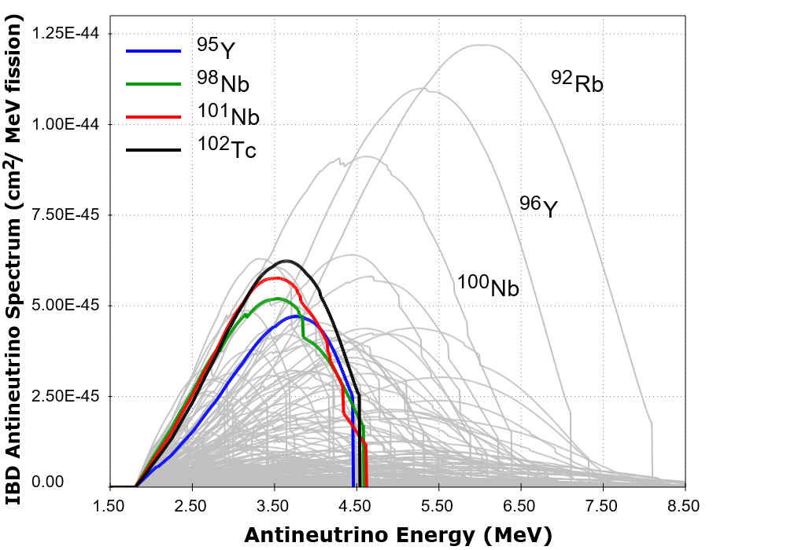
Nuclides behind fine structure
For more details, see:
A.A. Sonzogni, M. Nino, E.A. McCutchan arXiv:1710.00092

Slide 25
C O N C L U S I O N S
There is currently a very active nuclear reactor antineutrino research program.
Future projects include measuring the spectrum at around 50 km (JUNO) as well as a number of experiments at short distances, around 30 meters or less (NEOS, PROSPECT, NUCIFER).
Nuclear reactor monitoring using antineutrinos is a possibility.
Finish project on Fine Structure.
Working on Cumulative Fission Yield Correlations, which are needed for mean energies and IBD yields!
We need to expand ENDF-6 format to accommodate additional fission data.

