Slide 1
NNDC’s Fission Yield and Decay Data Evaluation Plans
A.A. Sonzogni, E.A. McCutchan, D.A. Brown, T.D. Johnson
National Nuclear Data Center

Slide 2
ENDF/B Decay Data Sub-library:
Contains decay data for all nuclides, ground state and isomers.
For ENDF/B-VIII.0 we updated the VII.1 sub-library with:
Added Beta intensities from TAGS/Rudstam to many decay datasets.
Used X-ray energies from NIST binding energies for actinides.
Corrected some errors/bugs.

Slide 3
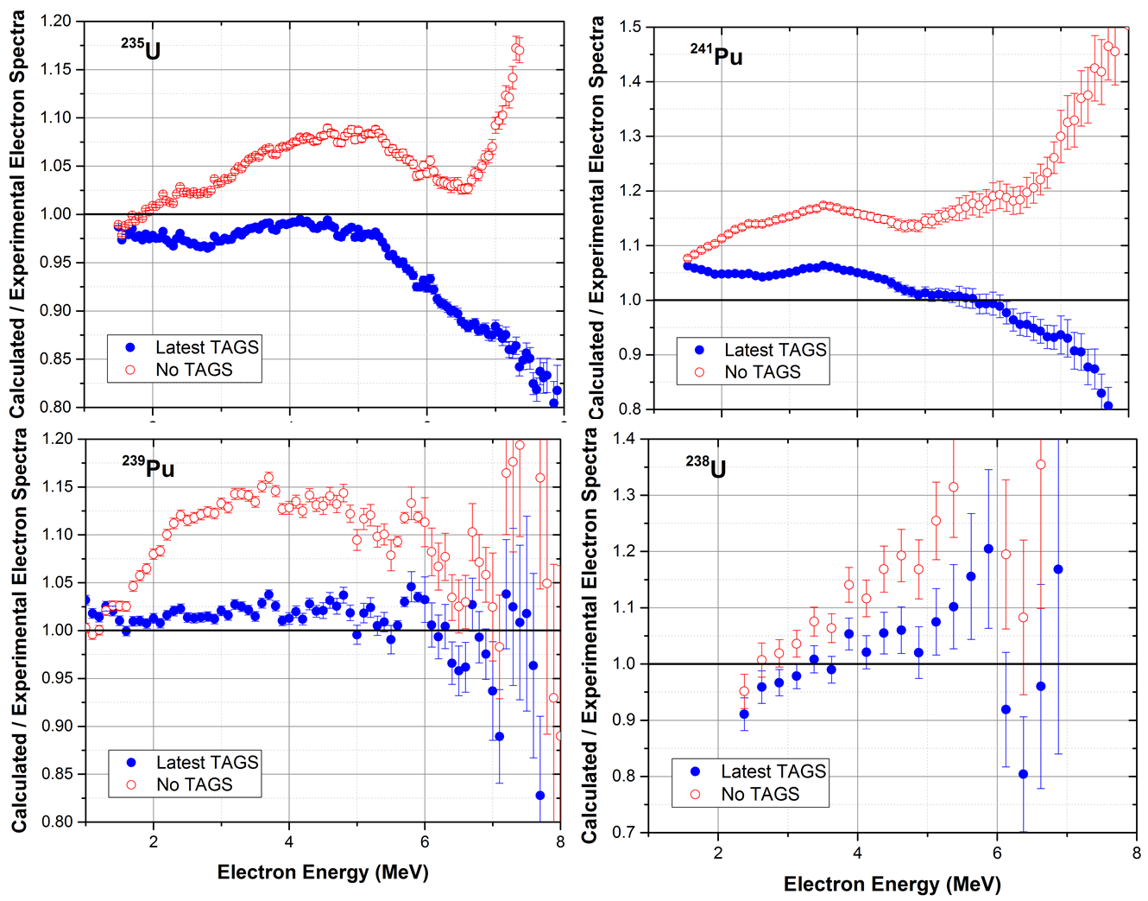
Example, effect of TAGS data on electron spectra

Slide 4
Plans for future Decay Data Sub-library:
Translate from the latest ENSDF file in combination with latest Atomic Mass Evaluation. Will include better decay data for medical radioisotopes.
Hopefully, will include results from experiments to address inconsistencies.
Obtain X-ray and Auger energies from NIST binding energies for all nuclides.
Incorporate experimental shape factors in beta spectra
Explicitly give neutrinos and antineutrino spectra.
Wish list:
Give decay scheme
Coincidences matrices (gamma-gamma, beta-gamma)
Give level scheme

Slide 5
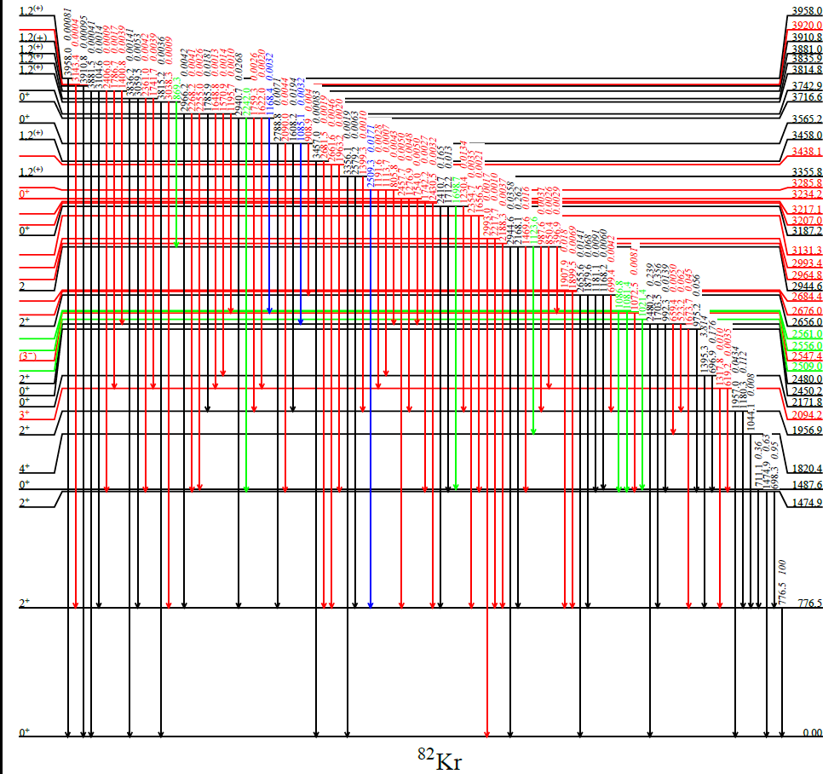
Highly precise decay data for medical radioisotopes
Experimental campaigns by BNL and ANL to improve the decay data for radionuclides used in nuclear medicine. Some results already in ENSDF. More details in E.A. McCutchan talk tomorrow.
Example, revised decay scheme of ⁸²Rb
New
Confirmed
Removed
Moved
M. Nino et al, Phys. Rev. C 93, 024301 (2016).

Slide 6
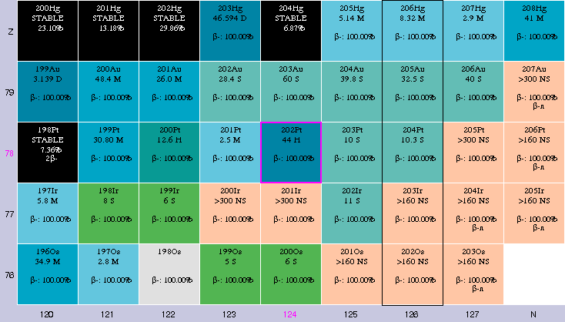
Addressing gaps in nuclear structure data
The half-life of ²⁰²Pt looks very suspicious
Performed experiment in ANL using ²⁰⁸Pb+²⁰⁴Hg and ¹³⁶Xe+²⁰⁸Pb in combination with Gammasphere

Slide 7
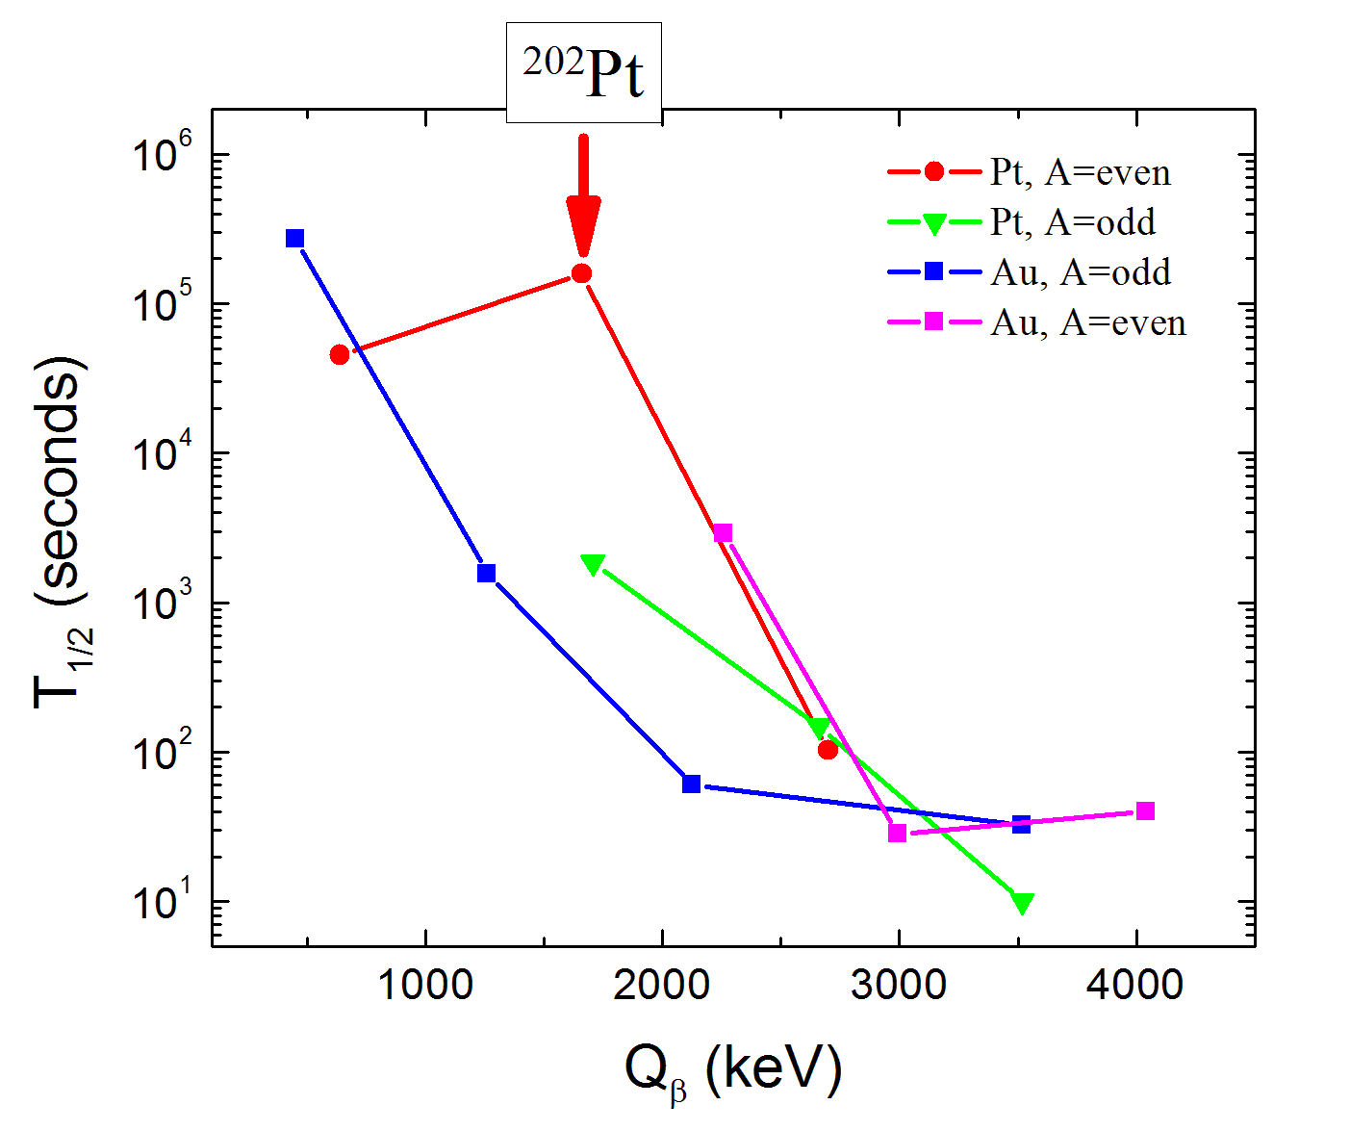
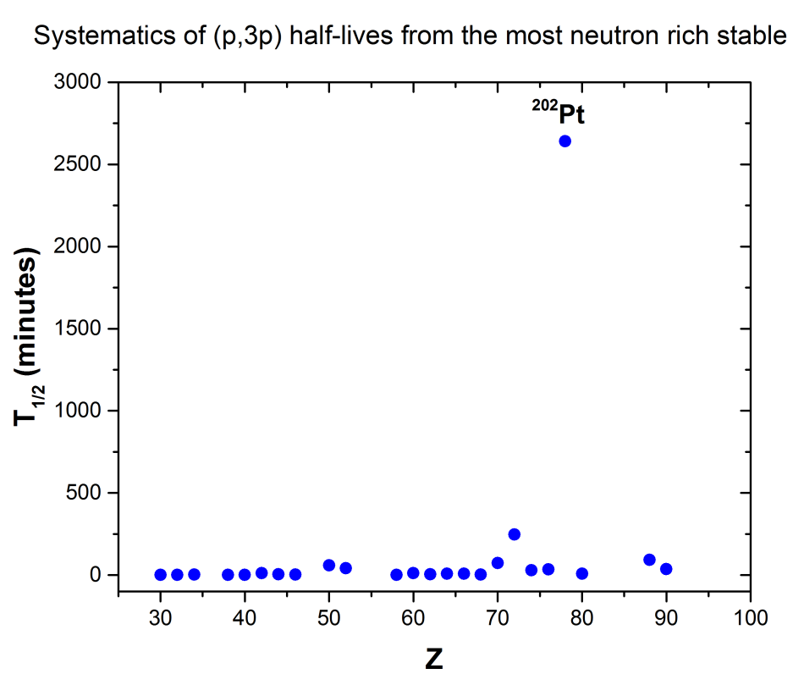
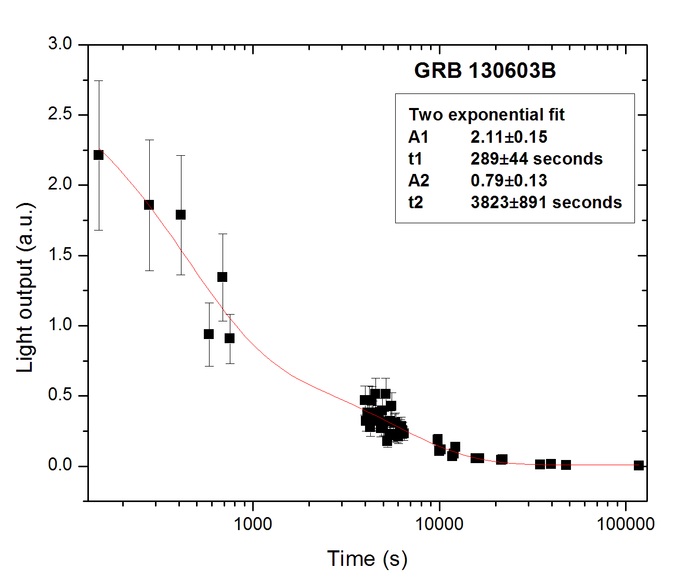
Anomaly in the half-life value
Why is this relevant?
Observation of Au lines from Gamma-ray bursts
We found a lot of interesting data from these experiments, but no T_{1/2}. More details on McCutchan talk tomorrow. Will pursue (n,2pn) venue.

Slide 8
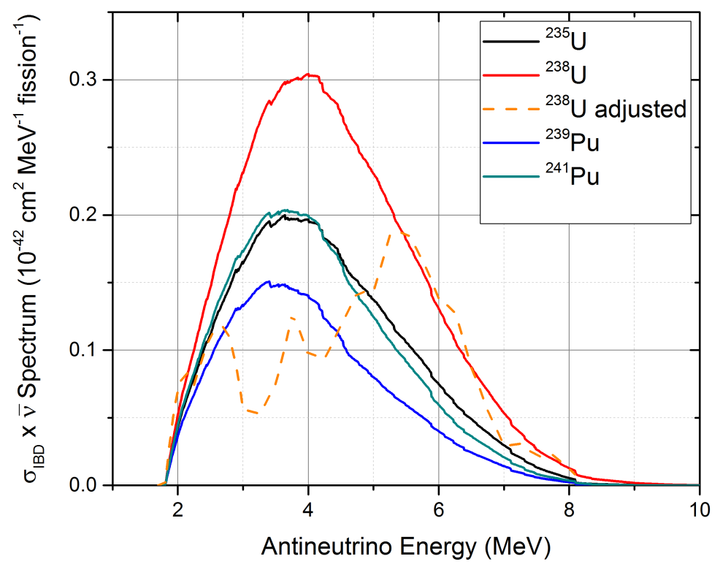
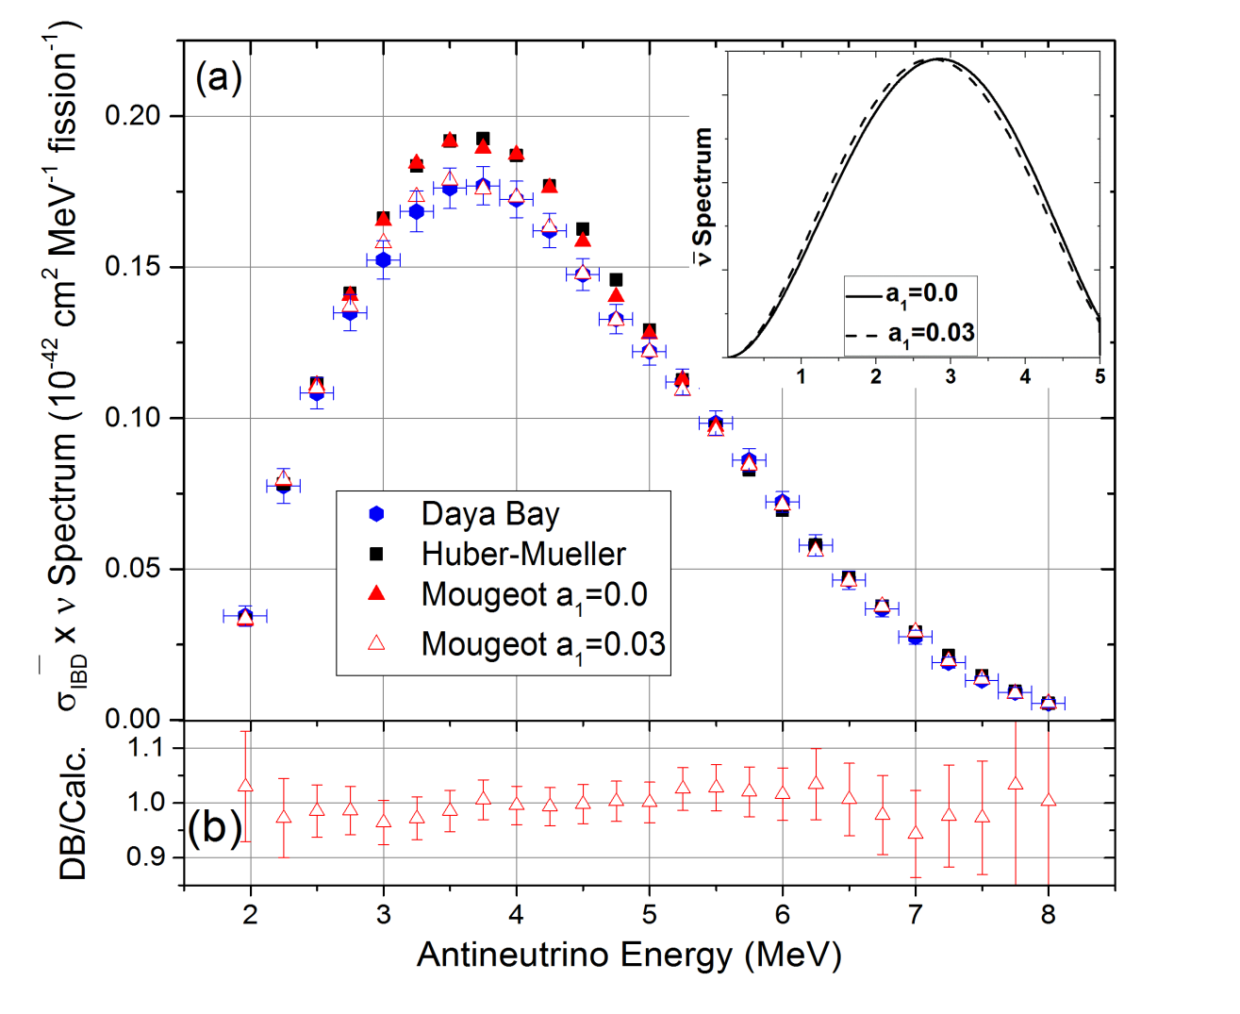
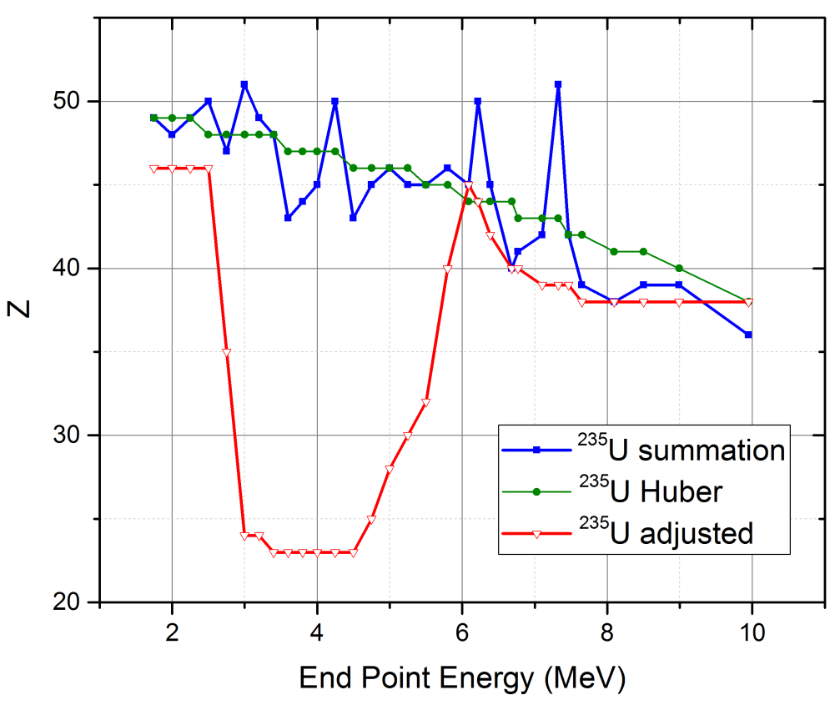
Beta Shape factors
We recently showed that the reactor antineutrino anomaly can’t be due to ²³⁸U spectrum or poor knowledge of Z_{eff} in the conversion method.
But shape factors of 6%MeV⁻¹ can.
Sonzogni, McCutchan, Hayes, PRL 119, 112501 (2017)

Slide 9
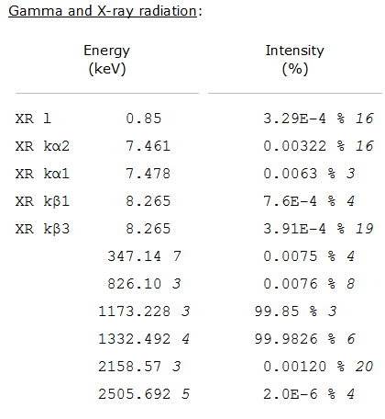
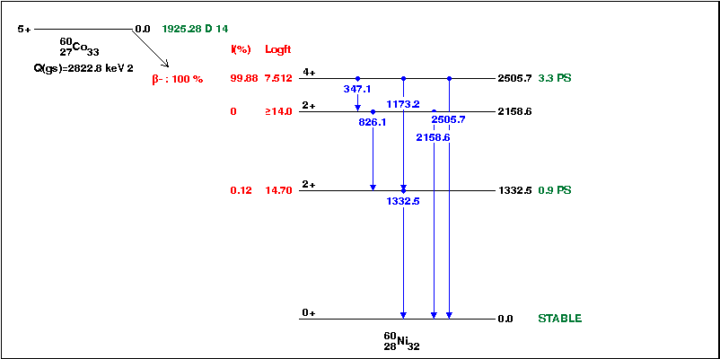
Additional Decay Data
At the moment, the sub-library just gives a radiation listing
By providing level data, we could build a decay scheme
Format will have to be expanded and software further developed
We could also provide a coincidence matrix between gamma rays

Slide 10
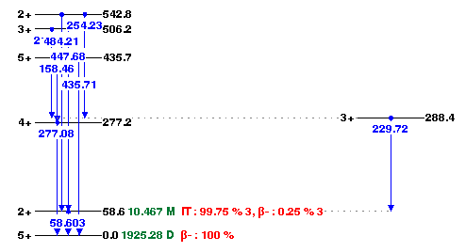
Additional Level Data
these data are not given in ENDF, but are crucial for cross section calculations!
Format will have to be expanded and software further developed

Slide 11
Fission Yields Work
Update and correct ENDF/B fission yields.
Make yields compatible with modern decay data.
Compile and group all measured yield data since mid-1980s. Work started by Pritychenko and Zerkin.
Generate fission yield correlation matrices.
Work partly driven by our own interests in nuclear reactor antineutrinos

Slide 12
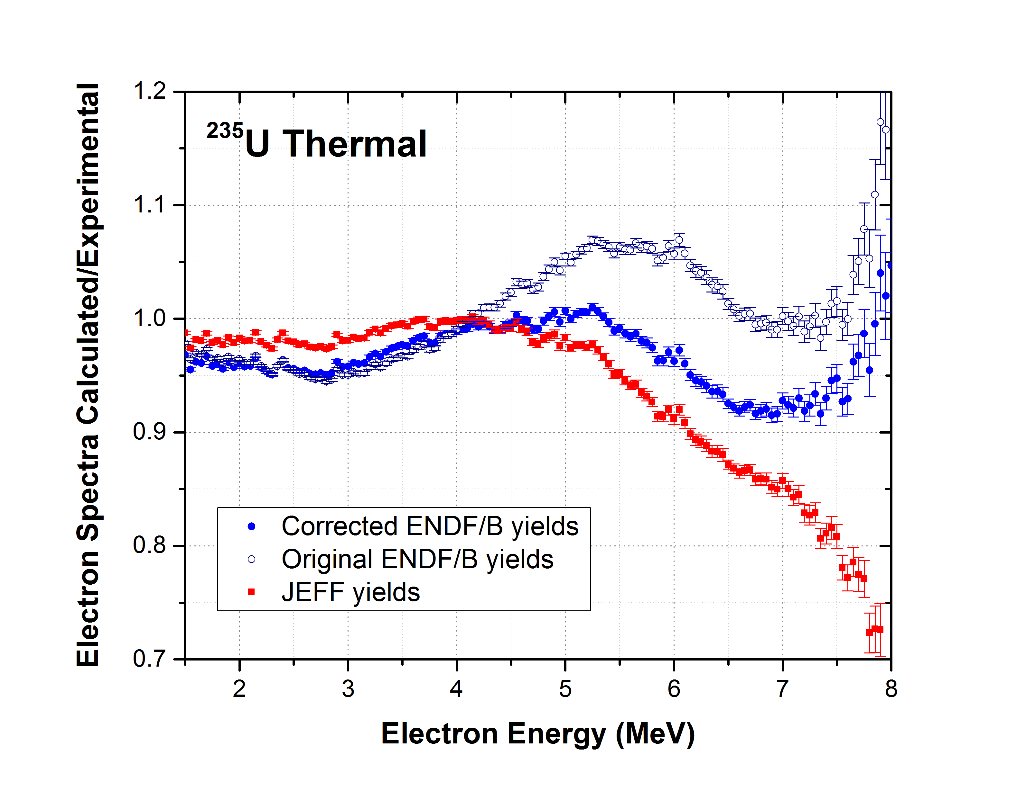
Example on updating ENDF yields
Corrected yields:
No electron excess.
Better agreement with JEFF.
A.A. Sonzogni, E.A. McCutchan, T.D. Johnson, P. Dimitriou, PRL 116, 132502 (2016).

Slide 13
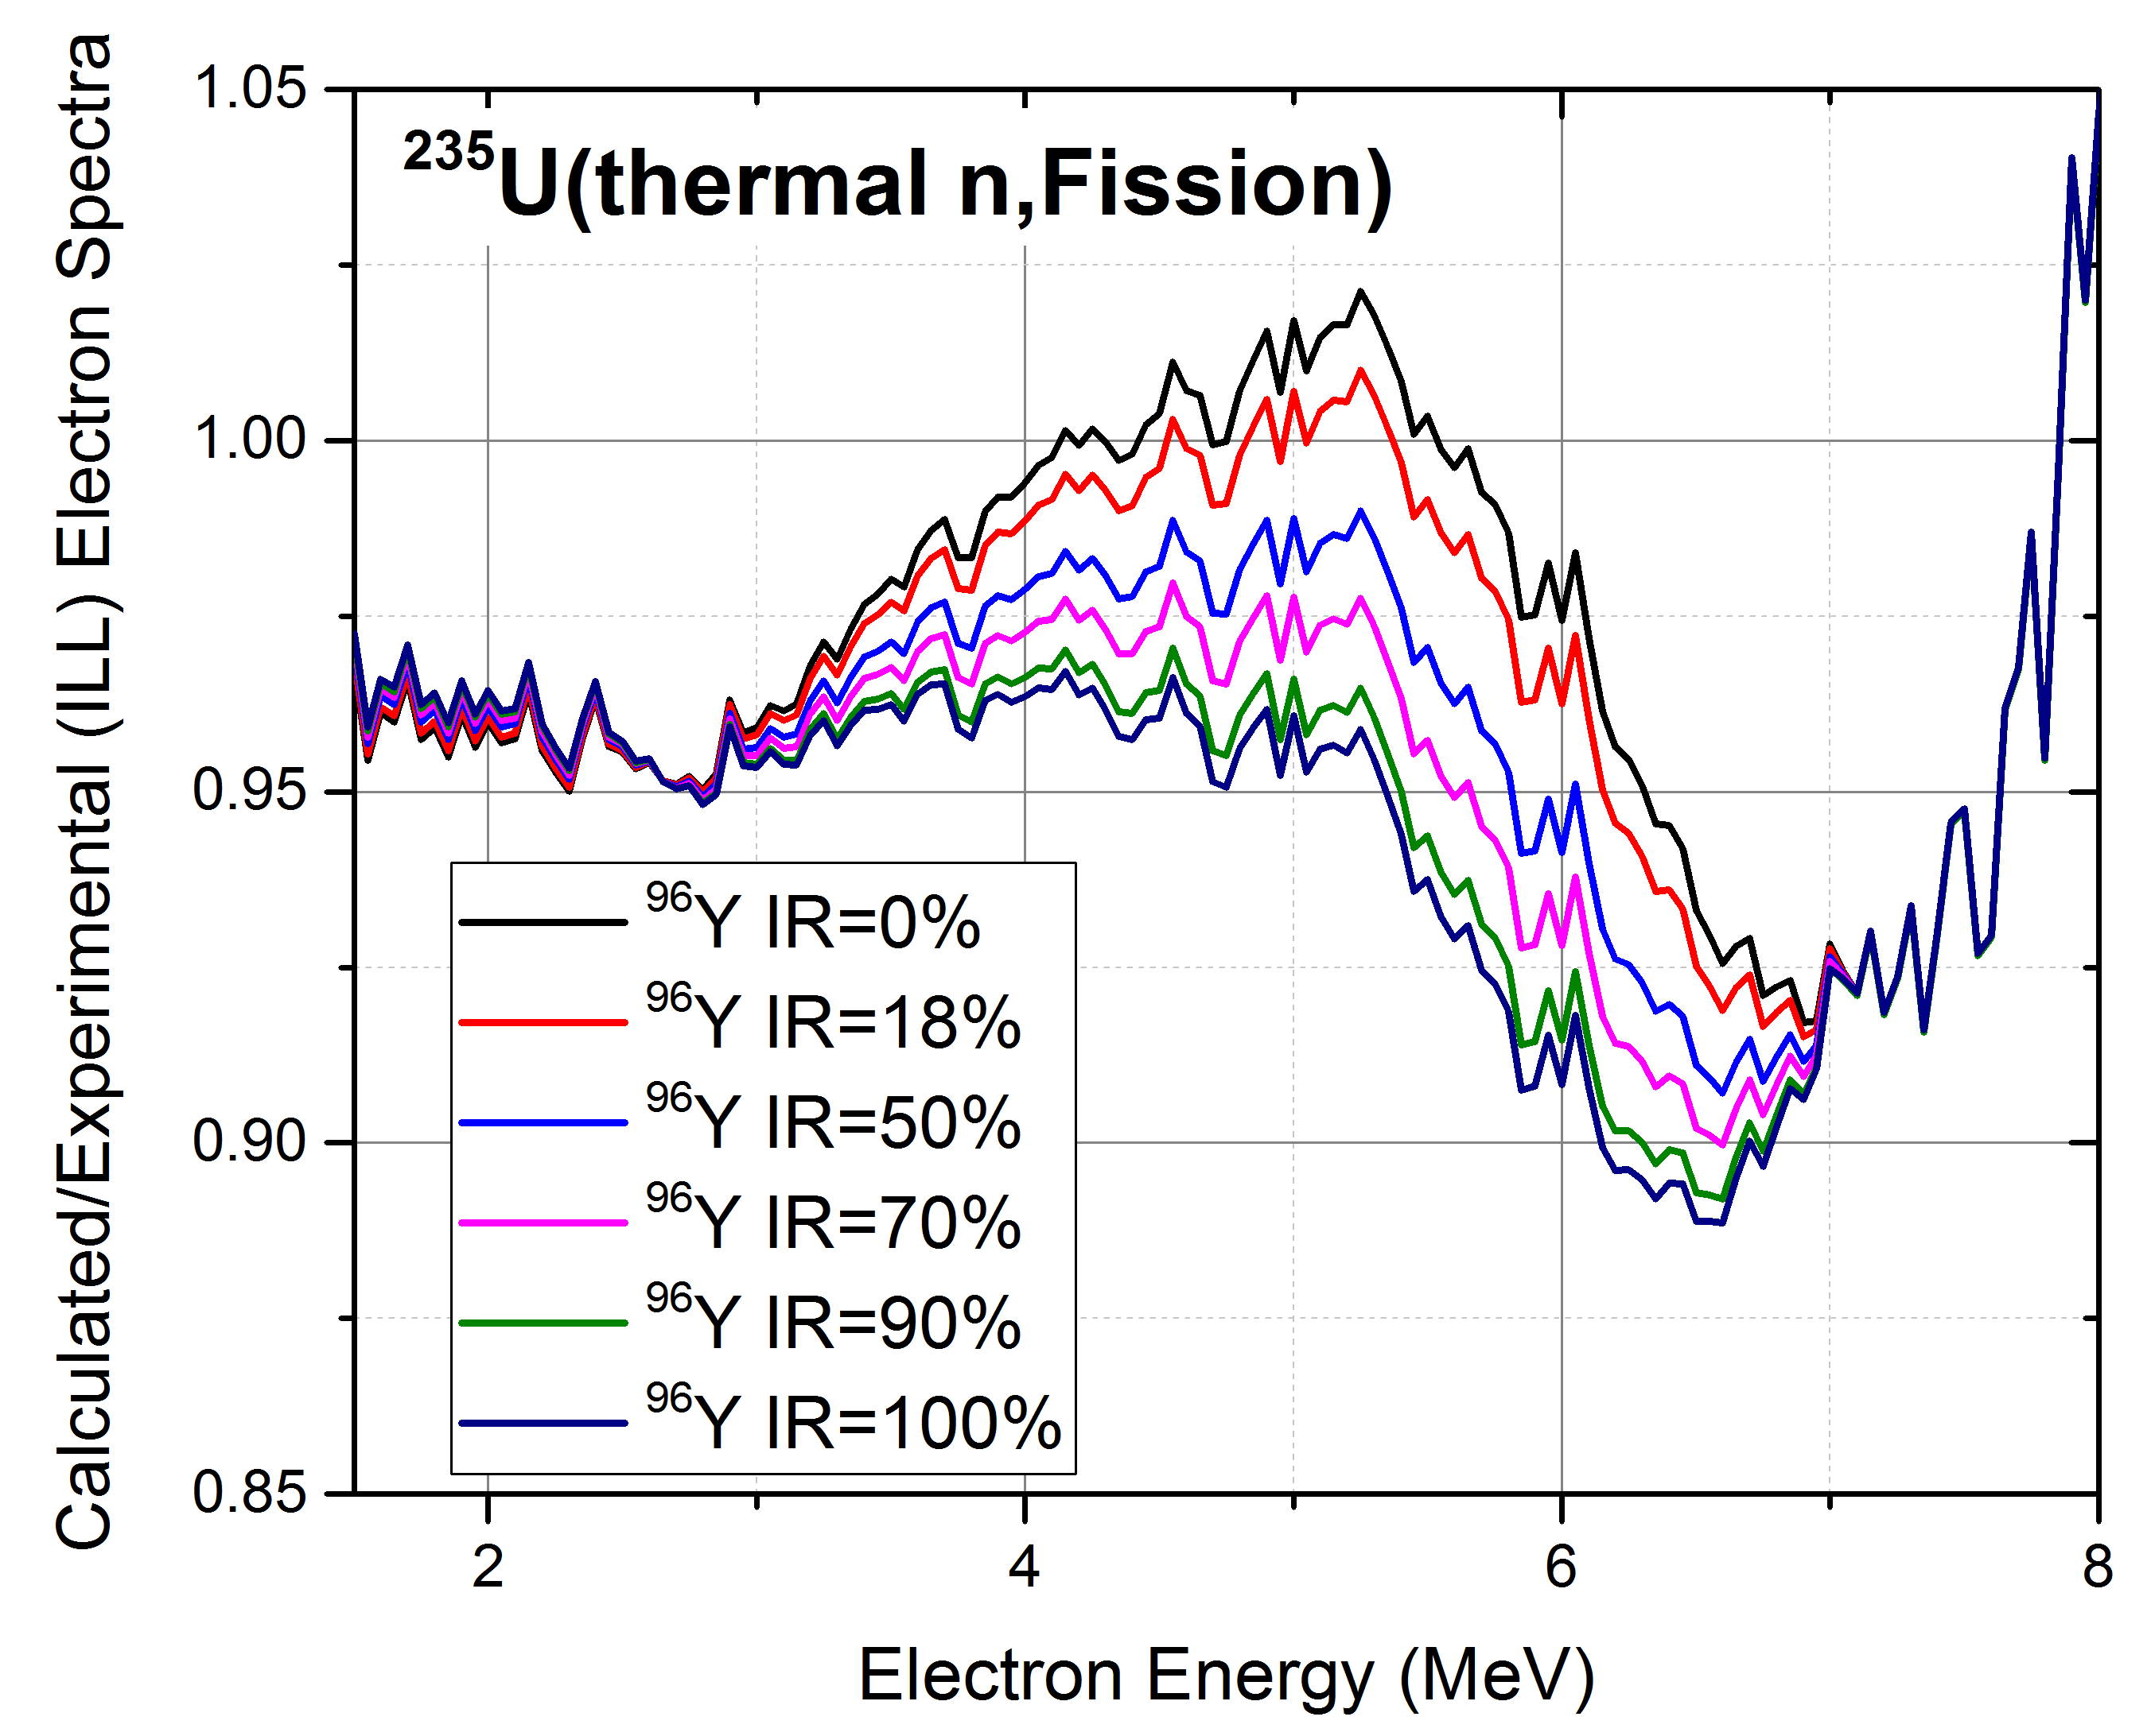
⁹⁶Y – Isomeric Ratio Effect
⁹⁶Y Isomeric Ratio:
CFY ~ 0.05
At about 5.2 MeV, changing IR from 0 to 100% changes the calculated to experimental ratio by 7%.
There is no journal publication of IR. Estimates vary from 18% to 70%.
Experiment in ILL (France)

Slide 14
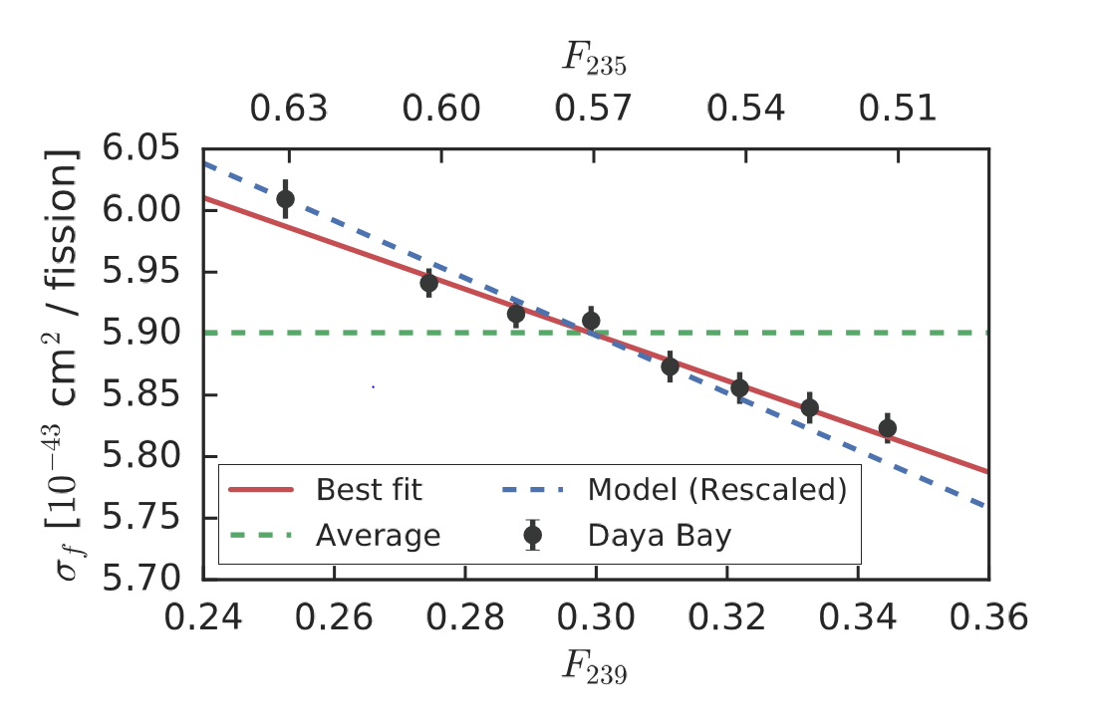
IBD Antineutrino yields (σ)
0.2% precision points!!!!
F.P. An et al,
PRL 118, 251801 (2017).
σ values (10⁻⁴³ cm²/fission)
Nucleus | Daya Bay 17 | Huber/Mueller | Our Summation
235U | 6.17+-0.17 | 6.69+-0.15 | 6.49
239Pu | 4.27+-0.26 | 4.36+-0.19 | 4.49
238U |  | 10.1+-1.17 | 10.2
241Pu |  | 6.04+-0.19 | 6.41
Must have CFY correlations for Summation uncertainties!

Slide 15
Correlations!
Integrated IBD yield:
Explicitly including the contributions :
Uncorrelated, small, possibly unknown, variance
Very correlated
Very correlated

Slide 16
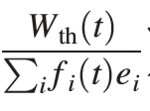
Average energy released in fission
The experimental IBD antineutrino spectrum has a normalization term
Where W_{th} is the thermal power, f_{i} are the fission fractions and e_{i} the average energies from fission converted in heat for ²³⁵U, ²³⁸U, ²³⁹Pu and ²⁴¹Pu.
In 2016, Daya Bay used the e_{i} values from V.Kopeikin, L.Mikaelyan, and V.Sinev, Phys. At. Nucl. 67, 1892 (2004).
In 2017, Daya Bay used those from X. B. Ma, Phys. Rev C 88, 014605 (2013).

Slide 17
Average energy released in fission converted to heat in a reactor
e_{i}=M_{i} +(1-nu-bar)M_{n} -Σ CFY_{i} M_{i} - <E_{ν}> - E_{long-lived}+ E_{neutron-capture}
Where the sum over cumulative fission yields is performed for a single A value nuclides near the valley of stability.
Using 2016 Atomic Mass Evaluation, and adding CFY_{i} uncertainties in quadrature, we obtain for ²³⁵U:
Work | Σ CFY_{i} M_{i} | % uncertainty
2004 Kopeikin | -173.430+- 0.050 | 0.0288
2013 Ma | -173.859+-0.062 | 0.0357
2017 ENDF/B corrected | -173.197+-0.213 | 0.123
2017 JEFF | -173.272+-0.486 | 0.281

Slide 18
Average energy released in fission
²³⁵U
Work | e_{i} | % uncertainty
2004 Kopeikin | 201.92+-0.46 | 0.228
2013 Ma | 202.36+-0.26 | 0.128
2017 ENDF/B corrected | 201.84+-0.68 | 0.339
2017 JEFF | 201.91+-0.81 | 0.402
²³⁹Pu
Work | e_{i} | % uncertainty
2004 Kopeikin | 209.99+-0.60 | 0.286
2013 Ma | 211.12+-0.34 | 0.161
2017 ENDF/B corrected | 210.87+-1.20 | 0.568
2017 JEFF | 210.61+-1.61 | 0.766

Slide 19
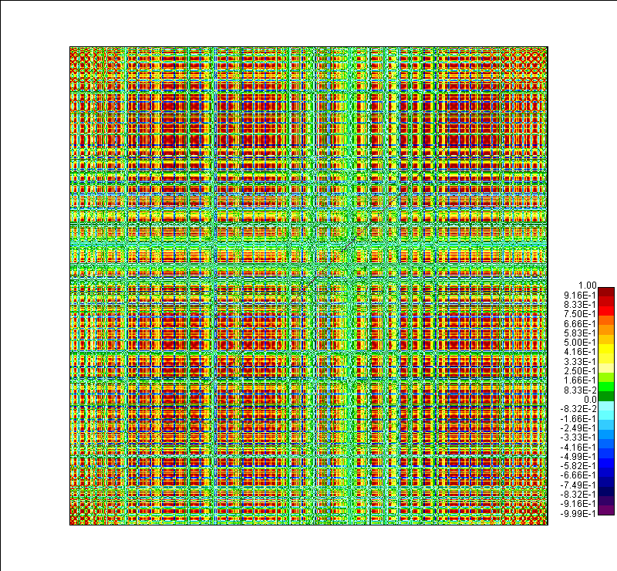
Independent Fission Yields Correlations
IFY(Z,A,liso)=( 5 Gaussians(A) ) x nu-bar(A) x Gaussian(Z) x Gaussian(Isomeric ratio)
Parameters obtained from fitting JEFF IFY values.
Then obtain correlations with a MC method.

Slide 20
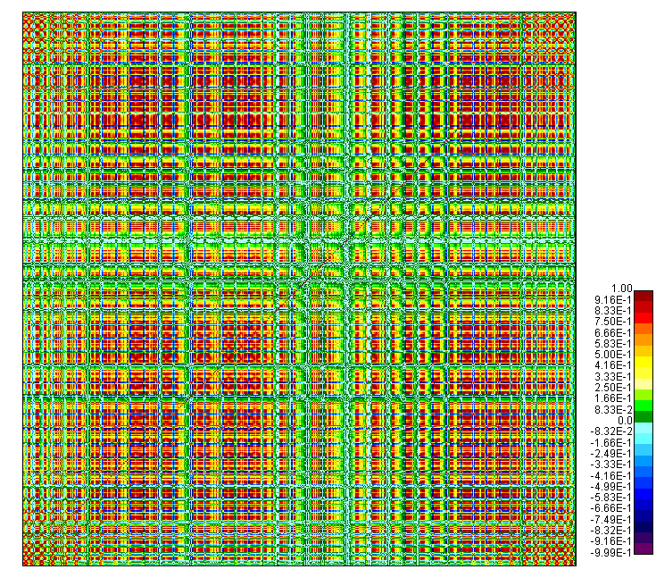
Cumulative Fission Yields Correlations
CFY= A IFY
Matrix A obtained from the ENDF/B-VIII.0 decay data sub-library.
MC method taking into account that %B- (1.0) and %B-n (1.5) are for our practical matters fully correlated.
Our preliminary results are that off-diagonal terms are less than 5% important for ei and σ calculations

Slide 21
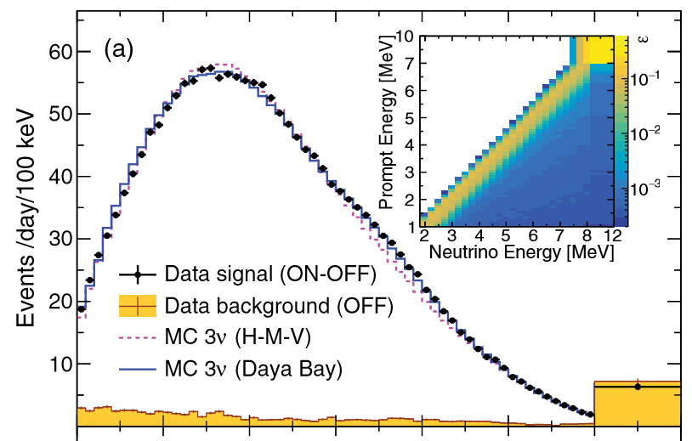
Fine Structure
(FY and decay data together)
NEOS data, 30 m from a power reactor
There seems to be structure?
Ko et al, PRL 118, 121802 (2017)

Slide 22
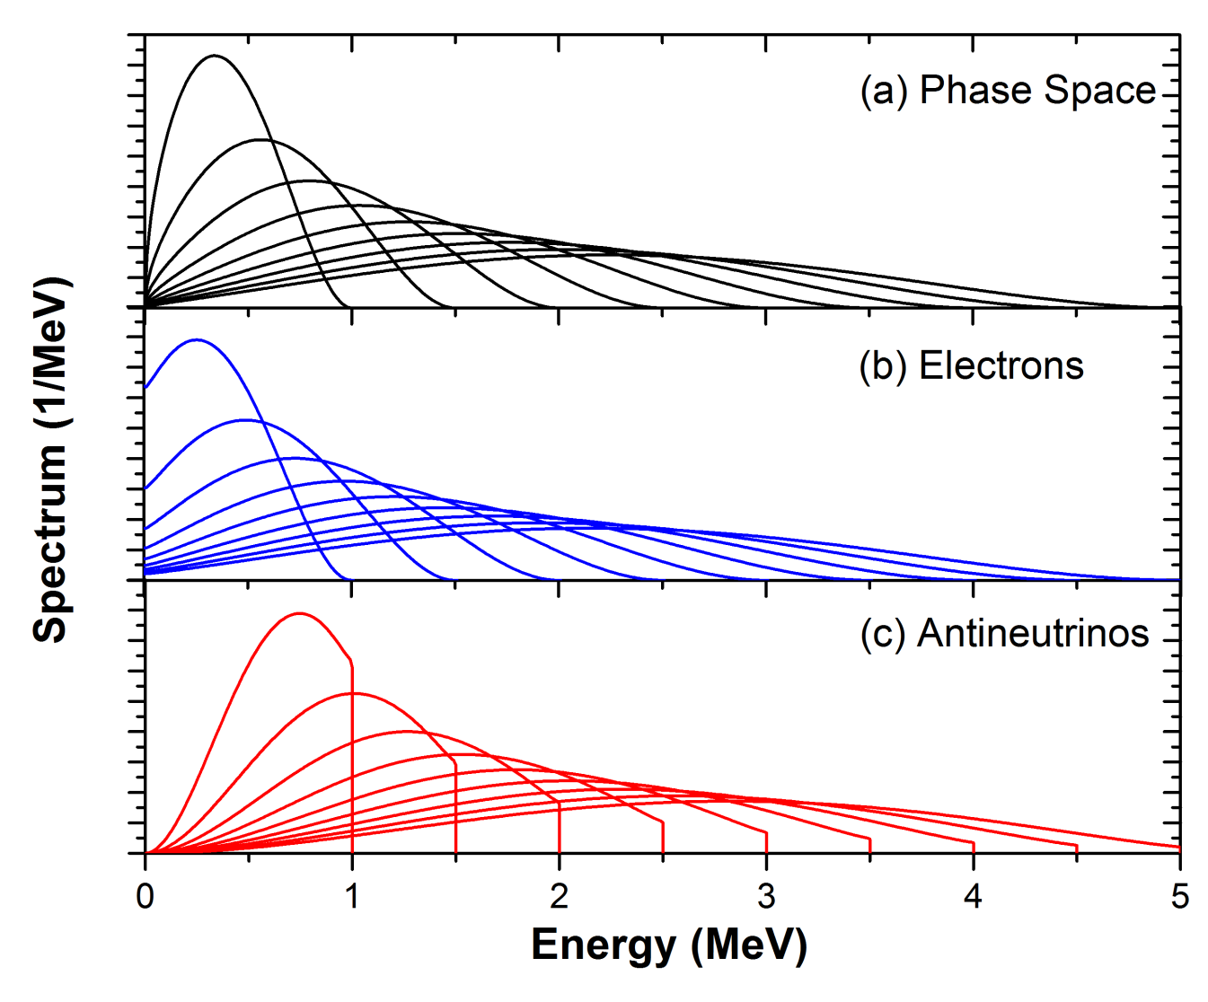
Electron spectra given by:
Wx(W²-1)^{1/2}x(W-Wo)²: Phase space
F(Z,W): Fermi Function
C(Z,W): Additional corrections
Rugged structure in the antineutrino spectrum due to Coulomb effects (Fermi function)

Slide 23
Fine Structure
As the reactor spectrum is the sum of ~800 individual spectra, can we seen individual effects?
Sharp cutoffs that can be seen with 0.1 MeV binning or less
Shoulder spanning several 100s keV

Slide 24
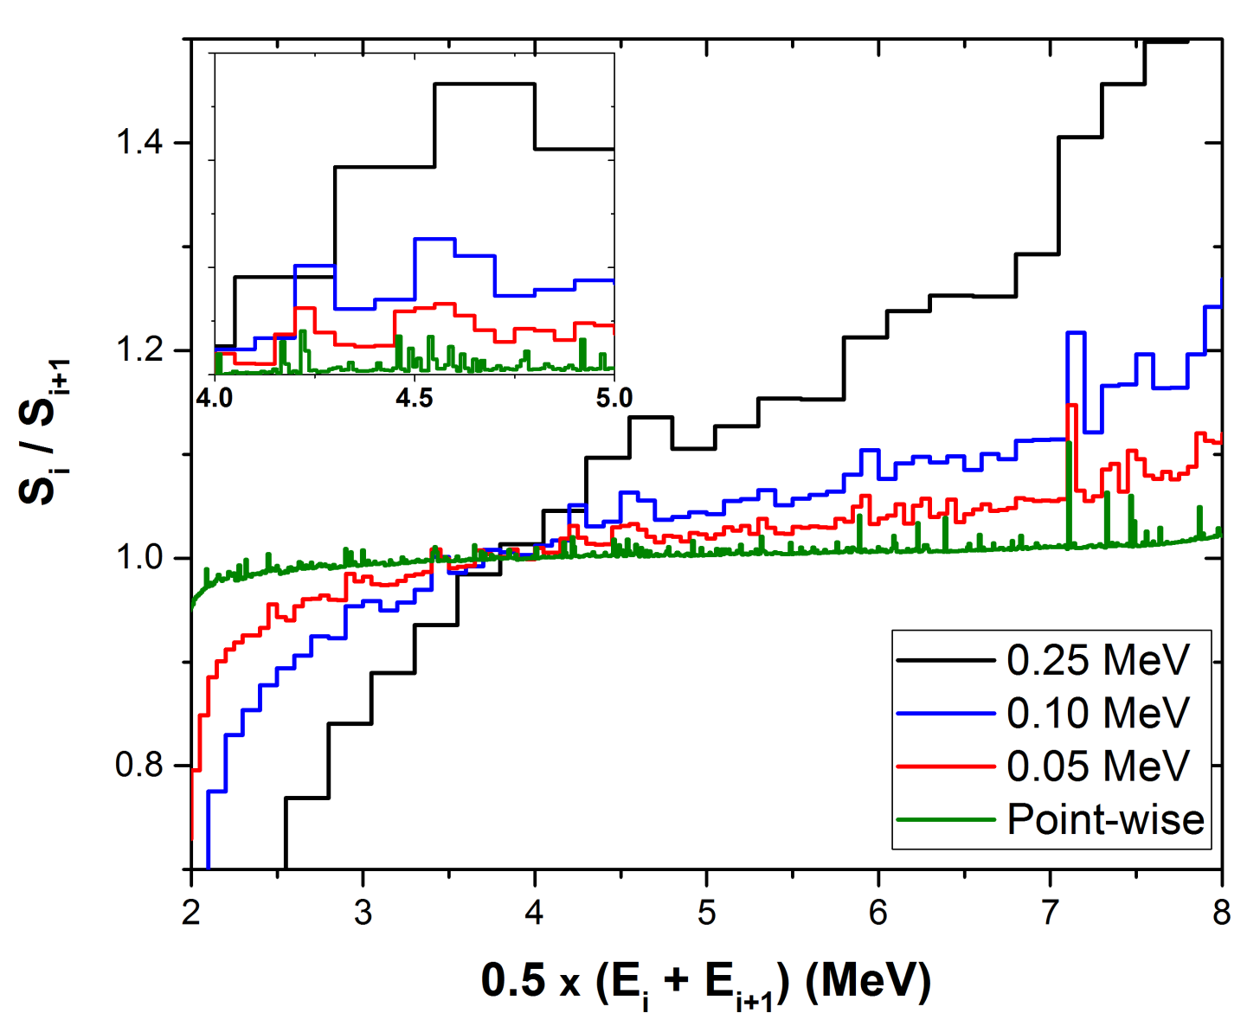
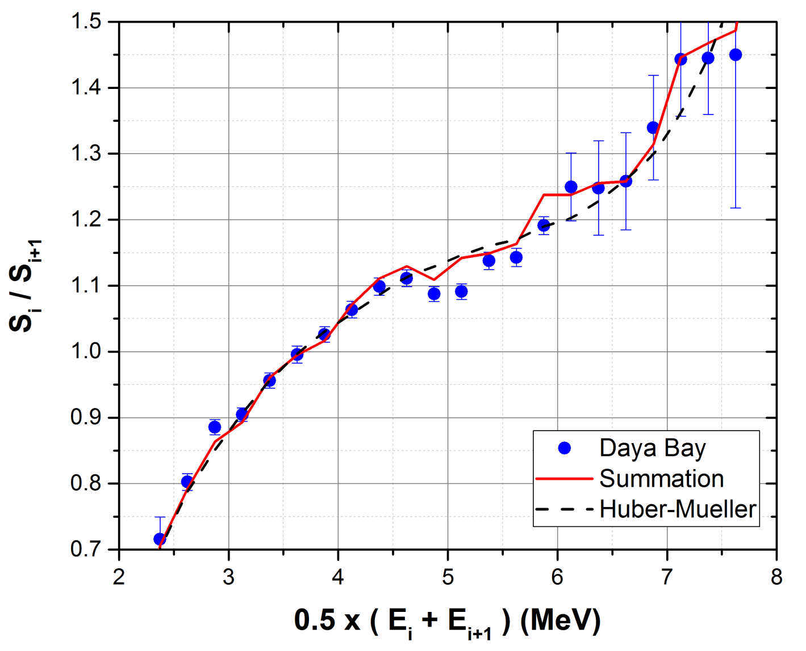
How to reveal Fine Structure?
Ratio of adjacent points:
R_{i}=S_{i}/S_{i+1}
Surprisingly, even with a 0.25 MeV binning a structure can be seen.
Structure observed in Daya Bay data, covariance matrix crucial for analysis.

Slide 25
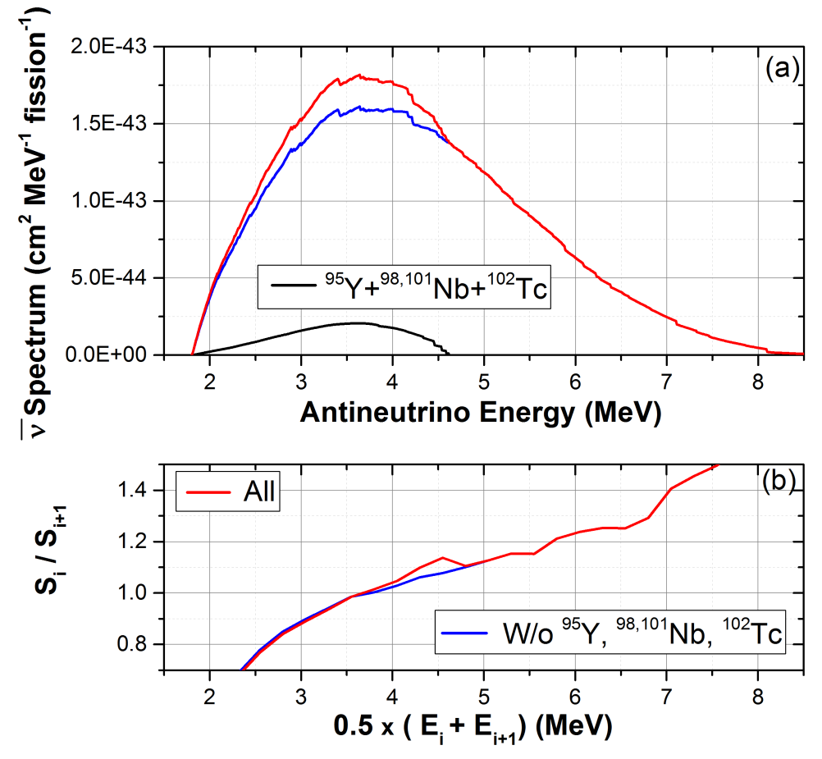
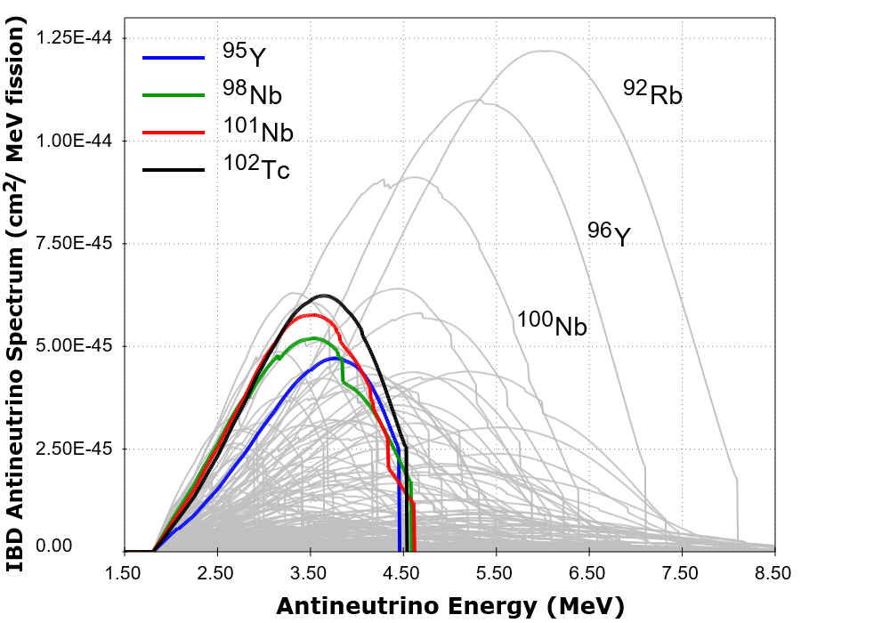
Nuclides behind fine structure
Incidentally, ¹⁰²Tc yields in ENDF/B need to be corrected.
For more details, see:
A.A. Sonzogni, M. Nino, E.A. McCutchan arXiv:1710.00092

Slide 26
C O N C L U S I O N S
We plan to produce a new decay data sub-library for the next ENDF/B release.
Taking advantage on the new GND format, we would like to add decay and excited level data as well as coincidence matrices.
Plan to update and correct ENDF/B yields.
New fission yields format would allow to add plenty of more information, such as:
Y(A) pre and post neutron emission
Nu-bar(A)
Correlation matrices

