Slide 1
The Nuclear Data Working Group: Accomplishments and Upcoming Workshop Catherine Romano
Cross Section Evaluation Working Group Meeting
(CSEWG)
November 6-9, 2017
Upton, NY

Slide 2
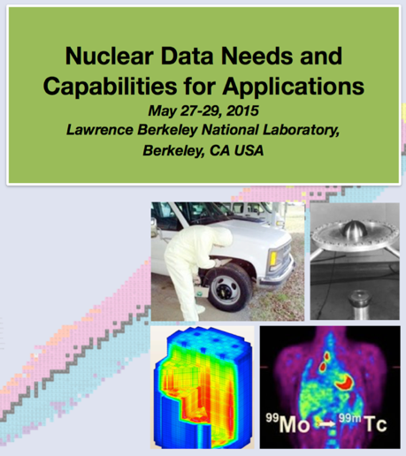
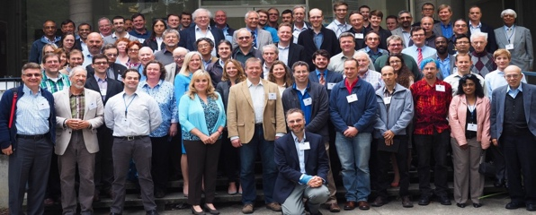
Recent Events in Nuclear Data
USNDP Review (7/14)
NDNCA Whitepaper release (10/15)
Interagency Nuclear Data Working Group (PMs) (6,7/16)
Nuclear Data Exchange Meeting Presentations to Program Managers (4/16)
NDIWG FOA Released
NP, NE, IP, NA-22, DNDO (4/17)
NDNCA Workshop (5/15)
Nuclear Data Working Group
DOE-NP, DOE-NE, NNSA, DTRA, DNDO
(11/15, 12/15, 2/16, 3/16)
NA-22 Nuclear Data Roadmapping Workshop (01/18)
Nuclear Data Needs and Capabilities for Basic Science Workshop (8/16)
Notes:
This is in your handout

Slide 3
The results of the workshop and a survey of the needs from current literature were compiled in the NDNCA whitepaper
Cross-cutting needs
Dosimetry Standards: for E_{n} up to 60 MeV to support IFMIF, ADS, and spallation sources.
Fission: the ‘Mother of All Fission Experiments,’ where TKE(A), ν, γ’s fragment yields for a range of Actinides for E_{n}=thermal-20+ MeV.
Decay Data & γ−Branching Ratios: including an IAEA list of decay data for “certain medical isotopes”.
Neutron Transport Covariance Reduction: Particular need for actinide (n,x) cross sections from 1-1000 keV.
Expanded Integral Validation: such as semi-integral data (e.g., pulsed sphere) to diagnose (n,n_{el}), (n,n_{inel}) shortcomings.
Antineutrinos from Reactors: with a specific call for new data for ^{235,238}U and ^{239,241}Pu…fission yields for odd-odd nuclei and β-spectral measurements.
http://bang.berkeley.edu/events/NDNCA/whitepaper

Slide 4
Nuclear Data Working Group (NDWG)
Several program managers met to discuss a path forward
Agreed that it would be beneficial and necessary to communicate and coordinate efforts
Idea: Facilitate communication and coordination through a group of program representatives made up of nuclear data experts at the national laboratories
The NDWG will:
Identify and prioritize nuclear data needs
Propose collaborative solutions

Slide 5
Partners | Program Manager | Program Area | NDWG Member
NNSA/DNN R&D | Donny Hornback | Proliferation Detection | Catherine Romano (Chair) Candido Pereira | ORNL ANL
DOE/SC/Nuclear Physics | Tim Hallman Ted Barnes | Nuclear Physics/Nuclear Data | Lee Bernstein Dave Brown | LLNL BNL
NNSA/DNN R&D | Donna Wilt | Forensics / Post Det. | Todd Bredeweg Jason Burke | LANL LLNL
DNDO/ Transformational & Applied Research | Namdoo Moon | Nuclear Detection |  | LANL
NNSA/NCSP | Angela Chambers | Criticality Safety | Mike Zerkle | LANL
NNSA/Defense Prog. | Ralph Schneider Staci Brown | Research and Development | Teresa Bailey | LLNL
NNSA/Defense Prog. | Douglas Wade Adam Boyd | Physics and Engineering Models | Bob Little | LANL
DOE/Nuclear Energy | Dan Funk | Nuclear Energy | Brad Rearden | INL
DNDO /Forensics | William Ulicny Jeff Morrison | Forensics | Richard Essex | NIST
NNSA /Forensics | Tom Black Steve Goldberg | Nuclear Technical Forensics | Bob Rundberg | LANL
DOE/SC/ Isotope Office | Jehanne Gillo Dennis Phillips | Isotope Production | Meiring Nortier | LANL
NNSA/Nuclear Safeguards and Security | Arden Dougan | Safeguards Technology | Sean Stave | ORNL
NNSA/DNN R&D | Chris Ramos | Safeguards | Chris Pickett | ORNL
 |  | Additional Expert Contributors | Mark Chadwick Patrick Talou Alejandro Sonzogni | LANL LANL BNL

Slide 6
FY 2016 NDWG Goal
Present a 5 year experimental plan that best meets the needs of multiple programs while leveraging facilities, funding, and expertise to minimize costs

Slide 7
Selection Criteria for Proposed Work
Cross-cutting needs
Emphasis on experiments that have not been accomplished within typical program funding and time constraints
Reach out to the community to utilize the best facilities and expertise across the complex
Include end-to-end data processing to ensure incorporation into ENDF
Work with and leverage current planned experiments
Minimize costs

Slide 8
NDWG Developed and Proposed 5-year, $50M proposal to address cross-cutting nuclear data needs
Proposals presented to 25 Federal Representatives: Program Managers from 7 DOE/NNSA offices, DTRA and DHS - Washington DC (4/14/16)
Revitalize the Nuclear Data Pipeline (Dave Brown)
Expand Covariance Data and its use (Skip Kahler)
Improve Inelastic Scattering Data for Neutron Transport (Lee Bernstein)
Upgrade Capture Gamma-ray Data in ENDF (Brad Sleaford)
Improve Theory, Modeling, Data and Evaluation of Fission Fragment Yields (Todd Bredeweg)
Reestablishment of Actinide Target Production Capabilities (Cathy Romano)

Slide 9
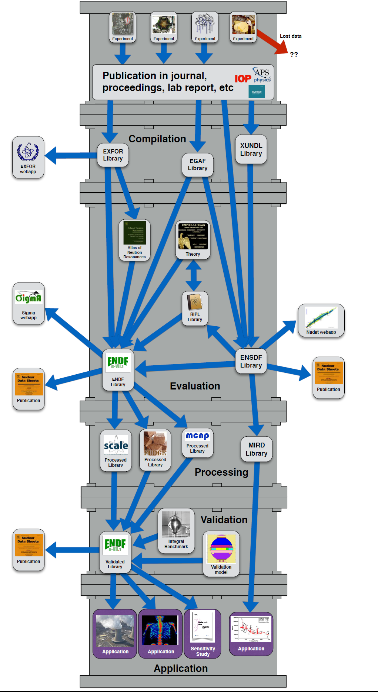
Topic 1: The Pipeline Dave Brown: Brookhaven Nat. Lab
Goal:
Update software and infrastructure
Train new workforce
Need to take a step back and build up the nuclear data platform
Supports all users of nuclear data

Slide 10
Topic 2: Covariance Data Skip Kahler: Los Alamos National Laboratory
Goal:
Provide uncertainties to the users for all data types
Enable capability to propagate uncertainties through the simulation
Need to take a step back and
build the framework
Many in nuclear reactor
community consider this the
number one need
Supports all users of
nuclear data

Slide 11
Topic 3: Inelastic Scattering Lee Bernstein: Lawrence Berkely National Laboratory
Goal:
Inelastic scattering cross section on ²³⁸U, ²³⁵U, and ²³⁹Pu from 1 keV to 3 MeV
Very large uncertainties
Hard-to-do experiment
Supports power reactors, criticality safety, and other neutronics models

Slide 12
Topic 4: Capture Gamma Spectra Brad Sleaford: Lawrence Livermore National Laboratory
Goal:
Evaluate and incorporate into ENDF existing data files of high-resolution gamma spectra
Supports interpretation of any gamma spectroscopy measurement

Slide 13
Topics 5-6: Fission Yields
Goal:
Understand fission yields
Uncertainties are large
Theoretical models feed evaluations and simulated neutron and gamma emission
Experiments validate the theory
Precursor to antineutrino solution
Support nuclear forensics, fuel depletion calculations, nondestructive analysis (NDA)

Slide 14
Topic 7: Target Production to Support Fission Experiments Catherine Romano: Oak Ridge National Laboratory
Goal:
Reestablish capabilities dismantled in the 1980s including vacuum evaporation and metal rolling
Proposed new vacuum evaporation for fission fragment energy experiments
Small-scale metal conversion and rolling capabilities for delayed fission gamma measurements

Slide 15
Nuclear Data Exchange Meeting
The Nuclear Data Exchange Meeting (NDEM) was held in April 2016
24 managers representing 11 programs
The NDWG gave an overview of the state of nuclear data and presented the proposal
Great question and answer session
Program managers were given a recommended path forward
Best practices for data management
Expectations for project costs and timelines
Information on the nuclear data process

Slide 16
The Nuclear Data Interagency Working Group (NDIWG)
The program managers formed a Nuclear Data Interagency Working Group
Currently about 16 program managers are communicating on a regular basis
Will meet twice a year
Led by Office of Science/Nuclear Physics
Additional programs may be interested in participating

Slide 17
NDIWG FOA Issued 04/26/2017
Collaborative FOA including funding from the following programs:
Nuclear Physics (NP)
Nuclear Energy (NE)
Isotope Program (IP)
Office of Defense Nuclear Nonproliferation Research and Development (NA-22)
Domestic Nuclear Detection Office (DNDO)
Incorporates NDWG recommendations for nuclear data management and evaluation
Projects can be funded up to 5 years
Requires an NNDC representative to be included in the project
These FOAs are intended to be annual
University call included for subsequent years

Slide 18
New Funded Projects
NNSA/DNN R&D and DOE NP agreed to co-fund the FIRE fission theory project
The NSSC Consortium was awarded ($25M, 5 years) to Berkeley in part because of their nuclear data focus on
Office of Nuclear Energy (NE) is considering funding nuclear data for the first time since 2012
FY17 DNDO funded nuclear data target development
NE has a nuclear data section of their university call
FY18 NA-22 O(alpha,n) evaluation (NA-22)
FY18 NA-22 F(alpha,n) thick target measurements
FOA FY18 funded by NP and NA-22:
Improving the Nuclear Data on Fission Product Decays at CARIBU
Novel Approach for Improving Antineutrino Spectral Predictions for Nonproliferation Applications

Slide 19
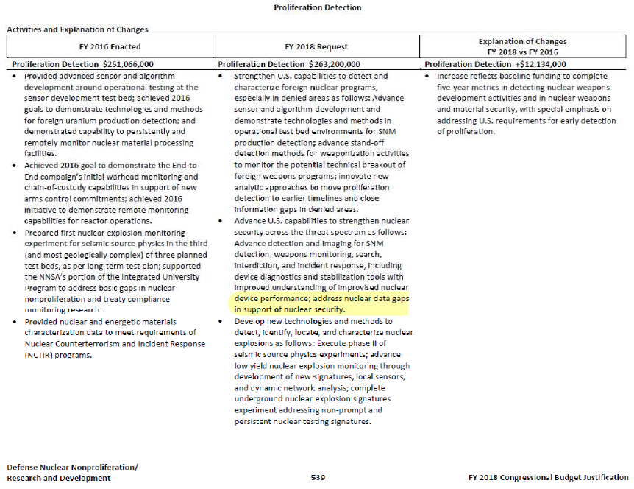

Slide 20
Conclusions
The NDWG has brought nuclear data to the forefront
Facilitated communication between Office of Science and application-based programs
The nuclear data community has been afforded an opportunity to inform headquarters of critical needs and provide solutions as a unified voice

Slide 21
NA-22 Nuclear Data Workshop and Roadmap
Workshop scheduled for Jan 23-25, 2018
Classified session Jan 26th.
Also provides input to Annual FOA
Tim Hallman (NP) is committed to FOA this year
University version will also go out
Federal Program Managers invited for Thursday afternoon recap/discussion session
All agencies invited
Roadmap will be written from conclusions of workshop
Will be shared with other agencies

Slide 22
Goal of Roadmap: Inform nuclear data funding decisions for Nuclear Nonproliferation
Provide mission driven nuclear data priorities with target uncertainties
Estimate reduction in mission application uncertainty based on improved nuclear data
Provide tasks required to provide high priority nuclear data available to users including:
Measurements – differential and integral
Evaluations
Testing
Processing Tools
Covariance
Validation
Coordinate tasks with existing program plans

Slide 23
Goals of the Workshop
Communication – Coordination – Collaboration
Breakout sessions allow nuclear data community to provide comprehensive solutions to known problems
Peer-reviewed ideas
Prioritize needs for mission driven applications
Ensure data improvements are useful
Examine opportunities to leverage or enhance existing funded/planned work
Informs the nuclear data community of what is important (i.e. what nuclear data task should I propose)
Shared expertise, facilities, equipment
Collaborative vs competing proposals
Think out of the confines of the typical funding mechanisms
What does it take to get it done right?
How long, FTEs

Slide 24
Workshop Agenda
Tuesday, Jan 23rd:
Morning: Introductions/Presentations
Afternoon: 3 breakout sessions
Wednesday, Jan 24th:
Morning: 3 breakout sessions
Afternoon: 3 breakout sessions
Thursday, Jan 25th:
Morning: 3 breakout sessions
Afternoon: Presentation of findings and Q/A sessions with PMs.
Friday, Jan 26th:
Invite only classified session

Slide 25
Brainstorm of Topic Areas Based on Nonproliferation Needs
(alpha,n) cross sections
Spontaneous fission neutrons
Gamma induced reactions for active interrogation
Capture gamma spectral data
NA-22 high priority list
Inelastic scatter on light nuclides – xs, gamma spectra
Fission Yields: create new, robust ENDF data
Fragments- independent/cumulative
Prompt and delayed Neutron/gamma
decay
Minor actinide cross sections – fission, capture
Uncertainty/Sensitivity studies for applications
Covariance data
Target material availability
Facility availability
Best practices for nuclear data management

Slide 26
Institute for Nuclear Materials Management (INMM) Baltimore, MD July 2018
Title: Nuclear Data For Nonproliferation
Morning Session: | Session Chairs D. Hornback/Lee Bernstein
Session Title: Nuclear Data Past and Present Efforts
1. NA-22 Nuclear Data Working Group Efforts | Cathy Romano | ORNL
2. Evaluation of Dat for Acceptance into libraries | Alejandro Sonzogni | BNL
3. Nuclear Data: A Historical perspective | Allan Carlson | NIST
4. Nuclear Data for Forensics
5. Past Efforts: UQ Workshop | Rian Bahran | LANL
6. Mag Micro-calorimetry Gamma spectrometry | Stephan Friedrich | LLNL
7. NDA Measurement needs | Stephen Croft | ORNL
8. Case Study for Uncertainty Quantification | Martyn Swinhoe | LANL
9. ASTM Requirements for NDA | Ram Vekataraman | ORNL
Afternoon Session: | Session Chairs: Chris Ramos/ Cathy Romano
Session Title: Nuclear Data Types
1. UF6 Cross-section efforts | Michael Smith | ORNL
2. Nuclear Data for forensics | Kenton Moody or Michael Kristo | LLNL
3. Nuclear data at RPI | Yaron Denon | RPI
4. Fission cross sections | Mike Heffner / Uwe Greife | LLNL/CSM
5. Fission yields | Fredrick Tovesson / Anton Tonchev | NNSA/LLNL
6. Neutron capture | Klaus Guber/ Arjan Plompen (JRC – Geel) | ORNL/JRC
7. Surrogate reactions | Lee Bernstein | LBNL
8. Reaction theory | Toshihiko Kawano | LANL
9. Uncertainty quantification | Denise Neudecker | LLNL
10. Modeling Systems | Ian Gauld | ORNL

