Slide 1
Welcome to BNL
Brookhaven Forum 2017
In Search of New Paradigms
Oct 11, 2017
Hong Ma
10 Years of Brookhaven Forum
Notes:
Safety!
70/100!

Slide 2



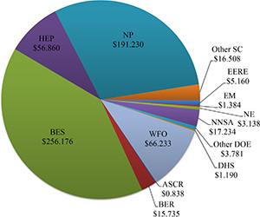
Brookhaven Lab at a Glance…
Established in 1947
One of 17 DOE Labs, 10 DOE Office of Science, 6 multi-program Office of Science Labs
Managed by Brookhaven Science Associates
  Core universities: Harvard, Princeton, Yale, MIT, Columbia, Cornell
3,000 employees => ~5400 jobs in NY State
  400 Grad/Undergrad Students (BNL payroll)
$600M annual budget
5,320 acres with 310 buildings
Major user facility for university and industry researchers
  Over 4,000 users per year
Fundamental, basic research to innovation, development and commercialization of technologies: energy S&T, nuclear and high energy physics, bio and environmental sciences, big data, national security
Recent Annual Funding
by Source (Costs in $M)

Slide 3
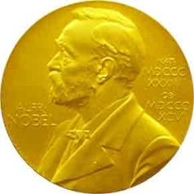
Some of BNL’s historical contributions to physics
Yang-Mills Theory in 1954
Parity Violation (Lee,Yang) in 1956
Neutrino Helicity (Goldhaber) in 1957
Two Kinds of Neutrinos (Lederman, Schwartz, Steinberger), 1962
CP Violation (Cronin, Fitch), 1964
Omega Minus (Samios), 1964
J-Particle (Ting), 1976
Solar Neutrinos (Davis) 2002
Quark-Gluon Plasma as perfect liquid (RHIC Experiments) 2005
Neutrino θ₁₃ (Daya Bay Experiment) 2012
Higgs Boson (ATLAS Experiment) 2012

Slide 4
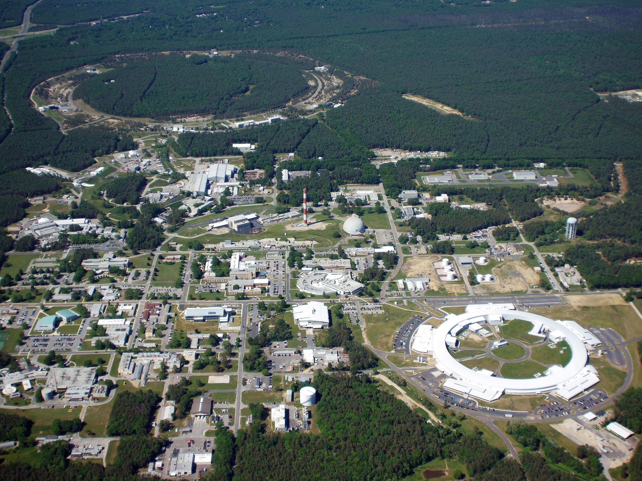
Brookhaven National Laboratory
RHIC
NSRL
BLIP
BNL Scientific Data and
Computing Center
Interdisciplinary Energy
Science Building
CFR-I
ATF
CFN
NSLS-II
Long Island Solar Farm

Slide 5
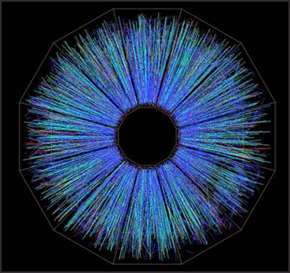
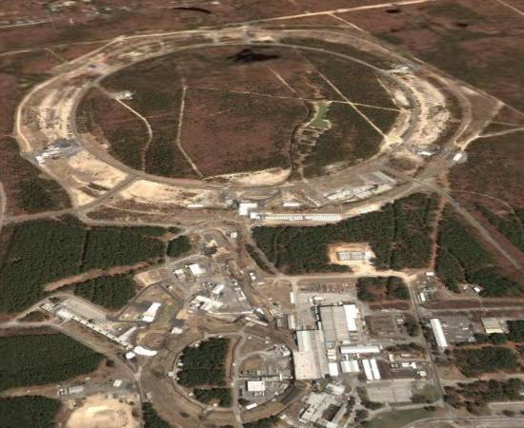
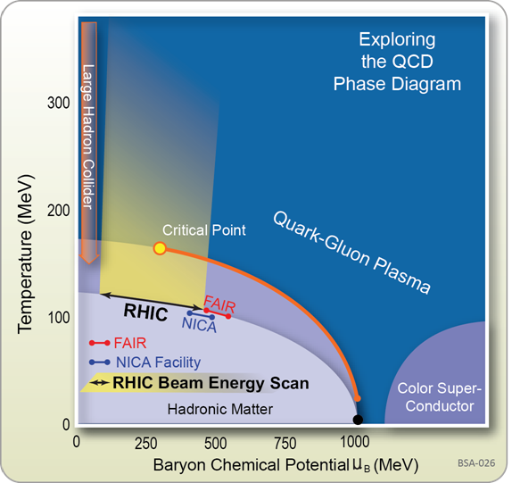
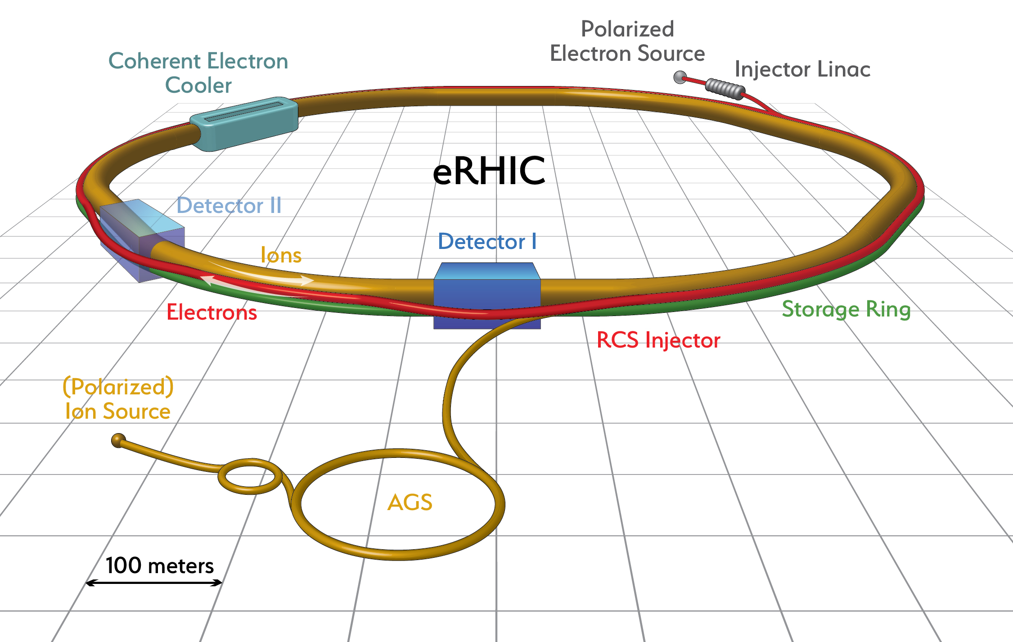
Relativistic Heavy Ion Collider (RHIC)
Dedicated high energy collider for fundamental nuclear physics
  World-wide collaboration of more than 1,000 scientists, engineers and students
Unique, most powerful microscope to explore the world of the strong force in heavy ion collisions and polarized protons.
  It is a Quark-Gluon Plasma
  and a “Perfect Liquid”!
Strategy for the future
  Measure the extraordinary properties of the perfect liquid: Isobar, beam energy scan-II, heavy flavor, jets
  Transition from RHIC to eRHIC to learn what’s at the heart of all visible matter
Notes:
Understand the origin of the universe a microsecond after the big bang

Slide 6
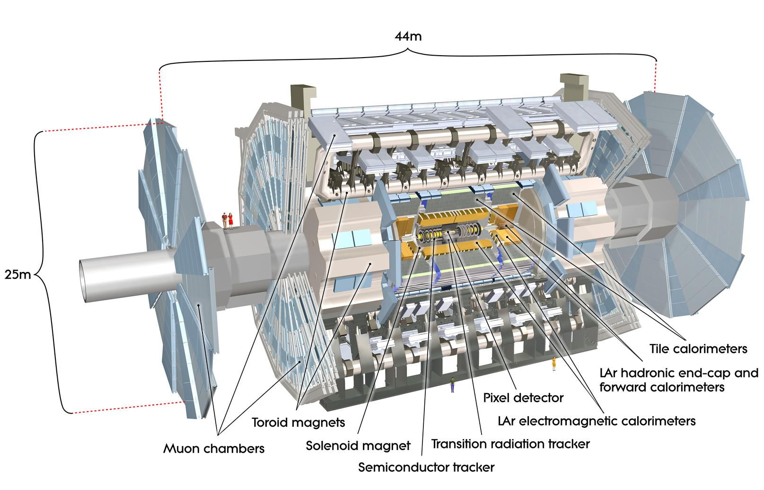
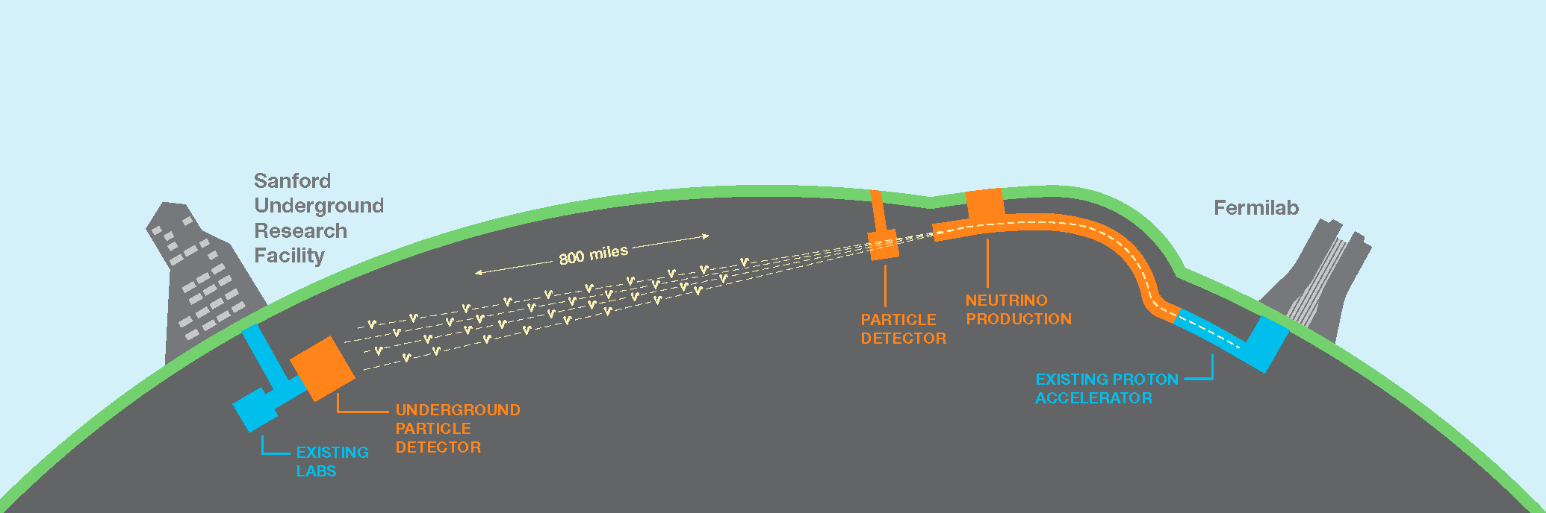
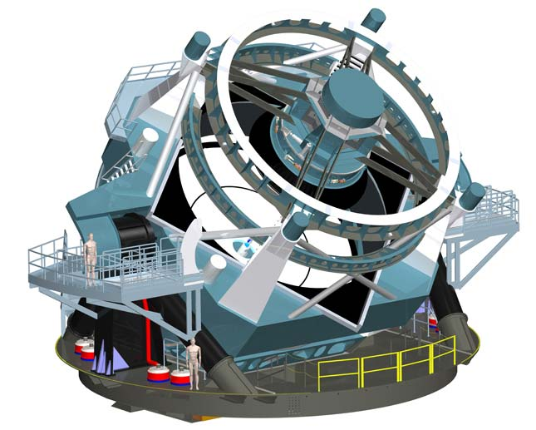
High Energy Physics
ATLAS
Energy Frontier: ATLAS
  US ATLAS Operations Program
  Phase I – Upgrade Project
  HL-LHC Upgrade Project
  Tier I Computing
  Software & distributed computing
  Physics analysis and support
Intensity Frontier: Neutrinos +
  LArTPC: MicroBooNE, SBND and DUNE.
  Host International DUNE Project Office
  Reactor ν Exp: Daya Bay & PROSPECT
  Muon g-2 Experiment
  Belle II Tier-1 Computing
Cosmic Frontier: LSST
  Development and characterization of CCD sensors and production of Science Rafts.
  Large scale structure theory and experiment, weak lensing and computing infrastructure
High Energy Theory
  Precision Electroweak, Collider phenomenology, Dark Sector, Lattice QCD
DUNE
LSST
Notes:
Understand the origin of the universe a microsecond after the big bang

Slide 7
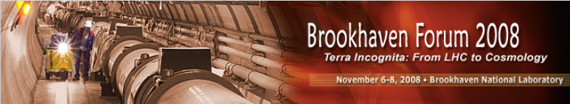

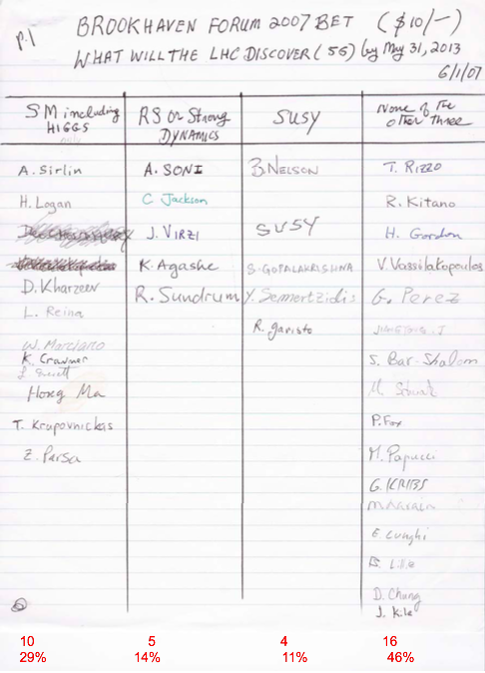
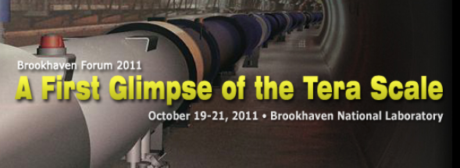
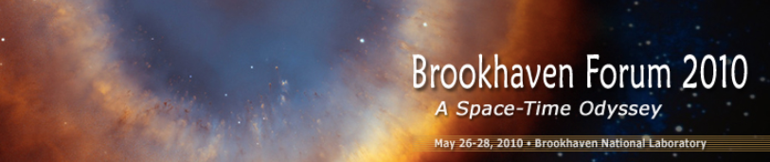
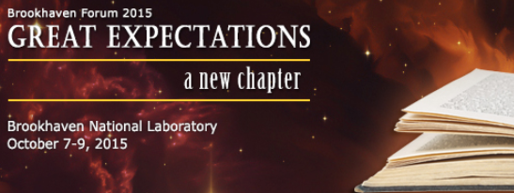

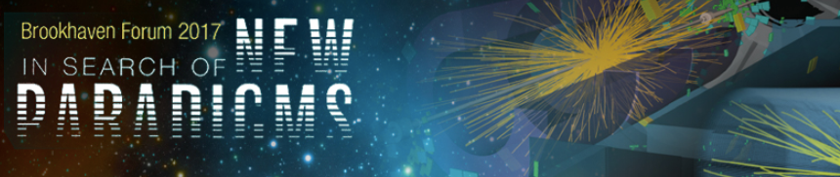

Slide 8
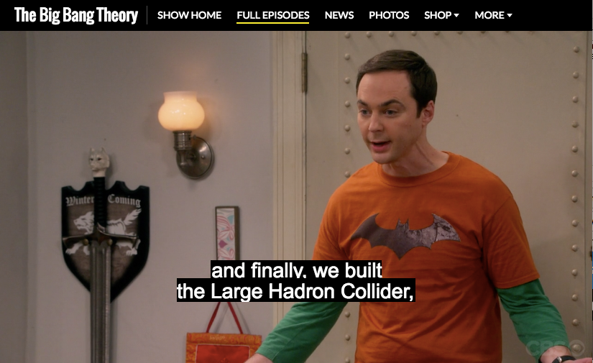
Sheldon: we have been hoping supersymmetry was true for decades, and finally we built the Large Hadron Collider, which is supposed to prove it by finding these new particles, and it hasn’t. And maybe supersymmetry, our last big idea, was simply wrong.
Leonard: Well, that sounds awful.

Slide 9
Have a Productive Workshop and Happy Searching!

