Slide 1
Revealing thermal transport mechanism in thermoelectric materials
Junjie Li, Gang Chen, Yimei Zhu
Brookhaven National Laboratory
Massachusetts Institute of Technology

Slide 2


Thermal conductivity
Figure of merit: inversely proportional to thermal conductivity
T: temperature
σ: Bulk thermal conductivity
unit: W/m·K
G: Interface thermal conductivity
unit: W/m²K
T_{A} TB

Slide 3
Phonon transport at nanometer
Thermoelectric materials:
MFP is too short
Zeng, L., Scientific Reports 5, 17131 (2015)

Slide 4
Interface thermal transport at nanometer
Acoustic-mismatch (AM) model
diffuse mismatch (DM)model
  the probability of being scattered to one side is simply proportional to the phonon density of states
A B
Nanometer scale materials:
theory and regular measurement method don’t work
Cahill, D. G., J. App. Phys. 93, 793 (2003)

Slide 5
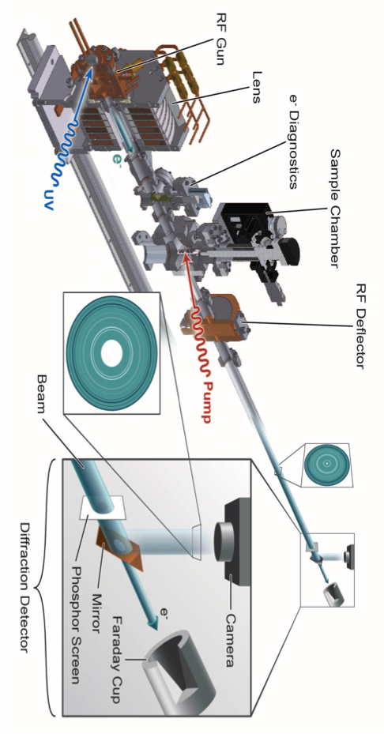
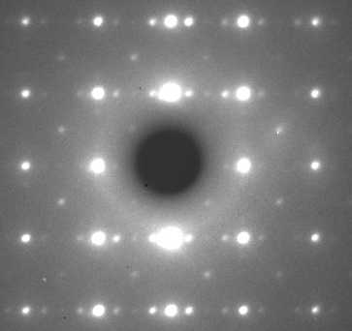
MeV-Ultrafast Electron Diffraction
Notes:
Here shows a typical optical pump probe measurement. The pump pulse will arrive first to initiate a dynamical process, This involves the interaction between laser and sample. Also it set the time-zero or the beginning of the whole process. Then after a short time-delay, at t1, the probe pulse arrives to measure the reflectivity. By adjusting the time delay, we finally can get a whole curve of how the optical properties change during the dynamic process initiated by the pump pulse.
Nowadays, there are many kinds of pump probe technique. They all use laser pulse to pump, but probe varies a lot.

Slide 6
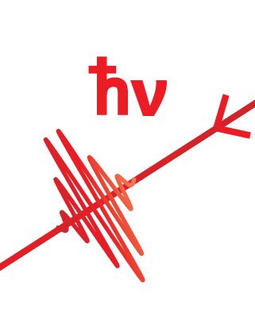
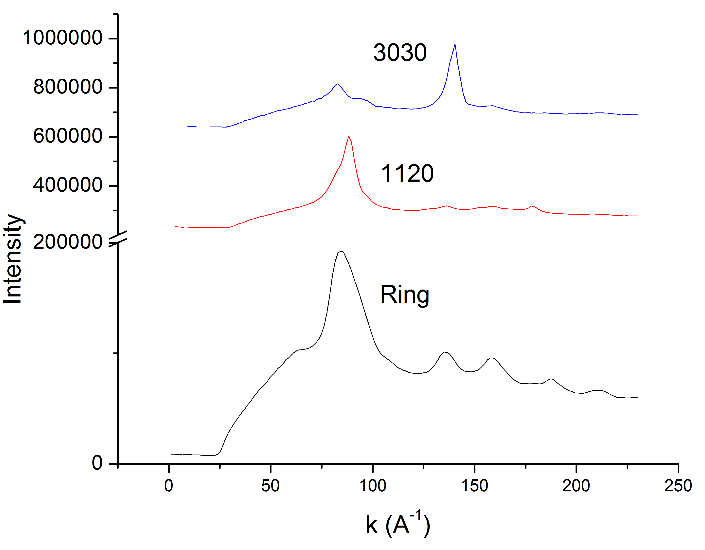
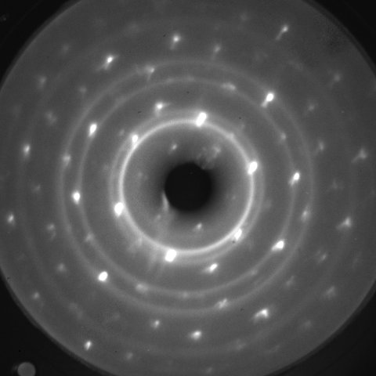
Electron diffraction test on Au/Bi₂Te₃
e⁻
Au
Bi₂Te₃
1120
3030

Slide 7
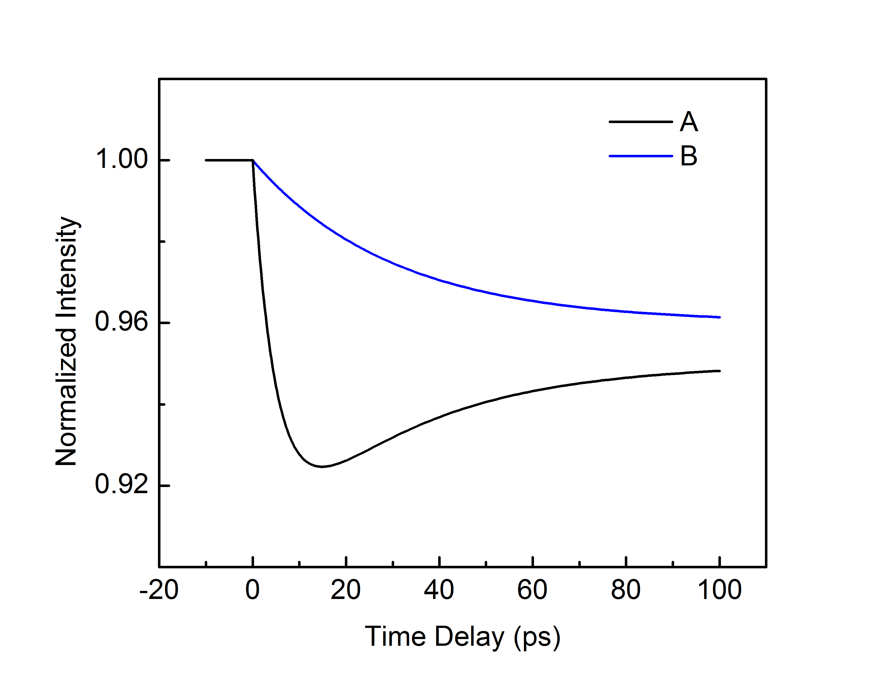
Time resolved method with UED
e⁻
A
A B
Heat
transport
A
A
B
Phonon scattering and
Thermal transport at interface
e-p coupling and
phonon coupling within A

Slide 8
Summary
Difficult to measure heat transport at nanometer scale
UED present a unique method to scale temperature and measure thermal conductivity.
Preliminary test shows promising result

Slide 9
Thank You!

