Slide 1
Overview of CO₂ Laser R&D Program
20th ATF Program Advisory Committee
and Users’ Meeting
December 5-7, 2016
Igor Pogorelsky

Slide 2
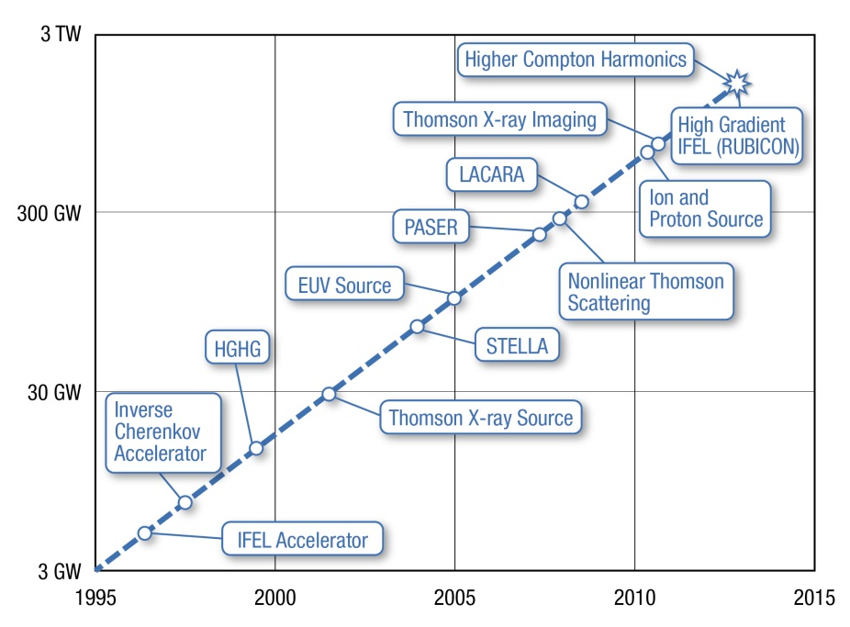
History of ATF CO₂ laser upgrades
30 TW
1995-2015
10x power increase every 7 years
Reached saturation at 2 TW due to nonlinear distortions
2016-2017
Regroup to implement new concepts
R&D to make new concepts productive
2018 and after
Continue initial trend of power increase alongside with continuing R&D
Reach tens of TW
2020
2025

Slide 3


Concept ultra-fast CO₂ laser (Original ATF-II Proposal)
35 µJ
350 fs
Amplifier 1
10 µJ
100 ps
Collection of innovations:
Ti:Al2O3
OPA
Stretcher
OPA: fs seed
Stretcher + compressor = Chirped pulse amplification
High-pressure, isotopic amplifiers
Nonlinear compressor
100 mJ
Amplifier 2c
Amplifier 2b
Amplifier 2a
70 J
50 J
2 ps
25 TW
Non-linear compressor
10 J
100 fs
100 TW
Compressor

Slide 4
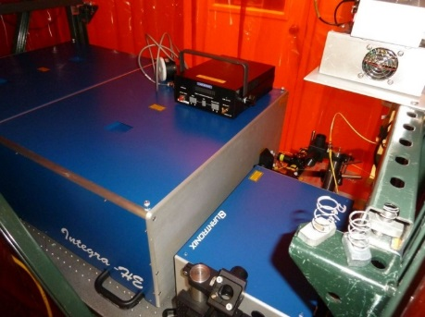
Present-day configuration
Ti:Al2O3
15 µJ
350 fs
Amplifier 1
OPA
1 µJ
80 ps
Collection of innovations:
Stretcher
10 mJ
25 ps
Recent past ---
OPA: fs seed
Stretcher + compressor = Chirped pulse amplification
High-pressure, isotopic amplifiers
Nonlinear compressor
20J
Regular gas
Isotopes
2017
R&D
Amplifier 2
8-9 J
Regular gas
Near future ---
Compressor
Isotopes

Slide 5
2017 R&D topics:
Ti:Al2O3
15 µJ
350 fs
Amplifier 1
OPA
CPA regime
Purpose: produce ~2TW peak power
1 µJ
80 ps
Stretcher
10 mJ
25 ps
Isotopic amplifiers
Purpose: produce a single 2ps pulse at 3-4TW peak power
20J
Plasma
Shutter
Amplifier 2
YAG
Plasma shutter
Purpose: block parasitic reflection that hinders delivering laser to plasma interaction point
~2 TW
Compressor
3-4 TW

Slide 6
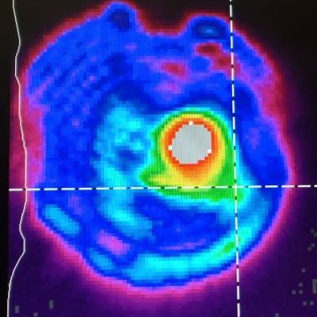
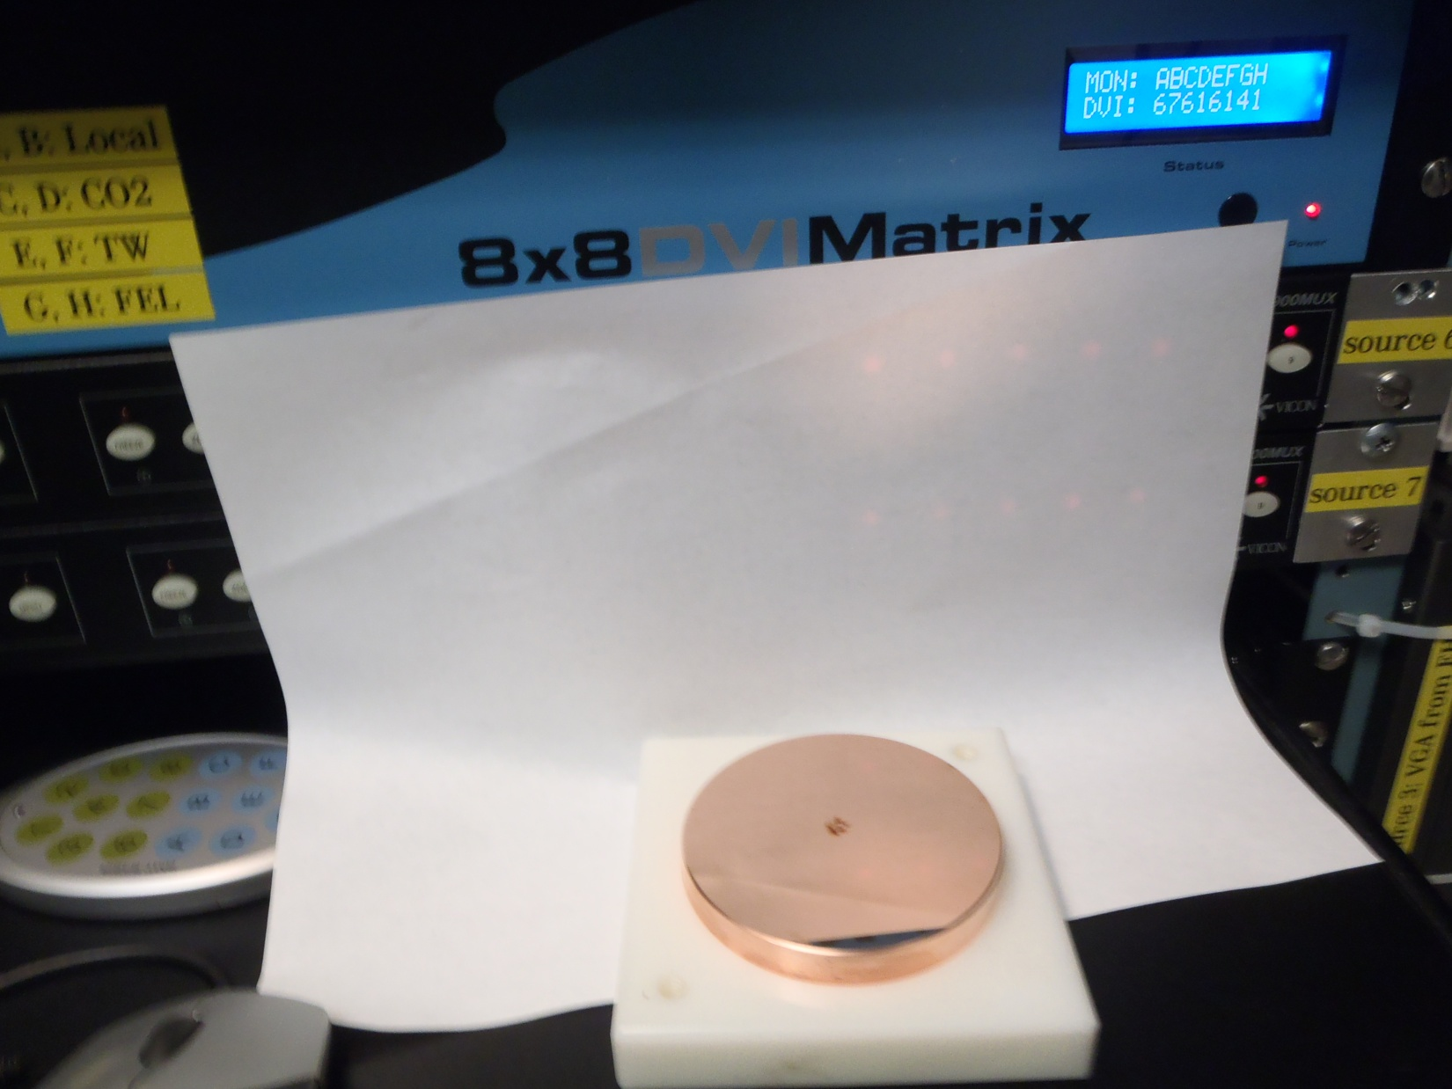
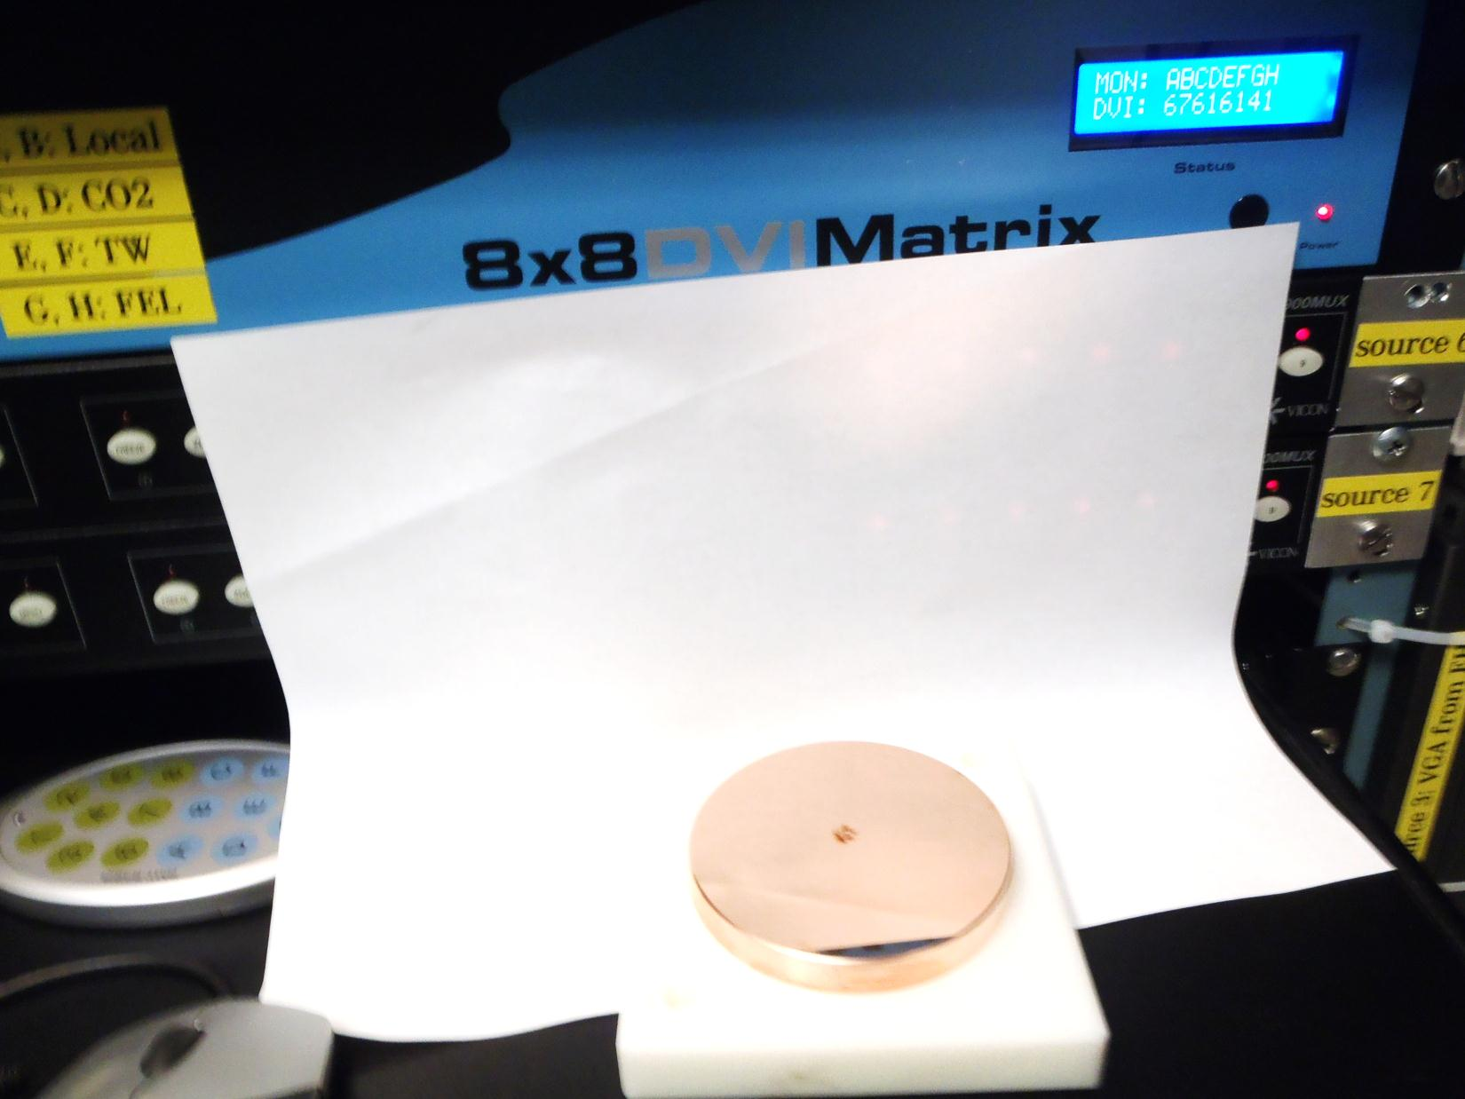
CPA R&D
1st step : Partial CPA
(direct amplification in Amplifier2)
New development: Full CPA
Ti:Al2O3
15 µJ
350 fs
Amplifier 1
Ti:Al2O3
15 µJ
350 fs
Amplifier 1
OPA
OPA
1 µJ
80 ps
1 µJ
80 ps
10 mJ
25 ps
Stretcher
10 mJ
25 ps
Stretcher
5mJ
3ps
6J
3-3.5ps
1.7-2TW
Small Compressor
20J
1st CPA demonstration published earlier
Remaining problem –
nonlinear distortions in the compressed output
Amplifier 2
Polyanskiy, Babzien, Pogorelsky,
"Chirped-pulse amplification in a CO₂ laser,"
Optica 2, 675-681, 2015
Amplifier 2
Above damage threshold 5J/cm²
We expected:
~10J
3.5ps
~2TW
3”
Compressor

Slide 7
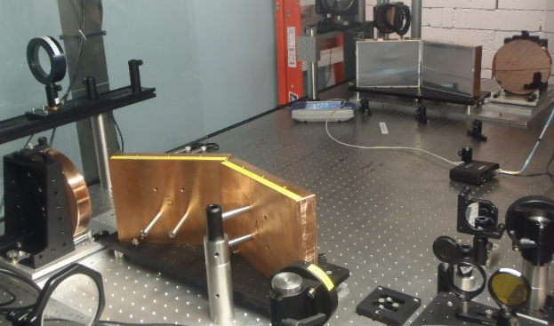
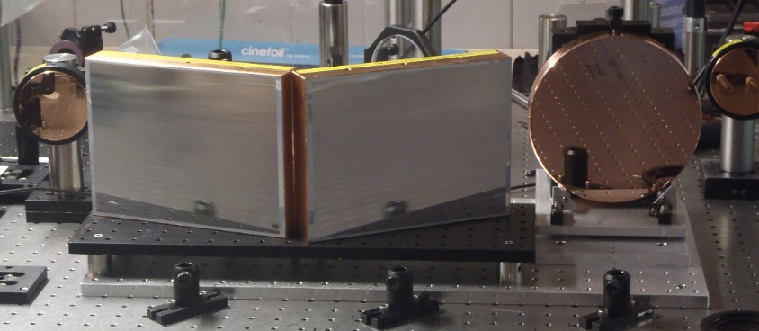
CPA R&D (continued)
  Approach (formulated at last User Meeting):
  Bypass a low-power compressor sending a stretched pulse through Amp2 and through air to experiment site where a CPA compressor will be located (in air).
  Al-coated replicas with damage threshold 0.5J/cm² need to be replaced by master gratings with ~10x higher damage threshold.
  Less expensive solution would be telescopes before and after gratings
  Implementation:
  Telescopes installed, beam size and profile optimized to avoid gratings damage
  Up to 8-9 J in a compressed pulse
  Compressor efficiency 50% (15% loss per grating)
  Actively searching for a supplier of better gratings
  Continue optimizing the compressor configuration to achieve the expected full compression (see next slide)
7

Slide 8
CPA R&D (continued)
Characterizing Compressor Performance (Streak camera)
  Main observations:
  Noticeable pulse expansion
  Pulse splitting emerges at low energies but disappears at >3 J
  Time resolution does not allow measuring pulse duration reliably (need to augment with autocorrelator, see next slide)
regen
4.66J
1.39J
5.68J
2.87J
6.68J
3.56J

Slide 9
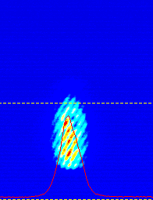
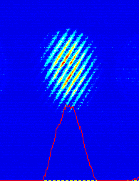
CPA R&D (continued)
Characterizing the Compressor Performance
(Autocorrelator)
  Observed:
  6-ps plateau up to 5J, fast pulse expansion above 5J
  Explanation:
  Uncompensated linear dispersion at low energies
  Nonlinear frequency chirping at high energies
  Spectral mismatch between amplifiers
  Solutions:
  Tune compressor length
  Stretch beam on the output window
    Use gratings with bigger dispersion (next procurement)
    Implement isotopes in the final amplifier (order initiated)
Typical raw images
2ps @ 9 μm
3.5ps @ 10 μm

Slide 10
Present and expected peak power
0
0
3
Legend:
  current status
  compressor length tuned to compensate for linear dispersion in materials
  isotopes – pulse compressed, nonlinear broadening eliminated
2
Peak power, TW
1
0

Slide 11
Suppressing nonlinearities on the output window
For a given stretcher configuration, duration of a chirped pulse is defined by its bandwidth
For a given bandwidth, duration of a chirped pulse is defined by the grating dispersion
Each of this approaches allows moving nonlinear threshold from 10 J to 20J (at amplifier output)
Their combination moves the threshold to 40J
We are pursuing procurement of new gratings with higher dispersion, efficiency, and damage threshold

Slide 12
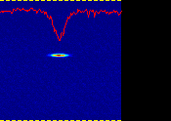
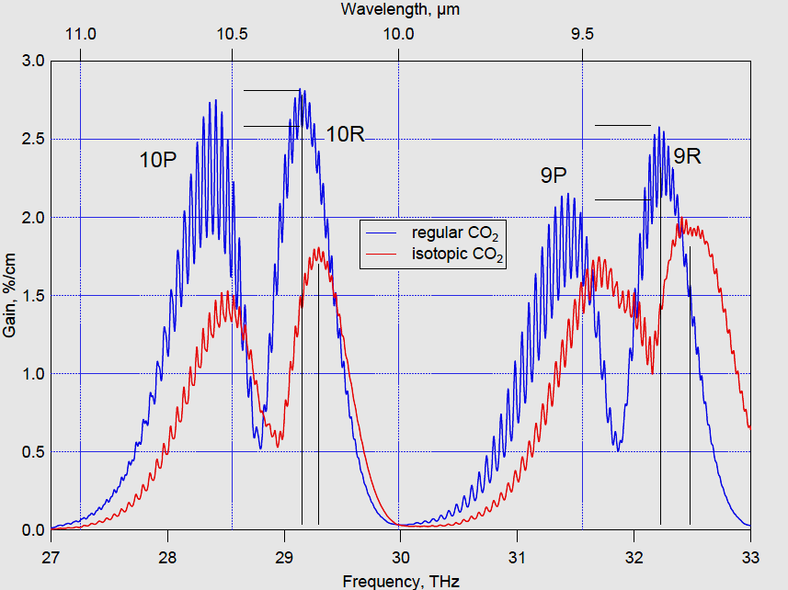
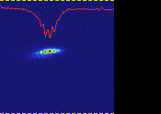
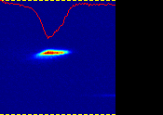
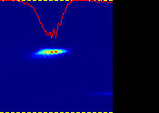
Isotopes R&D
Ti:Al2O3
15 µJ
350 fs
Amplifier 1
C¹⁶O₂
: C¹⁶O¹⁸O
: C¹⁶O₂
OPA
25% : 50% : 25%
1 µJ
80 ps
Stretcher
10 mJ
25 ps
20J
Regular gas
Isotopes
Amplifier 2
20J
Observed:
6J
~4ps
~1TW
Regular gas
9R branch (isotopic) is the choice for producing a single 2-ps pulse.
When using a combination of isotopic and regular amplifiers, need to operate at 10R branches where difference between maxima is minimal and gain is higher.
This results in a smaller band and a broader, 3.5 ps pulse and spectrum migration that may affect recompression.
Expected:
6-10J
2-2.5 ps
3-4 TW
Compressor
Isotopes
Peculiar spectrum migration between isotopic Amplifier 1 to a regular Amplifier 2
A single 2-ps pulse has been demonstrated from Amplifier 1. This will continue through Amplifier 2 if filled with isotopes

Slide 13
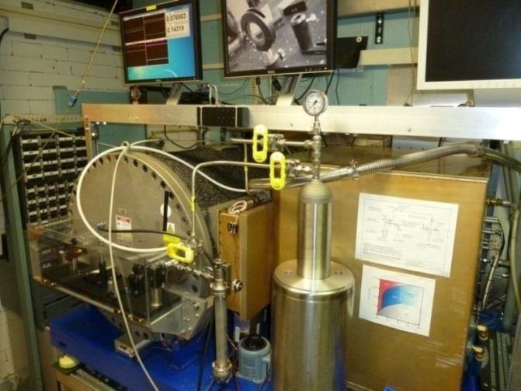
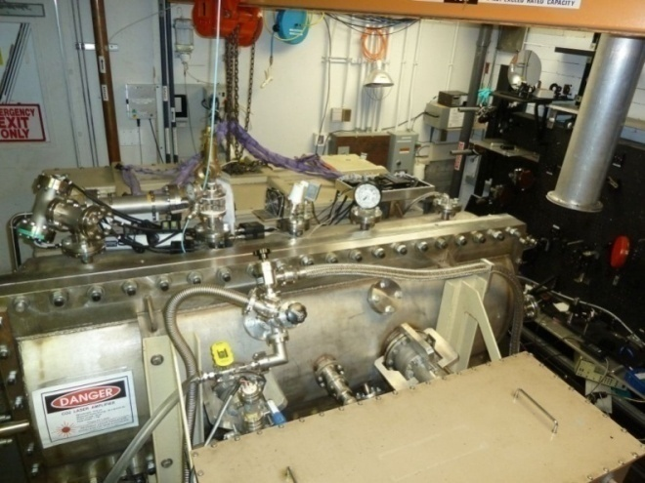
CO₂ recovery system
A new Cryogenic Recovery System is being tested to serve a bigger-volume, final amplifier.
The amplifier pressure integrity is brought to the standard of handling the isotopes without losses.
Cryogenic CO2 recovery has been successfully operated for our isotopic regenerative amplifier for last 5 years

Slide 14
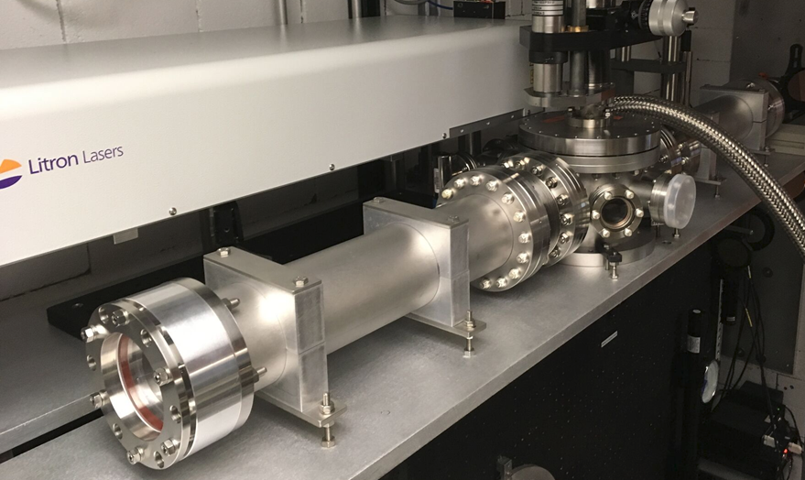
Plasma shutter
YAG
  Purpose: Eliminate reflection from plasma and other components of experiment that limit the delivered laser power.
  Approach: Start with a small-scale low-power pop test using available hardware, 1” windows and lenses, and a laser demonstrating truncation of a CO₂ signal upon igniting plasma. Then, design and build apparatus capable to transmit up to 20J of CO₂ pulse (3-4” aperture).
CO₂
formulated at last User Meeting
plasma
in vacuum
These goals have been fully accomplished In 2017.
Plasma shutter is ready for user experiments
Installed between the final amplifier and CPA compressor
Introduced losses to the beam:
  16% at low energies
  20% at 10J (after amplifier)
  27% at 20J (due to beam expansion)
Contribution to nonlinear beam chirping needs evaluation
Future improvements: integrate reflective optics in a vacuum interaction chamber

Slide 15
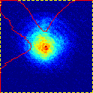
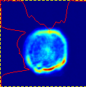
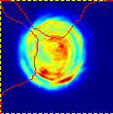
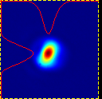
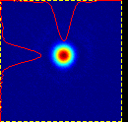
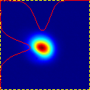
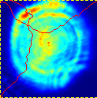
Beam quality (by pyro-camera and burn paper)
regen
Measurement of M² in a stretched pulse
Amplifier output
8J
after compressor
18J
18J at amplifier
before plasma shutter
before compressor
10 cm

Slide 16
Bldg 820 Development FY17-FY19
Building 820 CO2 Laser Configuration | Pulse Energy (J) | Peak Power (TW) | Pulse Width (ps) | Experimental Transfer (%) | Power to Experiments (TW) | Target Date for Users
FY16 | 6 | ~2 | 3-3.5 | ~25% | ~0.5 | FY16
CPA Reconfiguration (no Isotopes)* | 6-10 | 1.2 2-3 | 3-3.5 | 80-90% | ~1 ~1.6-2.4 | Mid FY17 In Place, OPTIMIZING
Addition of Plasma Shutter | 6 | ~1 ~2 | 3-3.5 | 80-90% | ~0.8 ~1.6-1.8 | Mid FY17 In Place
CPA Reconfiguration with Isotopes* | 6-10 | 3-4.5 | 2-2.5 | 80-90% | 2 ~2.4-4 | Early FY18 AMPLIFIER READY
Non-linear Pulse Compression* | >1 | >1 | <1 ps | 80-90% | ~1 | Late FY18 Now anticipated in FY19
*Addresses high power standalone TW CO2 Laser R&D Issue

Slide 17
Summary on CO₂ laser R&D
Developments during FY2017 within three major thrusts:
  CPA
  Isotopes
  Plasma shutter
Detailed results:
  Amplifier produces up to 20 J in a stretched pulse
  Up to 9 J in a compressed pulse
  Plasma shutter blocks parasitic reflections
  Limitations of CPA amplification with regular gas are assessed
  Amplifier is ready to handle isotopes
Near-future plan
  Finish optimization of a CPA compressor
  Purchase isotopes
  Initiate procurement of new gratings
  By implementing above changes, increase the laser power to ~3 TW
  Build optical transport to experimental hall for laser/e-beam interaction experiments
  Work on next design of plasma shutter with reduced losses
The ATF-I CO₂ laser upgrade will clear a path to continuing the ATF-II project by reducing R&D risks in achieving the next 5-TW milestone and further progress towards tens of TW goal.

