Slide 1
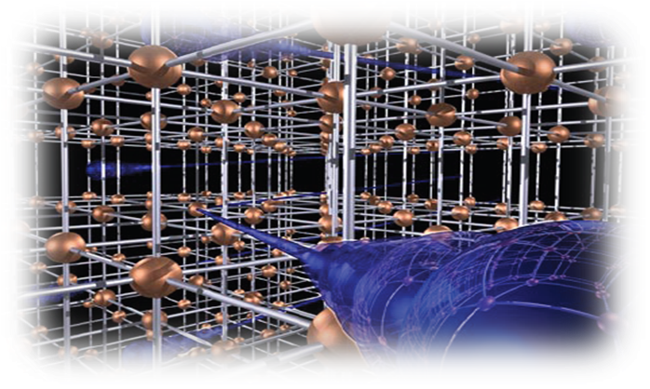
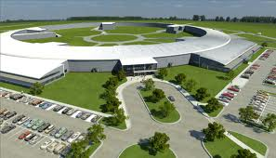
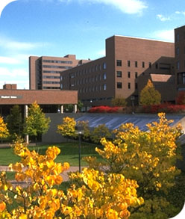
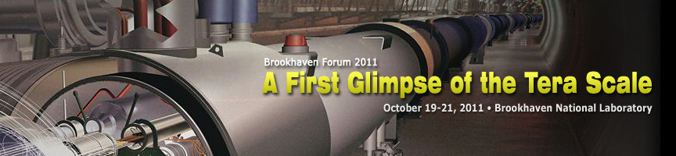

Vanishing Dimensions
Dejan Stojkovic
SUNY at Buffalo
A First Glimpse of the Tera Scale
Brookhaven, Oct 19-21, 2011

Slide 2
Based on:
Detecting Vanishing Dimensions Via Primordial Gravitational Wave Astronomy
J. Mureika, D. Stojkovic,
Phys. Rev. Lett. 106, 101101 (2011).
Searching for the Layered Structure of Space at the LHC.
L. Anchordoqui, D. Dai, H. Goldberg, G. Landsberg, G. Shaughnessy, D. Stojkovic, T. Weiler,
Phys. Rev. D83, 114046 (2011)
Vanishing Dimensions and Planar Events at the LHC.
L. Anchordoqui, D. Dai, M. Fairbairn, G. Landsberg, D. Stojkovic,
e-Print: arXiv:1003.5914 [hep-ph]
Nature Editorial: Nature 466, 426 (2010)
“Collider gets yet more exotic 'to-do' list”

Slide 3

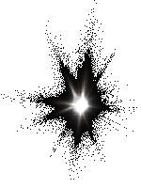

Outline
Brief overview
Evolving dimensions:
Our universe is lower dim on short scales and higher dim on large scales!
Dimensionality of space-time
Extra dimensions
Motivation for this proposal
Possible evidence
Potential problems
Experimental signature

Slide 4


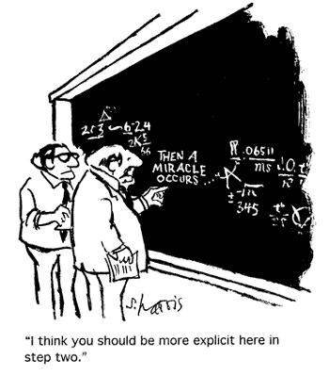
The current wisdom
Let’s make the things more complicated
Introduce extra dimensions, new particles, new structures…
And hope that the problems will miraculously disappear

Slide 5

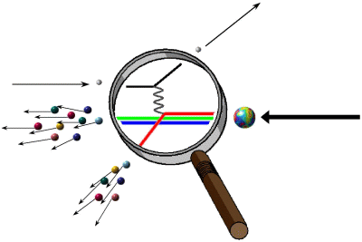
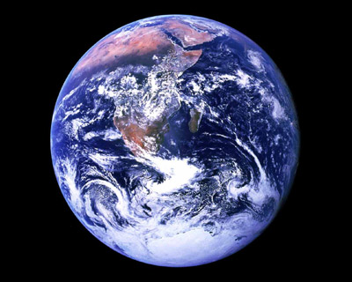
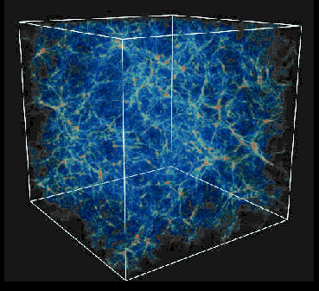
Proposal
Number of dim depends on scale which we are probing
  Short scales (L < TeV⁻¹) space is lower dimensional
  Medium scales (TeV⁻¹ < L < Gpc) space is 3-dim
  Large scales (L > Gpc) space is higher dimensional

Slide 6
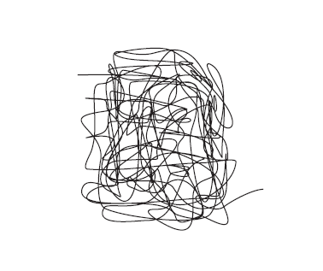
Example
An example of a structure which is 1d on short scales
while it appears effectively 2d on large scales.

Slide 7
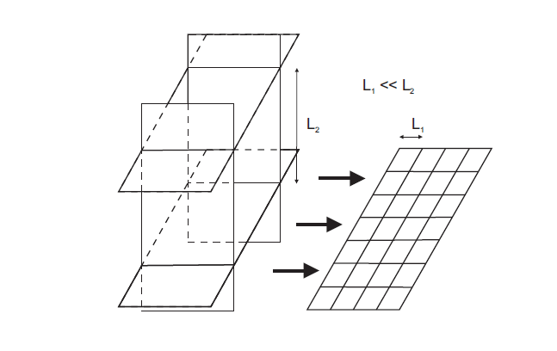
Ordered Lattice
Ordered Lattice. This structure is
1d on scales 0 < L < L₁,
2d on scales L₁ < L < L₂
3d on scales L₂ < L < L₃
…………………..

Slide 8
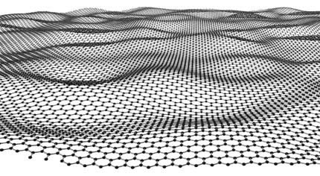
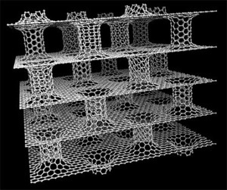
Graphene
Nature already builds these structures
L₂
L₁
L₃

Slide 9

Benefits?
What do we gain by having less dimensions at high energies?
P(r)=?
ε(r)=?
M(r) =?

Slide 10
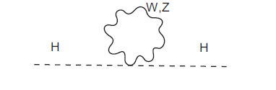

The hierarchy problem
Gauge boson corrections to the Higgs mass:

Slide 11
The hierarchy problem
If 3d → 2d crossover happens at 1 TeV
2d → 1d crossover happens at 10-100 TeV
The hierarchy problem disappears!
No need for new physics – just The Standard Model.

Slide 12
What about gravity?
In 2+1 dim any solution of the vacuum Einstein's eq. is locally flat
no local gravitational degrees of freedom
number of degrees of freedom in finite
problem of non-renormalizability disappears

Slide 13
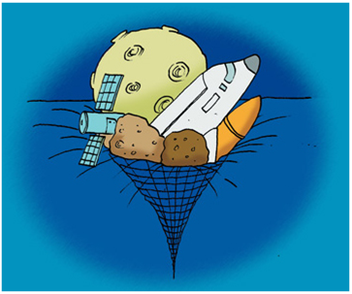
No Black Holes in 2+1 dim
In 2+1 dim any solution of the vacuum Einstein's eq. is locally flat
(unless we add negative cosmological constant – BZT black hole)
No real singularities – NO BLACK HOLES
As 3d BH evaporates, it becomes 2d, where it stops being a BH
NO INFORMATION LOSS PARADOX

Slide 14
Gravity stops being GR?
In 1+1 dim
Unless augmented by some scalar field
Fully integrable and quantizable

Slide 15
Benefits?
What do we gain by having more dimensions at large scales?
P(r)=?
ε(r)=?
M(r) =?

Slide 16
Our Universe may be 4+1 dim on large scales
Many 3d sheets comprise 4d space
Stars and galaxies are on 3d sheets
Universe becomes 4d on scales comparable to the horizon radius
horizon size

Slide 17
Cosmological constant
In 4+1 dim, 3d homogeneous and isotropic solution
Vacuum equations G_{AB} = 0, for a 3d observer at ψ = const, look like
where T_{μν} is induced matter with p = - ρ, ρ = Λ/(8πG)

Slide 18
Other large scale puzzles
Bulk flow
“Axes of Evil”
Lack of CMB power on large scales
horizon size
Could be just the physics of large wavelength excitations of the lattice

Slide 19
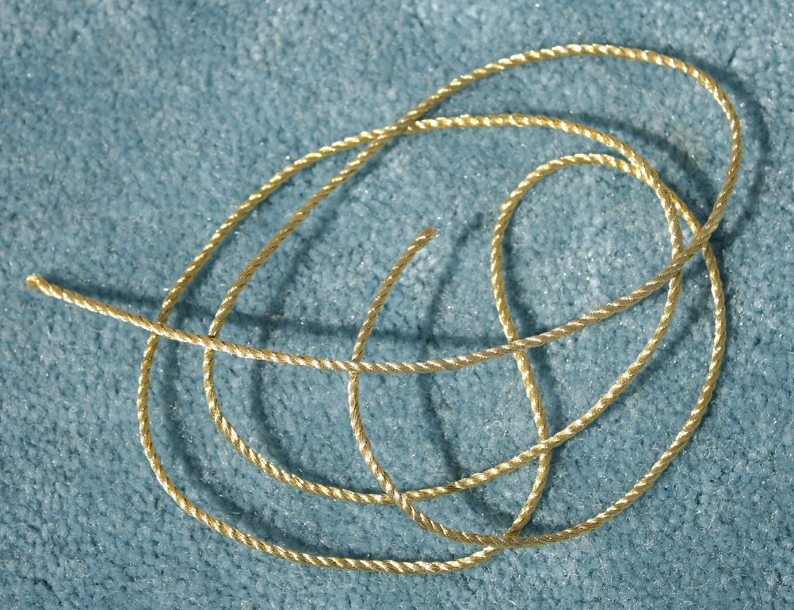
How to describe this evolving background?
I. R. Klebanov and L. Susskind, Nucl.Phys. B 309, 175 (1988)
Take a string and chop it into N segments
Let each segment carry non-vanishing P⁺ and P┴
P⁺ makes the string grow in length
P┴ is the source of the extrinsic curvature

Slide 20
Result
Such a string builds this structure:
total length of the string grows as N
radius of the induced space grows as (Log N)^{1/2}
in the limit of N →∞ the string becomes space filling

Slide 21
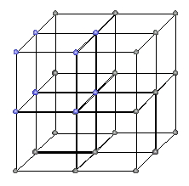
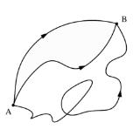
How do particles propagate on this background?
B
Between any two points
there are many possible paths
A
Feynman Path Integral
Due to quantum fluctuations particle follows a jagged path
Straight classical trajectory and paths nearest to it give the highest contribution
Interference of many possible paths gives a straight propagation on average
Our case: geometry of the lattice dictates the jaggedness of the path

Slide 22
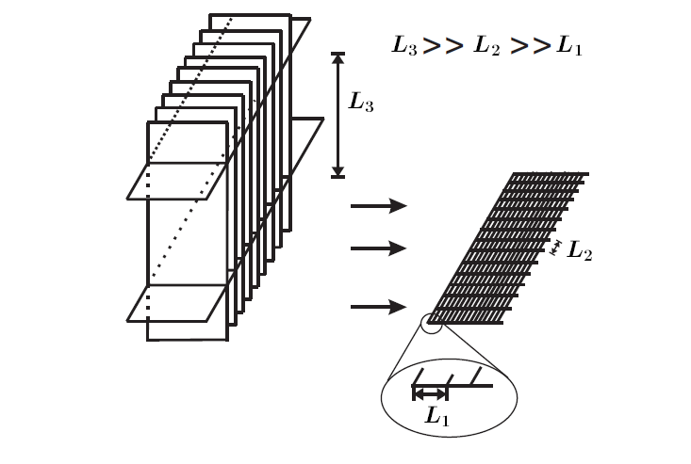
Geometry of the lattice
“Natural” Lattice
Stack of branes
Random Lattice
In all cases short distance physics is 2d (1d)
But the way one recovers 3d space at large distances is not the same

Slide 23
Geometry of the lattice
Random Lattice
Avoids preferred direction in space
Avoids systematic violations of Lorentz invariance
The preferred reference system may exist: the rest frame of the lattice
(no more problematic than the preferred rest frame of the CMB)

Slide 24
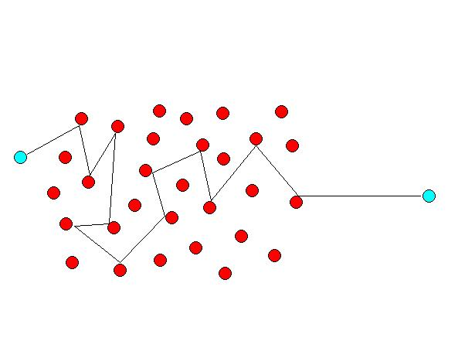
Lorentz symmetry violation
Lorentz invariance is restored on average on large distances
However, small fluctuations of the path can have measurable
effects for light propagating over large cosmological distances
The effective speed of light might change
Two simultaneously emitted photons of energy difference ΔE = E₁ − E₂
will arrive at the observer with a time delay Δt = t₁ − t₂

Slide 25
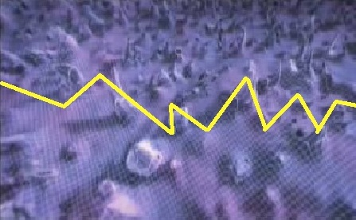
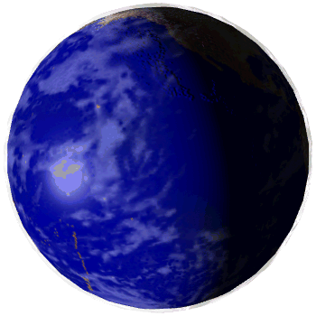
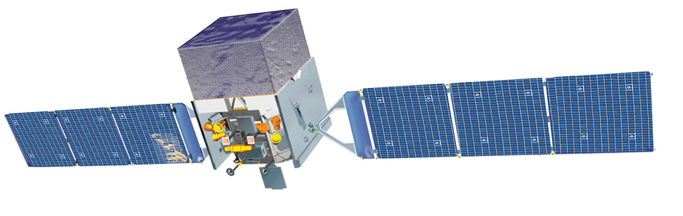
Usually interpreted as the limit E* ≥ M_{Pl}
Gamma rays and Fermi satellite
GRB
Space-time foam
Earth
Fermi observed one 31-GeV and one 3-GeV photon
arriving with the time delay of less than 1 sec

Slide 26
Fermi result and vanishing dimensions
Caveats:
Only one event observed
Physics of the source poorly understood
Limit E* ≥ M_{Pl} valid only if linear corrections exist (LQG)
Both photons E_{γ} < TeV → no c_{eff} (ΔE)
High interaction probability for high energy gamma rays with CMB and infrared background photons (e⁺ e⁻)

Slide 27
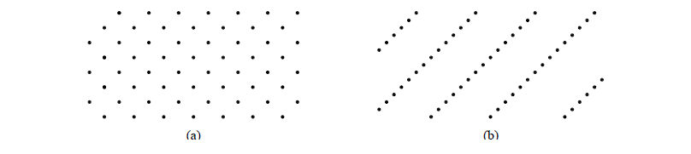
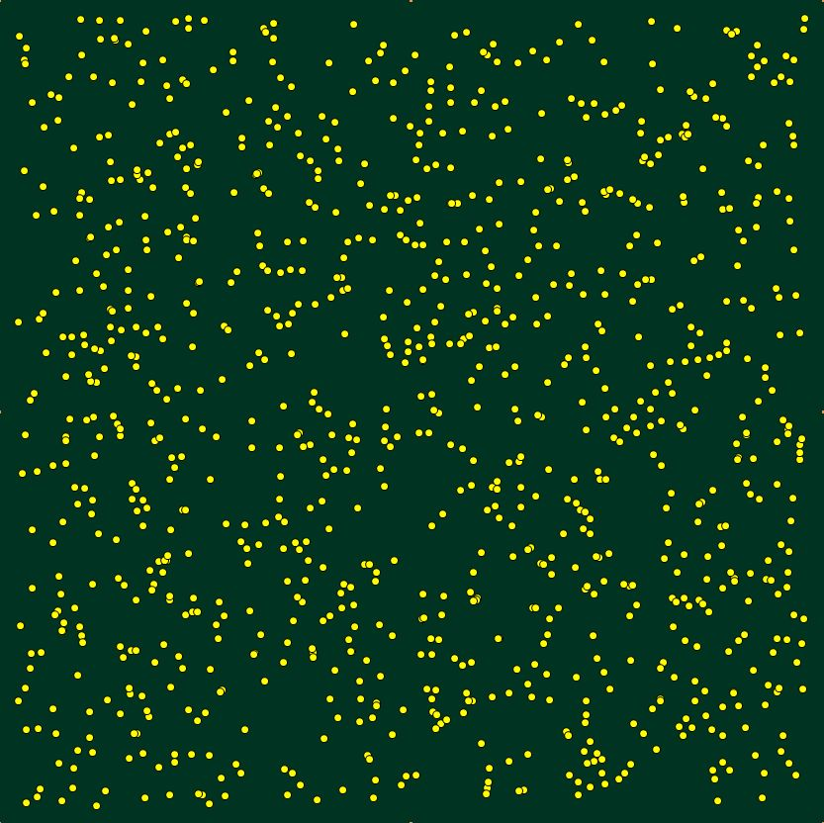
Regular vs. random lattice
F. Dowker, J. Henson, R. Sorkin, gr-qc/0311055
Regular lattice in two different Lorentz frames (a) and (b)
(Poison) Randomization is crucial:
One can’t tell what frame was used to produce sprinkling
Approximation is equally good in any frame
LM

Slide 28
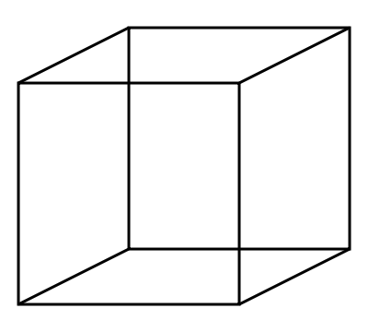

Effective speed of light
B
To propagate from A to B with c on a straight line
It must move with c_{eff} = √3 c along the sides
A
No problem in the Feynman path integral picture
In a short time (TeV⁻¹) particle can move with v > c due to quantum effects
e⁻
e⁺
e⁻
e⁻
Discrete structures don’t need to change an effective speed of light

Slide 29
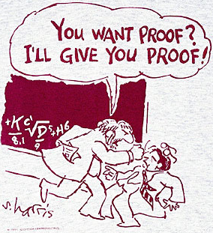
Concrete Model?

Slide 30

String theory solutions
C. Callan, J. Maldacena, Nucl.Phys. B513, 198 (1998)
N. Constable, R. Myers, O. Tafjord, Phys.Rev. D61 (2000) 106009
D-branes
1-brane
1-brane smoothly matching 3-brane
3-brane
r→0
r→0
dz²
0
3-brane that looks like 1-brane around every point

Slide 31
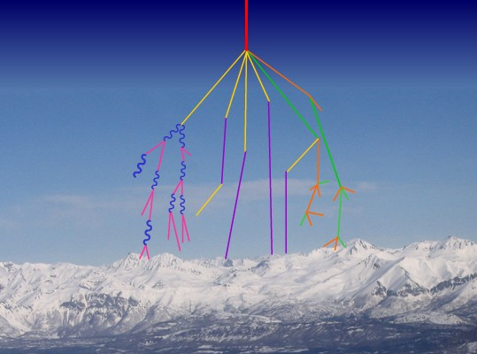
Experimental evidence?
Experimental evidence for vanishing dimensions may already exists.
Alignment of high energy secondary particles was observed in families of cosmic ray particles detected in the Pamir mountains
6 out of 14 events
Alignment is statistically significant for families with high energies
E > 700 TeV which corresponds to E_{COM} > 4 TeV
(Russia and Tajikistan)
Altitude 4400 m

Slide 32
Circle:
3d event
λ = 0
Ellipse:
Somewhat planar
λ > 0.5
Line:
Pure 2d event
λ = 1
Parameter λ measures the degree of alignment

Slide 33
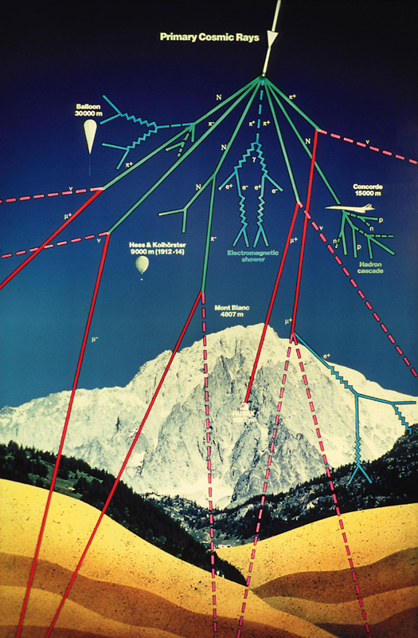
Experimental evidence?
Most of the aligned events originate just above the chamber
Thus, sea/ground level experiments can’t see the effect
Mt. Kanbala (in China)
E > 700 TeV , 3 out of 6 events
Two stratospheric experiments
E > 1000 TeV
λ = 0.99
STRANA superfamily, detected on board
of a Russian stratospheric balloon
JF2af2 superfamily, detected on a
high-altitude flight of the aircraft Concord

Slide 34
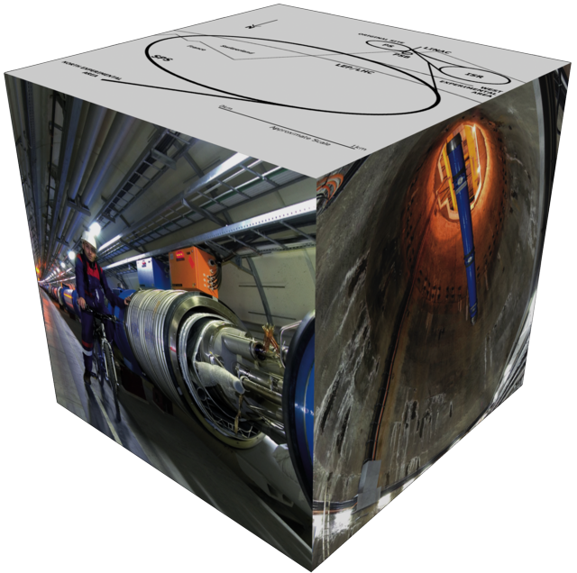
Possible LHC signature
If the alignment in cosmic rays at E_{COM} > 4 TeV is not a fluke
LHC might observe similar alignment

Slide 35
LHC signature
If the fundamental high energy physics is 2d , the following must be true regardless of the exact underlying model:
Cross section changes due to the reduced phase space
Higher order scattering processes at high energies become planar
Jets of sufficiently high energy may become elliptic in shape

Slide 36
3d momentum conservation
If λ_{de Broglie} < L₃
particle propagates locally in 2d, rather than 3d
p┴
p||
p┴
branons
Local description
p||
To preserve 3d momentum of particles propagating over L >> L₃ lattice absorbs p┴ and then re-emits it by the lattice back-reaction
Non-local description
Particle remembers its group velocity through quantum interference of several paths

Slide 37
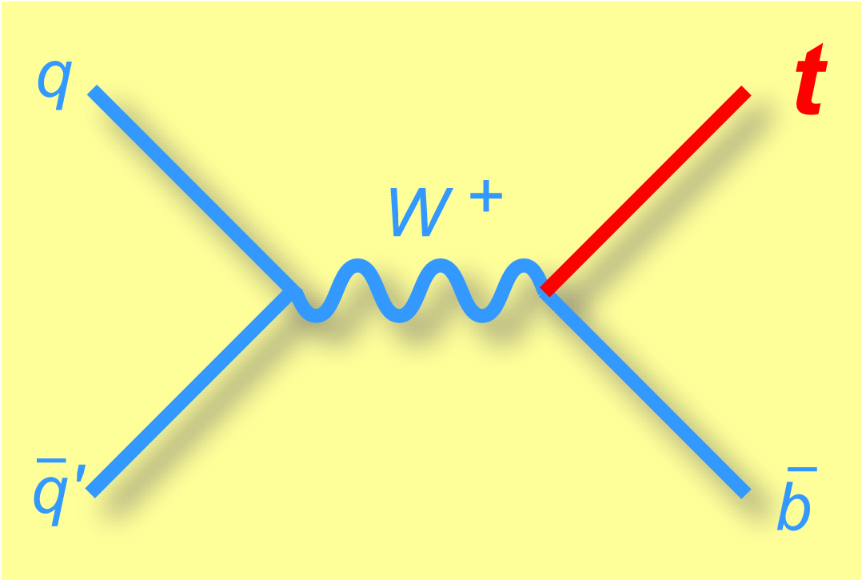
2d scattering
For scattering to be 2d , wavelength of the mediator must be < L₃
Momentum transfer
Q² > Λ₃²
Thus, only hard scattering can probe 2d structure of space

Slide 38
2d vs 3d scattering
Cross-section in 2d is a line (not a disk as in 3d)
3d cross section
2d cross section
Phase space ~ dΩ_{d}: total cross-section reduced by a factor of 2

Slide 39
2d vs 3d scattering
Coulomb Potential:
3d → α is dimensionless
2d → α = L⁻¹
3d
2d

Slide 40
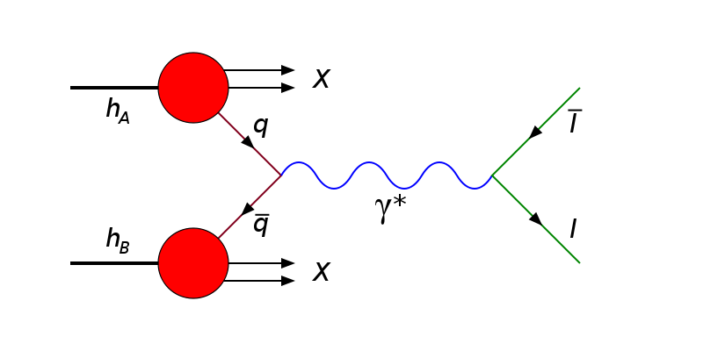
2d vs 3d scattering
Drell-Yan cross section will drop as 1/E³ instead of 1/E²
once the 3d → 2d crossover energy is surpassed
Drell-Yan process
Limits from Tevatron data Λ₃ > 800 GeV

Slide 41
Planar multijet events
In 2 → 3 scattering with Q² > Λ₃² , all the virtual particles (propagators) must move in the same 2d plane
3d scattering
2d scattering
Thus, outgoing partons must be in the same plane in the c.o.m. frame of the collision, thus drastically different from the 3d scattering

Slide 42
Planar multijet events
Local plane absorbs the initial p┴ momentum
Planar scattering happens in c.o.m. frame
Lattice transfers p┴ to the outgoing particles giving them boost
Planarity is preserved once we boost the particles back
c.o.m. frame
c.o.m. frame
Impossible in com frame even in 3d
Any three vectors originating from the common point and conserving overall zero momentum will be co-planar even in 3d

Slide 43
Planar multijet events
3d scattering
2d scattering
Need 4-jets for acoplanar events in 3d
Co-planar 4-jet events clear 2d signature

Slide 44
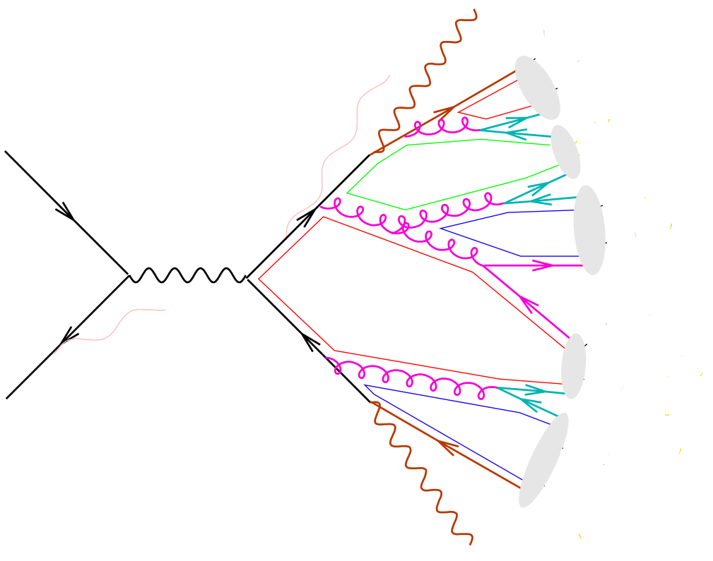
Elliptic Jets
If the lattice orientation is preserved over distances Λ⁻¹_{QCD} individual jets at very high energy may become elliptic in shape
Parton showers are ordered in Q²: the largest Q² happen first
Showers may not be spherical (start planar then expand in 3d)

Slide 45
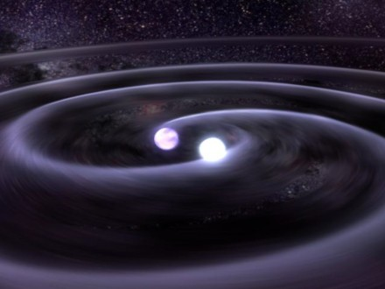
Gravity waves signature
In 2+1 dim any solution of the vacuum Einstein's eq. is locally flat
No local gravitational degrees of freedom
  no gravitons in quantum theory
  no gravity waves in classical theory

Slide 46
Gravity waves signature
The characteristic frequency of gravitational waves produced at some time t in the past is redshifted to its present-day value f₀ = f* a(t)/a(t₀)
Today’s frequency of primordial gravity waves created at T=T*

Slide 47
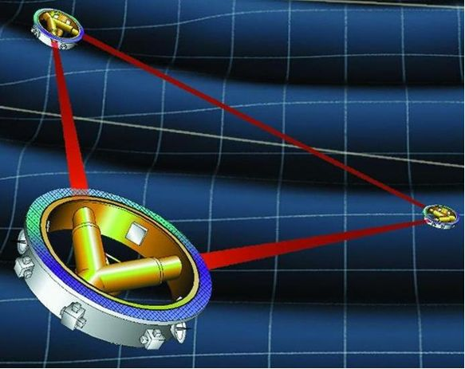
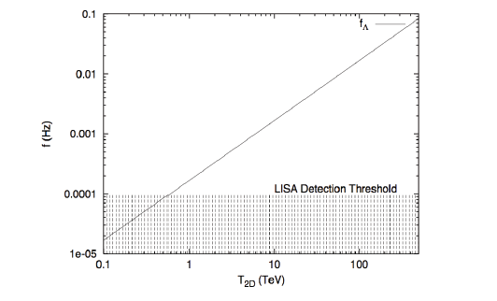
Gravity waves signature
LISA should be able to see a cut-off in GW frequency
LISA’s sensitivity

Slide 48



Conclusions
Fundamental problems have accumulated
Current ideas do not work
Time for radically new ideas
We introduced the concept of evolving dimensions
Many problems simply disappear
Clear model independent observational signature
Remains to be done:
Concrete Model - Lagrangian

Slide 49
THANK YOU

