Slide 1


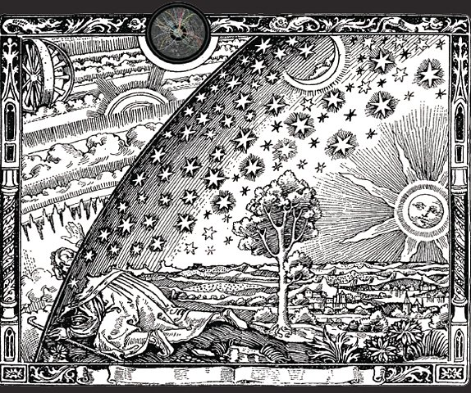
Searches for Supersymmetry with the CMS Detector at the LHC
Yuriy Pakhotin
On behalf of the CMS Collaboration
Brookhaven Forum 2011: A First Glimpse of the Tera Scale
October 19-21, 2011

Slide 2
Outline
Performance of Large Hadron Collider and CMS detector
  Prerequisites for discovery or precise measurement
Search for Supersymmetry (SUSY)
  Topologies
  Results: exclusion limits
Summary and conclusions

Slide 3
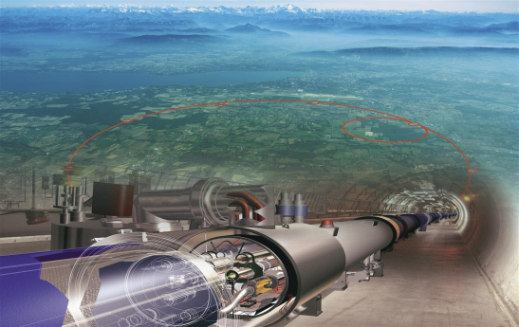
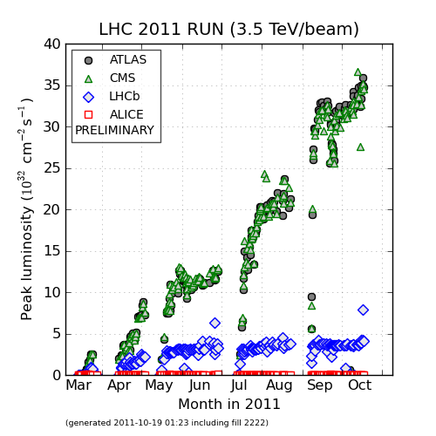
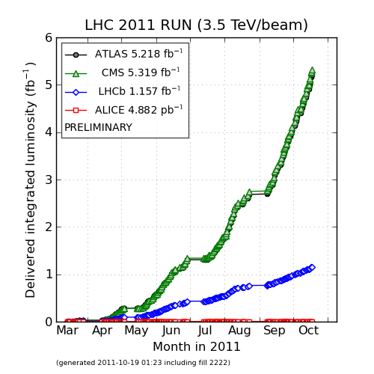
Large Hadron Collider (LHC)
LHC is running in 2011 very well:
Current center of mass energy: √s = 7 TeV
Current record luminosity: L ≈ 3.6·10³³ cm⁻²s⁻¹
Delivered luminosity to CMS: ∫L·dt ≈ 5.3 fb⁻¹
Stop expected at the end of October
http://lhc.web.cern.ch
3.6·10³³ cm⁻²s⁻¹
5.3 fb⁻¹
This talk
~1 fb⁻¹

Slide 4

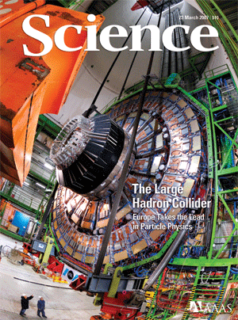
Compact Muon Solenoid (CMS)
JINST3:S08004 (2008)
SUPERCONDUCTING
CALORIMETERS
COIL
ECAL
HCAL
Scintillating
PbWO4 crystals
Plastic scintillator/brass
sandwich
Total weight: 12,500 t
Diameter: 15 m
Overall Length: 22 m
Magnetic field: 4 Tesla
IRON YOKE
TRACKER
Silicon Microstrips
Pixels
MUON
ENDCAPS
MUON BARREL
Drift Tube
Resistive Plate
Cathode Strip Chambers (CSC )
Muons:
muon system acceptance: |η|<2.4
muons momentum resolution: dp_{T}/p_{T}~1% (p_{T}~25 GeV)
Calorimetry:
HCAL |η|<5.0, δE/E ~ 100% / √E + 5%
ECAL |η|<3.0, δE/E ~ 3% / √E + 0.3%
Chambers ( DT )
Chambers ( RPC )
Resistive Plate Chambers (RPC)

Slide 5
Search for SUSY in 2011
Selection of simple generic topologies:
Many require jets assuming strong SUSY production of squarks and gluino
Categorized by number of leptons and photons enhancing SUSY signal
Common to various range of SUSY models
  Many include Missing Transverse Energy (MET) assuming R-parity conservation
twiki.cern.ch/twiki/bin/view/CMSPublic/PhysicsResultsSUS
Label | Search Topology | Link to PAS* | Lumi
0 L | All-hadronic events with missing energy | PAS-SUS-11-004 | 1.1 fb-1
 | All-hadronic events with α_{T} | PAS-SUS-11-003
 | All-hadronic events with M_{T2} | PAS-SUS-11-005
1 L | Events with a lepton and missing transverse energy (MET) | PAS-SUS-11-015
SSDL | Events with same-sign isolated dileptons, jets and MET | PAS-SUS-11-010 | 0.98 fb-1
OSDL | Events with opposite-sign dileptons, jets and MET | PAS-SUS-11-011
 | Events with a Z-boson, 2 or more jets and MET | PAS-SUS-11-017
 | Events with a Z-boson, 3 or more jets and MET | PAS-SUS-11-012 | 191 pb-1
1-2 γ | Events with photons, jets and MET | PAS-SUS-11-009 | 1.1 fb-1
Public results with 2011 data only
*PAS – Physics Analysis Summary – public CMS document with brief analysis description and results

Slide 6
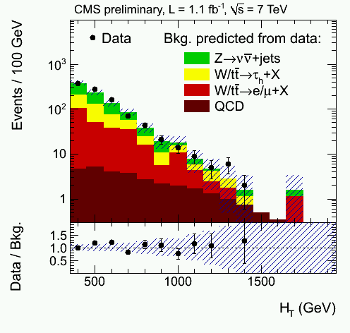

All-hadronic topology with missing energy
Most sensitive for strongly produced SUSY
Events selection
  3 or more high momentum jets
    $E_{T}>50 GeV\text{, }\text{|}\text{η}\text{|<2.5}$
  Large hadronic activity and missing energy
    $H_{T}>350 GeV$ - scalar sum of jet $E_{T}$
    ${MH}_{T}>200 GeV$ - negative vector sum of jet $E_{T}$
  Veto events with ${MH}_{T}$ aligned with jets
  Veto events with isolated leptons
PAS-SUS-11-004
Backgrounds
  Multi-jet QCD, Z→νν+Jets, W+Jets, ttbar+Jets
  All determined using data-driven methods
No excess observed

Slide 7
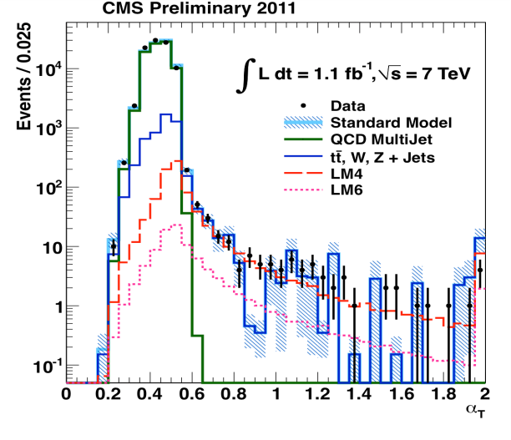
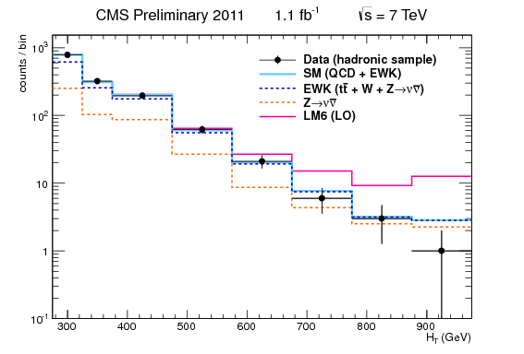
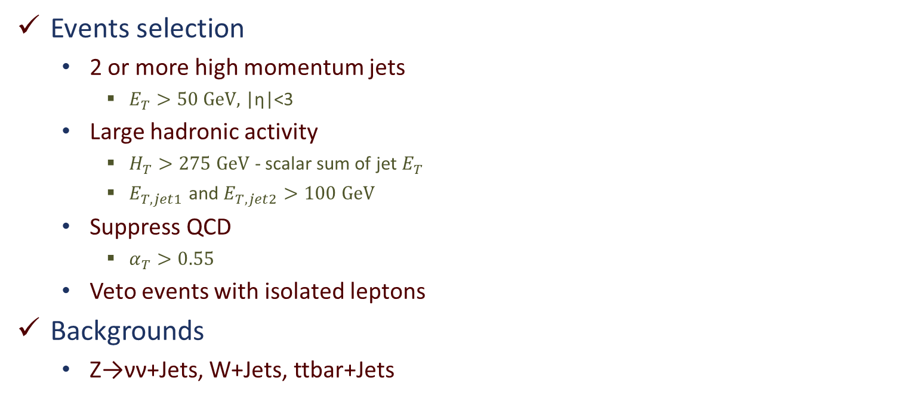



All-hadronic events with α_{T}
$$∆φ$$
$$∆φ$$
PAS-SUS-11-003
Jet 2
Jet 2
Jet 1
$$α_{T}=\frac{E_{T, jet2}}{M_{T,jet1+jet2}}=\sqrt{\frac{{E_{T,jet2}}/{E_{T,jet1}}}{2\left(1−cos⁡∆φ\right)}}$$
QCD
SUSY
Jet 1
LSP
LSP
0.55
Events selection
  2 or more high momentum jets
    $E_{T}>50 GeV\text{, }\text{|}\text{η}\text{|<}\text{3}$
  Large hadronic activity
    $H_{T}>275 GeV$ - scalar sum of jet $E_{T}$
    $E_{T,jet1}$ and $E_{T,jet2}>100 GeV$
  Suppress QCD
    $α_{T}>0.55$
  Veto events with isolated leptons
Backgrounds
  Z→νν+Jets, W+Jets, ttbar+Jets
No excess observed

Slide 8

















All-hadronic events with M_{T2}
PAS-SUS-11-005
$$V_{1}$$
$$m_{T}=\sqrt{{m_{e}}_{}^{2}+{m_{ν}}_{}^{2}+2\left({E_{T}}_{}^{e}{∙E_{T}}_{}^{ν}−{{\vec{p}}_{T}}_{}^{e}∙{{\vec{p}}_{T}}_{}^{ν}\right)}$$
$$p$$
$$S_{1}$$
$$χ$$
$$e$$
SUSY at LHC
$$p$$
$$S_{2}$$
$$χ$$
$$W$$
$$p$$
W at SPS
$$V_{2}$$
$$\overline{p}$$
$$ν_{e}$$
$$M_{T2}\left(m_{χ}\right)=\min_{{p_{T}^{}}_{}^{χ(1)}+{p_{T}^{}}_{}^{χ(2)}={p_{T}^{}}_{}^{miss}}\left[\max_{}\left({m_{T}^{}}_{}^{(1)},{m_{T}^{}}_{}^{(2)}\right)\right]$$
For 2 massless pseudo-jets:
Jet 2
PseudoJet 2
$$φ_{12}$$
Jet 4
$$M_{T2}=\sqrt{2{p_{T}}_{}^{(1)}{∙p_{T}}_{}^{(2)}\left(1+\cos{φ_{12}}\right)}$$
Jet 1
Hemisphere 2
PseudoJet 1
Hemisphere 1
Jet 3

Slide 9
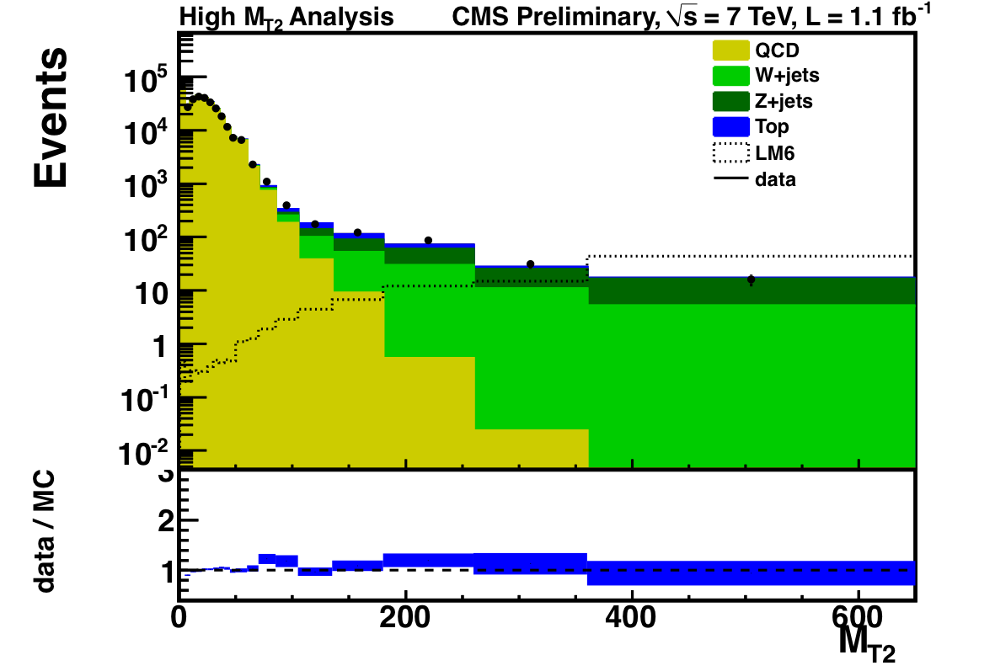
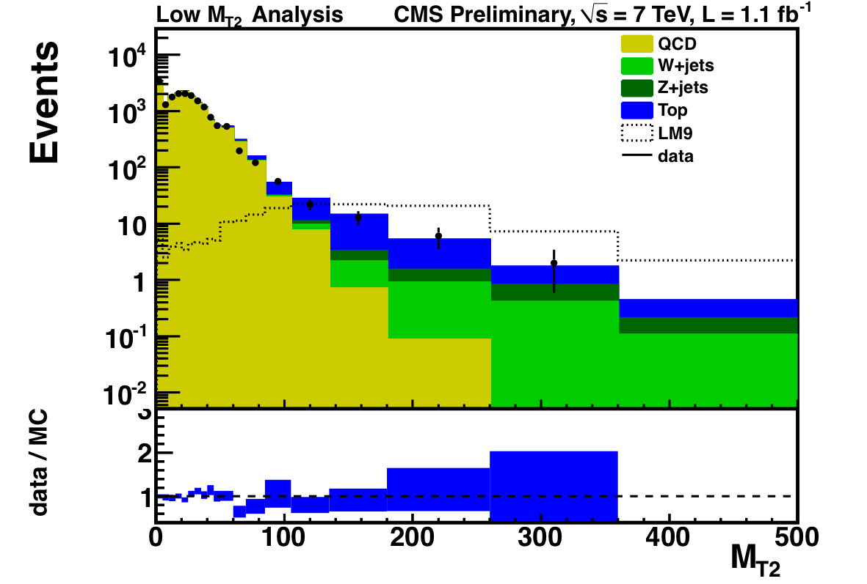
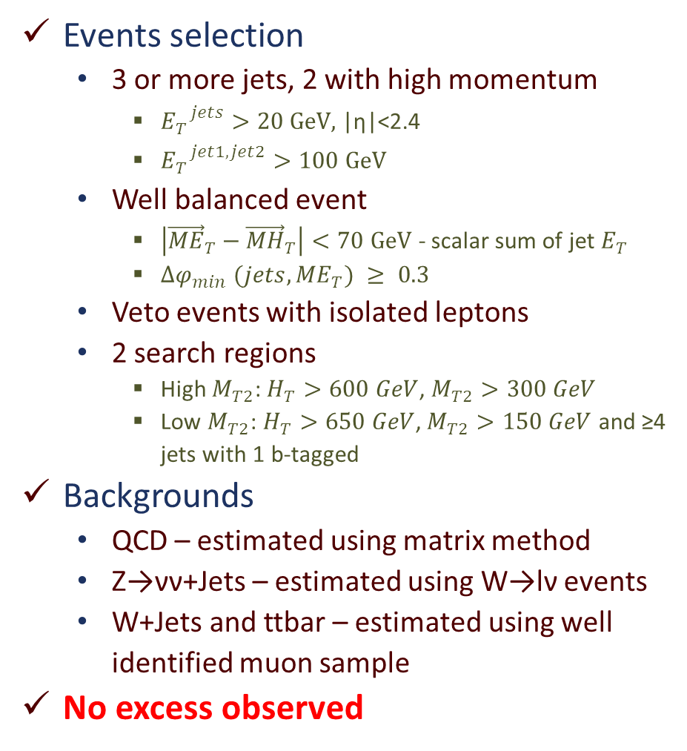
All-hadronic events with M_{T2}
Events selection
  3 or more jets, 2 with high momentum
    ${E_{T}}_{}^{jets}>20 GeV\text{, }\text{|}\text{η}\text{|<}\text{2.4}$
    ${E_{T}}_{}^{jet1, jet2}>100 GeV$
  Well balanced event
    $\left|{{\vec{ME}}_{T}−\vec{MH}}_{T}\right|<70 GeV$ - scalar sum of jet $E_{T}$
    ${∆φ}_{min} (jets, {ME}_{T}) ≥ 0.3$
  Veto events with isolated leptons
  2 search regions
    High $M_{T2}$: $H_{T}>600 GeV$, $M_{T2}>300 GeV$
    Low $M_{T2}$: $H_{T}>650 GeV$, $M_{T2}>150 GeV$ and ≥4 jets with 1 b-tagged
Backgrounds
  QCD – estimated using matrix method
  Z→νν+Jets – estimated using W→lν events
  W+Jets and ttbar – estimated using well identified muon sample
No excess observed
PAS-SUS-11-005

Slide 10
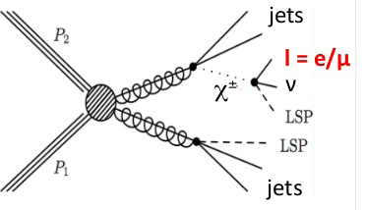
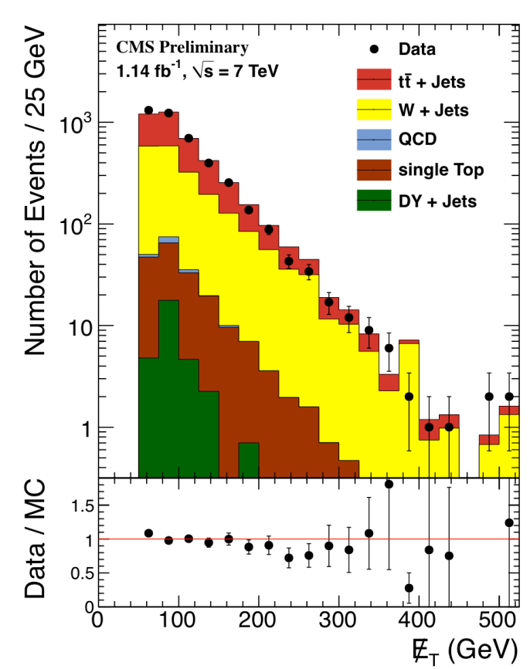
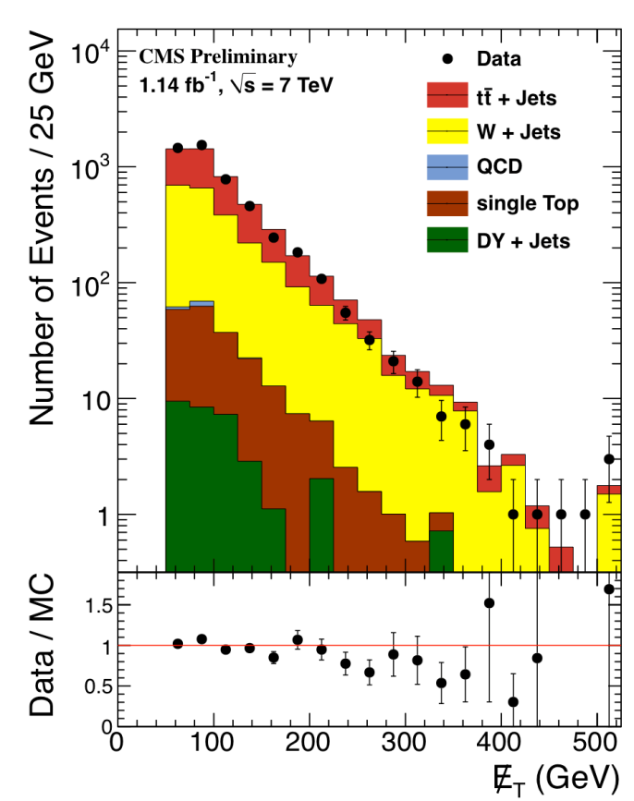
Events with a lepton and MET
Exactly 1 lepton, Jets and large MET
  Require exactly one isolated lepton with pT > 20 GeV
  At least 3 Jets with PT > 40 GeV
  HT > 300 GeV and MET > 60 GeV
Backgrounds
  ttbar, W+Jets
  Data driven methods
    Lepton Spectrum
    Lepton Projection
No excess observed
PAS-SUS-11-015
e
μ

Slide 11
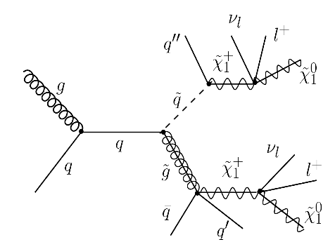
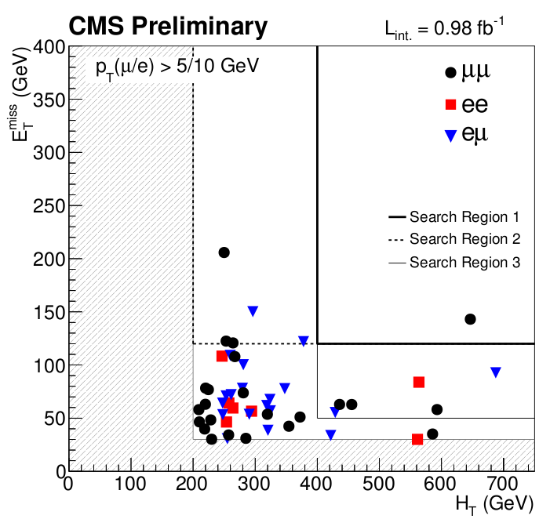
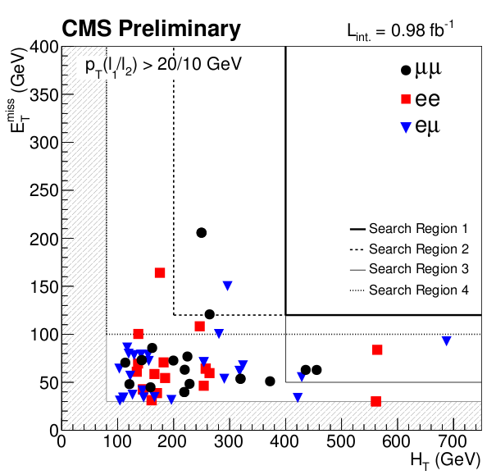
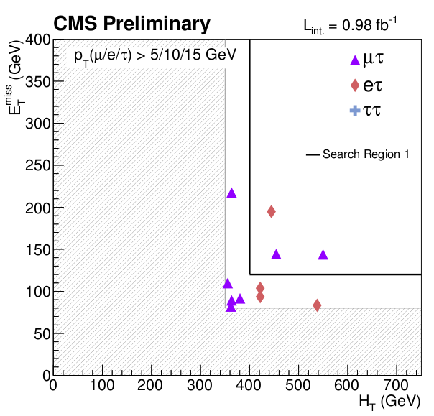
Events with same-sign dileptons
Two same-sign isolated leptons is natural signature in many SUSY models and rare in SM
Several regions are searched
  Different cuts on lepton pT
  Different cuts on hadronic activity: MET and HT
PAS-SUS-11-010
Inclusive dileptons
High-pT dileptons
τ-dileptons

Slide 12
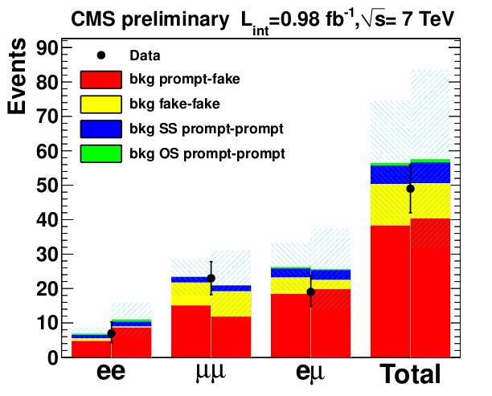
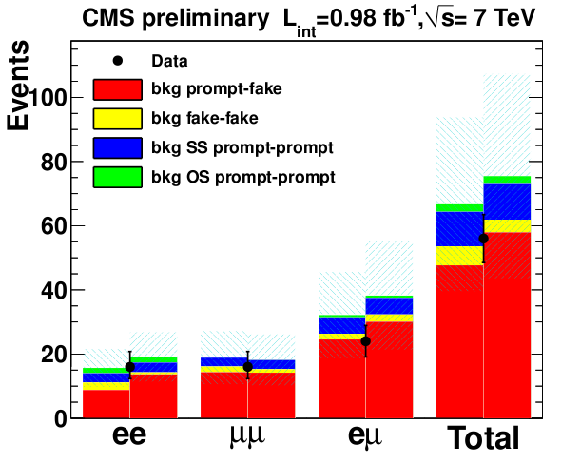
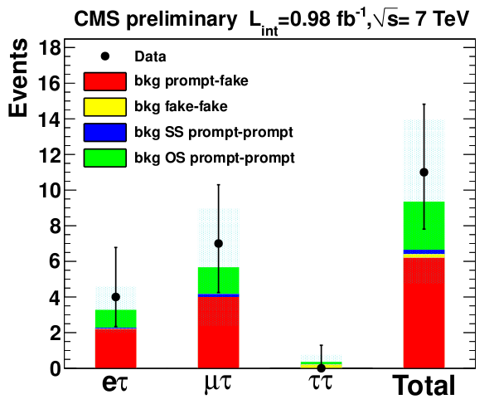
Events with same-sign dileptons
PAS-SUS-11-010
Backgrounds
  Fake leptons from ttbar (b/c→e/μ)
  Charge misidentification
  QCD fakes for final states with τα
No excess observed
Inclusive dileptons
High-pT dileptons
τ-dileptons

Slide 13
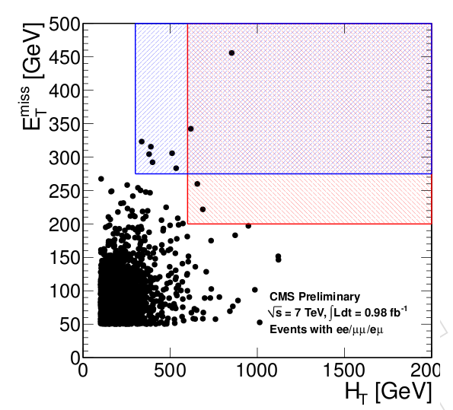
Events with opposite-sign dileptons
PAS-SUS-11-011
Counting experiment
Event selection
  Two isolated leptons (e, μ): one with pT > 20 GeV, other with pT > 10 GeV
  At least 2 jets with pT > 30 and |η| < 3.0, MET > 30 GeV, HT > 100 GeV
  Veto same-flavor pairs in Z mass window (76, 106) and mll < 12 GeV
Signal regions
  High MET signal region
    MET > 275 GeV, HT > 300 GeV
  High HT signal region
    MET > 200 GeV, HT > 600 GeV
Backgrounds
  Mostly ttbar
  Data driven methods
    Lepton spectrum method (pT(ll))
    ABCD’ method
No excess observed

Slide 14
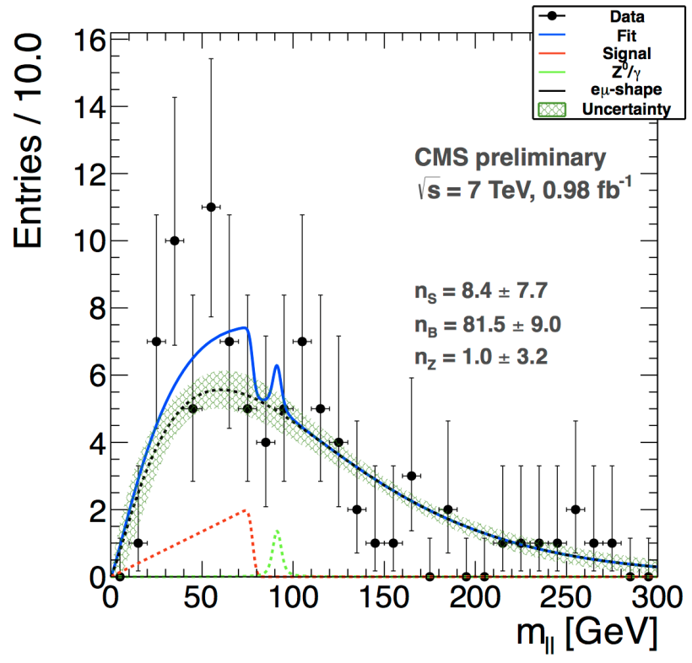
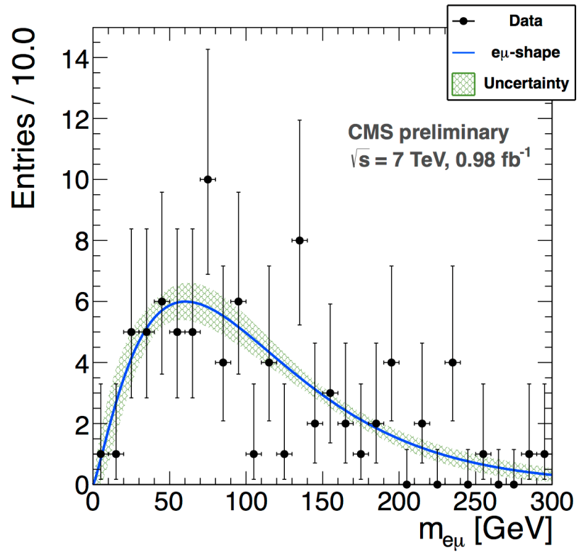
Events with opposite-sign dileptons
PAS-SUS-11-011
Search for kinematic edge in m(ll) distribution
Perform extended maximum likelihood fit simultaneously to ee, μμ, eμ events
  ee/μμ with signal + Z + bkg
  eμ : bkg only
Validate fit in control region dominated by ttbar
  MET > 100 GeV, 100 < HT < 300 GeV
Search for edges in signal region (MET > 100 GeV, HT > 300 GeV)
No evidence for kinematic edge, set upper limit on the signal
ee/μμ
eμ

Slide 15
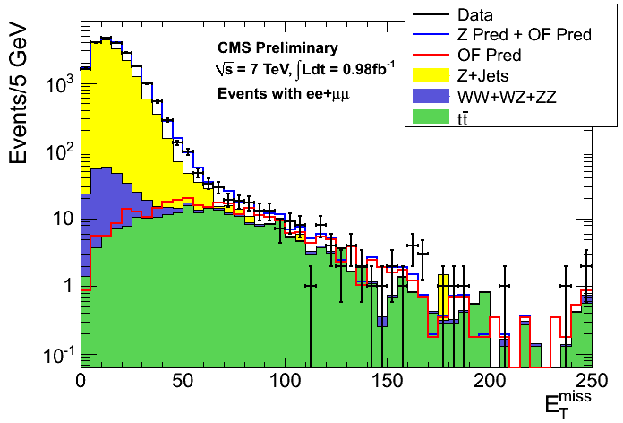
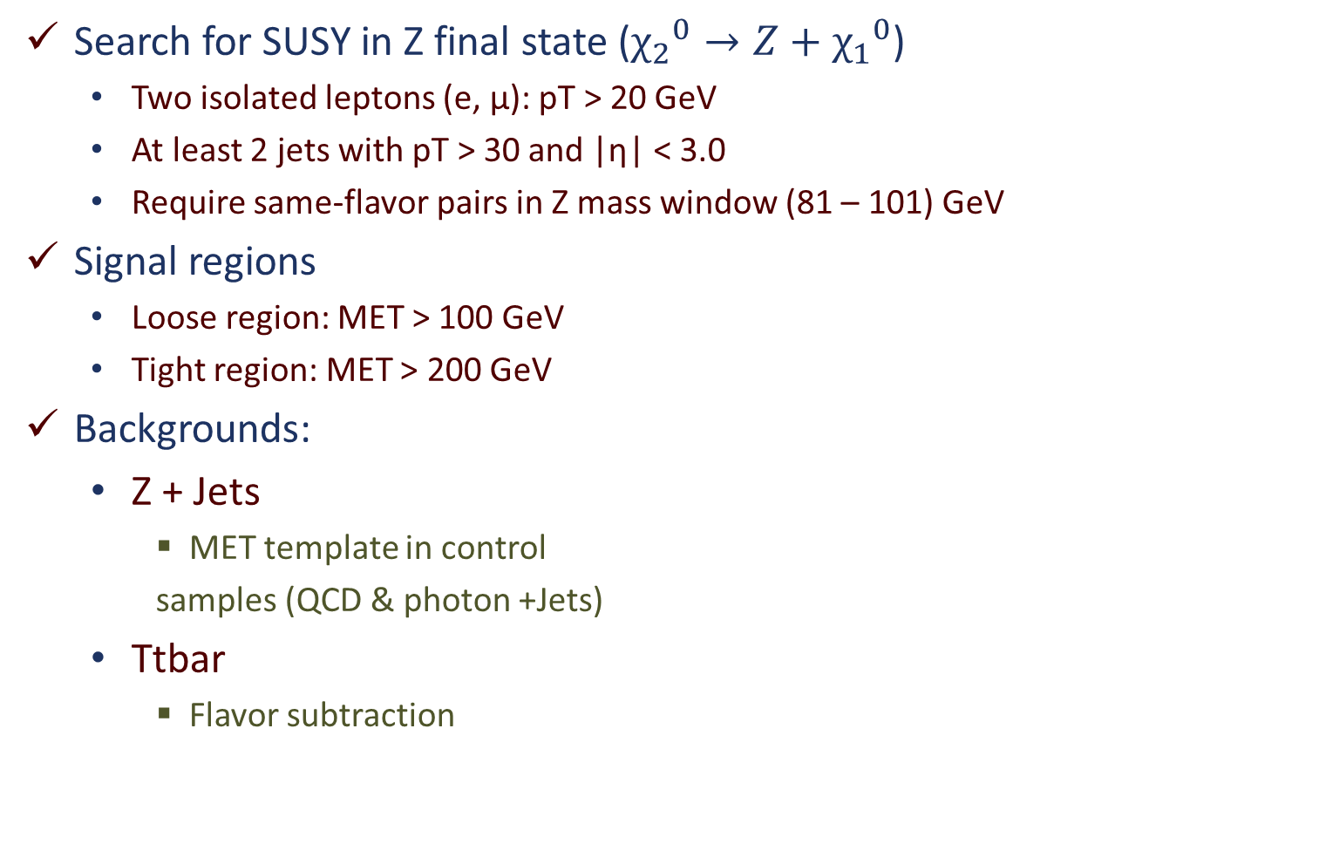
Events with a Z-boson, 2 or more jets and MET
PAS-SUS-11-017
Search for SUSY in Z final state (${χ_{2}}^{0}→Z+{χ_{1}}^{0}$)
  Two isolated leptons (e, μ): pT > 20 GeV
  At least 2 jets with pT > 30 and |η| < 3.0
  Require same-flavor pairs in Z mass window (81 – 101) GeV
Signal regions
  Loose region: MET > 100 GeV
  Tight region: MET > 200 GeV
Backgrounds:
  Z + Jets
    MET template in control
    samples (QCD & photon +Jets)
  Ttbar
    Flavor subtraction
No excess observed

Slide 16
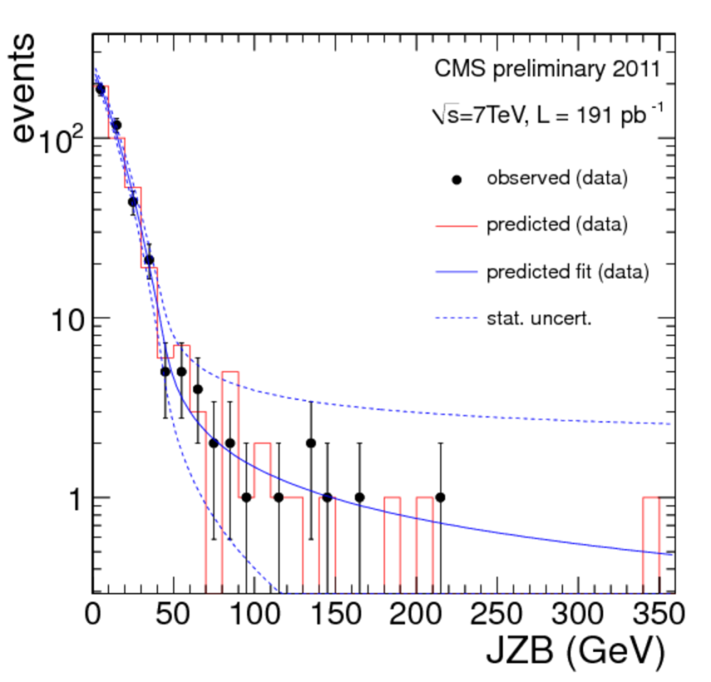
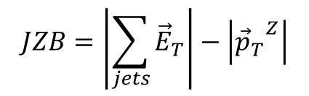
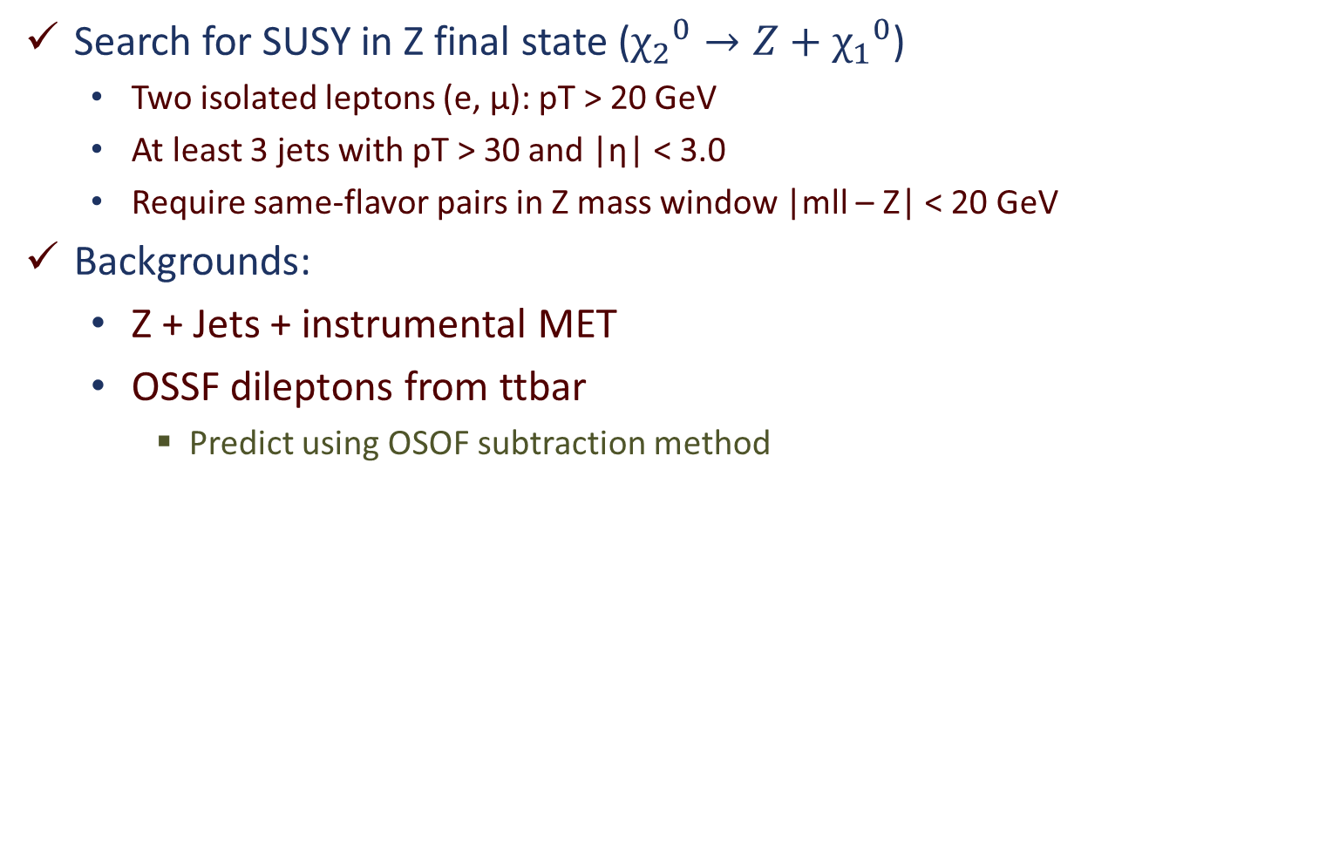
Events with a Z-boson, 3 or more jets and MET
PAS-SUS-11-012
Search for SUSY in Z final state (${χ_{2}}^{0}→Z+{χ_{1}}^{0}$)
  Two isolated leptons (e, μ): pT > 20 GeV
  At least 3 jets with pT > 30 and |η| < 3.0
  Require same-flavor pairs in Z mass window |mll – Z| < 20 GeV
Backgrounds:
  Z + Jets + instrumental MET
  OSSF dileptons from ttbar
    Predict using OSOF subtraction method
$$JZB=\left|\sum_{jets}{{\vec{E}}_{T}}\right|−\left|{{\vec{p}}_{T}}_{}^{Z}\right|$$
No excess observed

Slide 17
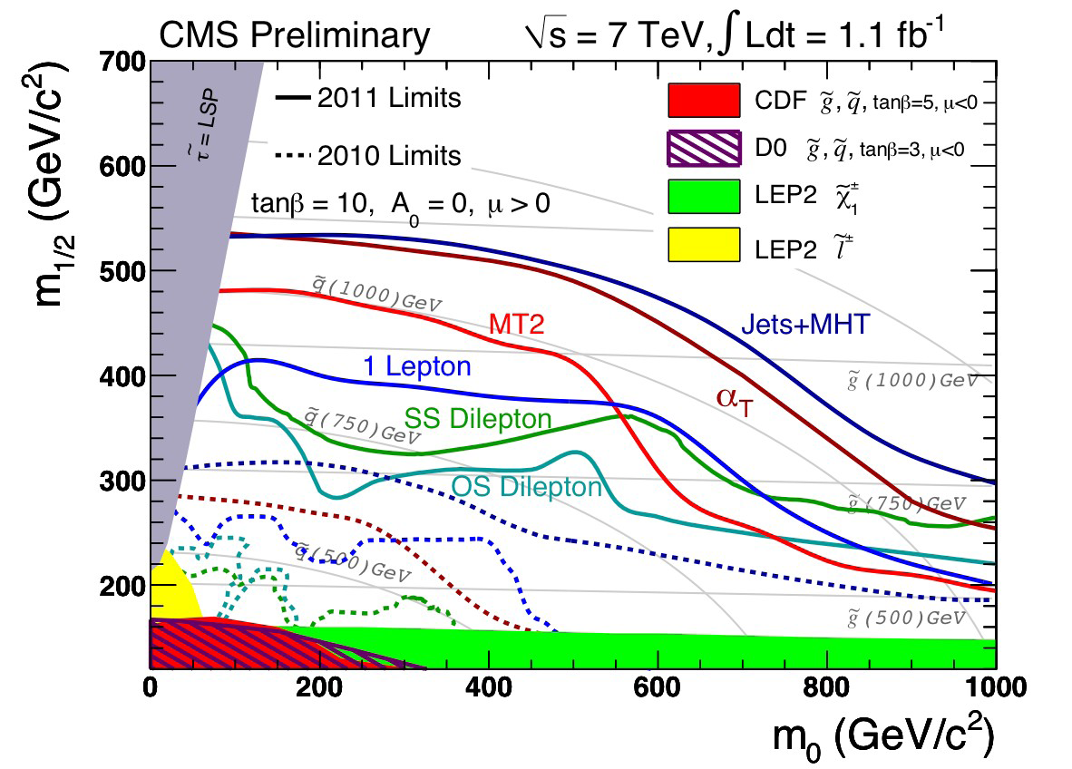
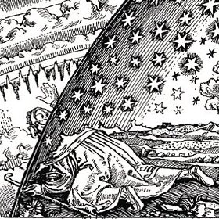
Exclusion Limits: Hadronic and Leptonic
Observed limits from 2011 CMS SUSY searches plotted in (m0,m1/2) plane of the Constrained MSSM
First glimpse at Tera scale

Slide 18
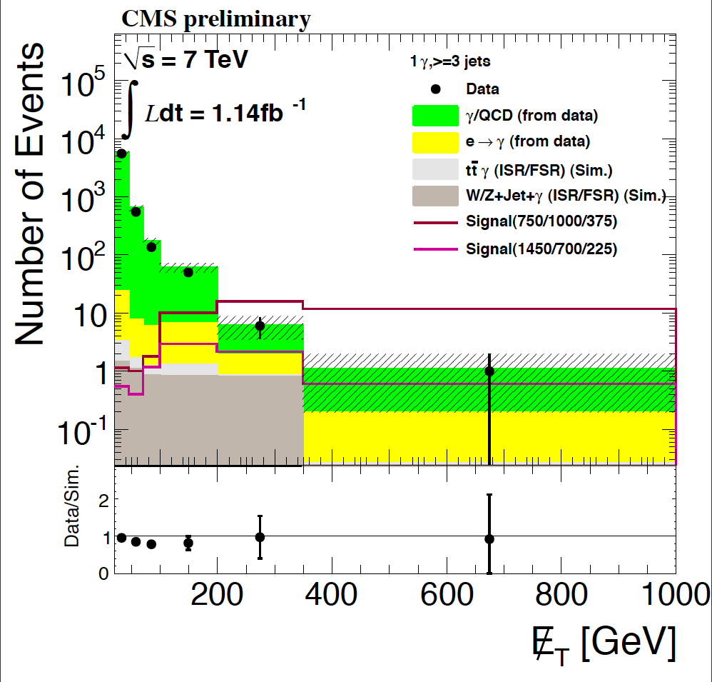
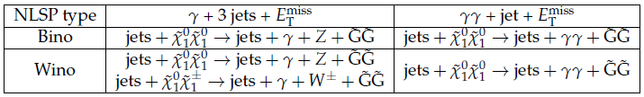
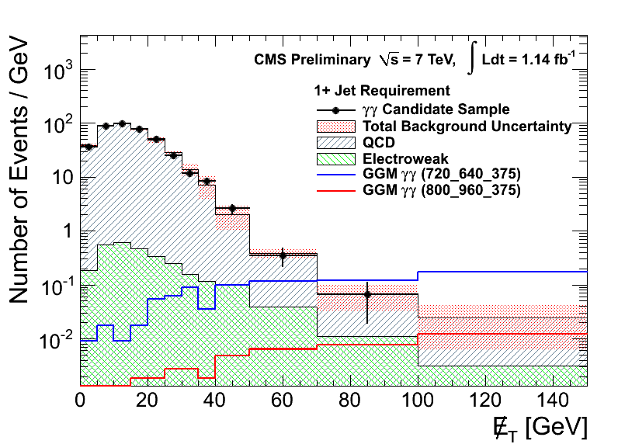
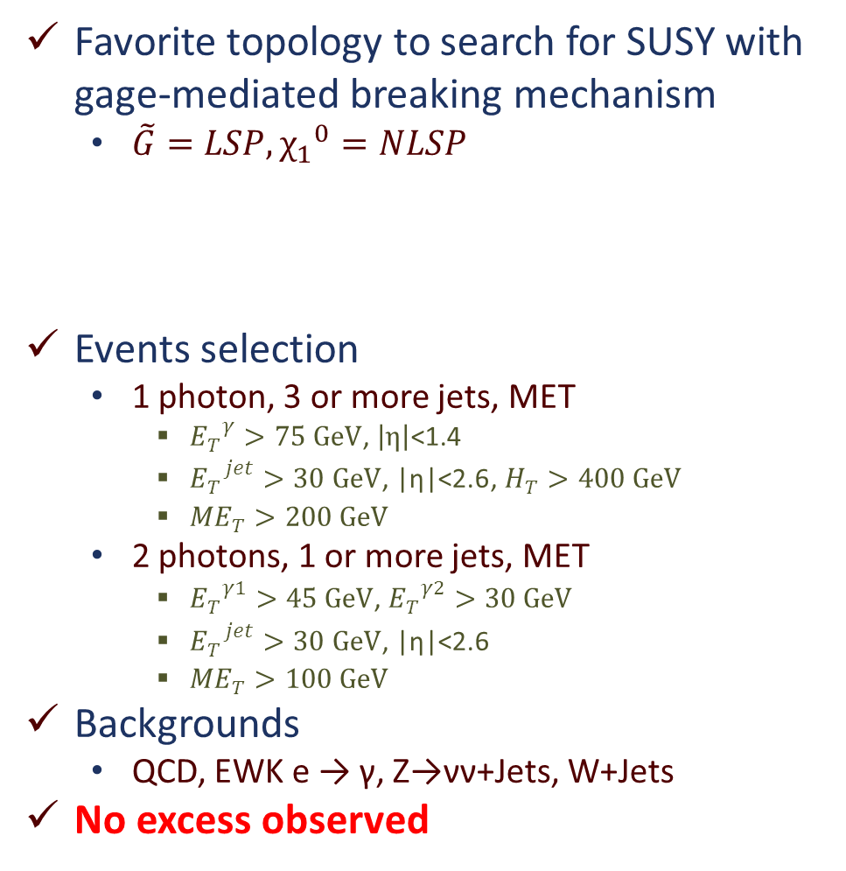
Events with photons, jets and MET
Favorite topology to search for SUSY with gage-mediated breaking mechanism
  $\tilde{G}=LSP, {χ_{1}}^{0}=NLSP$
Events selection
  1 photon, 3 or more jets, MET
    ${E_{T}}_{}^{γ}>75 GeV$, $\left|η\right|$<1.4
    ${E_{T}}_{}^{jet}>30 GeV$, $\text{|}\text{η}\text{|<2.6}$, $H_{T}>400 GeV$
    ${ME}_{T}>200 GeV$
  2 photons, 1 or more jets, MET
    ${E_{T}}_{}^{γ1}>45 GeV$, ${E_{T}}_{}^{γ2}>30 GeV$
    ${E_{T}}_{}^{jet}>30 GeV$, $\text{|}\text{η}\text{|<2.}\text{6}$
    ${ME}_{T}>100 GeV$
Backgrounds
  QCD, EWK e → γ, Z→νν+Jets, W+Jets
No excess observed
PAS-SUS-11-009

Slide 19
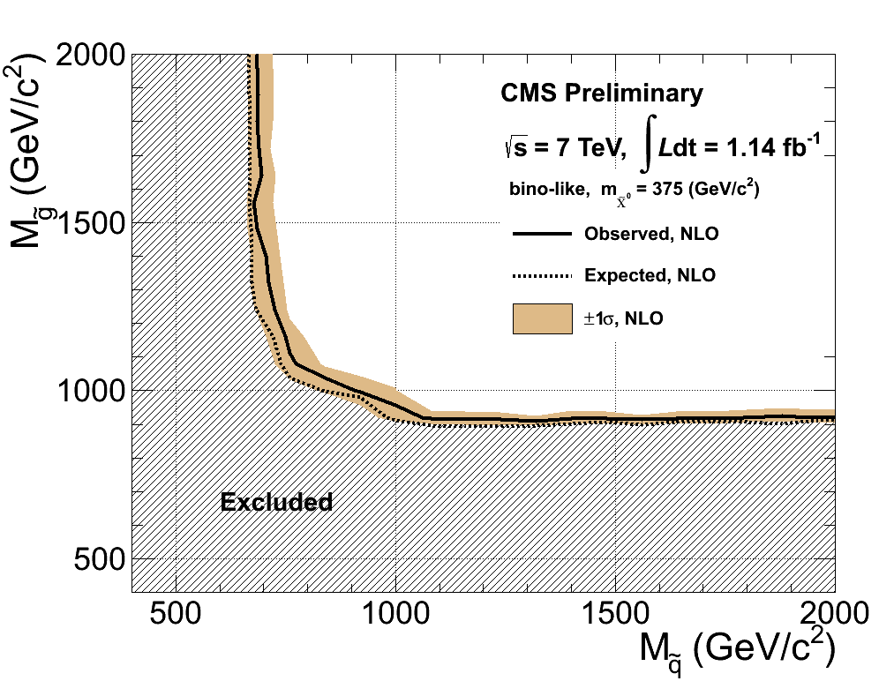
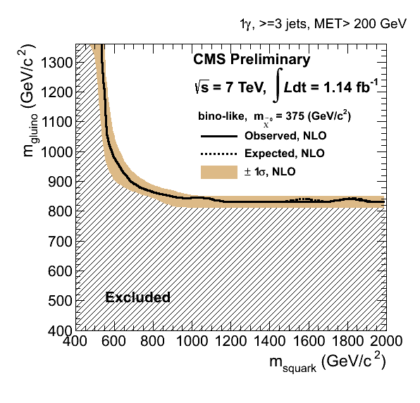
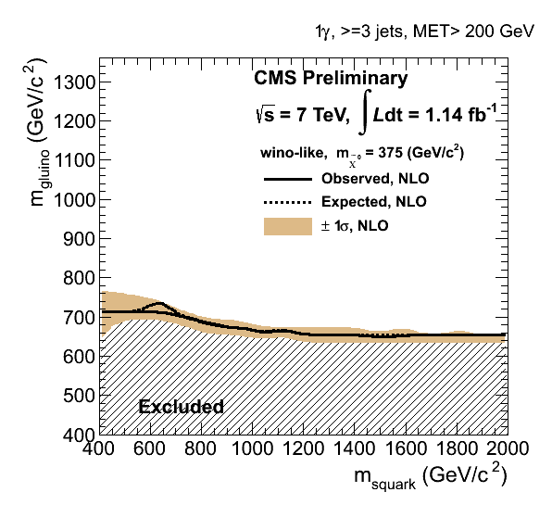
Exclusion limits: Photonic
PAS-SUS-11-009
Observed limits from 2011 CMS SUSY searches with photons plotted in the (m_{squark},m_{gluino}) plane of general gauge-mediation (GGM) SUSY scenario
2γ, ≥1 jet, MET>100 GeV
1γ, ≥3 jets, MET>200 GeV
1γ, ≥3 jets, MET>200 GeV

Slide 20
Conclusions
Searches for SUSY with the CMS is presented
  Model independent, signature oriented
Wide range of topologies is reviewed
  All-hadronic, leptonic and photonic
  Most backgrounds estimated from data
No excess over SM backgrounds observed
  Set exclusion limits using simple SUSY models
  Some limits enter Tera scale
Update with ~5 fb⁻¹ underway
  LHC running well (expected stop at the end of October)
  CMS collecting data with high efficiency (>90%)
  Stay tuned!

Slide 21
Back Up

Slide 22
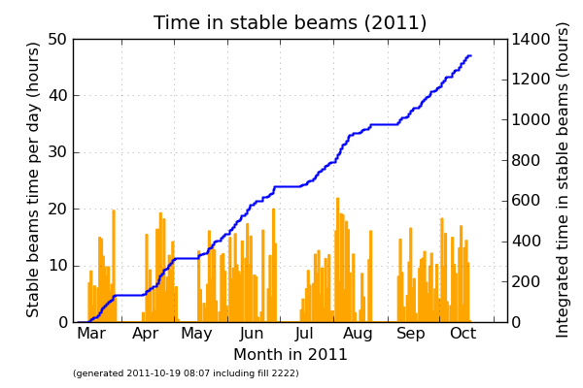
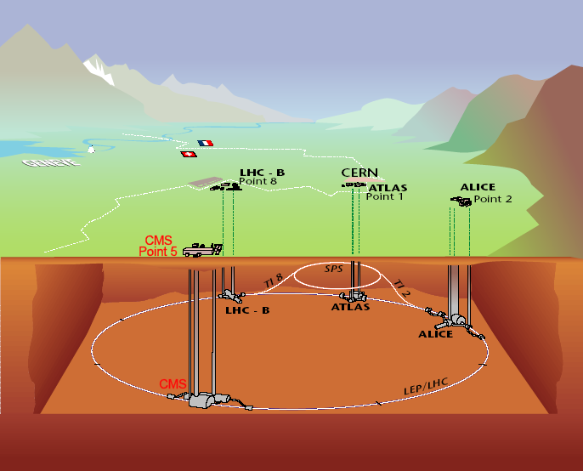
Large Hadron Collider (LHC)
design center of mass energy: √s = 14 TeV
design luminosity: L = 10³⁴ cm⁻²s⁻¹
current center of mass energy: √s = 7 TeV
Time with stable beams in 2011: T ≈ 1300 hours
current record luminosity: L ≈ 3.6·10³³ cm⁻²s⁻¹
delivered luminosity to CMS: ∫L·dt ≈ 5.3 fb⁻¹

Slide 23
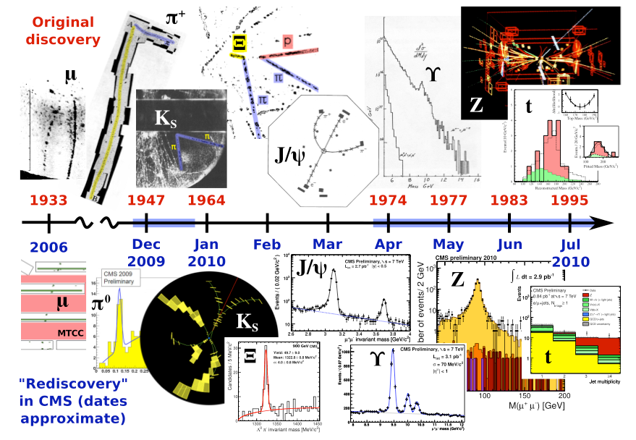
Rediscovery of Standard Model with CMS

Slide 24
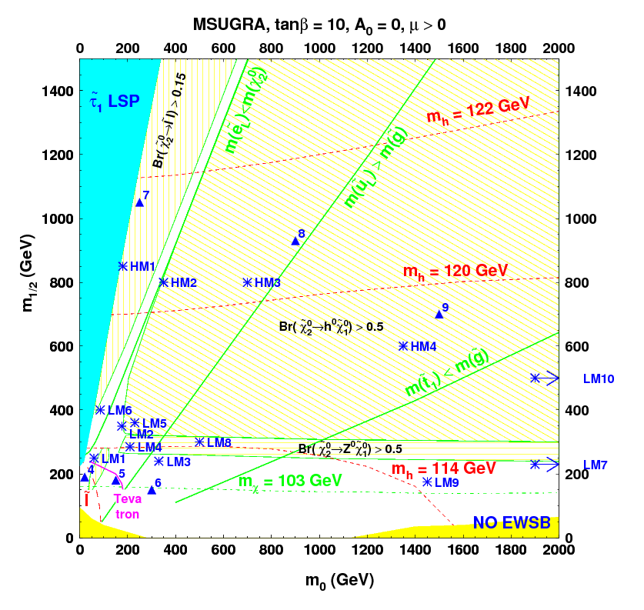
CMS Benchmark Points

