Slide 1
Codimension-2 brane back reaction and cosmology
Leo van Nierop
Brookhaven
October 2011
In collaboration with Prof. Cliff Burgess

Slide 2
Outline
The cosmological constant problem
A model of extra dimensions
Observational consequences
Summary

Slide 3
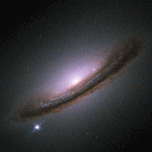
The universe accelerates
Saul Perlmutter,
Brian P. Schmidt
and
Adam G. Riess,
Nobel Prize 2011
Accelerating universe means
Sn94d
CREDIT: NASA/ESA, The Hubble Key Project Team and The High-Z Supernova Search Team

Slide 4
A simple negative pressure
Lorentz invariant energy density

Slide 5
The problem in a nutshell
Einstein’s equations
(Curvature) = (Energy)

Slide 6
Scales of particle physics
Planck scale: 10¹⁹ GeV
GUT scale: 10¹⁶ GeV
Electroweak scale: 246 GeV
W bosons: 80 GeV
Proton: 1 GeV
Pion: 140 MeV
Electron: 511 keV
Cosmological constant: 10⁻² eV

Slide 7
Scales of particle physics
Planck scale: 10¹⁹ GeV
GUT scale: 10¹⁶ GeV
Electroweak scale: 246 GeV
W bosons: 80 GeV
Proton: 1 GeV
Pion: 140 MeV
Electron: 511 keV
Cosmological constant: 10⁻² eV

Slide 8
Scales of particle physics
Planck scale: 10¹⁹ GeV
GUT scale: 10¹⁶ GeV
Electroweak scale: 246 GeV
W bosons: 80 GeV
Proton: 1 GeV
Pion: 140 MeV
Electron: 511 keV
Cosmological constant: 10⁻² eV

Slide 9
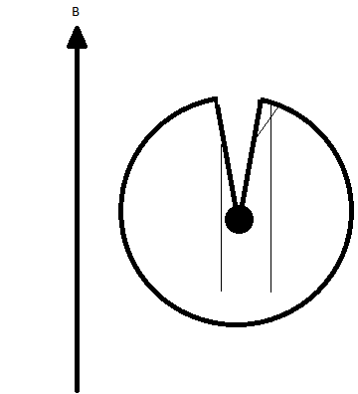
extra dimensions as a solution
Breaks the relation
(curvature)=(energy)
Example:
Cosmic Strings
Goal:
Vilenkin, 1981

Slide 10
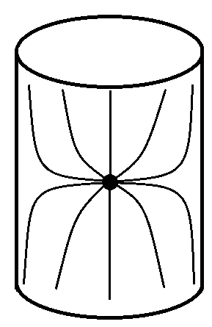
How many dimensions
Extra dimensions | Gravity scale M*
1 | 10⁹ GeV
2 | 10⁴ GeV
3 | 10 GeV

Slide 11
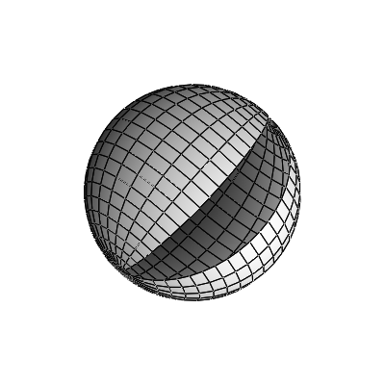
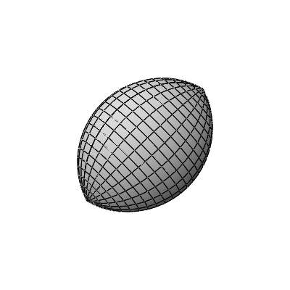
Conical extra dimensions
Graviton
Maxwell flux

Slide 12
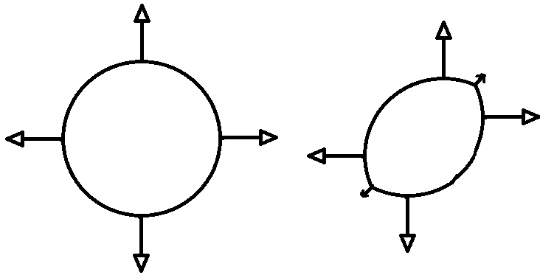
Conical extra dimensions

Slide 13
What else is needed?
Two extra dimensions of ~ 10 μm
Supersymmetry in the bulk
A mechanism that stabilizes the dimensions
A way for the system to relax to large perturbations of the 4-dimensional energy

Slide 14
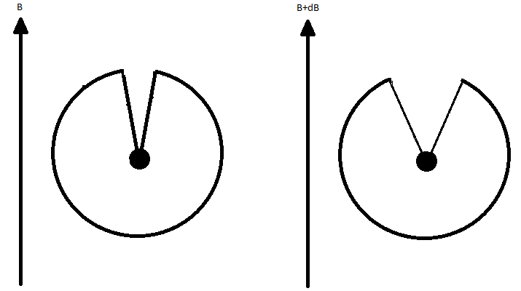
Cosmological constant problem
What happens now if the tensions change?
T
T+δT

Slide 15
No miracles

Slide 16
An explicit model: The bulk
Gauged Chiral Supergravity
Graviton Dilaton Maxell field Potential
Branes:
Tension Brane Flux
Scaling symmetry:

Slide 17
Rugby Ball solutions

Slide 18
Connection to source branes
Sources described by lower dimensional actions
For the rugby ball, the tensions are constant and equal, and satisfy

Slide 19
4d Flat supergravity solutions
General solutions are known for which the dilaton approaches a constant at the brane
They are all flat on the brane
They match to branes that have an action that is independent of the dilaton
Notes:
But also scale invariant: runaways!

Slide 20
A small cosmological constant
Flux quantization stabilizes the dilaton at a large value
Volume is proportional to exp(φ₀)
Brane independent of φ: Λ=0 classically

Slide 21
Stable against perturbations
Classical result
Λ=0 as long as there is no direct coupling of the brane to the dilaton
Brane Loops
Already included: T is arbitrary
Bulk Loops
Loop counting parameter is which is related to the volume by

Slide 22
Predictions of the model
Quantum gravity at LHC!
String excitations of known particles
Energy loss in the extra dimensions
More bulk fields than just graviton
Supersymmetry at low energy but NO MSSM spectrum
Deviations from 1/r² gravity below few 10 μm (current limits are close)
Scalar-Tensor gravity

Slide 23
Predictions of the model
Quantum gravity at LHC!
String excitations of known particles
Energy loss in the extra dimensions
More bulk fields than just graviton
Supersymmetry at low energy but NO MSSM spectrum
Deviations from 1/r² gravity below few 10 μm (current limits are close)
Scalar-Tensor gravity

Slide 24
Open questions and challenges
Insert a big number ~ 10³⁰ - 10³⁵ TeV in the flux-brane Lagrangian, where does this come from?
Cosmology at long distances is a scalar-tensor theory: evade current bounds?
What does the cosmological evolution look like?
Is there a dark matter candidate?

Slide 25
summary
Cosmological constant problem points to 2 extra dimensions with size ~ few 10 μm
The scale of gravity in the extra dimensions is ~ 10 TeV
Low scale supersymmetry without MSSM
Very testable in the near future
Deviations from Newton’s law
Scalar-tensor gravity
String theory at the LHC

Slide 26
Equations of motion
Only free parameter is n, the flux quantization integer

Slide 27
A paradox
Imagine a perturbation to the tensions:

Slide 28
A paradox
Imagine a perturbation to the tensions:
There is a contradiction!

Slide 29
General matching conditions
Burgess, Hoover, de Rham, Tasinato (2008);
Bayntun, Burgess, LvN (2009)
with

