Slide 1
Discovering Higgs in SUSY GUTs with Tau Leptons at LHC
Kesheng Yang
(In collaboration with Prof. C. Kao)
Homer L. Dodge Department of Physics
University of Oklahoma

Slide 2
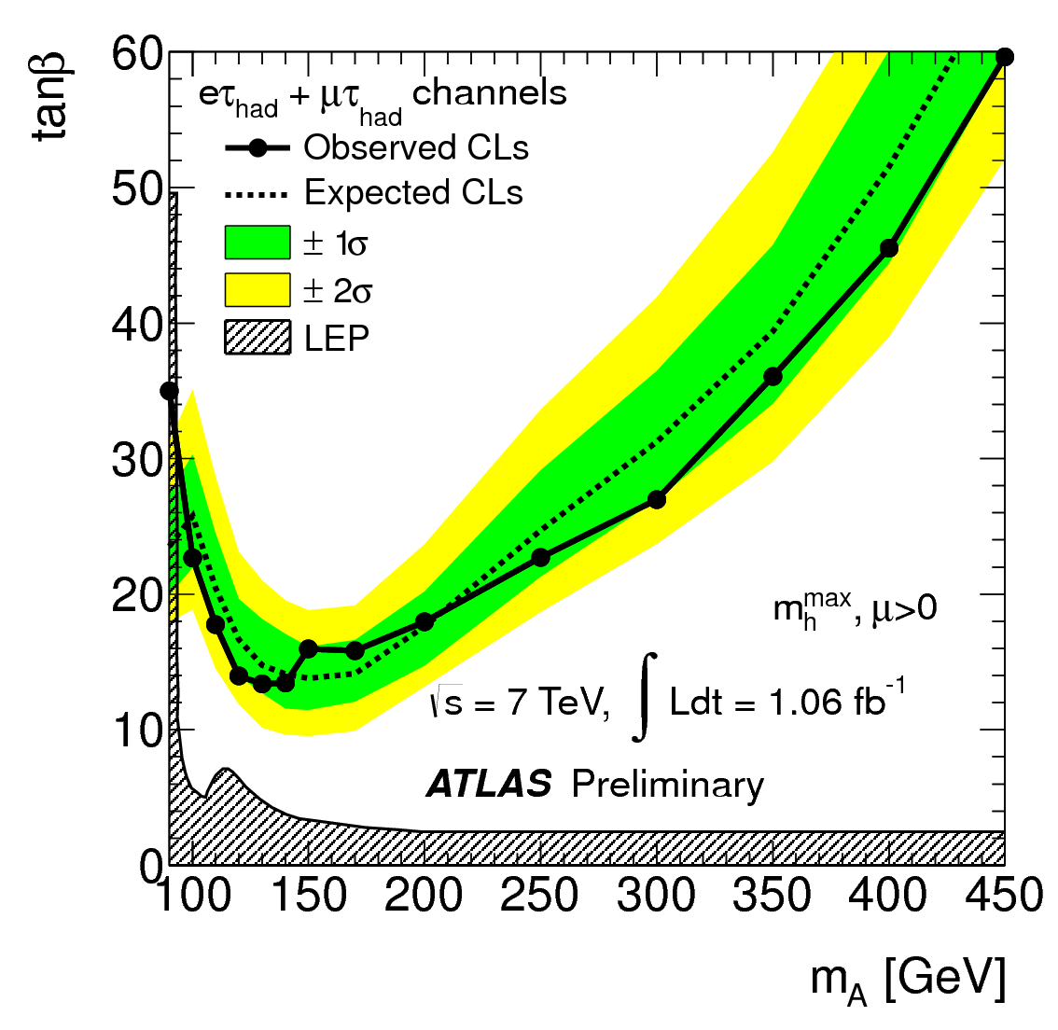
MSSM Higgs searches from ATLAS and CMS
(ATLAS-CONF-2011-132)
(CMS-PAS-HIG-11-009)

Slide 3
Higgs Searches in the MSSM
Higgs production associated with one b jet, and Higgs decay into pairs.
One b jet in the final state is helpful to handle the fake jets by applying b tagging technique.
Neutral scalar could be or .
In low mass region, . If , we add the contribution from together with that from pseudo scalar.
In high mass region, , If , we put the contribution from together with that from pseudo scalar.
Scalars predominantly decay to , and .

Slide 4
The biggest decay mode of tau pairs is one into hadronic jet with the other into electron or muon.
(PDG)
One final lepton helps to remove huge QCD background.
Collinear Approximation of decay.
K. Hagiwara, A. D. Martin and D. Zeppenfeld(1990)
Reconstruction of scalar mass.
D. Rainwater, D. Zeppenfeld and
K. Hagiwara(1998)
Chung Kao, Duane A. Dicus, Rahul Malhotra and Yili Wang(2008)

Slide 5
Total cross section of signal.
Five flavor parton distribution function: CETQ6L1
Factorization scale:
Renormalization scale:
Background processes.
Drell-Yan processes:
To include the higher order correction, factor is chosen to be 1.3.

Slide 6
production:
are quark and anti-quark pair form decay.
production:

Slide 7
The production of and are negligible.
Acceptance cuts.
One more set of cuts is required by the physical meaning of energy fraction.

Slide 8
Tagging efficiency and mistagging efficiency.
Criterion for the observability of some signal .
corresponds to .

Slide 9
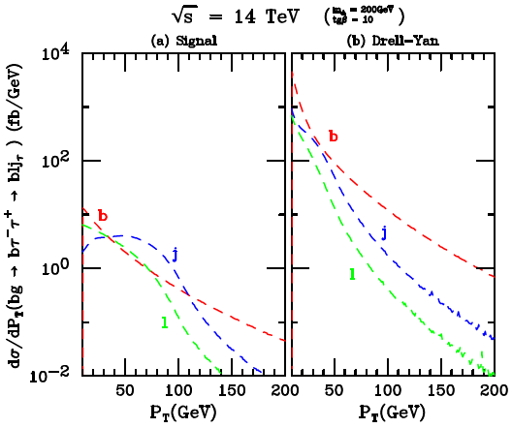
distribution without any cuts.

Slide 10
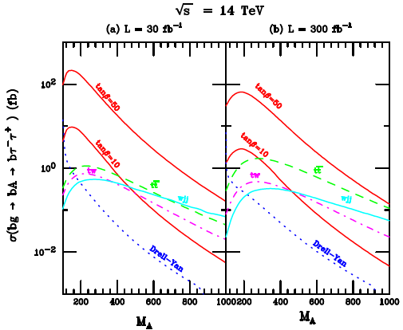

Slide 11
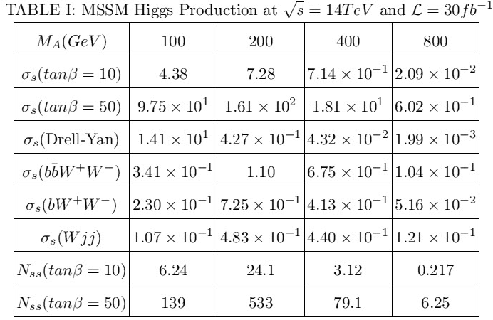
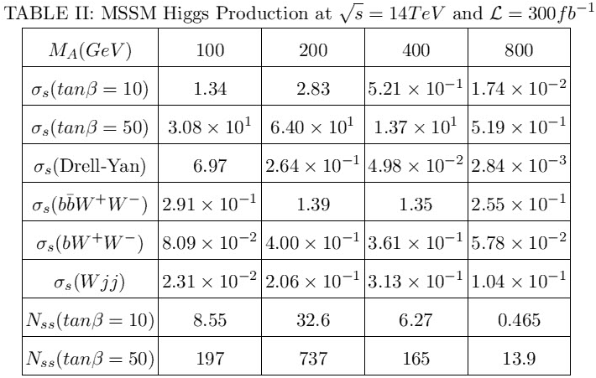
Signal significance.

Slide 12
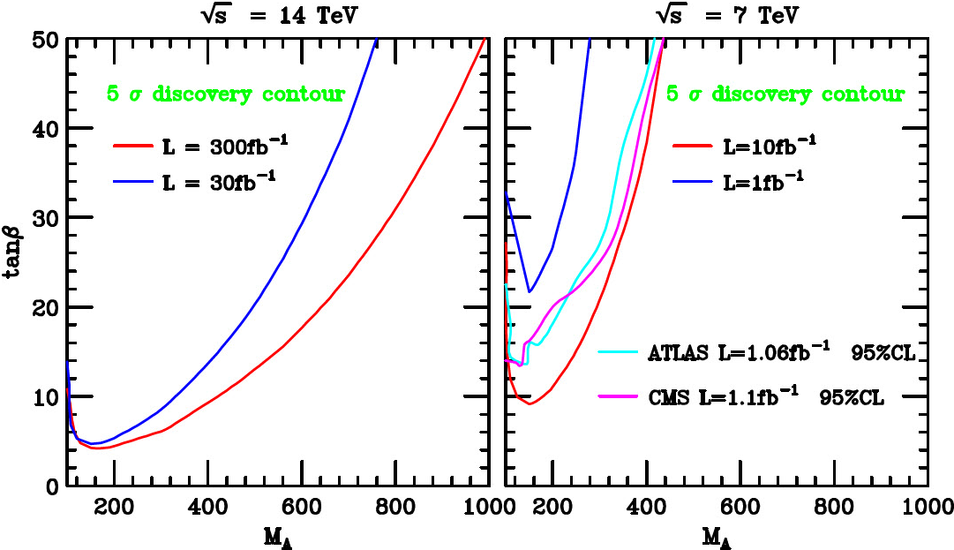
discovery contour.

Slide 13
Several Experimental Constrains
A. J. Buras arXiv:1012.1447v2
LHCb-CONF-2011-047
Becher & Neubert (2007)
Misiak et al. (2007)
Wenfeng Wang (2011)
PDG (2010)
T. Teubner (2010)
Gi-Chol Cho, Kaoru Hagiwara, Yu Matsumoto
and Daisuke Nomura (2011)

Slide 14
mSUGRA Higgs Discovery Potential
SUSY breaking happens in a hidden sector, and is mediated to visible sector by a messenger, gravity.
mSUGRA/CMSSM assumes unified scalar mass , fermionic mass and trilinear coupling at GUT scale. These are free inputs.
In addition, two more parameters are defined at low-energy scale, and .
RGEs evolve from GUT scale down to EW scale, and then generate particle spectrum at EW scale.
Isajet 7.81 (H. Baer, F.E. Paige, S.D. Protopopescu, X. Tata)
The following parameter space will be scanned.

Slide 15
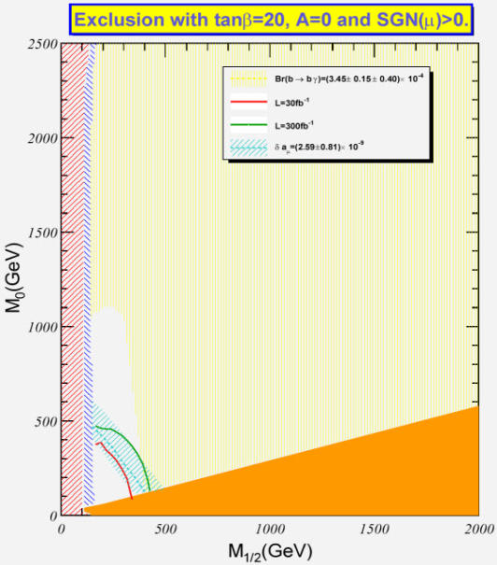
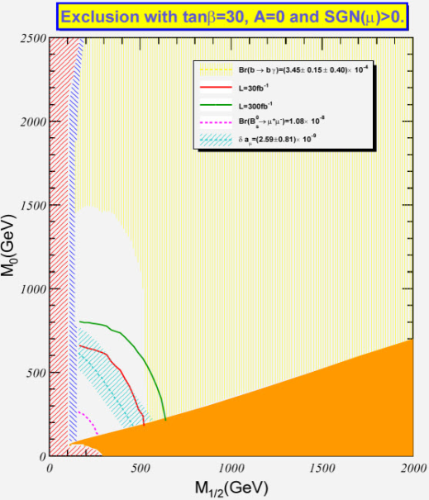
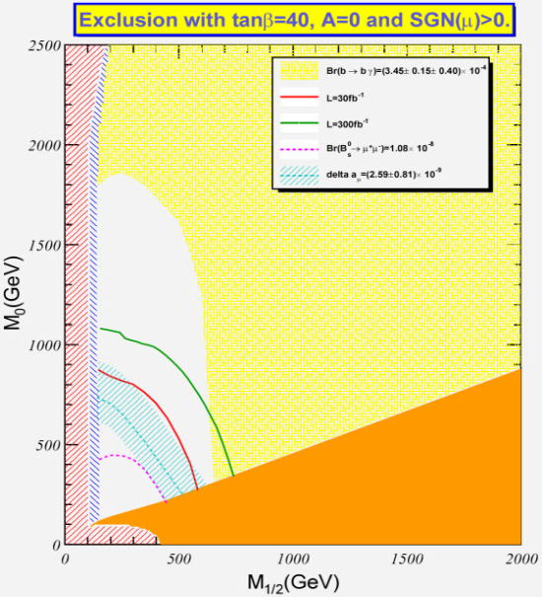
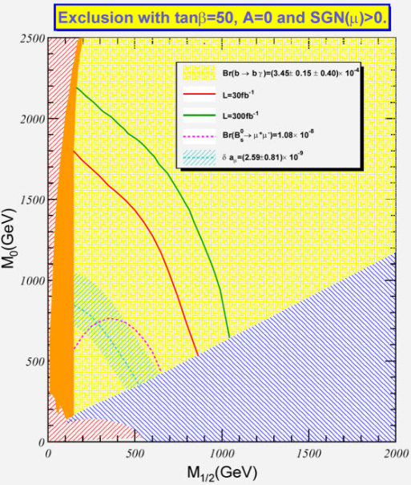

Slide 16
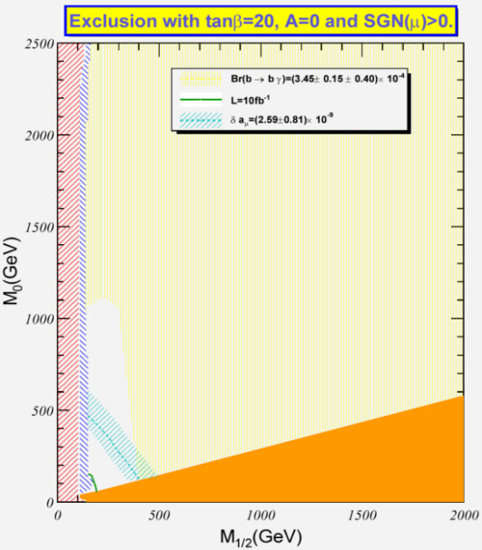
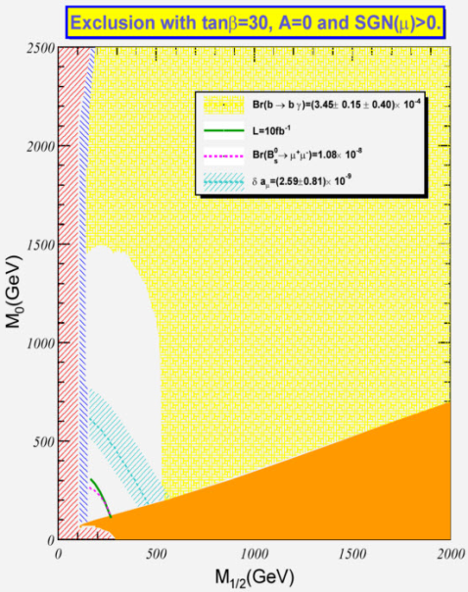
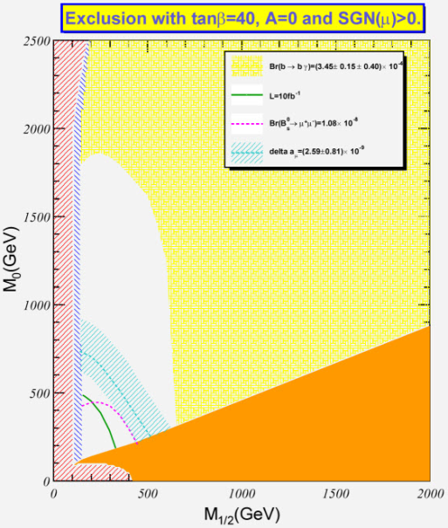
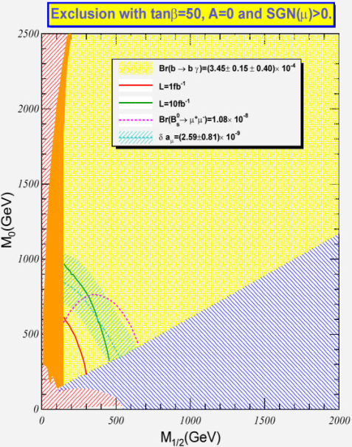

Slide 17
mAMSB Higgs Discovery Potential
SUSY breaking happens in a separate brane, and is mediated to visible sector by super-Weyl anomaly.
The parameter space is formed by four parameters.
The scanned parameter space

Slide 18
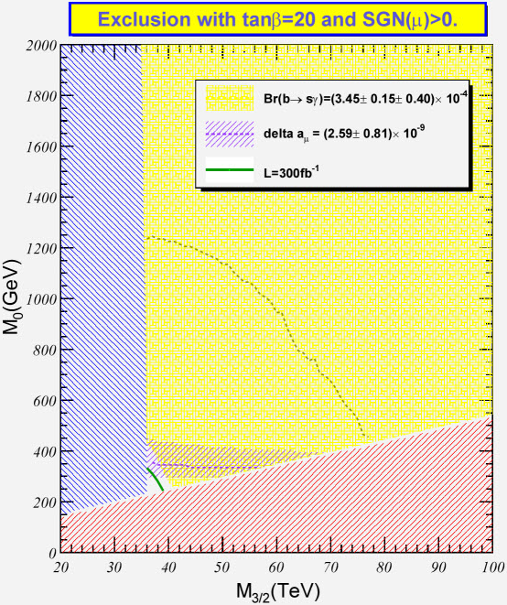
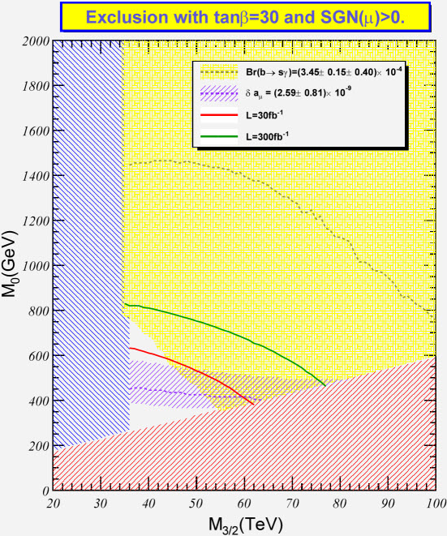
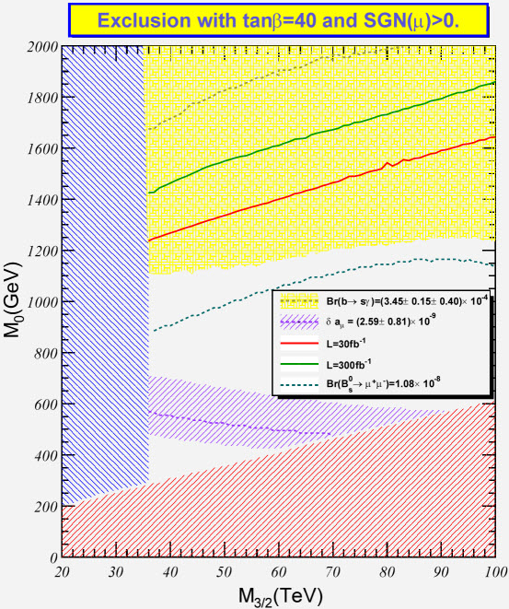

Slide 19
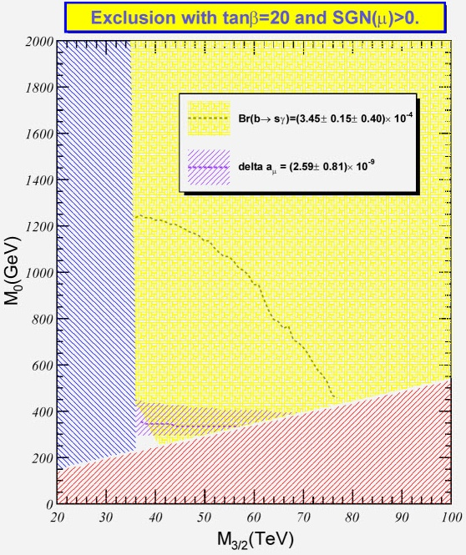
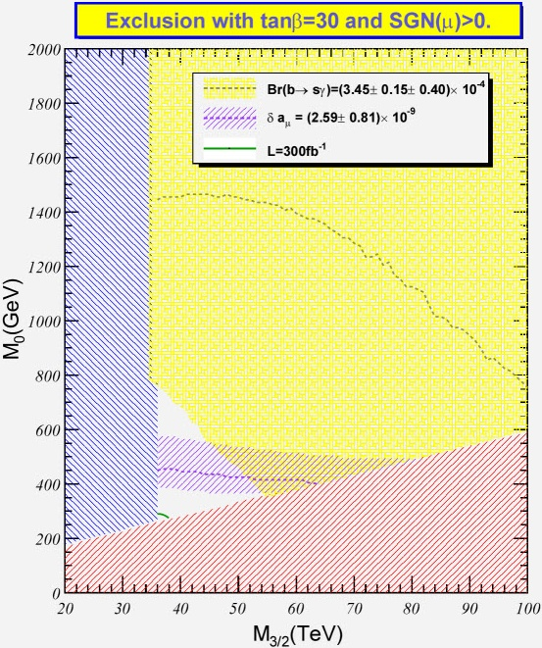
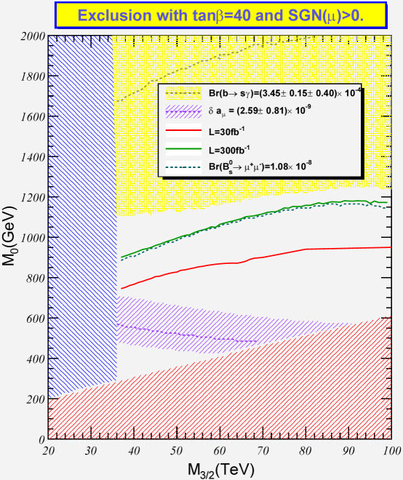

Slide 20
Conclusion
It’s promising to discover Higgs by tau lepton pairs, even with Higgs mass up to 1 TeV at LHC.
In mSUGRA, the model with high favors the discovery of Higgs.
In mAMSB, the model with intermediate favors the discovery of Higgs.
GMSB and related channels will be added.

