Slide 1
Introduction to the OpCenter
Rob Rainer
WAO Conference
October 3rd, 2018

Slide 2
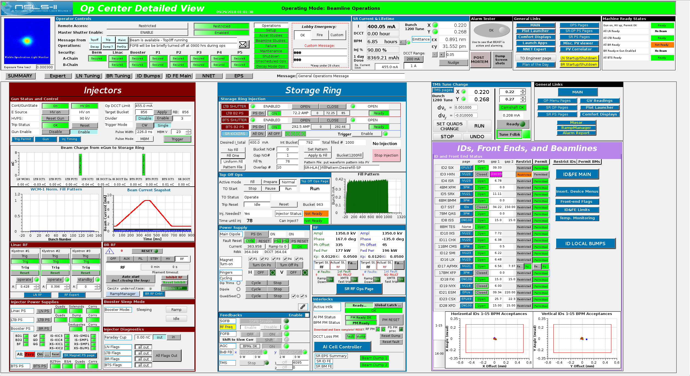

Slide 3
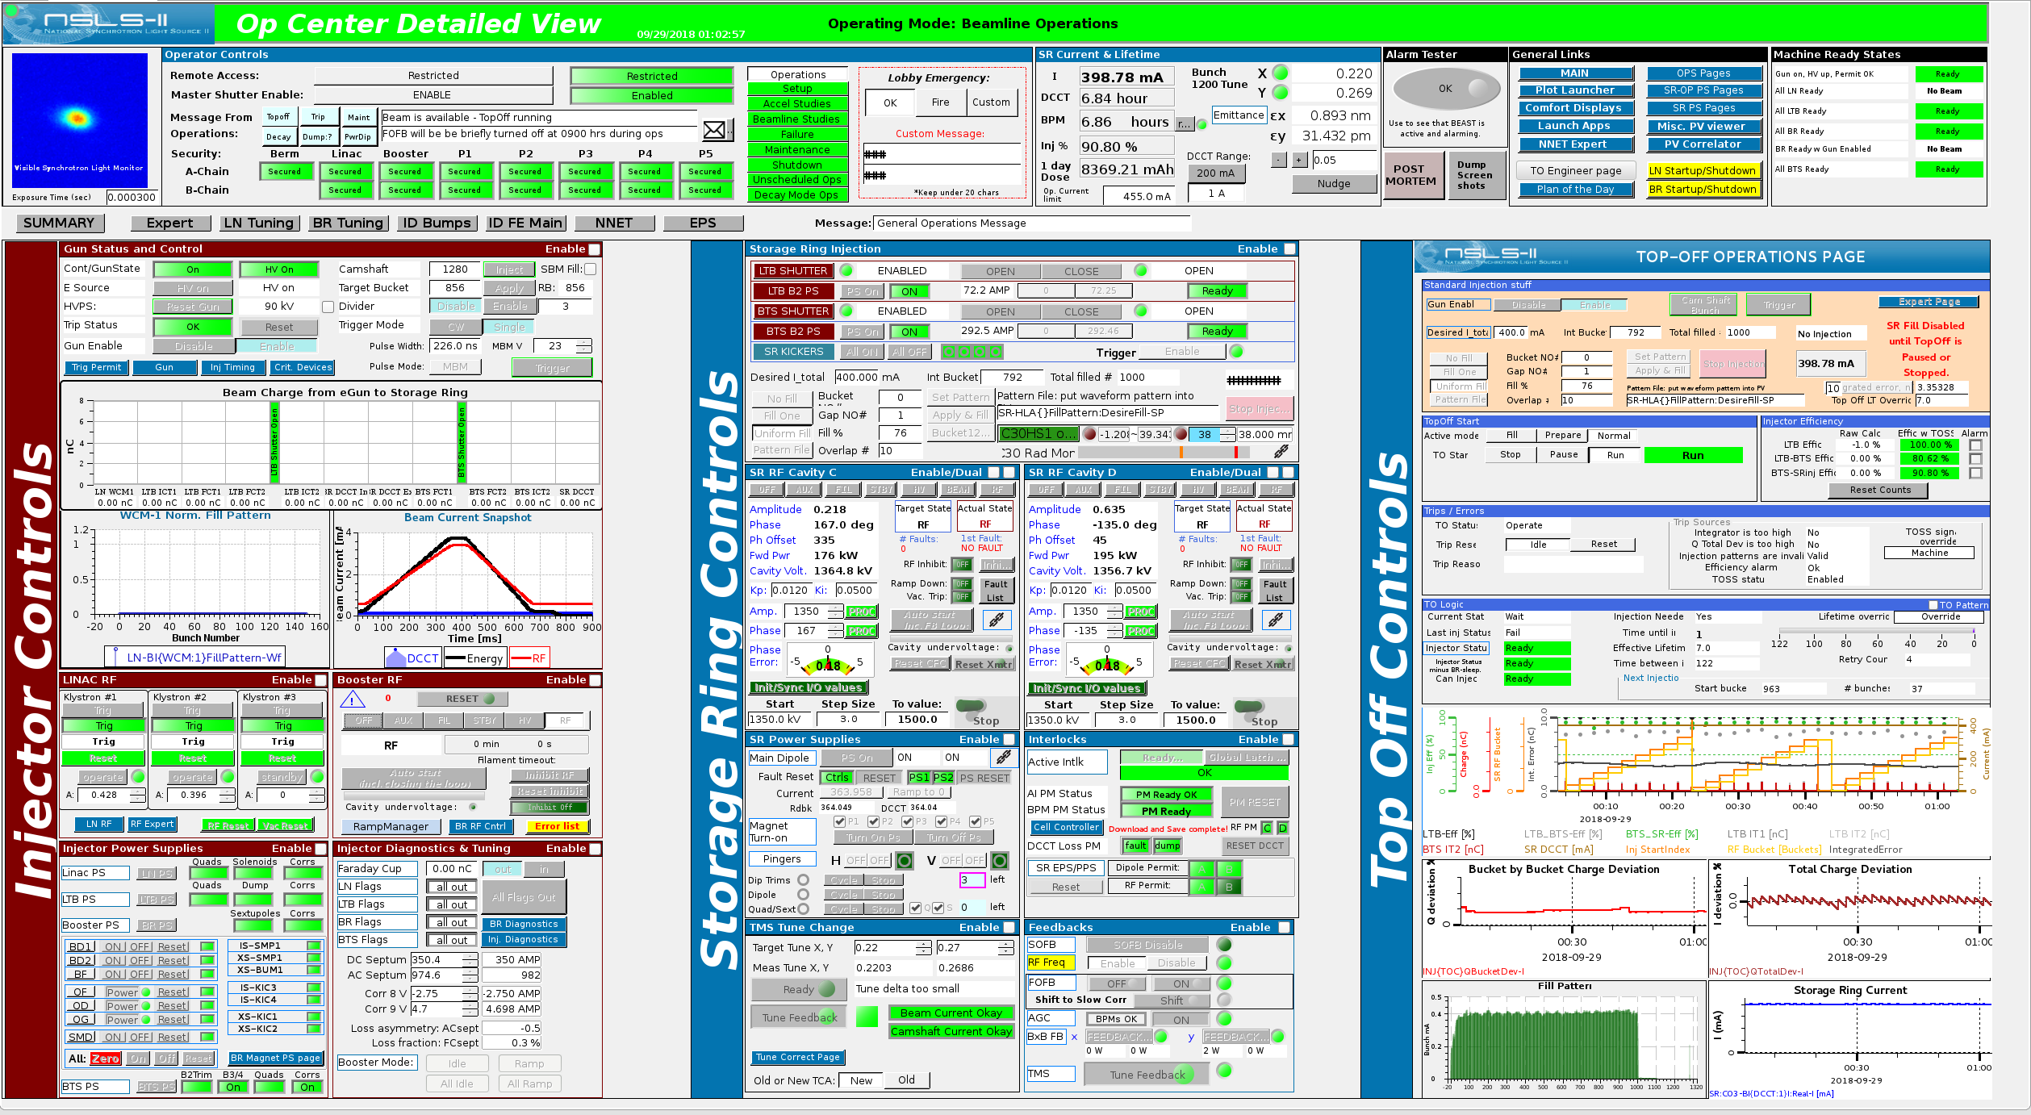

Slide 4
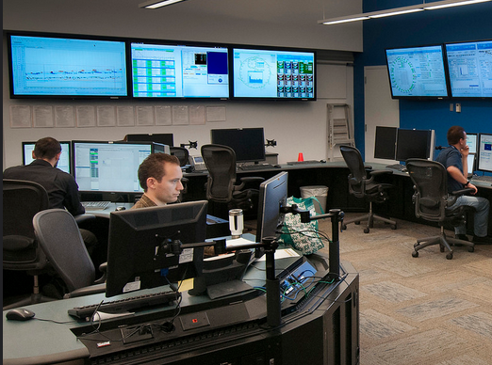
OpCenter is a tool
OpCenter gives us…
Ease of use
What is the “OpCenter” ?
Condensed info
Easy access
Less processing
One Stop Shopping

Slide 5
OpCenter Layout
OpCenter Layout

Slide 6
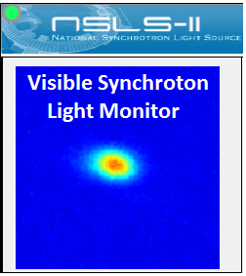
OpCenter Banner
The Banner has…
Master Shutters
Remote Access
Ops Messages
Beam Status, etc.

Slide 7
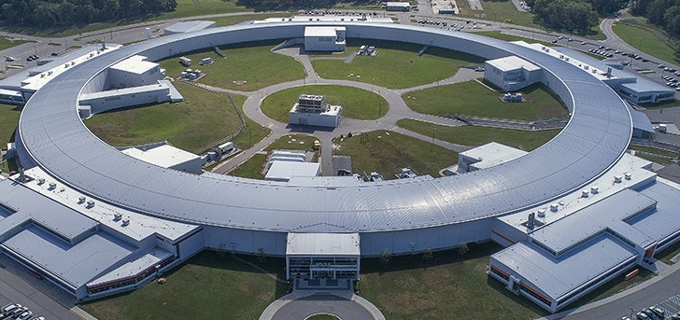
OpCenter Summary
Summary has…
Injector Controls
SR Status
Critical Devices
ID & FE Status
Important Links

Slide 8
OpCenter Expert
Expert Panel
Injector Controls
SR Controls
Critical Devices
TO Status
Important Links

Slide 9
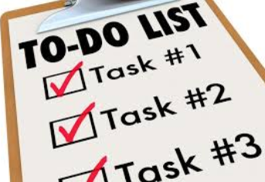
Task Driven Sections
Task Sections…
Summary/Expert
LN Tuning
BR Tuning
ID Bumps
ID & FE Main
NNET Main

Slide 10
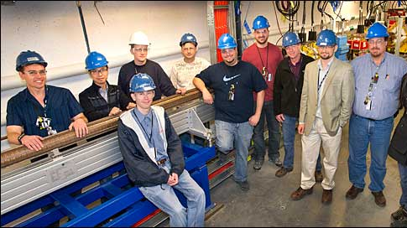
LINAC Tuning
LN Tuning Page
BD & Quads
BL Comp.
LTB Controls
LN RF
Flags

Slide 11
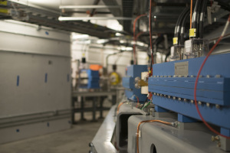
Booster Tuning
BR Tuning
TbT Plot
LN RF Controls
LTB Controls
BR Main PS

Slide 12
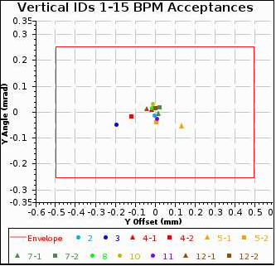
ID Local Bumps
Local Bumps
Desired Bumps
Local FBs
Global FBs
Angles & Offsets
AI Window

Slide 13
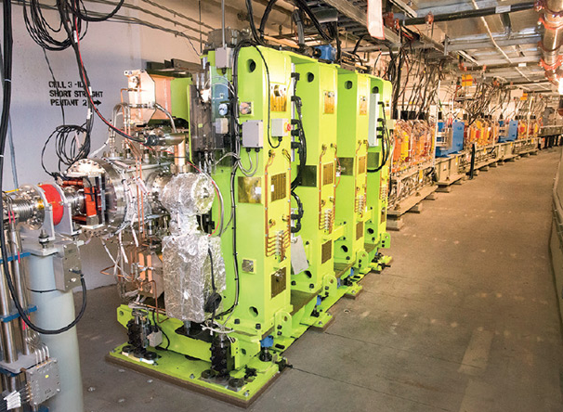
ID & FE Main
ID & FE Main
Shutter Controls
BL Permissions
ID Controls
Some Vacuum

Slide 14
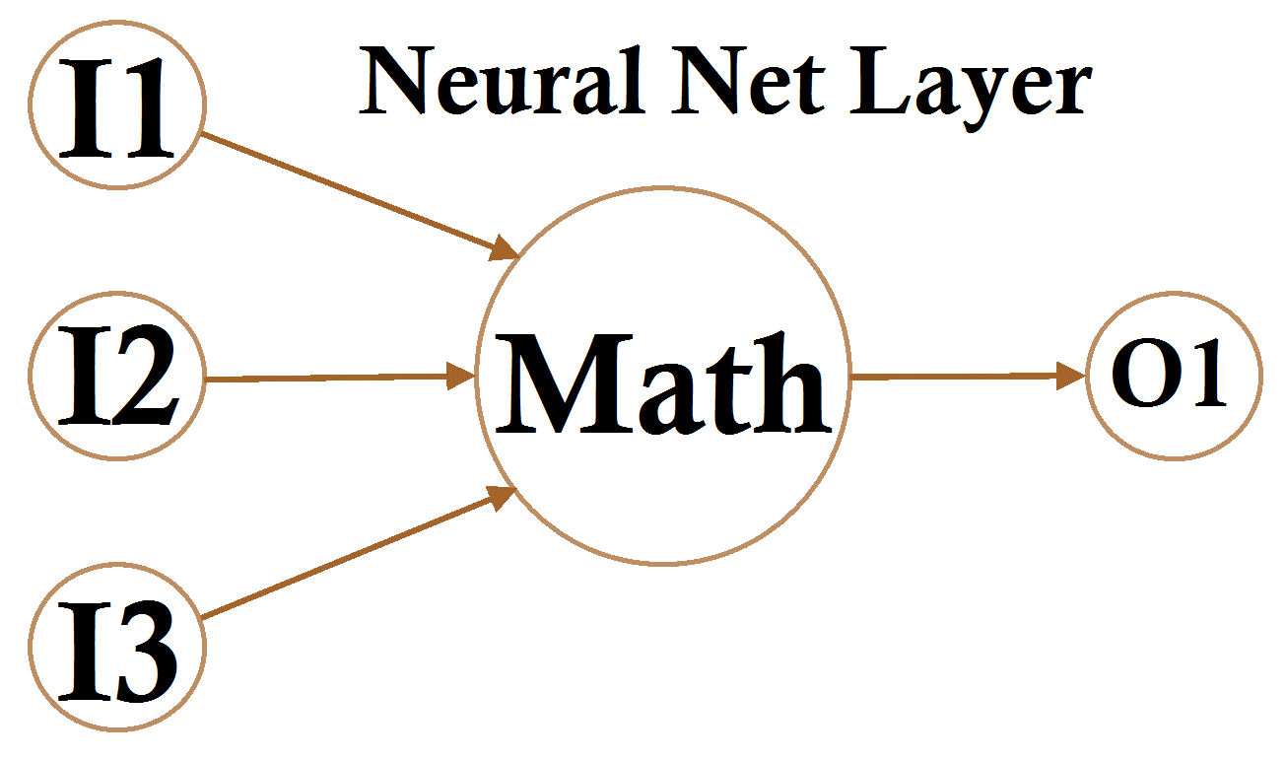
NNET Application
NNET Main
NNET Controls
Data Collection
Efficiencies
RF & PS Data

Slide 15
OpCenter Principles
Principles
Ever-changing
Needs based
Improved Reliability
Customizable

Slide 16
Acknowledgements
NSLS II Operations
NSLS II Staff
WAO Conference
October 3rd, 2018

Slide 19
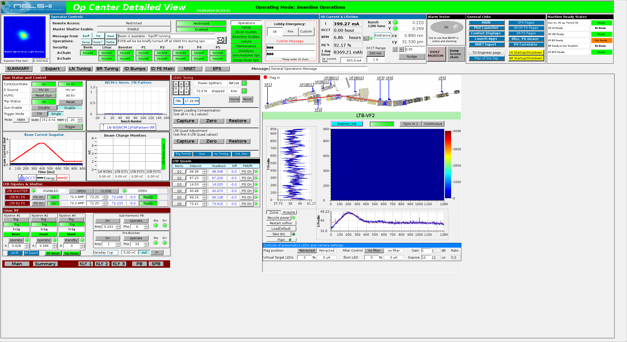

Slide 20
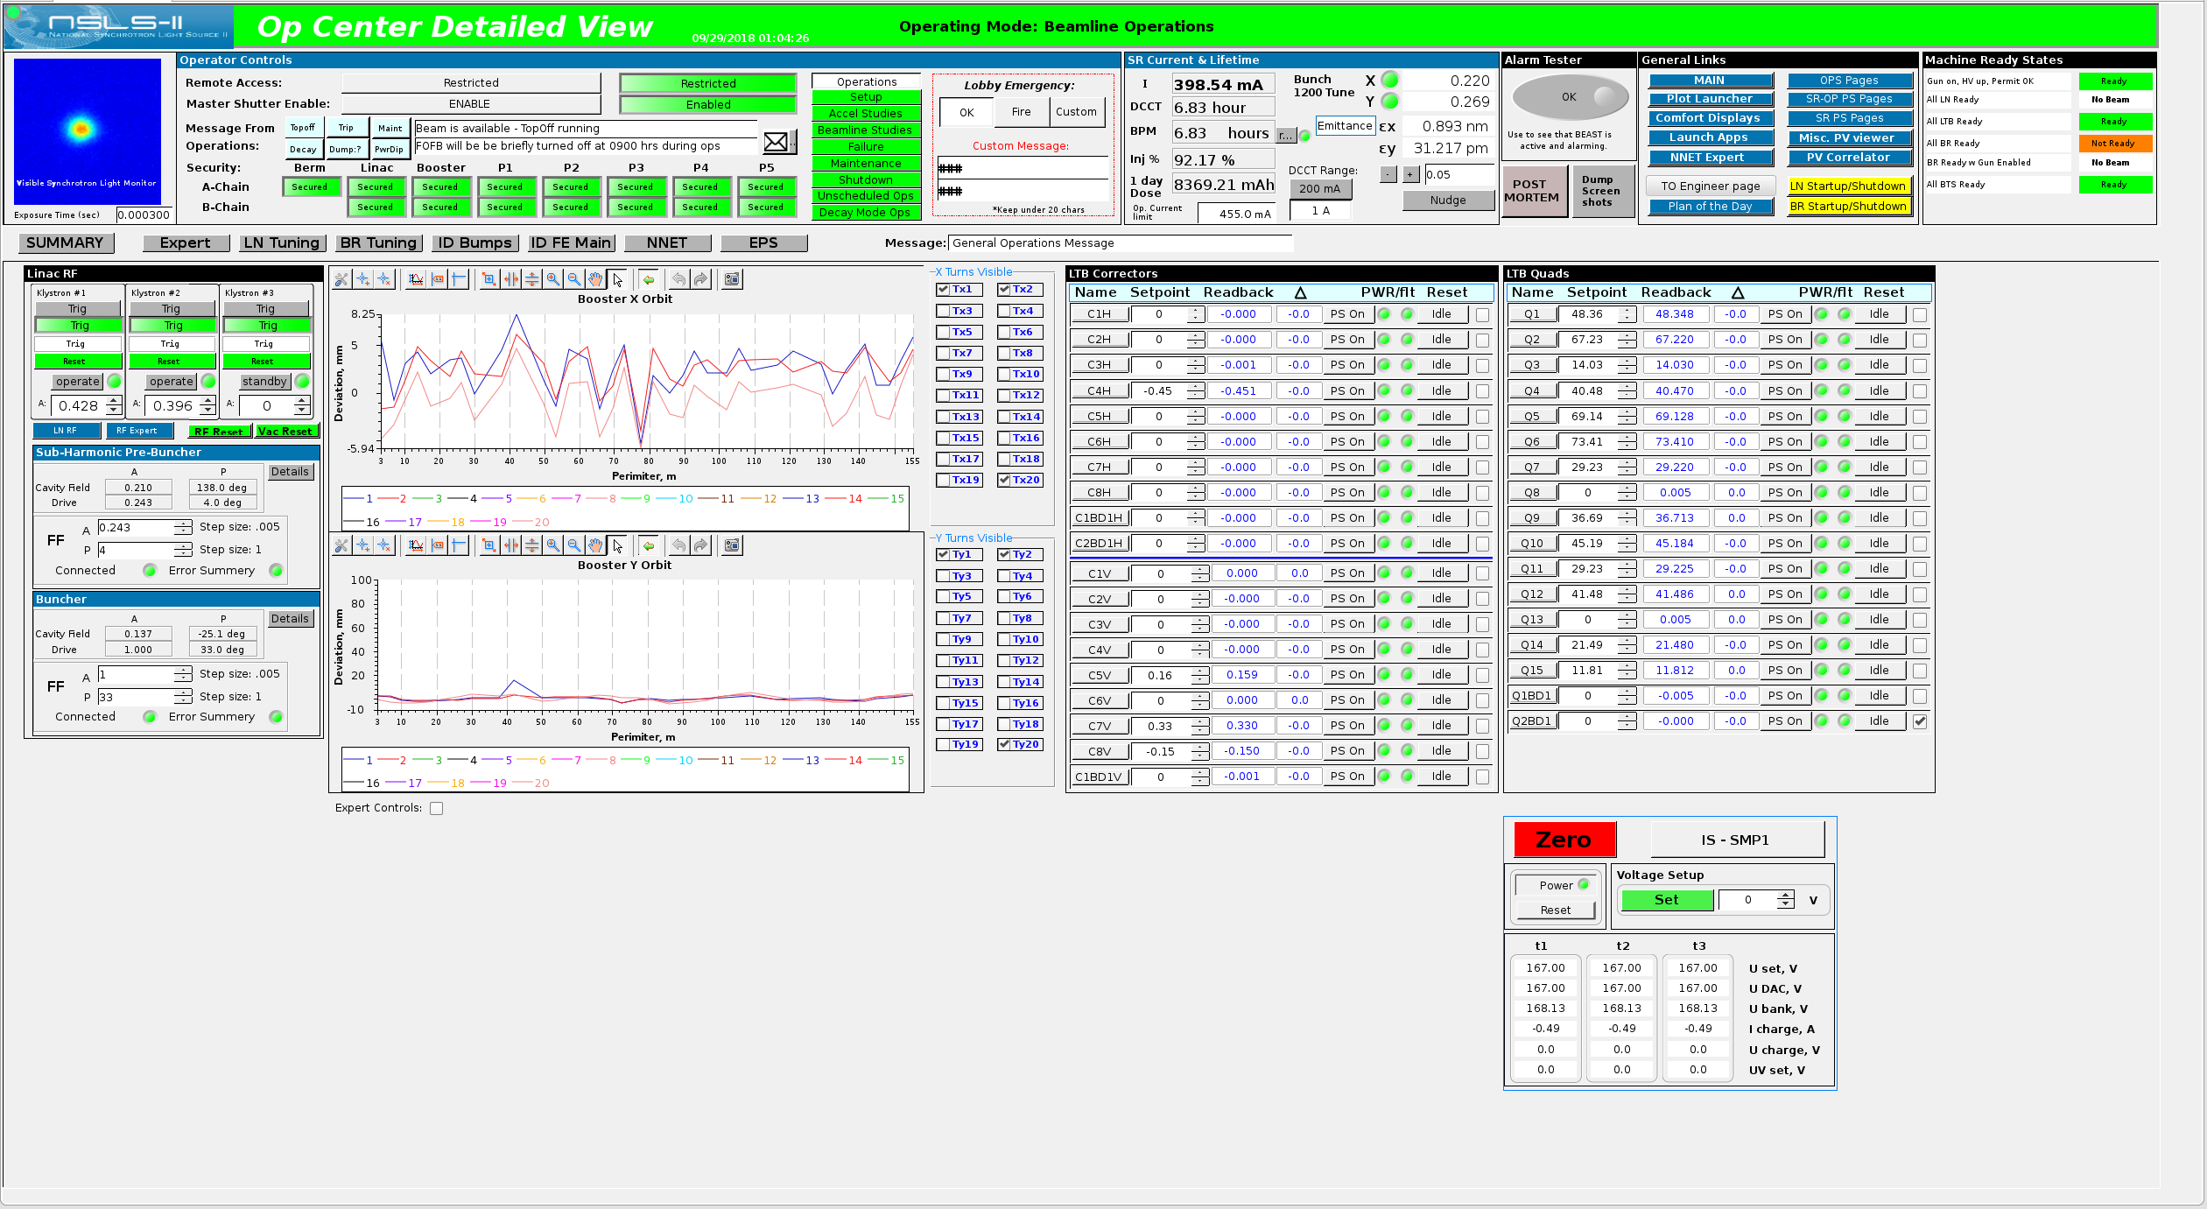

Slide 21
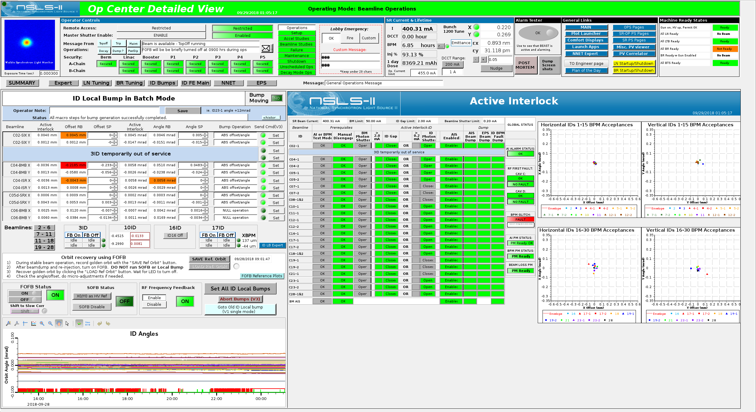

Slide 22
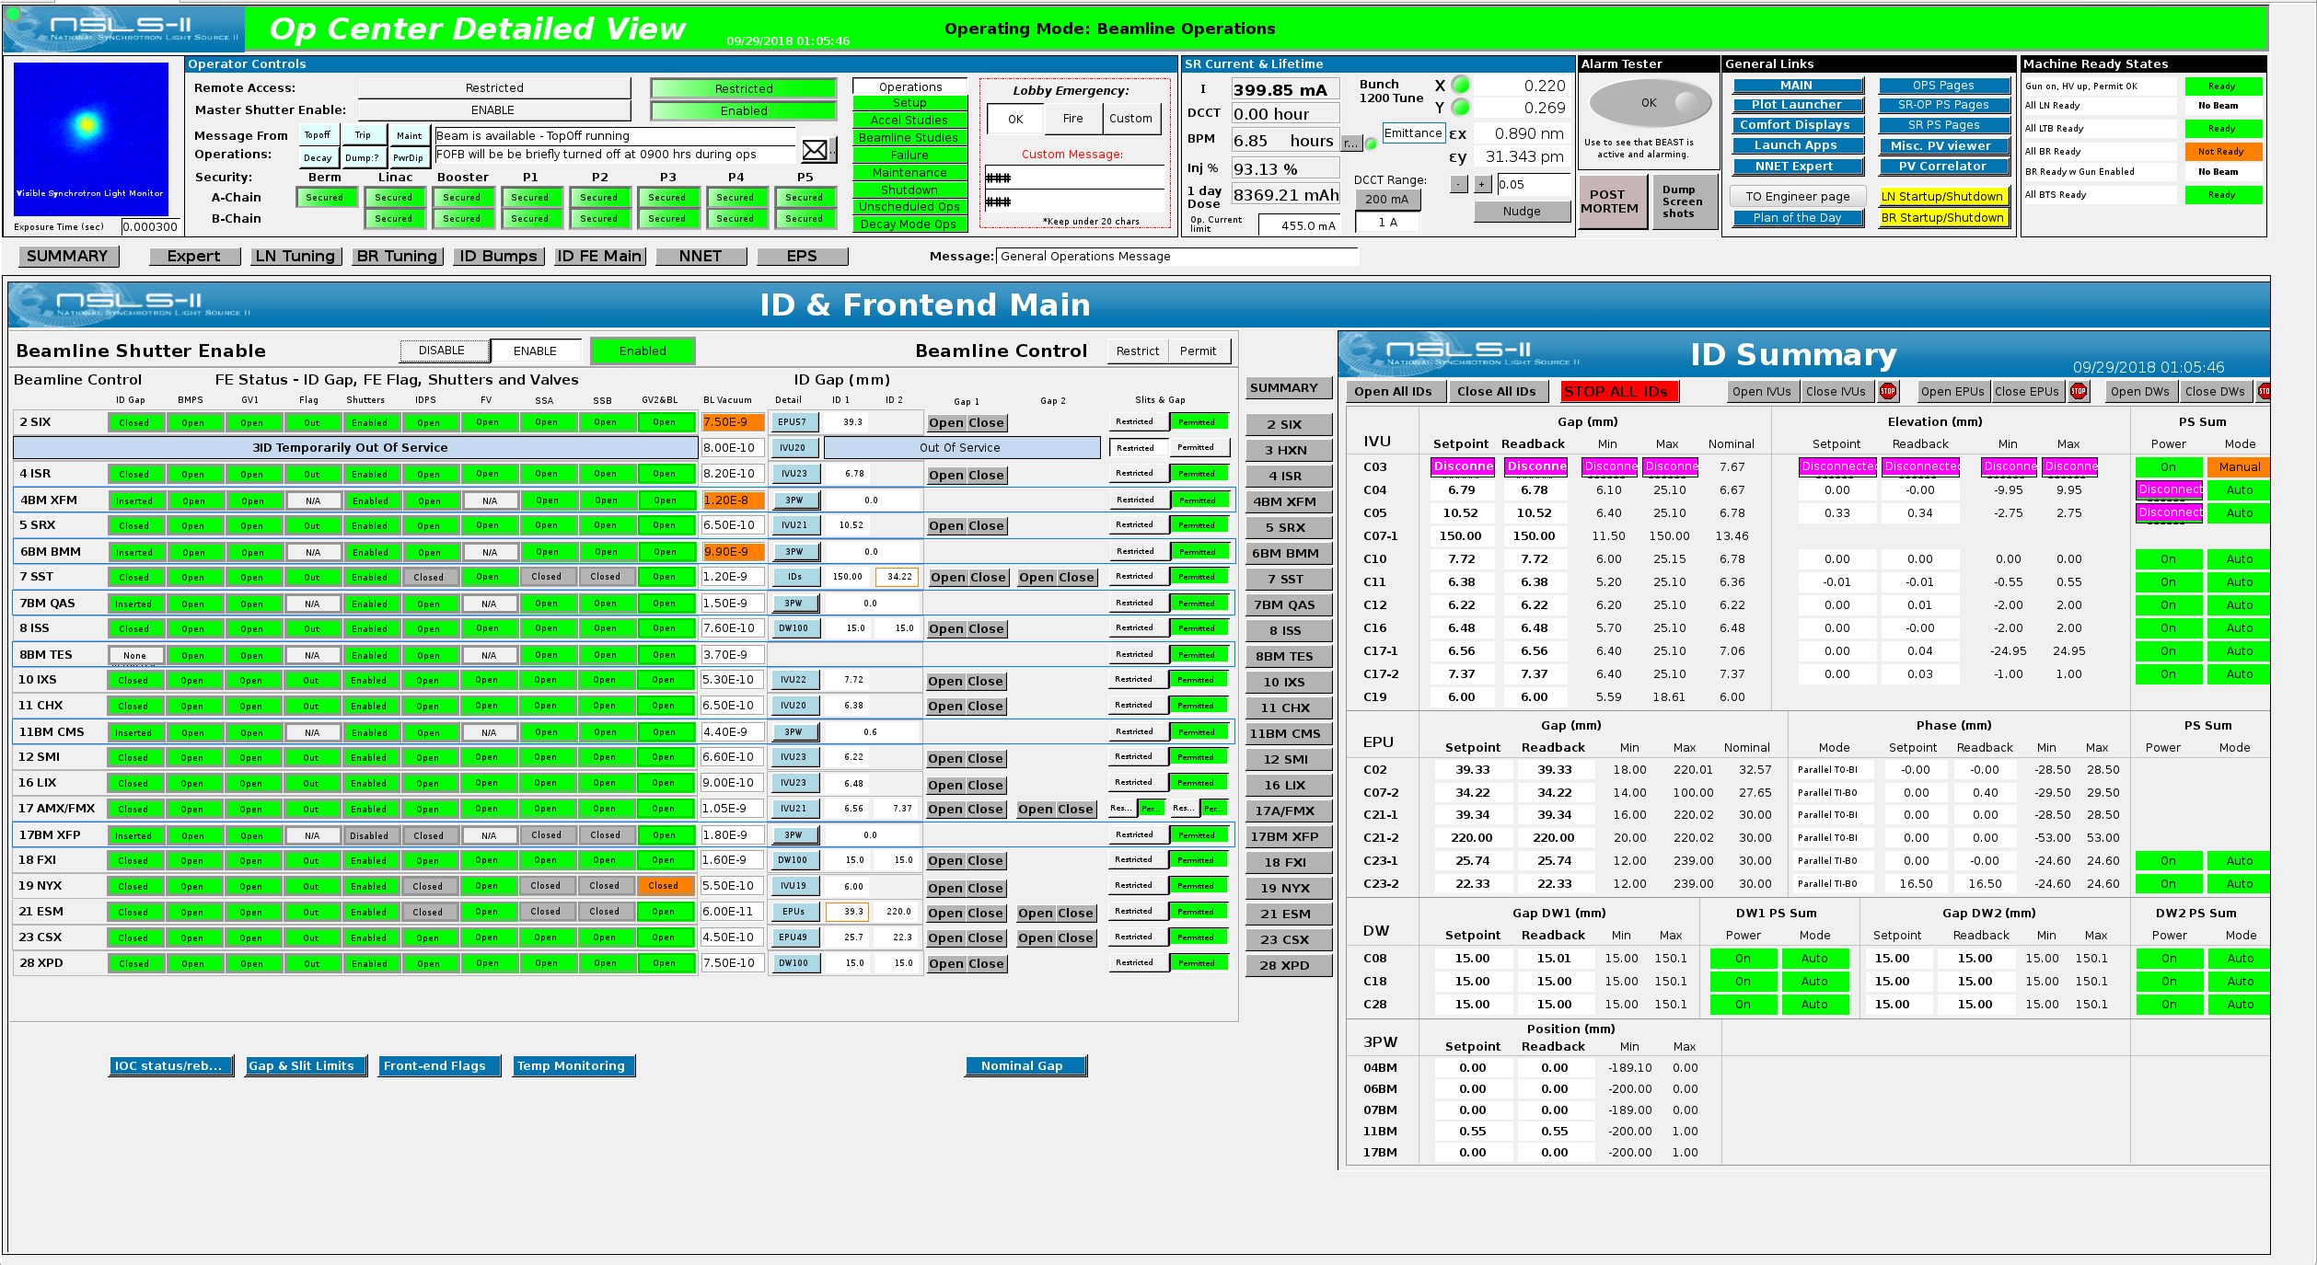

Slide 23
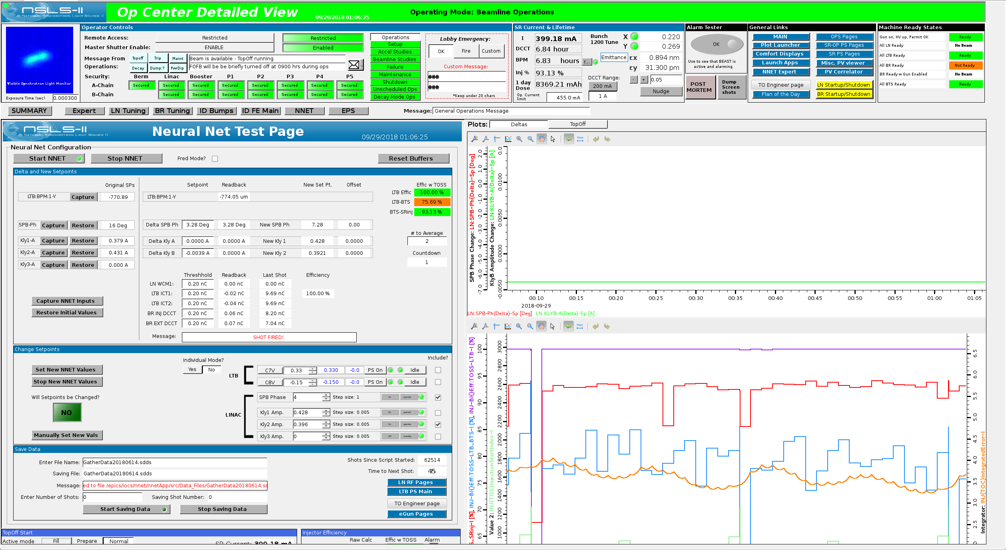

Slide 24
