Slide 1
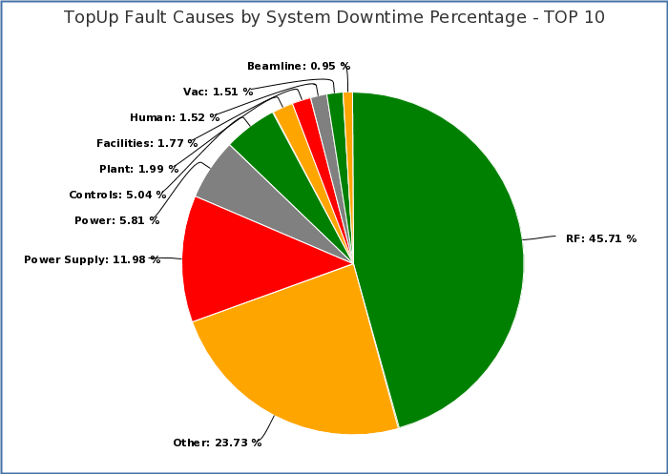
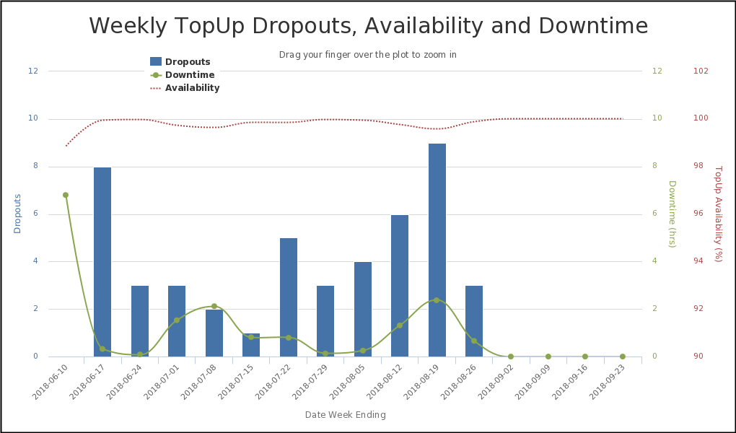
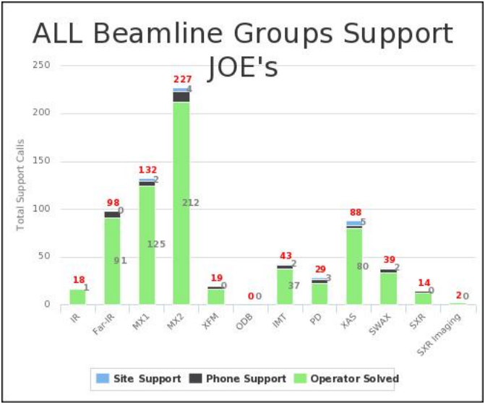
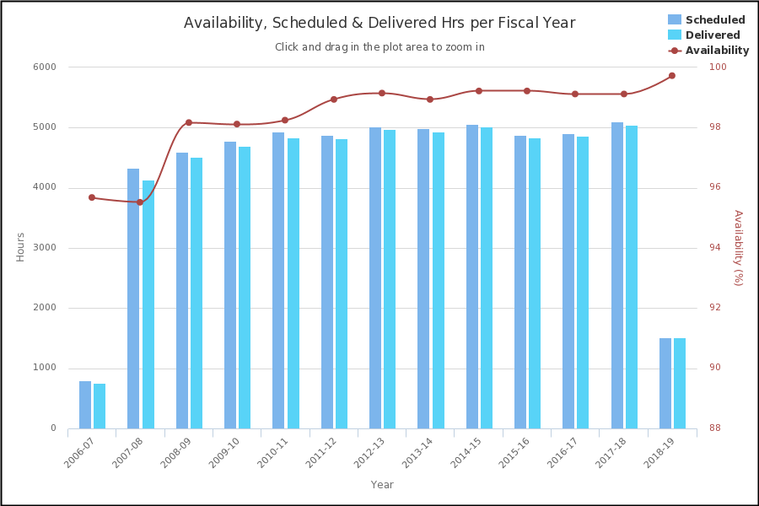
Mike Lafky, Joel Trewhella, Cameron Rodda, Danielle Martin
Background:
The Systems Operations Log (SOL)
Developed in-house
Main electronic logbook
Source of accelerator Key Performance Indicators (KPIs)
Mean Down Time (MDT)
Mean Time Between Failure (MTBF)
Machine Availability (MA)
New project:
Extend SOL reporting functionality to the Beamlines
Solution:
The Joint Operations Event (JOE) system.
Developed in-house by the Operators, designed to
Log Accelerator AND Beamline faults
Enable fast, accurate reporting
Accelerator KPIs
The synchrotron is “delivering” if it is:
Storing more than 100 mA of current
Has the safety system permit enabled
If the shift is dedicated to User beam operations
All three KPIs are generated from only three PVs.
Other Accelerator Reporting Tools
Top Up mode
The synchrotron has been running in Top Up mode since 2012, tracked automatically by SOL & used to identify emerging faults in the injection system.
Support call-outs
Operators service the beamlines after business hours e.g. replacing gas cylinders, debugging software, moving samples into position, etc.
Simple logging of tasks in
Simple reporting to demonstrate labor
Features:
Operators or Beamline Scientists use the same interface to report accelerator or beamline faults (i.e., “log a JOE”).
Operators developed an SBS structure to assign ownership of Beamline faults.
Also created a Python notification server to alert System Owners by email or SMS that a JOE has been logged.
With just a few clicks anyone can generate a “report on a page” for the Accelerator or the Beamlines.

