Slide 1
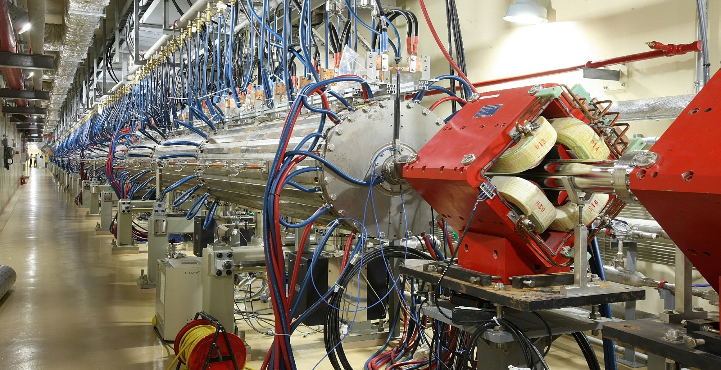
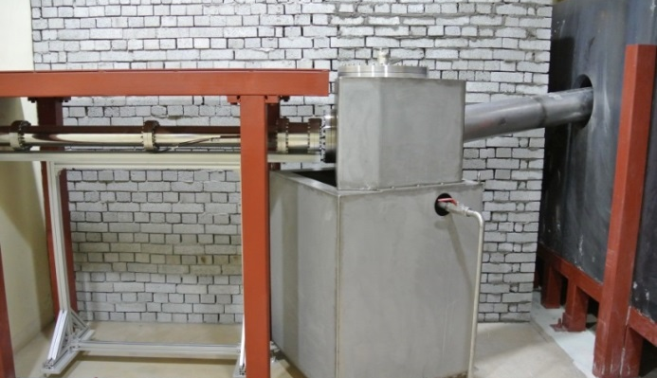
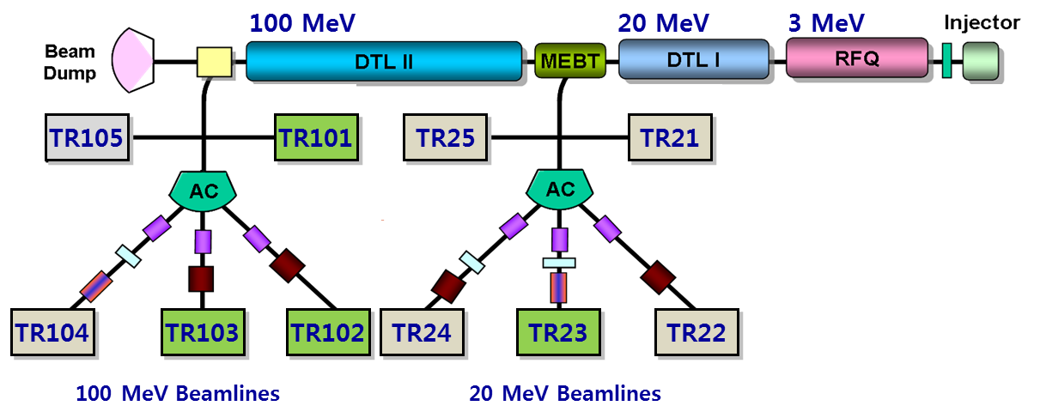
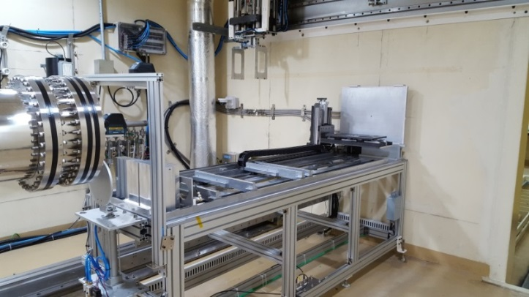
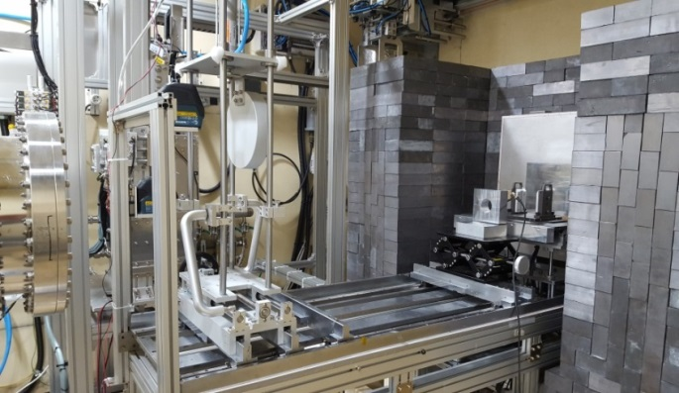
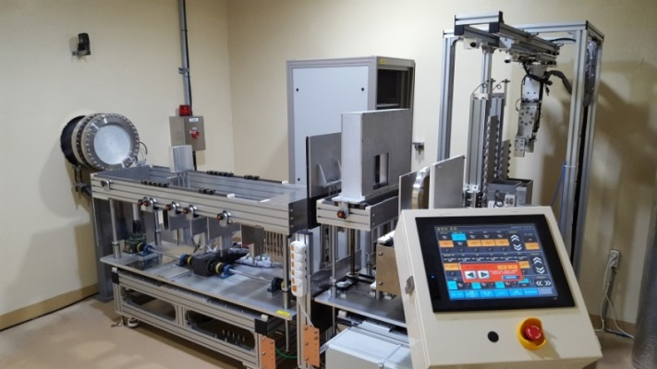
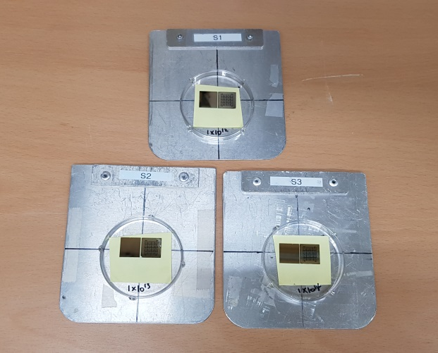
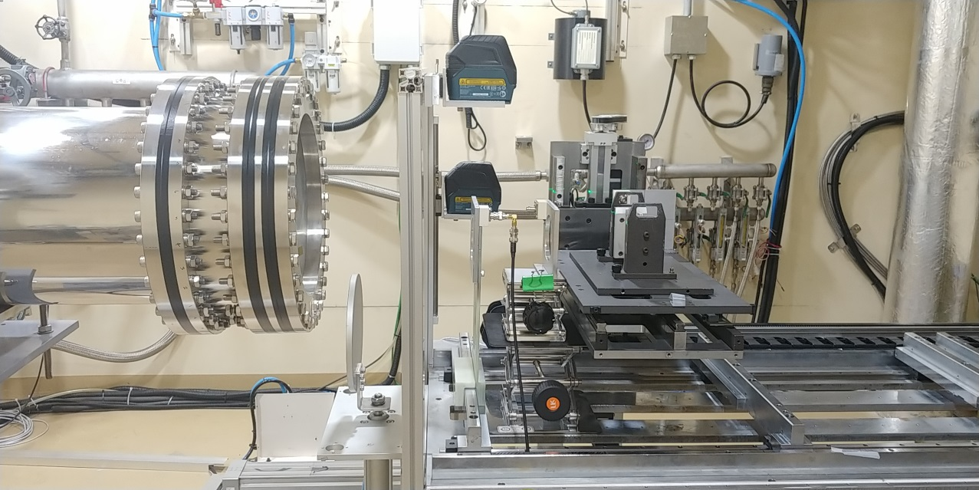
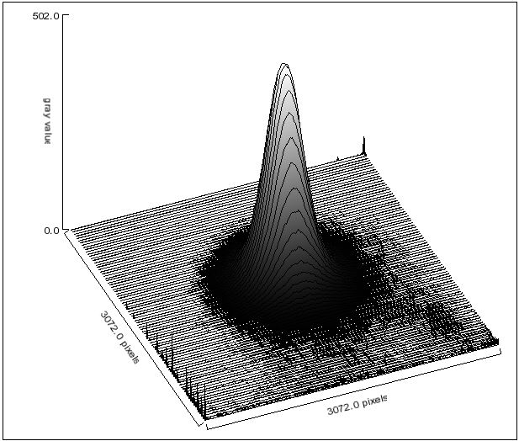
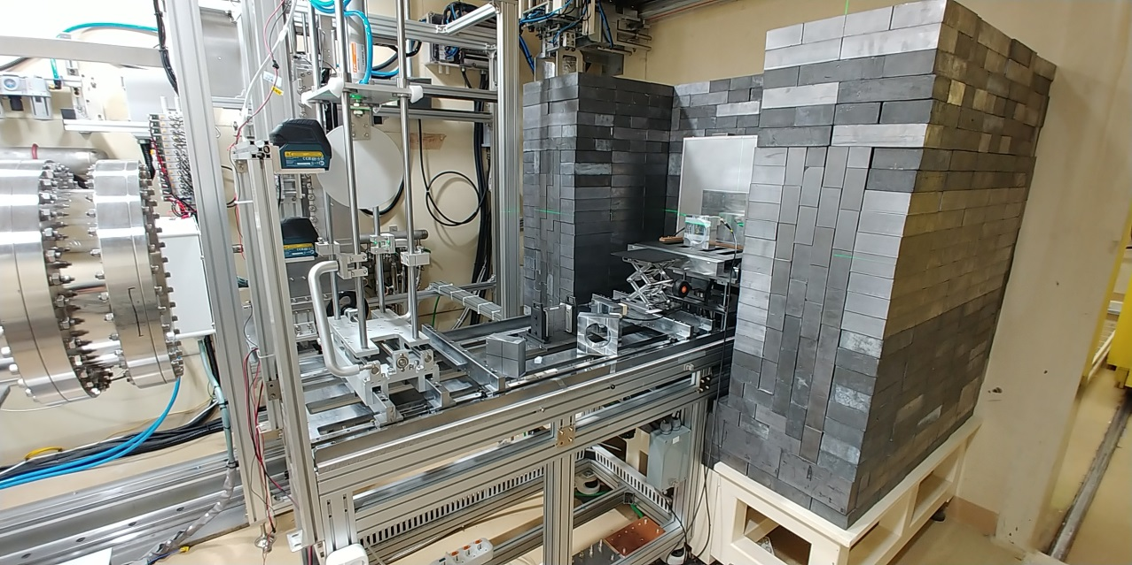
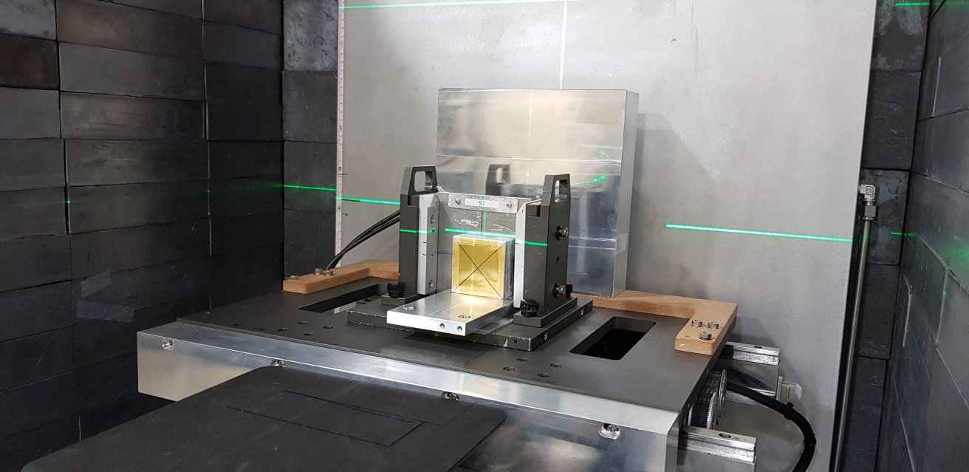
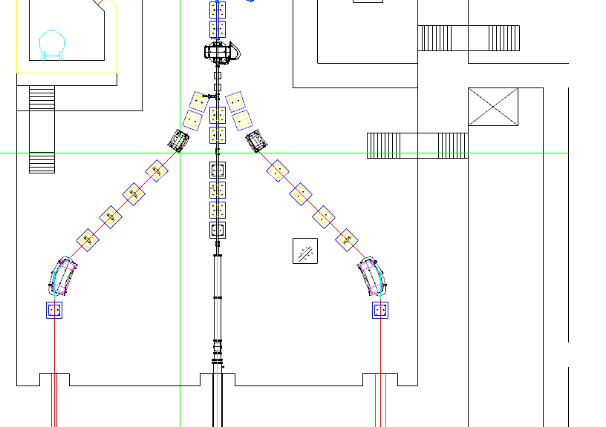
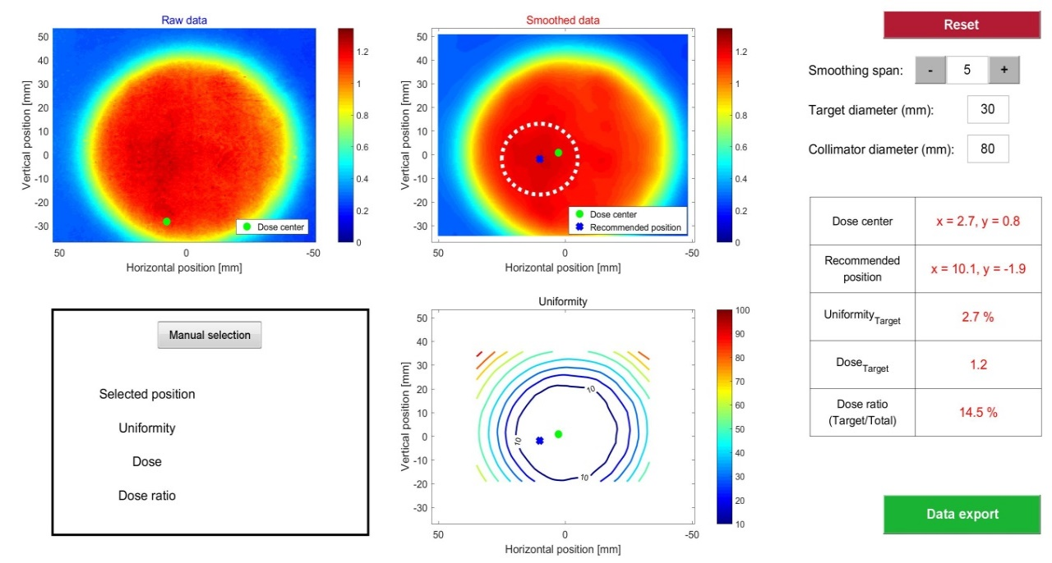
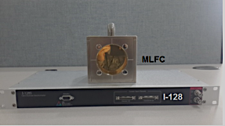
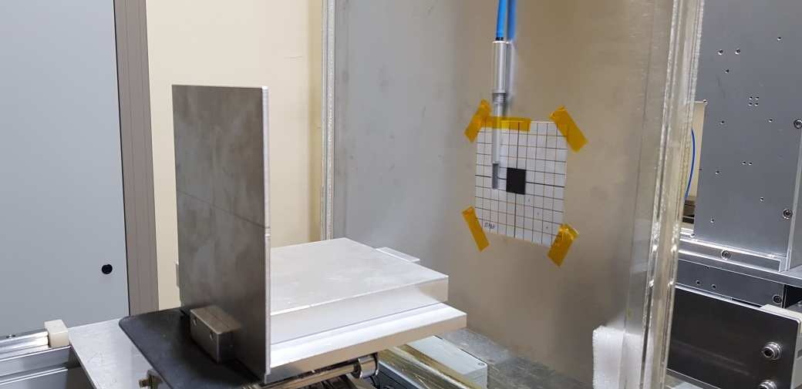
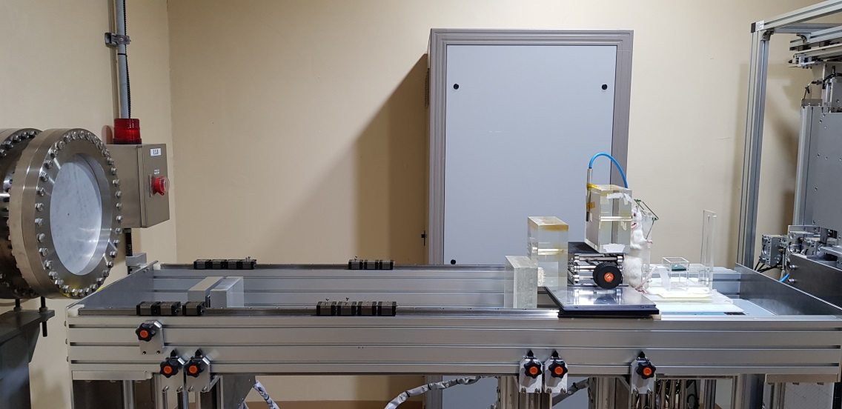
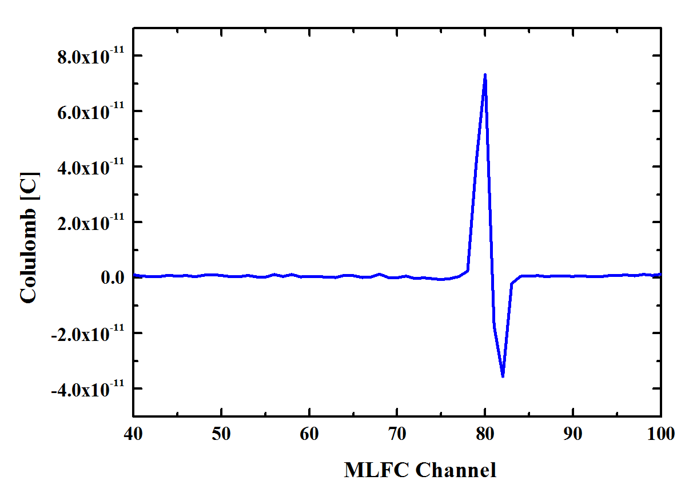
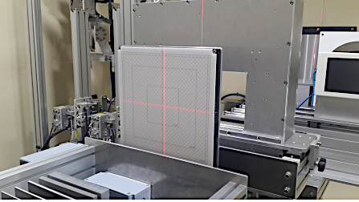
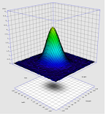
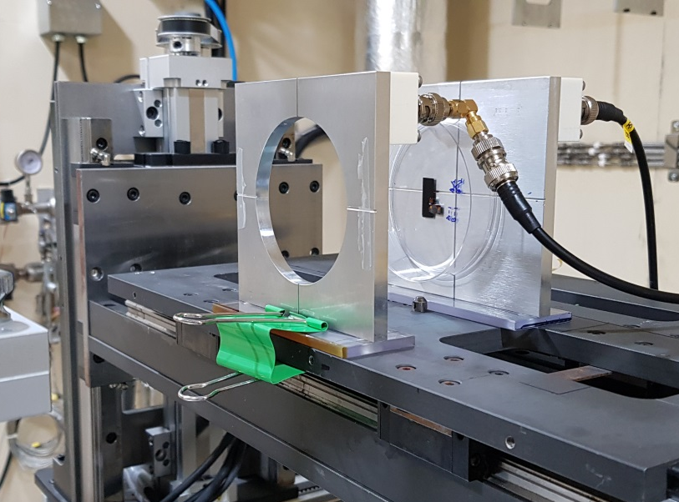
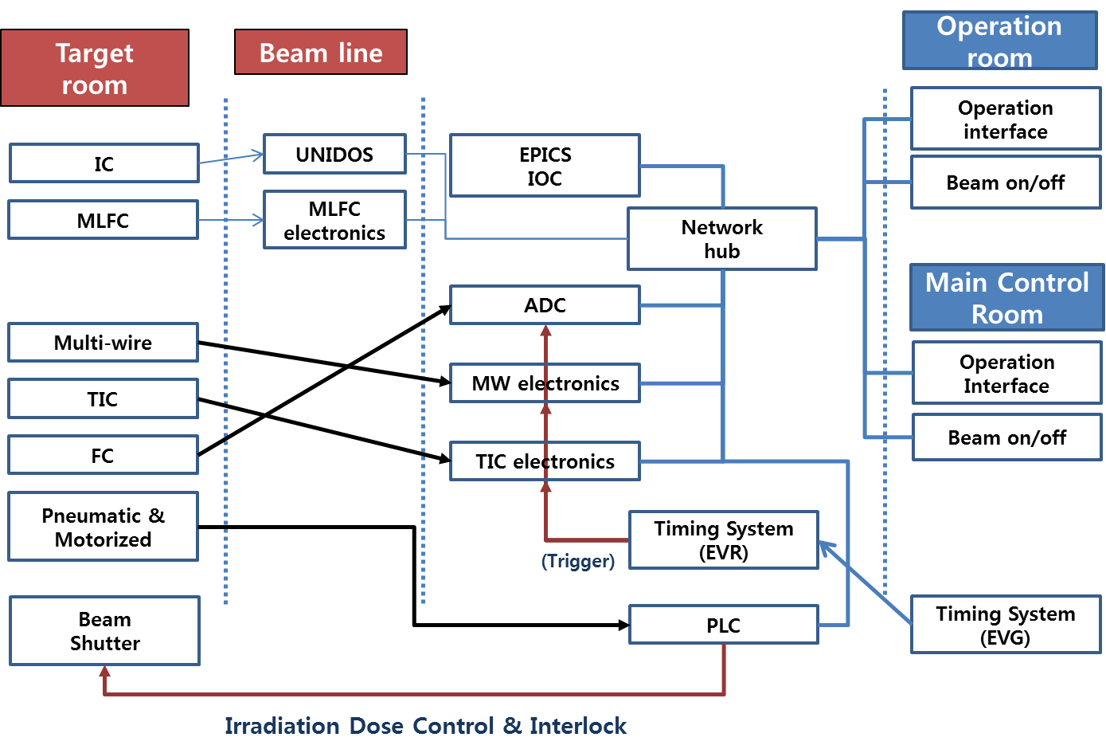
WAO18, 2018. 9.30 - 10.5
Operation Status and Upgrade Plan of the KOMAC Proton Irradiation Facility
Sang-Pil Yun, Young-Gi Song, Yu-Mi Kim, Jeong-Jeung Dang, Pil-Soo Lee, Hyeok-Jung Kwon
Korea Multi-purpose Accelerator Complex, Korea Atomic Energy Research Institute, Gyeongju, South Korea
Acknowledgement:
This work has been supported through KOMAC (Korea Multi-purpose Accelerator Complex) operation fund and the NRF grant (No. NRF-2017M2A2A6A02071070) by MSIT
100MeV Linac of KOMAC and Beam Line
Features of KOMAC 100MeV linac
50-keV Injector (Ion source + LEBT) 3-MeV RFQ (4-vane type) 20 & 100-MeV DTL RF Frequency : 350 MHz Beam Extractions at 20 or 100 MeV 5 Beamlines for 20 MeV & 100 MeV
TR101: RI production
TR23: General purpose
: KOMAC provide 20 & 100 MeV proton beam through the 3 kind of irradiation facility
TR103: General purpose
TR102: Low flux
Operation status of Proton irradiation Facility
TR23 facility : general purpose
TR103 facility : general purpose
In – air Irradiation
Mostly High Fluence & thin target (thin film, semi-conductor…)
Incident Proton Energy : 20 MeV
Available Proton Energy : 3 ~ 17.8 MeV
- adjusted by the distance beam window – target
- < 10 MeV not recommended due to energy spread
Typical Fluence : 1E10 ~ 1E14 [#/cm2]
- Limited by Air radio-activation
Sample
In – air Irradiation (fixed position)
High Fluence & thick target
Incident Proton Energy : 102, 92, 81, 69, 57, 45, 33
Available Proton Energy : 100 ~ 20 MeV
- adjusted by the degrader
Typical Fluence : 1E11 ~ 1E15 [#/cm2]
- Limited by residual radio-activation
Typical
Beam Profile
Beam window
Typical
Beam Profile
Beam window
Proton beam
Proton beam
Sample holder
Sample holder
TR102 facility : for low flux density
Beam Quality Assurance
In – air Irradiation
Low Fluence & thick target
Incident Proton Energy : 102, 92, 81, 69, 57, 45, 33
Available Proton Energy : 100 ~ 20 MeV
- adjusted by the Al degrader
Typical Fluence : 1E5 ~ 1E8 [#/cm2]
Typical beam shape: square like
Typical Uniformity: < 10%, 100 mm X 100 mm
Low radio-activation : easy access
Instrument & Method
- Beam profile : Radiochromic film, 2D array IC, Flat Panel Detector
- Reference Dosimetry (fluence or dose): FC, IC, Radiochromic film
- Beam Energy: Range in Polycarbonate, MLFC
Collimator
& Degrader
Radiochromic
film
Analysis Software(by Matlab)
MLFC
Ion chamber
Octupole
Typical
Beam Profile
2D Array Ion Chamber
Peak Ch. : 80
→ 101.5 MeV
Faraday cup
Proton beam
Upgrade Plan
Main Feature
New experimental set-up
New control interface for proton irradiation
In-situ / real-time Beam monitoring
: Efficient beam tuning & QA
Dual Beam on / off system
: User can control the beam delivery
New united interface for beam instruments
: signal processing & storage by EPICS IOC
: Easy management of experimental data
Automation
: Auto beam cut off by the mechanical shutter
: remote control of the instruments in target room
Test location
Proton
Beam
FC
Beam window
Defining
Collimator
Monitoring Instruments
: In-air ACCT
: MWPM, SWIC
Test
Collimator
Ref. Dosimetry
: IC & FC

