Slide 1


Development of the NSRL Galactic Cosmic Ray Simulator
Nicholas Kling

Slide 2
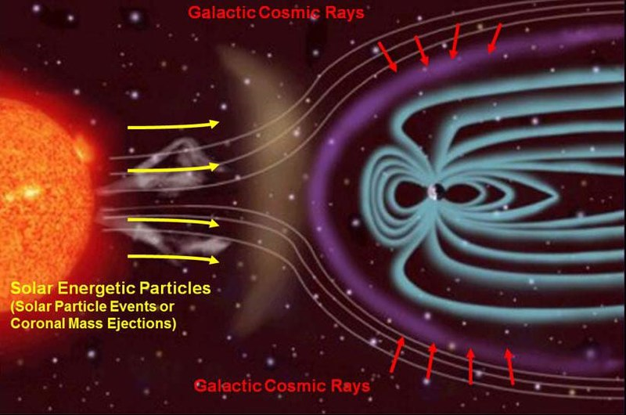
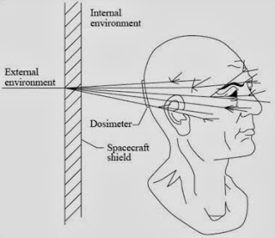
The Problem
Space Radiation: Galactic Cosmic Rays (GCR)
GCR radiation
Limiting factor for space flight beyond low earth orbit
A mix of ions over a wide range of energies.
Existing shielding strategies for spacecraft are insufficient for GCR radiation and actually causes more harm due to secondaries.

Slide 3
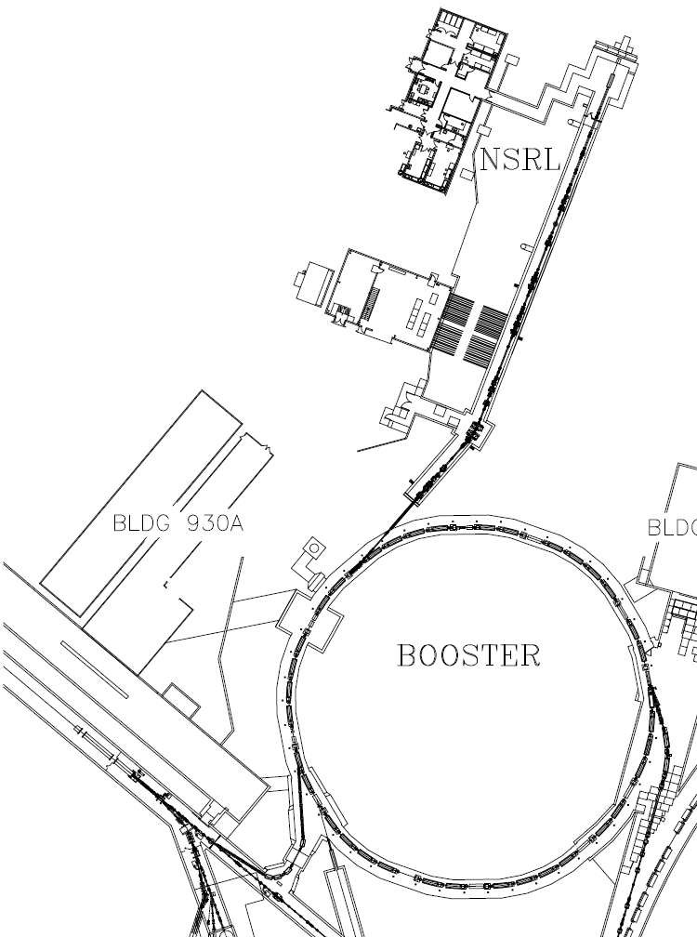
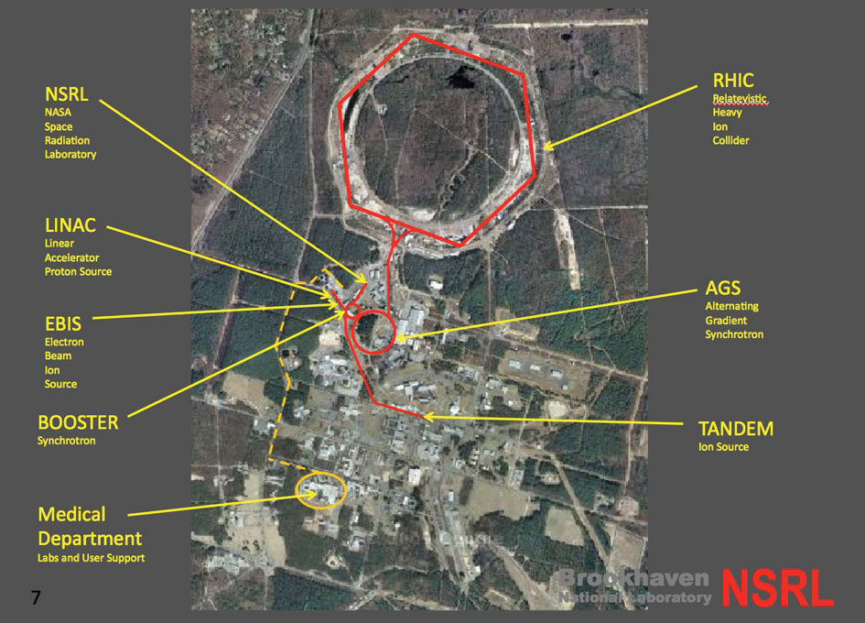
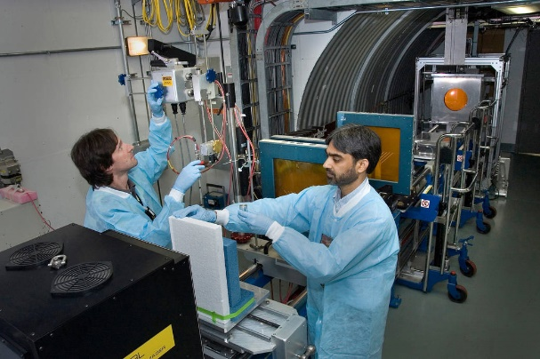
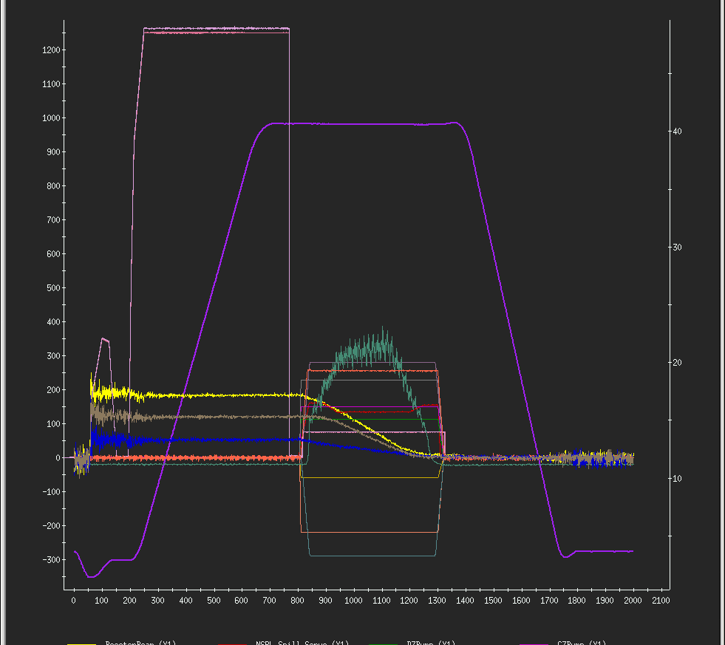
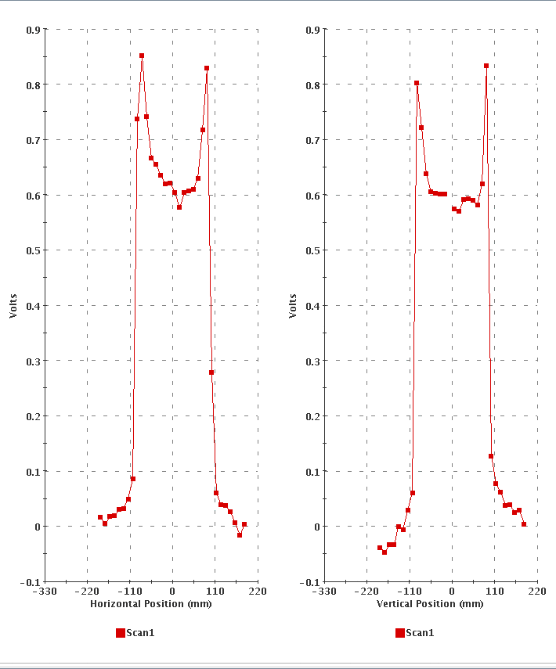
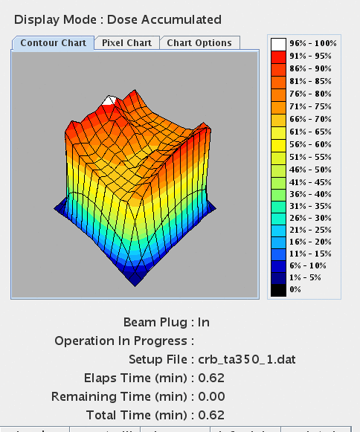
Background
NASA Space Radiation Laboratory (NSRL)

Slide 4
The Challenge
Galactic Cosmic Ray Simulator at NSRL
“The plan for implementing GCR simulation at NSRL is to spend 2016 refining the control tools, integrating the various components of the system to deliver a uniform beam of any one of a list of many ions, including protons. The intent is to do so rapidly, reliably and without intervention from machine experts and operators, a feat which will no doubt take more than one iteration.”
Galactic cosmic ray simulation at the NASA Space Radiation Laboratory
Norbury et al. (NASA Langley Research Center)
Ion | Energy (MeV/n) | LET (keV/µm) | Dose (mGy)
¹H | 50 | SPEsim degrader to
¹H | 100 | 0.7 | 37.2
¹H | 150 | 0.6 | 33.4
¹H | 250 | 0.4 | 65.7
¹H | 1000 | 0.2 | 117.9
⁴He | 50 | SPEsim degrader to
⁴He | 100 | 2.9 | 8.5
⁴He | 150 | 2.2 | 7.1
⁴He | 250 | 1.6 | 15.6
⁴He | 1000 | 0.9 | 23.7
¹²C | 1000 | 8.0 | 11.2
¹⁶O | 350 | 20.9 | 14.7
²⁸Si | 600 | 50.4 | 7.7
⁴⁴Ti | 1000 | 107.7 | 4.3
⁵⁶Fe | 600 | 173.8 | 4.0
Total |  |  | 500.0
Ion | Energy (MeV/n) | LET (keV/µm) | Dose (mGy)
¹H | 7.4 | 5.9 | 16.7
¹H | 10.2 | 4.5 | 8.1
¹H | 14.0 | 3.5 | 9.6
¹H | 19.2 | 2.7 | 11.8
¹H | 26.4 | 2.1 | 14.3
¹H | 36.2 | 1.6 | 17.1
¹H | 50.0 | 1.3 | 35.7
Two Years later we have the list...
And the tools.
Ion | Energy (MeV/n) | LET (keV/µm) | Dose (mGy)
⁴He | 7.4 | 23.5 | 8.1
⁴He | 10.2 | 18.2 | 2.7
⁴He | 14.0 | 14.1 | 3.1
⁴He | 19.2 | 10.9 | 3.7
⁴He | 26.4 | 8.4 | 4.3
⁴He | 36.2 | 6.5 | 4.9
⁴He | 50.0 | 5.0 | 9.2

Slide 5
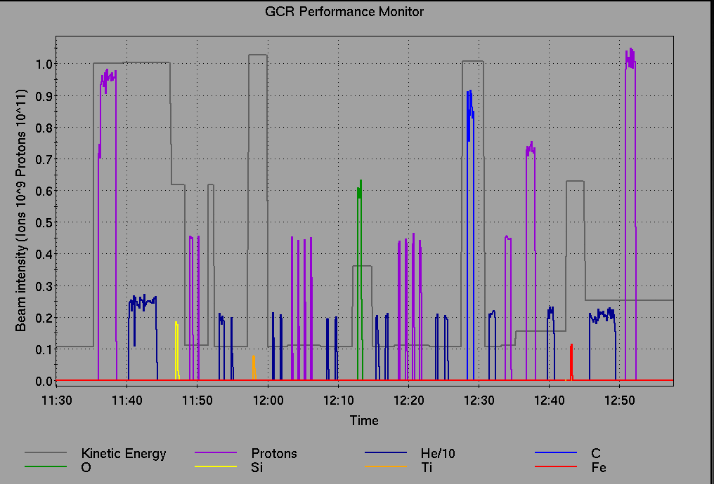
First “Full Spectrum” GCR Exposure
33 distinct setups in 1.17 hours
7 different Ions
Full control of dose rate
Uniform 60x60 cm square profiles on samples
No human intervention once process initiated

Slide 6
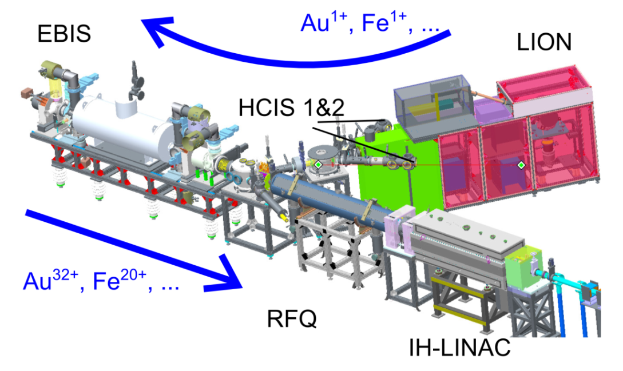
Required Hardware : Ion Source
EBIS - Electron Beam Ion Source
Provides Ion beams of any element Helium or larger.
Can run beam for multiple programs concurrently.

Slide 7
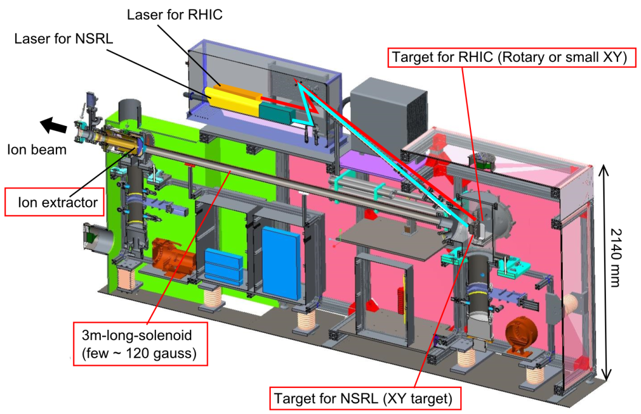
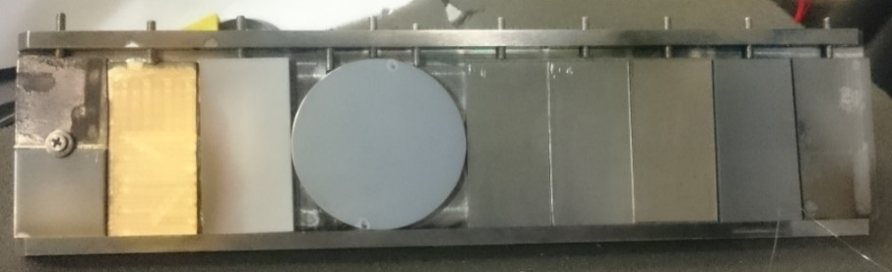
Required Hardware : Ion Source
EBIS LION – Laser Ion Source
Can produce Ions from pure element or multiple Ions from compounds.
Can switch between targets in <30 seconds.
Laser XY Target stage

Slide 8
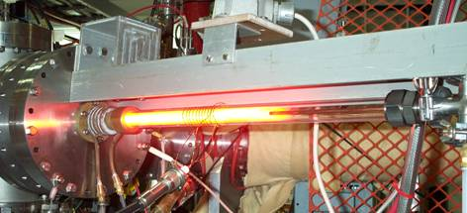
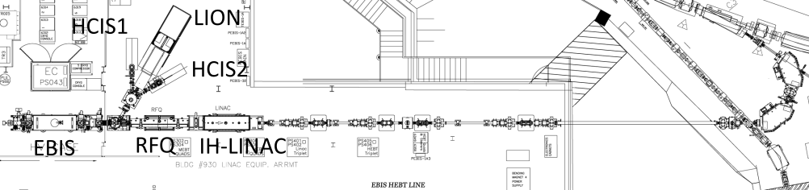
Required Hardware : Ion Source
EBIS Hollow Cathode Sources
Source for He and other noble gasses.
Species changes require physical intervention.

Slide 9
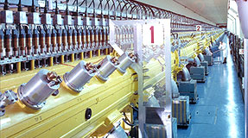
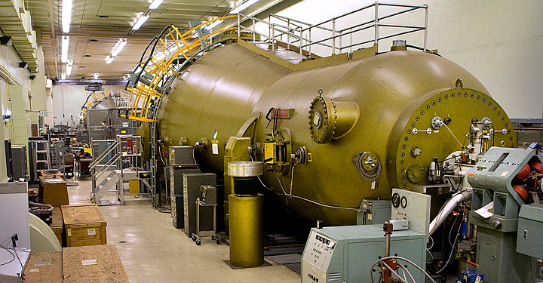
Required Hardware : Proton Sources
LINAC Tandem Van de Graff
The primary Proton source for NSRL when it is running for Isotope production or RHIC.
Provides beam at 116MeV or 200MeV.
Intensity is very good but low energy beams require deceleration in the Booster.
The Proton source for NSRL when LINAC is Off.
Lower beam intensity than LINAC, but with 20 MeV injection there is no need for deceleration in Booster.

Slide 10
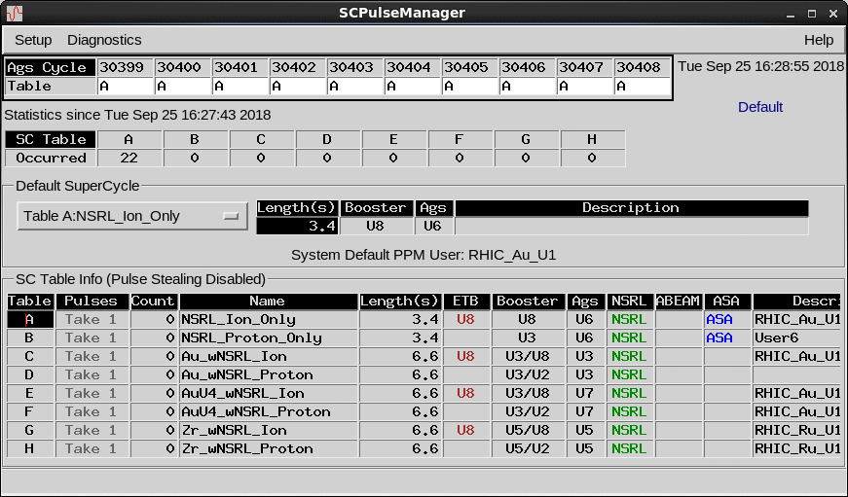
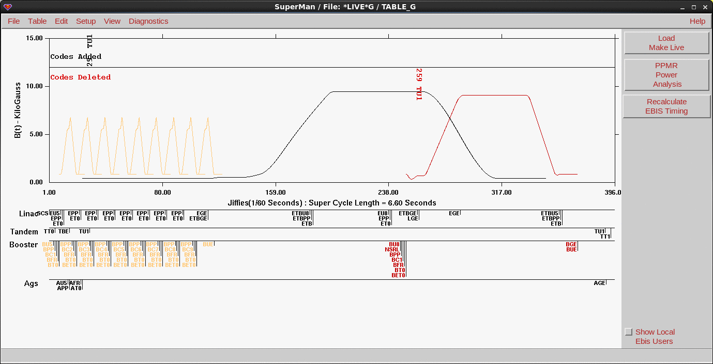
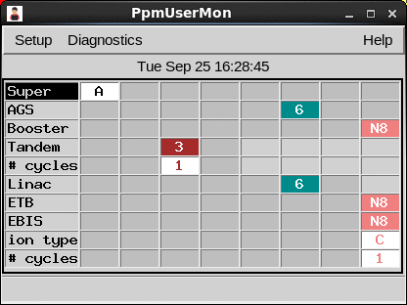
Required Hardware : Controls System
PPM – Pulse to Pulse Modulation and SuperCycle
PPM - Most devices are capable of have multiple buffered values that can be activated rapidly.
SuperCycle – Series of events that synchronize all parts of the injector chain.

Slide 11
The Operator built tools:
Simplifying the problem
“deliver a uniform beam of any one of a list of many two ions, including protons. …reliably and without intervention from machine experts and operators.”
-There only two beams that matter. The one that is live and the one that comes next.
-Once this process is perfected it just needs to be repeated and repeated and…You have a GCR simulator.
How do we do this?

Slide 12
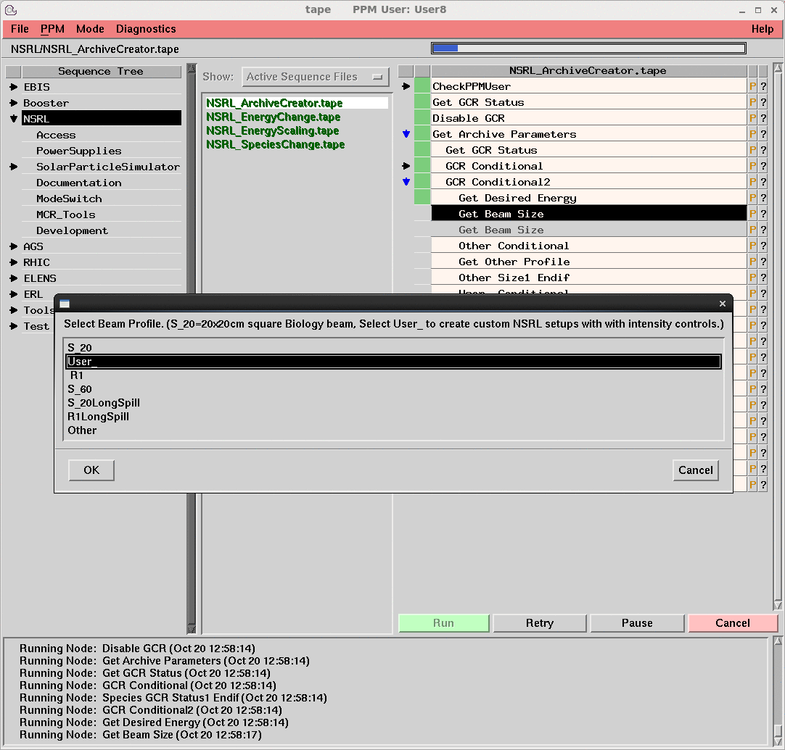
The Operator built tools:
Tool for Automated Procedure Execution (Tape) Sequences
The powerhouse software tool for complex process control throughout facility.
Tape controls:
RHIC ramps, luminosity control, mode switching, shutdown/turn on...
It is the “Go” button for the complex. (the button actually says "Run").
Easy to program, edit and debug sequences.

Slide 13
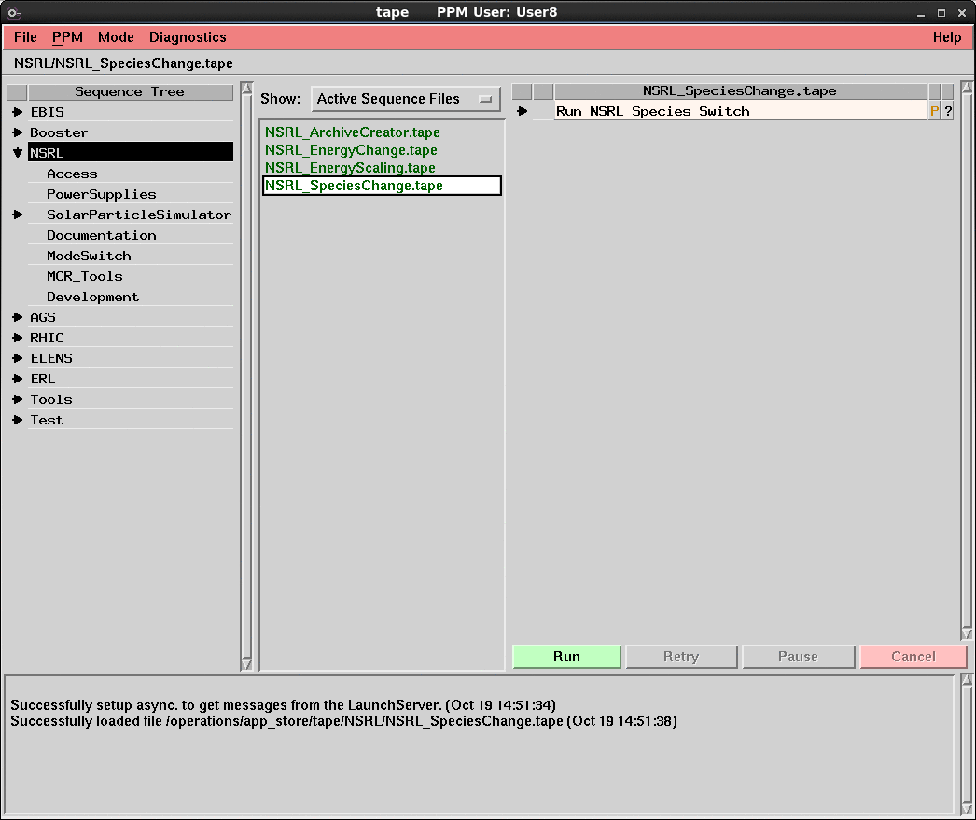
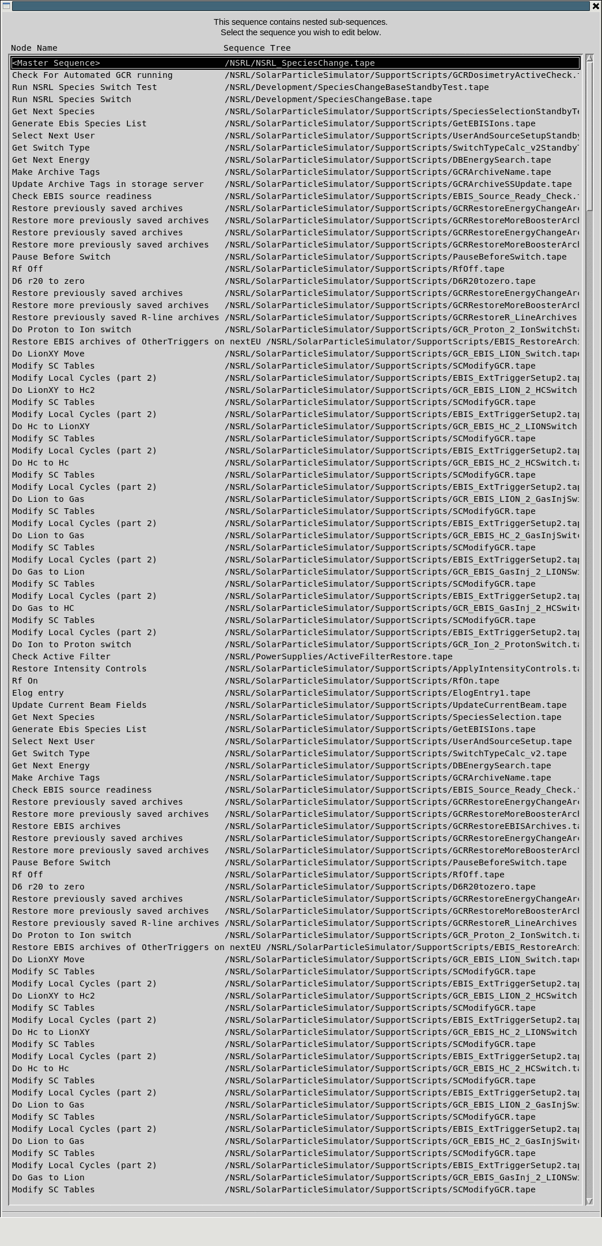
The Operator built tools:
Species Change Sequence
Predates the GCR project but has been streamlined for automation and reliability.
3 Inputs: Species, Energy, Beam Shape.
The sequence determines and executes the rest.
The same sequence is called for by GCR simulation and for standard species changes.

Slide 14
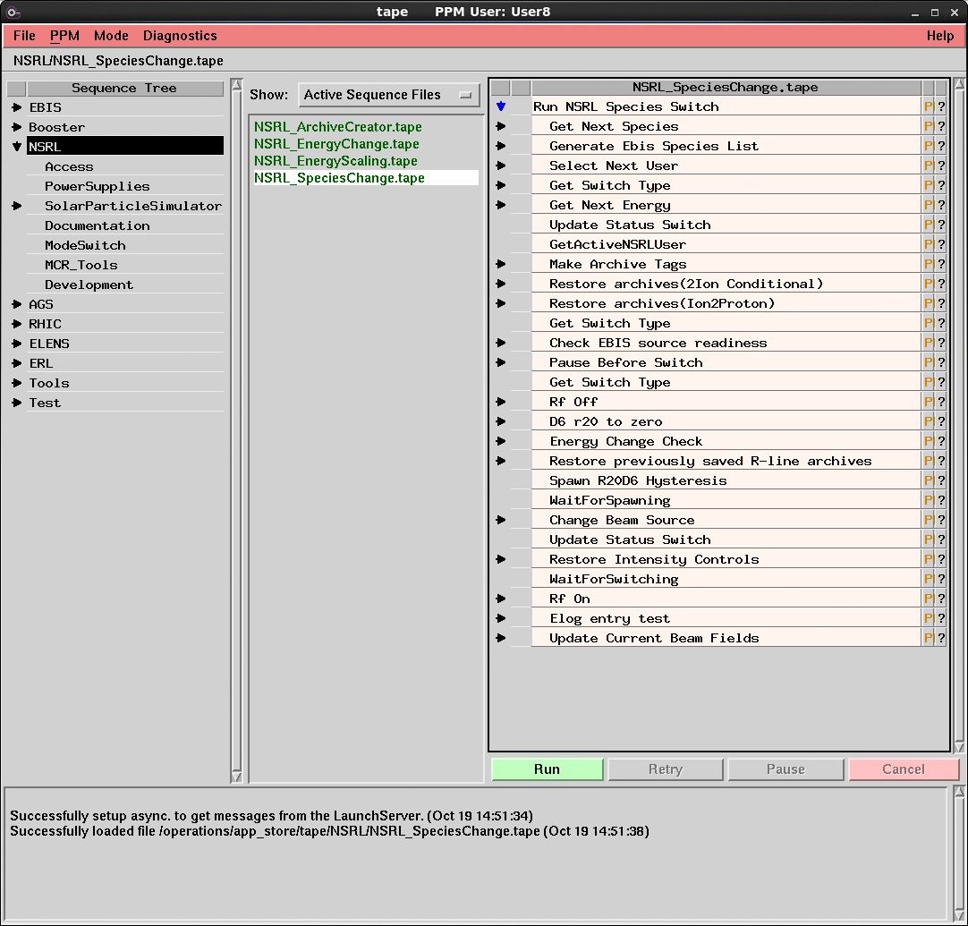
The Operator built tools:
Species Change Sequence
To minimize switching time the sequence is broken up into two parts.
  The top portion of the sequence collects the inputs, determines which type of switch is needed, loads ppm archives to the next user, and checks for EBIS source readiness.
  It is run while the live beam is being delivered to the samples.

Slide 15
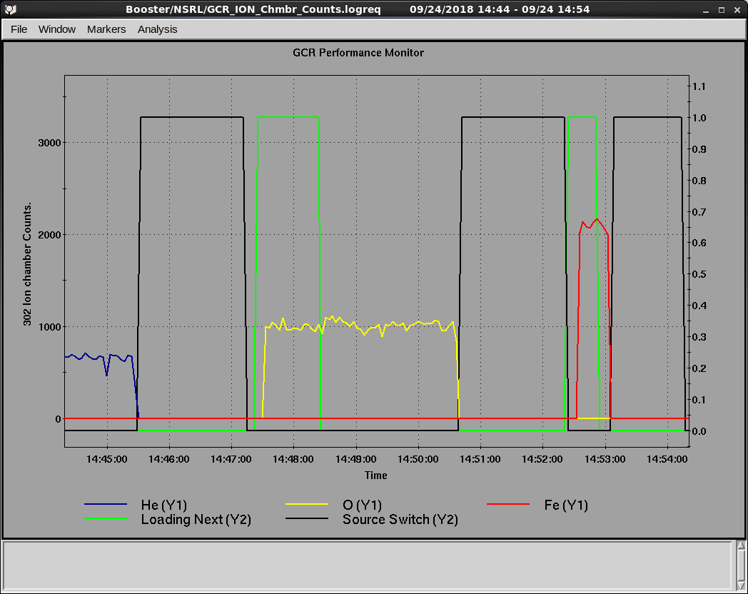
The Operator built tools:
Species Change Sequence
The lower half of the sequence is where next beam becomes the live beam.
  The beam source is changed.
  Non-ppm devices are loaded.
  SuperCycle tables are modified or switched.

Slide 16
The Operator built tools:
Simplified Species Change Flow Chart
Species selection
Rf Off and transport line to zero
Determine next user and Beamline
Restore transport line archives
Determine switch type
Spawn transport line hysteresis sequence
Get next energy and beam profile
Execute source switch
Load ppm archives to next user if applicable
Apply intensity controls and take current transformer baseline
Check EBIS source readiness
Wait for hysteresis sequence to complete
Wait for source switch trigger
Turn Rf on and deliver beam to NSRL

Slide 17
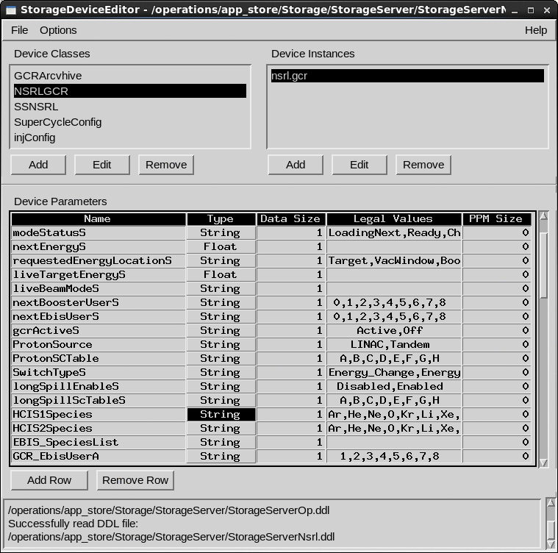
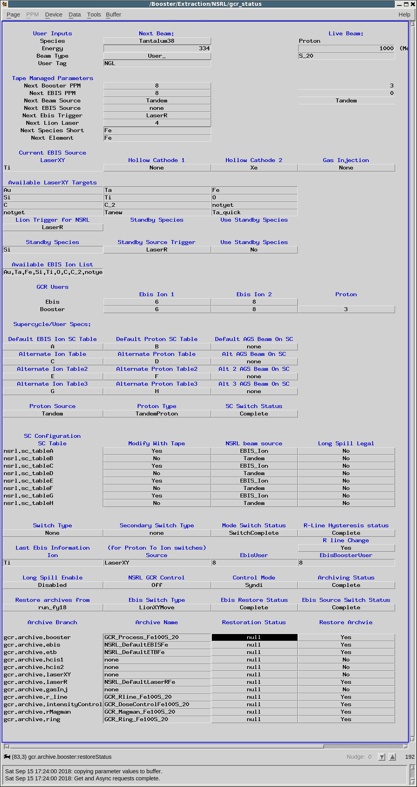
The Operator built tools:
Storage Server
Virtual devices with no physical connection to any device but have many benefits and uses.
  Configuration control
  Status indicators
  Process flow control
  Error diagnostics
  Simple to create
  Instantly available
  Flexible

Slide 18
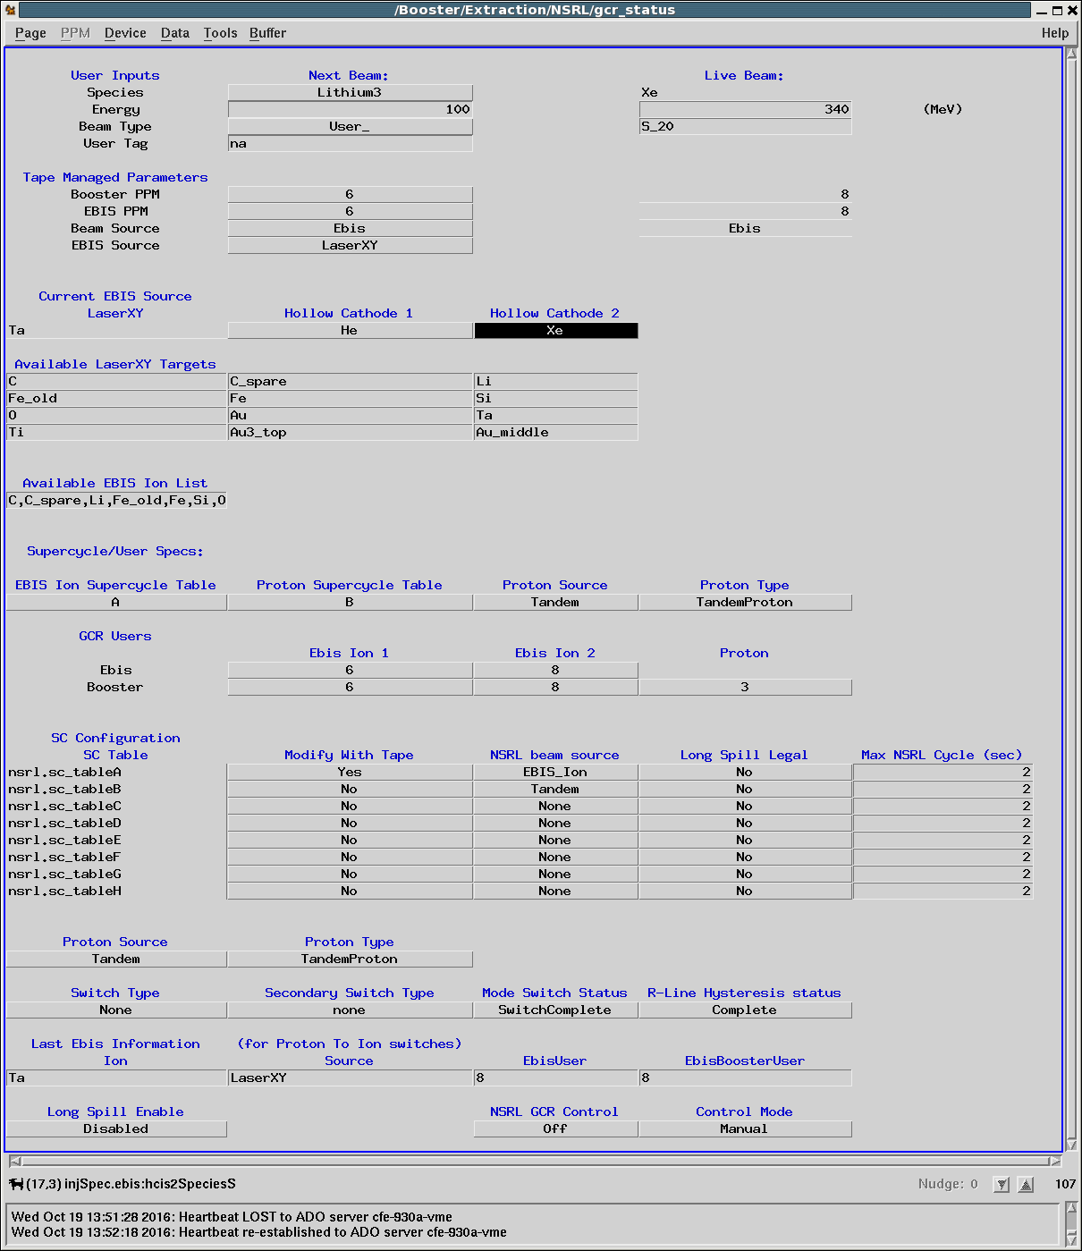
The Operator built tools:
The NSRL Storage Server
Next beam parameters:
User inputs
Tape determined
parameters
Live beam: Read from controls system
Available EBIS beams:
Hollow Cathode beams available
Laser target beams available
Complete list of available EBIS beams (for Tape to search)
SuperCycle and ppm user Configuration:
-Defines proton source ppm user and SC table
-ppm users and SC tables for ion beams
Switch type indicators
Tape controlled status switches:
Control timing of interactions with dosimetry system, spawned subsequences and display progress user interface.
Last EBIS beam info:
For Proton to Ion switches
Sets the sequence automatic mode.

Slide 19
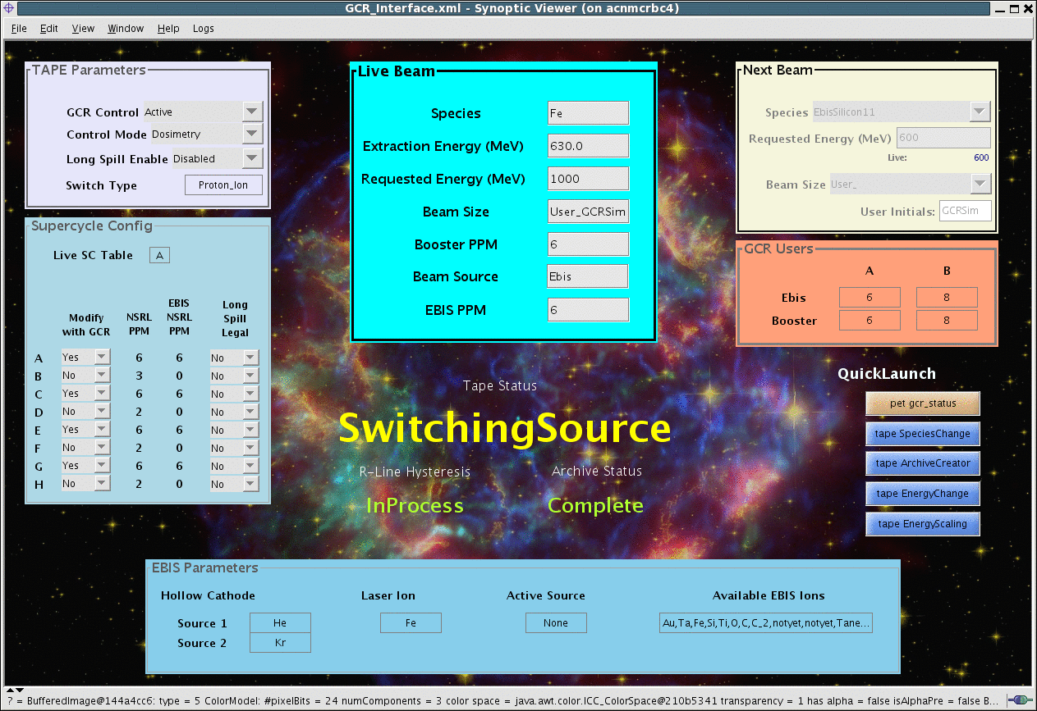
The Operator built tools:
GCR Synoptic Display

Slide 20
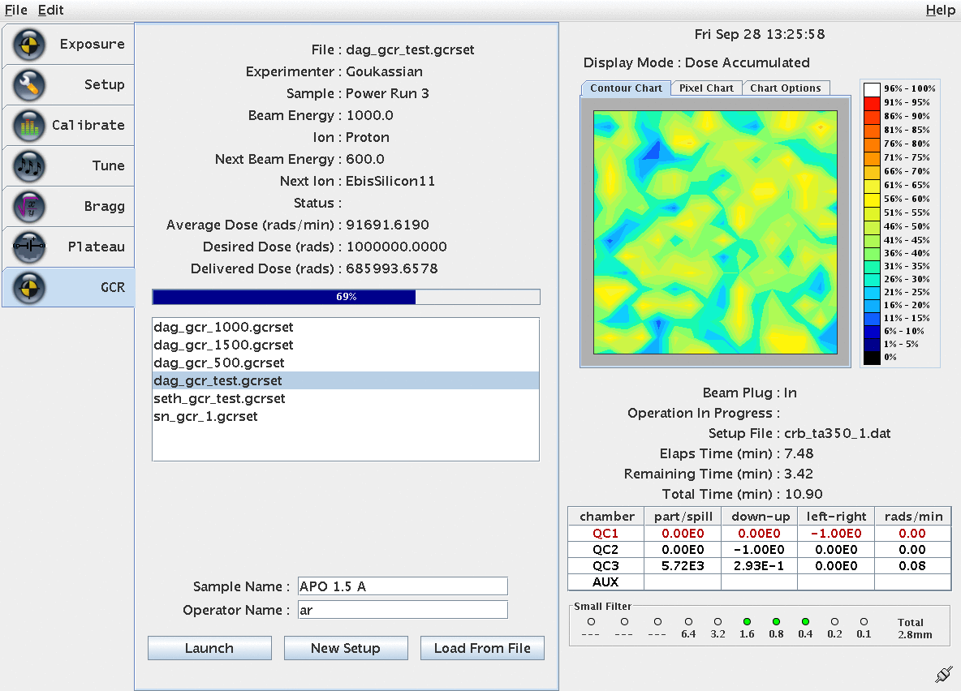
The Final Piece:
NSRL Dosimetry Interface

Slide 21
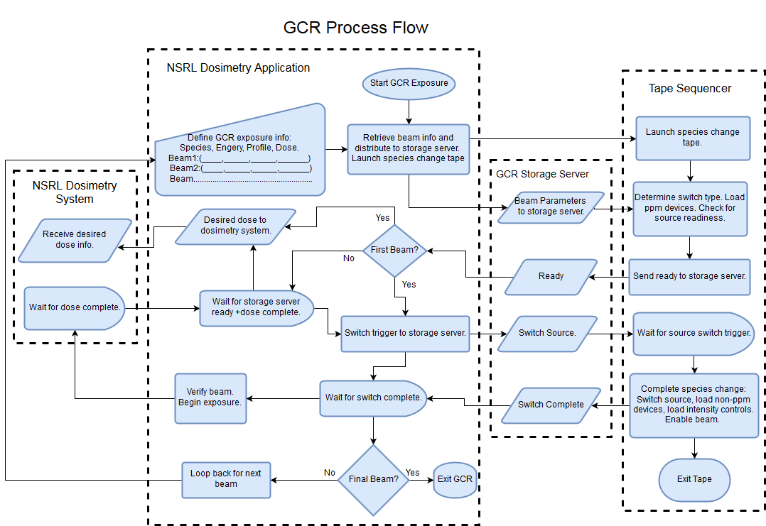
GCR Process Flow

Slide 22
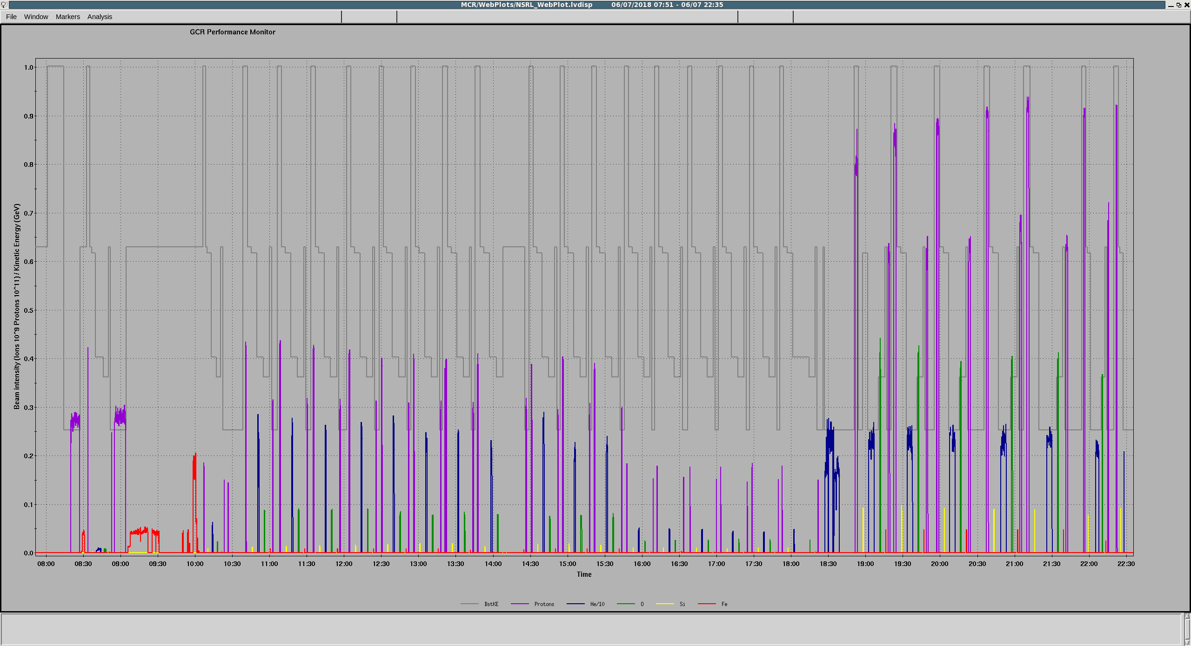
Typical “Simplified” GCR Day
162 species changes
Concurrent with RHIC setup and BLIP isotope production.
No involvement from Operations personnel needed
“08:00 We are getting NSRL ready for the day.
10:35 NSRL science started”
Summary- ”…NSRL science ran for ~ 4.2 hours and had about 14 minutes of failure”
-OC log shift 2 06/07/2018

Slide 23
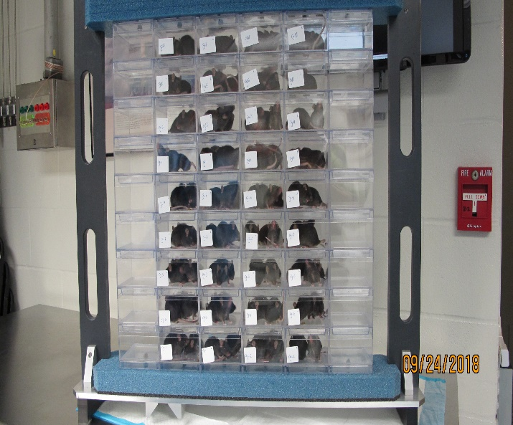
Remarks
The brave astronauts preflight
The spaceship
The voyage

Slide 24
Credits
Takeshi Kanesue – EBIS source control, readiness checks, motivation, organization
Seth Nemesure – NSRL dosimetry
John Morris – Controls Support
Adam Rusek/Mike Sivertz – NSRL operations
Travis Shrey – Synoptic Display

