Slide 1

Operational Software Tools for the Injection Efficiency Improvement in the PLS-II
Mun Gyung Kim
PAL
BNL/ Oct. 1, 2018
Workshop on Accelerator Operation in 2018

Slide 2

Abstract
One of the main issues of the linac operation problems in the PLS-II is injection efficiency for top-up mode to keep radiation safety levels. The energy spread of the injection beam is the main beam parameter to effect injection efficiency. So we try to develop several operational software tools to reduce the amount of energy spread. And also beam energy jitter is another parameter for injection efficiency. We tried to develop related operational software tools about these parameters. So this report introduces these operational software tools

Slide 3
PAL Overview: Chronology
I. PLS
  Project for 2.0 GeV 200 mA PLS started Apr. 1988
  Construction Start Apr. 1991
  User Service 2.0 GeV 180 mA Decay Op. Sep. 1995
II. 2nd Major Upgrade of the PLS (PLS-II)
  3.0 GeV PLS-II Upgrade Dec. 2011
  3.0 GeV 150 mA User Service Mar. 2012
  3.0 GeV 400 mA Top-up Operation July 2015
  * S.R. is a new machine, but linac is almost the same.
III. PAL-XFEL: Another Fancy Machine
  Government approval of PAL-XFEL project Jan. 2010
  Beam commissioning started April 2016
  User service started June 2017

Slide 4
Operation Parameters
In normal operation
Operation Parameters for users
Top-up Current: 400 mA
Current Difference : 0.5 ~ 0.7 %
Duration Time: 190 sec
Injection Time: ~5 sec, 30 sec limit
Injection Charge: 50 ~ 60 pC
Injection Efficiency: 80 ~ 90 %
 | 10th, 2018
 | Start | Average
Beam Energy (GeV) | 3.00 | 3.00
Beam Current (mA) | 400.2 | 399.8
Beam Size X (um) | 74.9 | 74.7
Beam Size Y (um) | 14.0 | 12.7
Tune X | 0.365 | 0.365
Tune Y | 0.145 | 0.145
rms X (um) | 0.163 | 0.134
rms Y (um) | 0.106 | 0.105
Injection Efficiency (%) | 90.2 | 86.4
Injection Charge (pC) | 54.5 | 55.4

Slide 5
Important of the Injection Efficiency
Limit by PSI interlock system on the top-up mode for radiation safety
: Transfer to the decay mode operation in the case of three times under 50 %
- Keep below 3 uS / hour
- Distortion storage ring orbit status during injection by the injection transient of the kicker system
: Reduce the injection time as short as possible

Slide 6
The Effect of Injection Efficiency on Radiation
Injection Efficiency
100
80
(%)
60
40
20
0
0
1
2
3
4
5
6
7
8
Time(day)
Full injection
MK trip in injection
QD18 Failed
20
15
(uS)
10
5
0
0
1
2
3
4
5
6
7
8
Time(day)
Sum of the highest 3 radiation monitoring systems around injection area

Slide 7
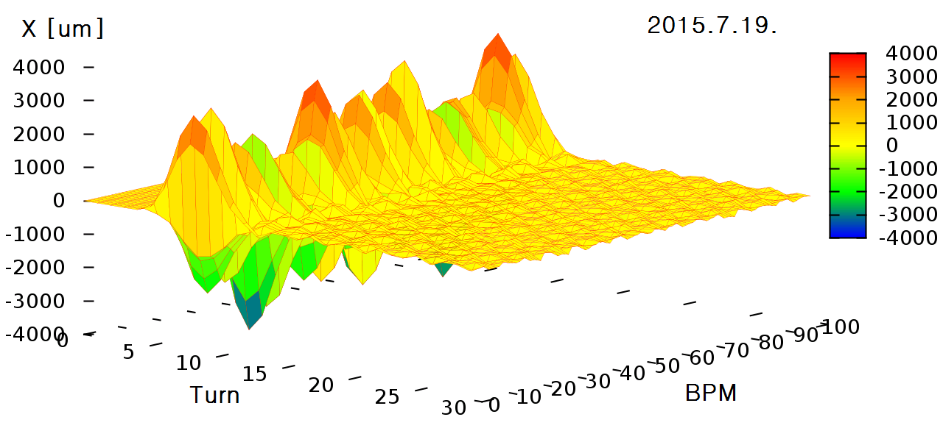
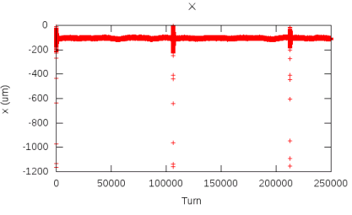
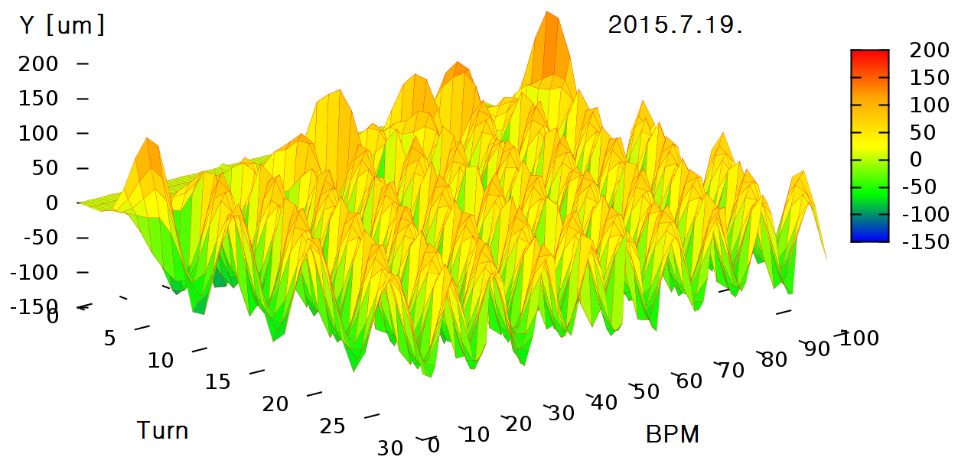
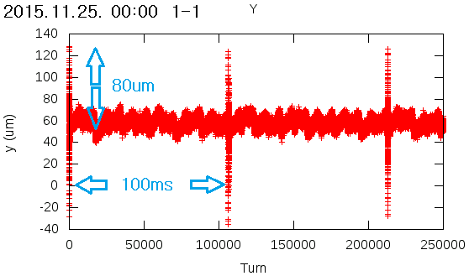
Injection Transient

Slide 8
Parameters Related to the Injection Efficiency
Injection Beam Energy Stability
: RF Power & Phase, Timing Jitter, LCW & Air temperature
Energy Spread
: Linac LCW & Air Temperature, RF power & phase, Preinjector Stability(MK01, Prebuncher, Buncher)
- Injection Trajectory & Lattice(Position, Angle, Size)
: Status of MPS, Gun, Preinjector
SR Beam Dynamic Parameters(especially related in SR RF, ID Gap)

Slide 9
Layout of the PLS-II RF System
4.2 ms
2 W Pre-amp.
with PSK
LLRF
2,856 MHz
Master Osc.
180º
0º
3 dBm CW
(with PSK)
2 W CW
(w/o PSK)
1.1 ms
3 dBm CW
(w/o PSK)
RF Phase State
800 W Peak
SSA
7/8" Coaxial Phase Reference Line
Load
C2
20 dB
C3
15 dB
C9A
6 dB
C12B
6dB
K1
1&5/8”
Main Drive Line
26.5 dB
W/G – Coaxial
Cross Coupler
120 kW
Load
C2
16 dB
C3
12 dB
C9A
10 dB
C12B
6 dB
LLRF
SSA
IPA
IPA
IPA
IPA
K2A
K2B
K3
K8
K9A
K12B
20 dB
Attenuator
10 dB
Attenuator
SLED
SLED
SLED
SLED
SLED
Phase
Shifter
Phase
Shifter
GUN
P.BUN
BUN.
A1
A2
A3
A4
A5
A6
A7
A8
A9
A10
A31
A32
A45
A46
Modulator-Klystron: 17 set
6 M-K sets with 4 acc., 11 M-K sets with 2 acc.
Accelerating Columns: 46 ea
Energy Doubler: 16 set

Slide 10
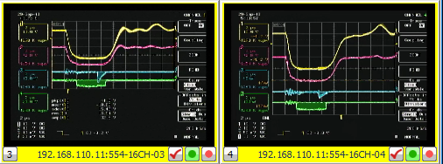
RF & SLED Pulse Form
Energy & Energy Spread Instability Source
: RF Power & Phase Jitter, Timing Jitter

Slide 11

Beam Diagnostic Area
End of the Linac
Start of the Beam Transport Line
MK12B
Phase Control
Using on user serveice
180º
Fast Closing
Shutter 2 ea
BPRM
No#5
BPM
T02
BTOTR2
HSLIT
BPM
T01
BT
GV1
BPRM
No#04
(OTR)
QD03
BCM
LI#07
HB1
QD01
QD02
10º
BCM
BTL#1
ACC45
ACC46
BPM
T01
ICT1
7.5º
BCM
BAS31
BAS3
Designed for 2 GeV, 10º Beam
Non linear field for 3GeV, 10º Beam
BPRM
BAS3
BPM
BAS3
Using on reference

Slide 12
Energy Maximization Program at BAS3
Purpose
Measure Reference Performances at BAS3 for Turn on
Find peak phase of energy maximum
Find equations related to energy and phase of all of M-K Modules.
Check additional amount of beam energy for energy feedback system
- Minimize Energy Spread (usually 0ff crest about -3º)
Use the equation of M-K12B:
to measure dispersion in the BTL,
to calibrate BPM02 and BTOTR2,
to measure linac energy stability
Algorithm
Get beam energy by changing RF phase angle
Fit sine function with the data
Set phase angle on the crest
* It has some time to measure for whole phase
MK12B Phase-Energy Relaton
200
150
100
50
Measured Energy (MeV)
0
-50
155.0426sin(0.017821X + -0.75292)
-100
-150
-200
0
50
100
150
200
250
300
350
Klystron Phase Angle(degree)

Slide 13
Calibration Factor for BTL Diagnostics
E (MeV) = 6.508X + 2956.5
E (MeV) = 3280.5 – 7.540X for OTR peak energy
Energy Spread = 0.257 %/mm for OTR beam size

Slide 14
M-K Performance Analysis
MKname | HV(kV) | Rfpower(MW) | Calc. Energy | Measure Energy | SLED Factor | Peak Phase | Res. Energy | Total Energy | Deviation to Avg.(%)
MK02B | 36.0 | 35.1 | 83.79 | 107.726 | 1.29 | 140.4 | 2911.23 | 3018.96 | -0.21
MK03 | 40.0 | 55.3 | 148.73 | 231.598 | 1.56 | 349.9 | 2792.83 | 3024.42 | -0.03
MK04 | 39.5 | 60.4 | 155.43 | 240.540 | 1.55 | 209.3 | 2781.73 | 3022.27 | -0.10
MK05 | 39.5 | 58.6 | 153.10 | 268.426 | 1.75 | 240.0 | 2755.75 | 3024.17 | -0.03
MK06 | 39.5 | 57.5 | 151.66 | 206.569 | 1.36 | 319.8 | 2824.23 | 3030.80 | 0.18
MK07 | 39.0 | 51.8 | 143.94 | 268.761 | 1.87 | 234.3 | 2768.99 | 3037.75 | 0.41
MK08 | 39.5 | 64.9 | 161.12 | 261.991 | 1.63 | 347.1 | 2756.88 | 3018.88 | -0.21
MK09A | 39.1 | 49.7 | 99.70 | 162.620 | 1.63 | 165.8 | 2857.78 | 3020.40 | -0.16
MK09B | 39.5 | 52.8 | 102.76 | 165.101 | 1.61 | 143.1 | 2860.10 | 3025.20 | 0.00
MK10A | 39.5 | 53.3 | 103.25 | 181.447 | 1.76 | 312.3 | 2846.61 | 3028.05 | 0.09
MK10B | 39.5 | 45.2 | 95.08 | 151.642 | 1.59 | 276.7 | 2874.08 | 3025.72 | 0.02
MK11A | 38.5 | 43.3 | 93.06 | 171.090 | 1.84 | 189.4 | 2846.40 | 3017.49 | -0.26
MK11B | 39.5 | 63.8 | 112.96 | 200.119 | 1.77 | 317.0 | 2833.65 | 3033.77 | 0.28
MK12A | 40.0 | 61.6 | 111.00 | 199.733 | 1.80 | 109.2 | 2822.80 | 3022.54 | -0.09
MK12B | 38.5 | 47.8 | 97.78 | 168.434 | 1.72 | 66.8 | 2859.25 | 3027.69 | 0.08
MK01: measure at BAS1 not using energy maximizing program 1.
MK02A: Not possible cause of too low energy to transmit to the end of linac
Focusing on SLED Factor for performance check.

Slide 15
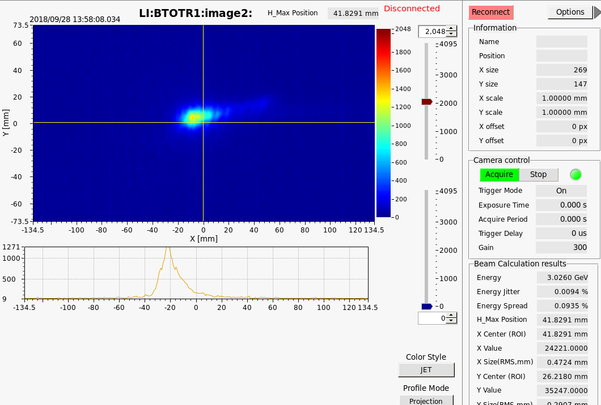
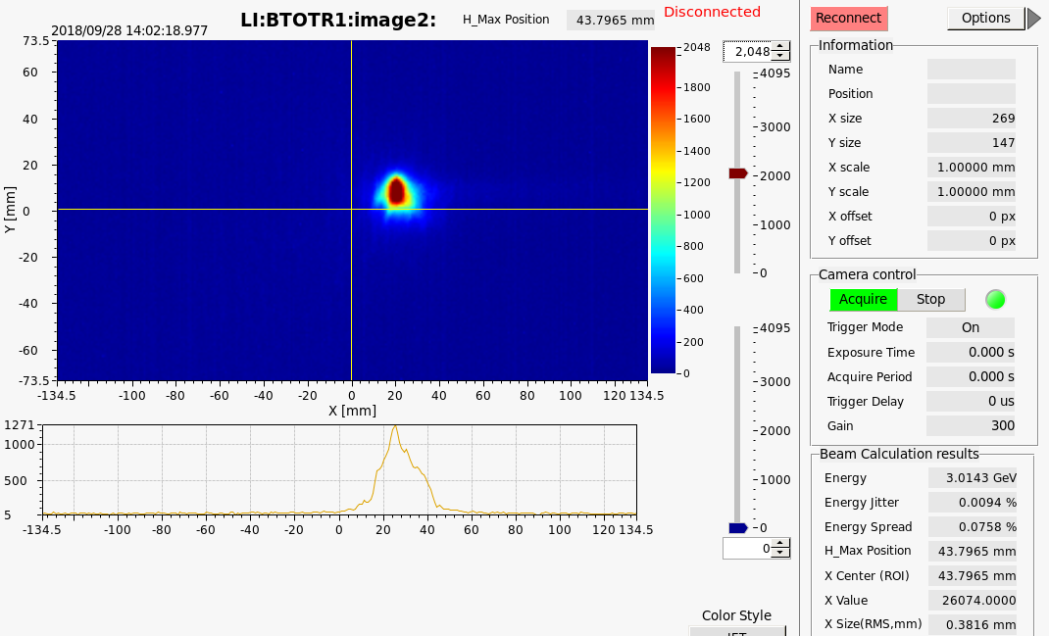
Minimize Energy Spread
All of Phase On Crest
Off Crest about -3º

Slide 16
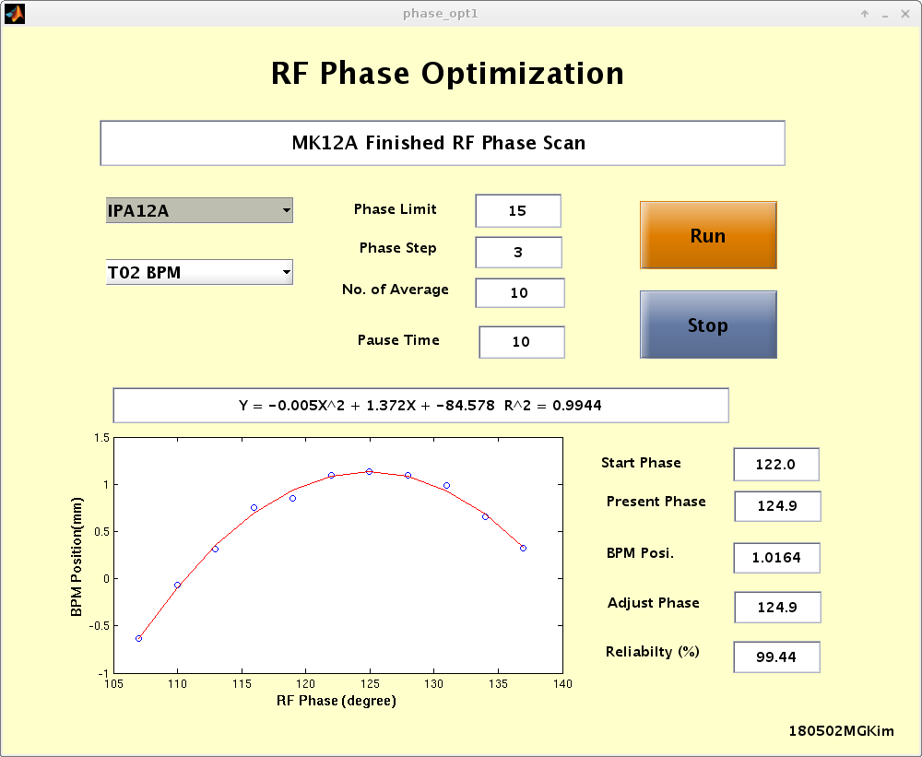
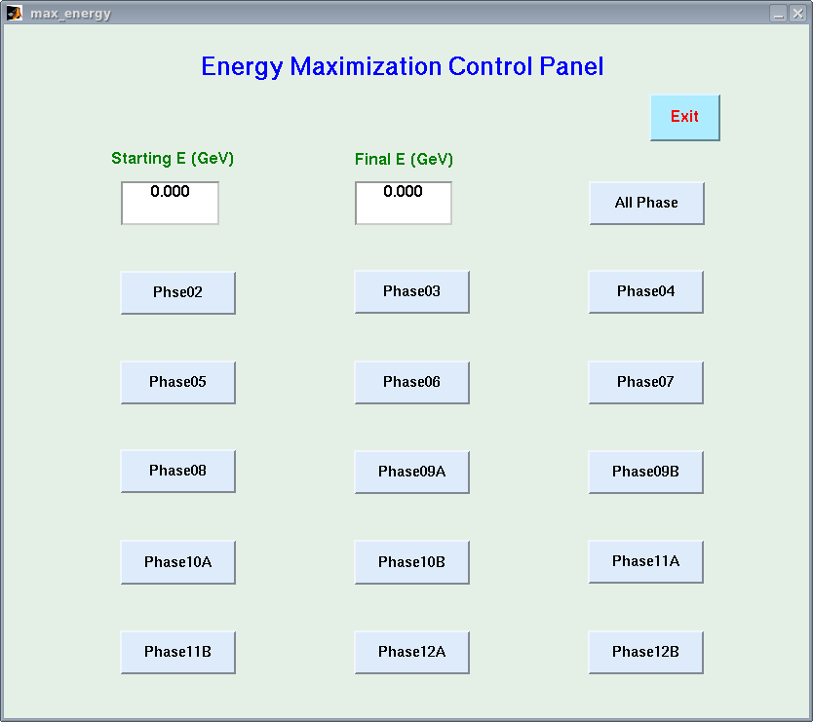
Energy Maximization Program at BTL
Purpose
It is possible to find peak phase at BPMT02 in user service
: Sometimes we have trouble in an MK module in user service
Reduce time to measure at BTL
Use 2nd order linear fitting instead of sine curve fitting at BTL
It is possible using linear magnetic field at BTL in change of small energy
Old vr. of Energy maximize program (only at BAS3)
: It is possible for one stop process, but operators prefer to new one.
New vr. of Energy maximize program (possible at BPMT02)

Slide 17
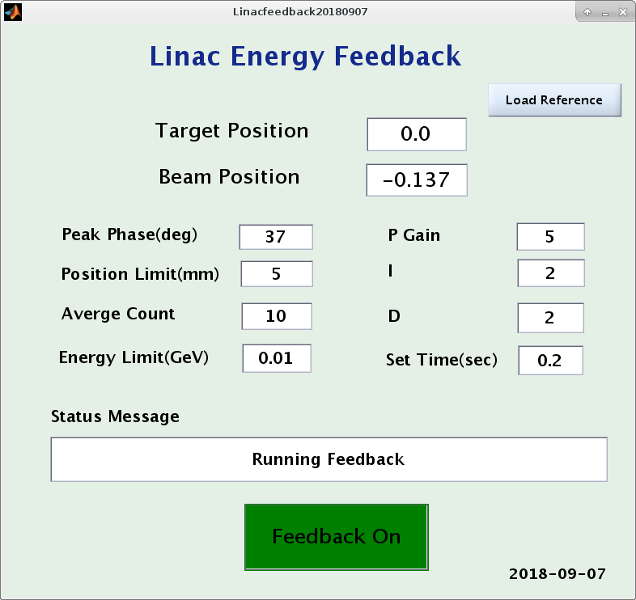
Energy Feedback Program
MK12B Phase-Energy Relation
200
fitted curve
150
100
50
Measured Energy (MeV)
0
-50
-100
162.62sin(0.017302X + 0.91418) + 2833.91
-150
Peak Phase = 37.6212
-200
0
50
100
150
200
250
300
350
Klystron Phase Angle(degree)

Slide 18
Linac Energy Stability for 1 User Run
 | mean | rms | rms Stability (%)
Linac Energy (MeV) | -9.35 | 10.00 | 0.333
BPMT02 (mm) | -0.03 | 0.33
Injec Energy (MeV) | -0.20 | 2.15 | 0.072

Slide 19
Energy Spread Adjustment Program
Assumption
If it happens something problem in machine status,
power, phase, temperature, ect., in most case electron beam confronts phase offset of RF wave in the accelerating columns. It makes some energy change and energy spread increasing. In that case, instead of solving machine problem, move all of RF phase all (except MK12B) with same amount to fit that effect. And adjust the change of linac energy with energy feedback program with MK12B phase
200
200
150
150
100
100
50
50
Measured Energy (MeV)
Measured Energy (MeV)
0
0
-50
-50
-100
-100
-150
-150
-200
0
50
100
150
200
250
300
350
-200
0
50
100
150
200
250
300
350
Klystron Phase Angle(degree)
Klystron Phase Angle(degree)

Slide 20
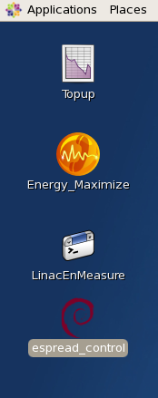
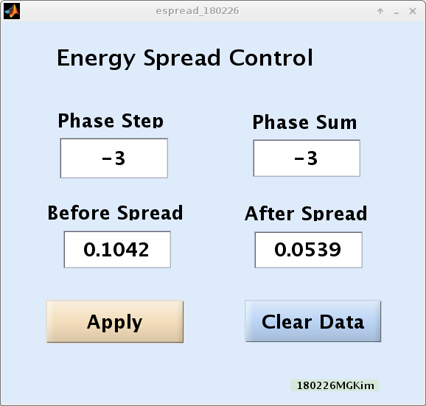
Energy Spread Control Program

Slide 21
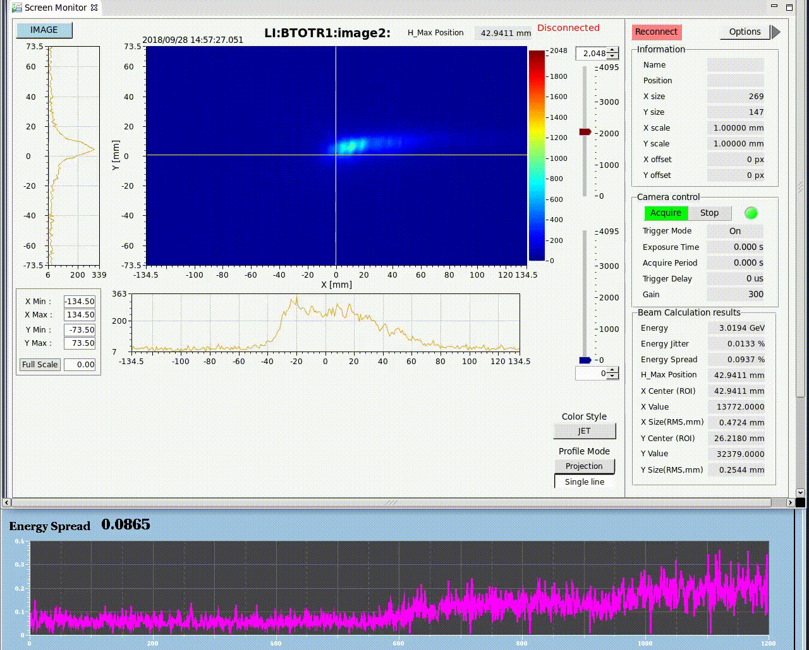
Energy Spread Adjustment
Phase
E Spread(%)

Slide 22
Energy Spread Control for 1 User Run

Slide 23
Efficiency vs Espread for 1 User Run
 | mean | std
Injection Efficiency(%) | 87.030 | 7.920
Energy Spread (%) | 0.057 | 0.019

Slide 24
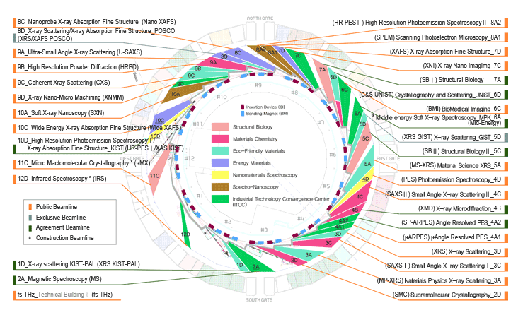
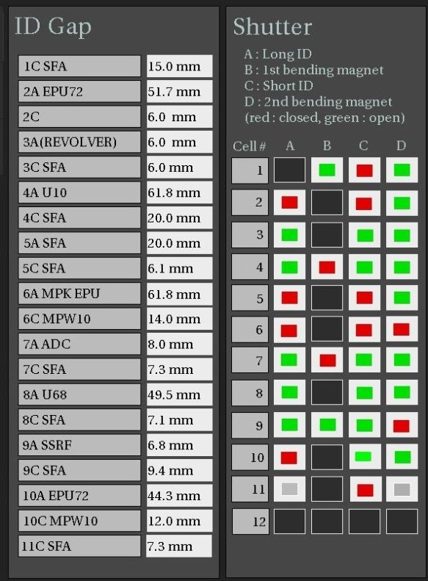
PLS-II Beamlines
Beamline map: 34 Beamlines , 20 ID Beamlines

Slide 25
ID Gpas vs. Injection Efficiency

Slide 26
SR RF Frequency vs. ID Gaps

Slide 27
SR RF Frequency vs. Injection Efficiency

Slide 28
Summary
Use several programs to optimize injection parameters.
It is possible to keep energy spread under 0.1 %
Improve injection efficiency up to 90%
As possible as try to add operator – friendly concepts

Slide 29
Future Plan
- To improve control speed :
limited phase control speed in present
To be upgrade automation process in energy spread control program with plotting process
Try to search S.R. parameters to change optimized injection energy and to develop program to adjust that effect.

Slide 30

Thank you

