Slide 1

Web Applications
for
Scheduled Work
Nina He
Operator from
RIB Operations Group
2018-09-21
Notes:
Hello everybody! Welcome to my presentation! My topic today is Web Applications for scheduled work.

Slide 2
Operators’ Life At an Accelerator Facility
In a facility which runs 24/7, shift work is necessary for operations
The shift work needs to be fully scheduled ahead of time.
The schedule is planned by group leaders.
The schedule will be modified for days off and/or shuffling that occur throughout the year.
Why scheule is important?
Group leaders need to get shifts information to manage the operations.
Operators need to plan their vacation ahead of time and update
actual off hours.
Human Resources needs the work hours to finish payroll calculations (shifts differential).
Notes:
First, let’s talk about operators’ life. For a facility like ours, which runs 24/7, shift work is necessary for operations. I belive most of people here know something about shift work. But do uou know, what is first thing to be remembered for operators? it is work schedule, we need to know which day come to work!
In our group, we have three shifts a day, two operators per shift. Every operator has a different work schedule.
Starting shift work operators have to follow the schedule and We call this planned schedule. It is setup by group leader, at the time before we start the shift.
Modified schedule we call it interactive schedule. It is information records for actual work or off dates. This part needs operators’ input.
<click>
Who need to use the schedule? <click>
First, Group leaders need to get shifts information to manage the operations.
Second, operators need to plan their vacation ahead of time and input anything changed from planned schedule, include shifts shuffling, over time, extra worked hours, Lieu hours and so on.
Last, Human resources needs work hours to finish the payroll calculation. This part called timesheet.

Slide 3
Scheduled Work and Timesheet Work Flow
Step 1 Plan
Group leaders make our shift work schedule for new year
Step 2 Input
Operators input actual dates off or shift change.
Step 3 Timesheet
Timesheets will be submitted to HR every half month.
Notes:
General say, schedule work has three steps.

Slide 4
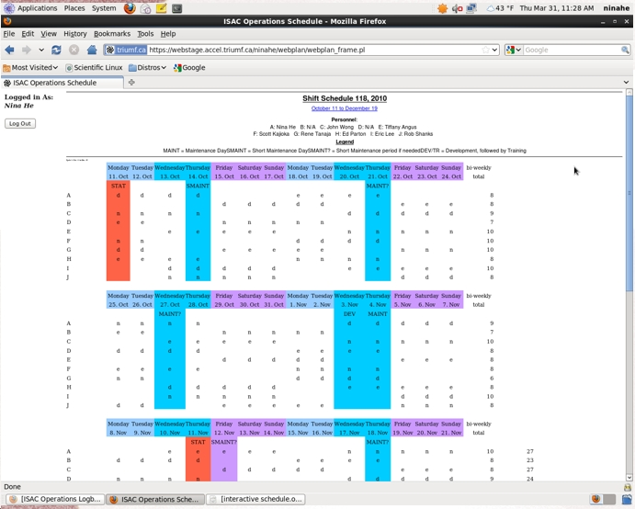
History: What it used to be like?
STEP #1: PLAN
Original planned schedule page.
Everyone needed to log in
to look at the work schedule
Planned work schedule
requested a lot of work
Notes:
Let me show you what we have 8 years ago. This is original planned schedule page.
<click>
We needed to log in to check work plan schedule. It was complicate to see the shifts arrangement.
<click>
Because it was a HTML page but code wroted by manually so it needed a lot of time.

Slide 5
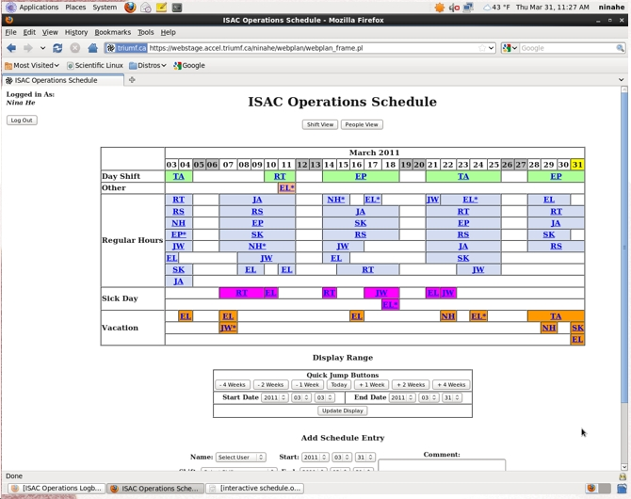
History: What it used to be like?
STEP #2: INPUT
Interactive schedule V 1.0 page
Operators needed to fill this online schedule for ACTUAL work or OFF dates.
Notes:
<click>
8 years ago we had a version 1 interactive schedule which was just for taking the records.
<click>
When operators filled up it they must put both work days and off days. That means we need input everything for everyday.

Slide 6
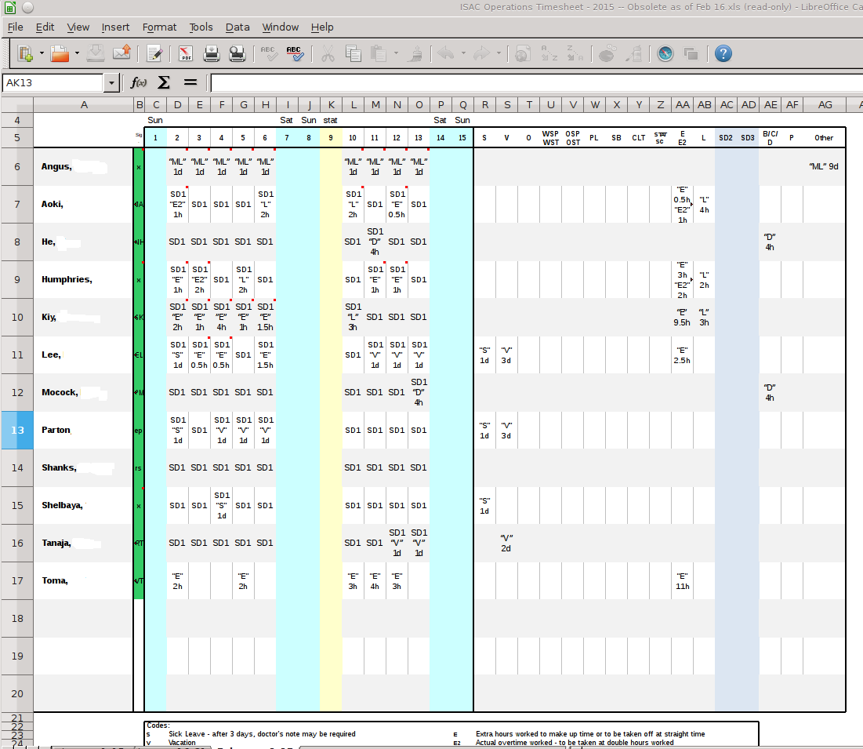
History: What it used to be like?
STEP #3: TIMESHEET
Old timesheet using spreadsheet
Everyone had to fill it
out every half month.
Notes:
The timesheet was using spreadsheet several years ago. Everyone had to fill it out every half month.

Slide 7
Problems With The Old System
Programs were in three different locations
Inconvenient to use
Input Data only for records
Notes:
<click>
From the talk above we know there are 3 part of components in shift work system. In old system three parts of them not connected together. At leased we had to log in twice to different accounts.
<click>
People had to check cross over to get the results they wanted. For example to fill out timesheet, compare planned schedule and interactive schedule was necessary and repeated work. Spent a lot of time for every half month. Human errors could occur due to operators made a mistake.
<click>
No data processing program so the interactive schedule was only for records.

Slide 8





What is Changed by our New Applications?
PLAN
INPUT
TIMESHEET
NEW INTERACTIVE SCHEDULE
New Interactive schedule includes several functions:
  Planned schedule
  Interactive schedule
  Timesheet
  Calculation and summary of off days
Notes:
Started since 2010, I have worked on new interactive schedule system to work out a solution. Purpose is to raise operational efficiency and save time.
We have plan,input,timesheet integrated into a new interactive schedule.
Reduced operators job to only one: input. And input only for the dates off, shift moving or over time. That means you don’t need to do anything unless the actual work date is not match the planned schedule.
Data processing is being used and generates different kind of reports according to query request.

Slide 9
Programming Design Flowchart
Input from Ops
Vacation Report
ScheduleAvailable?
yes
Inteactive Schedule
Start
Lieu Hours Report
no
Install Into Database
Print Personal Schedule
Other Leave Report
yes
Group
no
Satisfy ?
Generate Timesheet
Calculate
Simulation

Slide 10
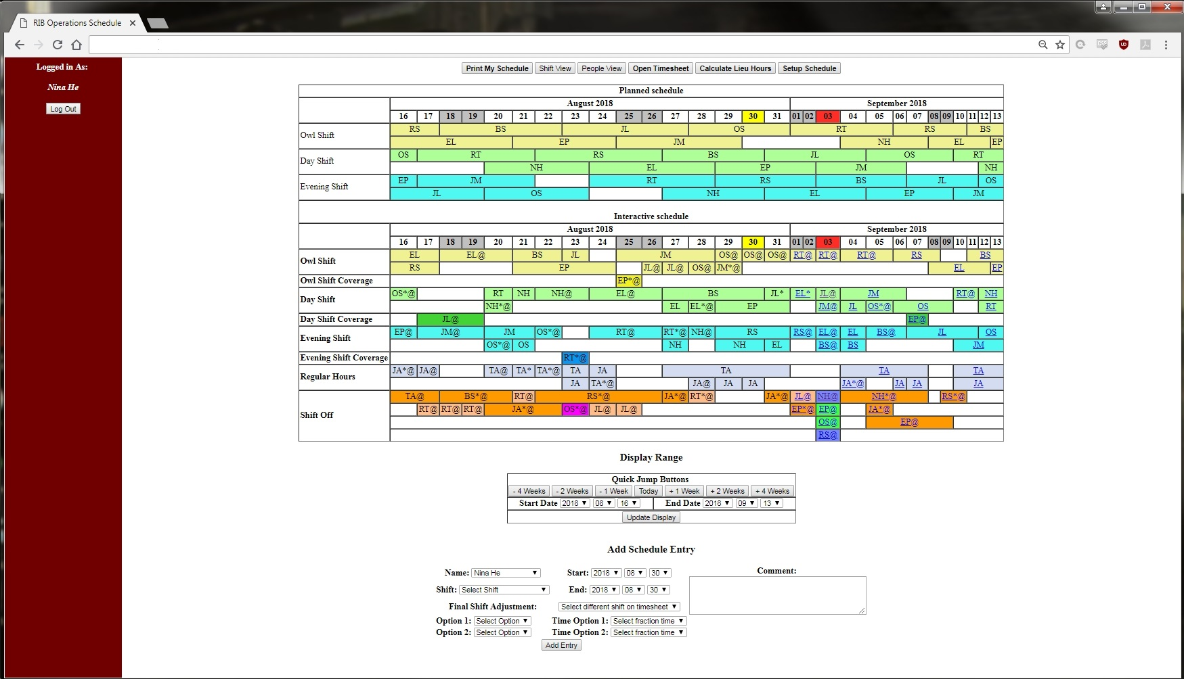
Interactive Schedule System
Function Buttons
Planned Schedule
Interactive Schedule
Notes:
At beginning, planned schedule and interactive schedule are sample. After data input and modify interactive schedule become a time records to show a real world.

Slide 11
Interactive Schedule System
Print Personal Year Schedule
Different View of Schedule
Generate Timesheet
Vacation & Lieu Hours Report

Slide 12
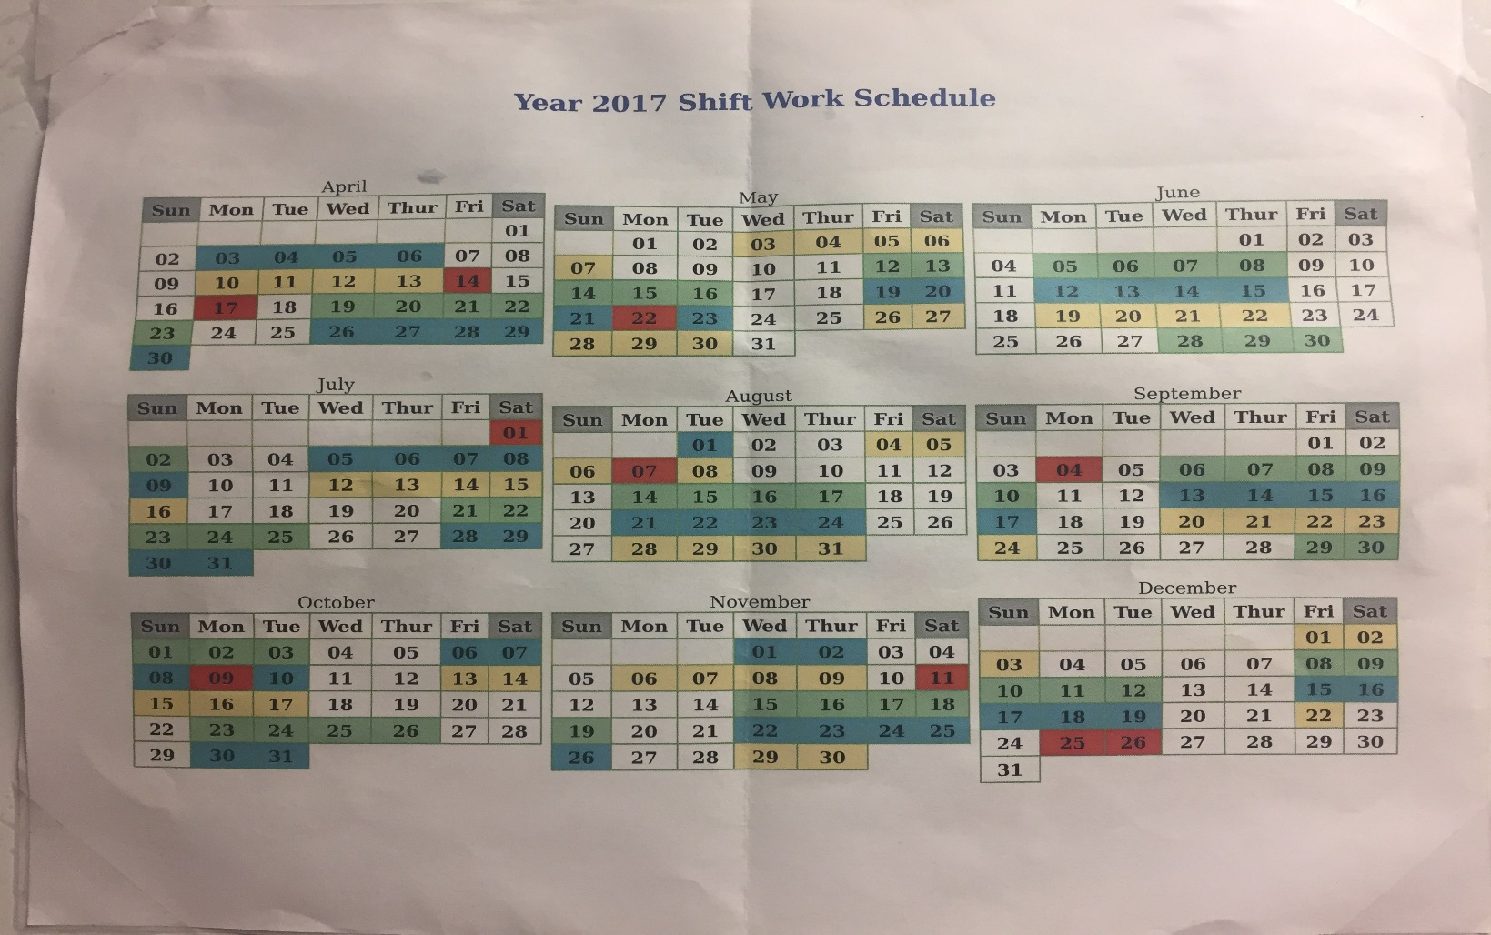
Interactive Schedule System
Personal Schedule for Year

Slide 13
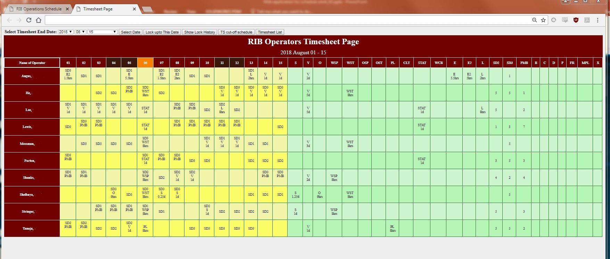
Interactive Schedule System
Timesheet submit to HR

Slide 14
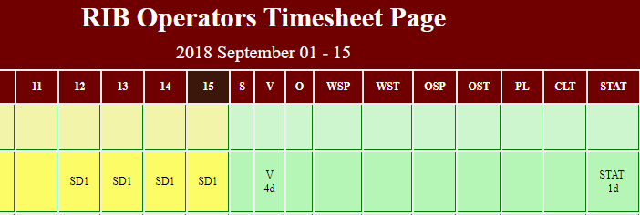
Interactive Schedule System
Timesheet submit to HR

Slide 15
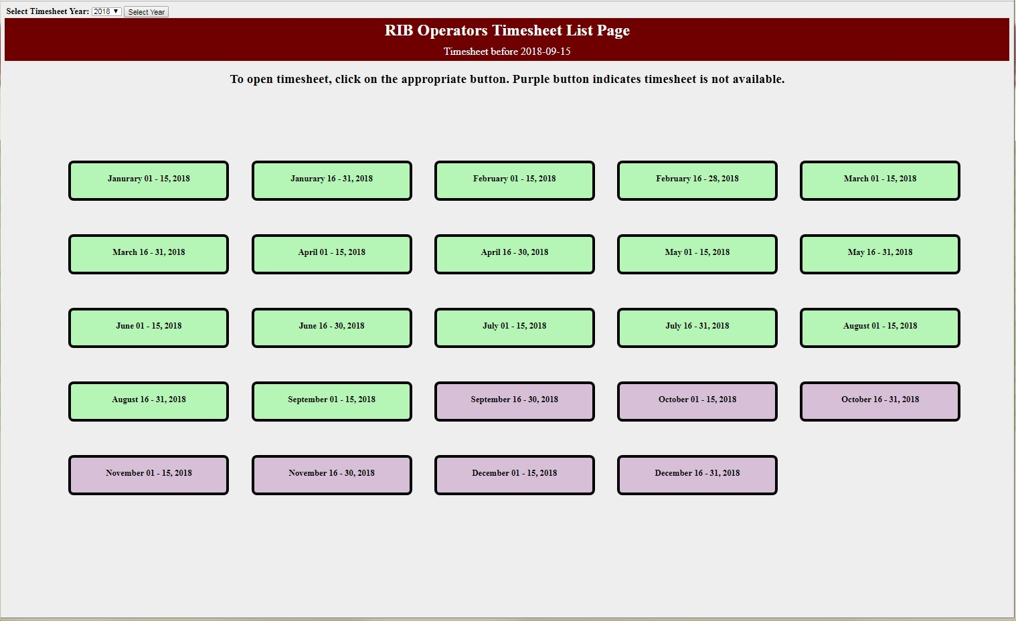
Interactive Schedule System
Timesheet list submit to HR

Slide 16
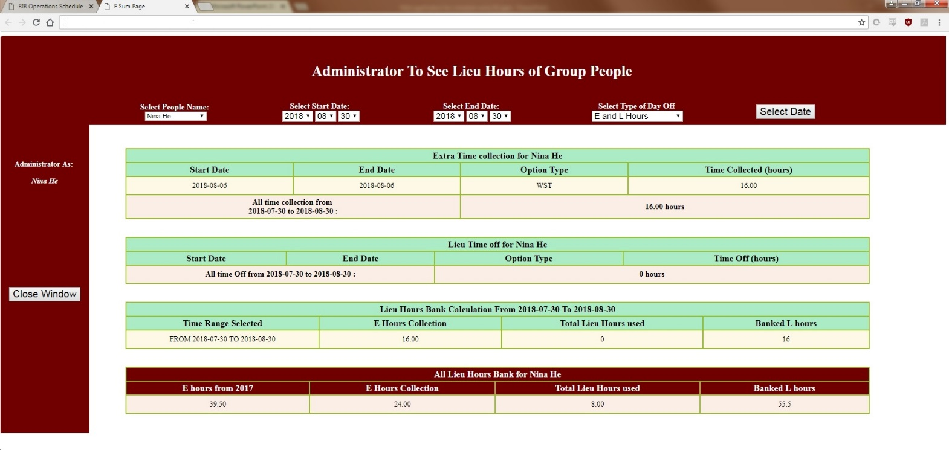
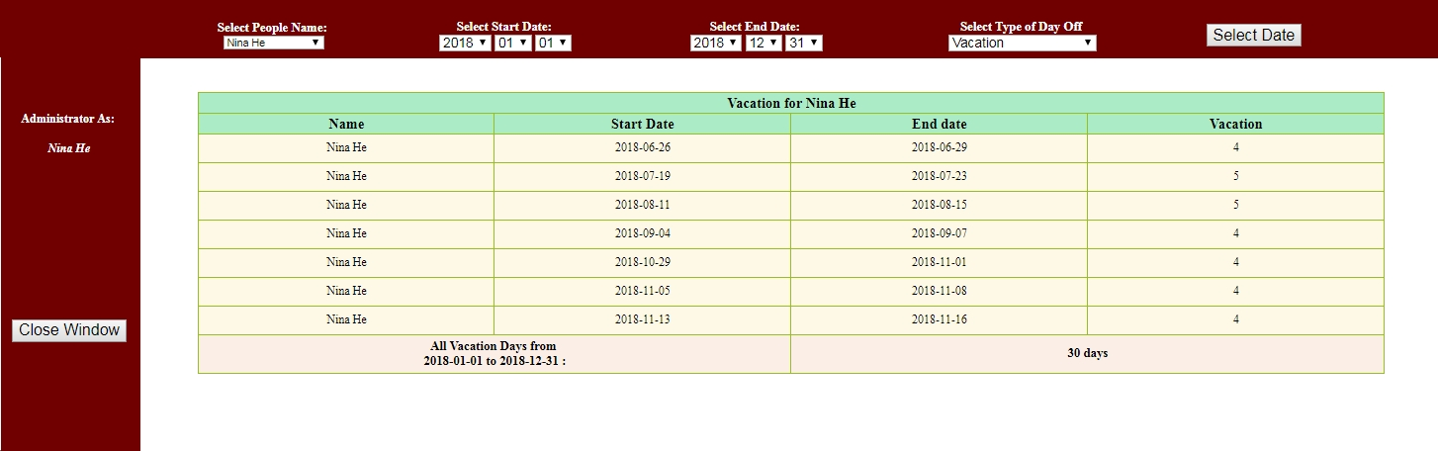
Interactive Schedule System
Vacation report
E/Lieu hours can
be checked easily

Slide 17
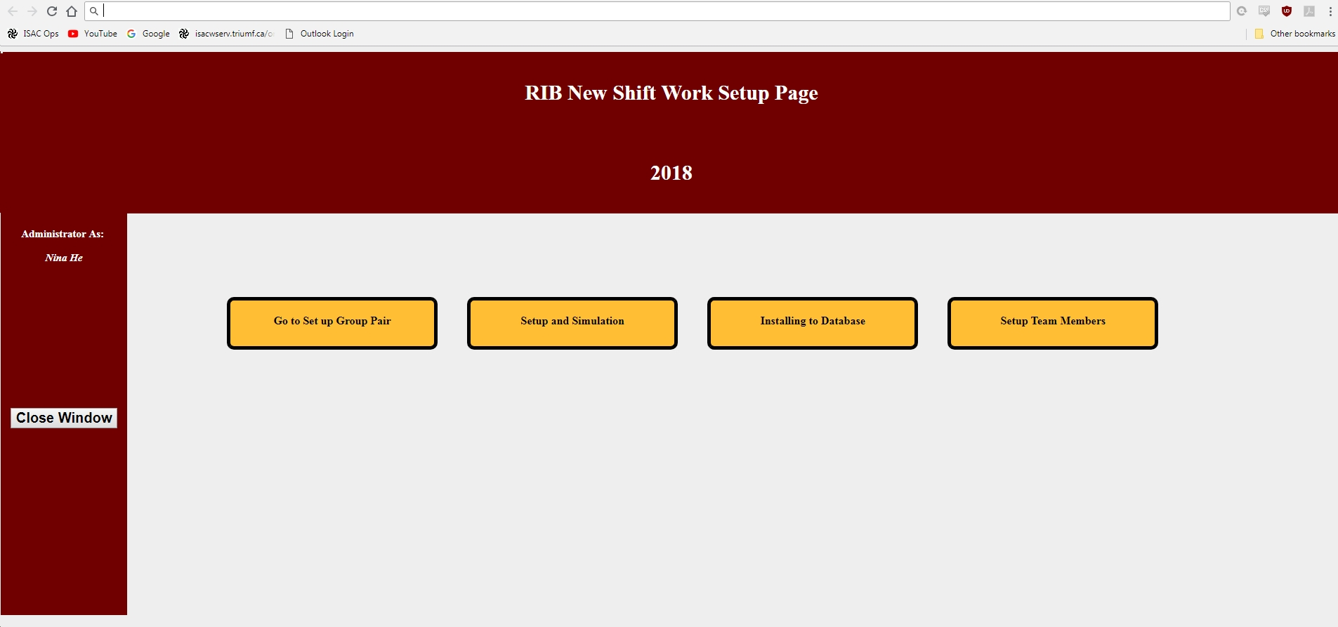
Interactive Schedule System
Setup planned schedule
Add or Remove team members

Slide 18
Achievement of New Interactive Schedule Program
Integrated three programs into one
  Plan + Input + Timesheet
  Reduce operators work & save time
  Benefit from early planning.
Output by utilizing database & data process
  Generate Timesheets
  Display vacation and Lieu hours reports
  Get results easily for any queries.
Notes:
1.From new interactive schedule we integrated three components into one. The operators only need to focus on input and saved a lot of time. It’s benefit from earlier plan and find coverage, shuffling shifts, and so on.
2. Data processing is being used for generate the report. It generates Timesheets, display vacations and Lieu hours reports. Can get results from any queries.
3. Because we have run this program for several years, it is stable and useful. We think it can be expanded to other area.

Slide 19
New Application for Support Groups
Scheduling System expanded to support groups
Purpose is to reduce down time
Support group leaders can set up the schedule easily
Operators can get support experts’ contact information quickly
Notes:
We developed a new application for support groups. The idea came from the problem, which was for timing issue. Usually the support groups arrange a support schedule before an experiment start. They would send us an e-mail for contact information. However, an email from one week ago hardly to be found when the devices problem suddenly happen. Specially when operators come back from vacation and have more than hundreds of unread e-mails. Searching support contact information could spend 5 ~ 15 minutes and the time would be counted into downtime. By using online support web application, setup by support group leaders, the information can be get in a second.

Slide 20
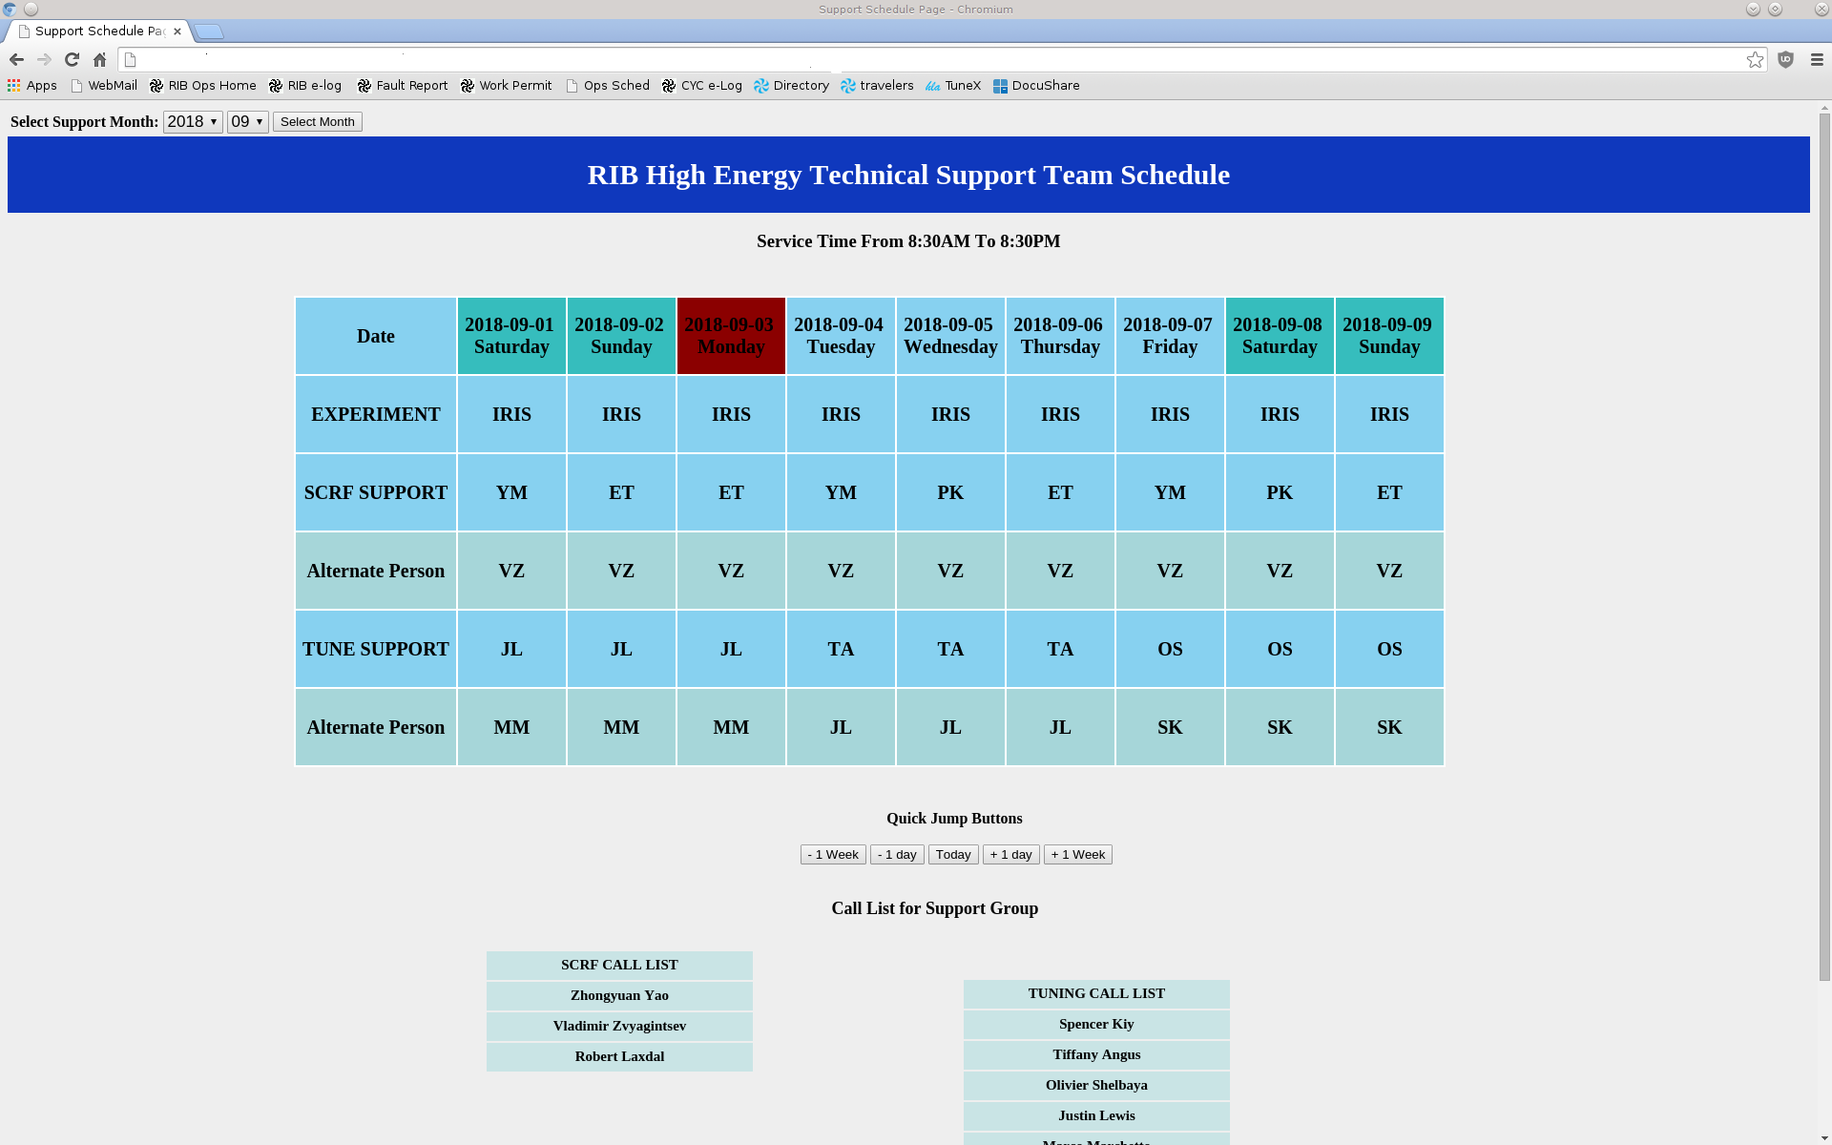
New Application for Support Groups
The page
for operators’
use
Contact Information
shows
when mouse
hovers over the name
Notes:
This page is for operators use.

Slide 21
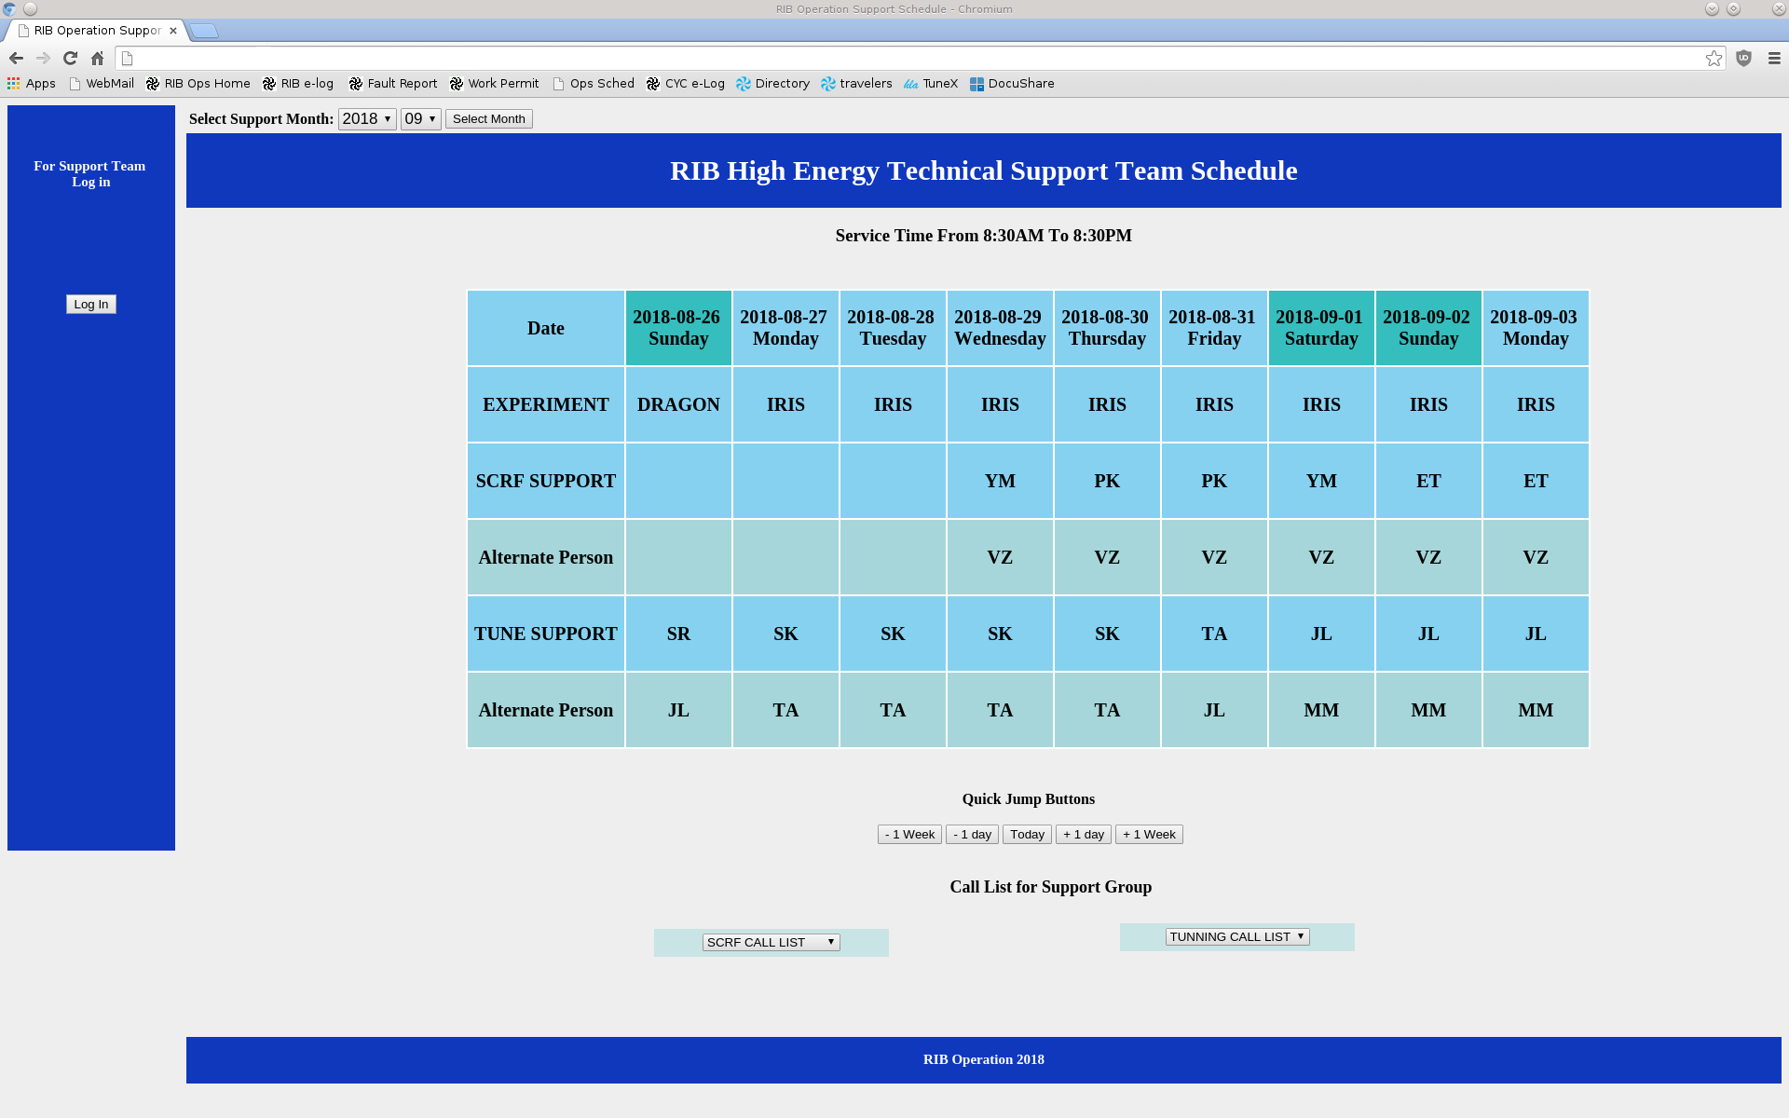
New Application for Support Groups
The page
for support groups’
use
Support Schedule setup by support group administrators

Slide 22
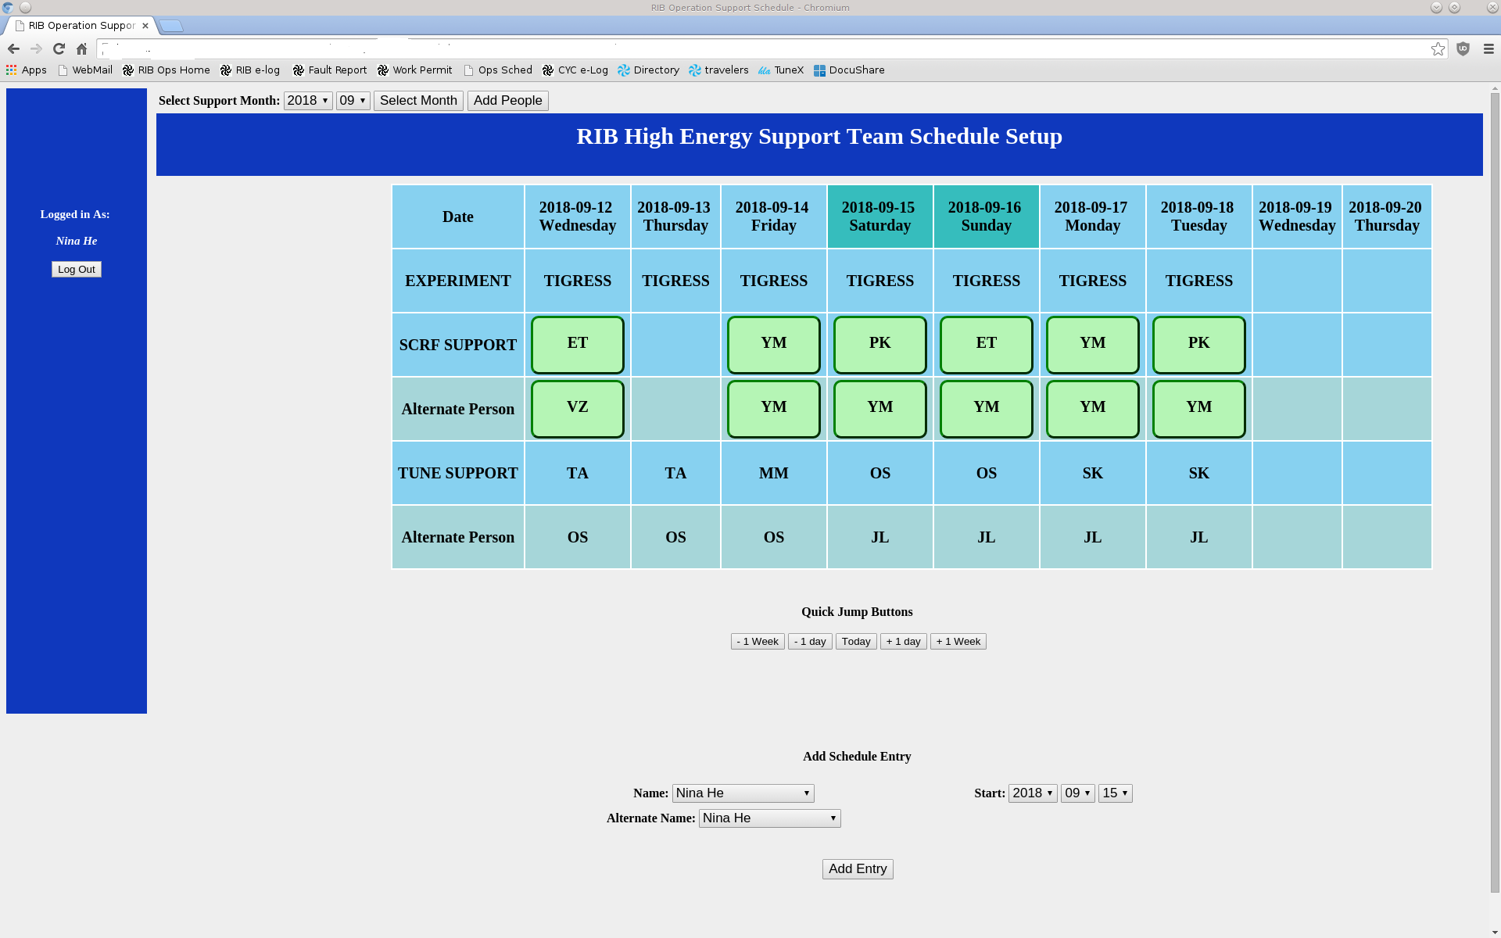
New Application for Support Groups
The page
for support groups’
use
Support group administrators can edit team members info

Slide 23
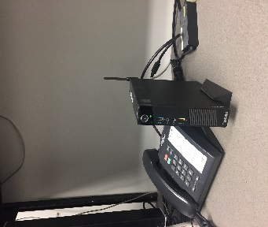
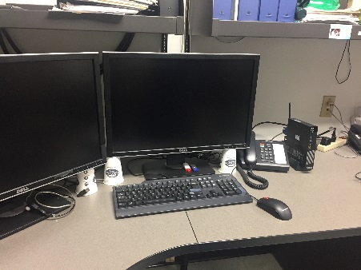
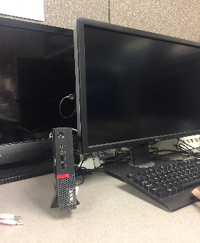
Summary for Our Application
Hardware: Mini PC as a server with Linux OS.
Technology Stack: HTML with CSS, JavaScript (View)
          Perl (Controller)
          PostgreSQL (Model)
Development, backup, maintenance by our operators.

Slide 24
Utilizing Web Application
Modular Programming Design
Standard CCS and Javescript files
Expand to different areas
Notes:
We found that the web application is very useful for a group people to use inside of the company. The technology and equipment are not difficult to get. Taking advantage of developed modules and making modular design, web application can be extended to any other area easily. In the future we are going to develop more APP for other group people to use. This is my shutdown project for many years and it is a time killer when the shifts were very quiet.

Slide 25
Utilizing Web Application
Save time for operators and leaders
Reduce human errors
Utilize input data to get report quickly
Users can plan the actions early
Notes:
I’d like to bring this presentation to a close with summarizing our web application program:
1. It can save operators and group leaders time and that means high efficency.
2. It can reduce human errors as human does less jobs.
3. It can utilize the input data to get reports quickly.
4. It can give more information to all users which they need to plan actions ahead of time.

Slide 26
END OF PRESENTATION
THANK YOU
MERCI
Notes:
I sincerely appreciate that I’ve had this opportunity to present to you. If anyone has any questions, please feel free to ask now and I ‘ll do my best to answer.

Slide 27
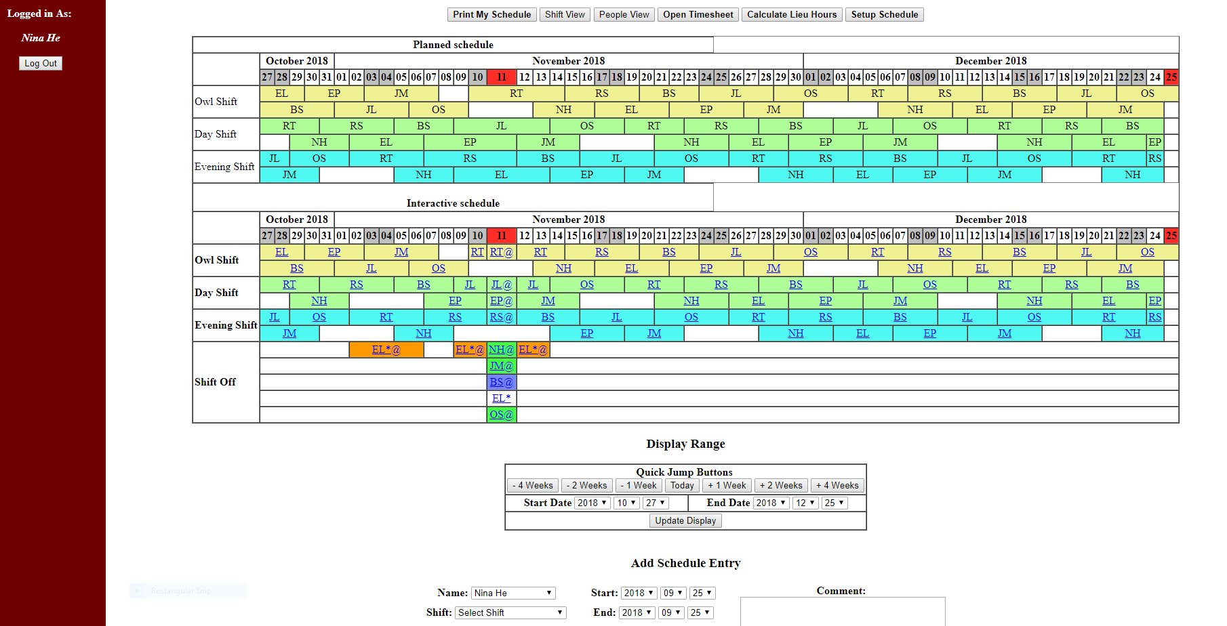

Slide 28
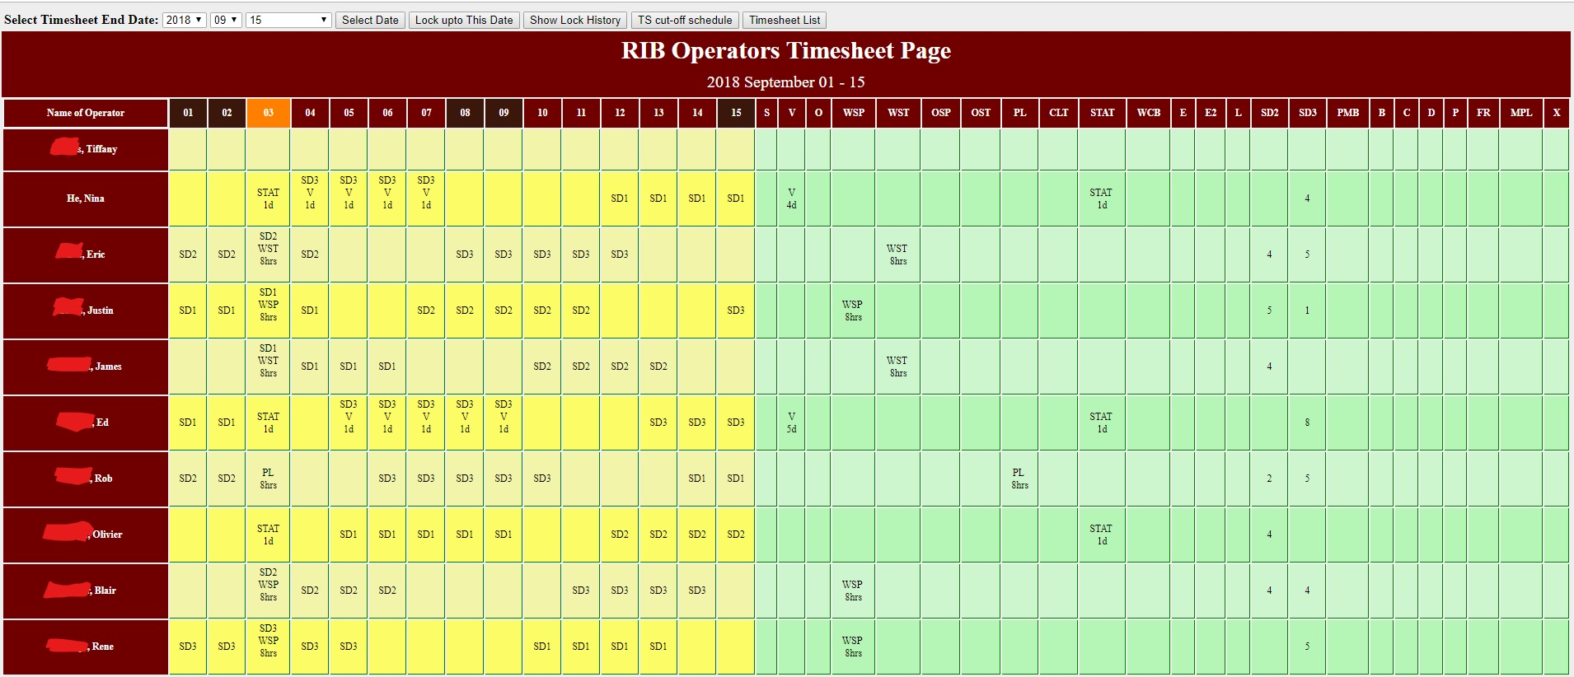

Slide 29
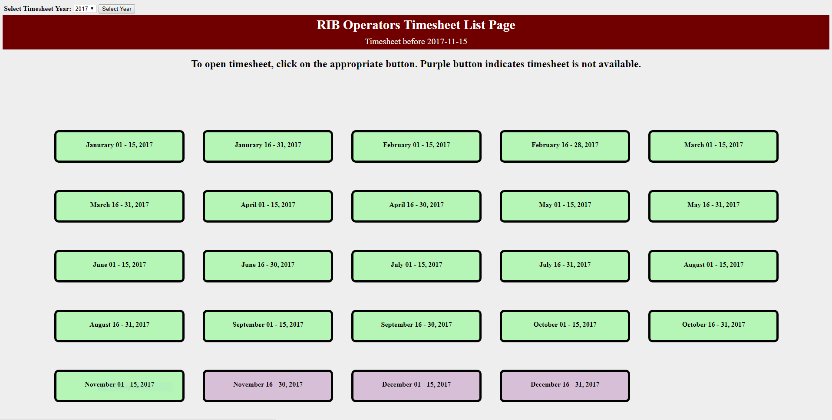

Slide 30
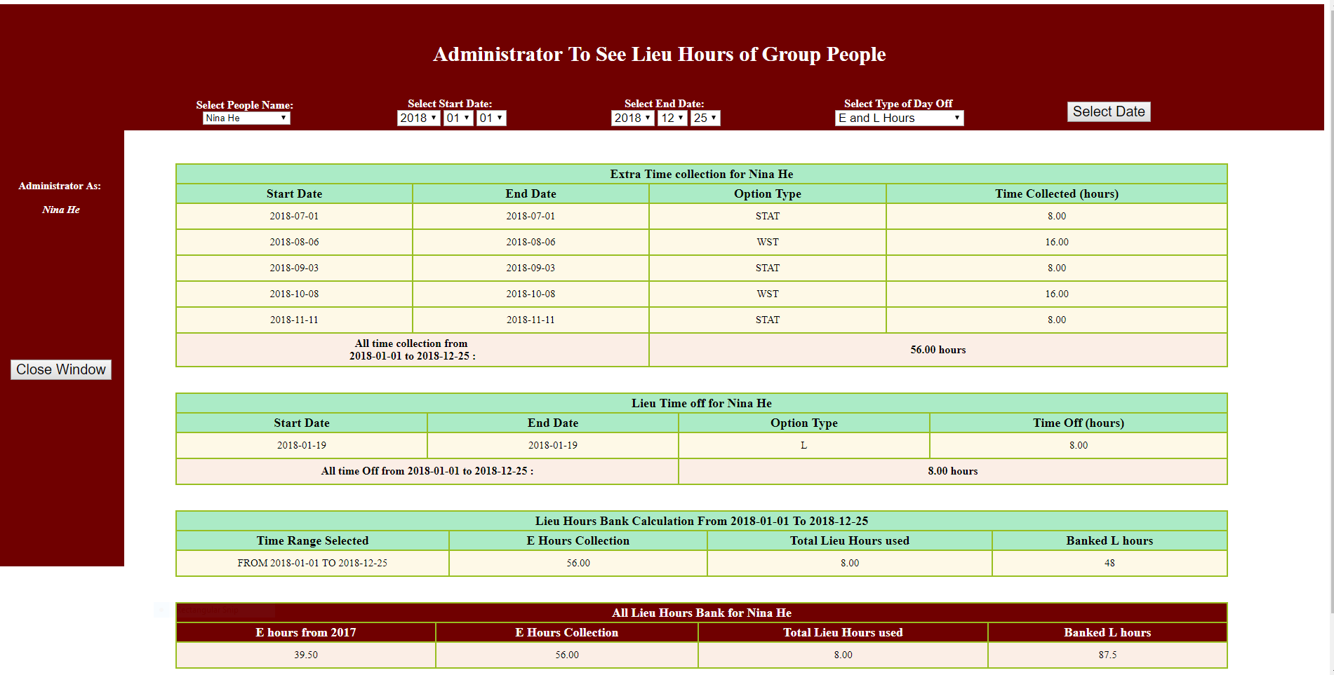

Slide 31
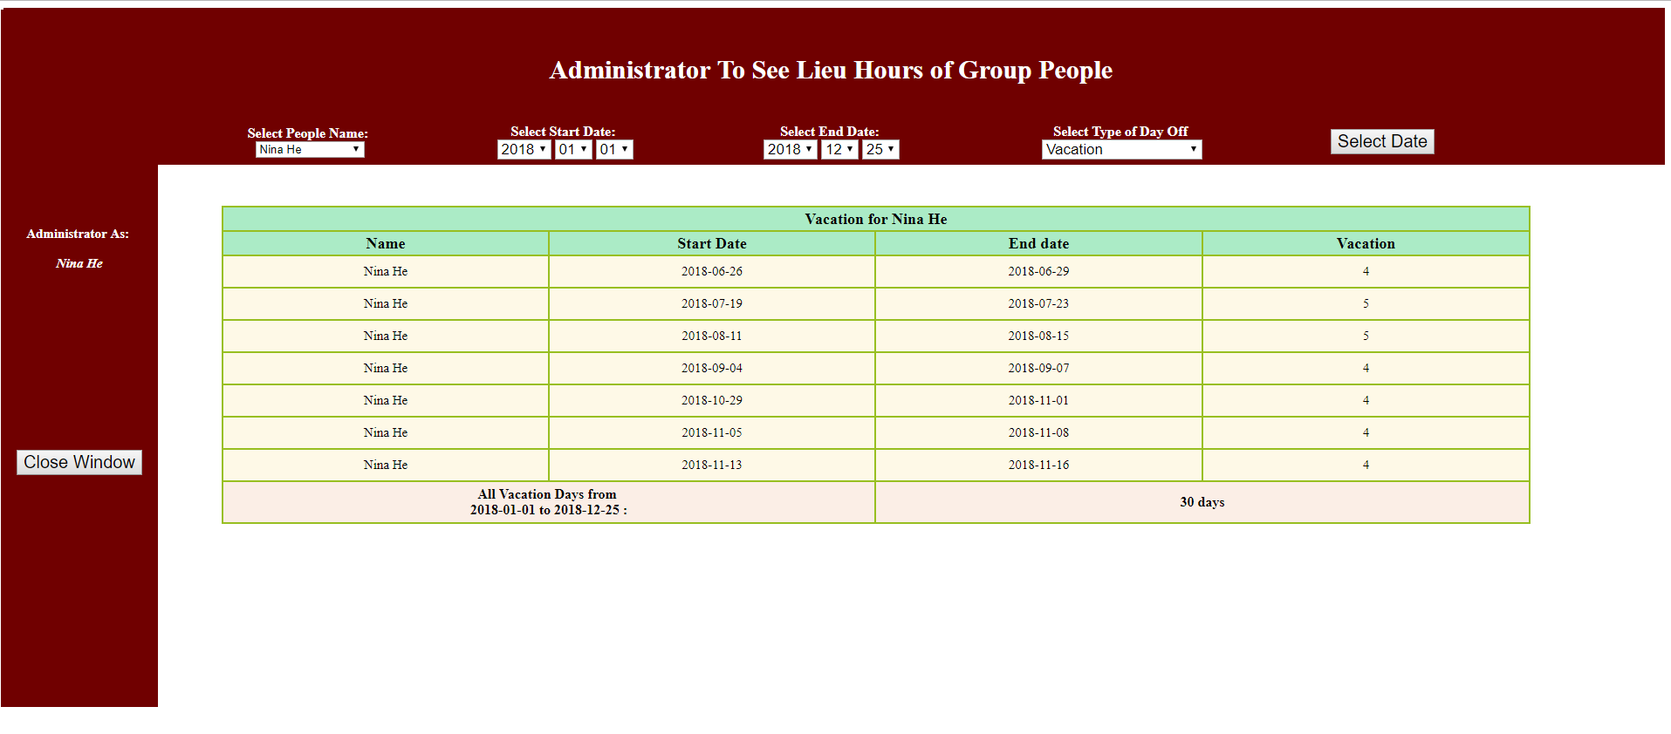

Slide 32


