Slide 1


Commissioning New CERN Accelerators :
Linac 4 & PS Booster 2020 Re-commissioning
Abdelouahid AKROH
BEams Department (BE) - OPerations Group (OP) – PS Booster section(PSB)
On behalf of Re-commissioning coordinators team
Notes:
Good morning everyone,
My name is Abdel, I’ve been working at CERN for 8 years as shift Leader of PS Complex.
I’d like to start by saying that it’s my first talk given in English, then don’t hesitate to interrupt myself if something is not understood.
I’m gonna talk about the re-commissioning of the machine after a 15 months shutdown.

Slide 2
OUTLINE
LHC injectors complex
Long-term Schedule
Re-commissioning
Long Shutdown 2 works in the Booster
2020 machines preparation: Linac4/Booster
Summary
Notes:
I’ll start my talk by presenting the LHC injector complex,
I will also say few words about the LHC and its injectors long term schedule
Then I will explain what is the recommissioning and how we do it.
The coming long-shutdown 2 work in the PS Booster.
The 2020 machine start-up preparation
And I will conclude.

Slide 3
OUTLINE
LHC injectors complex
Long-term Schedule
Re-commissioning
Long Shutdown 2 works in the Booster
2020 machines preparation: Linac4/Booster
Summary

Slide 4
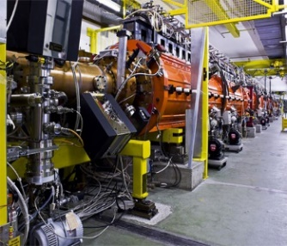
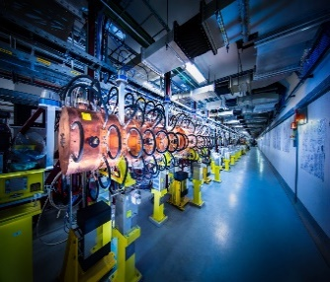
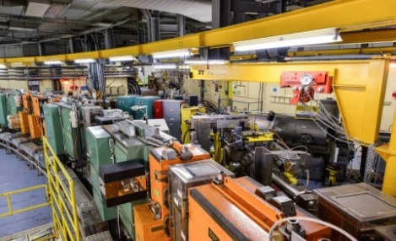
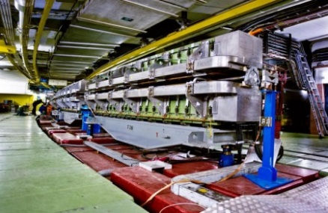
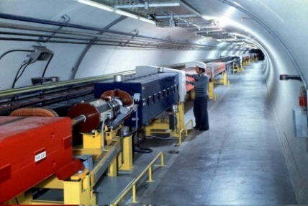
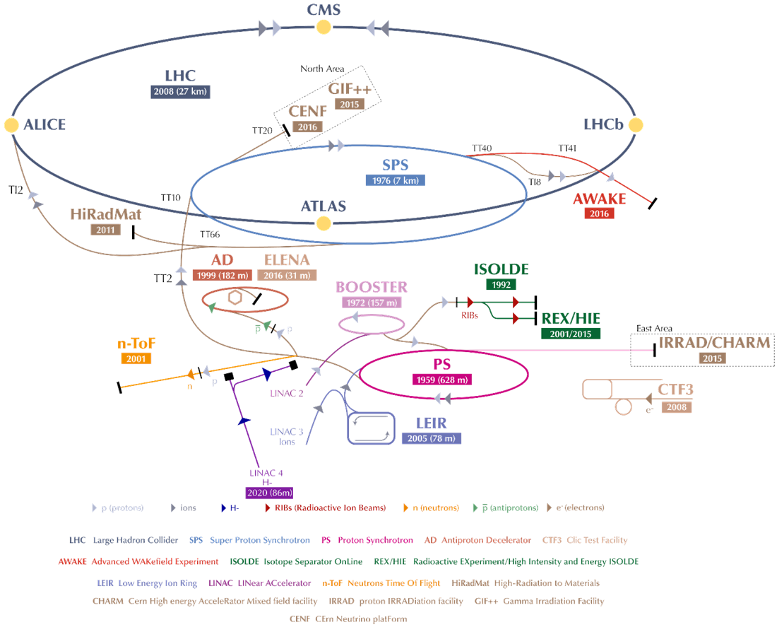
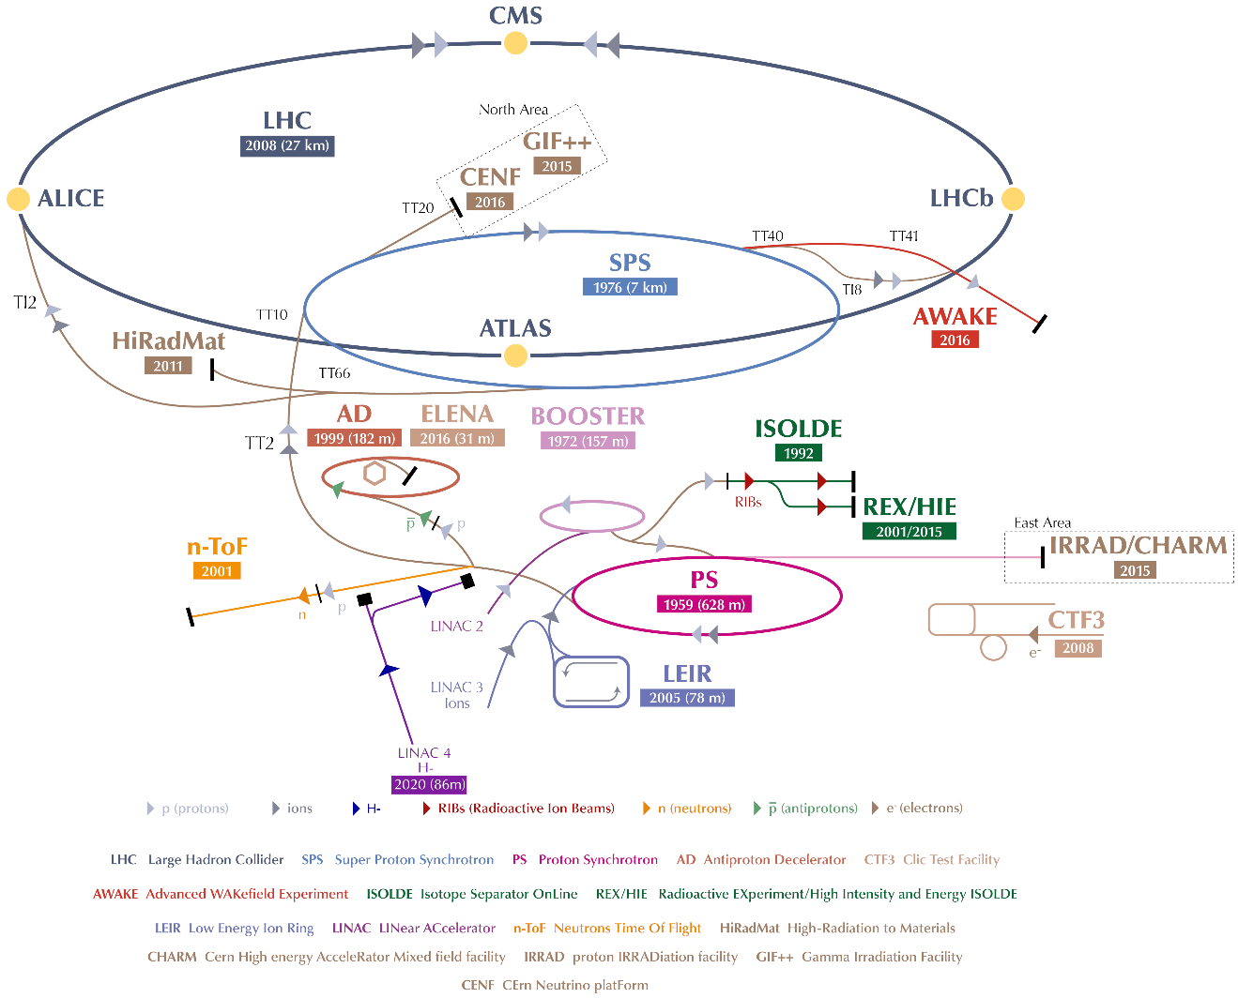
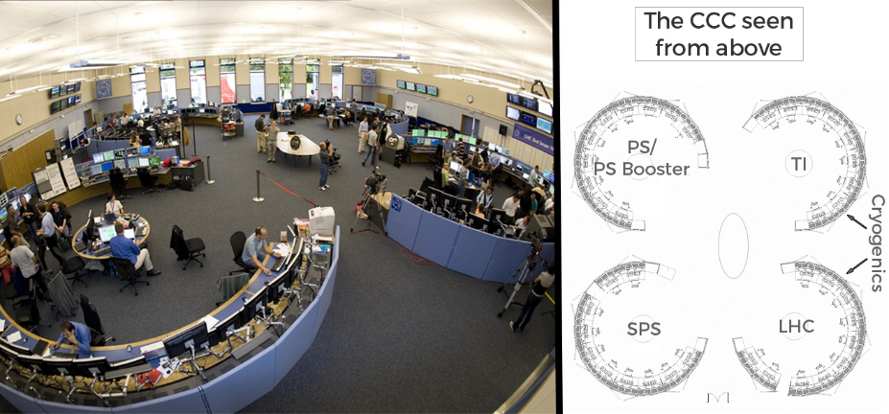
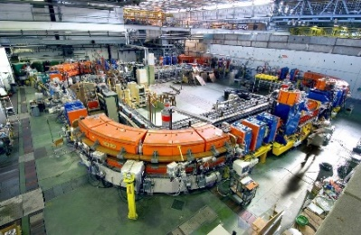
LINAC 2→ LINAC 4
Proton→ H- source and first stage of acceleration (50MeV/160MeV)
Booster
Determines beam intensity, Hor./Ver. parameters (1.4GeV/2GeV)
PS
Gives longitudinal structure
(26GeV)
SPS
Final acceleration for LHC injection (450GeV)
CCC - Cern Control Centre
(cf. R.Giachino’s talk)
Main topic of this talk
LEIR
Ions provider for LHC Ion physics run
(72 MeV)

Slide 5
OUTLINE
LHC injectors complex
Long-term Schedule
Re-commissioning
Long Shutdown 2 works in the Booster
2020 machines preparation: Linac4/Booster
Summary

Slide 6
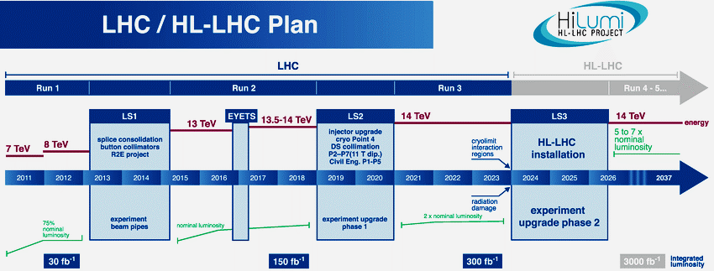
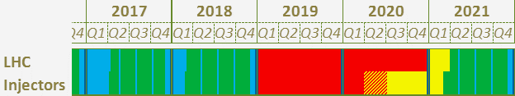

In order to increase the LHC performances, in the framework of LIU (LHC Injector Upgrade):
Injectors have to be adapted,
After technical stops and shutdowns, recommissioning of the machines is needed.
We’re here
Notes:
This slide shows a master plan of the LHC era moving to the High Luminosity LHC era. Since the LHC is running, we needed to place few slots of long breaks/shutdowns:
LS1: for the LHC energy upgrade (to ramp above 3.5TeV to 6.5TeV)-> (Consolidation of ~1500 Interconnections) Splices quality check done by the operators.
LS2: Mainly for the LHC Injectors Upgrade.
LS3: Will host the final consolidation and upgrade for the HL-LHC (new crab-cavities, many new magnets with new technology and upgrade of the interaction points: ALICE/ATLAS/LHCB/CMS)
In order to prepare and to increase the LHC performances we had to adapt all the injectors, that’s what will very soon take place in LS2. Of course the upgrade is very important BUT the recommissioning is even more important.

Slide 7
OUTLINE
LHC injectors complex
Long-term Schedule
Re-commissioning
Long Shutdown 2 works in the Booster
2020 machines preparation: Linac4/Booster
Summary

Slide 8
New approach
Since 2016 the operation group is responsible of re-commissioning.
Each accelerator has one (or two) re-commissioning coordinator(s), members of the Operation group:
ARW’13
Australian
Synchrotron
WAO’18
BNL
WAO’12
SLAC
WAO’16
SSRF
WAO’14
DESY
Re-commissioning team for the LHC protons/ions injectors
Mandate of re-commissioning coordinators:
Prepare the machine for an efficient re-start from shutdown to beam operation
  Participate in shutdown coordination meeting (with facility coordinator) in order to organize the recommissioning activities and create a planning.
  Participate actively in the hardware re-commissioning.
  Organize and participate in the dry runs.

Slide 9
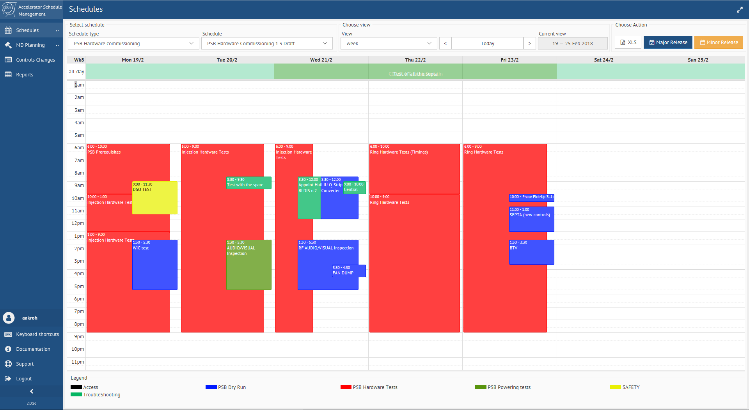
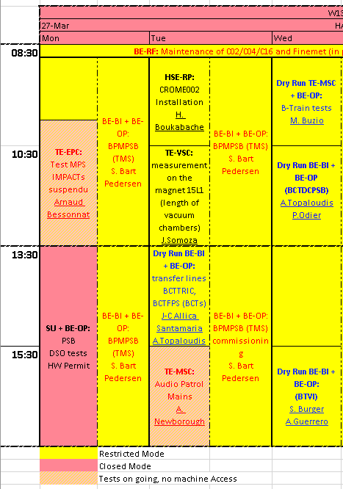
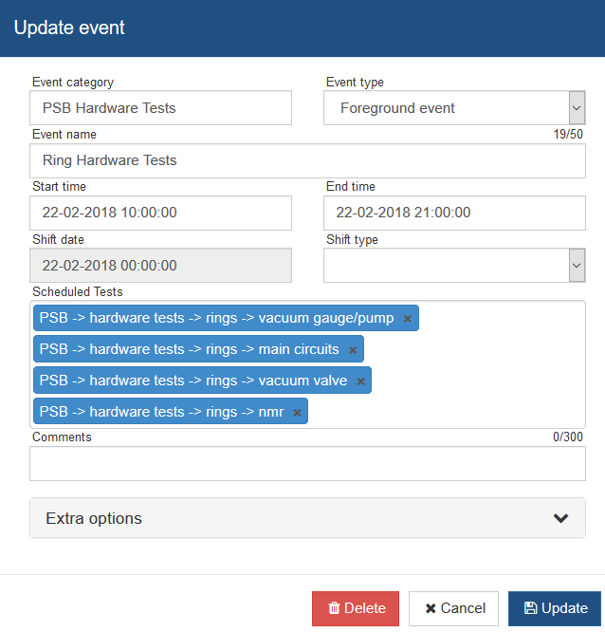

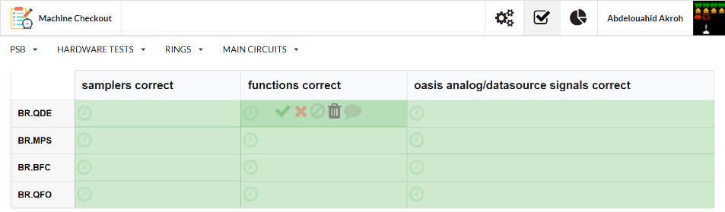
Planning tool
Developed by the COntrol Group in collaboration with OPeration
NEW: Online Accelerator Schedule Management (ASM), generic for all schedules.
OLD: Basic and laborious “Microsoft Excel” planning
Link between the Planning tool and the Checklist.

Slide 10
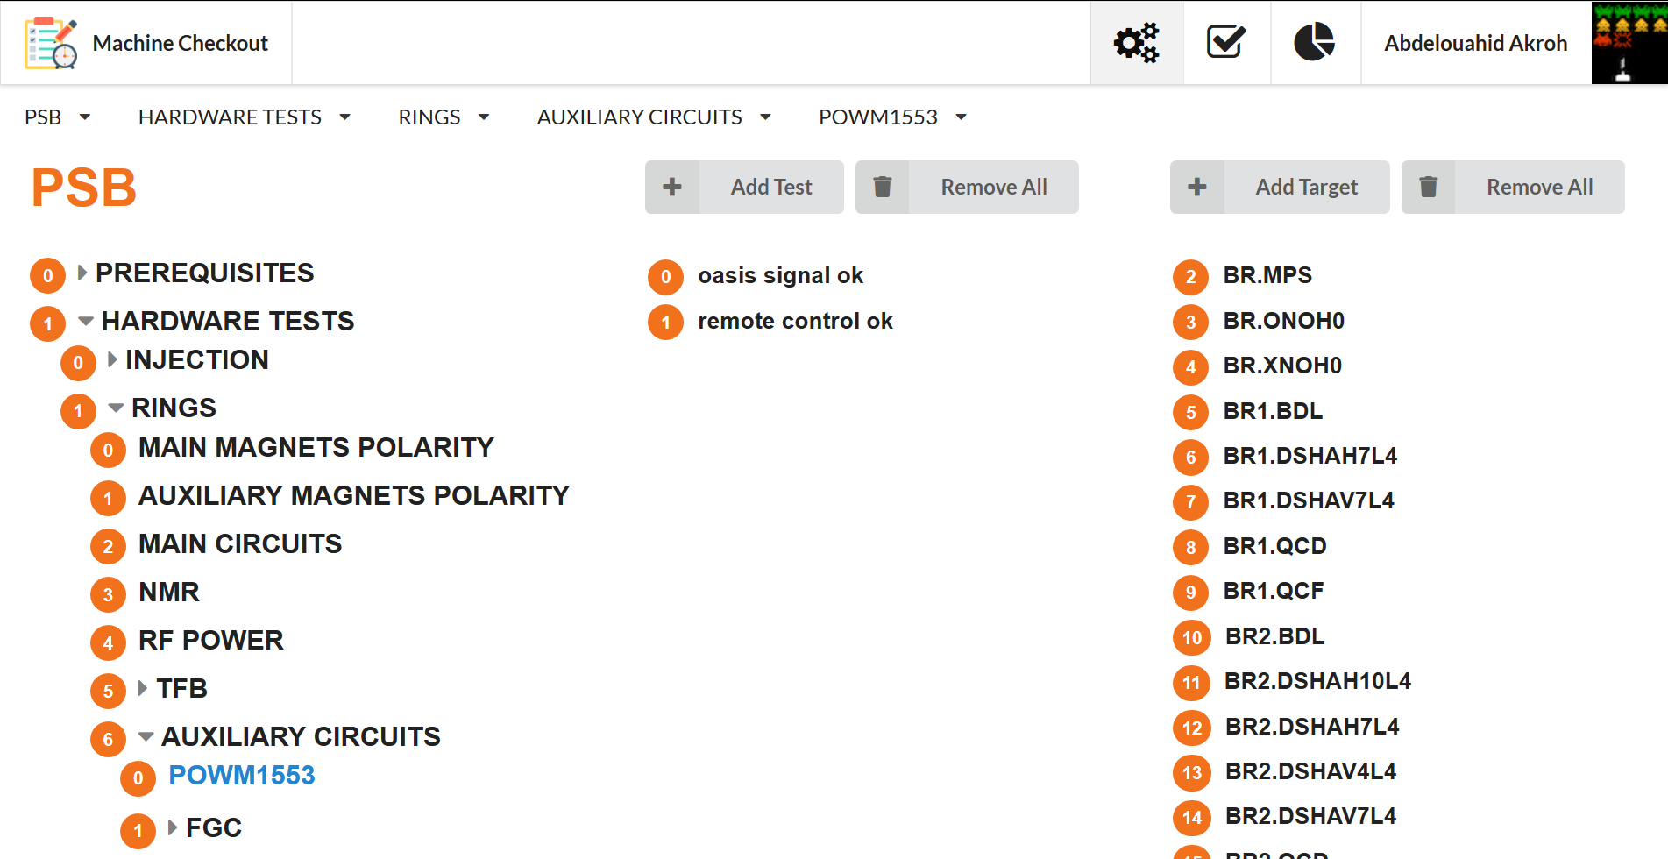
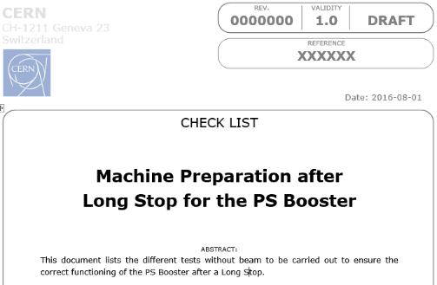
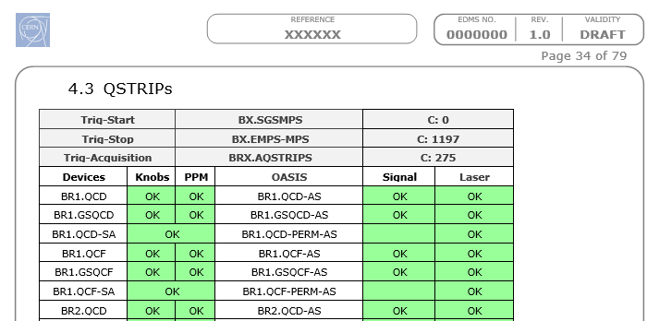
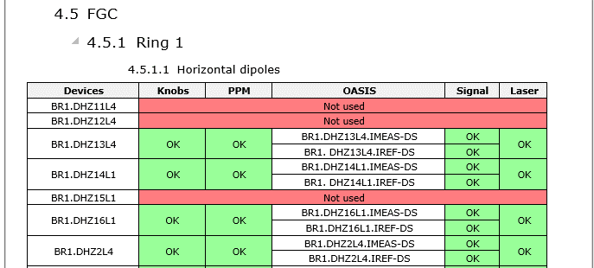
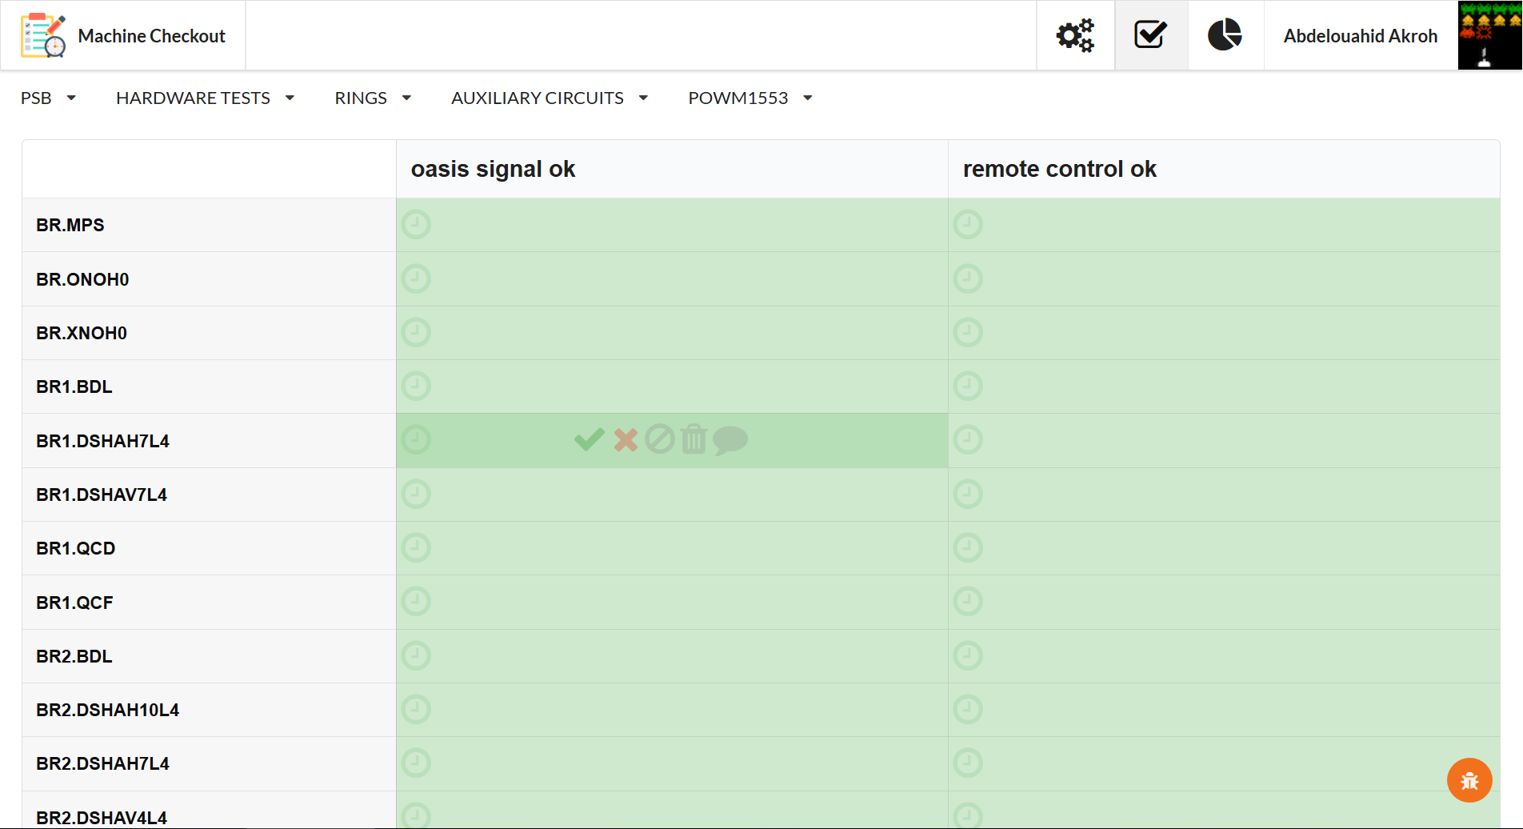
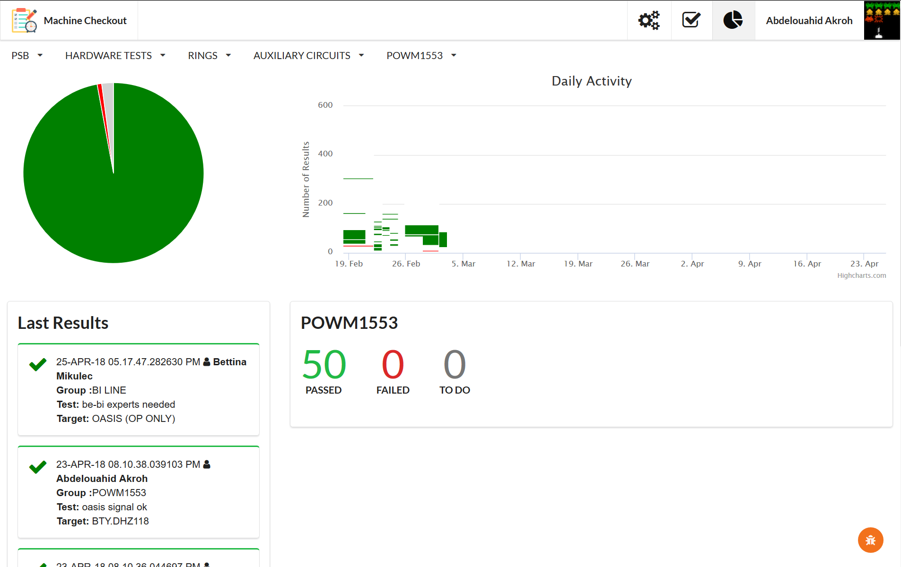
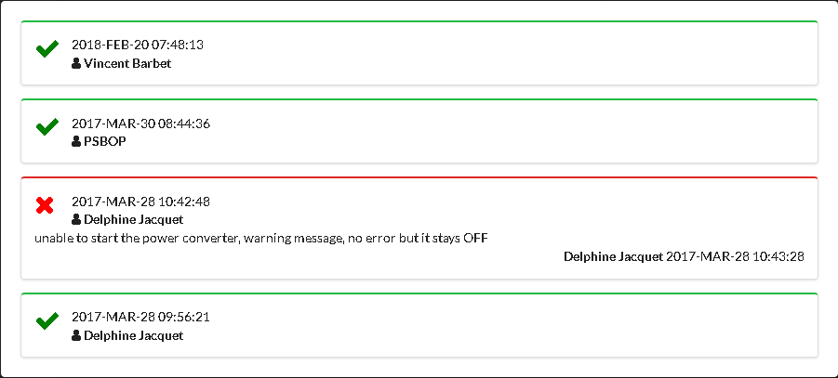
Machine Checklist
Developed by an OPerator
NEW: Online Machine Checklist.
OLD: Basic and laborious “Microsoft Word” checklist
PATH
TEST
PATHS
TESTS
TARGETS
TARGET
“Statistic view” to have an overview of the status of the machine re-commissioning.
“Tree Table view” prepared by the checklist “Administrators”: (Recommissioning coordinators).
“Test view” filled in by all the Booster operators on shift during the re-commissioning period.

Slide 11
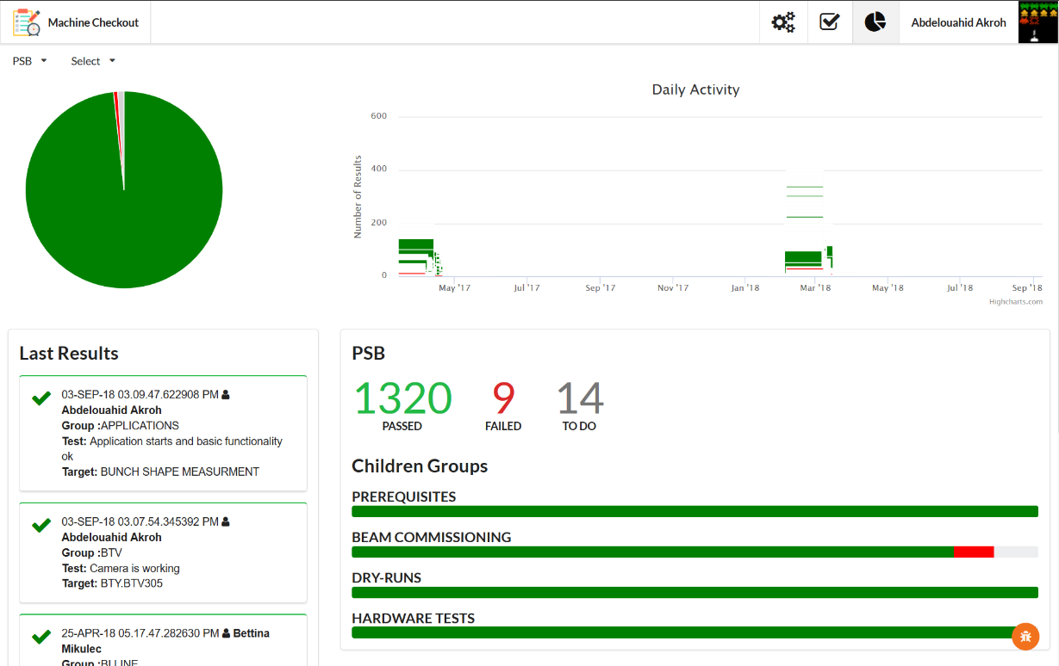
Importance of a good recommissioning
RESTART 2016-17: Huge De-cabling/cabling campaign took place in the Booster machine: 4332 cables pulled-out, and 0.7% were cut by error (32 cables).
11/04/2017
01/03/2018
Dry Runs during the recommissioning allowed to get used with new equipment.
3 weeks
2 weeks
Hardware Re-commissioning allowed to overcome very critical problems at the restart.
RESTART 2017-18: Mainly for LHC injector upgrade advancement:
New SEM-grid, new Tune pick-up, WIC (Warm Interlock Control) for the magnet protection, few magnets polarity check...

Slide 12
OUTLINE
LHC injectors complex
Long-term Schedule
Re-commissioning
Long Shutdown 2 works in the Booster
2020 machines preparation: Linac4/Booster
Summary

Slide 13
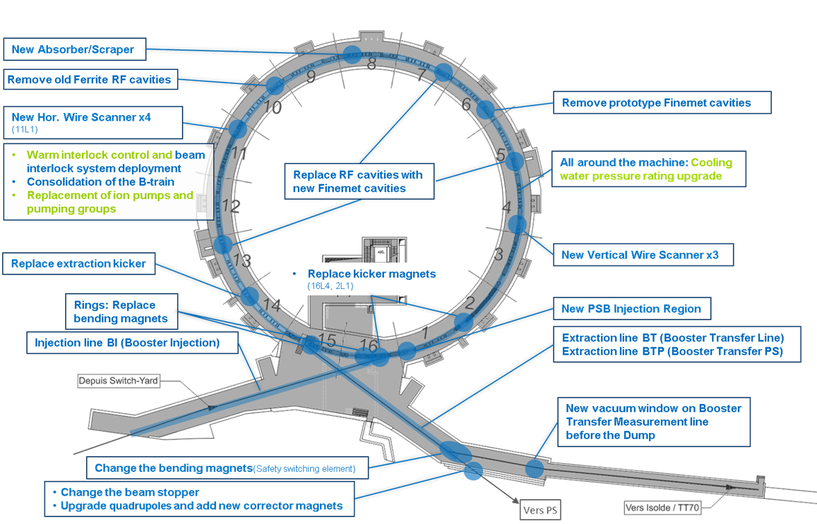
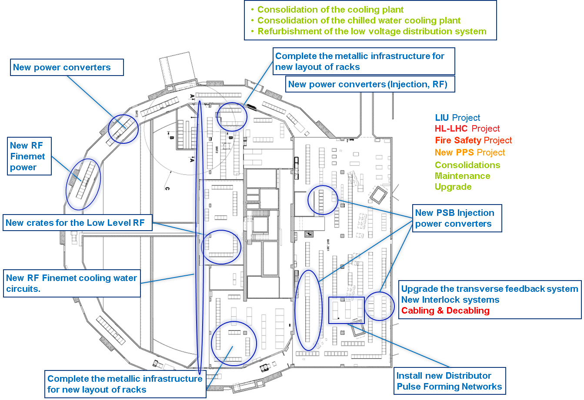
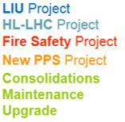
PSB activities: surface and underground
SURFACE
UNDERGROUND
New Booster Power Supply tests on the magnets

Slide 14
OUTLINE
LHC injectors complex
Long-term Schedule
Re-commissioning
Long Shutdown 2 works in the Booster
2020 machines preparation: Linac4/Booster
Summary

Slide 15
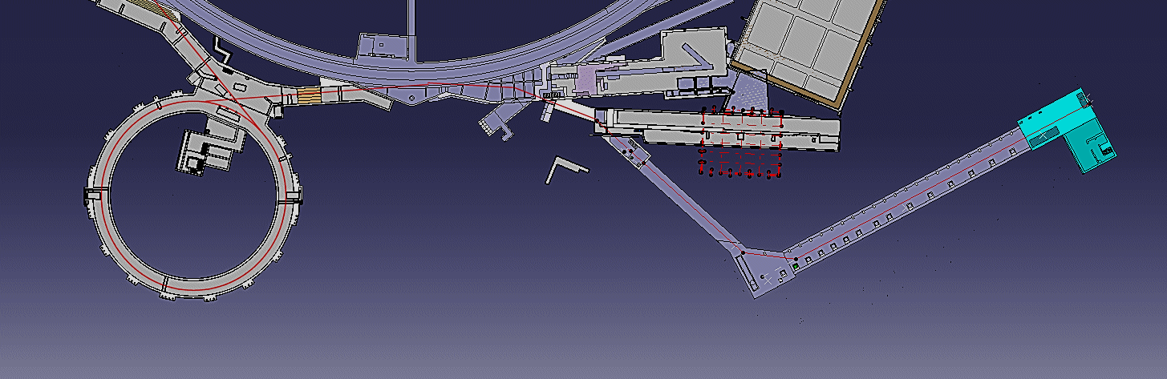
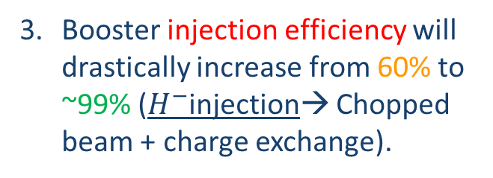
Why Linac4?
The Linac 2 is 40 years old (1978), and is now accumulating aging problems.
Booster injection efficiency will drastically increase from 60% to ~99% ($H^{−}$injection→ Chopped beam + charge exchange).
With the Linac 4, the luminosity of the LHC will increase, because the beam brightness will increase.
Linac 4 has been fully commissioned from Long shutdown 1 (2013-2014) to end of 2016.

Slide 16
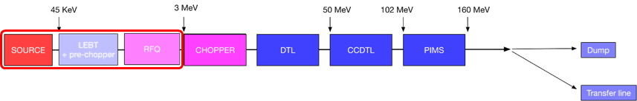
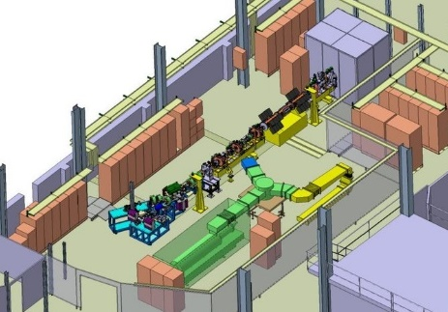
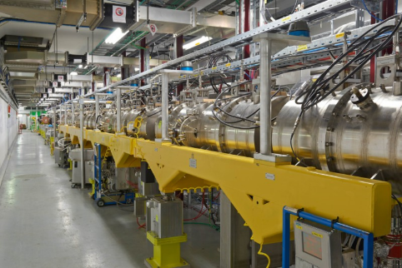
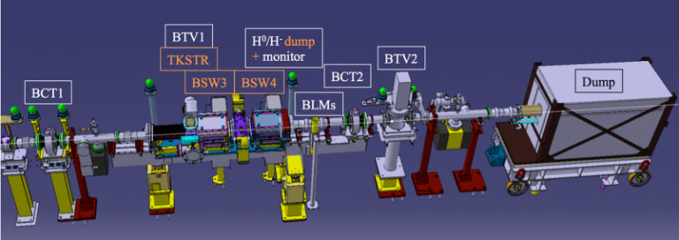
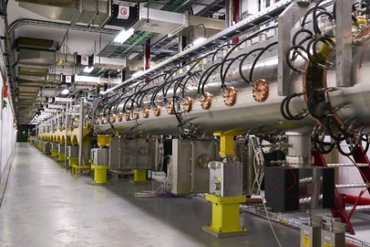
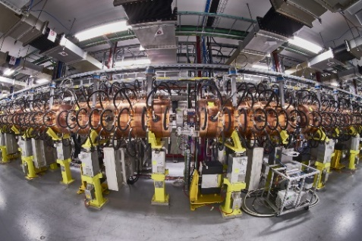
Linac 4 commissioning before Long shutdown 2.
March 2013 – April 2014
3 MeV at the “Test stand” commissioning
August 2014
DTL1 installation:
12 MeV commissioning
November 2015
DTL tanks installation:
50 MeV commissioning
June 2016
CCDTL tanks installation:
102 MeV commissioning
October 2016
PIMS tanks installation:
160 MeV commissioning
Beam Physics + Operation + Equipment experts
Beam Physics + Equipment experts
The 3 MeV test stand
October 2016
HST (Half Sector Test). Gain experience on the future Booster H- injection.
CCDTL
Operation
Mid 2017- Now
Linac4 Reliability Run.
Making Linac4 as ready as we can before the connection
DTL
PIMS
To PSB

Slide 17
Booster restart planning
2.5 months of beam commissioning. The Operation team tests equipment with beam and set-up first beams for the users.
4 months of Booster Hardware tests.
The Operation team organizes & plan machine interventions and tests.
1 month of Cold Checkout. The Operation team tests all the equipment of the machine without beam.

Slide 18
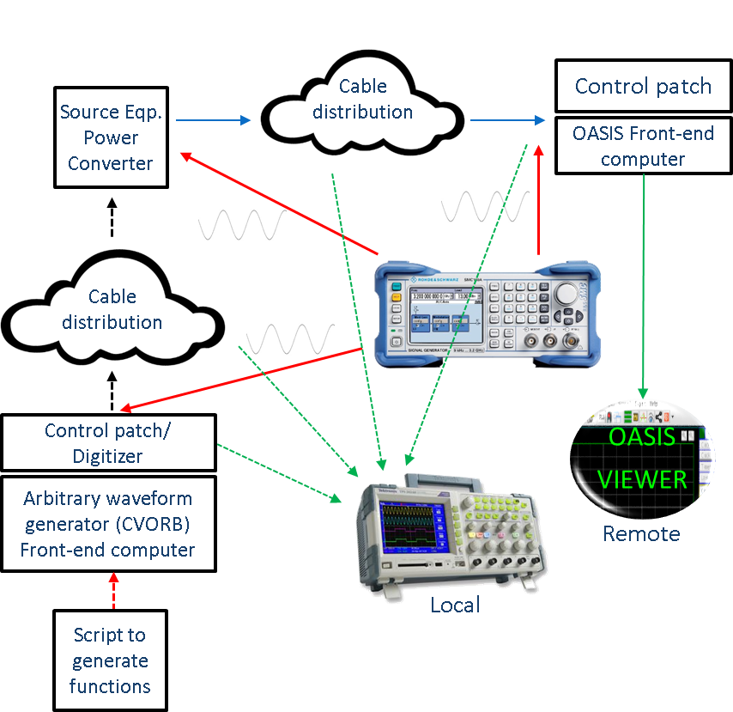
Hardware tests
Hardware tests will mainly be done by equipment experts.
Some equipment will have to be tested in collaboration with operation group, e.g. OASIS (Open Analog Signal Information System).
The aim will be to check all the cabling distribution from the Source to the
OASIS front-end computer, after a huge cabling and de-cabling campaign:
Recommissioning Coordinators & Booster Operators
Organise
Solve
Report
Solve
OASIS
SUPPORT
TEAM
EQUIPEMENT
EXPERTS
Report

Slide 19
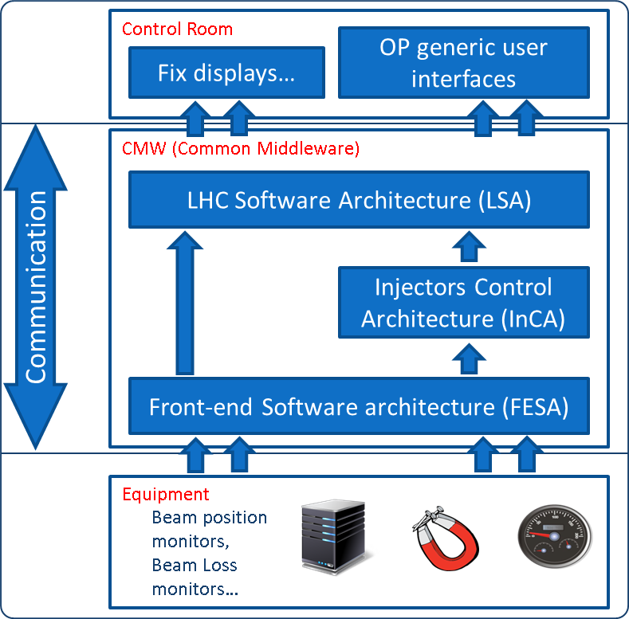
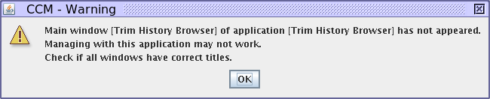
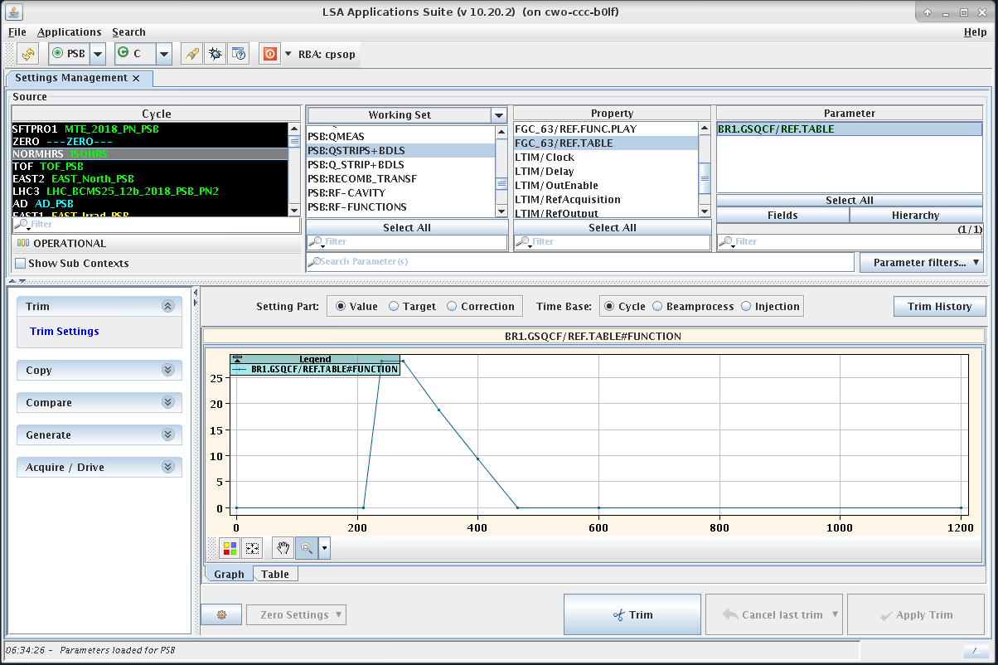
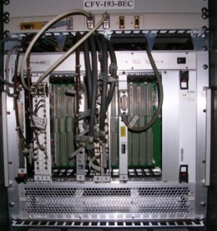
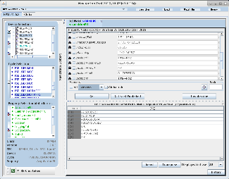
Check of the control system
We will have to test the complete Control Architecture:
Test of accelerator equipment with their entire control chain
Application has not appeared
Front-End class OK
LSA setting management ok
The Control Architecture is one of the key element for operation. During the re-commissioning many issues can be identified and solved.

Slide 20
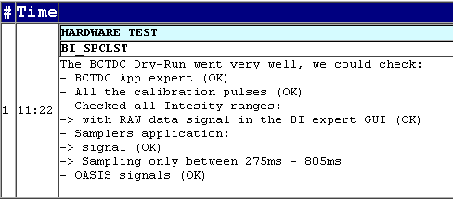
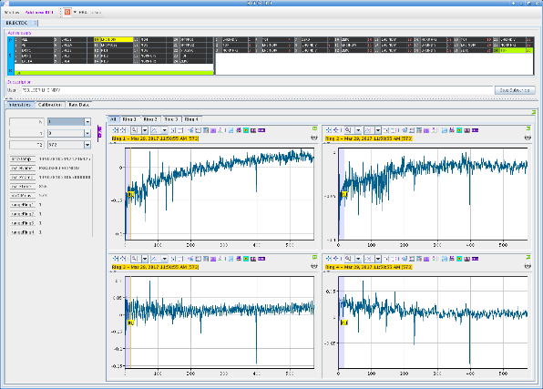
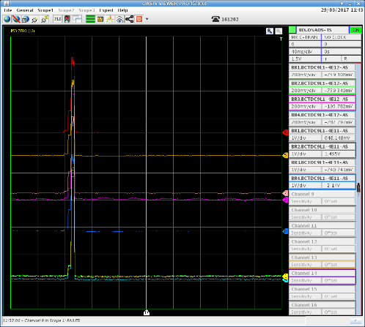
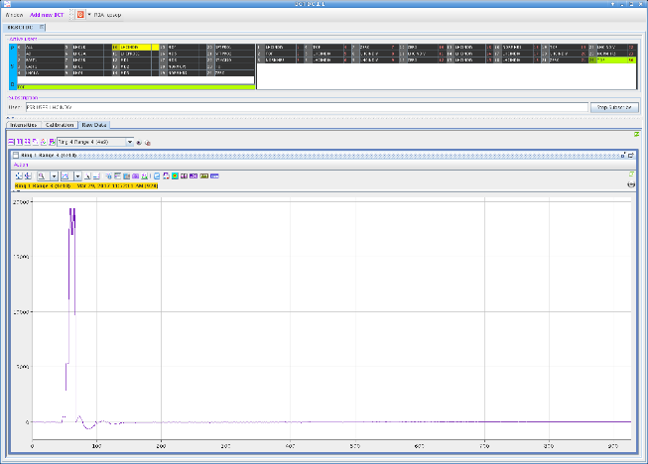
Machine checkout
We will have to plan few Dry Runs:
Complete process of testing equipment without beam:
Ring Beam Current Transformer
Beam Instrumentation Specialist
The operation team will perform dry runs for all equipment that have been modified or changed, and issues like wrong cabling, wrong calibration or missing timings, could be identified.

Slide 21
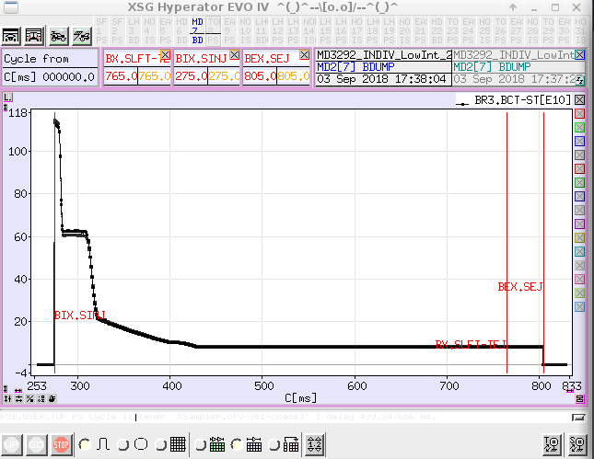
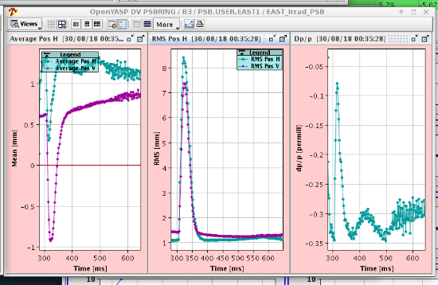
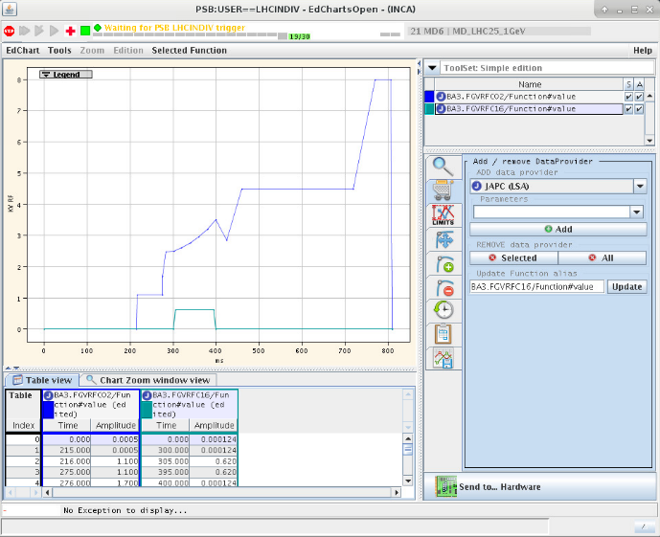
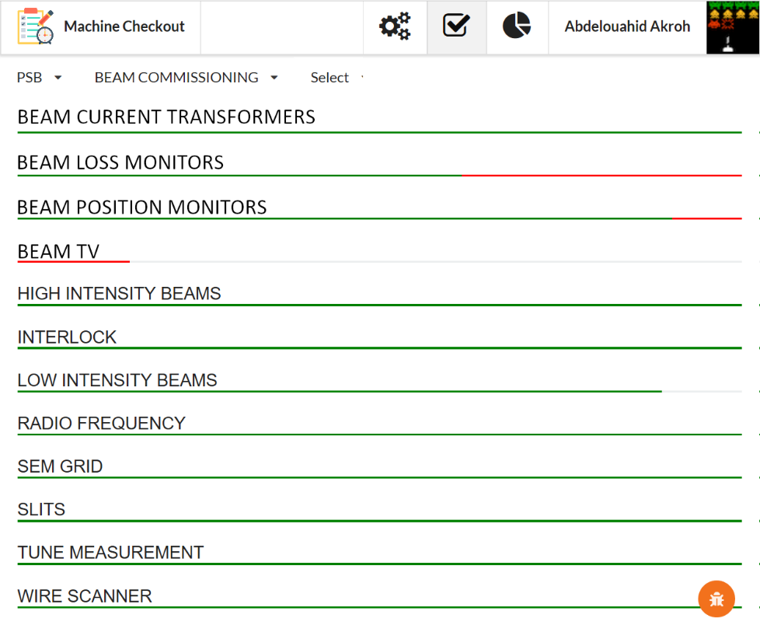
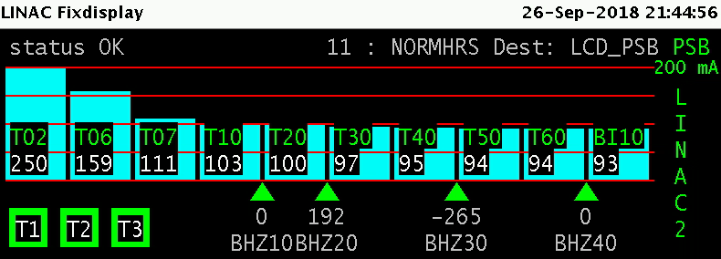
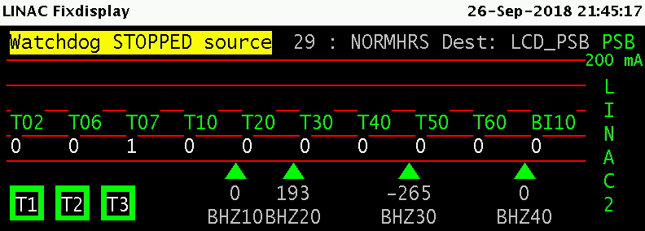




Beam commissioning
The Beam commissioning will follow a checklist and a planning:
  Checking of all instrumentations with beam.
  Check the RF parameters for the longitudinal characteristics of the beam.
  Test the “Watchdog” interlock (check beam transmission thresholds between two BCTs).
  Prepare Low and High intensity beams for LHC, ISOLDE, PS and SPS.
Beam current along the cycle
Beam position (Orbit)
After the Long Shutdown 2, the priority will be to prepare a PROBE beam (very small beam: 1 bunch with 5E9 protons ) for the LHC first beam injection.
Low intensity:
LHC indiv. -> 1 bunch on ring 3: 1.2E11 protons.
LHC multi-> 4 bunches: 1.6E12 protons/bunch.
High intensity:
ISO GPS/HRS -> 4 bunches: 8.3E12 protons/bunch.
SPS Fixed Target -> 8 bunches: 2E12/bunch
Limit: 75%
Beam Losses
Beam TV

Slide 22
OUTLINE
LHC injectors complex
Long-term Schedule
Re-commissioning
Long Shutdown 2 works in the Booster
2020 machines preparation: Linac4/Booster
Summary

Slide 23

LHC Long Shutdown 2 will imply an important injectors upgrade.
Recommissioning of the Booster with the new Linac 4 connection will be paramount.
LHC future performance will largely depend of a good restart of the CERN injector complex.
The new tools and our experience for re-commissioning will be crucial for a smooth restart of our machines.
We are still giving it all we can and will continue to give it all!!!

Slide 24





Special thanks:
B. Mikulec (PSB section leader)
F. Chapuis (CPS shift leader; 2nd PSB recommissioning Coordinator)
E. Matli (ISOLDE supervisor; Web Developer)
B. Urbaniec (Computing Engineer in the Control Group; Web Developer)
THANK YOU FOR YOUR ATTENTION!

